Slide 1
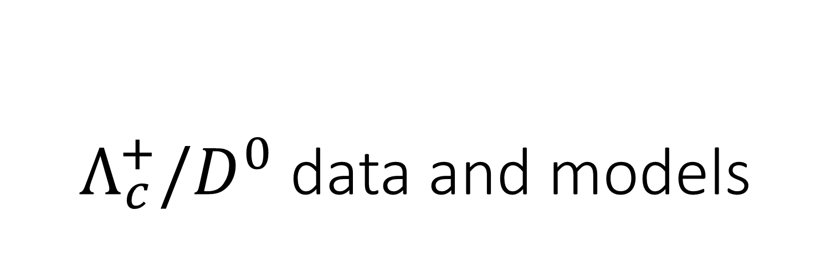
$Λ_{c}^{+}/D^{0}$ data and models
HonexComb meeting
Sandor Lokos
22.02.2022

Slide 2
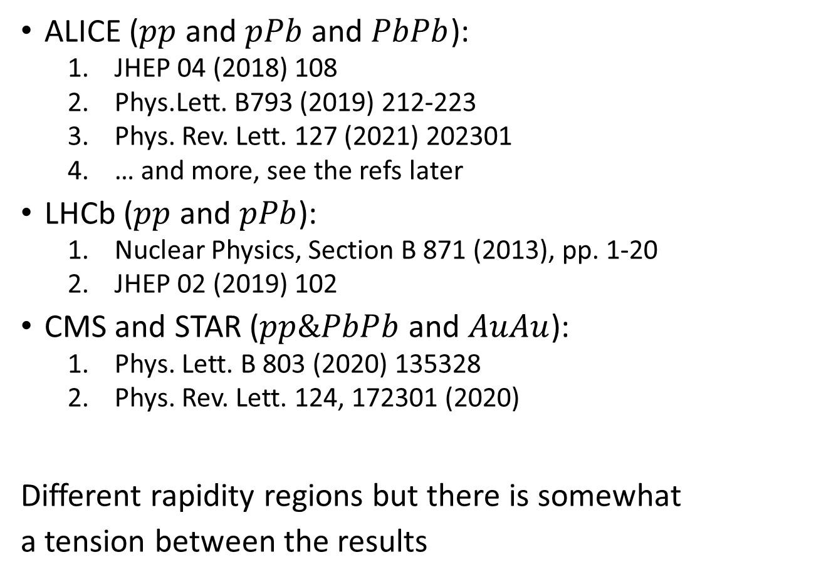

$Λ_{c}^{+}/D^{0}$ ratio
2/12
System / Energy | pp | pPb | PbPb / AuAu
5.02 | ALICE (2021) CMS | ALICE (2018 & 2021) LHCb | ALICE CMS (STAR)
7 | ALICE (2018) LHCb
13 | ALICE
ALICE ($pp$ and $pPb$ and $PbPb$):
  JHEP 04 (2018) 108
  Phys.Lett. B793 (2019) 212-223
  Phys. Rev. Lett. 127 (2021) 202301
  … and more, see the refs later
LHCb ($pp$ and $pPb$):
  Nuclear Physics, Section B 871 (2013), pp. 1-20
  JHEP 02 (2019) 102
CMS and STAR ($pp\&PbPb$ and $AuAu$):
  Phys. Lett. B 803 (2020) 135328
  Phys. Rev. Lett. 124, 172301 (2020)
Different rapidity regions but there is somewhat
a tension between the results
Time for a combined paper

Slide 3
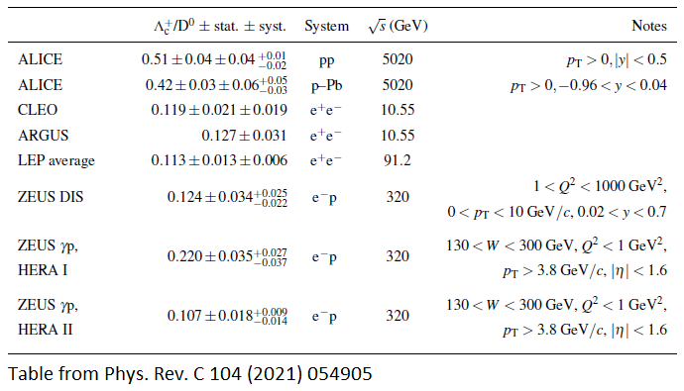
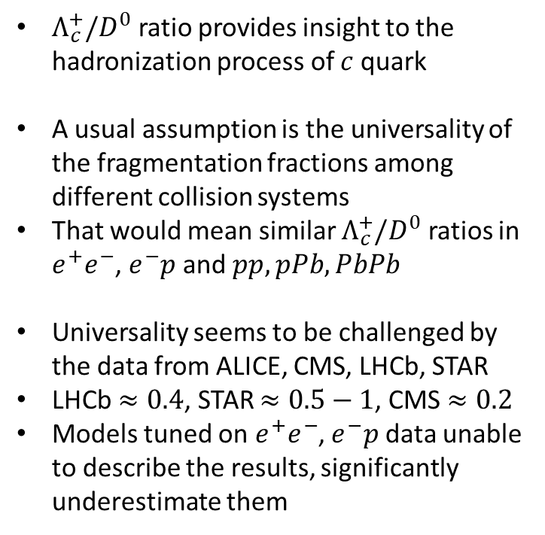
Why is it interesting?
3/12
$Λ_{c}^{+}/D^{0}$ ratio provides insight to the hadronization process of $c$ quark
A usual assumption is the universality of the fragmentation fractions among different collision systems
That would mean similar $Λ_{c}^{+}/D^{0}$ ratios in $e^{+}e^{−}$, $e^{−}p$ and $pp, pPb, PbPb$
Universality seems to be challenged by the data from ALICE, CMS, LHCb, STAR
LHCb $≈0.4$, STAR $≈0.5−1$, CMS $≈0.2$
Models tuned on $e^{+}e^{−}$, $e^{−}p$ data unable to describe the results, significantly underestimate them
Let’s see the available public data!

Slide 4
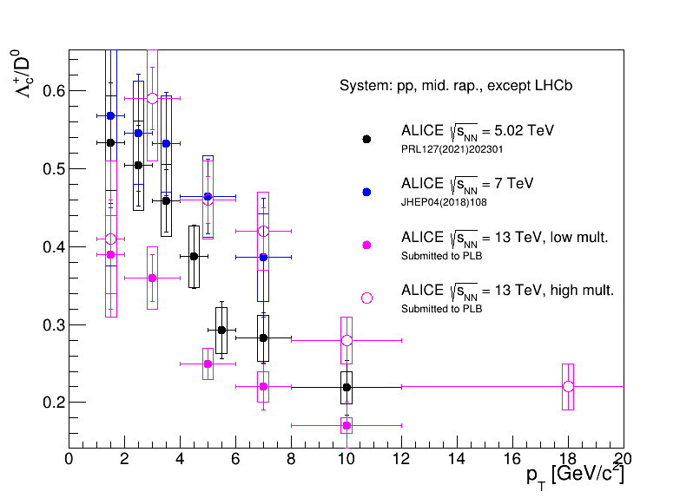
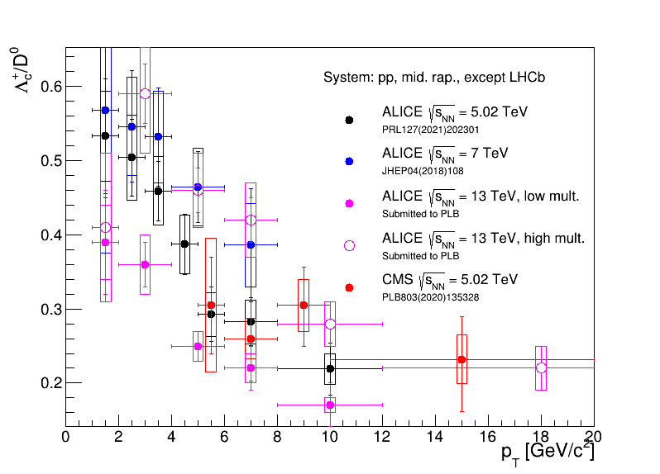
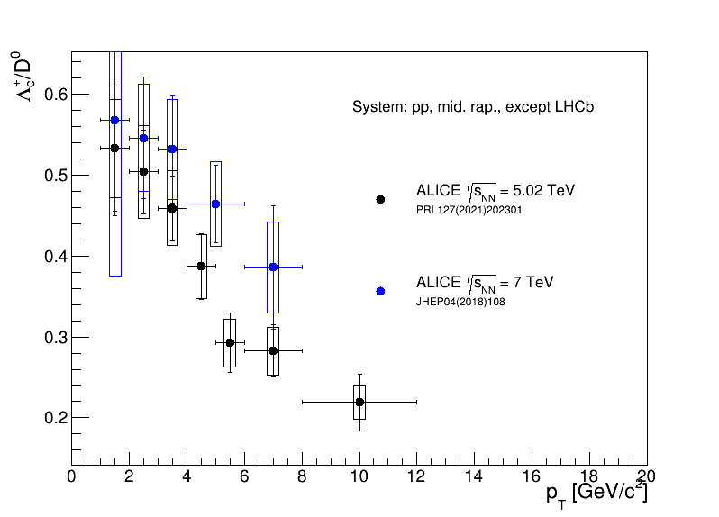
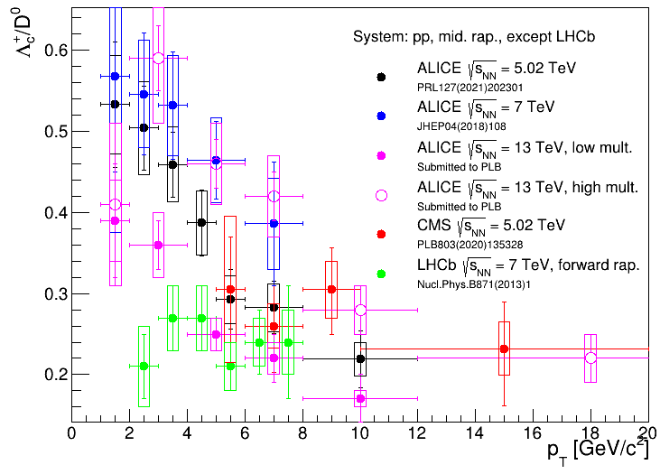

$Λ_{c}^{+}/D^{0}\left(p_{T}\right)$ ratio in $pp$
4/12
ALICE 2018 and 2021 results a bit different but compatible
There are differences in the analysis details
Difference as a function multiplicity also visible
Newer ALICE result overlaps with CMS
LHCb results are in a different rapidity range

Slide 5
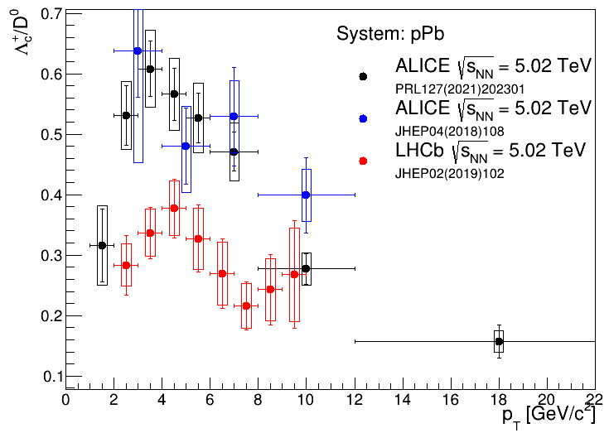
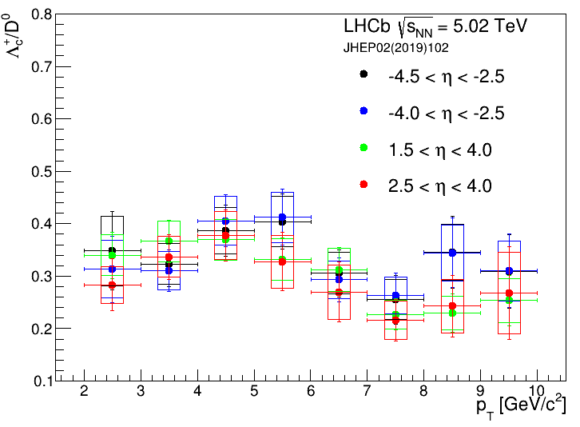

$Λ_{c}^{+}/D^{0}\left(p_{T}\right)$ ratio in $pPb$
5/12
Same measurable with ALICE
Same trends
Disagree with LHCb but use a different rapidity
Comparison of rapidity dependence (see later)

Slide 6
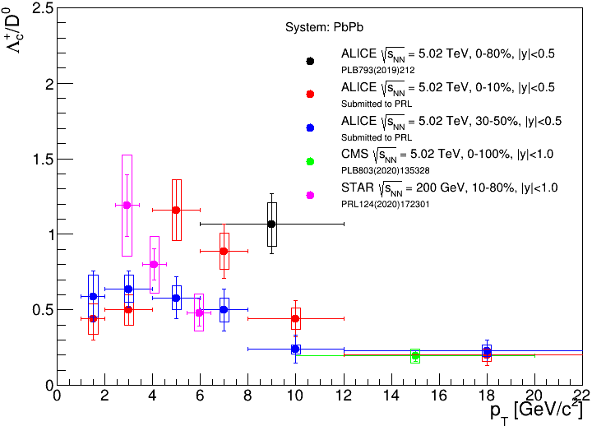

$Λ_{c}^{+}/D^{0}\left(p_{T}\right)$ ratio in $PbPb$
6/12
ALICE and CMS agrees but CMS only has 1 point published
STAR points at lower energies
Except the first point, there is a good agreement
Clear multiplicity dependence is visible in ALICE results

Slide 7
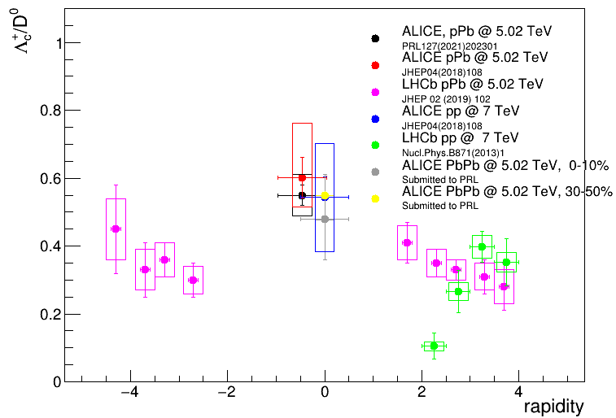
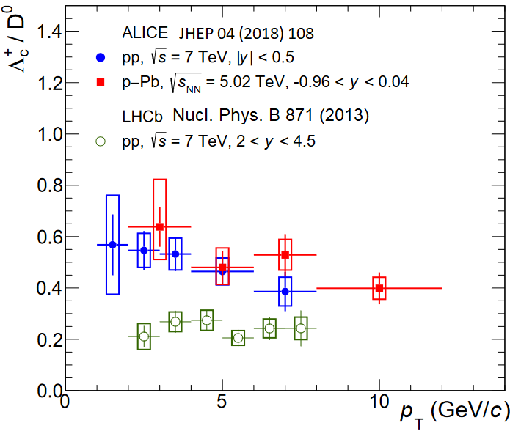

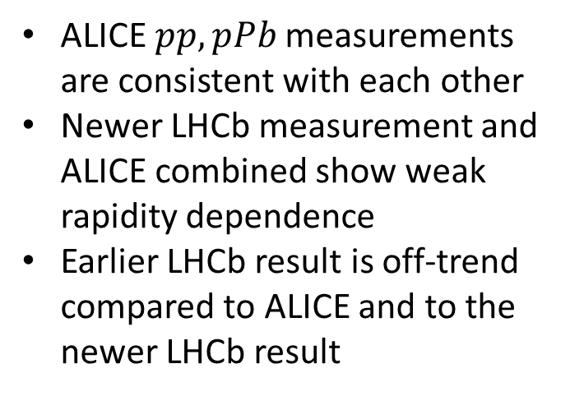
$Λ_{c}^{+}/D^{0}$ ratio – rapidity
7/12
ALICE $pp, pPb$ measurements are consistent with each other
Newer LHCb measurement and ALICE combined show weak rapidity dependence
Earlier LHCb result is off-trend compared to ALICE and to the newer LHCb result

Slide 8
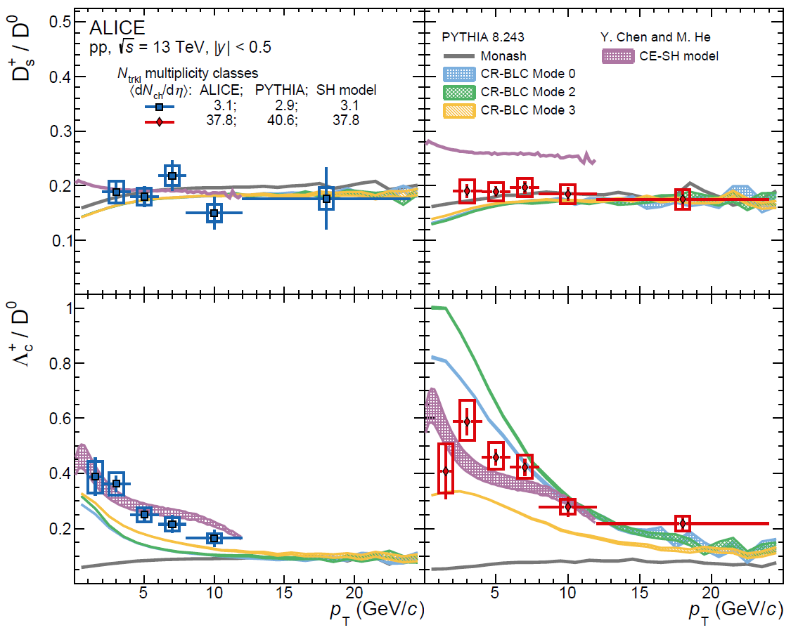
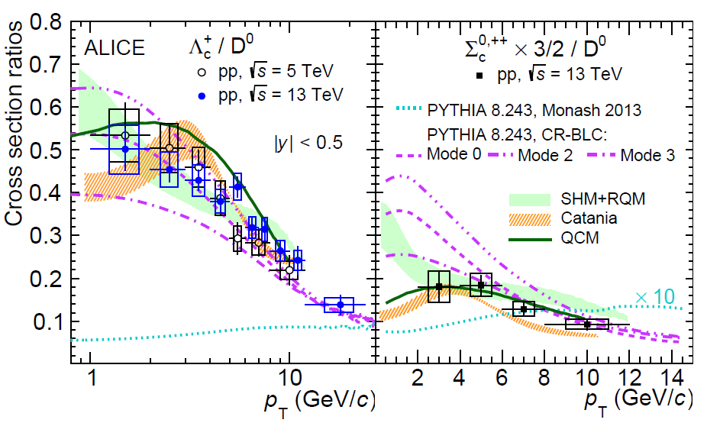
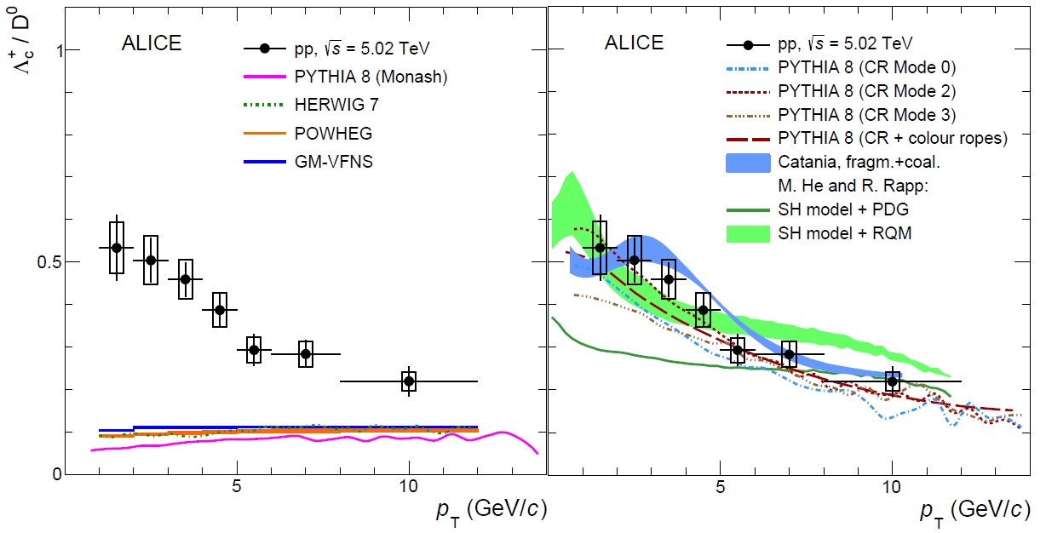
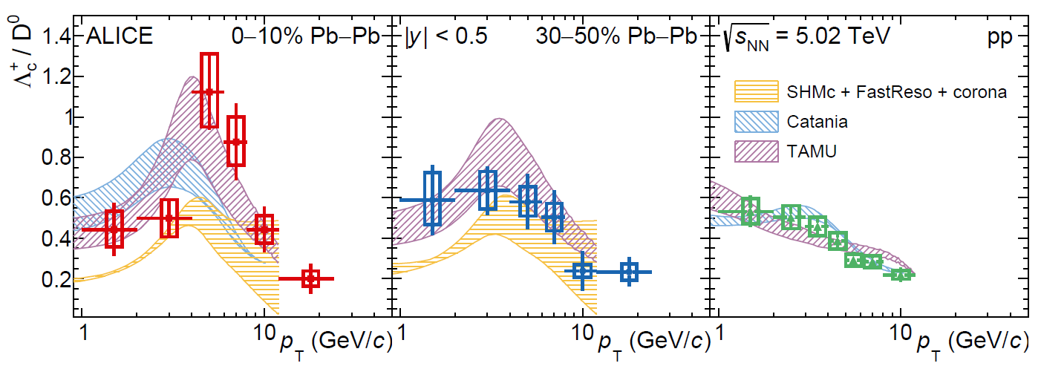

ALICE - comparison to models so far mid-rapidity, $pp, pPb,PbPb$, $5.02−13$ TeV
8/12
PRL 128 (2022) 012001
PRC 104 (2021) 054905
Submitted to PLB
Submitted to PRL
A bit messy but PYTHIA 8 with CR seems to work

Slide 9
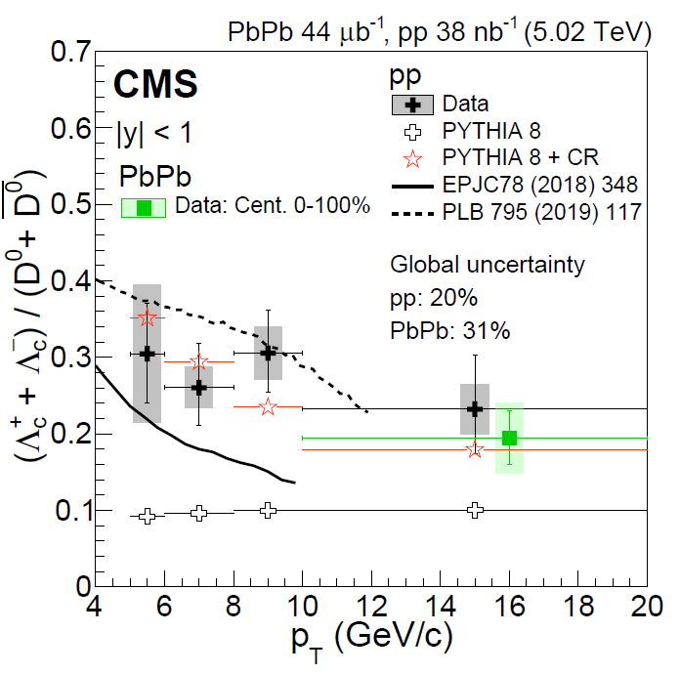

CMS – comparison to models so far mid-rapidity, $pp,PbPb$, $5.02$ TeV
9/12
PYTHIA underestimate the ratio
PYTHIA+CR seems to reproduce the data
SH based models are qualitatively in an agreement

Slide 10
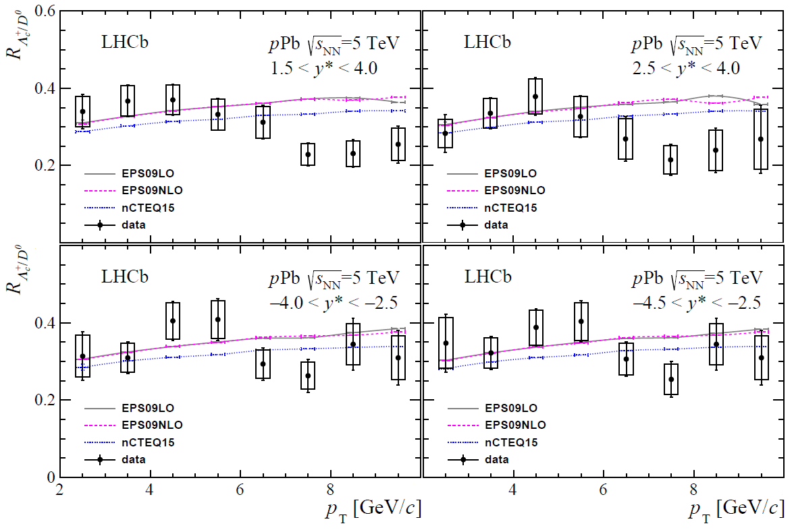
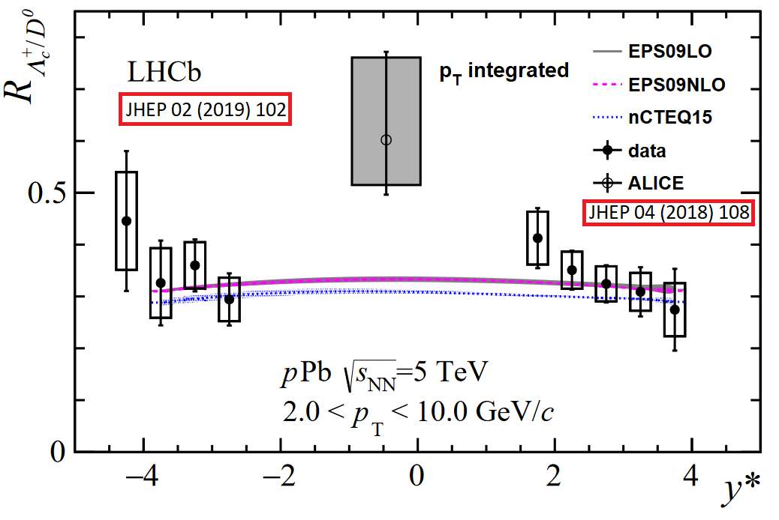

LHCb – comparison to models so far forward and backward rapidity, $pp, pPb$, $5.02, 7$ TeV
10/12
Agreement a bit better with new data
Good agreement with the model
It was tuned on pp data

Slide 11
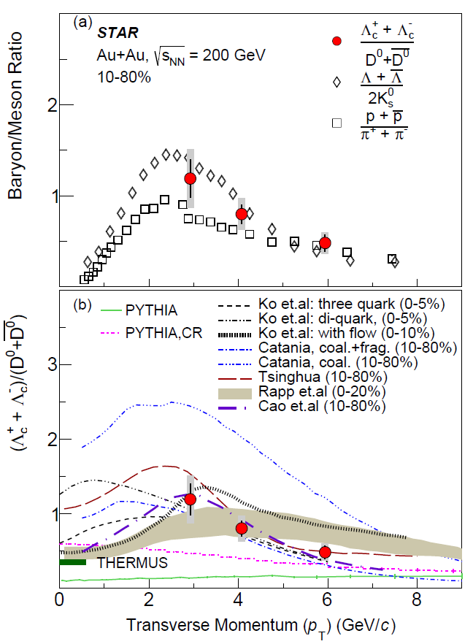

STAR - comparison to models so far mid-rapidity, $AuAu$, $200$ GeV
11/12
Coalescence models agree with the data
PYTHIA and PYTHIA+CR underestimate
Qualitative agreement with light flavor data

Slide 12
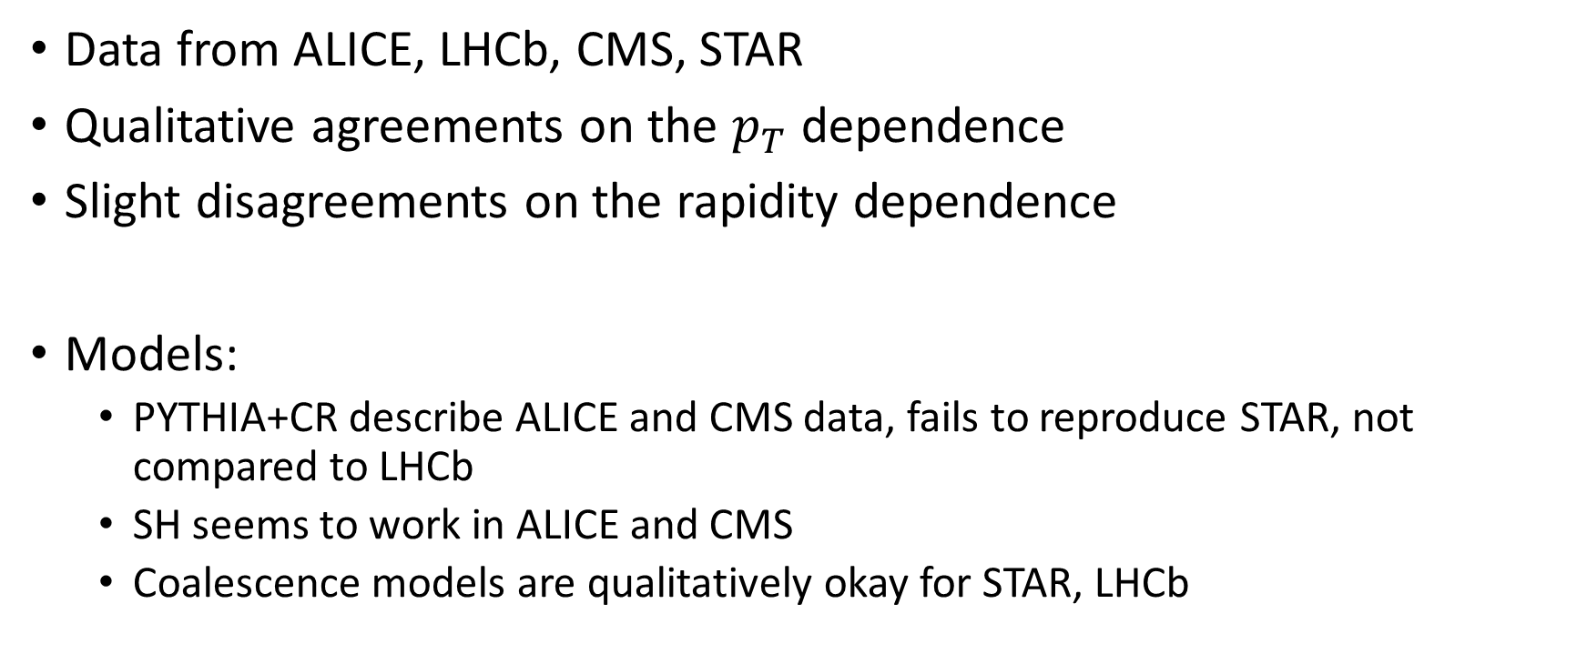
Summary
12/12
Data from ALICE, LHCb, CMS, STAR
Qualitative agreements on the $p_{T}$ dependence
Slight disagreements on the rapidity dependence
Models:
  PYTHIA+CR describe ALICE and CMS data, fails to reproduce STAR, not compared to LHCb
  SH seems to work in ALICE and CMS
  Coalescence models are qualitatively okay for STAR, LHCb

Slide 13
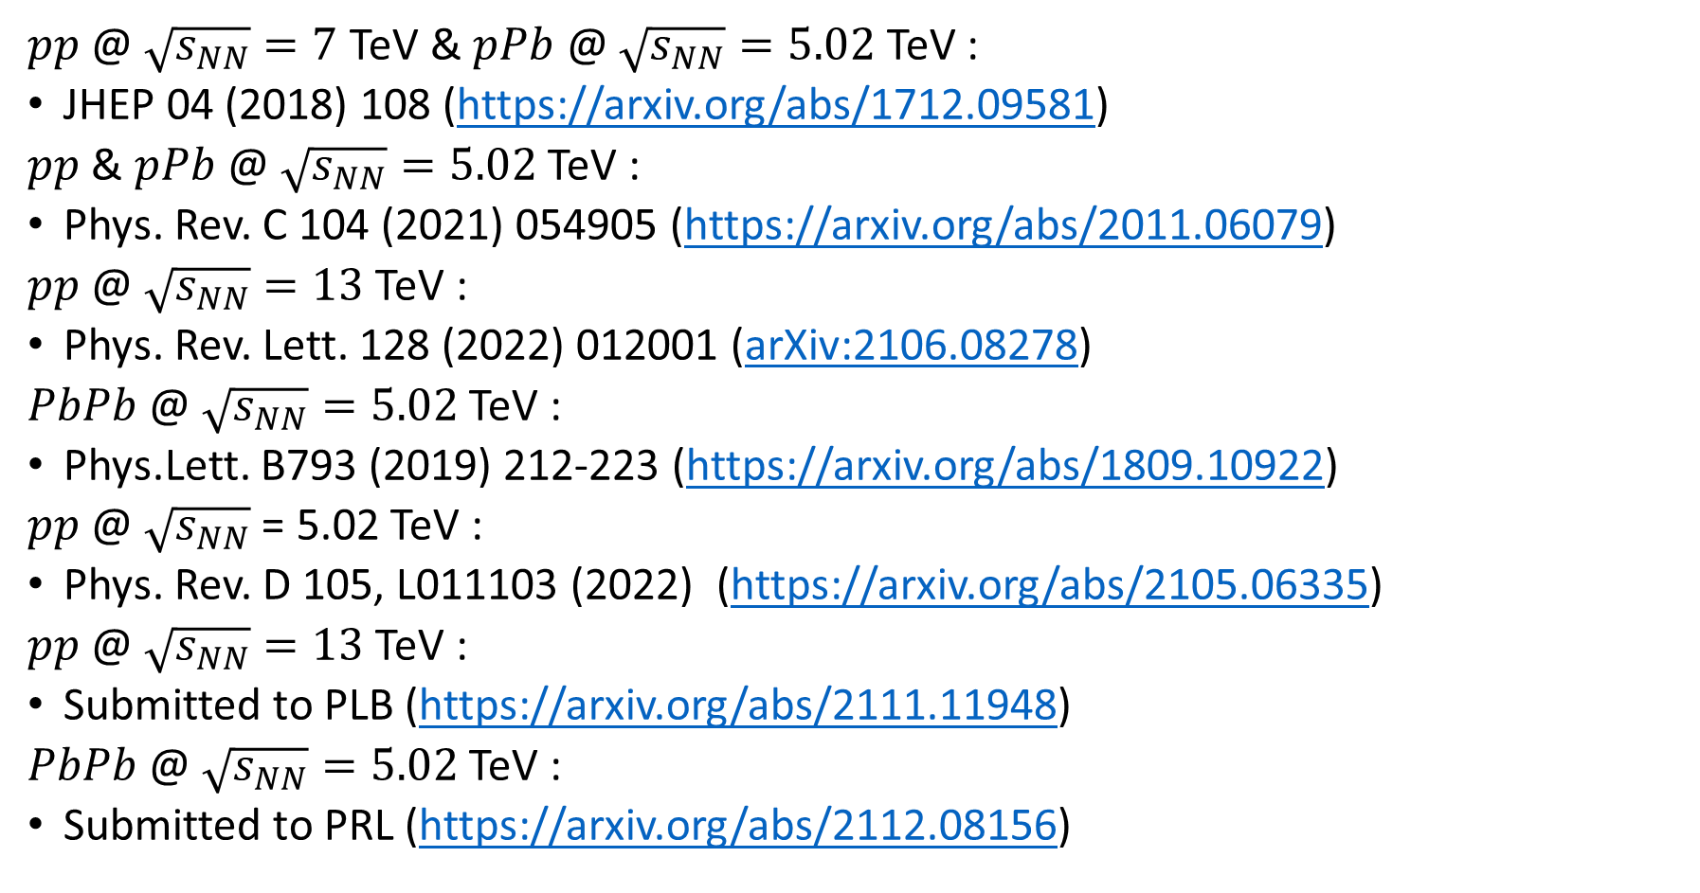
Available data – ALICE
13/12
$pp$ @ $\sqrt{s_{NN}}=7$ TeV & $pPb$ @ $\sqrt{s_{NN}}=5.02$ TeV :
JHEP 04 (2018) 108 (https://arxiv.org/abs/1712.09581)
$pp$ & $pPb$ @ $\sqrt{s_{NN}}=5.02$ TeV :
Phys. Rev. C 104 (2021) 054905 (https://arxiv.org/abs/2011.06079)
$pp$ @ $\sqrt{s_{NN}}=13$ TeV :
Phys. Rev. Lett. 128 (2022) 012001 (arXiv:2106.08278)
$PbPb$ @ $\sqrt{s_{NN}}=5.02$ TeV :
Phys.Lett. B793 (2019) 212-223 (https://arxiv.org/abs/1809.10922)
$pp$ @ $\sqrt{s_{NN}}$ = 5.02 TeV :
Phys. Rev. D 105, L011103 (2022) (https://arxiv.org/abs/2105.06335)
$pp$ @ $\sqrt{s_{NN}}=13$ TeV :
Submitted to PLB (https://arxiv.org/abs/2111.11948)
$PbPb$ @ $\sqrt{s_{NN}}=5.02$ TeV :
Submitted to PRL (https://arxiv.org/abs/2112.08156)

Slide 14
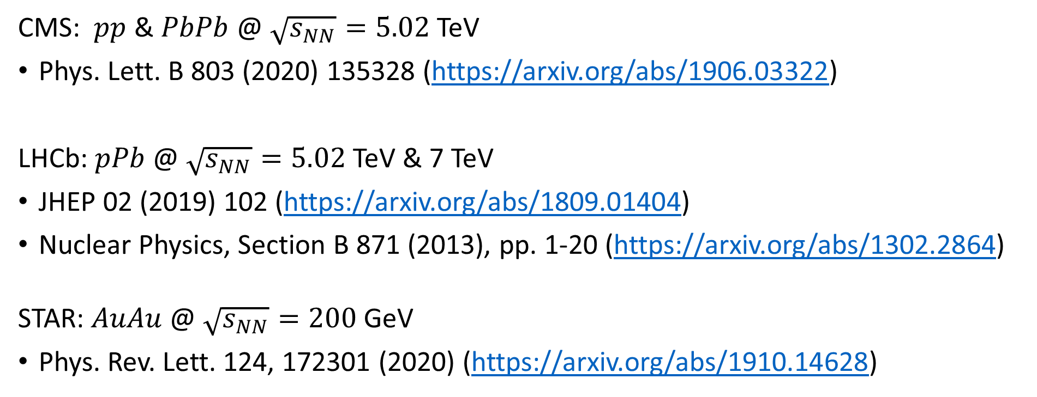
Available data – LHCb, STAR and CMS
14/12
CMS: $pp$ & $PbPb$ @ $\sqrt{s_{NN}}=5.02$ TeV
Phys. Lett. B 803 (2020) 135328 (https://arxiv.org/abs/1906.03322)
LHCb: $pPb$ @ $\sqrt{s_{NN}}=5.02$ TeV & 7 TeV
JHEP 02 (2019) 102 (https://arxiv.org/abs/1809.01404)
Nuclear Physics, Section B 871 (2013), pp. 1-20 (https://arxiv.org/abs/1302.2864)
STAR: $AuAu$ @ $\sqrt{s_{NN}}=200$ GeV
Phys. Rev. Lett. 124, 172301 (2020) (https://arxiv.org/abs/1910.14628)

