Slide 1
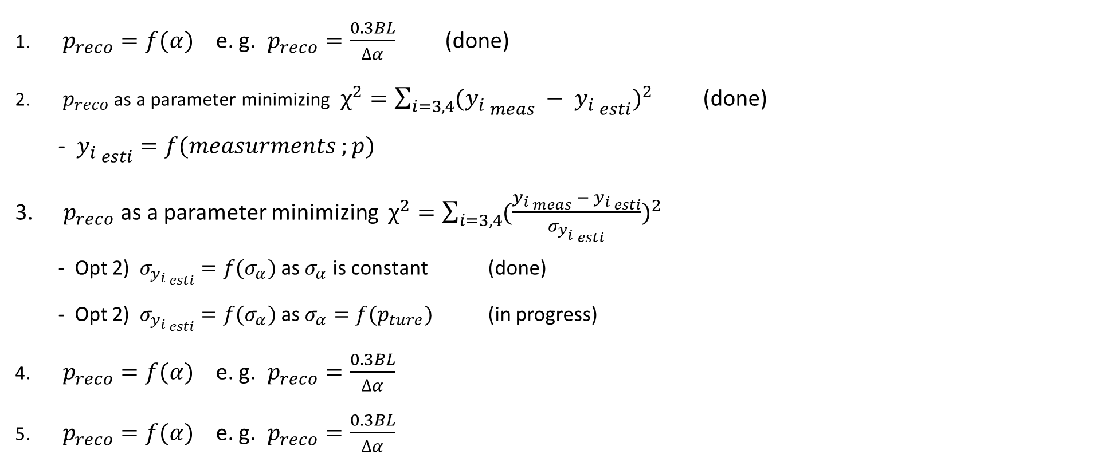
List of options for momentum reconstruction
$p_{reco}=f(α)$ e. g. $p_{reco}=\frac{0.3BL}{∆α}$ (done)
$p_{reco}$ as a parameter minimizing $χ^{2}=\sum_{i=3,4}{{({y_{i}}_{ meas} − {y_{i}}_{ esti})}^{2}}$ (done)
  - ${y_{i}}_{ esti}=f(measurments ;p)$
$p_{reco}$ as a parameter minimizing $χ^{2}=\sum_{i=3,4}{{(\frac{{y_{i}}_{ meas} − {y_{i}}_{ esti}}{σ_{{y_{i}}_{ esti}}})}^{2}}$
  - Opt 2) $σ_{{y_{i}}_{ esti}}=f(σ_{α})$ as $σ_{α}$ is constant (done)
  - Opt 2) $σ_{{y_{i}}_{ esti}}=f(σ_{α})$ as $σ_{α}=f(p_{ture})$ (in progress)
$p_{reco}=f(α)$ e. g. $p_{reco}=\frac{0.3BL}{∆α}$
$p_{reco}=f(α)$ e. g. $p_{reco}=\frac{0.3BL}{∆α}$

Slide 2
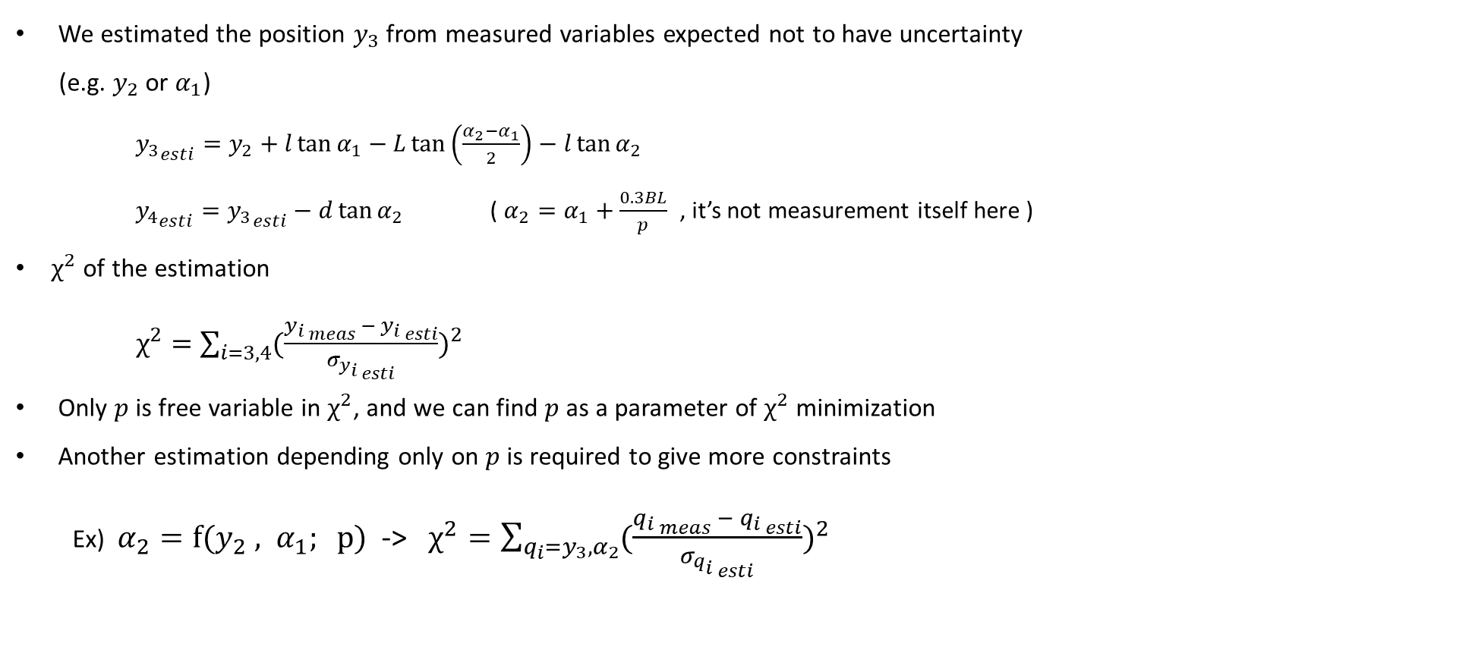
List of options for momentum reconstruction
We estimated the position $y_{3}$ from measured variables expected not to have uncertainty
(e.g. $y_{2}$ or $α_{1}$)
    ${y_{3}}_{esti}=y_{2}+l\tan{α_{1}}−L\tan\left(\frac{α_{2}−α_{1}}{2}\right)−l\tan{α_{2}}$
    ${y_{4}}_{esti}={y_{3}}_{esti}−d\tan{α_{2}}$ ( $α_{2}=α_{1}+\frac{0.3BL}{p}$ , it’s not measurement itself here )
$χ^{2}$ of the estimation
    $χ^{2}=\sum_{i=3,4}{{(\frac{{y_{i}}_{ meas} − {y_{i}}_{ esti}}{σ_{{y_{i}}_{ esti}}})}^{2}}$
Only $p$ is free variable in $χ^{2}$, and we can find $p$ as a parameter of $χ^{2}$ minimization
Another estimation depending only on $p$ is required to give more constraints
  Ex) $α_{2}=f(y_{2} , α_{1}; p)$ -> $χ^{2}=\sum_{q_{i}=y_{3},α_{2}}{{(\frac{{q_{i}}_{ meas} − {q_{i}}_{ esti}}{σ_{{q_{i}}_{ esti}}})}^{2}}$

Slide 3
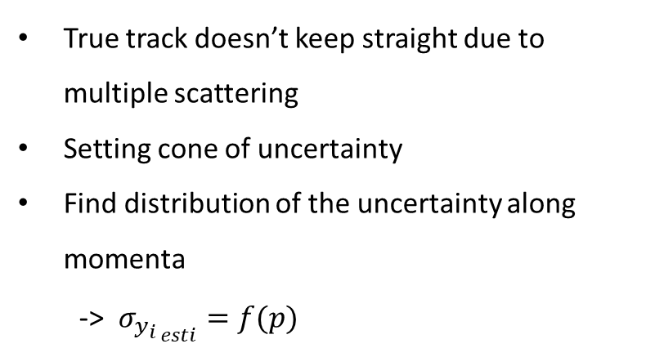

Estimating uncertainty of $y_{3}$
y
B field
2nd sensor
1st sensor
z
True track doesn’t keep straight due to multiple scattering
Setting cone of uncertainty
Find distribution of the uncertainty along momenta
  -> $σ_{{y_{i}}_{ esti}}=f(p)$
4th sensor
3rd sensor
: True track
: Cone of uncertainty at 2nd hit

Slide 4


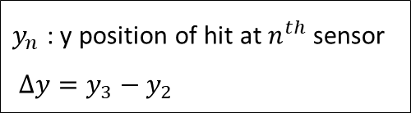
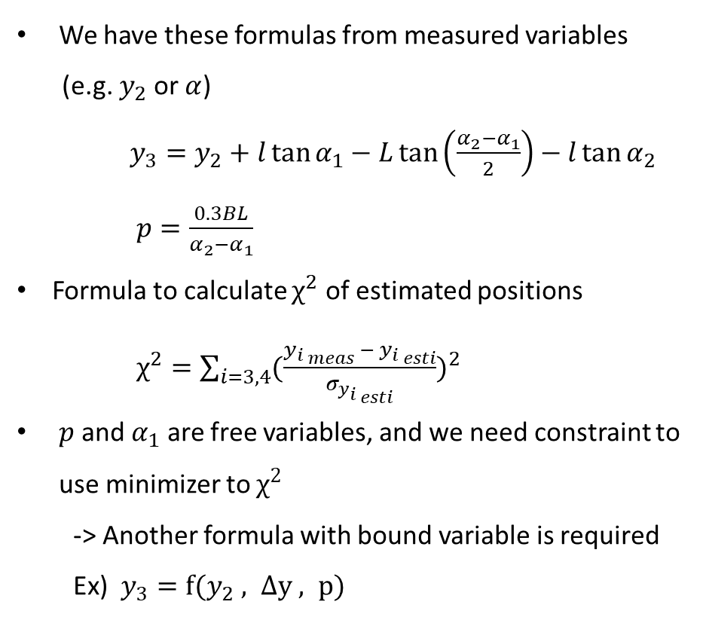

2nd formula of positon $y_{3}$
y
We have these formulas from measured variables
(e.g. $y_{2}$ or $α$)
    $y_{3}=y_{2}+l\tan{α_{1}}−L\tan\left(\frac{α_{2}−α_{1}}{2}\right)−l\tan{α_{2}}$
    $p=\frac{0.3BL}{α_{2}−α_{1}}$
Formula to calculate $χ^{2}$ of estimated positions
    $χ^{2}=\sum_{i=3,4}{{(\frac{{y_{i}}_{ meas} − {y_{i}}_{ esti}}{σ_{{y_{i}}_{ esti}}})}^{2}}$
$p$ and $α_{1}$ are free variables, and we need constraint to use minimizer to $χ^{2}$
  -> Another formula with bound variable is required
  Ex) $y_{3}=f(y_{2} , ∆y , p)$
2nd
1st
z
$$∆y$$
$$l$$
d
L
4th
3rd
$y_{n}$ : y position of hit at $n^{th}$ sensor
$∆y=y_{3}−y_{2}$

Slide 5
Estimating uncertainty of $y_{3}$
y
B field
2nd sensor
1st sensor
z
True track doesn’t keep straight due to multiple scattering
Setting cone of uncertainty and matching hit in the cone to reconstruct track
4th sensor
3rd sensor
: True track
: Cone of uncertainty at 1st hit
: Cone at 2nd hit from upper edge of 1st cone
: Cone at 2nd hit from downer edge of 1st cone

