Slide 1
whatrecord
Ken Lauer
LCLS, SLAC National Accelerator Laboratory
September 23rd, 2022
https://github.com/pcdshub/whatrecord/

Slide 2
Motivation
EPICS IOCs/modules/extensions are comprised of a conglomeration of weird file formats:
  Process database files (.db)
  Database definition files (.dbd)
  Template / substitutions files
  IOC shell scripts (st.cmd)
  StreamDevice protocols (.proto)
  State notation language programs (.st)
  Gateway configuration (.pvlist)
  Access security files (.acf)
  Facility-specific things like LCLS’s IOC manager configuration
  Build system Makefiles
  …
  At the LCLS, we have somewhere around 3,000 IOC instances in total – including those from the accelerator side and the photon side.

Slide 3
Motivation
Wouldn’t it be neat if…
We could easily parse those formats outside of an IOC and represent them in a widely-used interchange format like JSON?
We could understand a bit better what’s in our existing IOCs, whether they are deployed and running or not?
We could see how different records, different IOCs, all relate to one another… without even running an IOC?
We could somehow jump from a PV name to its database file/record definition/st.cmd/IOC?
We could dive a bit deeper by linking records to PLC code? To StreamDevice protocol information? To gateway access rules? Shell commands to source code, even?

Slide 4
whatrecord: supported parsing tools
Parse any of the following into intuitive Python dataclasses using lark:
  Database files (V3 or V4/V7), database definitions, template/substitution files
  Access security configuration files
  Autosave .sav files
  Gateway pvlist configuration files
  StreamDevice protocol files
  snlseq/sequencer state machine parsing
Interpret IOC shell scripts (i.e., st.cmd) and track:
  What files were loaded during startup?
  What records are available?
  What errors were found?
  What file and line did record X get loaded?
  Inter- or intra-IOC record relationships
https://github.com/pcdshub/whatrecord
https://pypi.org/project/whatrecord/

Slide 5
whatrecord core: other things
EPICS build system Makefile introspection
  sumo-inspired implementation, but only JSON details or dependency graph output
GDB Python script that inspects binary symbols to find IOC shell commands, variables and source code context
dbLoadRecords [str: filename] [str: substitutions]
modules/database/src/ioc/db/dbIocRegister.c line 53
Accurate EPICS macro handling (epics-base macLib, wrapped with Cython in epicsmacrolib (GitHub; PyPI)
Plugins for loading happi devices, TwinCAT PLC projects, IOC information from LCLS’s IOC manager, …
  Process database record -> PLC source code definition

Slide 6
whatrecord: accessing the parsed information
Python API, command-line tools for some of the above things
And a web-based API/backend server to monitor IOC scripts and serve IOC/record information.
  Load up all EPICS IOCs (either user-specified or those listed in LCLS’s IOC manager tool)
    Load the startup scripts
    Load all the databases and supported files
  Monitor loaded files for changes
  Provide a backend service for querying the information
Based on the backend server, provide a frontend for easy access to that information
  Vue.js-based frontend single-page application
  Search for records/IOCs/etc by name and dig into the details...

Slide 7
Demo Some screenshots

Slide 8
`whatrecord parse`: Quick example with jq
$ whatrecord parse whatrecord/tests/iocs/db/pva/iq.db |
jq '.records[] | [.name, .record_type, .fields.OUT.value]'
[
"$(PREFIX)Rate",
"ao",
"$(PREFIX)dly_.ODLY NPP"
]
[
"$(PREFIX)Delta",
"ao",
null
]
...
$ whatrecord parse whatrecord/tests/iocs/db/pva/iq.db |
jq '.records[] | [ .name, .info["Q:group"]]'
[
"$(PREFIX)Rate",
null
]
[
"$(PREFIX)Phase:I",
{
"$(PREFIX)iq": {
"phas.i": {
"+type": "plain",
"+channel": "VAL"
}
}
}
]
...

Slide 9
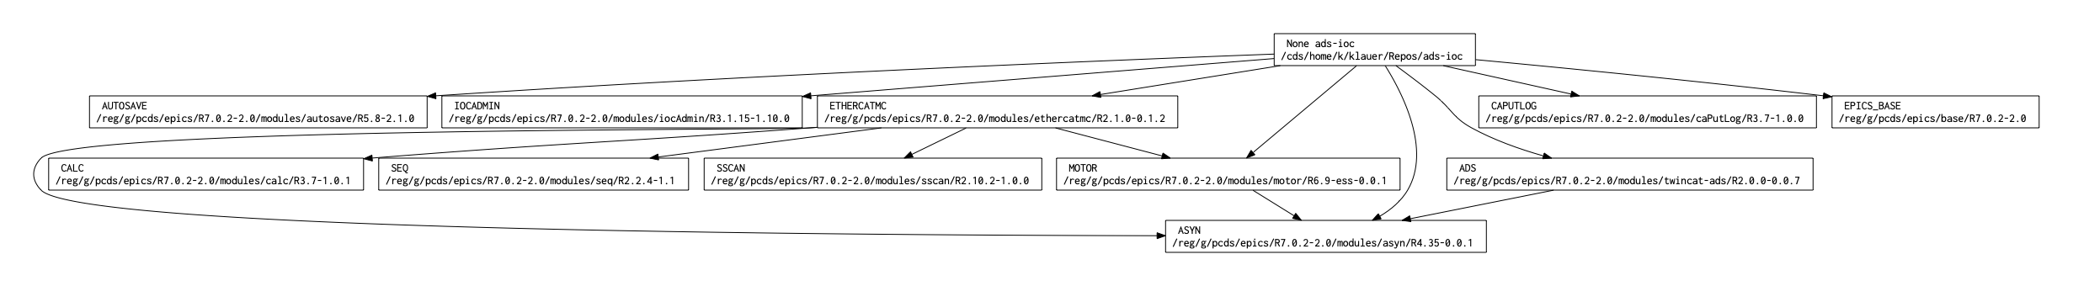
`whatrecord deps`:
Makefile-derived dependency graph tool

Slide 10
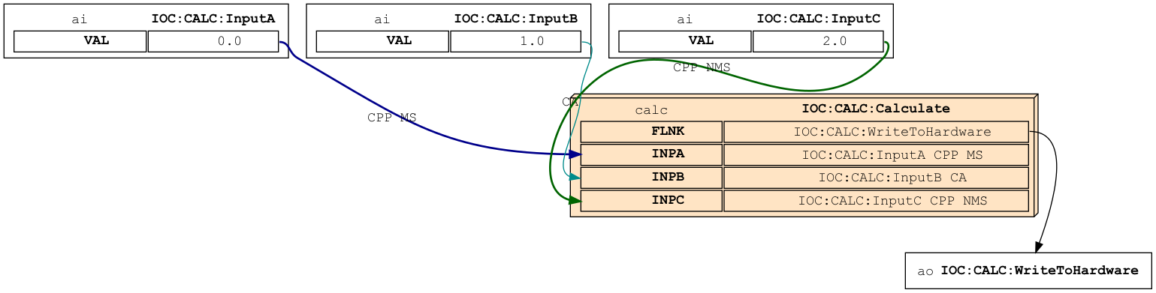
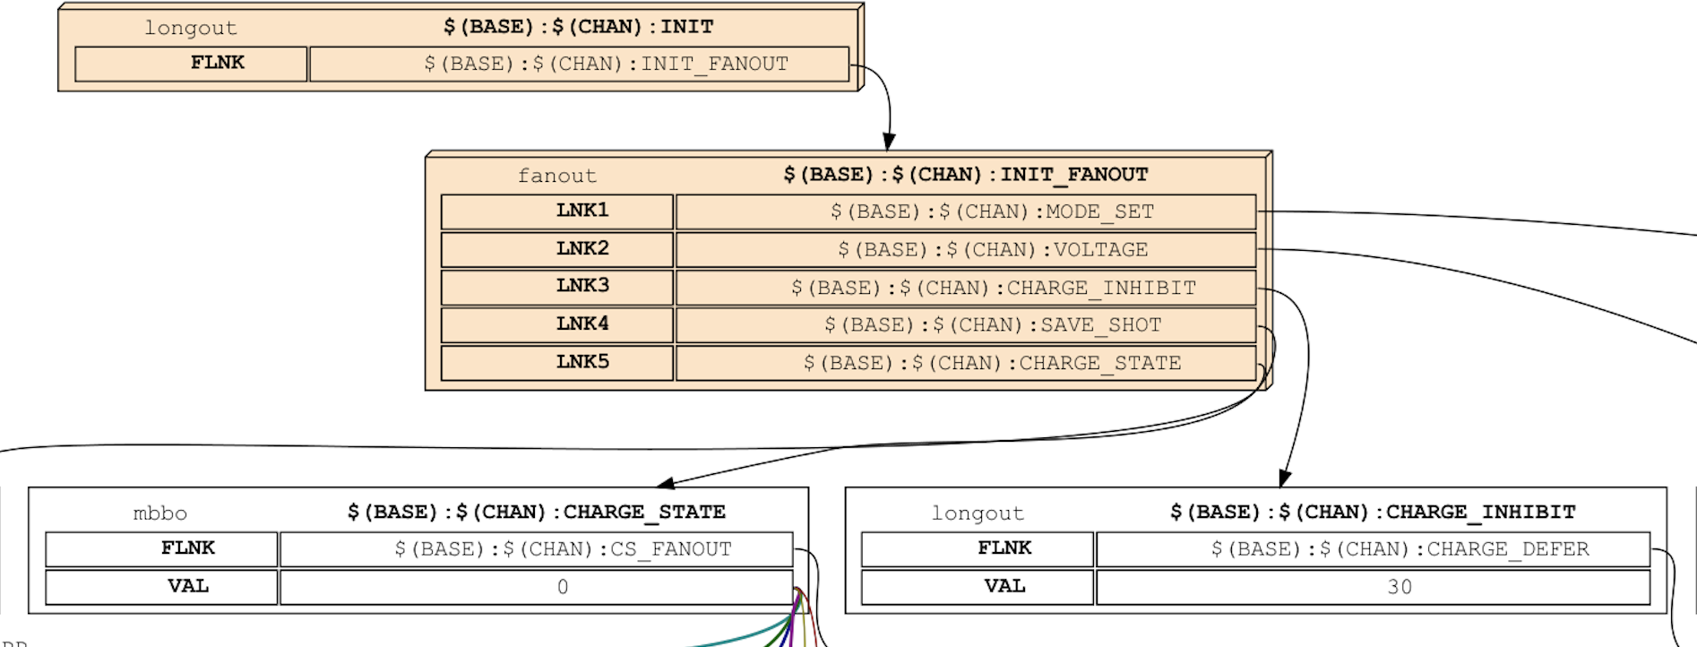
`whatrecord graph`: Intra/inter-IOC record graphs

Slide 11
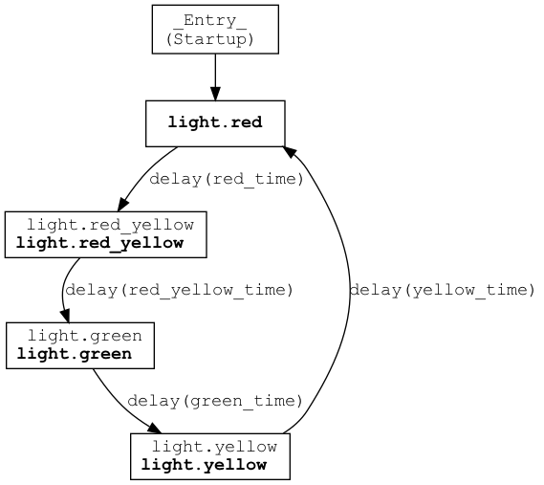
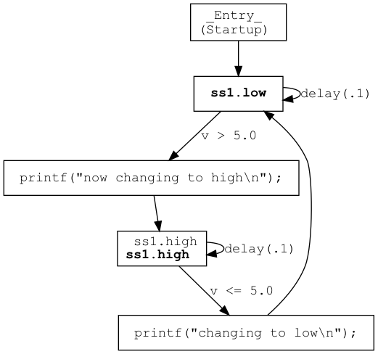
`whatrecord graph`: State notation language transition diagrams

Slide 12
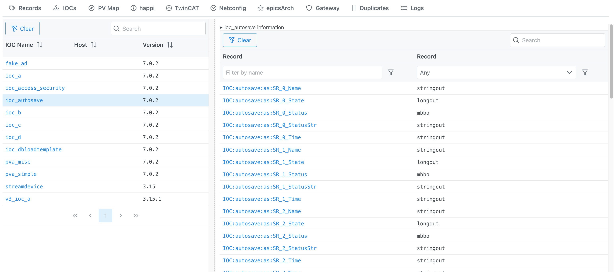
`whatrecord server` Vue.js frontend: IOC listing

Slide 13
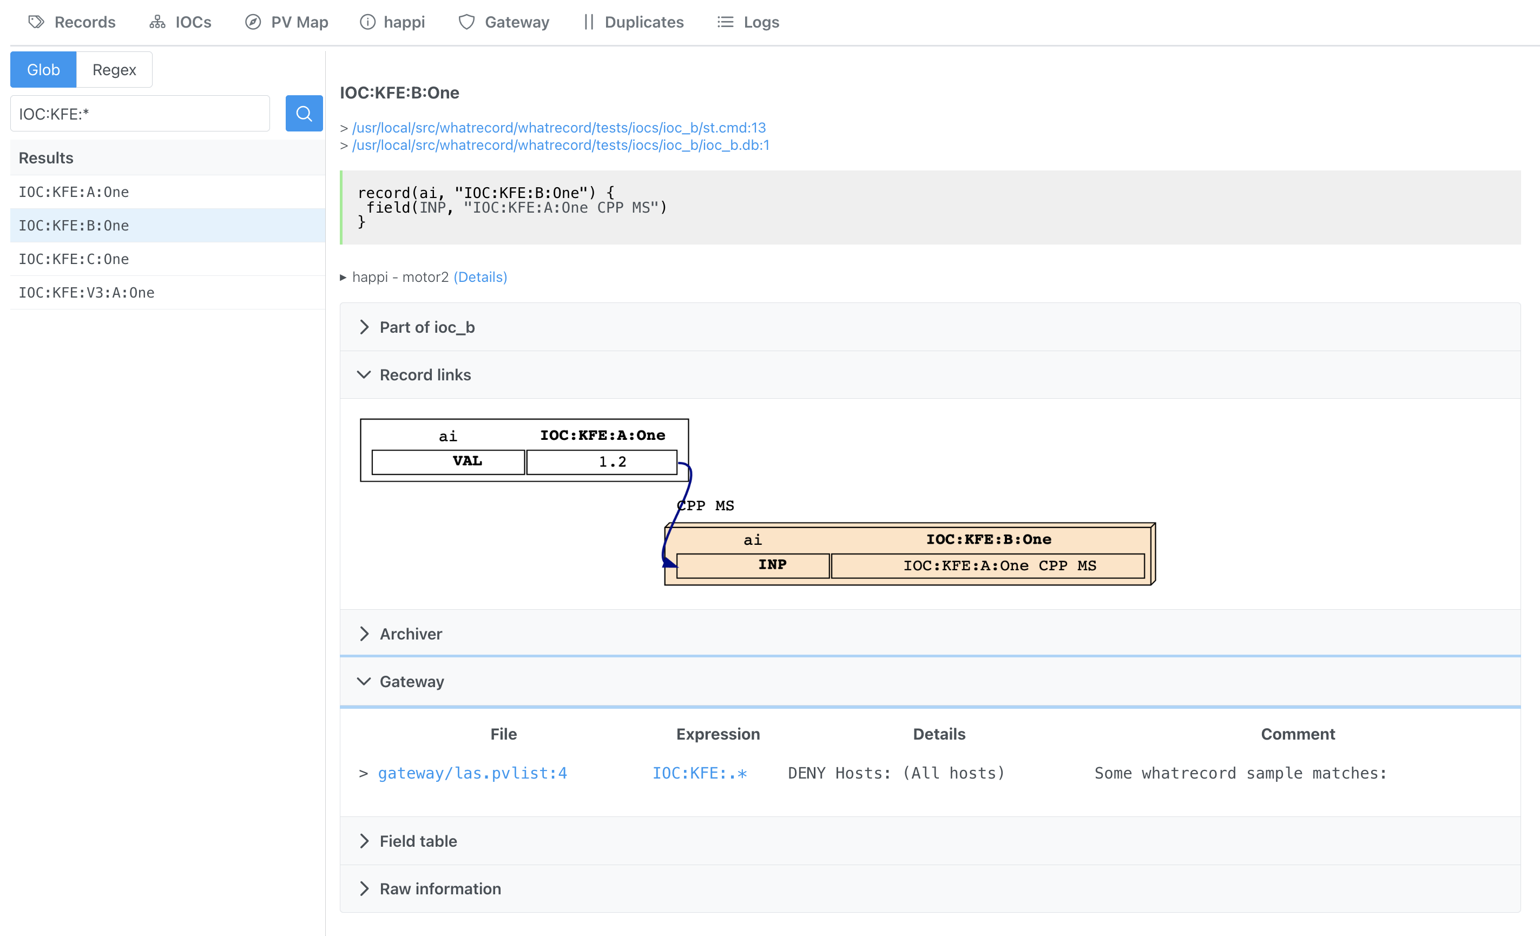
Web frontend: record details

Slide 14
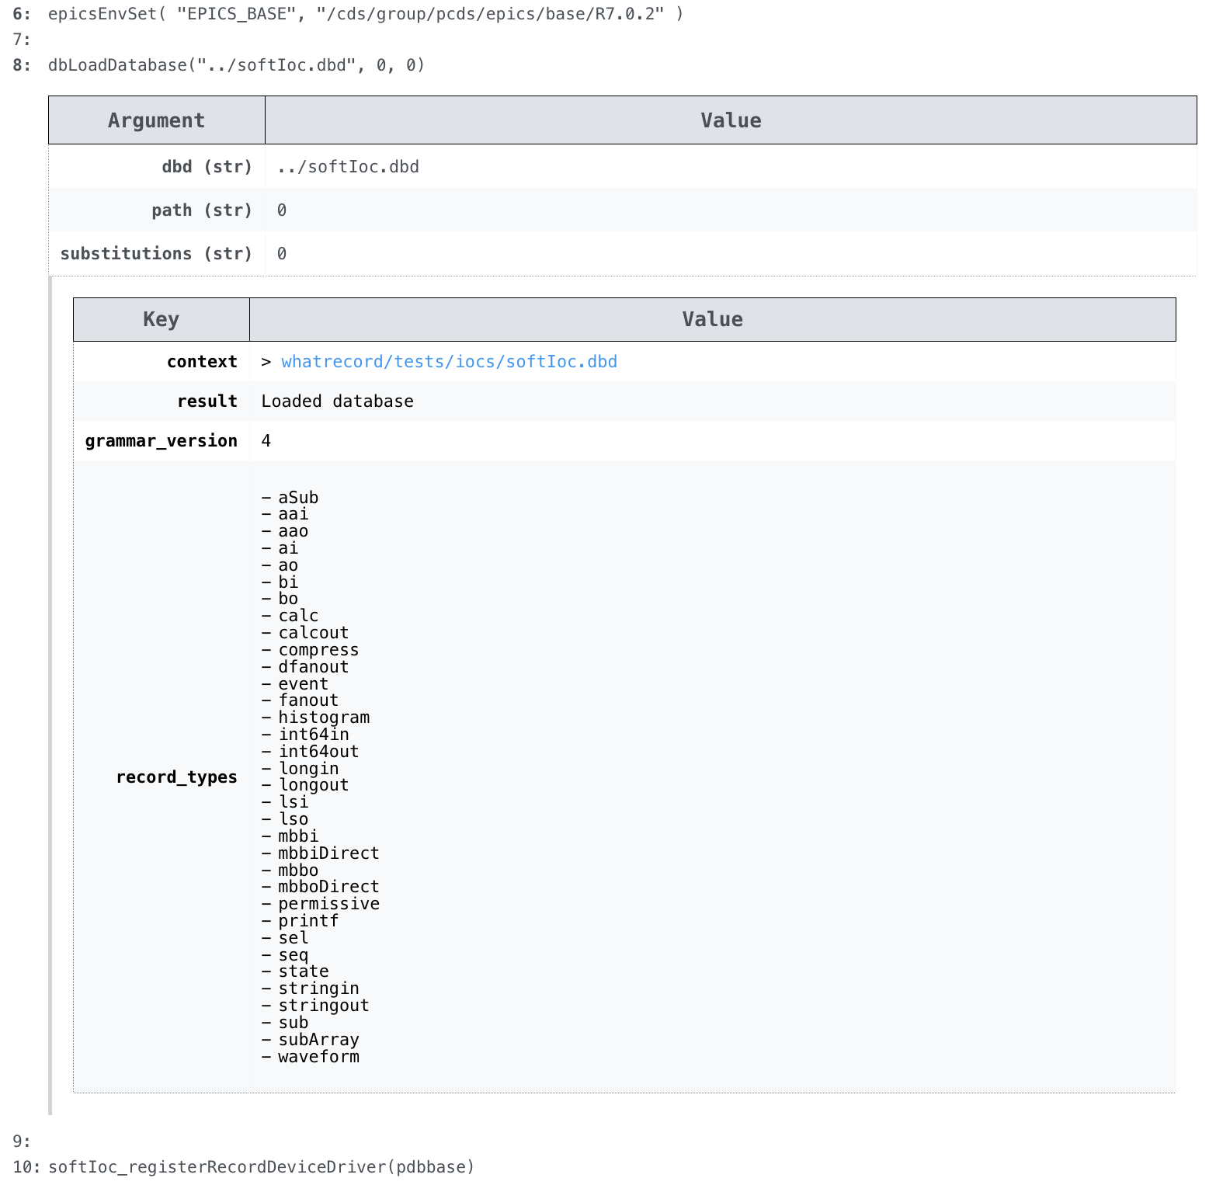
Web frontend: startup script line information

Slide 15
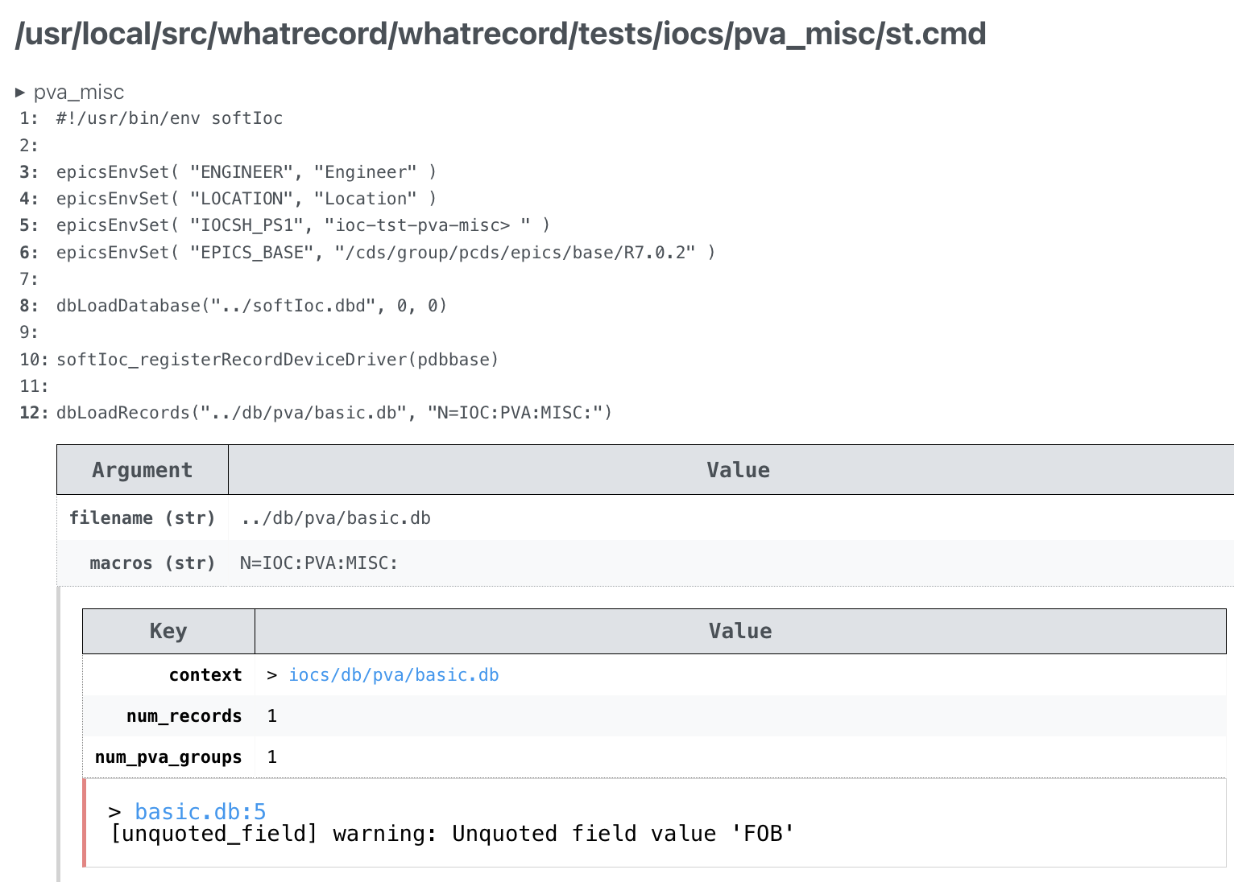
Web frontend: startup script line lint

Slide 16
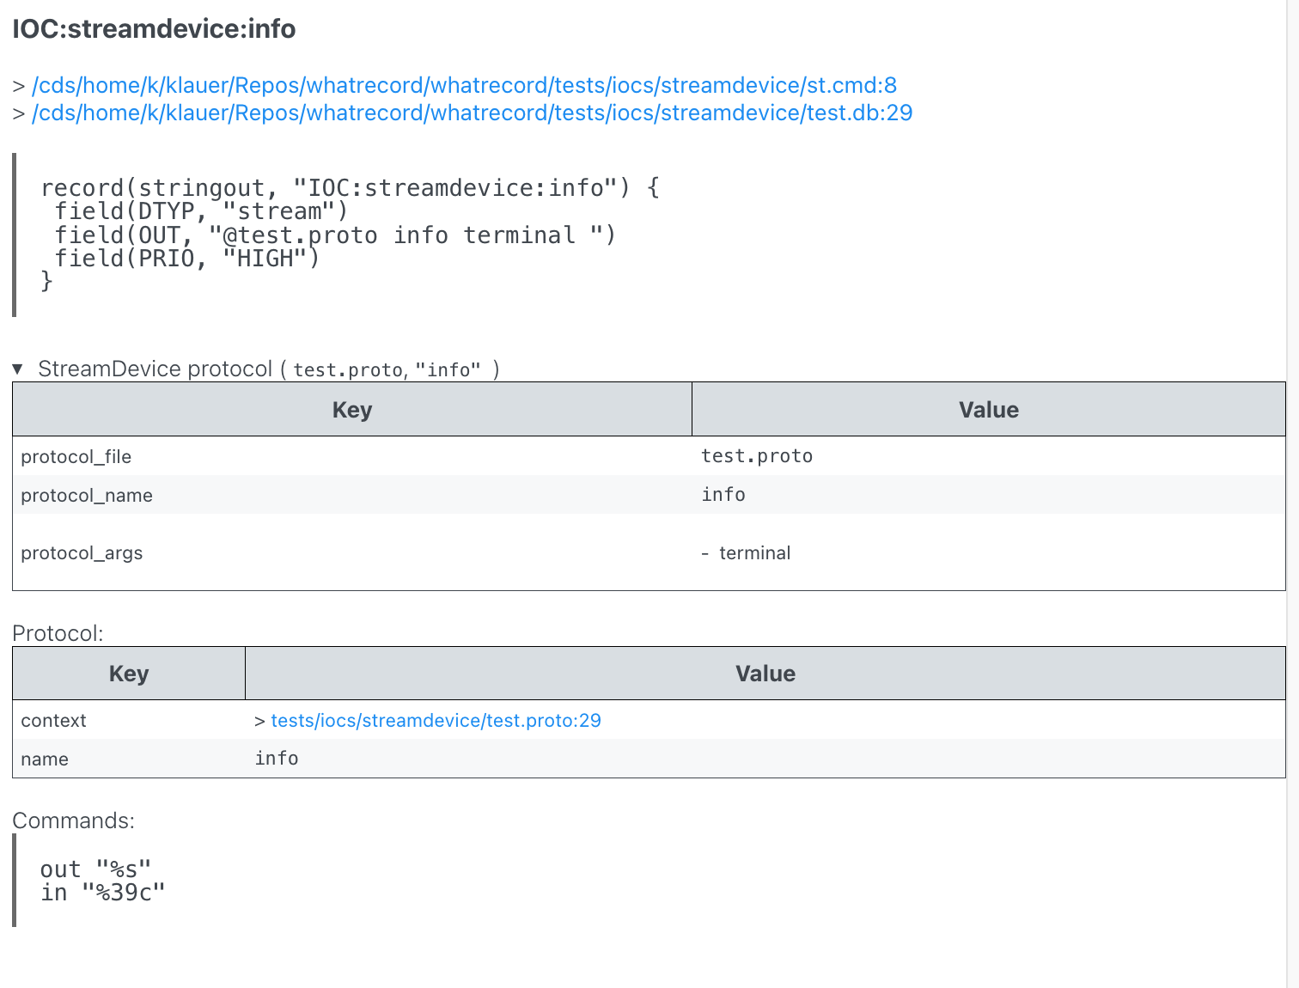
Web frontend: Record to StreamDevice information

Slide 17
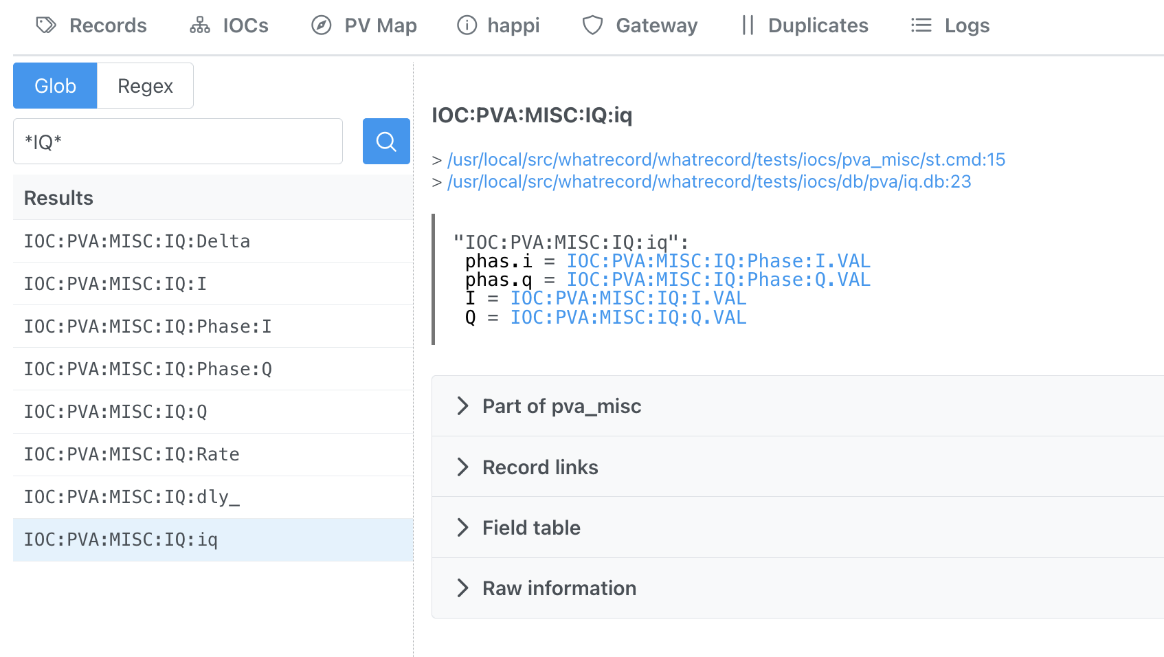
Web frontend: PVAccess group information

Slide 18
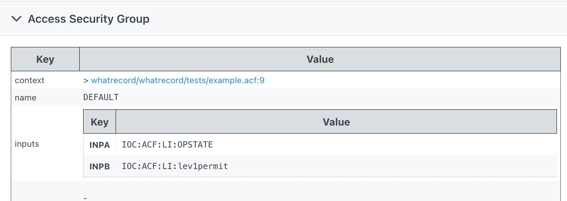
Web frontend: ASGs

Slide 19
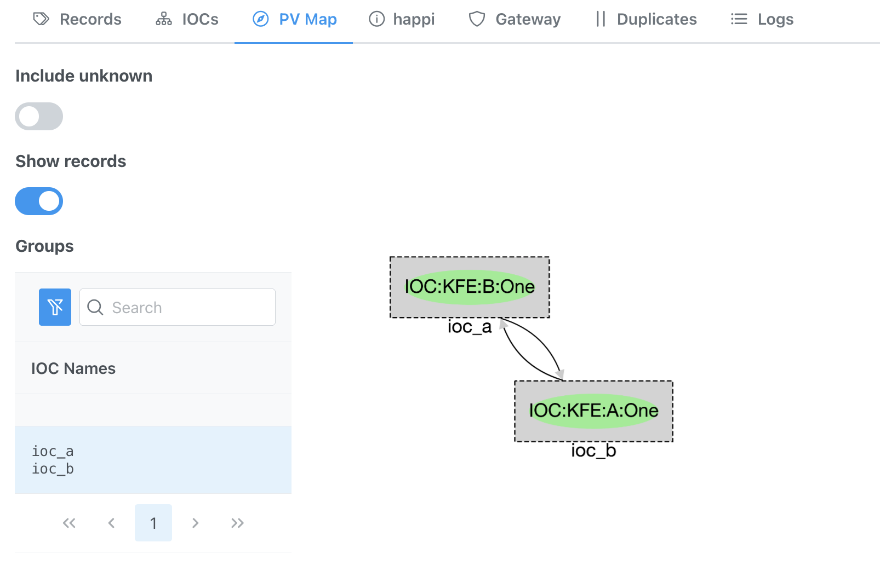
Web frontend: IOC/record relationship map

Slide 20
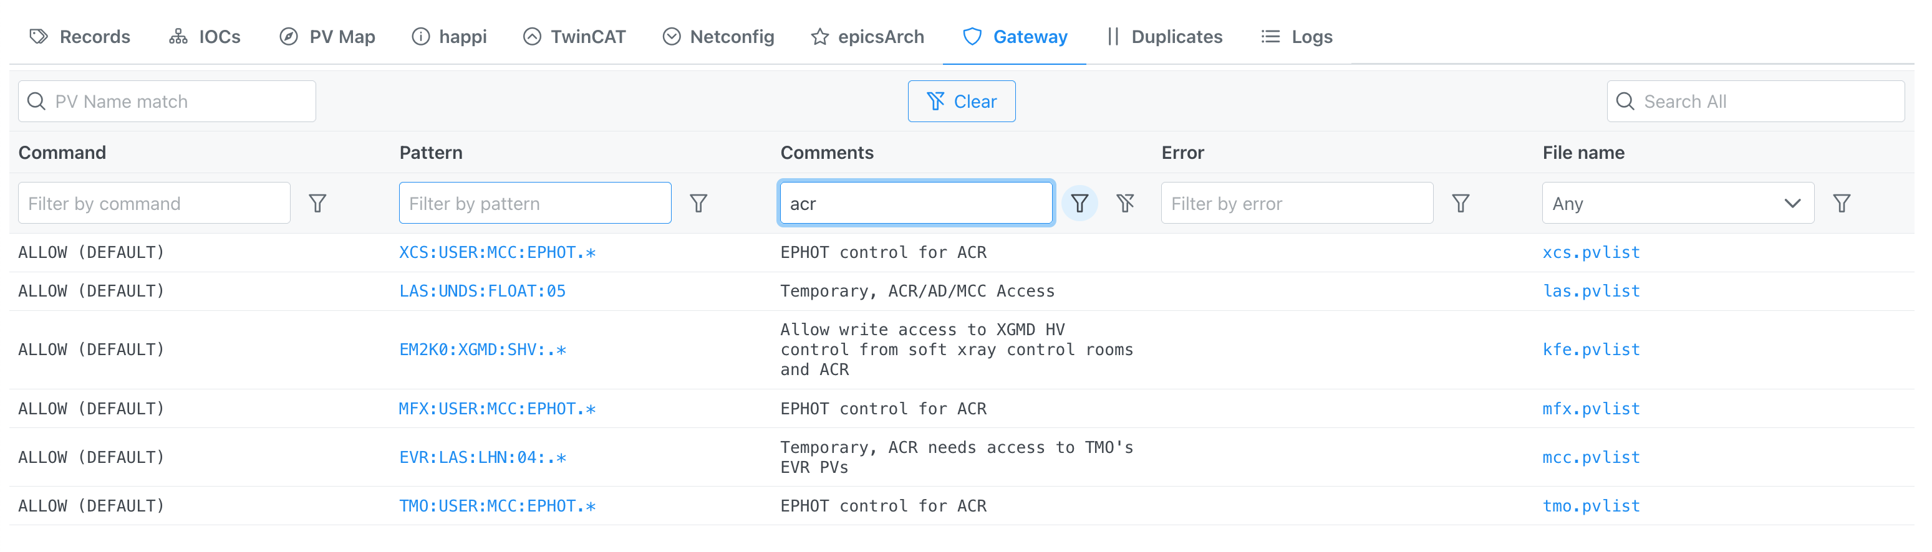
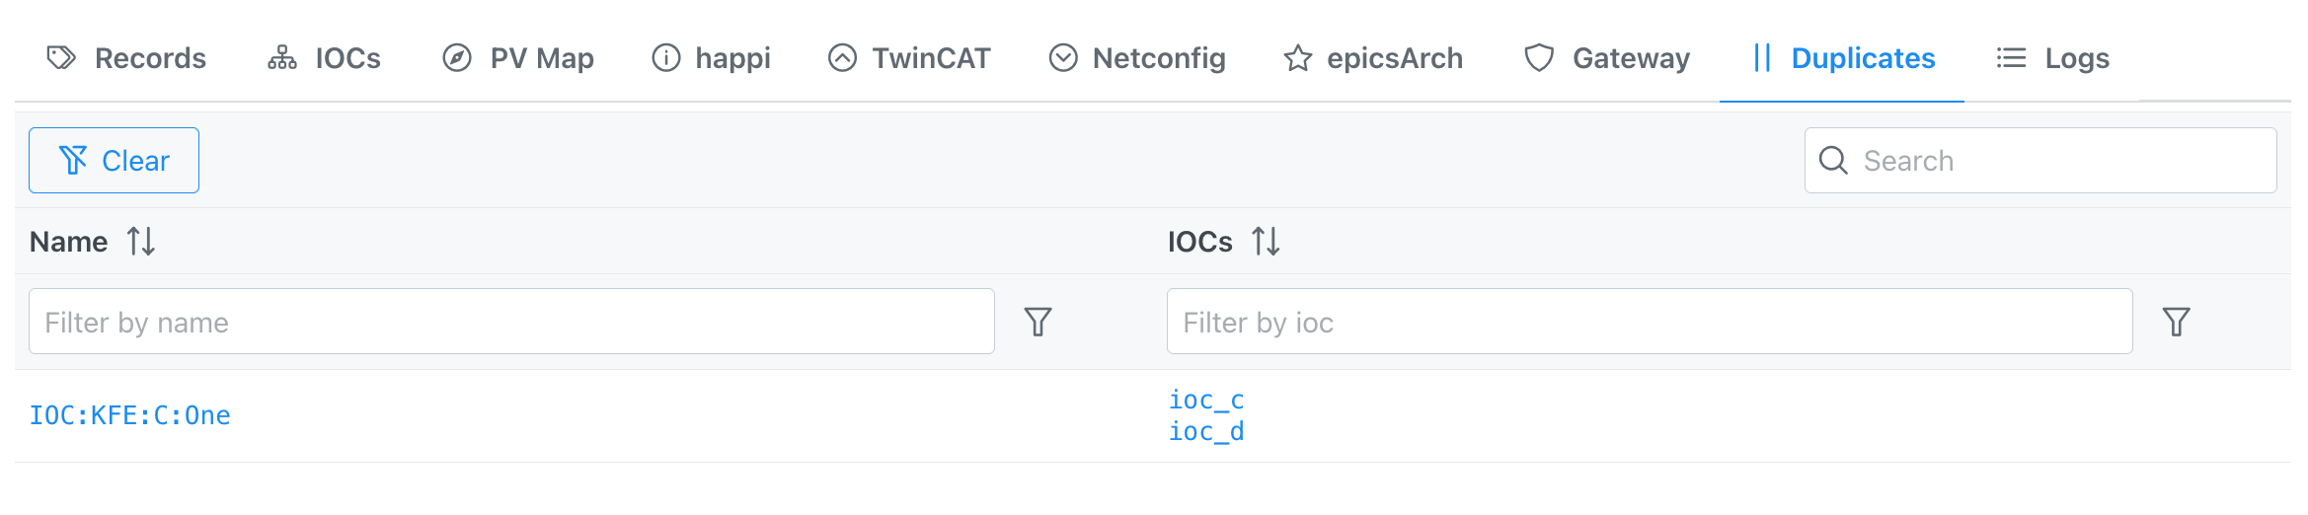
Web frontend: miscellaneous
Gateway pvlist entries
Duplicate records in more than one IOC

Slide 21
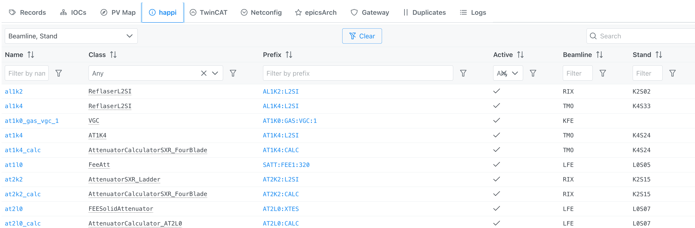
Web frontend: happi (ophyd Device database) entries

Slide 22
What isn’t whatrecord?
It isn’t for live views: no PVAccess and no Channel Access.
As a toy/side-project with no charge code:
It isn’t well-documented (bet you didn’t see that one coming)
  But there are nice docstrings, generally!
It isn’t error-free/bug-free
  It aims to be as compliant as possible when parsing the files, but there may be discrepancies
It isn’t a good example of how to store relational data or do web development
  Goal was breadth-first whim-first:
    Parse and interpret everything: in-memory dataclasses storing all information
    Get it to be displayed in a friendly way
  Database-backed information along with and corresponding backend/frontend changes may need to be pursued

Slide 23
Trying it out
Easiest method to try the frontend/backend as shown in the slides is with docker:
  $ git clone https://github.com/pcdshub/whatrecord
  $ cd whatrecord/docker
  $ docker-compose up
  # (Wait a couple minutes, then open http://localhost:8896 in browser)
Or try the parsing tools with just Python (3.8+):
$ pip install whatrecord
$ whatrecord --help

Slide 24
Thank you for your time.

Slide 25
Backup

Slide 26
Your browser to the server
Your web browser tab #683
Frontend server
API server
Worker subprocesses
iocmanager-loader
Parse st.cmd
Parse st.cmd
happi finder
pytmc loader

Slide 27
Grammar-based parsing?
EBNF Grammar rules - simplified excerpt from the V3 database grammar:
database: record*
record: "record" record_head record_body?
record_head: "(" string "," string ")"
record_body: "{" record_field* "}"
record_field: "field" "(" string "," string ")"
| "info" "(" string "," string ")" -> record_field_info
| "alias" "(" string ")" -> record_field_alias
Using a pure-Python parsing library “lark”:
Take the above to make a .db file into a set of tokens.
Take those tokens and put them in a useful data structure.
https://github.com/pcdshub/whatrecord/tree/master/whatrecord/grammar
Notes:
Extended Backus–Naur form

