Slide 1
APS-U Accelerator Controls System Update
Presented by Karen White for APS-U COntrols
Advanced Photon Source
Argonne National Laboratory
09-14-2022

Slide 2
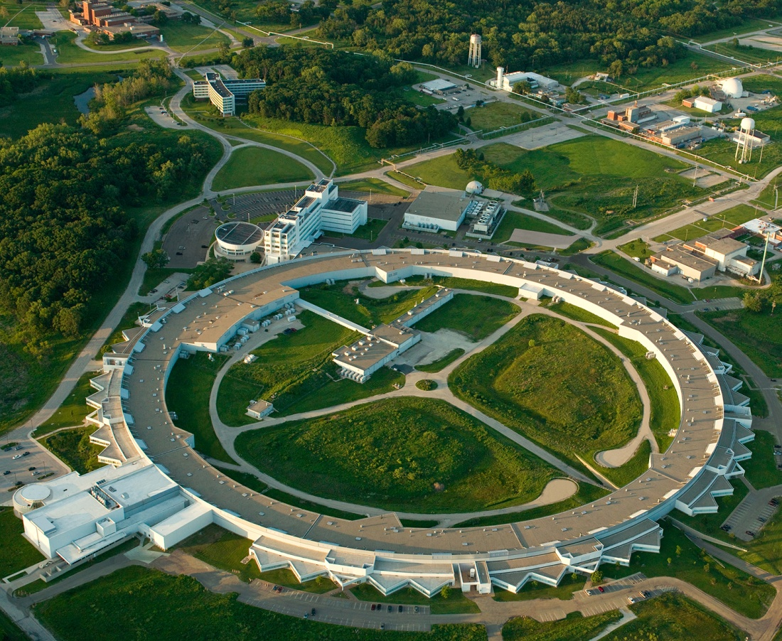
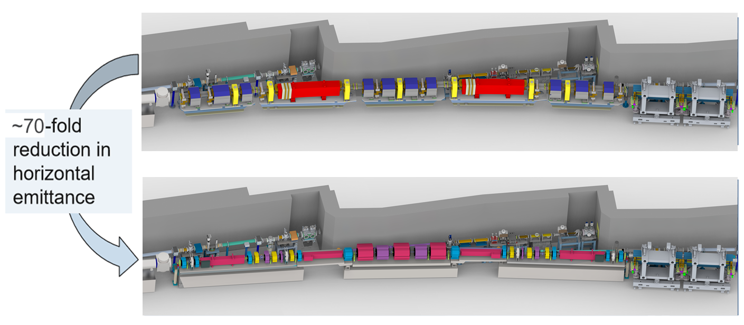
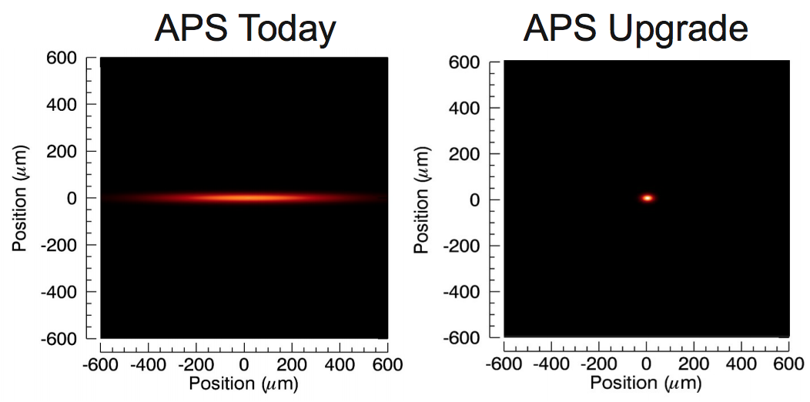
APS & APS-U Overview
APS Accelerator Complex & its Upgrade
Booster
Linac
PAR
LEA
Storage Ring
APS double bend lattice
APS-U multi-bend achromat lattice
Notes:
The APS is a user facility which provides hard X-Ray to support scientific research during past 25 years. It consists of
1. A S-band Linac, which provides 250-500 MeV electron beam at a repetition rate of 30 Hz
2. PAR (Particle Accumulate Ring), which accumulates the particle from Linac to 1-4nC, and injects the beam to Booster 2Hz
3. Booster: which ramps the beam to 7GeV and injectors the beam into its Storage Ring at 2Hz
4. Storage Ring, which has a circumference of 1.1km, with 40 sectors with mirror symmetry, or 20 symmetric double sectors.
5. Various beam transport lines
6. LEA (Linac Extension Area): which provides opportunities for R&D of advanced accelerator technologies and future FEL as well as THz accelerators
Currently, APS SR operates at 7GeV with 100mA, and has 40 ID (insertion device) and 21 bend magnet user beamlines.
Its storage ring accelerator consists of 40 sectors, or 20 double sectors.
The APS-U project is to refurbish its storage ring with an MBA (Multi-Bend Achromat) structure with 7 bends.
It reduces its emittance significantly to 42 pm-rad from 3000 pm-rad and doubles its beam current from 100mA to 200 mA current.

Slide 3
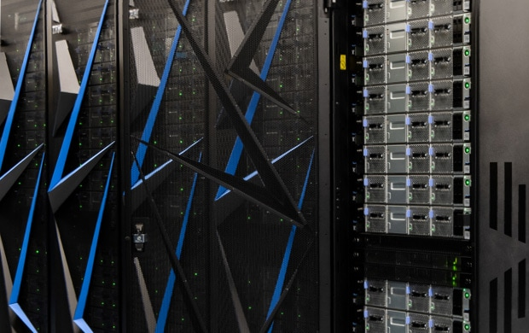
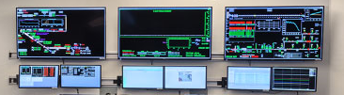
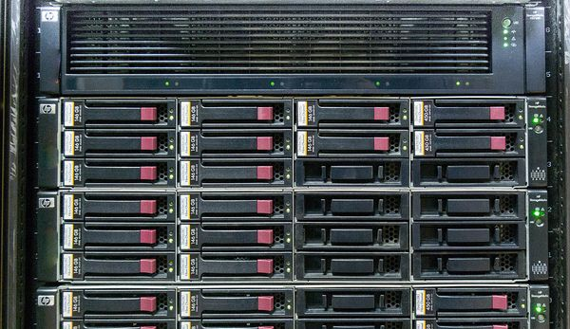
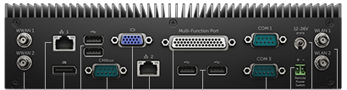
APS-U Controls System Architecture
Standard 3-tier distributed structure with EPICS7 as software framework
Archiving, Alarm Management, Strip charts, Save/Restore Utility
High Performance
Storage
Fiber Network for High Performance System (Timing, etc)
Data Acquisition
Ethernet – EPICS Channel Access, PTP/NTP Timing
Vacuum Control
High Precision Timing
Power Supply Control
RF Control
Diagnostic Control
Experimental System
I
OC
Serial
Comm
PLC
(DI, DO, Temp, Interlock)
CPU
EVG
IOC
DAQ IOC
PLC
(Temperature, Interlock)
IOC
DAQ IOC
HVRF
IOC
IOC
DAQ IOC
PLC
(DI, DO, Temp, Interlock)
I
OC
Motor
Controller
DAQ
Vacuum Controller (Pump, Gauge, Valve, …)
Power Supply
LLRF
RF Amp
Digitizer
Motor Controller
Motion Control
Magnet
Analog Front End
Motor

Slide 4
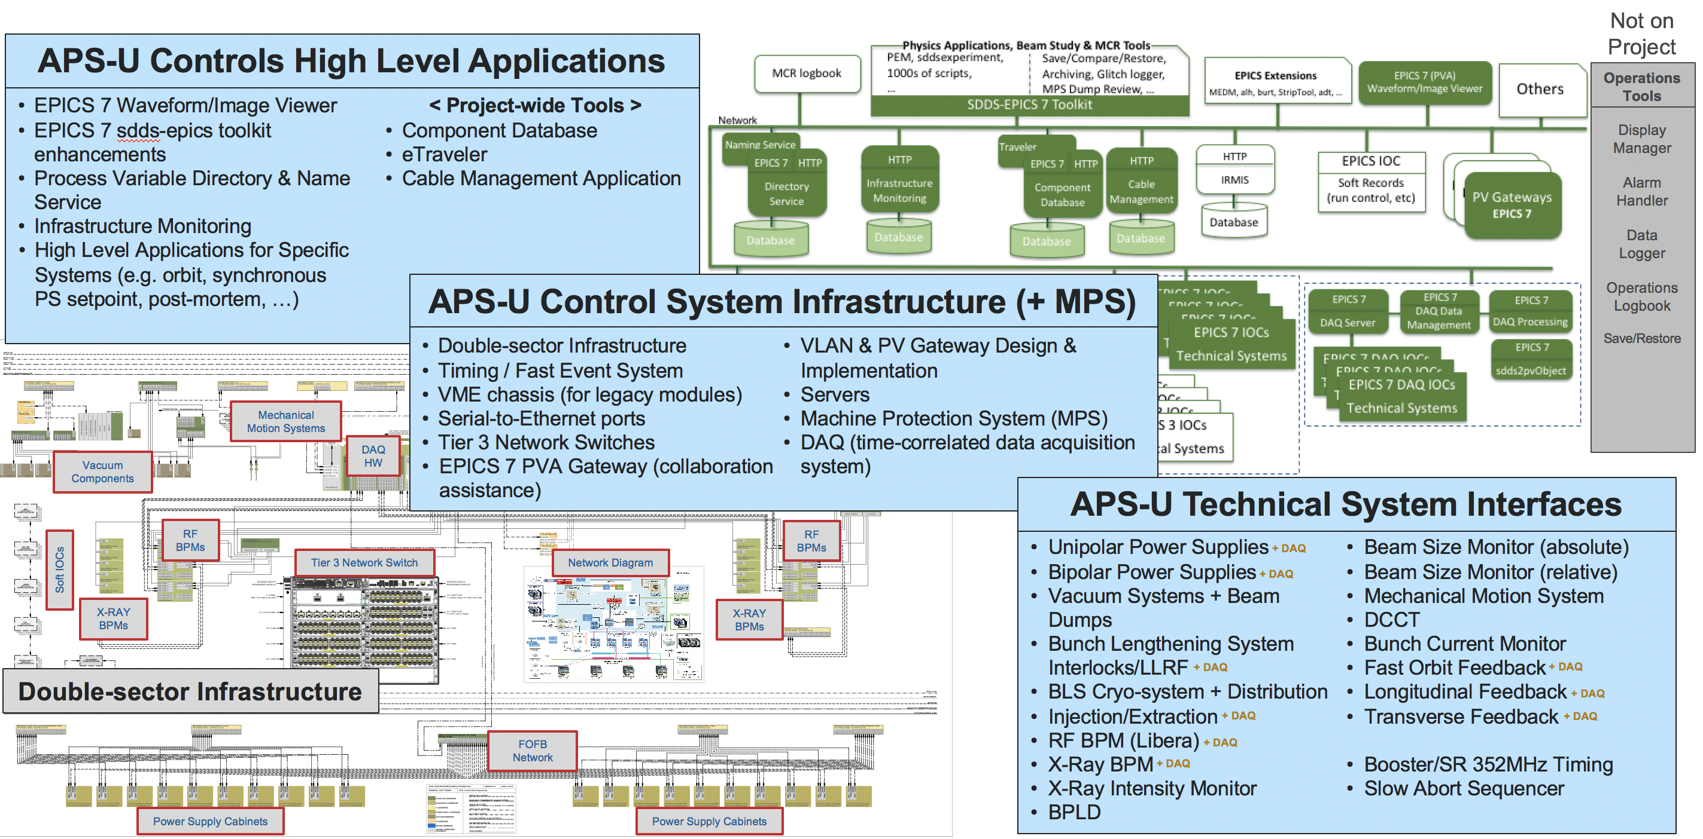
Overview of APS-U Controls System
Notes:
The APS-U control system mainly consists of 3 portions:
1. High level application, which includes global database application like CDB, Cable, eTraveler, as well as other EPCIS7 tools
2. Control system infrastructure, which includes network, MPS, timing, DAQ, etc
3. EPICS IOC for technical subsystem controls like power supply, diagnostics, vacuum, RF, etc

Slide 5
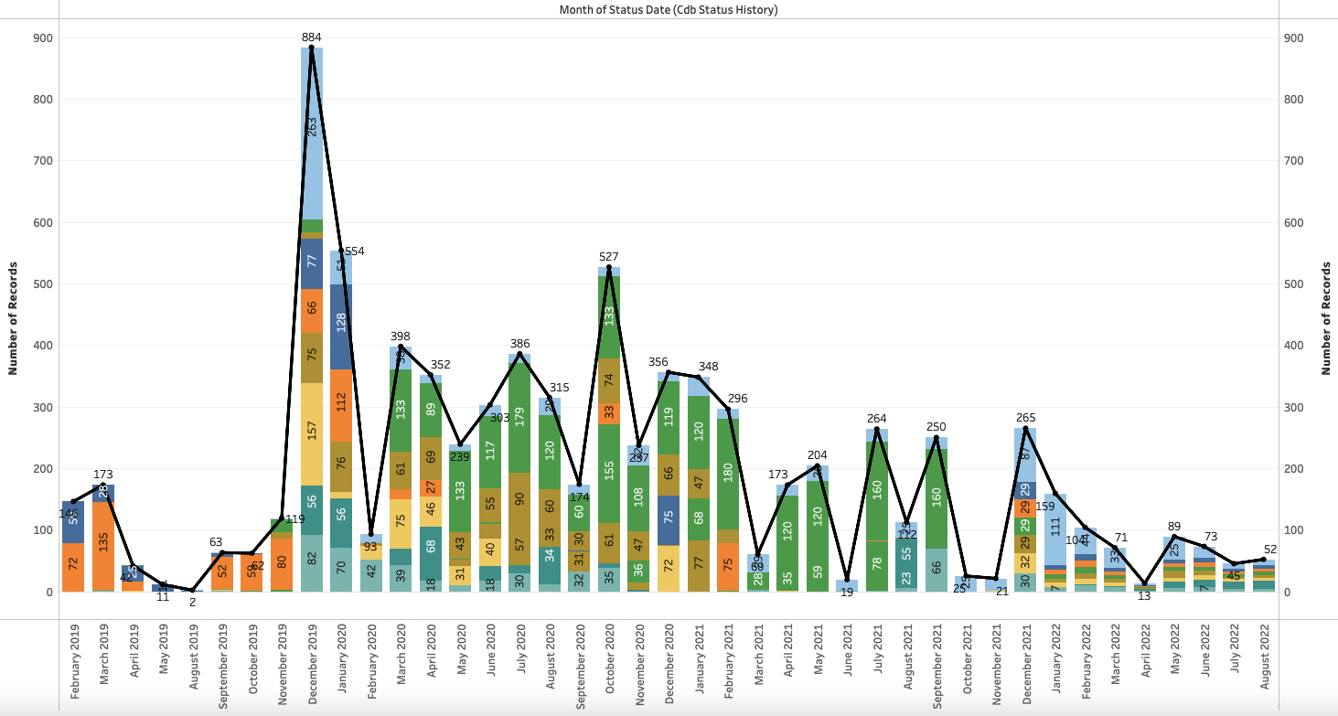
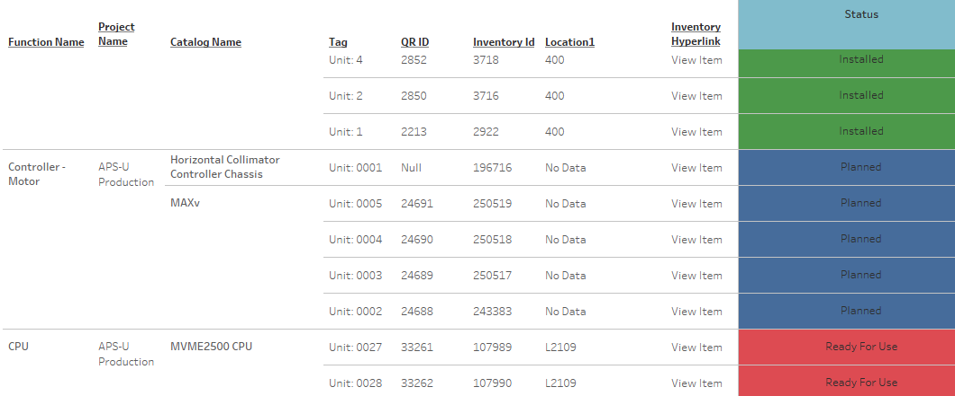
Database Applications
CDB, CDB/Cable, eTraveler are actively supporting project construction
  CDB Mobile application provides sufficient flexibility to support in field work
  Some statistics of data entry
CDB:
  Registered Users 341​
  Catalog Items 2,706​
  Inventory Items 33,841
  Machine Elements 30,391
  MAARC Items 163,063
Cable:
  Cable Catalog Items 176
  Cable Inventory Items 2,365
  Cable Design Items 11,875
eTraveler
  Registered Users: 287
  Draft Forms: 703
  Released Forms: 960
  Active travelers: 18,564
  Finished travelers: 12,825
  Archived travelers: 7,418
Inventory Item Tracking in CDB
CDB Inventory Status Change by Month
Notes:
The inventory Item is tracked in CDB, including its catalog name, inventory ID, location, inventory hyperlink to the detailed info of each particular unit, the installation readiness status

Slide 6
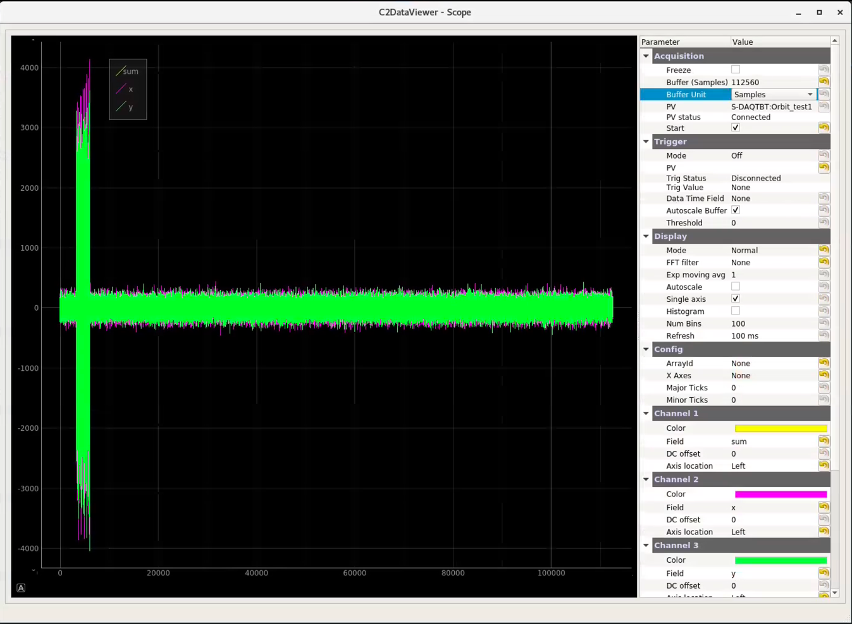
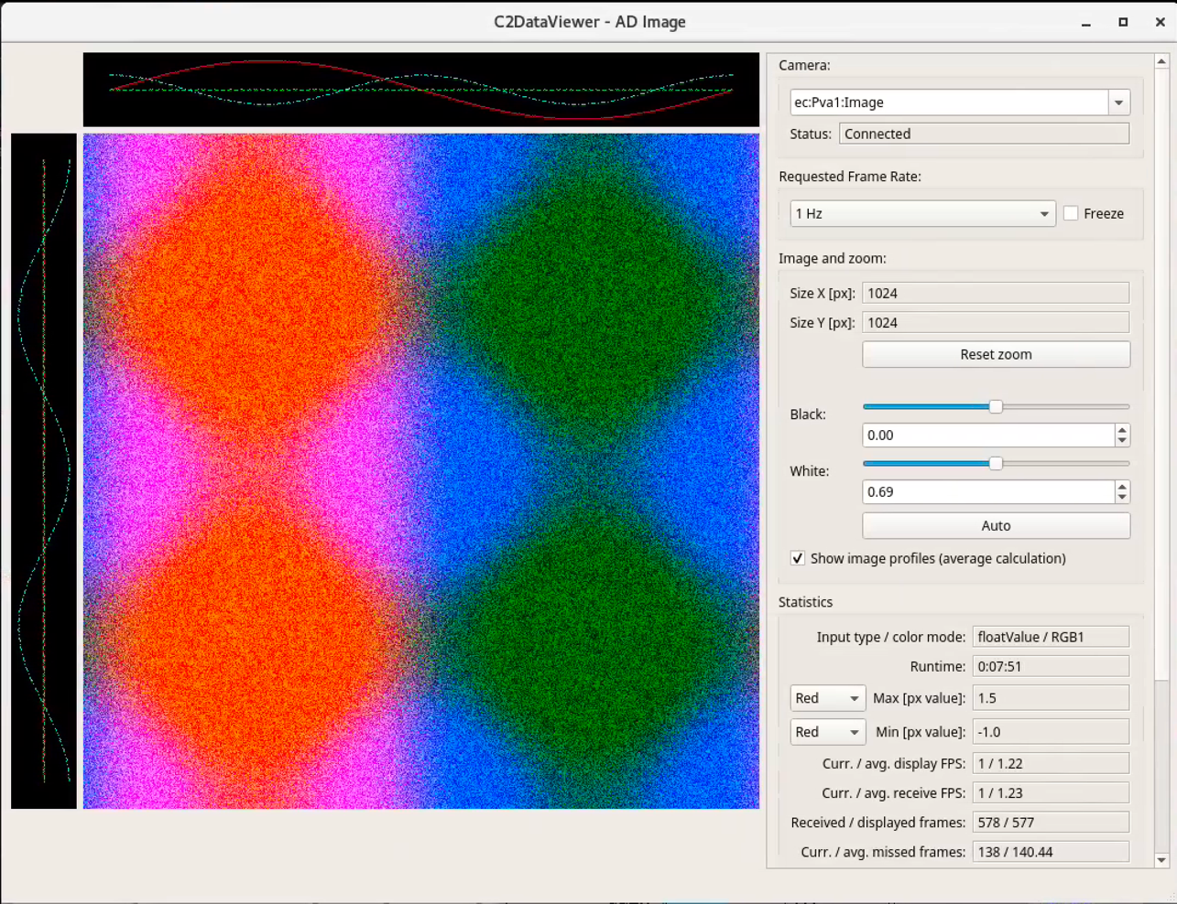
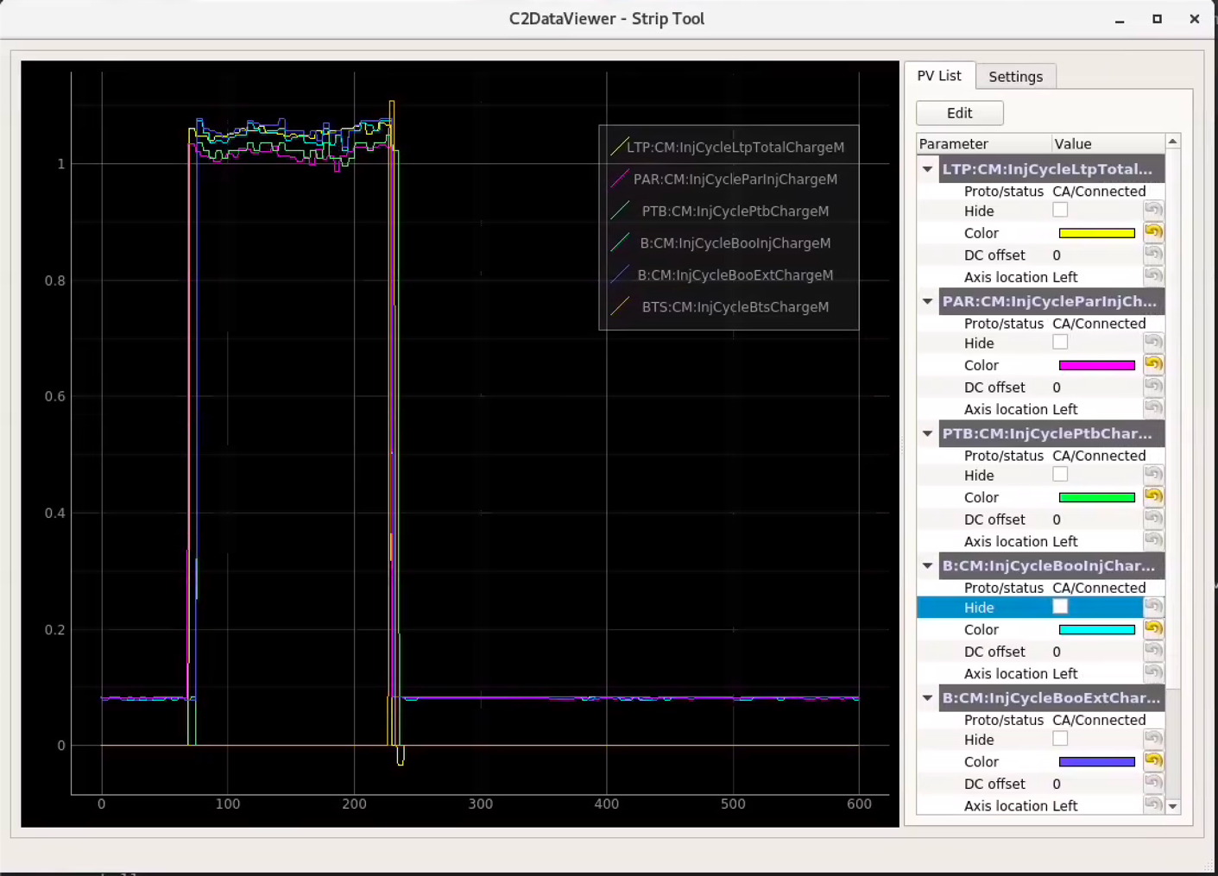
EPICS 7 Waveform/Image Data Viewer (C2DV)
C2DV: A Python based data visualization tool for EPICS 7 high speed DAQ system
  A scope viewer for plotting PVA waveforms
  An image viewer for displaying streaming Area Detector image data over PVA
  A striptool for monitoring CA and PVA scalar PVs
  Scope viewer
  Image viewer
  Striptool
Notes:
Scope Viewer
Scope viewer plots PVA waveforms in real-time. It supports plotting a stream or plot on a PV trigger, displaying multi-axis, and plotting data as FFT, moving average, or histogram. Scope viewer is used extensively for troubleshooting and diagnostics of existing APS-U RF systems and for development of the DAQ system and Low-Level RF system.
Image Viewer
Image viewer displays detector or camera images from an EPICS areaDetector driver. Viewer is designed to handle data streaming at high rates, and automatically adjusts processing rate based on CPU and network usage. Image viewer is used by both accelerator and x-ray science divisions for monitoring and troubleshooting beamline data.
Striptool
Striptool can plot both CA and PVA scalars simultaneously. Has a simple and easy-to-use UI. Supports plotting data as FFT, moving average, or histogram.

Slide 7
Other High-Level Applications
A web-based naming system, which was developed originally at FRIB, has been introduced to manage the APS-U naming convention
  600+ name entries captured in the naming system
OpenNMS was selected to monitor controls system infrastructure
Olog is deployed as next logbook management system
  Existing Controls logbook data has been migrated into this system now
Logging as well as IOC console message to be logged into ElasticSearch using logstash, and browse it on Kibana

Slide 8
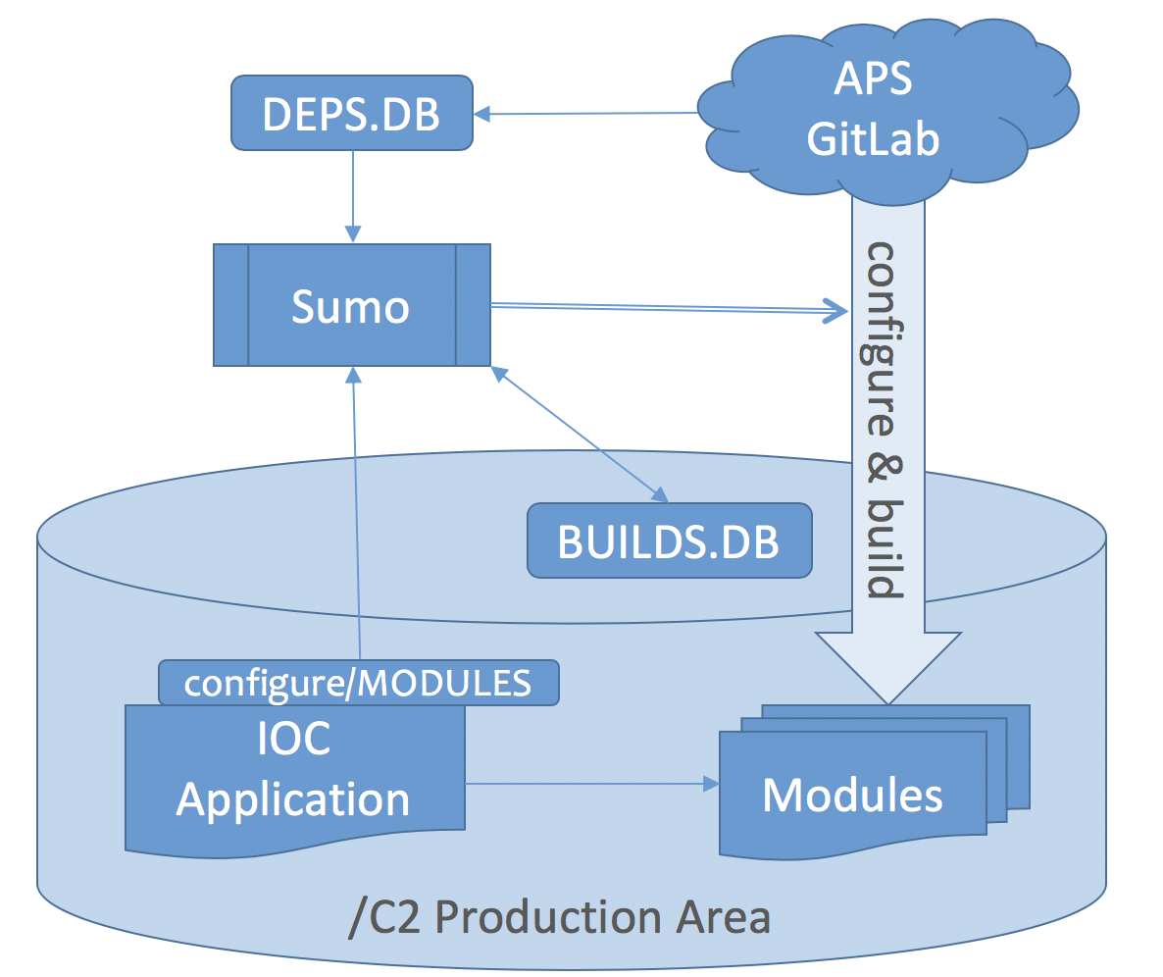
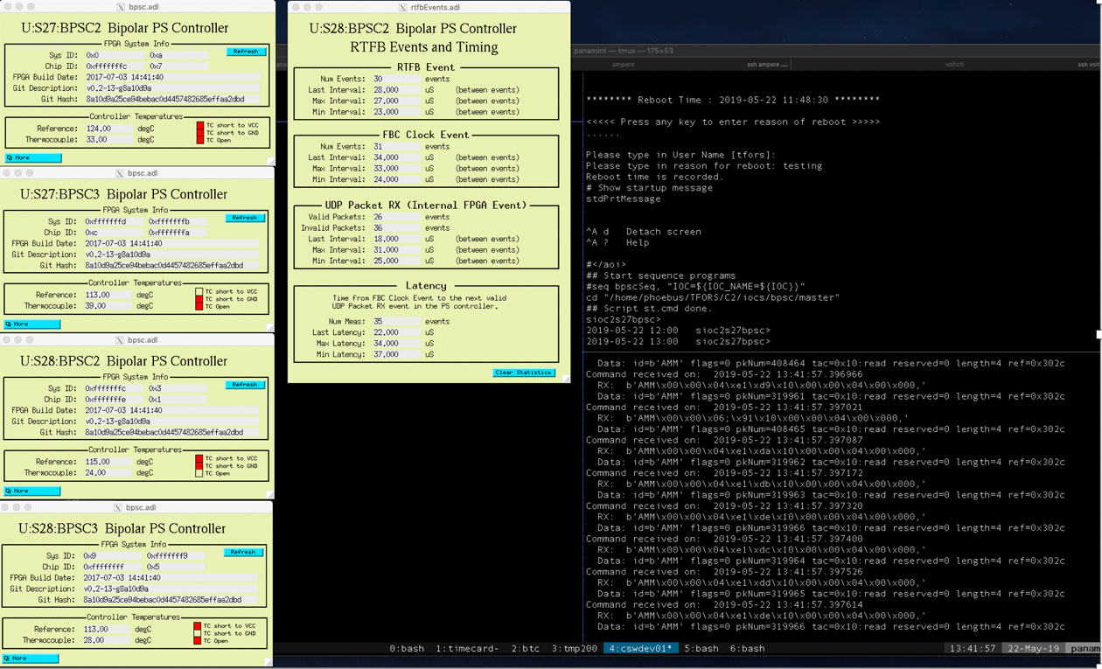
EPICS Module Configuration, Build, and Management
Using Conda for software environment management including EPICS
Adopted ‘Sumo’ package to automate IOC modules configure/build
  Sumo (HZB/BESSY) to build IOC support modules from source on demand
  All source comes from APS’ GitLab server
  IOC applications will specify needed support modules and versions
  Sumo is used similarly to create private module build areas to assist development
  Where appropriate we hope to include PLC, FPGA, and DSP code in the same environment
  We are developing against an EPICS 7 release

Slide 9
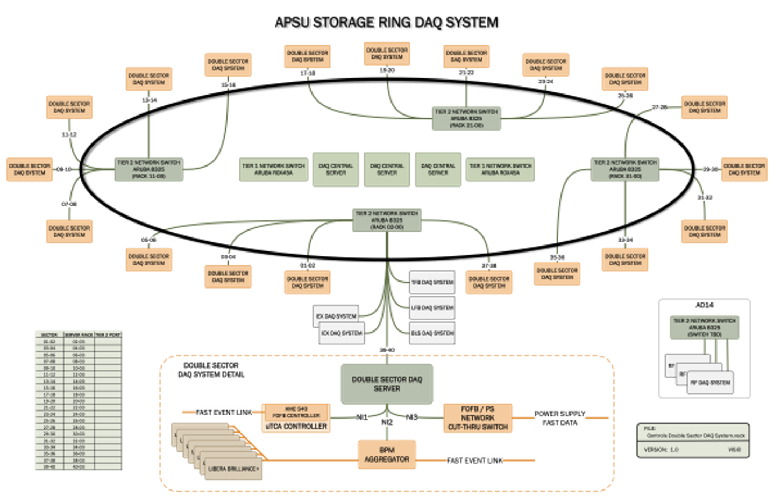
APS-U Time-Corelated DAQ System
Architecture
data rate of ~ 150MB/s per double sector,
& 3+ GB/s data rate for entire storage ring.
Notes:
APS-U technical subsystems utilize state-of-the art technologies and high-bandwidth communication links that can capture gigabytes of data and must be consumed by the control system.
Its DAQ software represents framework and tools that enable fast data collection for controls, statistics and diagnostics of the embedded controllers utilized by the new APSU machine.
In the DAQ system design, we consider both data volumes and data rates to scale systems appropriately. Some major design aspects include
Large data volume
Fast data rates to scale systems appropriately.
Time-corelated data acquisition to ensure data quality to enable future machine learning
In order to shield the rest of the control system and network from potential impact caused by the DAQ data traffic, we will isolate this data from the main controls network.
In order to help promote code reuse, reduce development effort, and simplify DAQ user interfaces, we strive to provide standard solution for the DAQ implementations crossing different technical subsystems like LLRF, PS, BPM TBT, etc.
This slide is showing DAQ hardware architecture. There are a total of 24 DAQ system: 20 double sectors around the storage ring and 4 in each quadrant section.
In each double-sector we have
one FPGA base data aggregator for BPM turn-by-turn data at 271KHz;
one data aggregator for PS fast data at 22.6KHz;
one DAQ server, which is a linux machine that will be running IOCs for turn-by-turn, power supplies, etc.
Both turn-by-turn and power supply aggregators receive data from their respective individual system components, such as libera brilliance+ BPMs or individual power supply controllers, they aggregate this data into a single network stream, and send it to their respective DAQ IOCs, and the DAQ IOCs stream the data to its downstream users over EPICS7 pvAccess.
It is important to note that just those subsystems in one double sector taken together offer more than 14000 channels of data that can be collected simultaneously, which streams data at least 150MB/s per one double sector, and 3GB/s for the whole storage ring.

Slide 10
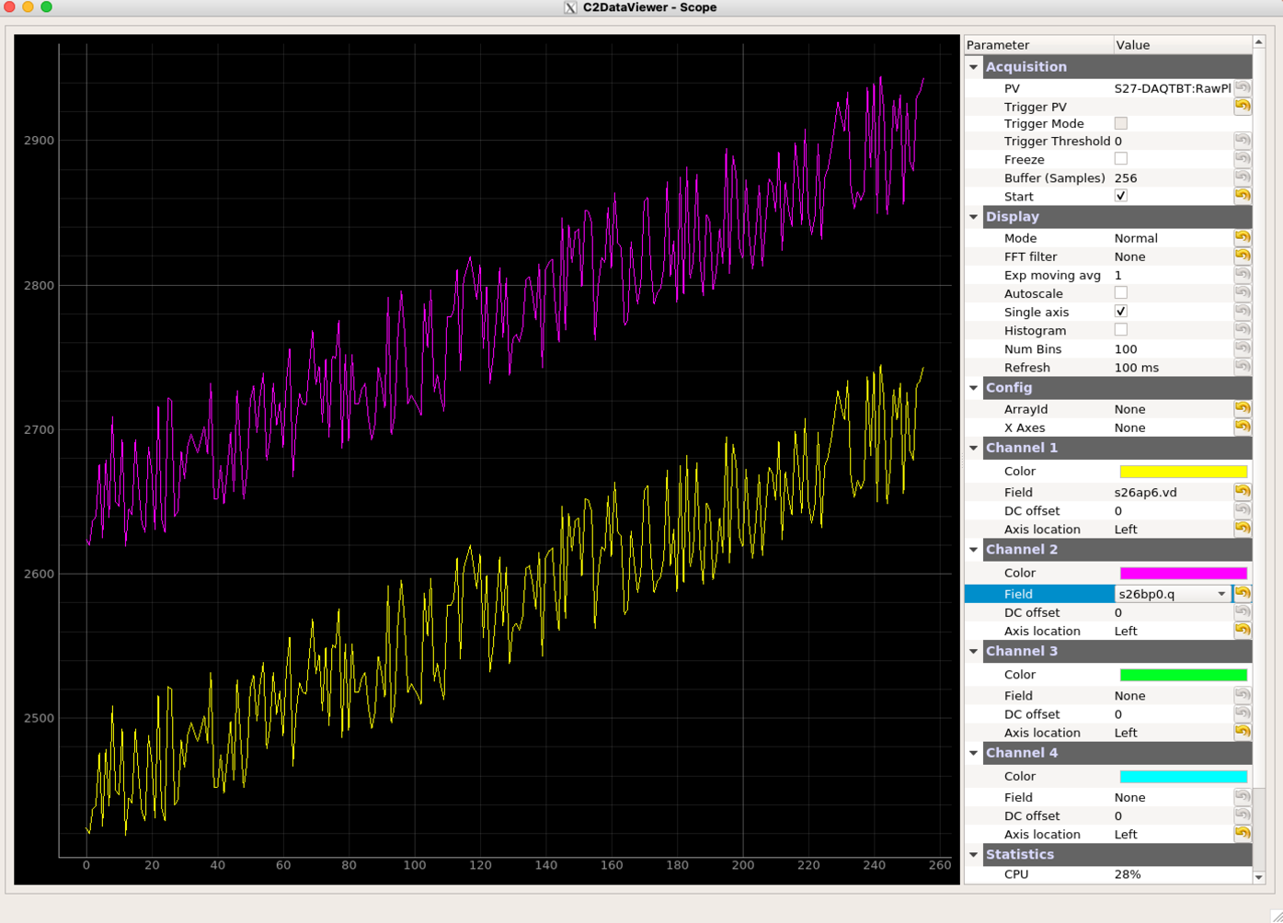
DAQ System Simulation Environment
In order to run the DAQ system in different test environments, several simulation tools were developed including data source simulator and data collector simulator
  Data source simulator: simulate the hardware that generates and sends data to a specific DAQ IOC. The simulation generates simple linear data with noise to easily verify that the data was processed correctly
  Data collector simulator: captures PV objects published by the DAQ IOC, and save the data into a local file in desired format like HDF5, or other site-specific data format (e.g. Self-Describing Data Sets [SDDS] at APS)
PV data monitor client
DAQ Data Source (FPGA)
PV channel
DAQ IOC
Data source Simulator
UDP
Data collector
Data Collector Simulator
C2DV Client

Slide 11
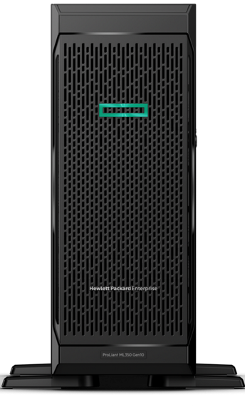
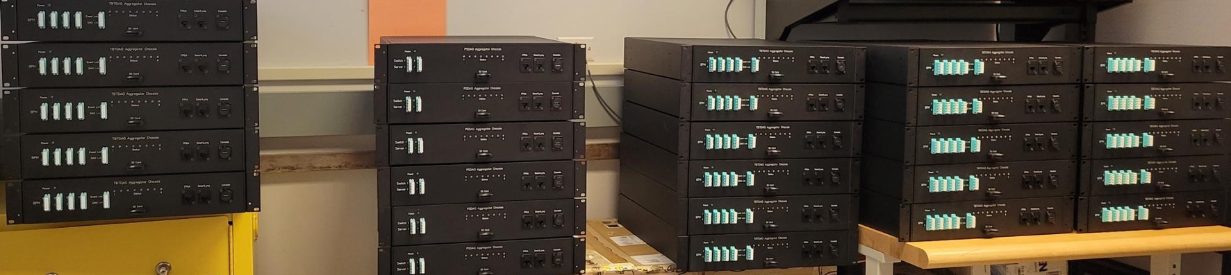
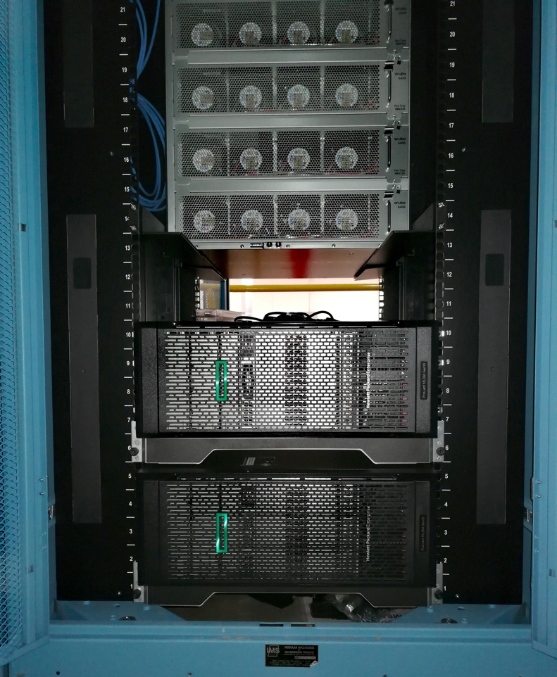
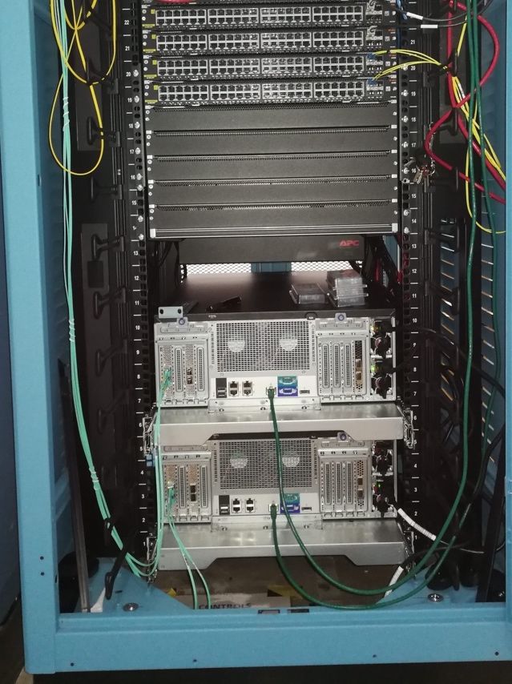
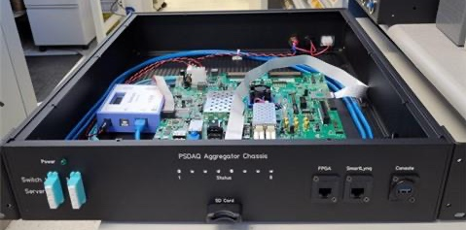
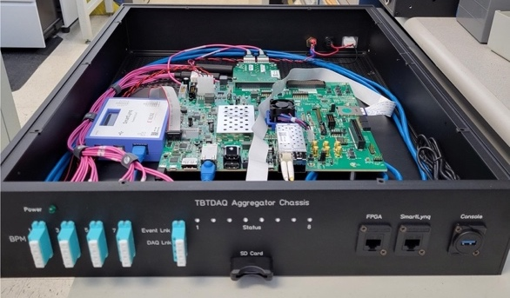
APS-U Time-Corelated DAQ System
DAQ Hardware
DAQ Linux Servers
Fully assembled DAQ aggregator FPGA chassis
PS DAQ aggregator FPGA chassis
TBT DAQ aggregator FPGA chassis
Example of DAQ Linux Servers installed

Slide 12
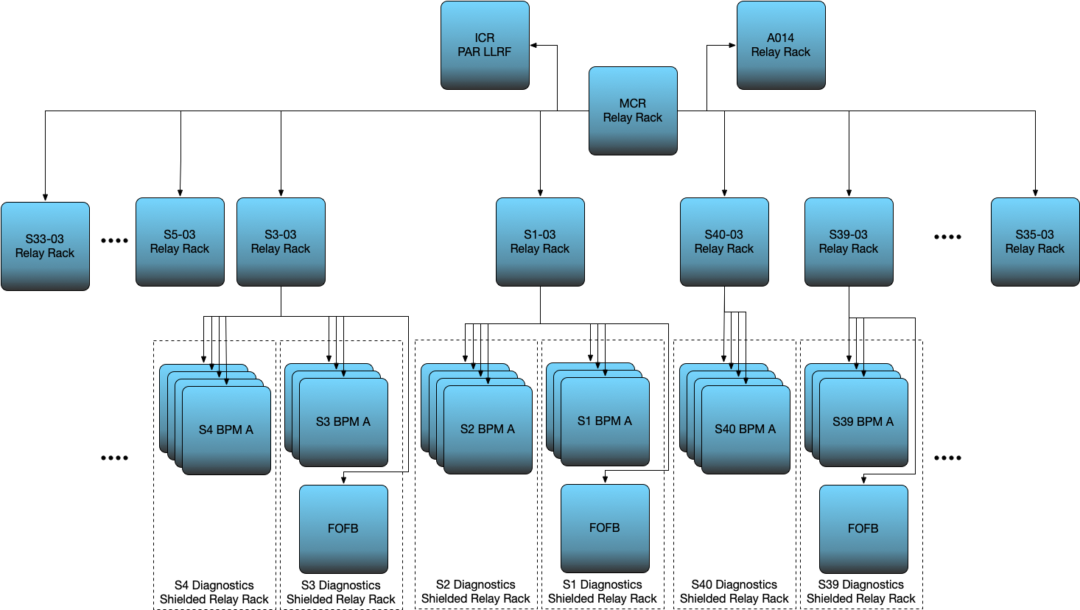
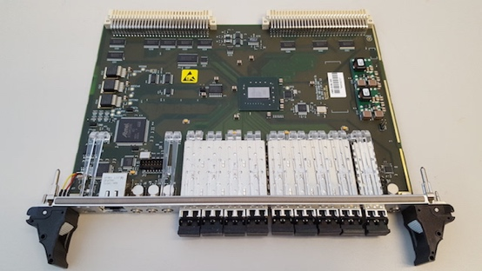
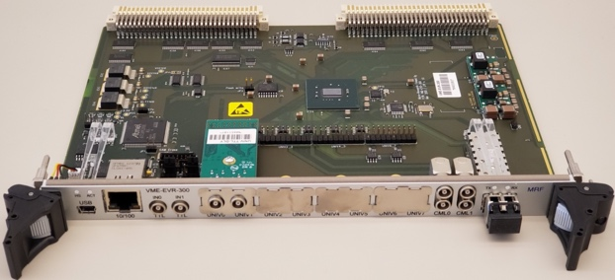
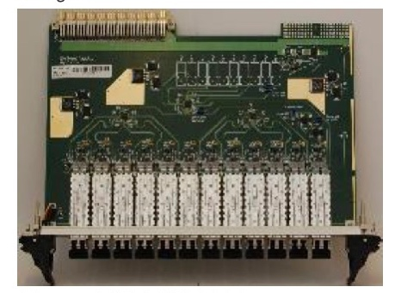
APS-U MRF Fast Event/Timing System
New timing system with MRF 300-series hardware
  Event Link distributed to 232 technical systems
  113 + Individual Triggers (TTL) to technical systems
Jitter measured relative to event clock reference at APS
Fully use delay compensation function to compensate
the time delay in the fibers
A few testing stands setting up
  In Diagnostics lab, supporting RF BPM acceptance test
  Along SR mezzanine floor
  In installation preparation warehouse
Generator | Receiver | Fanout | Rear Transition | TTL Input | TTL Output
33 | 41 | 45 | 9 | 31 | 162
 | UNIV Output |  | CML Output
PLL Bandwidth | RMS | Pk-Pk | RMS | Pk-Pk
MH (375 Hz) | 16.15 ps | 101.56 ps | 8.70 ps | 78.13 ps
VME-EVM-300
VME-EVR-300
VME-FOUT-12
Testing Setup along SR Mezzanine Floor

Slide 13
APS-U MPS and BPLD System
System Architecture
LOCAL= BPLD + MPS
I/O (x40)
BPLD: Beam Position Limit Detector
Notes:
APS-U MPS is an equipment protection system to protect accelerator hardware from a system failure
The BPLD system is a fast response system to protect the accelerator hardware from anormaly of beam behavior.
The BPLD system will ensure the electron beam stay in position/angle boundaries in phase space.
The system is a star connection topology, with possible to expand it to a ring structure in the future
It consists of one main MPS node in Main Control Room, and 20 local node distributed in each double sector.
Hardware wise, it is a combined function of MPS and BPLD
Each local node consists of
28 BPMs
40 inputs per chassis to detect for example, ID gap and fault, water system failure, power supply system etc.
It accepts MRF EVR link for the trigger & timestamp
Main node consists of
30 I/O which includes local MPS/BPLD inputs, RF inputs, etc
DCCT to read back the beam current
MRF EVR link
Others

Slide 14
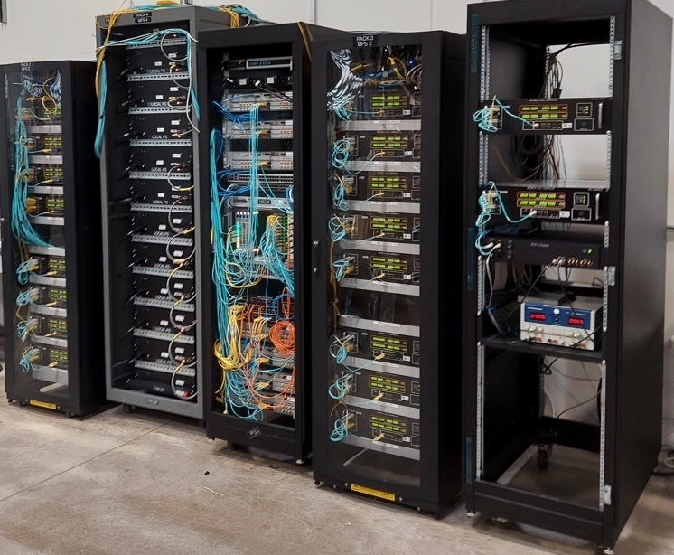
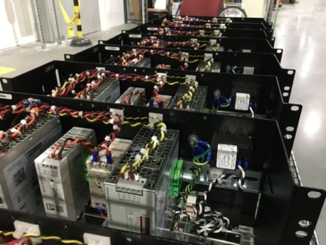
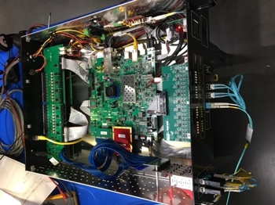
APS-U MPS and BPLD System
System Hardware
Main MPS Chassis
MPS Chassis Power Supply
Fully populated MPS stand under integration testing
Left to right:
MPS chassis rack #1,
MPS chassis power supply rack,
electronics rack (BPM, MRF timing, network, etc),
MPS chassis rack #2
MPS chassis rack #3
Local MPS/BPLD Chassis

Slide 15
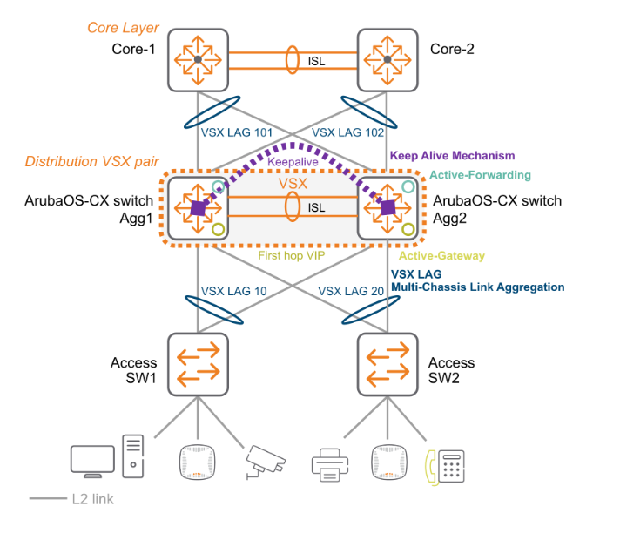
APS-U Accelerator Network
Architecture
Tier-1 to Tier-2
200Gbps
Tier-2 to Tier-3
50Gbps (2x25Gbps)
Tier-3 to electronics
Gbps
10Gbps

Slide 16
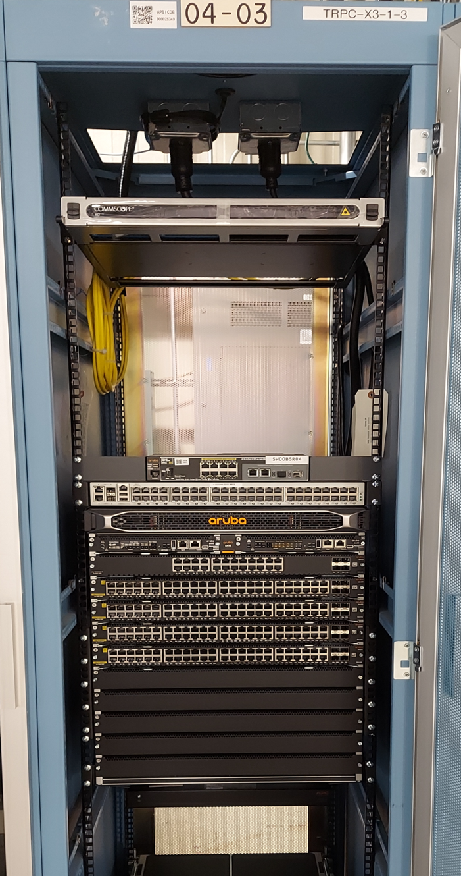
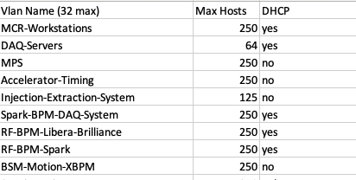
APS-U Accelerator Network
Network Infrastructure Status
  APS-U network installation finished, including its fibers
  Network subnet/VLAN (total 31 VLAN) design finished, implemented, and ready to use
Terminal server
Network fibers
Example APS-U accelerator VLAN implemented and ready to use
Tier-3 switch
Tier-3 Network installed
16

Slide 17
Summary
APS-U is under active construction and preparation for its dark time starting from April 2023
Database application like CDB, Cable, as well as eTraveler system plays critical role to support the project
EPICS7 based time-corelated DAQ system capable to stream data over pvAccess with data rate higher than 3GB/s, which is gaining more and more interesting in supporting beam commissioning and future operation
MRF 300-series based timing system, with lots of new functions enhanced to meet APS-U needs including full functional delay compensation capability
The MPS/BPLD system starts with a star connection topology with future extendibility to a ring structure
A high-performance network with 31 VLAN in place to meet various needs
Installation started in the place where suitable including network as well as rack mounted DAQ computer server

