Slide 1
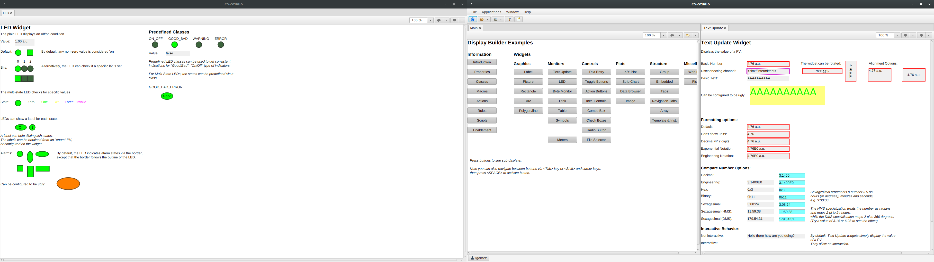
Quick Intro To (Automated) GUI Testing With TestFX

Slide 2
Reasons Why (GUI) Tests Matter
Find bugs early
Keep evolving GUIs(such as Phoebus) robust
Keep the quality of software high

Slide 3
Real World Examples of Bugs
As I came up with this talk, my GUI unit tests found real bugs in Phoebus(we missed null-checking a global). https://github.com/ControlSystemStudio/phoebus/issues/2377

Slide 4
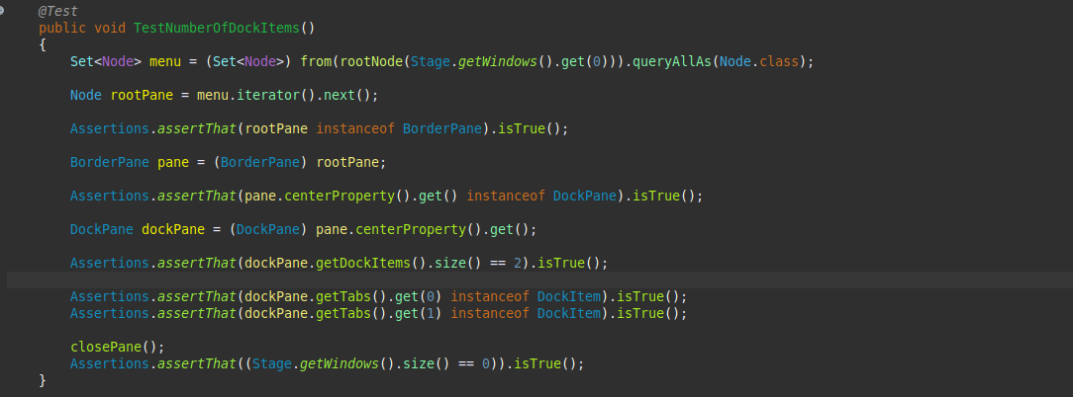
Is it Possible(Practical)? Yes!

Slide 5
JavaFX and TestFX
Phoebus uses JavaFX
TestFX can be used to test JavaFX GUIs(it has headless support too*)
Can easily integrate with maven and execute with a command like
“mvn Dtest=DockPaneTestUI test”
Can Integrate into automated workflows via the headless mode

Slide 6
References and Links
JavaFX:https://openjfx.io/
TestFX:https://github.com/TestFX/TestFX
Phoebus:https://github.com/ControlSystemStudio/phoebus

