Slide 1
TwinCAT – EPICS with motion timestamping
Torsten Bögershausen
www.europeanspallationsource.se

Slide 2
Buzz words
Imaging+scanning (tomography)
All data in Apache Kafka
Facility-wide timing system (”MRF”)
Precise Timing Protocol
TwinCAT
Motor position timestamping in the controller
EPICS IOC

Slide 3
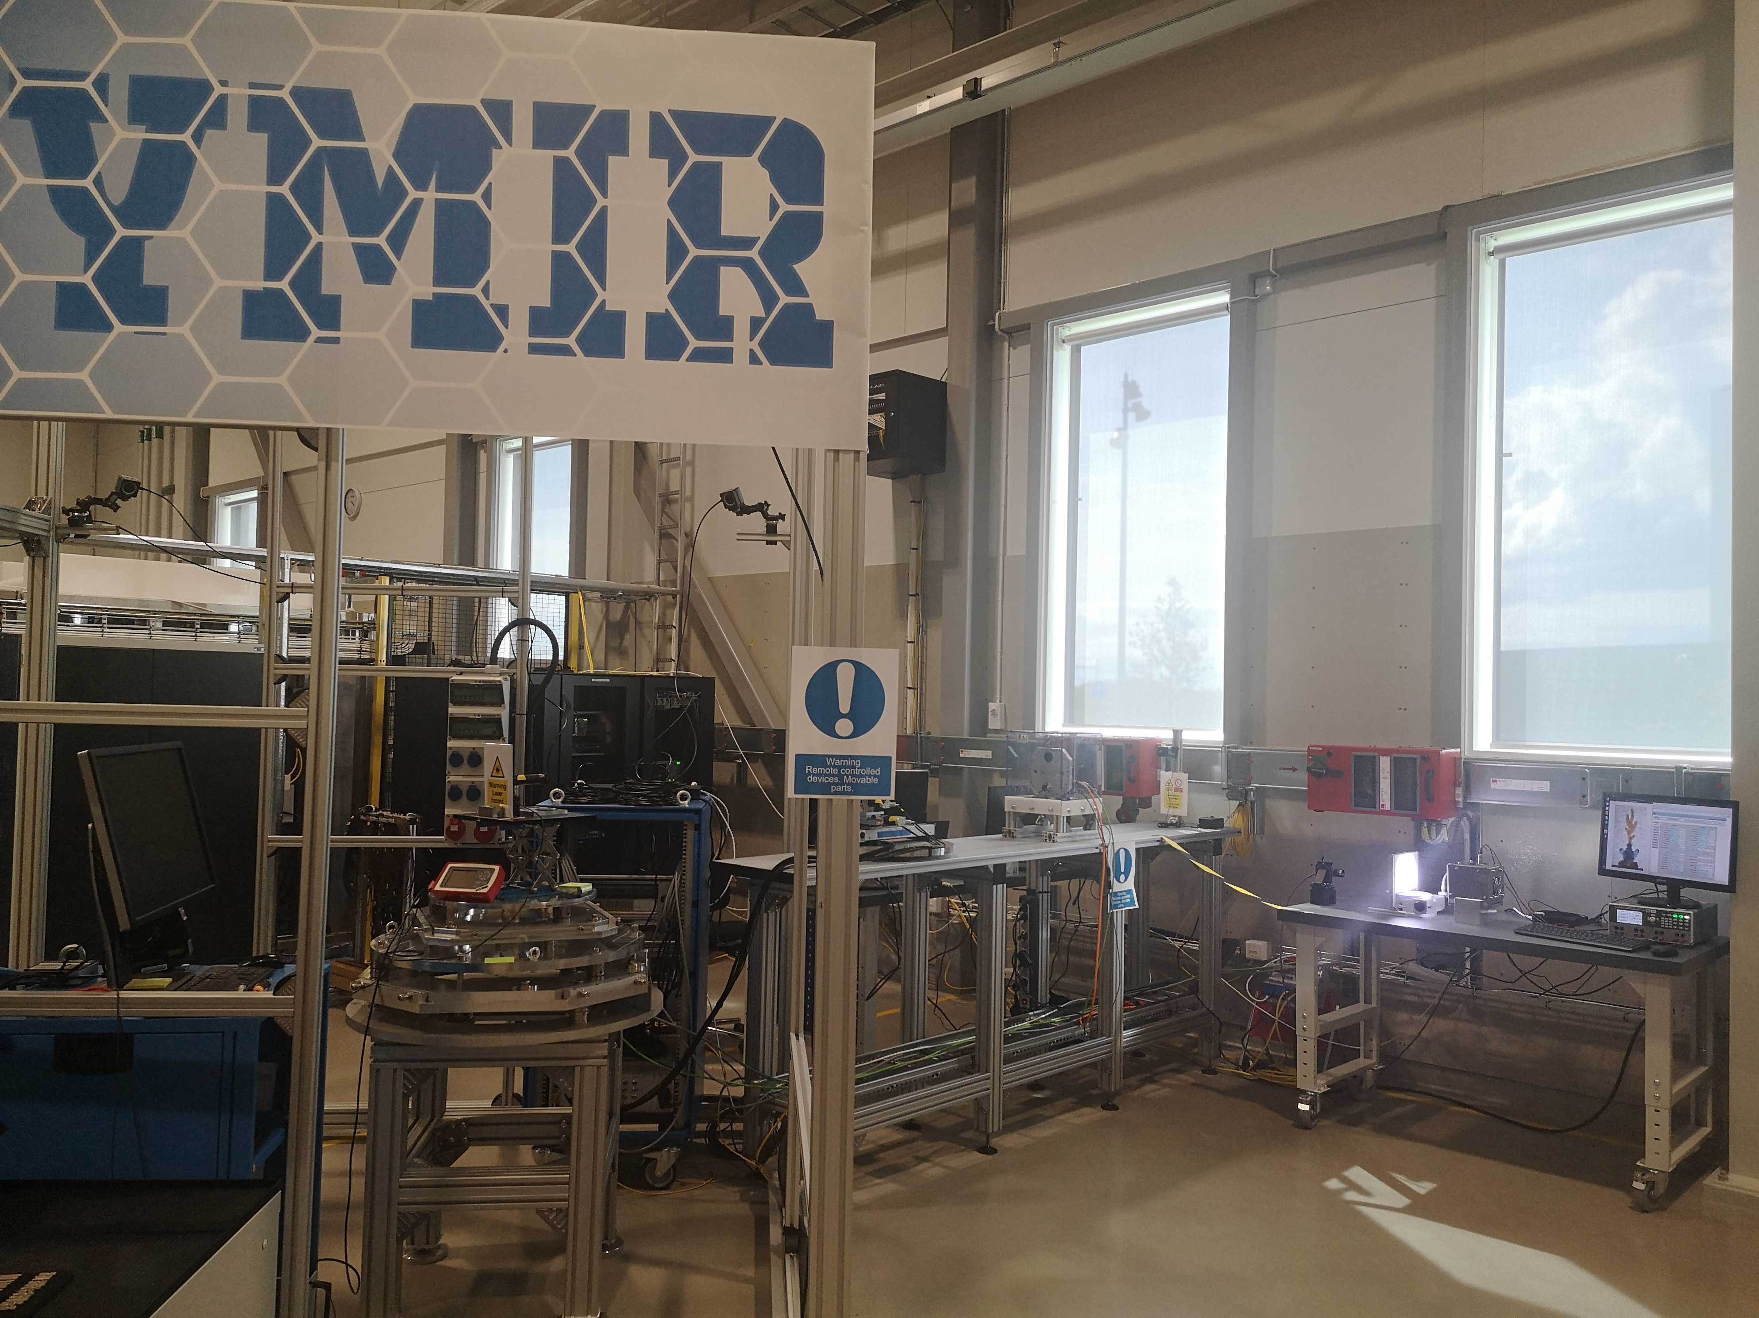
YMIR

Slide 4
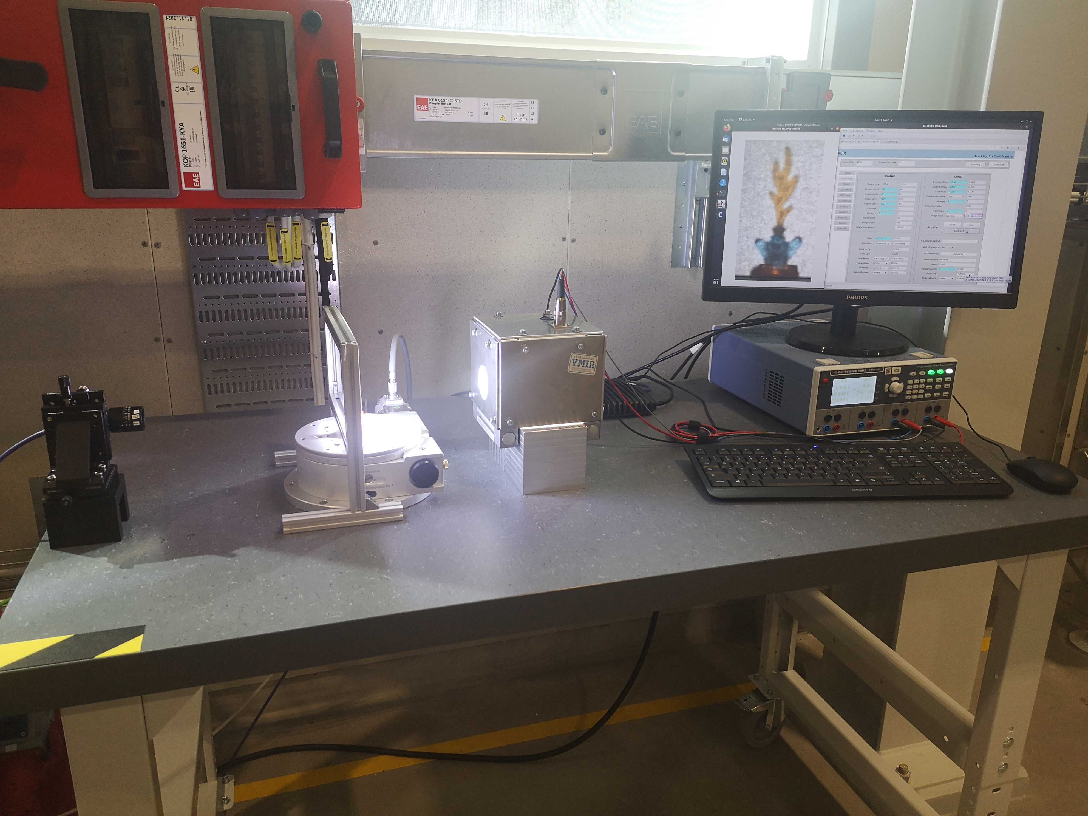
Light tomography

Slide 5
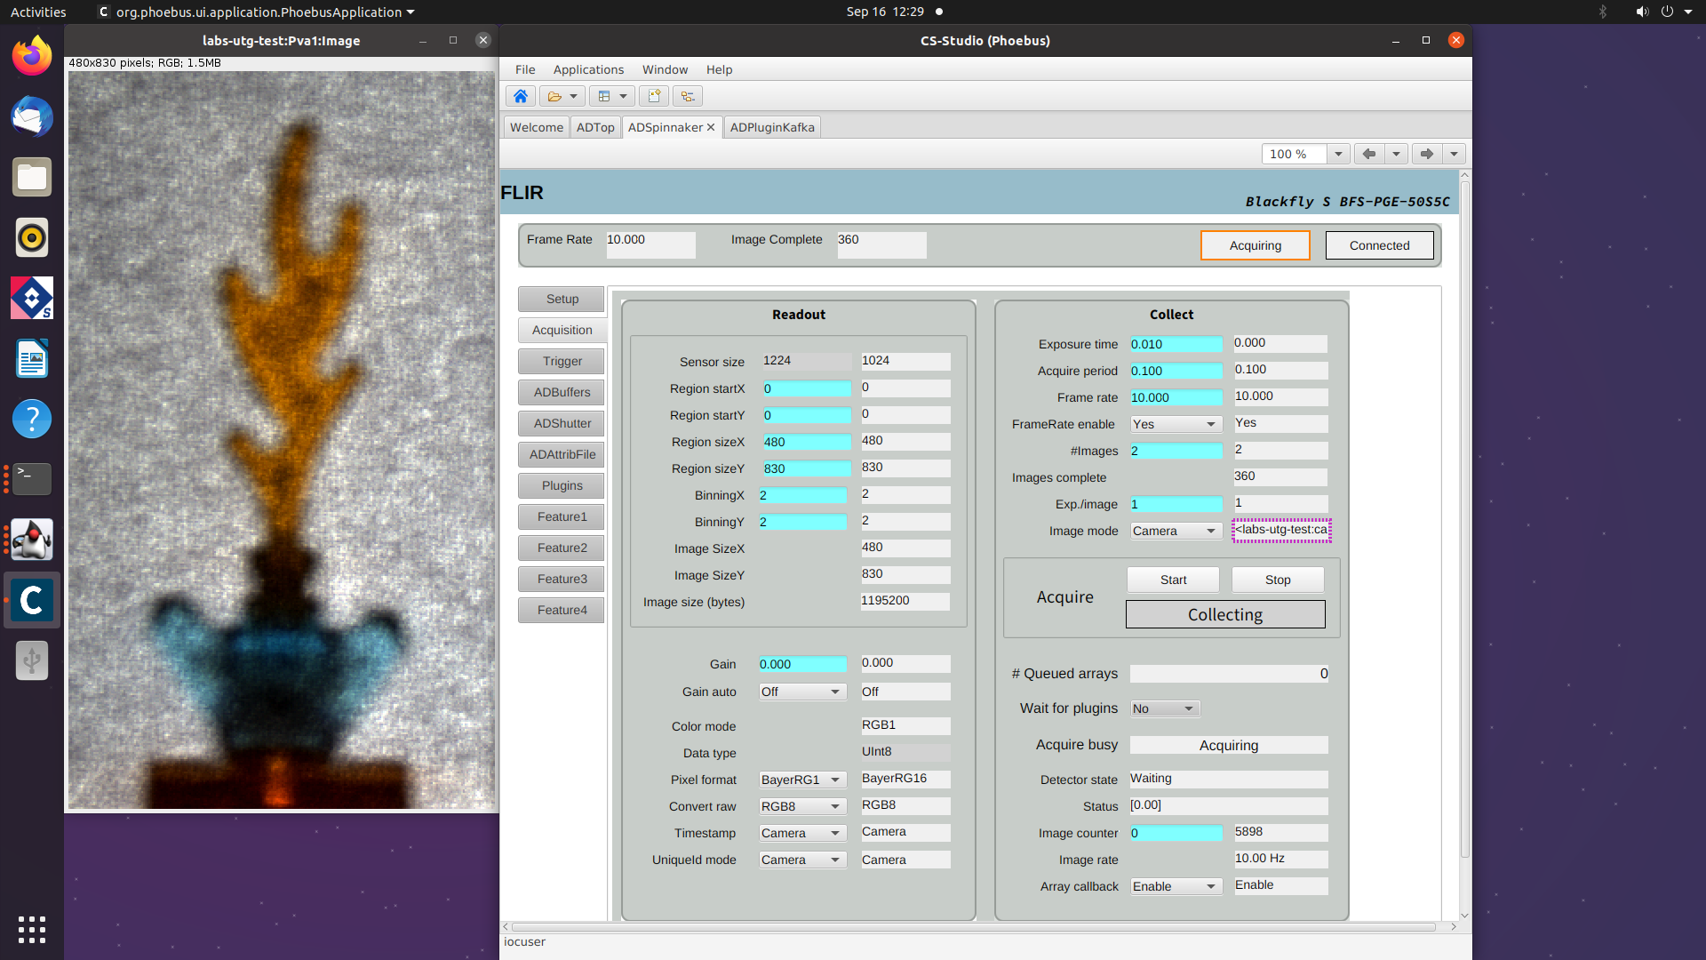
Control screen

Slide 6
Timestamping – what, how
Motor positions and EPICS:
- Motor positions are “acquired” in MCU
Visible in EPICS motorRecord (“.RBV”)
EPICS records are “timestamped” in
the IOC, when they are processed.
Roundtrip times of a poll:
- 10..20 msec/axis (1st gen: EPICScom module)
- 5..10 msec/axis (2nd gen: twincat-ads)
- 5..15 msec all axes (3rd gen: PILS)

Slide 7
Old communication MCU-EPICS
10 msec roundtrip / axis:
We run into a limitation:
8 axes: 80 msec poll time
16 axes 160 msec poll time
Motor positions of different axes
are ”someone somewhere somewhen”

Slide 8
Timestamping – not accurate enough
For positioning: 100 msec is good enough
(many axes)
E.g. tomography needs something better: specs ???
specNotYetFullyDefinedException @ ESS
Our assumption:
<= 1 msec is good enough for scanning

Slide 9
Time stamping in MCU/PLC
Each PLC cycle (every 10msec):
Read all motorPositions
Read status of all axes (error, busy, homed, LS)
Read other sensors
Gets UTC from timing system
Put everything into continuous memory block
EPICS IOC polls this every 10..1000 msec

Slide 10
Timing system; PTP
An EVR acts as a PTP master (chrony on eth2)
TwinCAT needs a PTP terminal: EL6688
Needs to be configured (in TwinCAT)
Needs to be evaluated

Slide 11
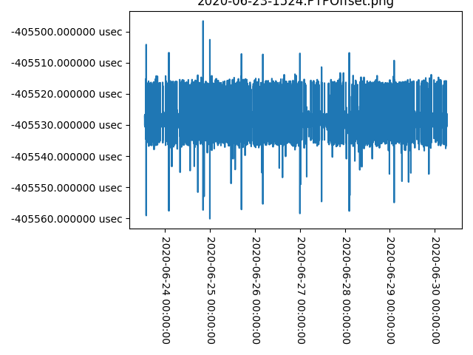
PTP Offset master - EL6688

Slide 12
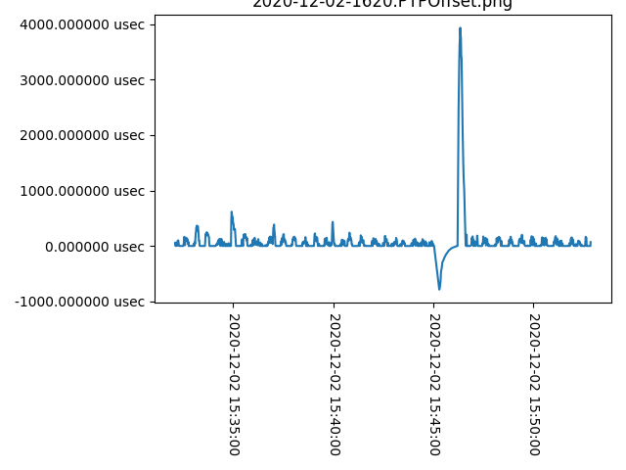
PTP Offset master - glitch

Slide 13
Transport protocol TwinCAT - EPICS
Raw TCP Socket ? Or: ADS
(locked against PLC cycle)
ADS_READ (start, length),
ADS_WRITE (start, length)
Application protocol ”on top” : ”PILS”
(the 3rd generation)

Slide 14
Memory layout – Runtime data
Poll data, example:
Date/Time (UTC)
Additional IO
Motor1 (position, status)
Motor2
Motor3
PILS gives us a description

Slide 15
IOC::asynPortDriver::poll()
IOC reads all data with every poll()
Distributes it into the different Records
(asyn parameters)
Calls asyn::setTimeStamp()
We have additional ai PVs:
”$P$R-RBV-TSE.VAL” for the motor position
”$P$R-RBV-TSE.TIME” derived from MRF->PTP

Slide 16
PILS
Credits to:
PLC Interface Layout Specification
https://forge.frm2.tum.de/public/doc/plc/master/singlehtml/#device-address
(Introduction/Lessons on request)

Slide 17
Next steps
Verification that everything works
(“kafka has good data”)
(motors, detectors, cameras)
Ongoing project:
Light tomography with a camera

Slide 18
Questions
hvala
thanks
tack
danke
Merci

Slide 19
Links
https://kafka.apache.org/
https://en.wikipedia.org/wiki/Precision_Time_Protocol
https://www.beckhoff.com/en-en/products/i-o/ethercat-terminals/el6xxx-communication/el6688.html
https://forge.frm2.tum.de/public/doc/plc/master/singlehtml/#device-address
https://www.ijs.si/time/

