Slide 1
EPICS Tools and Services
Kunal Shroff – NSLS2
Kay Kasemir – SNS
Georg Weiss, Anders Harrisson, Fredrik Soderberg – ESS
Will Rodger, Rebecca Williams – DLS
Tynan Ford – ALS
Genie Jhang, Tanvi Ashwarya – FRIB
Jacqueline Garrahan – SLAC
Ralph Lange – ITER
Imran Usmani – ALS

Slide 2
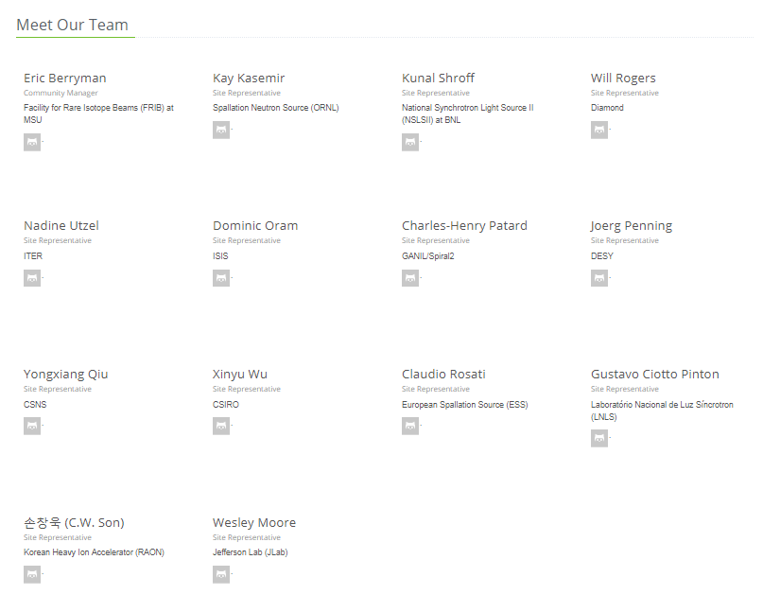
CS-Studio Collaboration
17+ sites actively packing a site-specific CS-Studio products or Participating in the development of one or more of the EPICS services
(NSLS2, SNS, ESS, FRIB, ALS, ITER, DLS, ISIS, CEA, NSRCC, KEK, FZB, DESY, CSNS, LNLS, ROAN, JLAB,…)
12+ sites/labs/institutions using prepackaged products
Additionally, many users who do not create their own products.

Slide 3
EPICS Tools and Services
EPICS Tools
Phoebus
CS-Studio
EPICS java core:
Consists of Channel Access and PVAccess client libraries, utility libraries
EPICS middle layer Services:
Archiver, Alarm, Save Restore, Channel Finder, Olog, …
EPICS tools:
CS-Studio & Phoebus
EPICS Service
Archiver, ChannelFinder
Save Restore, Olog,
Alarm
…
Notes:
Explain each of the modules

Slide 4
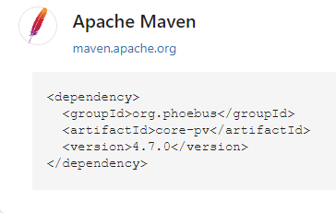
Release 4.7
EPICS core, services, and tools version 4.7.x was released on Aug 19th, 2022
The release is published to maven central
https://search.maven.org/search?q=org.phoebus
Simplified and standardized release process*
  mvn release:prepare
  mvn release:perform
Notes:
EPICS release 4.7.0

Slide 5
EPICS Core: Channel Access (CAJ)
Switch to GitHub Actions for CI
Additional CAJ properties to configure channel access echo timeout & minimum search interval
Improvements in error messages and logging
Agreements on the roadmap for CAJ/JCA and CA support
  Mostly bug fixes, emphasizing stability
  New features will go into PVA
Notes:
EPICS core: changes to ca and pva
Minimum interval in seconds between CA search broadcasts. Default is 0.1 seconds
Wrap EPICS_CA.. format errors into more helpful exceptions
.. so end user can tell which EPICS_CA_.. setting caused the problem without having to check the source code

Slide 6
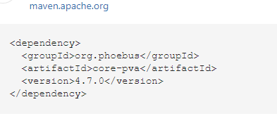
EPICS Core: PVAccess
PVA (core-pva)
  IPv6 Support
  EPICS_PVA_NAME_SERVERS for
  TCP-only name lookups
Prototype for NameServer using the core-pva PV Server lib
  Listens to name searches via UDP or TCP, IPv4 or IPv6
  Replies with TCP address & port of actual PVA server
  For now, manual config, plan to eventually use e.g. Channel Finder
Notes:
EPICS core: changes to ca and pva
Server will always allow name lookups via its TCP port.
Client, as before, defaults to lookup via UDP (...ADDR_LIST, AUTO_ADDR_LIST), but now also checks EPICS_PVA_NAME_SERVERS for a list of TCP addresses.
Supports both IPv4 and IPv6.
Server and client have been tested with PVXS server & client for both IPv4 and 6.

Slide 7
EPICS Core: Type definitions
Expanding EPICS VTypes
  Support additional fields in the VImage meta data
    x & y offset
    reversed flag
  Add “description” field to all VTypes, PVAccess clients receive description updates
  Range’s support expanded to allow cases where only part of the range limits are defined
Notes:
Java interfaces for values
Not tied to protocol or implementation (i.e. we can read them from databases, epics protocol, file, …)
Not tied to memory representation (i.e. they can come directly from the network buffer, can be lazily calculated, …)
Immutable
It’s the “just give me some value from somewhere that is safe to read”
Alarm, Time, Display, … through composition (not inheritance)
Expanding vtype and Vimage su
PVA clients do receive the description within the NTScalar, at least with QSRV.
CA clients on the other hand don't get that with any dbr_.. type for a record "xx" unless they create a separate channel to "xx.DESC", which would double the number of channels and fail for non-IOC CA servers.pport
On an IOC, it's perfectly fine to only set an analog record's HIGH limit to say 100 but not the LOW limit

Slide 8
Epics services
EPICS middle layer services
  Reactive Services
  Adoption of modern solutions and technologies ( e.g. springboot, kafka, elastic, mongoDB, …)
Services which have been redesigned/refactored
  ChannelFinder
  Olog
  Alarm Services (Alarm Server, Alarm Message Logger, Alarm Configuration Manager)
  Save Restore
  Scan Engine
  …
Standardize the release process
Migration from elastic 6 → 8
  Migration of data
Notes:
Epics services:
EPICS middle layer services
Reactive Services
Adoption of modern solutions and technologies ( e.g. springboot, kafka, elastic, mongoDB, …)
Services which have been redesigned/refactored
ChannelFinder
Olog
Alarm Services
Save Restore
Scan Engine

Slide 9


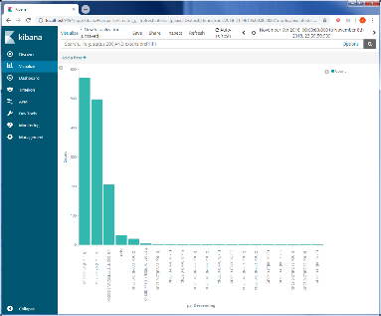
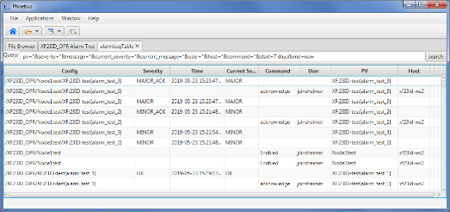


EPICS Services: Alarm logger
Records all alarm messages (Alarm State changes, User actions, Automated actions, etc…)
Alarm
Message
Logger
Notes:
Epics services:
New alarm logger rest interface

Slide 10
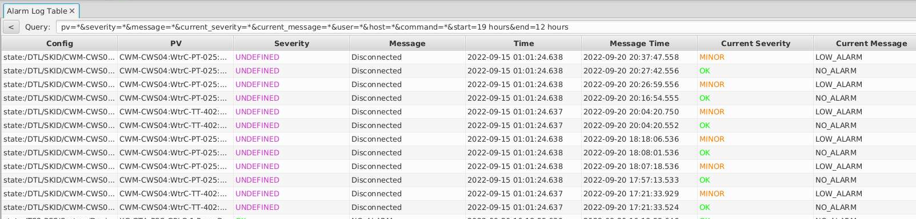
EPICS Services: Alarm logger
REST Service API
Alarm
Message
Logger
Developed a REST service for the Alarm Logging Service
  Optimization of Queries
  Clients are unaffected with changes to backend
Migrate from elastic 6 -> 8
Notes:
Epics services:
New alarm logger rest interface

Slide 11
EPICS Services: ChannelFinder
Channel Finder improvements/maintenance
  Publish “ENGINEER”, “LOCATION” or configurable env. vars from IOC
  Improve error reporting and add display errors to GUI tools
  Refresh GUI when editing channel data
Migrate from elastic 6 -> 8
Ongoing effort to develop a NameServer using the core-pva PV Server lib, which uses the Channel Finder directory service
Notes:
Channel Finder

Slide 12
EPICS Services: pvInfo
pvInfo web project
  Displays ChannelFinder information
  Adds live data from PV web socket
  Adds history data from Archive Appliance
Check out “Phoebusgen & PV Info” talk
Notes:
Epics services: code a thon update

Slide 13
EPICS Services: Save Restore
Based on the MASAR Epics middle layer service
These can be used to
  create and manage save sets (aka configurations) and snapshots
  retrieve and compare snapshots
  restore settings from snapshots
REST services using the SpringBoot framework
java [options] -jar service-save-and-restore-.jar
Documented the REST service API of the new Save Restore service
Ongoing effort to migrated to a NoSQL backend with a simplified REST services API and data model

Slide 14

EPICS tools
CS-Studio ( eclipse based and Phoebus )
Notes:
EPICS tools

Slide 15
Status of individual sites
Original 32-bit “Eclipse RCP”
64-bit “Eclipse RCP”
Latest “Phoebus”
Static, no longer supported, but otherwise runs fine
Bug fixes,
long and awkward build
New features, bug fixes, easy development
SNS Accelerator
DLS
ITER
ISIS
FRIB (partially)
NSLS-II (accelerator)
…
SNS Beam Lines
ESS
ALS
FHI
FRIB (partially)
NSLS2 (some beamlines)
…

Slide 16
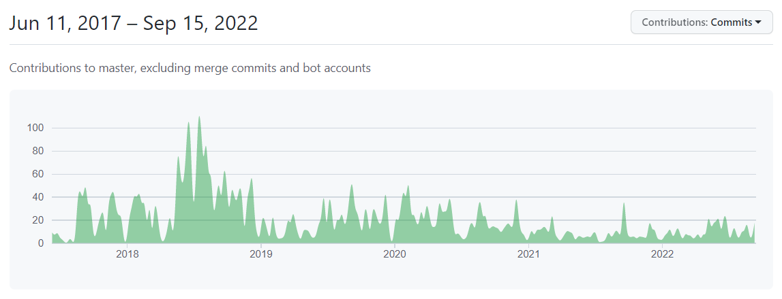
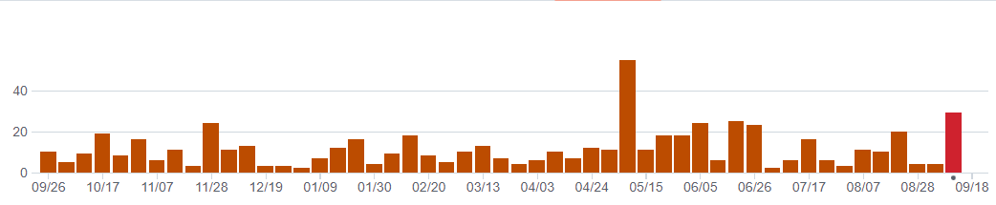
CS-Studio Collaboration Status (Phoebus)
Notes:
Phoebus – collaboration statistics
Charts on the commits/ PR/ issues

Slide 17
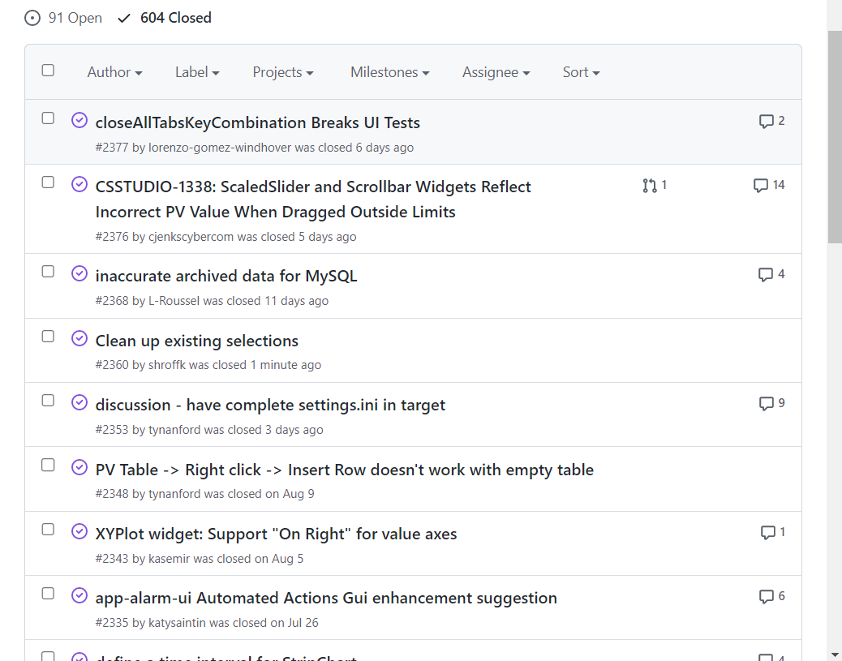
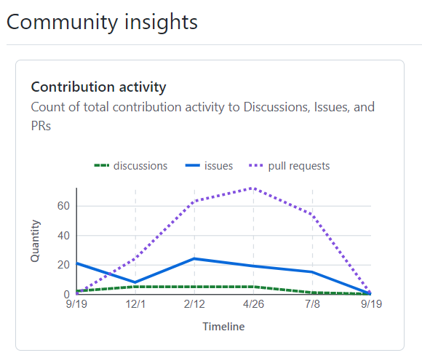
CS-Studio Collaboration Status (Phoebus)
128 Issues closed 35 new issue still open
344 Closed PR’s
Notes:
Phoebus – collaboration statistics
Charts on the commits/ PR/ issues
128 Issues closed 35 new issue still open
344 Closed PR’s

Slide 18
CS-Studio Collaboration Status (Eclipse)
CS-Studio eclipse release 4.6
  Upgraded to use eclipse 2020-12
  Upgraded to build and run with JDK11
  Will be supported till October 2024
  Ongoing work to upgrade to JDK17 (should significantly extends the support deadline… but please consider migrating to CS-Studio Phoebus)
Notes:
State of the eclipse based cs-studio
latest release ( still being maintained )
will be maintained till oct 2024

Slide 19
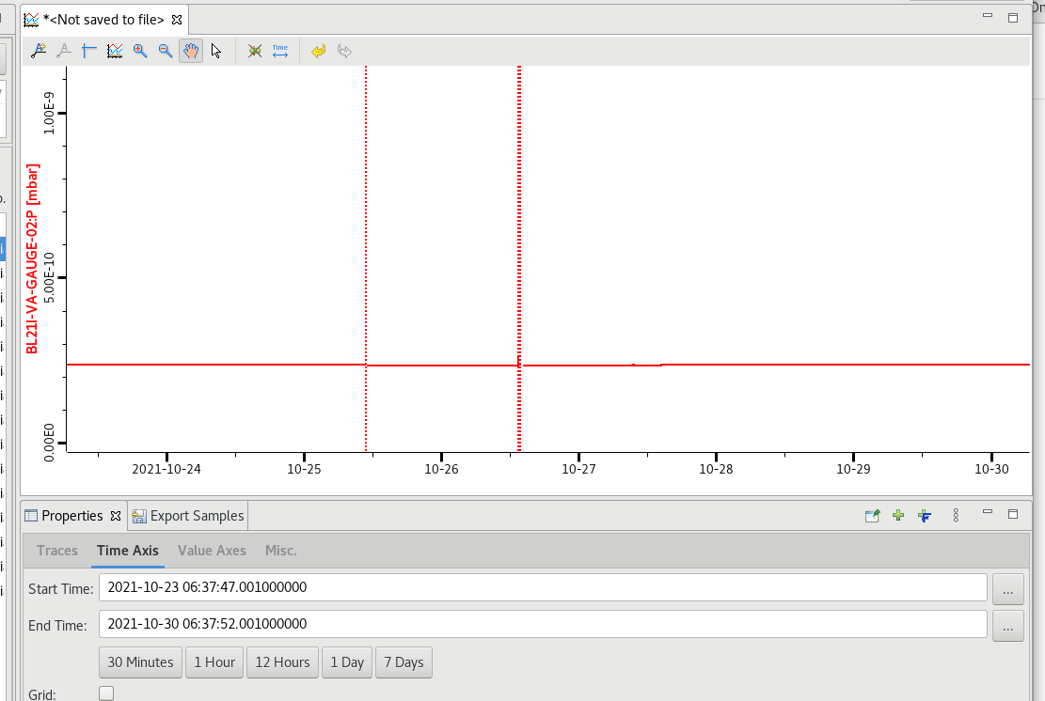
DataBrowser
Improvements
Show in the databrowser the events where the archiver appliance disconnected from a PV.
Notes:
Show in the databrowser the events where the archiver appliance disconnected from a PV.

Slide 20
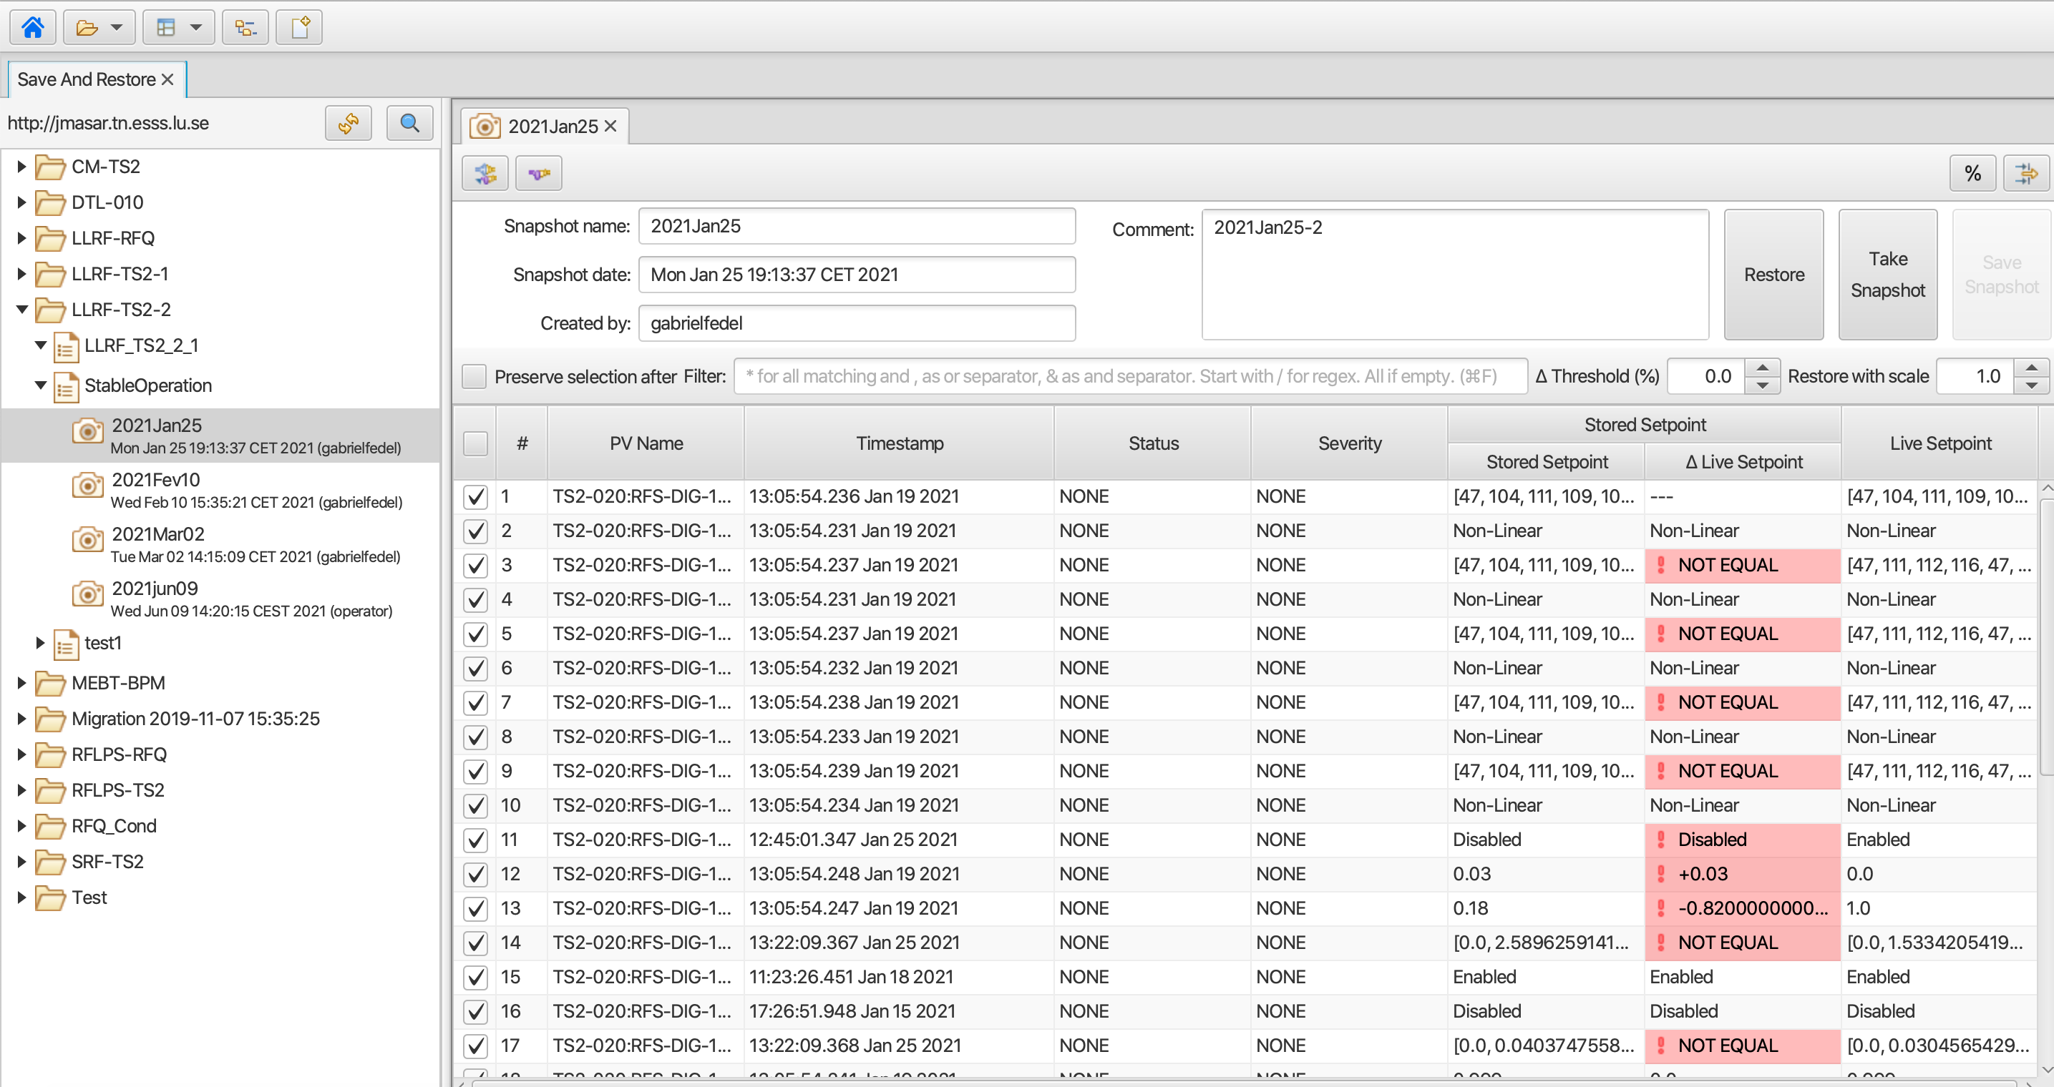
Save Restore

Slide 21
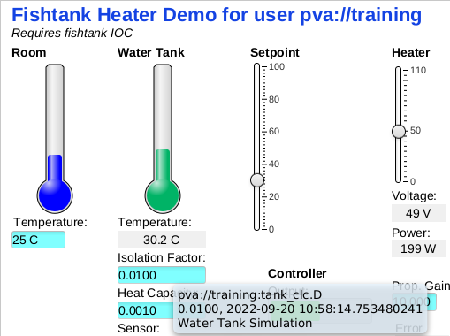
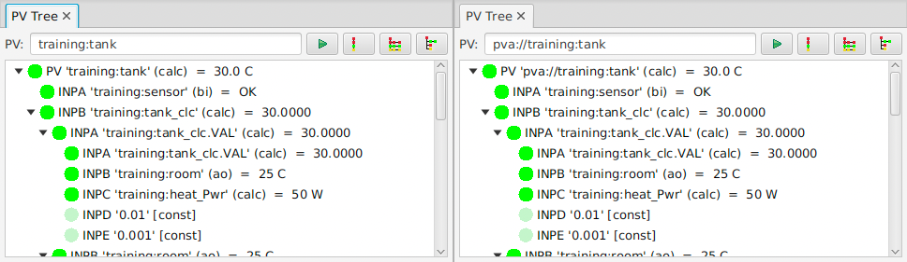
PVAccess
Pvaccess supported by all applications ( probe, pvtree, alarm, display builder, … )
Use pva://… prefix to select PV Access
Set default in phoebus settings.ini
Notes:
Use pva://… prefix to select PV Access
Set default in /ics/tools/phoebus/settings.ini

Slide 22
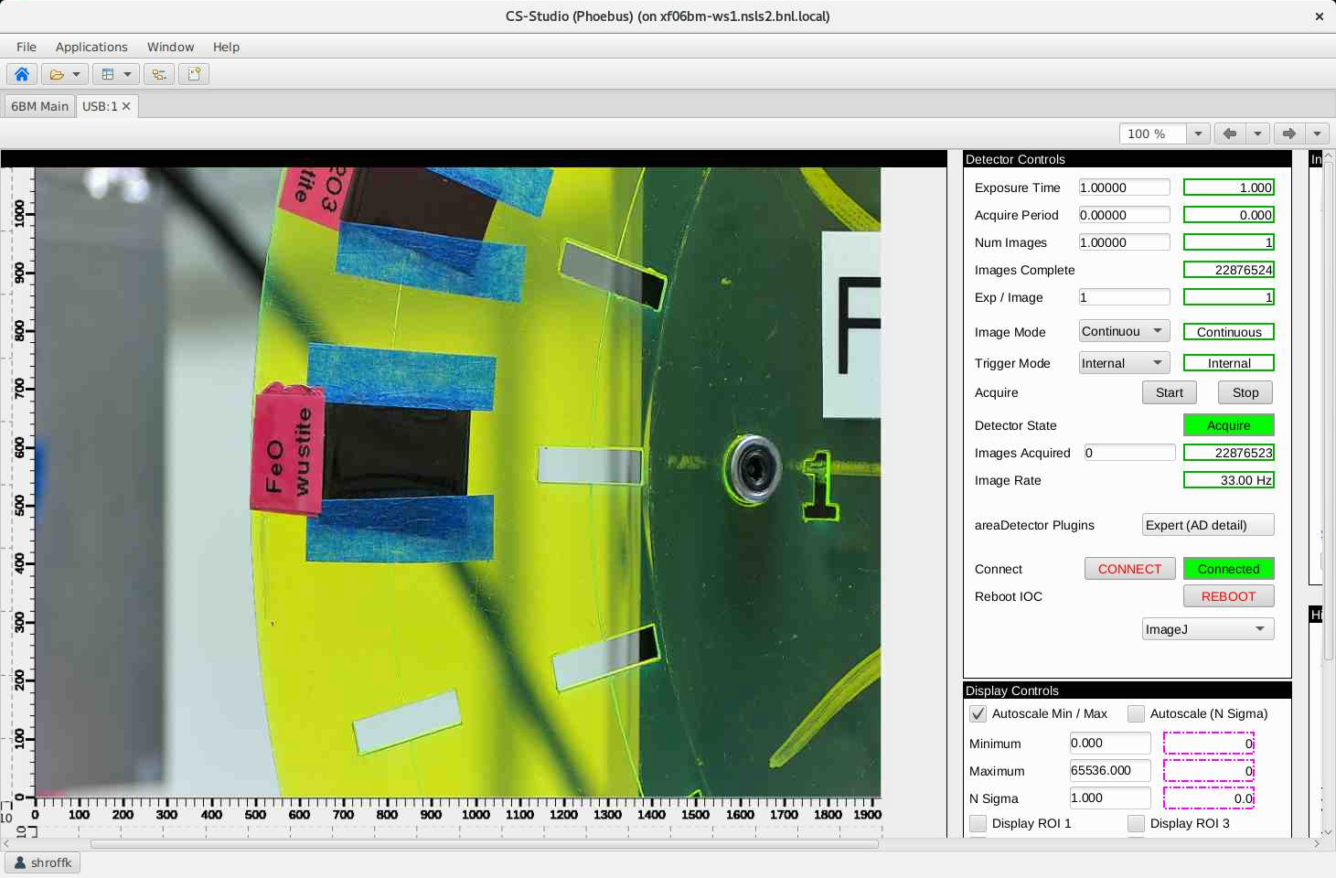
PVAccess & VImage
pva://my_ad_image
The Image MetaData and Image data are packaged together in the NTNDArray
Notes:
The NDPva plugin has been shown to significantly outperform the NDStdArray
The use of smart pointers.
The Image MetaData and Image data are packaged together in the NTNDArray Structure ensuring consistency.
Alarm-sensitive colors that used to be fixed and slightly different are now configurable and default to the same.
We're on top of PV Access, now supporting IPv6, EPICS_PVA_NAME_SERVERS for TCP-only connections, compressed NTNDArray images.

Slide 23
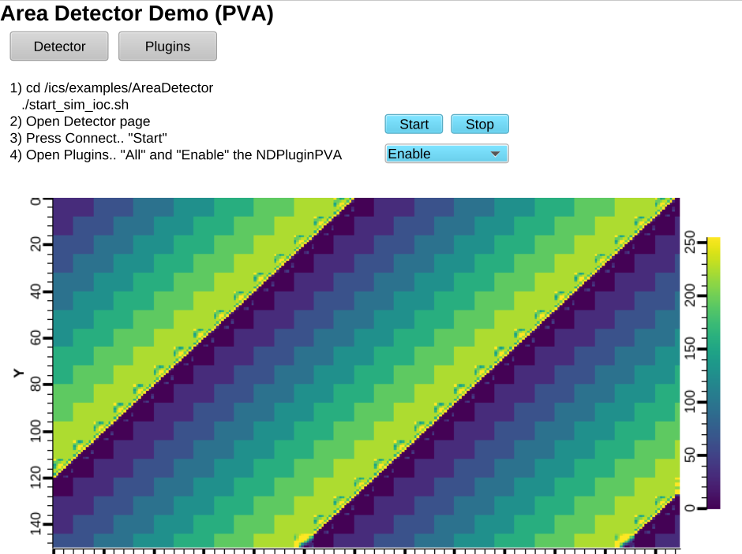
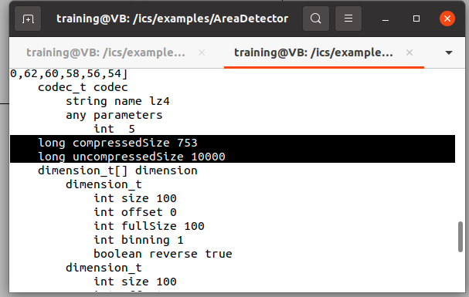
PVAccess & VImage
pva://my_ad_image
Support for
x & y offset
reversed
compressed
Notes:
The NDPva plugin has been shown to significantly outperform the NDStdArray
The use of smart pointers.
The Image MetaData and Image data are packaged together in the NTNDArray Structure ensuring consistency.
Alarm-sensitive colors that used to be fixed and slightly different are now configurable and default to the same.
We're on top of PV Access, now supporting IPv6, EPICS_PVA_NAME_SERVERS for TCP-only connections, compressed NTNDArray images.

Slide 24
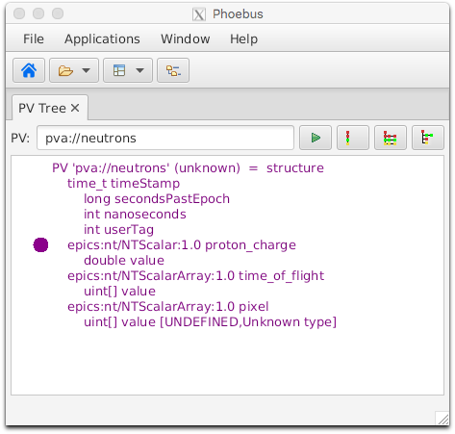
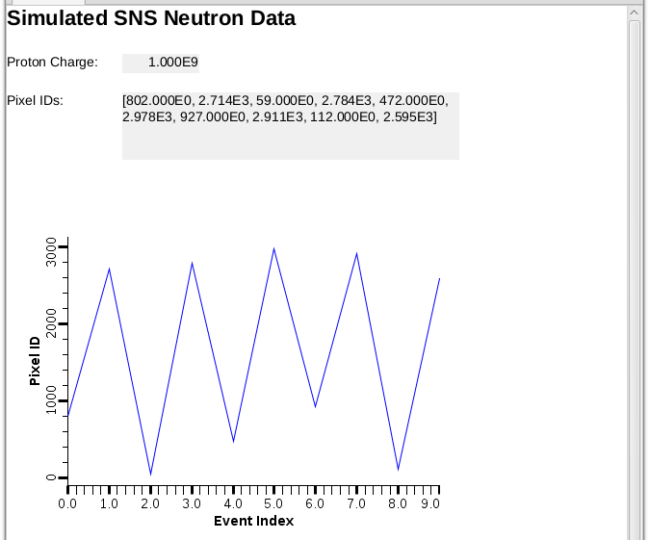
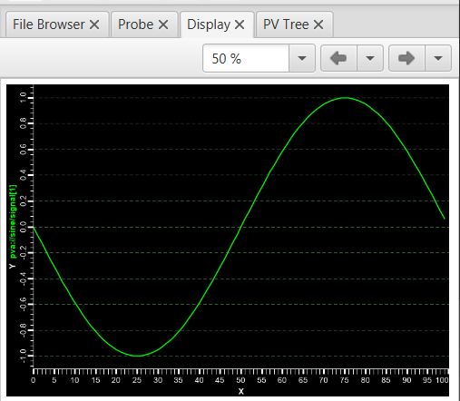
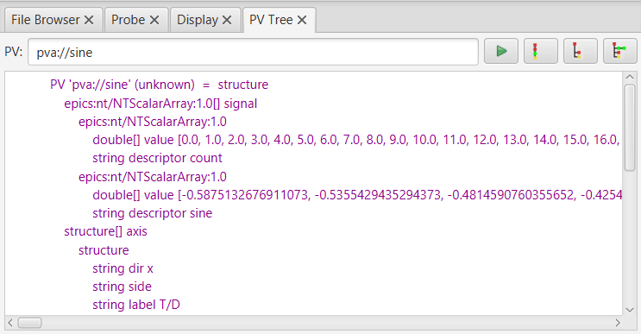
PVAccess
Handling custom PVStructure
Reference a field/subfield
  pva://neutrons/pixel
Reference elements of an array
  pva://sine/signal[1]
Notes:
Pvaccess support in Phoebus

Slide 25
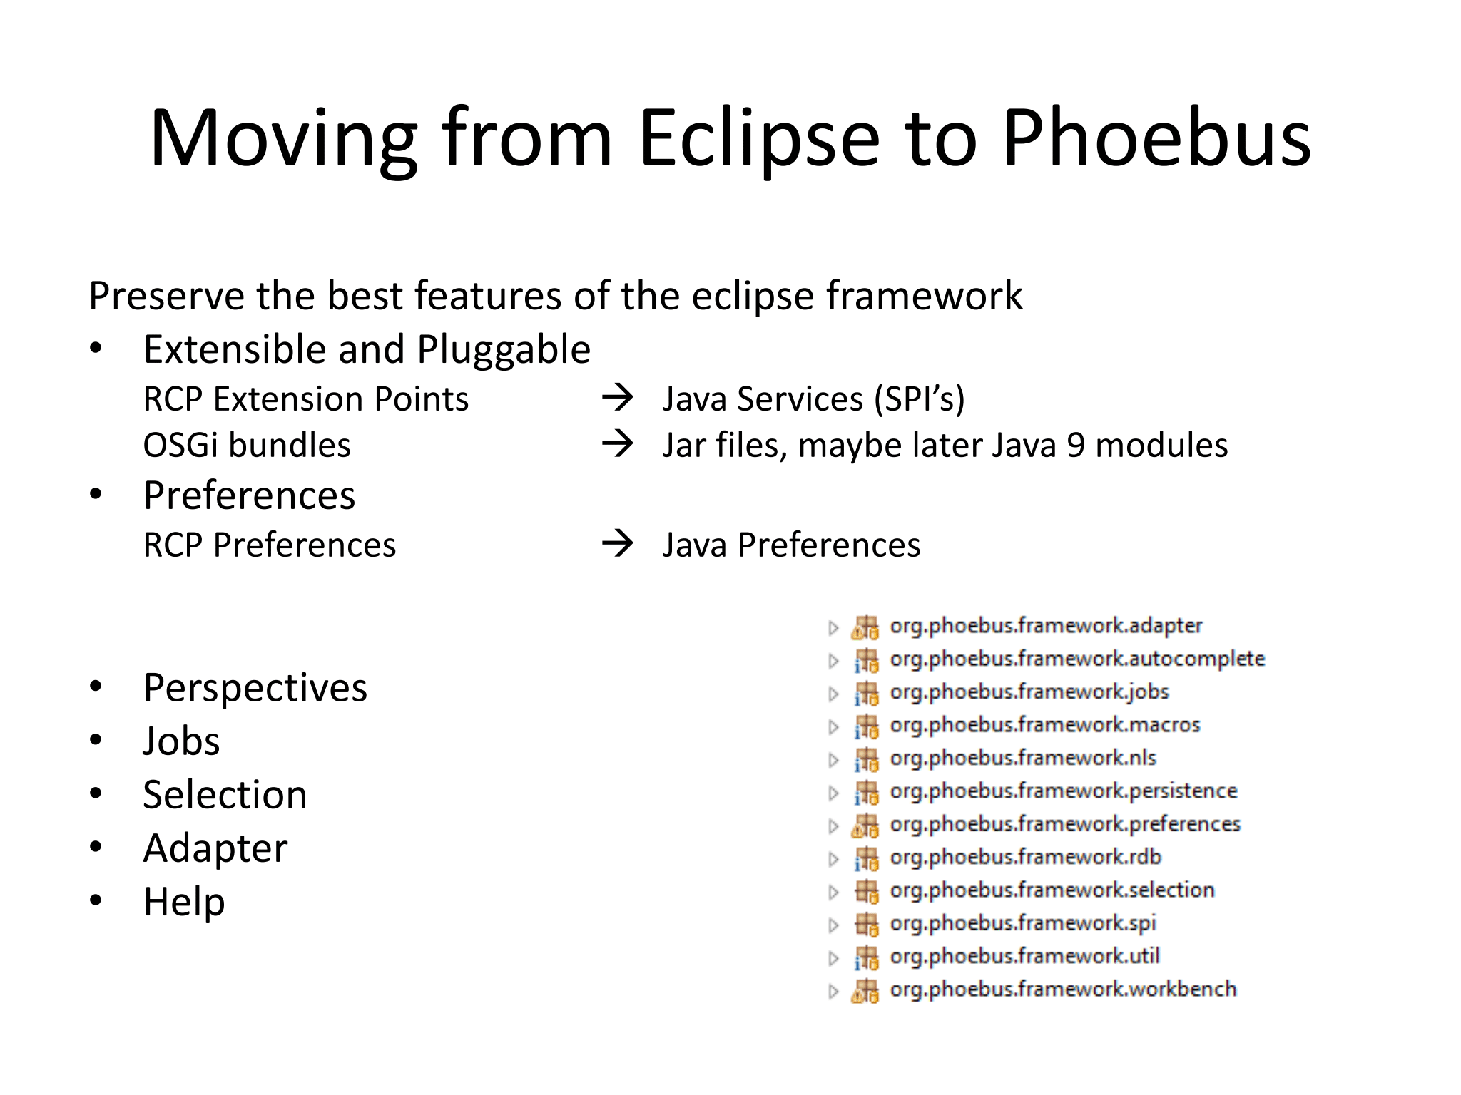
Phoebus framework
Framework 4.7 release
Cleanup of Selection Services and Adapter Services
Preferences framework
  Severity Colors use preferences for local adjustments
Additional Launch parameters
  Phoebus launchers allows launching individual apps, resources, or combination of both
  Launch layouts
  Launch in a target window with specific dimensions and position
  -resource 'file:/abs/path/file?app=display_runtime&MACRO=value&target=window@800x600’
Notes:
Improvements in the core modules
Severity Colors use preferences for local adjustments
Support `-resource xyz?target=window@800x600+100+300`
In addition to plain "target=window" we now support "target=window@.."
with a geometry specification similar to the X11 `-geometry` paramter.
Format is
{width}x{height}+{x}+{y}
or
{width}x{height}
or
+{x}+{y}

Slide 26
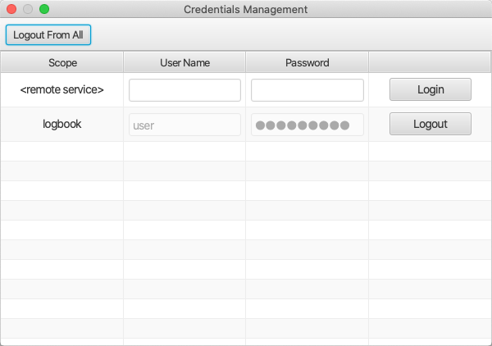
Phoebus framework
Core-security: SecureStore
Stores user credentials in an encrypted store
Core-ui: Credentials Manager
User Interface to the Phoebus SecureStore to manage saved credentials
Notes:
Some applications may need to prompt the user for credentials, e.g. when interacting with a protected
remote service. One such example would be the electronic logbook.
Further, Phoebus may be configured to store the credentials entered by the user to avoid repeated prompts.
In order to also support an explicit logout capability, the Credentials Management application offers means to
remove stored credentials.

Slide 27
Useful links
https://controlsystemstudio.org/
http://phoebus.org
Fork us on github
https://github.com/ControlSystemStudio
ChannelFinder
http://channelfinder.github.io/
Olog
https://github.com/Olog
SaveRestore, Alarm Services, Scan Server
https://github.com/ControlSystemStudio/phoebus/tree/master/services

Slide 28
Developers meeting
EPICS developers meeting in 24th to 28th Oct, 2022
https://github.com/epics-base/epics-base/wiki/EPICS-Developers-Meeting-Oct,-2022
Session
  EPICS tools and services
  EPICS base
  EPICS build and deployment

