Slide 1
Migrating to Phoebus
Kunal Shroff,
Andi Barbour,
Oksana Ivashkevych,
Serena Inderjit,
Sharwari Joshi

Slide 2

Motivation
Great at the time:
  Build Setup
  Module System
  Preferences
  Extensibility
  Graphics… but there are now (better) alternatives
But…
  Awkward layout constraints for control system user interface
  “Workspace” that’s different from the file system
  Odd menu entries that we don’t need
  Performance and Reliability Issues
Phoebus
  Better look and feel
  Better performance
  Lesser code
  JavaFX greatly facilitates the MVC design pattern
Notes:
Why are we moving to Phoebus
Better performance and lesser code
A simpler build system has meant a simpler CI/CD pipeline which enables adoption of a a more agile development lifecycle
openjdk 11 reaches EOL oct 2024 and we wish to migrate by then

Slide 3
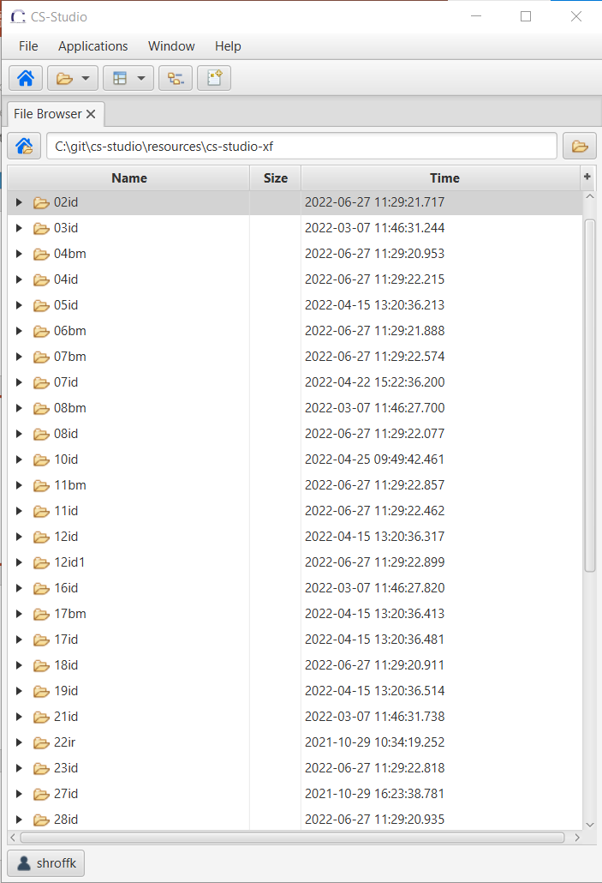
CS-Studio & Phoebus at NSLS2
Different products packaged for different use cases
CS-Studio (for accl) → phoebus-accl
CS-Studio (for beamlines ) → phoebus-beamlines
Both CS-Studio and Phoebus are installed on all workstations
>> run-css
>> run-phoebus
OPI screens are organized into 2 repo
cs-studio-accl ( ~10k .opi & .plt )
cs-studio-xf (~20k .opi & .plt)
Notes:
Current state of the system
cs-studio-acc repo
cs-studio-xf repo
each contain 10k+ .opi screens
we do not aim to convert them all at once for all users.. instead we choose a subset of screens for a subset of users

Slide 4
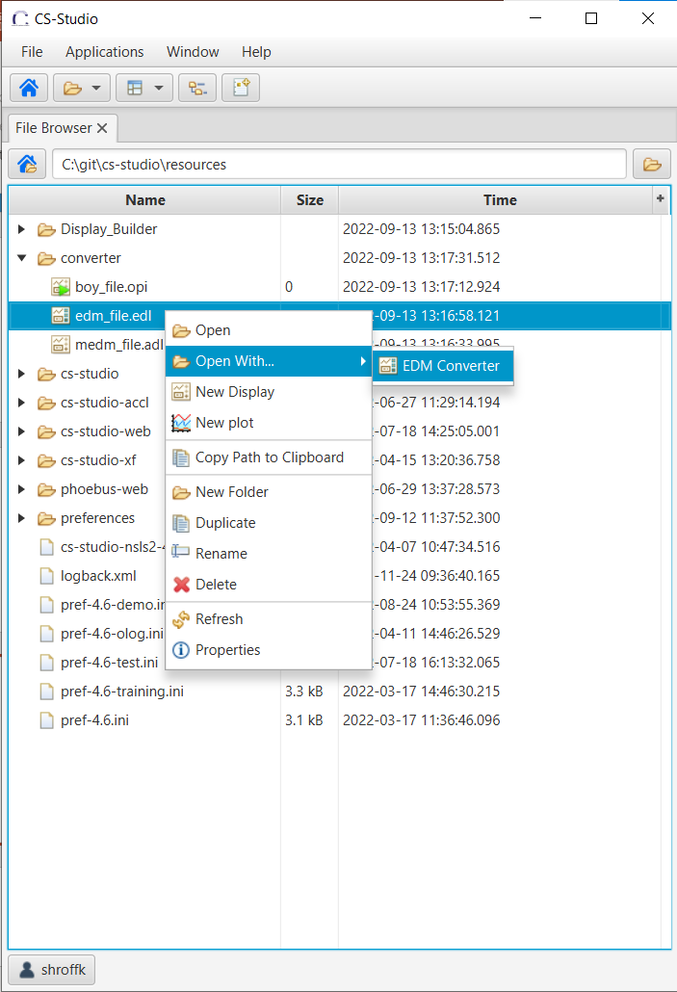
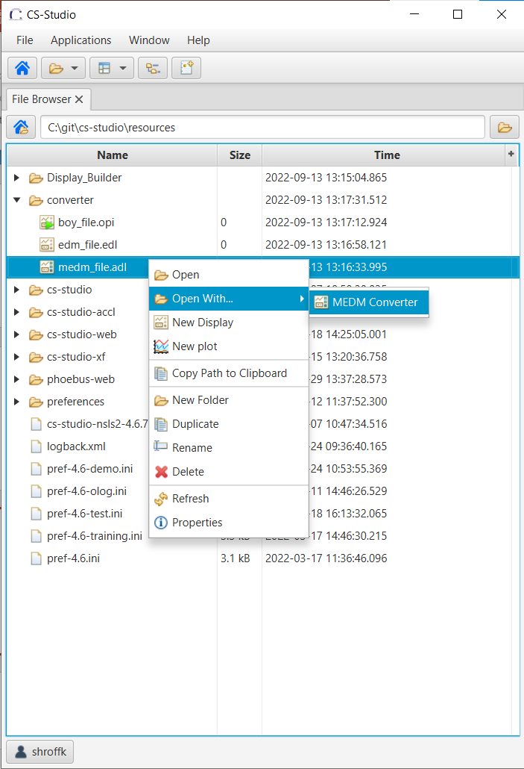
Auto converters
The display builder can read existing BOY .opi displays
The display builder also supports converters for
MEDM: .adl → .bob
EDM: .edl → .bob
Notes:
Phoebus auto converter
Built in converter can understand .opi .adl .edl files

Slide 5
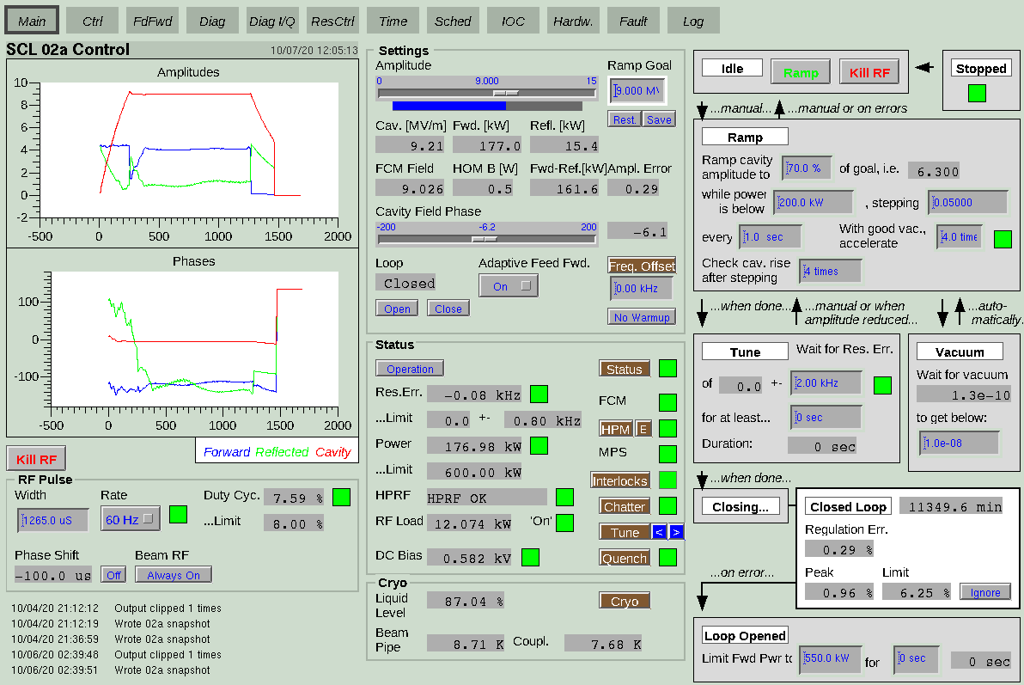
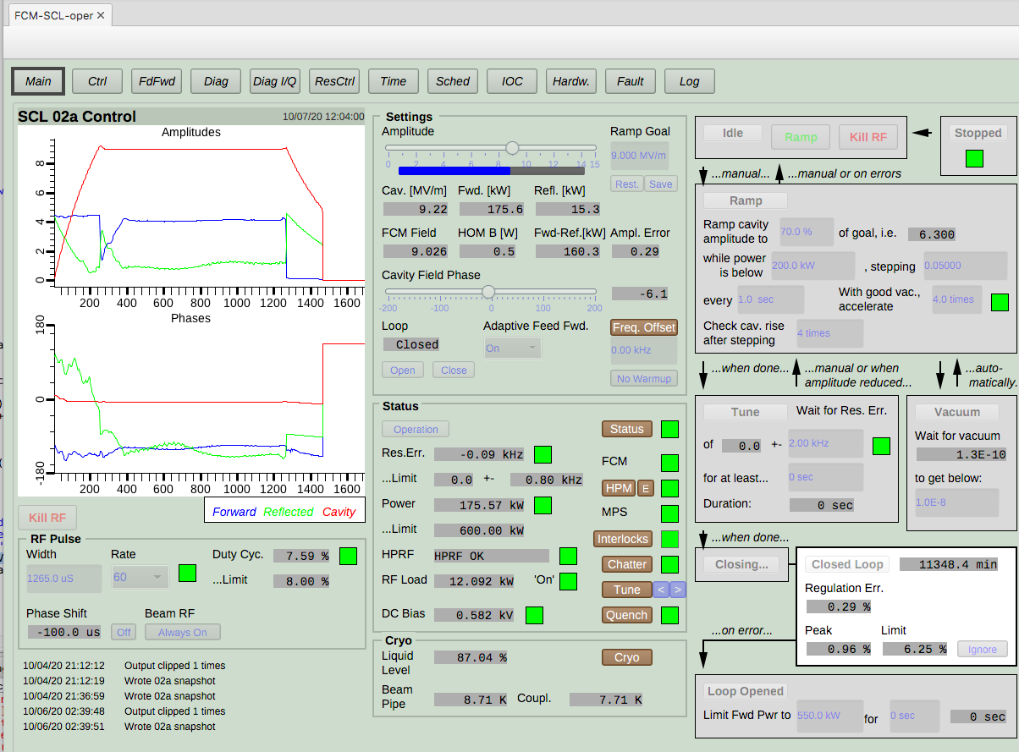
EDM screens converted on runtime

Slide 6
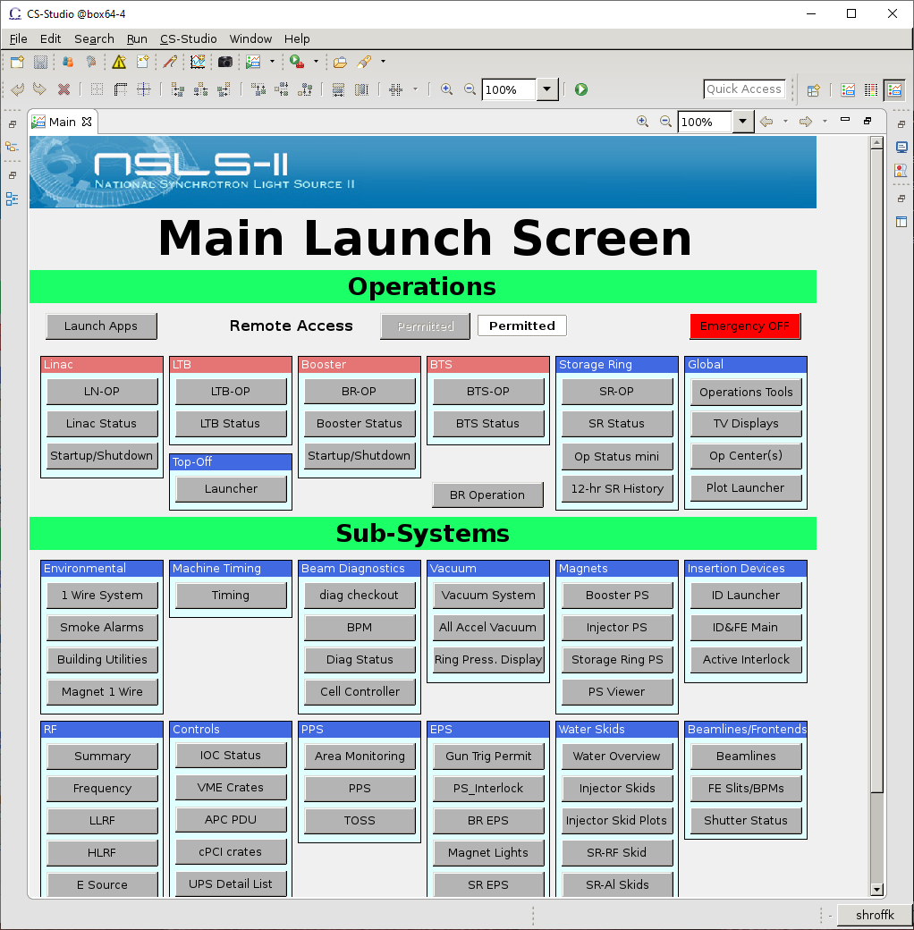
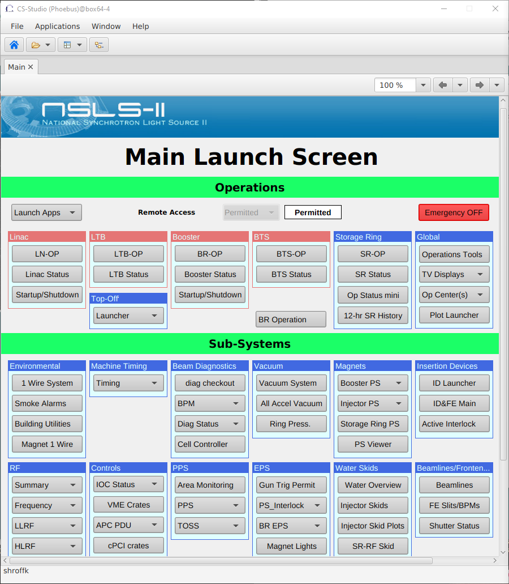
BOY screens converted at runtime
Notes:
Case 1:
A lot of screens converted easily
large number of OPI’s were made up of text update/text input/action & menu button/LEDs

Slide 7
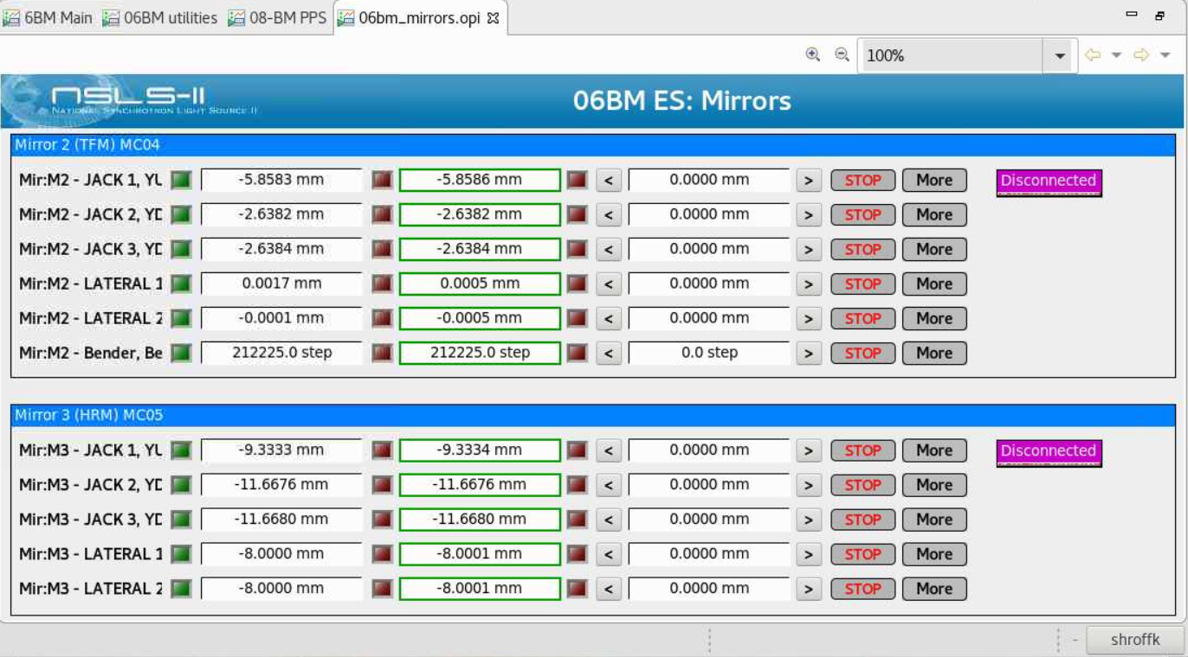
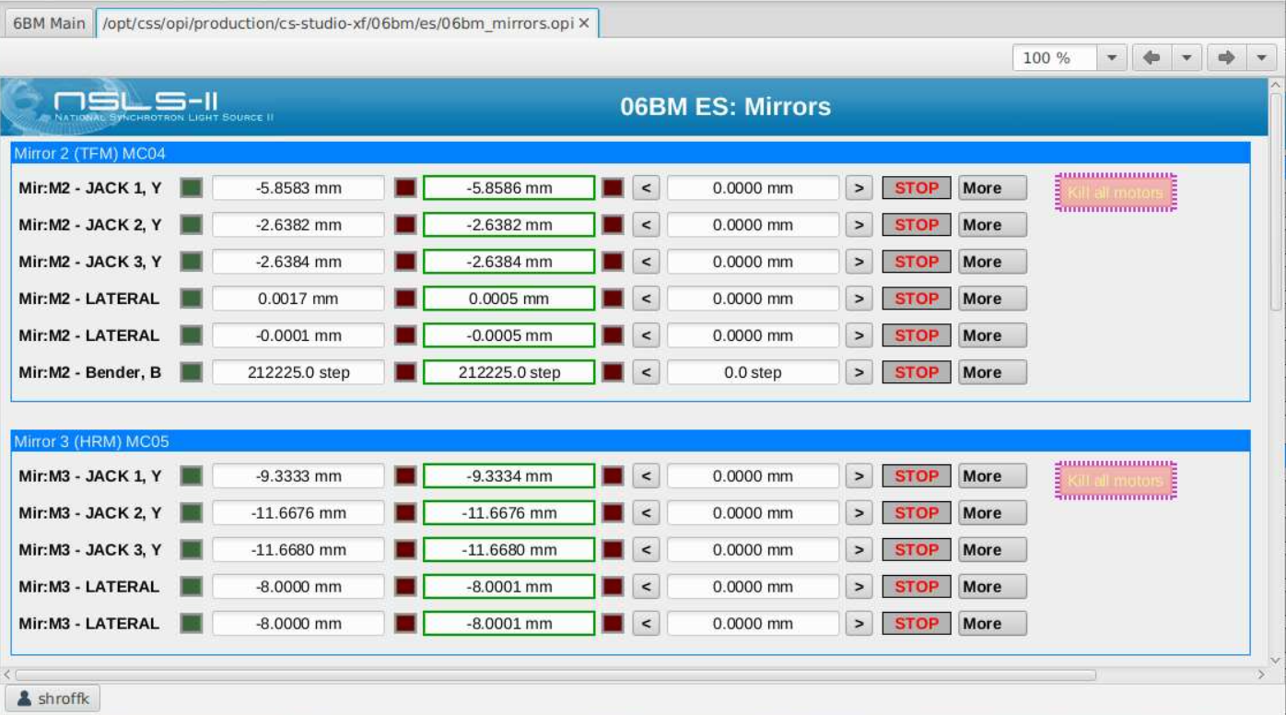
Converted BOY screens
Notes:
Case 1:
A lot of screens converted easily
large number of OPI’s were made up of text update/text input/action & menu button/LEDs

Slide 8
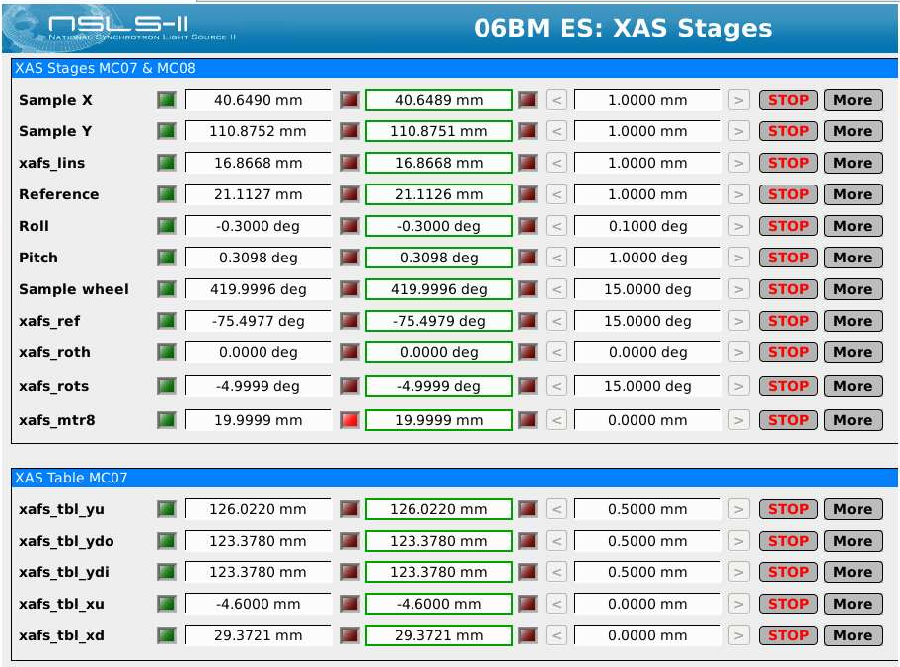
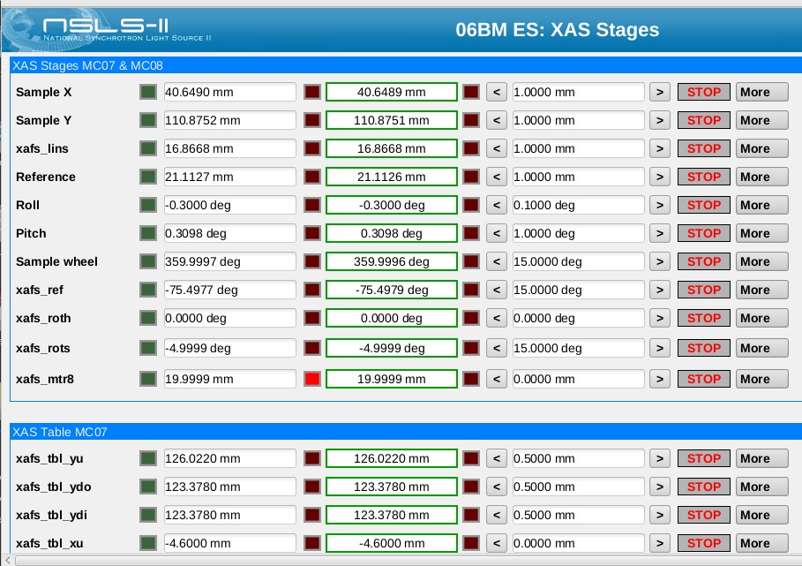
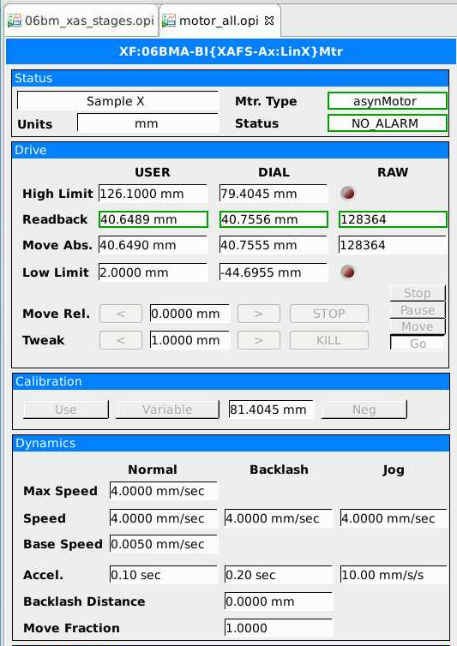
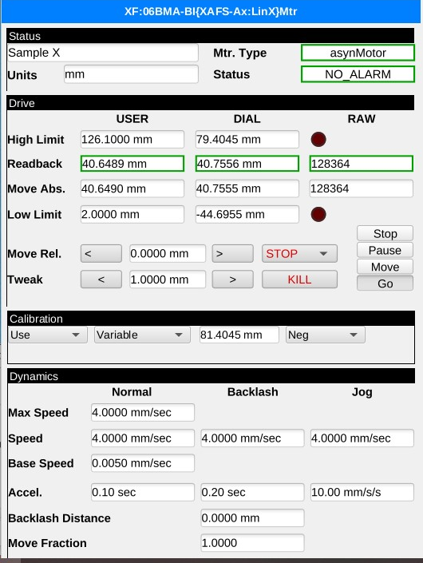
Converted BOY screens
CS-Studio
Phoebus

Slide 9
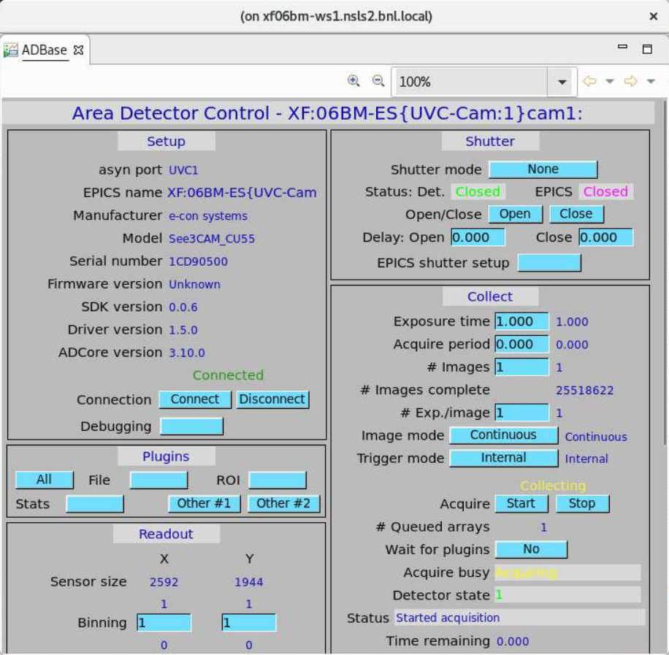
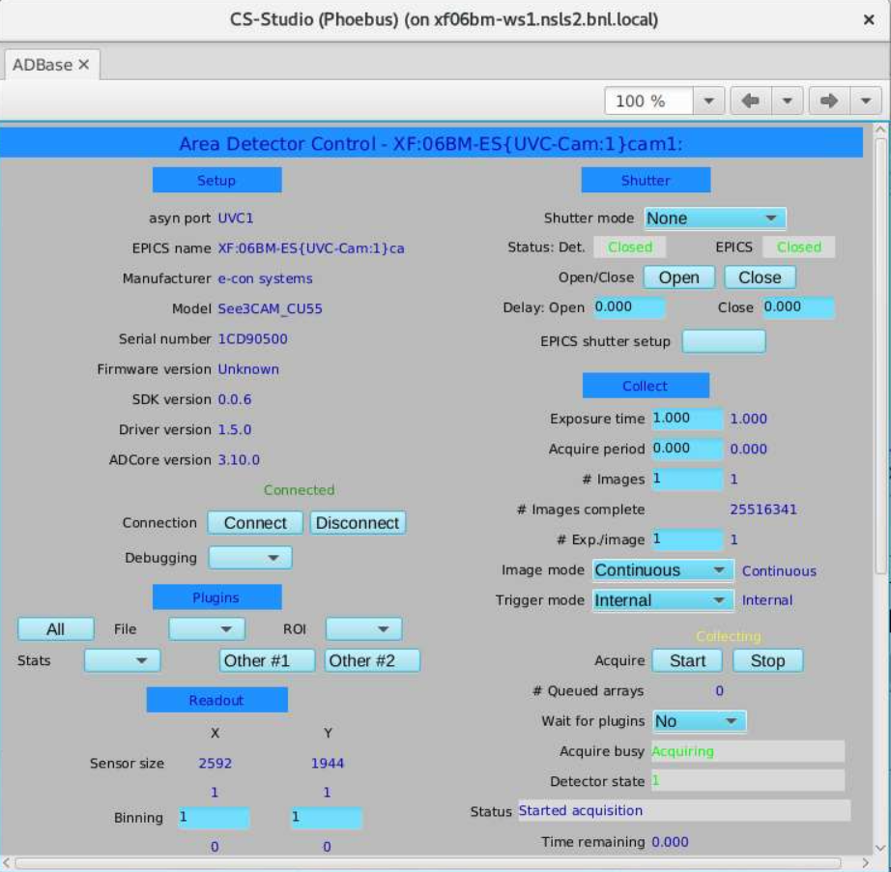
BOY screens converted (not perfectly)
Notes:
Case 1:
A lot of screens converted easily
large number of OPI’s were made up of text update/text input/action & menu button/LEDs

Slide 10
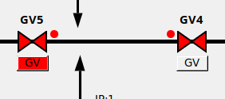
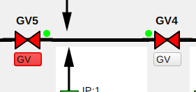
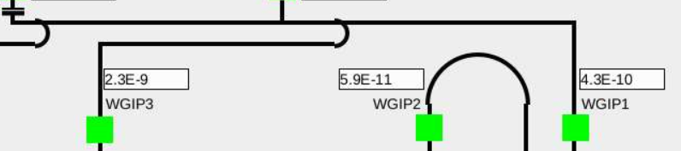
BOY screens converted (not perfectly)
Case 1a:
The auto converted screens are completely functional but have aesthetic issues
The most common of these has been alignment of widgets inside auto resized containers
Changes are made to the original .opi file to avoid use of auto resize
Notes:
Case 1a:
Some time minor changes are needed
- we try to fix these in the original .opi if possible… a good examples is to remove the dependency on auto re sizing

Slide 11
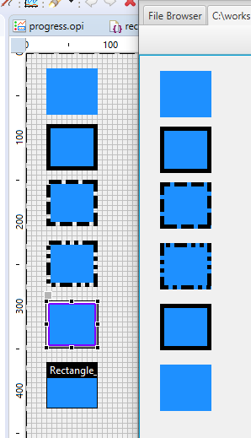
BOY screens converted (not perfectly)
Case 1b:
The auto converter is not converting some widget properties correctly.
The Phoebus auto converter is updated to handle the conversion issue
e.g. Issue #1564 & Issue #1771
For certain shapes the “border” property from the .opi files was being ignored
Notes:
Case 1b:
Updating the auto converter itself to handle conversion issues
e.g. outline/border properties of certain widgets
In BOY the shapes had "borders" AND "outlines"... with borders being potentially alarm sensitive.

Slide 12
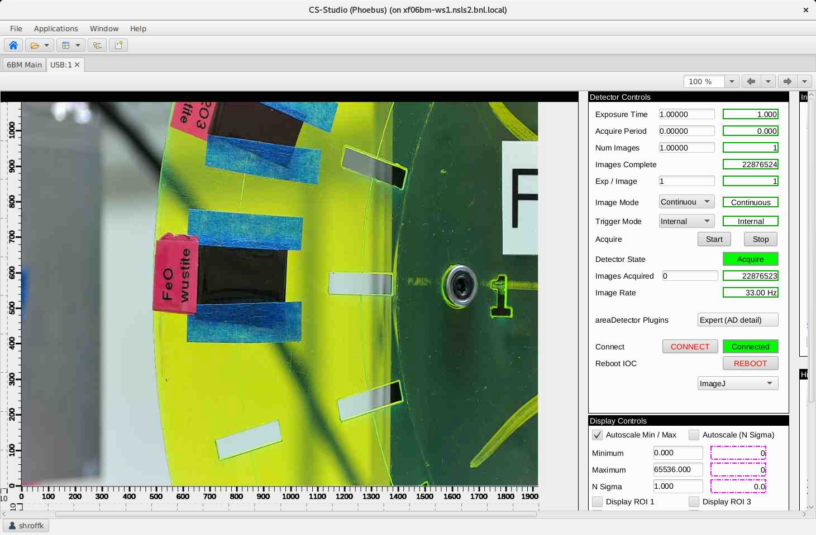
BOY screens converted (not perfectly)
BMM USB camera
PVA Images handled automatically
Dozens of rules needed to properly render the Image are no longer needed
Notes:
Case 2: manually fixing the converted screens
e.g. 1 Image / Camera opis

Slide 13
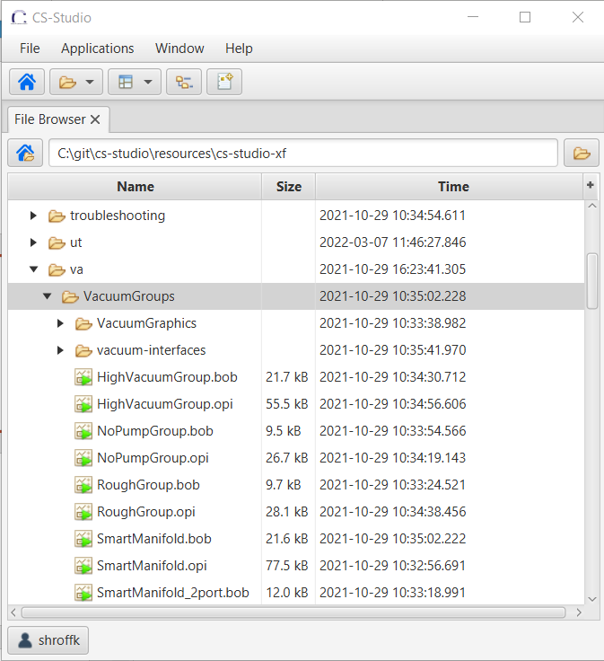
Good Neighbours
Once a converted file is modified it is stored as a .bob file
The Display Builder runtime will first check for a .bob file, if found it will open it otherwise fall back on the .opi file
No impact on existing use of CS-Studio
Notes:
co-habitation of .opi and .bob files in the nsls2 screen repo.
How the runtime resolves which screen to open.
Once modified the file is stored as a .bob file, future “open” requests will launch .bob files if they are present

Slide 14
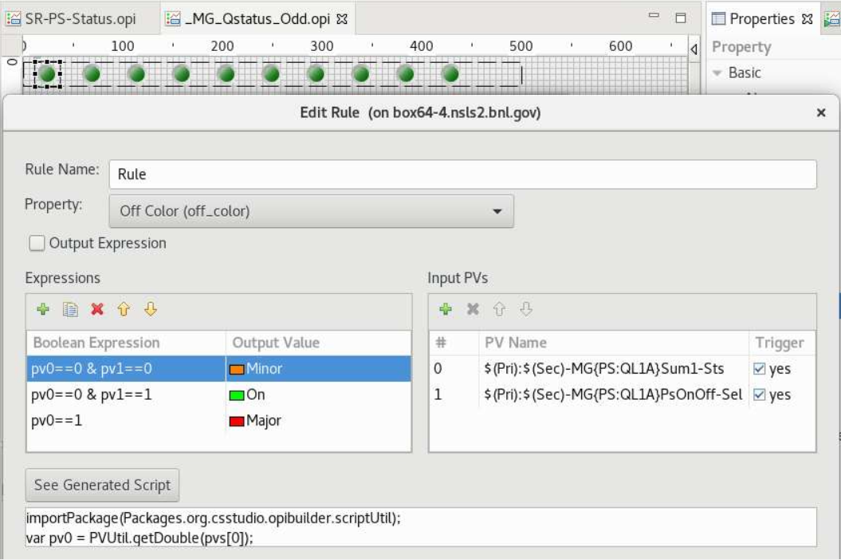
Redesign Screens in Phoebus (more efficient)
Some screens which are converted perfectly can still benefit from a redesign
Notes:
An exercise to rethink and redesign screens.
Using formula functions more and more
Here is show an example of why scripts and rules have overhead.

Slide 15
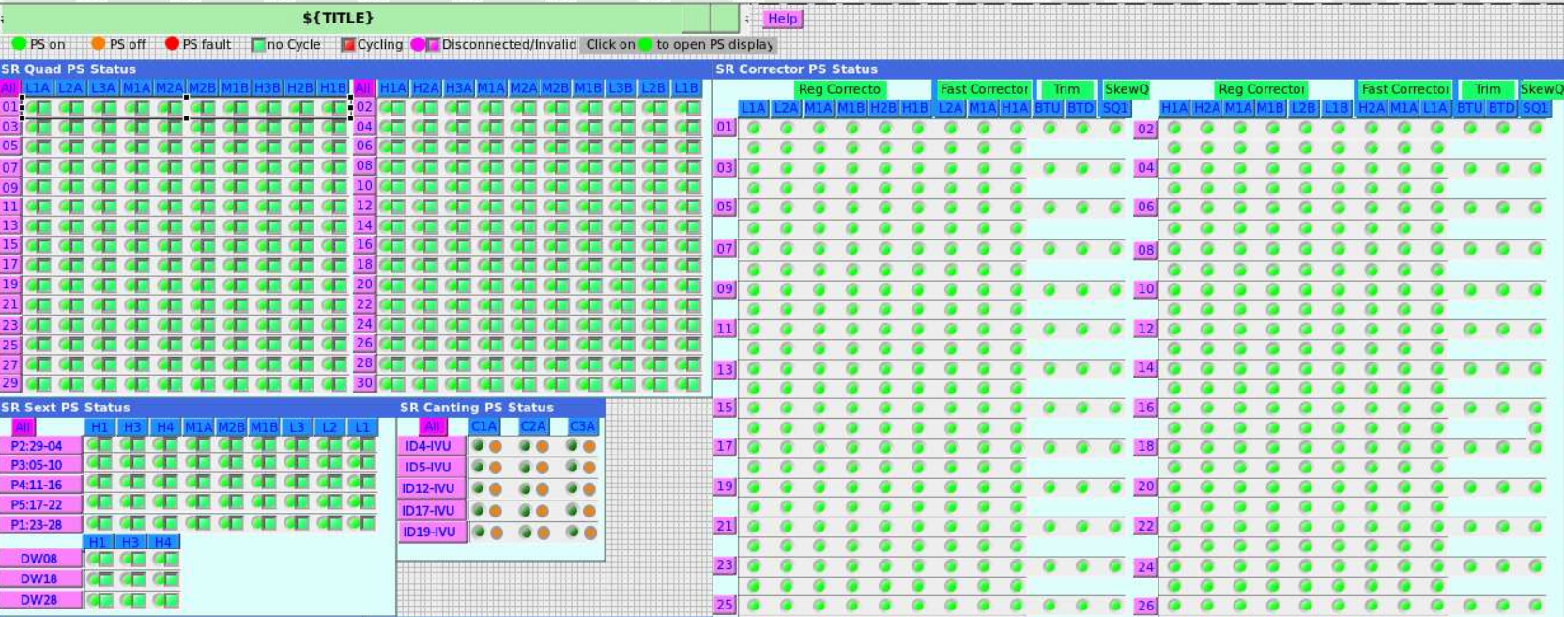
Redesign Screens in Phoebus (more efficient)
1800 rules to create multi state LED’s
Notes:
An exercise to rethink and redesign screens.
Using formula functions more and more
Here is show an example of why scripts and rules have overhead.

Slide 16
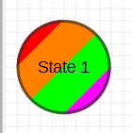
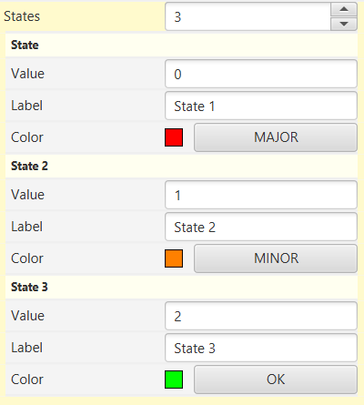
Redesign Screens in Phoebus (more efficient)
The same functionality can be accomplished using
multistate LEDs + Formula functions
Faster loading of .bob files
Less load on the UI thread since formulas are processed off the UI thread
=(pv0==1? Major : pv1 ==0 ? Minor : OK)
(Major, Minor, OK are 3 states)
Notes:
An exercise to rethink and redesign screens.
Using formula functions more and more
Here we show how formula functions can solve this problem in a more efficient manner

Slide 17
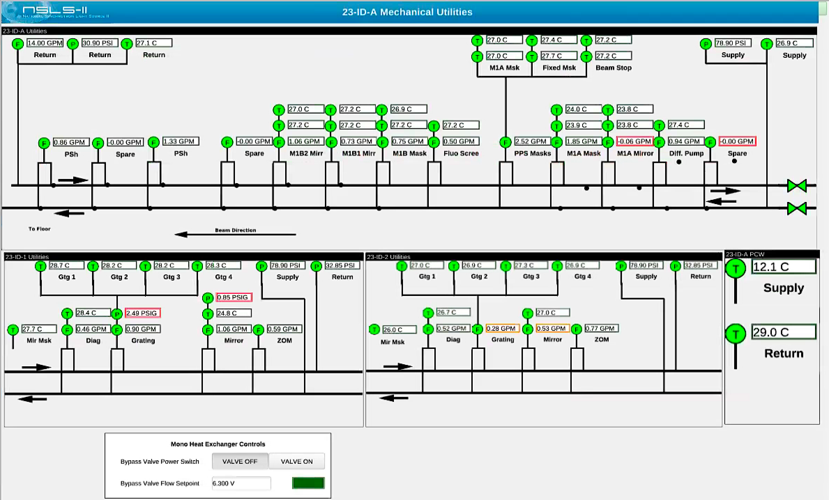
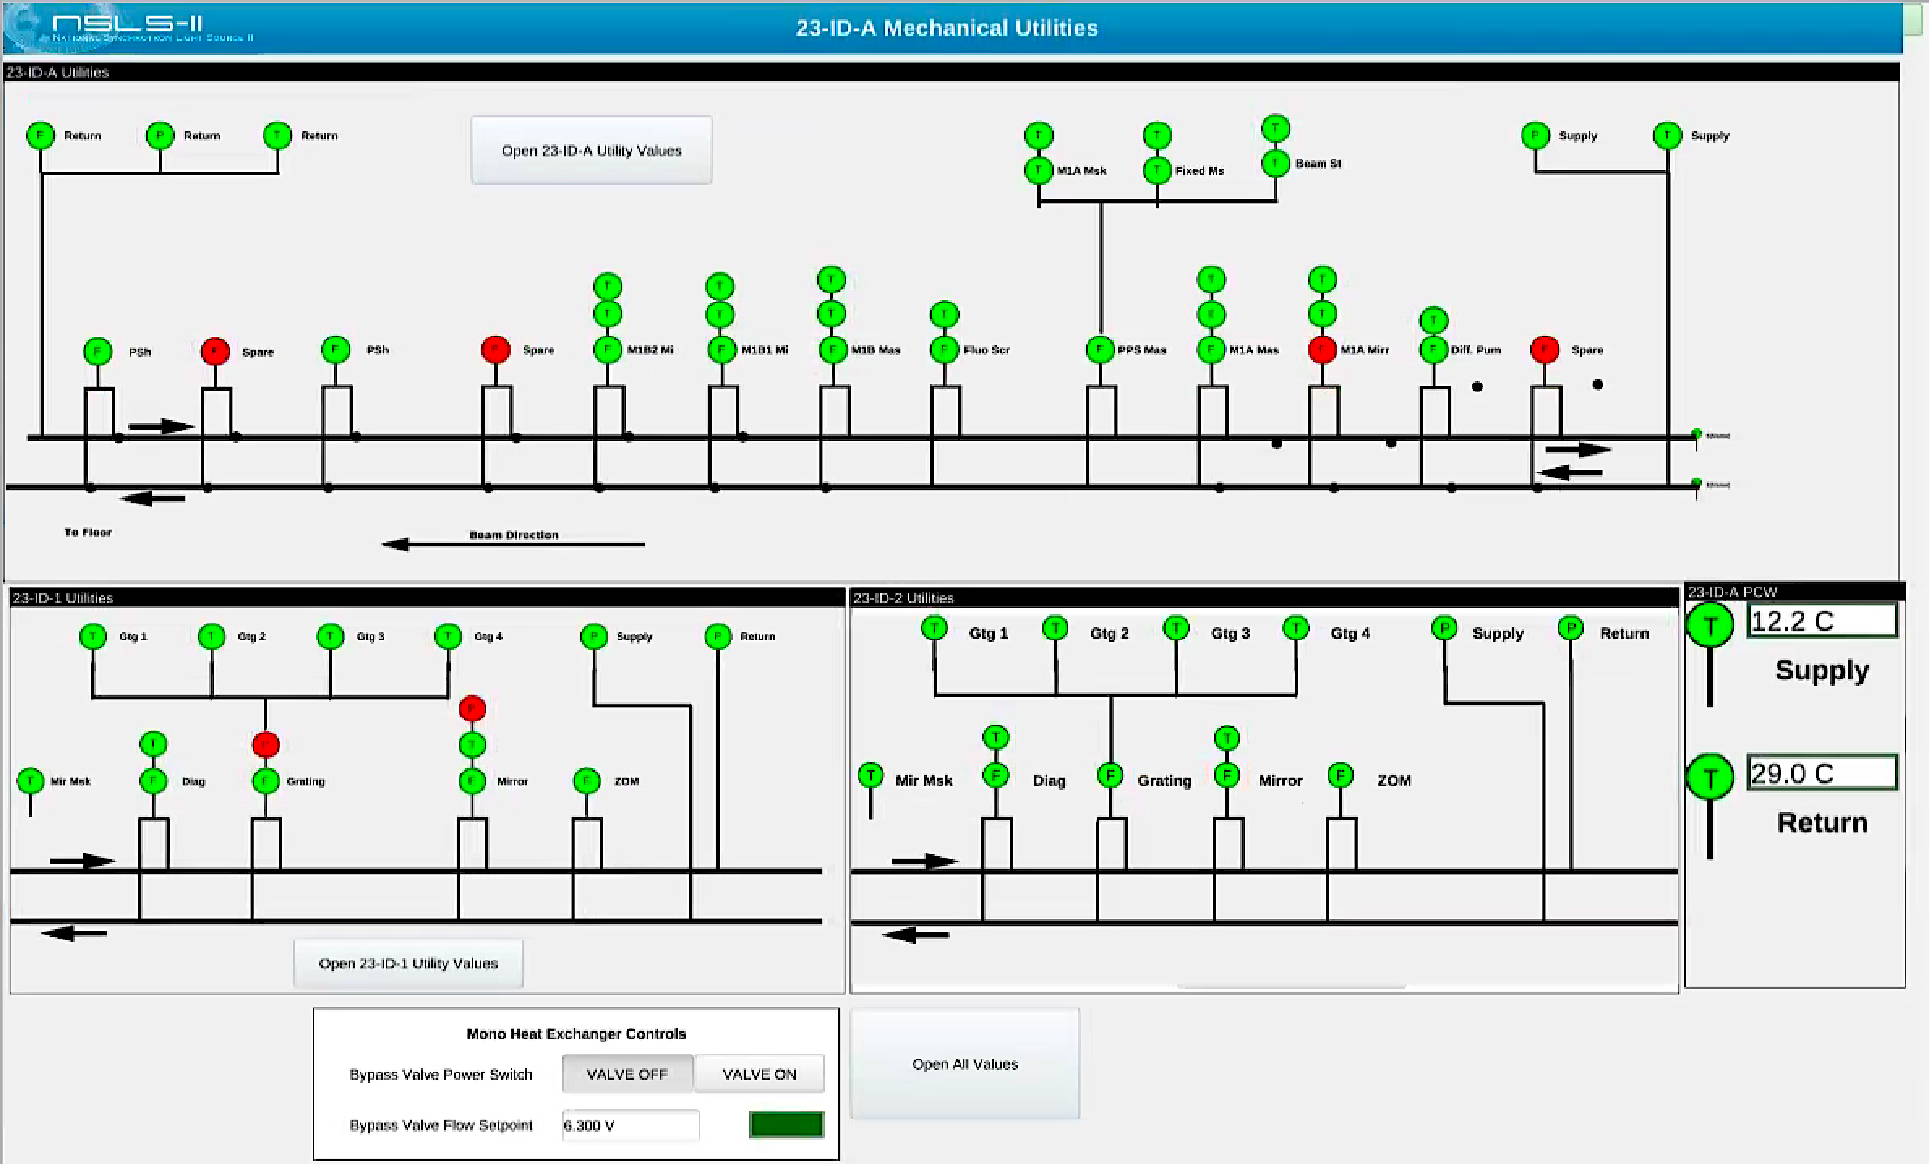
Redesign Screens in Phoebus (more usable)
Notes:
Rethink top level / Overview screens

Slide 18
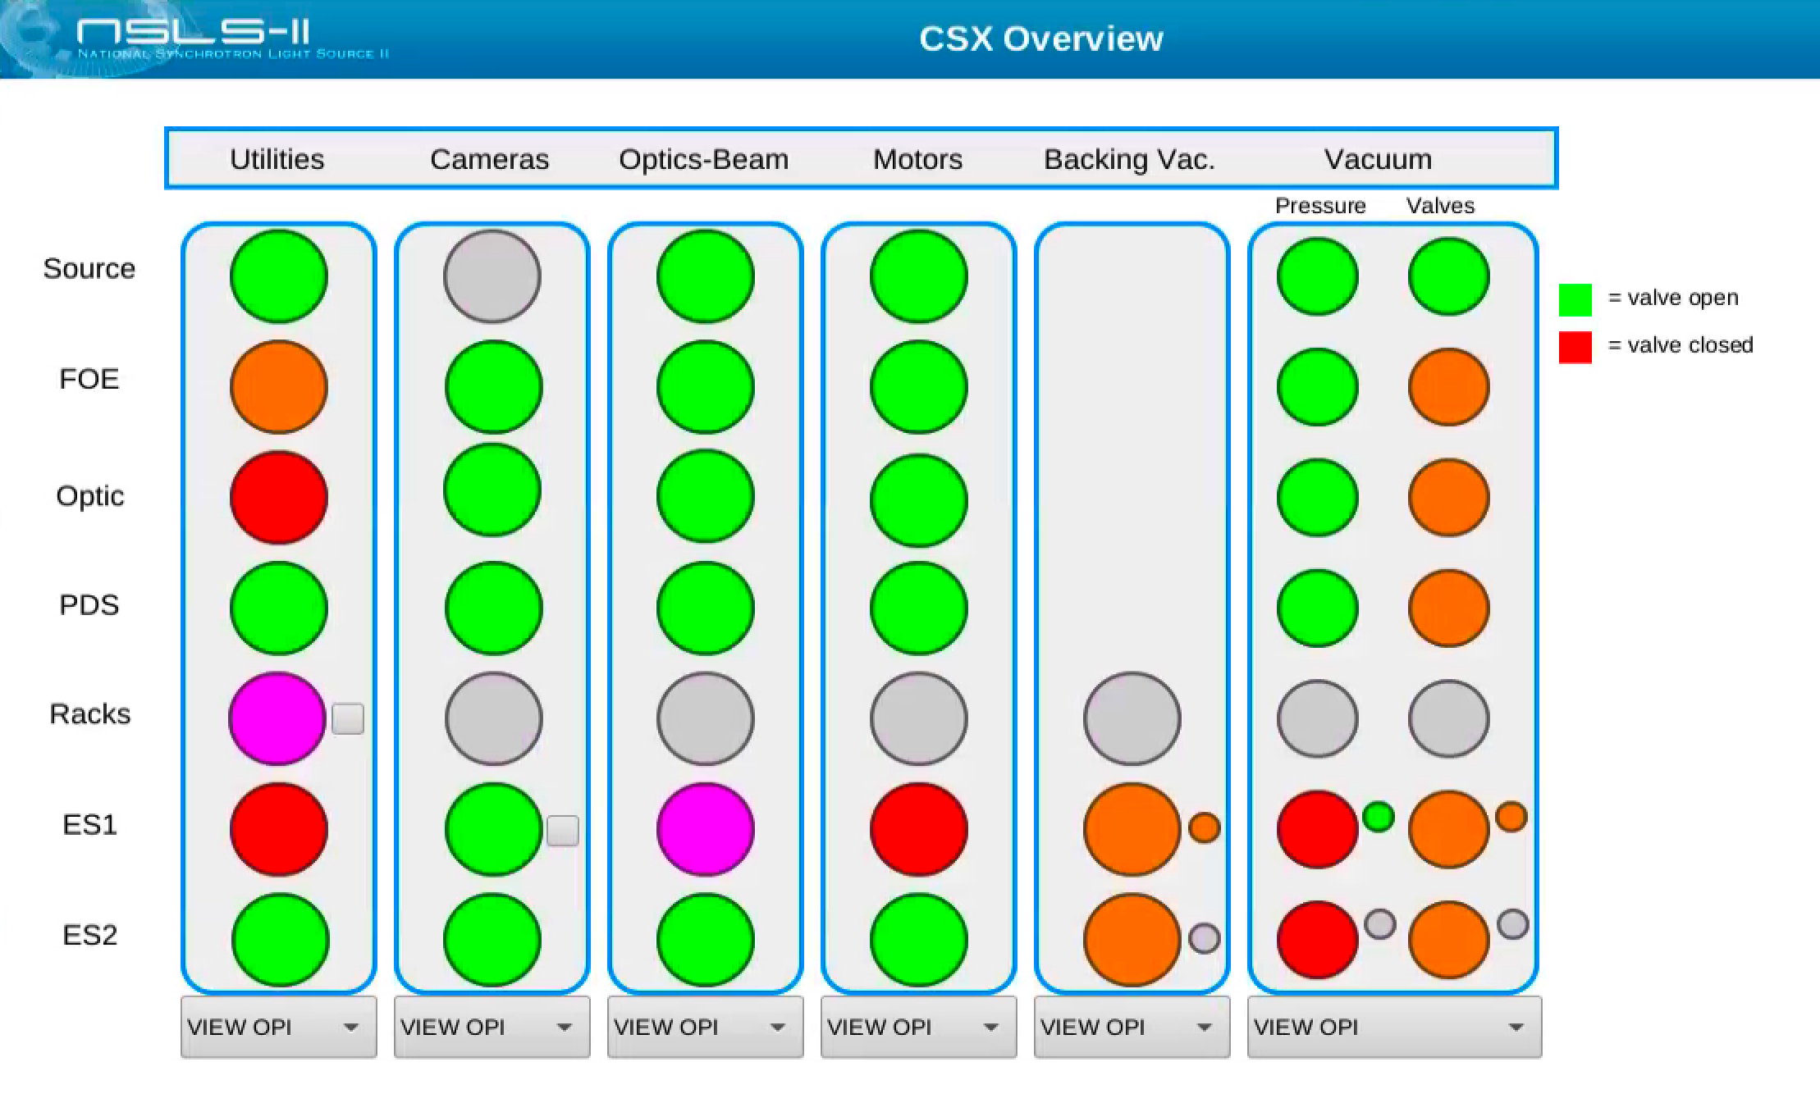
Redesign Screens in Phoebus (more usable)
Notes:
Rethink top level / Overview
House keeping
Screens should:
Be easier to discern information from
Provide the building blocks to create similar screens at other beamlines.
screens

Slide 19
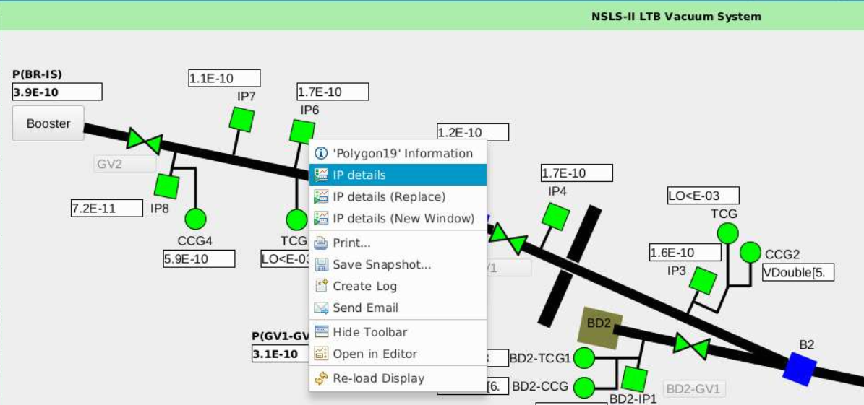
Redesign Screens in Phoebus (more usable)
Rethink the use of “on click actions”
Notes:
An exercise to rethink and redesign screens.
On click actions on shapes are gone → this is a good thing, we can make sure there are no hidden things that happen on screens on clicks

Slide 20
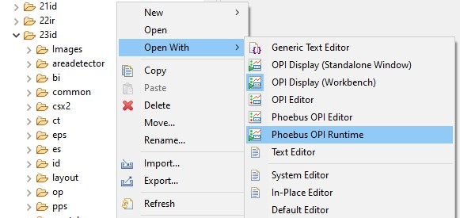
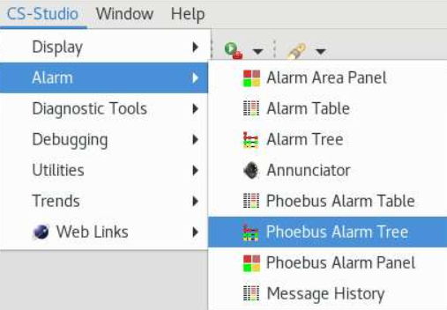
Iterative migration
Individual .opi files can be opened in the Phoebus editor or runtime
Individual Phoebus apps can be launched
Notes:
Iterative approach to migration to Phoebus
Context menu in CS-Studio
Action in BOY/CS-Studio

Slide 21
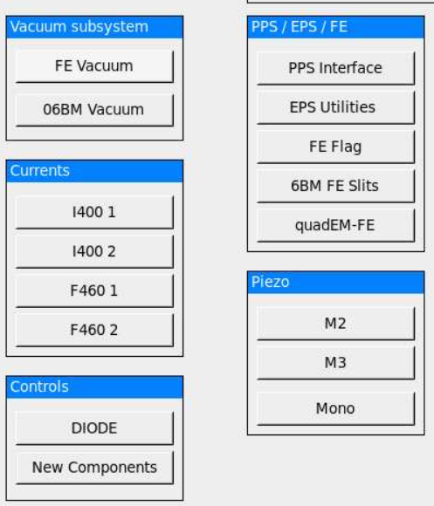
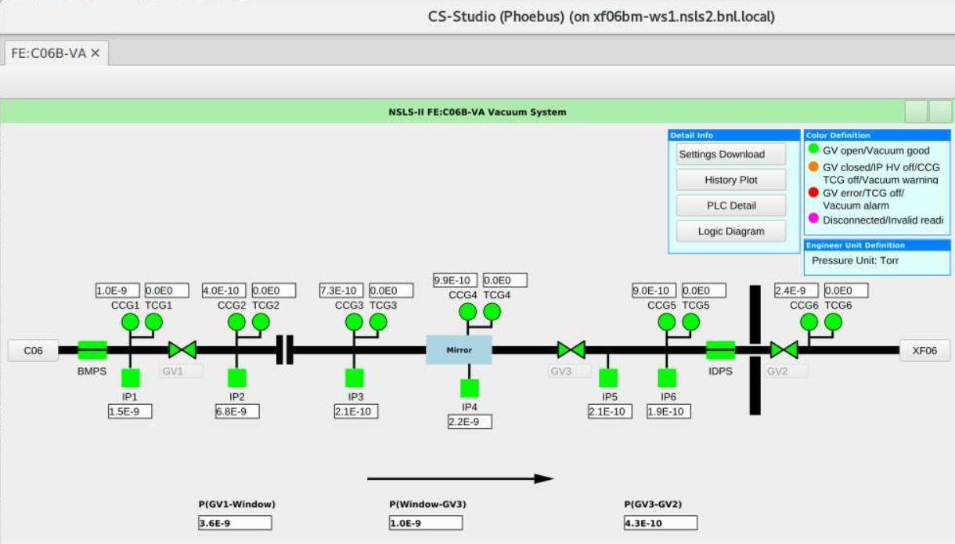
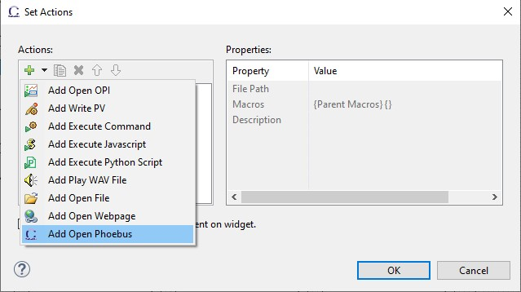
Integrating .bob files in existing .opi screen hierarchy
Action Buttons & Menu
Buttons can be configured to open .opi/.bob files in Phoebus
Notes:
Iterative approach to migration to Phoebus
Context menu in CS-Studio
Action in BOY/CS-Studio

Slide 22
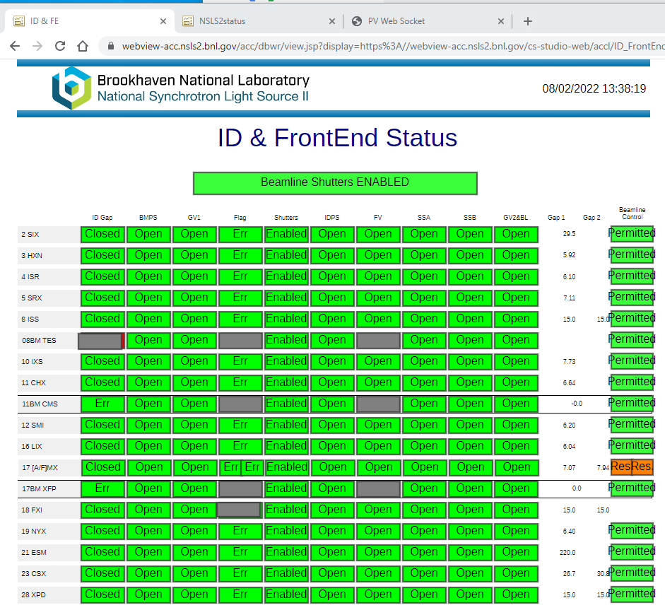
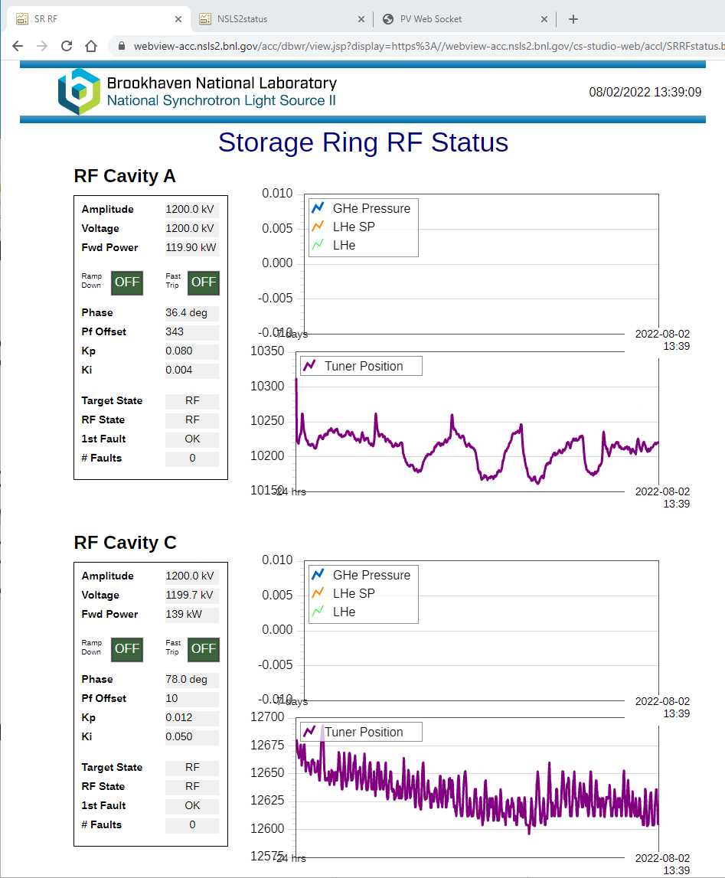
Phoebus on the web
Help support remote operations by bringing OPI screens to the web
.bob files converted to web runtime OPI’s
Notes:
Converted screens used in webruntime

Slide 23
Future plan
2 beamlines have moved over completed to Phoebus and the new EPICS middle layer services and 4 more are in the process
The accelerator is using Phoebus with the new alarm services and started testing some of the basic screens
Training workshops on Phoebus to encourage conversion to be accompanied with adoption of new features and conventions
Notes:
Future plan:
converting the rest of the screens
conversion is going to be coupled with the migration to the new middle layer services

Slide 24
Useful links:
https://controlsystemstudio.org/
http://phoebus.org
Fork us on github
https://github.com/ControlSystemStudio
Documentation and Help
https://control-system-studio.readthedocs.io/en/latest/
Notes:
Useful links:

Slide 25
Questions?
Notes:
Questions?

