Slide 1
Centralized Deployment of EPICS Systems for Zynq-based Devices
Ji Li, David Peter Siddons
EPICS Collaboration Meeting
09/22/2022

Slide 2
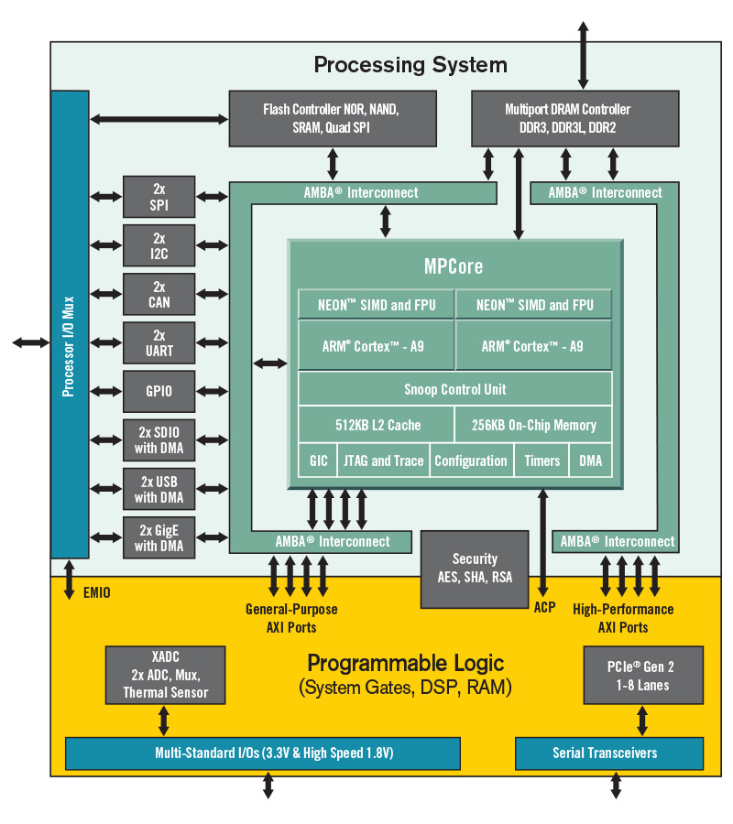
Overview
Zynq-based solutions become popular
  Flexibility: Processing System
  Real-time performance and I/O versatileness: Programming Logic
  All-in-one solution
Hundreds of Zynq devices deployed at NSLS-2
  BPM, quadEM, Pizzabox, etc.
  Problems:
    Non-trivial build/maintenance work
      Cross-compile/compile on ARM is time-consuming
    Corrupted file system

Slide 3
Zynq System
EPICS
NFS Server
Linux Root File System
Debian root file system
Linux Kernel
Device Drivers
PetaLinux
U-boot
fs
fs
…
fs
First Stage Boot Loader
boot
boot
boot
Hardware
hw
hw
hw
Zynq
Zynq
Zynq

Slide 4
Boot images
Xilinx PetaLinux workflow
  Configure to file system boot from NFS
  Boot.bin, image.ub, boot.scr
  Stored in SD Card
  Build only once
  MAC addresses as Device IDs
  Managed MAC address pool
  Assign MAC address in U-boot boot script
  Create a DHCP entry for each device
NFS Server
Debian root file system
ID 1
ID 2
ID N
fs
fs
…
fs
boot
boot
boot
hw
hw
hw
Zynq
Zynq
Zynq

Slide 5
Root File System
Standard Debian root file system
  PetaLinux version →
  Kernel version →
  Debian version
Multiple root file systems
  PetaLinux versions
  Architectures: 32-bit (Zynq-7000), 64-bit (Zynq UltraScale+)
Export on NFS server
Create only once
PetaLinux | 2017.1 | 2019.1 | 2022.1
Linux | V4.9 | V4.19 | v5.15
Debian | 9/Stretch | 10 (Buster) | ~11 (Bullseye) (v5.10)

Slide 6
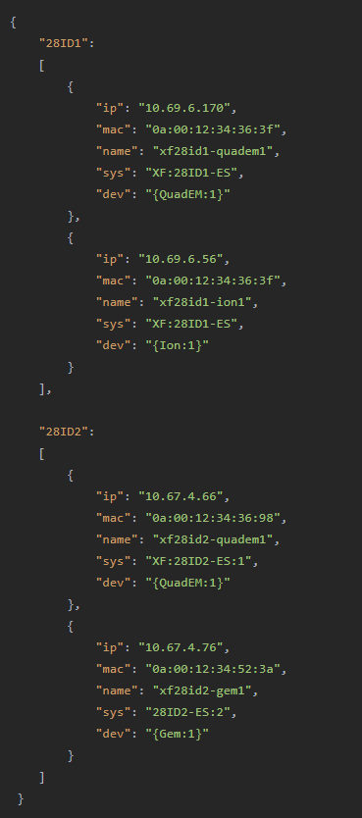
Device Record
/epics/data/zynq-dev.json
Information for all managed Zynq devices
  Grouped by beamlines
  DHCP validation
  Name
    Hostname/IOC name
  PV name prefix
    IOC start script, substitution files
Updated for each new device

Slide 7
EPICS
EPICS infrastructure
/epics/base-x.xx.x
/epics/base-x.xx.x/support
  Multiple EPICS base versions
  Multiple EPICS module versions
  Build only once
IOC Binary
/epics/modules/ion
  Build only once
IOC Instance
/epics/iocs/xf28id1-ion1
  IOC name=hostname
  Startup script and Substitution files
    References to /epics/modules/ion
  Autosave directory
  config
  Installed as services
    manage-iocs
  Create for each new device
  No compilation needed

Slide 8
Start Up
Select IOC at runtime - avoid writing to file system
  Get name by IP address
    name=`jq -c '.[]' zynq-det.json | awk '/'$my_ip'/ {print $0}' | jq -c '.[]' | awk '/'$my_ip'/ {print $0}’ | jq -r '.name’`
  Start the IOC if the IOC is for the current device
    if [ $name != $IOC ]; then exit fi
  Each device only start its own IOC
    One instance

Slide 9
Summary
Significantly simplifies deployment/maintenance
  For each new device type
    Build boot images, IOC binary
    Create root file system (optional)
  For each new device
    Copy boot images, update boot script
    Update device record, DHCP
    Create IOC instance
    Install IOC
    Avoid compilation
More robust file system.

Slide 10
Thank you

