Slide 1
EPICS 7 Workshop Summary
EPICS Collaboration Meeting
Slovenia, Sept. 2022
Kay Kasemir

Slide 2
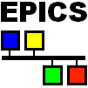
August 10 “Would you .. PV Access, PVXS, Java Interface, sample client”
Sept. 19 EPICS 7 Workshop
Network Diagram
Network Diagram (new)
“Integrate into EPICS” = “Make accessible on Network”
EPICS 7 = EPICS with CA and PVA

Slide 3
For material,
follow EPICS Meeting web page to
https://controlssoftware.sns.ornl.gov/training/2022_EPICS/

Slide 4
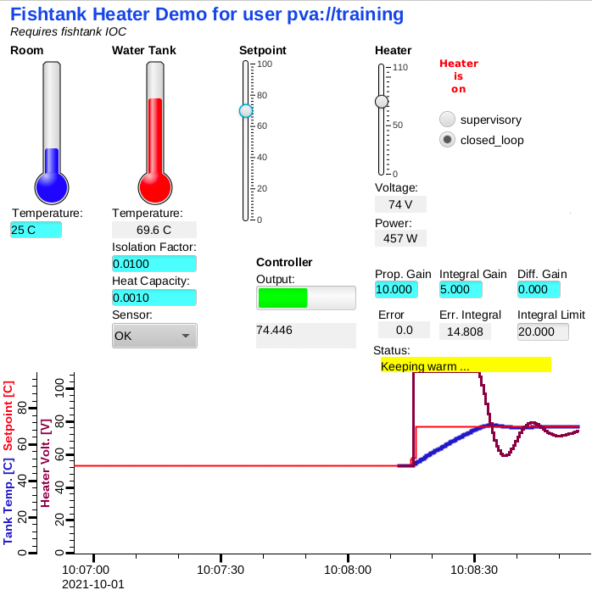
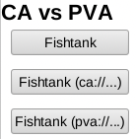
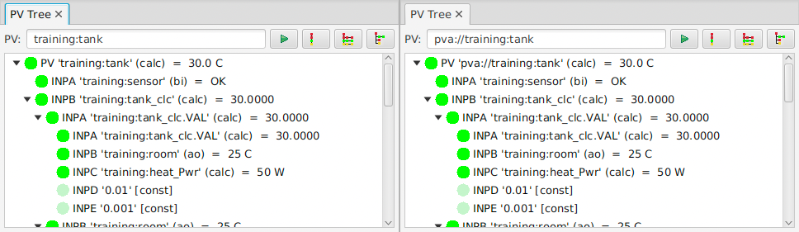
EPICS IOCs are now Bi-Lingual!
Channel Access
  cainfo, caget, caput, camonitor
  Still fully supported
PV Access
  pvinfo, pvget, pvput, pvmonitor
  CS-Studio: ‘pva://’ prefix
  Looks very similar

Slide 5
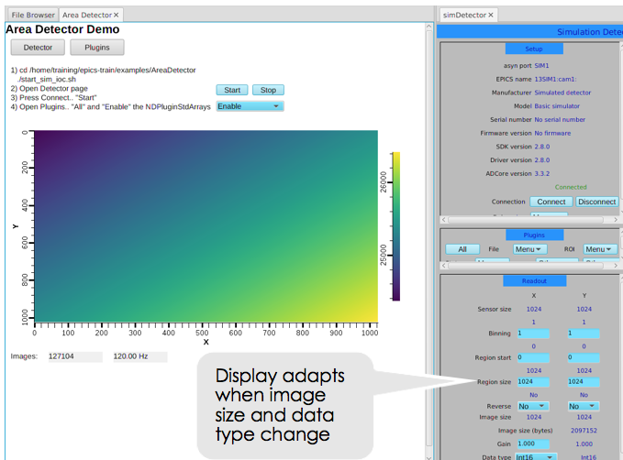
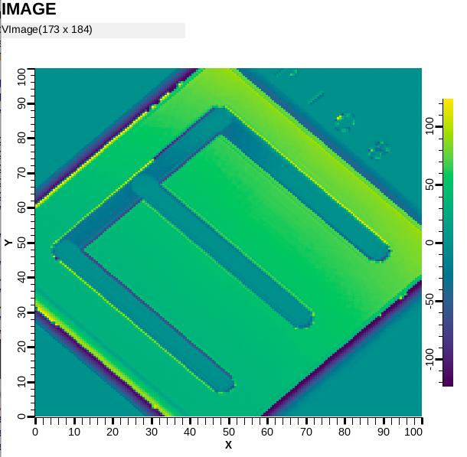
Advantage PVA: Images
“NTNDArray” type combines
  Pixels
  Color modes
  Dimensions
  Compression settings

Slide 6
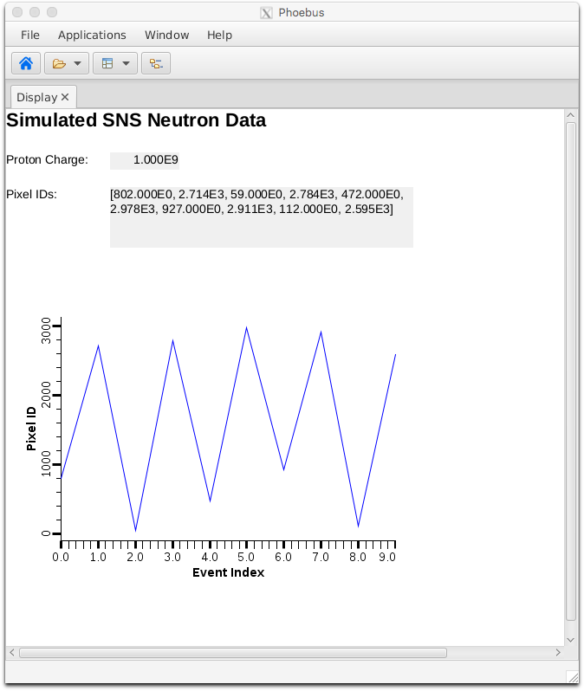
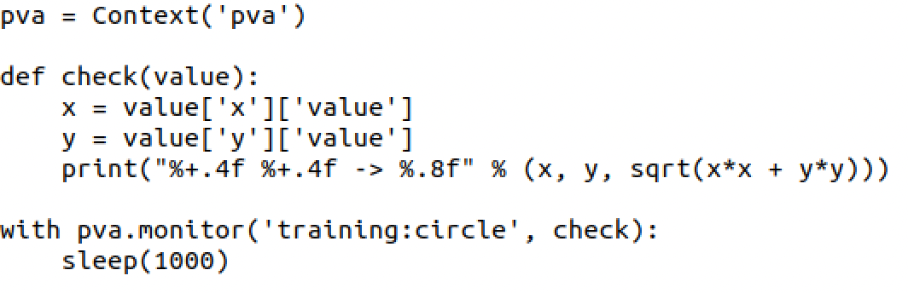
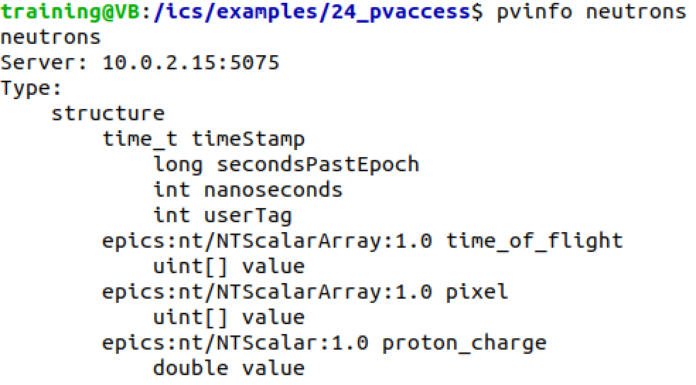
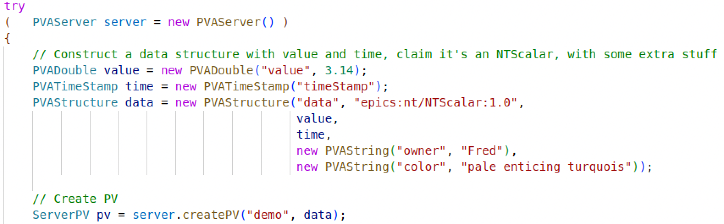
Custom Data
Create from IOC, python, java, C++
Use in python, java, CS-Studio, C++

Slide 7
State of PV Access, Sept. 2022
Done, operational
Server and client libraries for C++, Java, Python
Area Detector image transfer
  Used to distribute processing from camera hosts
Custom data servers and clients
  SNS: neutron data
  APS: services
Done, to be tested
PVA server for records in IOC
  All record types
  ‘Description’
  Full ‘units’
  Full 64 bits for
  ‘int64in’, ‘int64out’
  No enum state limit
  Supports changing metadata
CS-Studio client
Gateway
To do
IOC links
  Default to CA.
  Initial support for
  field(INP, {pva:{pv:”tgt”}})
  Channel Access Get/put callback → ??
How to best combine data from records into custom PVA data?

Slide 8
Summary: PV Access is ..
Alternative to Channel Access
  Both can be used in parallel
Similar, but supports custom data types
  Already useful for images and site-specific cases
Since EPICS 7 included in base IOC

