Slide 1

EPICS Collaboration Meeting September 2022
EPICS Build and Deployment
Report on the Tuesday Workshop

Slide 2
General:
~75 registered participants (50-60 attending)
Two main areas of interest:
  Management of building many dependent modules with individual release cycles
  Deployment and execution of operator tools and IOCs for development, test and production
Eight contributions discussing the solutions at different places:
e3 (ESS), sumo/rsync-dist (BESSY), sumo/Conda (APS-U),
CODAC Core System distro (ITER), RPM packaging (NSLS-II),
Nix based deployment (CEA), IOCs in Docker (PANDA),
IOCs in Docker using Helm/Kubernetes (Diamond)

Slide 3
Building Modules:
Flexible: Tool using a database that manages the dependencies and the built version sets
sumo (BESSY, APS-U), e3 (ESS)
Rigid: Release of fixed version sets
CCS Distribution (ITER), Mega-RPM (NSLS-II)
Using a CI/CD system
everyone

Slide 4
Deployment of Libraries and Applications:
System package managers
CCS (ITER), NSLS-II, FRIB
System independent package managers
Conda (APS-U), Nix (CEA)
Containers
Docker (Diamond, PANDA), Singularity (BESSY; for OPI apps)
Remote copy of structures (w/ tags, soft link switching)
rsync-dist (BESSY; for IOCs)
Shared file system (NFS)
e3 (ESS)

Slide 5
Linking IOCs:
Using a Python wrapper to resolve dependencies and load shared libraries from NFS when starting the IOC
e3 (ESS)
Linking shared libraries that are installed by package managers
most places
Linking shared libraries that are inside containers
Docker (Diamond, PANDA), Singularity (BESSY; for OPI apps)
The era of static linking is over

Slide 6
Different Requirements/Goals:
IOCs need to run on different (less predictable) host systems
Free the app developer from having extensive knowledge of module versions and dependencies
Stability / reproducibility vs. ability to quickly provide bugfixes
Fixed sets of versions are easier to test and maintain

Slide 7
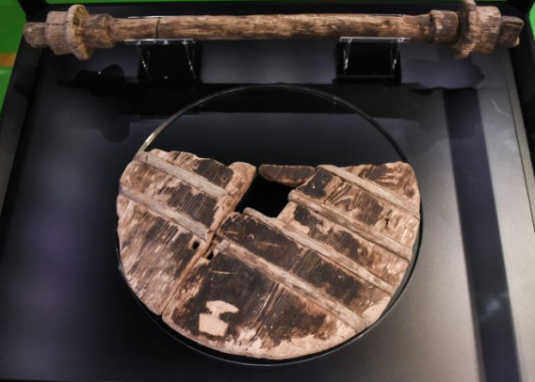
For Reinventing the Wheel:
There’s no better place to do that… 1st wheel (found near Ljubljana)

Slide 8
It Seems That...
Everyone has an implementation that meets their requirements and needs some improvements here and there
Everyone would love to collaborate – on their solution
Are B&D solutions the “display manager of the 2020s”?

Slide 9
Thanks a Lot to the Contributors:
Timo Korhonen (ESS): e3 (ESS EPICS Environment)
Thomas Birke (HZB/BESSY): SUMO and rsync-dist
Andrew Johnson (APS): C2 – SUMO and Conda for APS-U
Anze Zagar (ITER): Packaging and deployment in CODAC Core System
Anton Derbenev (NSLS-II): Packaging and deployment at NSLS-II
Rémi Nicole (CEA): EPNix – Nix-based EPICS packaging
Florian Feldbauer (PANDA): Running IOCs in Docker containers
Ronaldo Mercado (Diamond): Running IOCs using Kubernetes
Talks and Zoom recording will be available from the meeting website.

