Slide 1





Device Support
Connecting Controllers
Ralph Lange, ITER Organization

Slide 2
Motivation
Existing EPICS interfaces to Siemens S7 PLCs:
s7plc: TCP Data Block Transfer
  needs programming on the PLC
  complete data blocks only
s7nodave: Snap7 based (S7 protocol)
  no need for PLC side programming
  access to the whole PLC memory
Both work fine, but have disadvantages
  low level configuration (byte offsets into data blocks)
  -> address mismatch may have drastic consequences!
  pretty specific/proprietary solutions

Slide 3
Requirements / Wish List
Symbolic addressing
  names, not numbers
No PLC programming
  keep contractors happy
Industrial standard
  one to connect them all
Portability
  at least Linux, Windows
User-defined structures
  for reusable PLC objects
Subscription mechanism
  update on change
Server-side queues
  handle bursts well
Browsing support
  find variables easily
Security (TLS, X.509)
  encrypt, sign, authenticate
Remote procedure calls
  with parameters and results

Slide 4
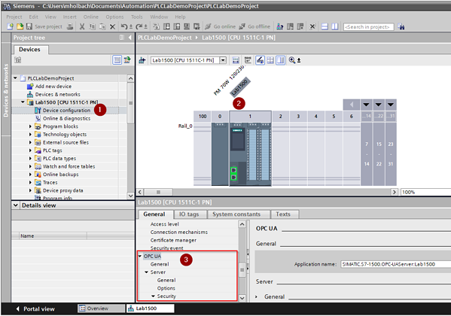
OPC UA
Industrial standard (2006) to interface SCADA to PLCs
  Covers data, alarms, events, historical data, remote methods
Based on OPC Classic (Microsoft; 1996), plus
  Portability → UA does not require DCOM/Windows like Classic
  Safety/security (authentication, encryption)
  Information modeling (user defined structures)
  Remote method execution
Gaining momentum in industrial context
as universal integration standard
Siemens S7-1500 series PLCs
include an embedded OPC UA server

Slide 5
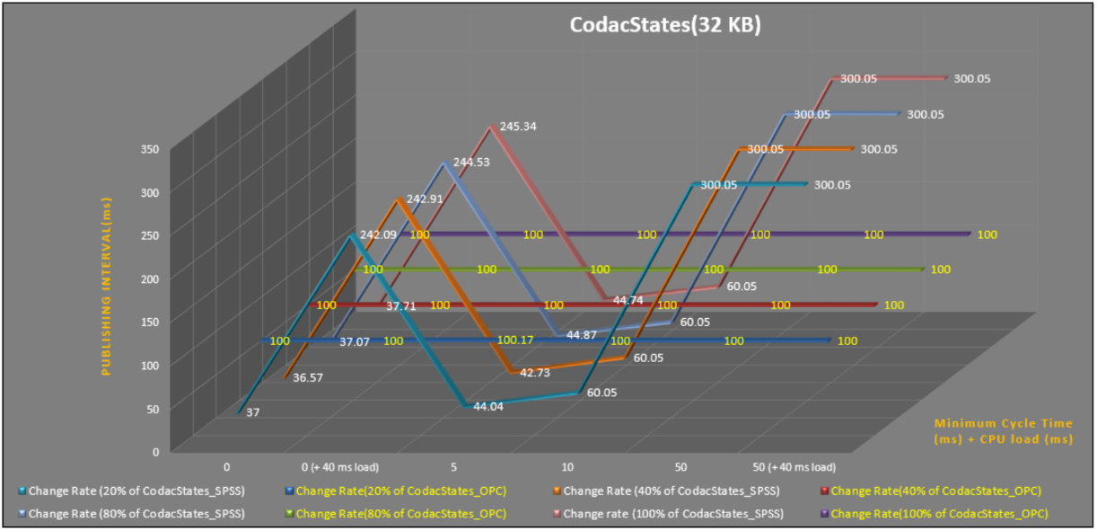
Performance
It all depends – mostly on the server
early tests by TCS, comparing TCP Data Block transfer with OPC UA:
“big” S7-1518, 32kB data (integers), “empty” / 40ms cycle artificial load

Slide 6
Performance
Test in 2021 for ITER building automation integration
  Trying to verify realistic conditions
  3x the estimated size (500kB data, mixed types)
  On a mid-size S7-1516
  250ms sampling/publishing period
  No performance fine-tuning
Results:
  Fit for this purpose
  Best performance when using few large structures

Slide 7
Limitations
Mostly found on the server end
  S7-1500: depends on the model (S/M/L) and data organization
  How many, how large, how often?
  Client-side fine tuning available
  e.g., “registering” items to cache server-side name resolution
  Servers separate from PLCs introduce additional latency
Found one limit in the client
  LabView serving 600 arrays of 7500 doubles each (~36MB data)
  -> SDK client has a limit of ~16MB for the serializer
  workaround: 3 subscriptions of 200 arrays each

Slide 8
EPICS Device Support
Based on commercial C++ Client SDK by Unified Automation
  4k€ for source code and 1 year support (extend support: 20% per year)
  one developer/many products or many developers/one product
  Binaries can be deployed/distributed royalty-free
  Platforms: Windows and Linux
  Evaluation bundles available
Evaluation of client library options and Device Support prototype
Bernhard Kuner (HZB/BESSY)
ITER use cases tested by F4E (Spain) and TCS (India)
  Against S7-1516/1518 embedded OPC UA server
  Against WinCC-OA embedded OPC UA server

Slide 9
Status
Requirements Specification v1.1: https://bit.ly/opcua-srs-11
Design done (still no formal doc)
Implementation nearly complete
  All basic data types and arrays thereof (read/write/subscribe)
  Supporting all applicable record types (bidirectional outputs)
  User-defined structures (read/write/subscribe), timestamps from data
  Server-side queues, configurable connection behavior
  OPC UA Security (encrypt, sign, authenticate)
  Lots of testing help by Roland Fleischhauer (HZB/BESSY)
  Integrated end-to-end test against a software server
  Work by Ross Elliot and Karl Vestin (ESS)

Slide 10
Users
Facility | OPC UA Server | Status
ASIPP | LabVIEW | production
 | PLC Siemens S7-1500 | production
Australian Synchrotron | PLC Siemens S7-1500F | near production
BESSY II @HZB | PLC Siemens S7-1500 | production
 | Phoenix Contact | production
 | Softing uaGate | production
CHIMERA @CCFE | PLC Siemens S7-1500 | development
 | LabVIEW | development
ESS | PLC Siemens S7-1500F | production
 | ABB Power SCADA | near production
 | Siemens DESIGO | development
Fermilab | Kepware KEPServerEX | testing
 | PLC Siemens S7-400 | development
IPR | PLC Siemens S7-1500 | testing
ITER | PLC Siemens S7-1500 | production
 | Siemens WinCC OA | production
 | PCVue | production
KATRIN @KIT | LabVIEW | prototyping
PSI | PLC Siemens S7-1500 | development
Varian ProBeam | PLC Siemens S7 | production
 | PLC Beckhoff | production

Slide 11
Roadmap
Currently working on:
  Merging the integration of (free) open62541 client library
  Work by Dirk Zimoch (PSI) and Carsten Winkler (HZB/BESSY)
Soon:
  Support for OPC UA methods (remote execution of PLC code)
  User Manual
Under EPICS license
Upstream repository and statically linked binaries containing the UA client (shared libraries to link against your IOCs):
https://github.com/epics-modules/opcua

