Slide 1
Temperature Control of Crystal Optics
The meV-resolved Inelastic X-ray spectrometer at NSLS-II
Kazimierz Gofron
EPICS Collaboration Meeting
Ljubljana, Slovenia
September 21, 2022

Slide 2


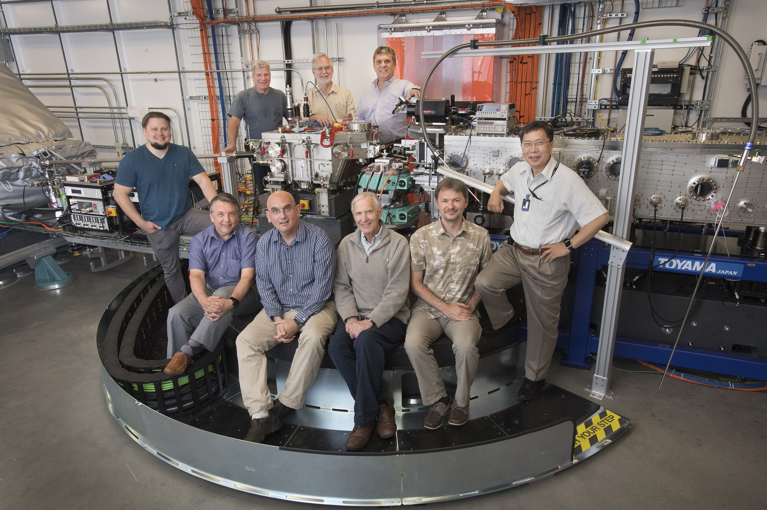
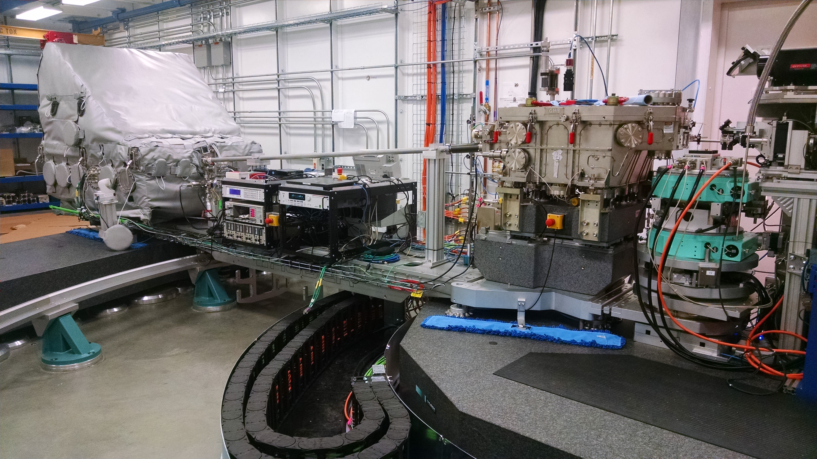
Inelastic X-ray Spectrometer (9.1keV)
PRESENT AND FORMER TEAM MEMBERS
Analyzer Optics
Sample
CDW
Montel Mirror
Back Row (L-R): Dima Bolmatov, Rick Greene, Scott Coburn, Kazimierz Gofron
Front Row (L-R): Alexey Suvorov, Alessandro Cunsolo,
Ron Pindak, Misha Zhernenkov, Yong Cai

Slide 3
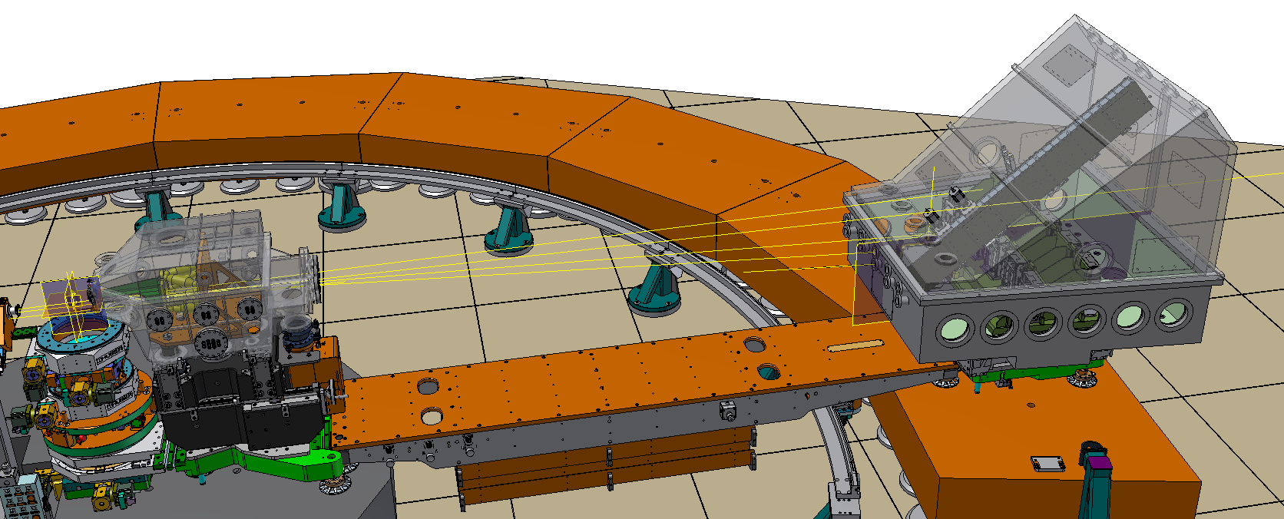
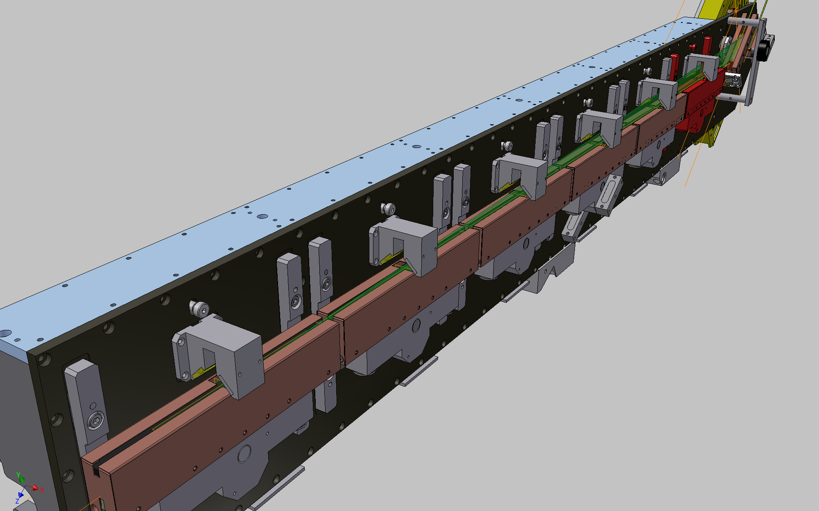
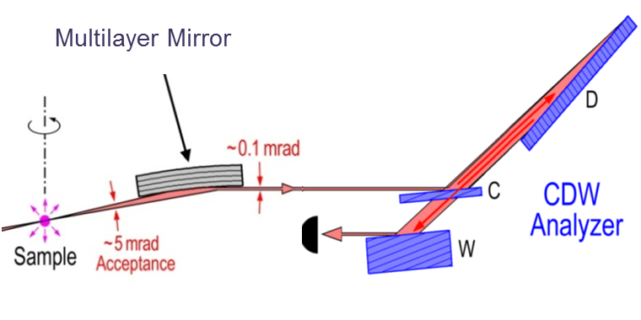
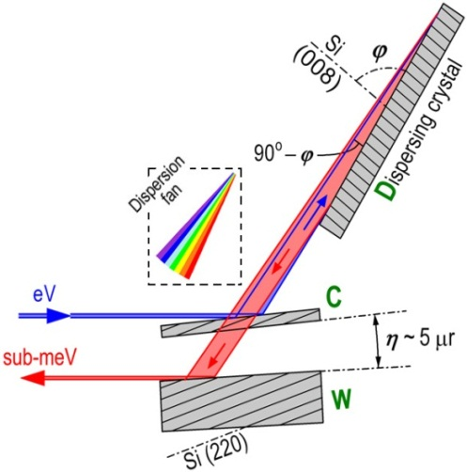
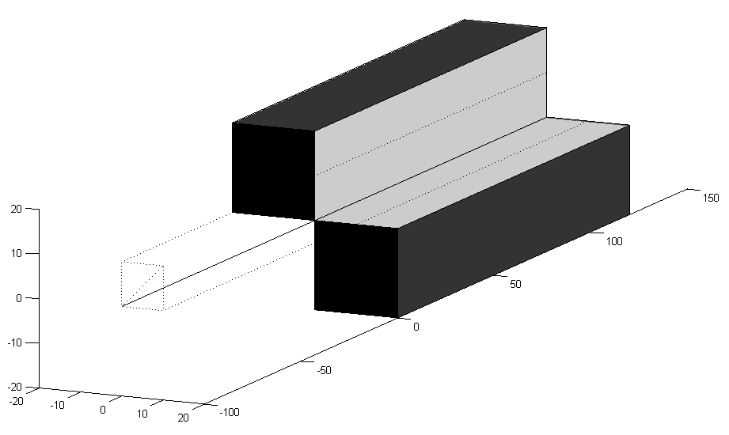
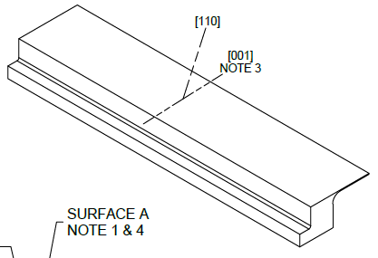
Optical Layout of Montel-CDW IXS Analyzer
Operation energy: 9.1 keV – Si(008) back reflection
Angular acceptance : ~ 7.5 (V) x15 (H) mrad²
Temperature < 1 mK
Projected Longitudinal Length
@ 40 um Transerve Acceptance
Montel Mirror
(Montel)
~1.5 mm
~0.1 mrad
1.2 m
(6 crystals of 200mm each)
~10 µm
~10 mrad
Acceptance
~
200mm
Detector
Angular dispersive optics with post-sample collimation
Thickness ~ 200 um

Slide 4
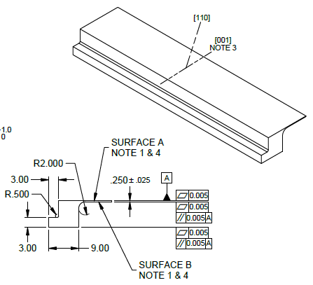
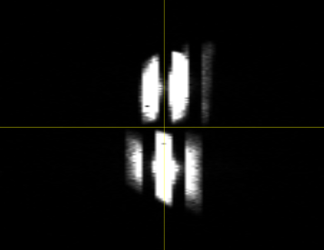
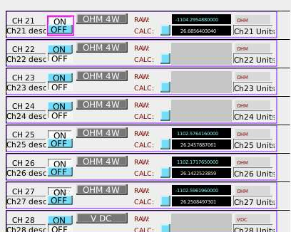
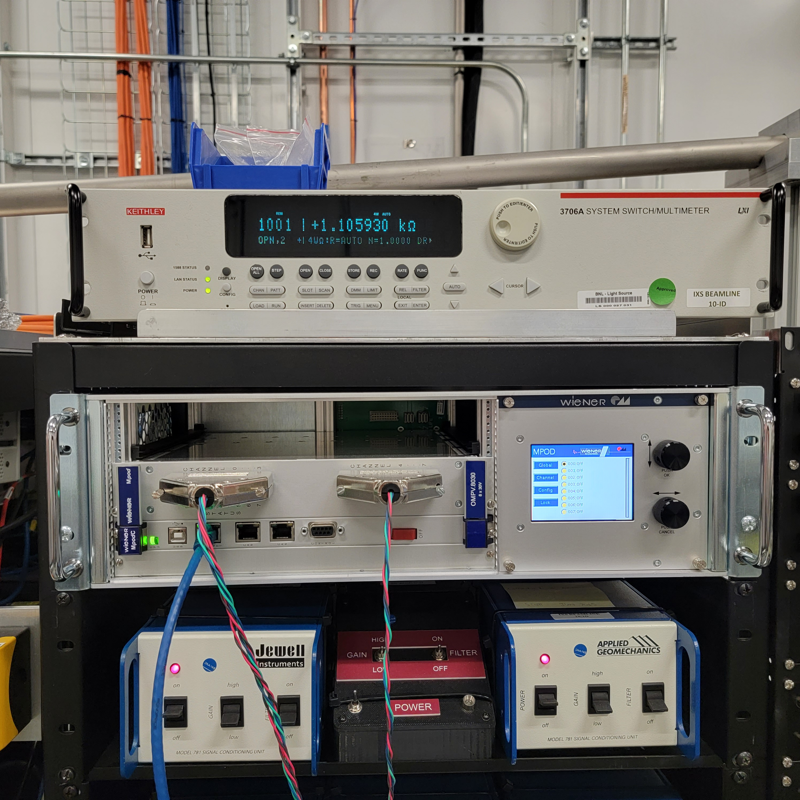
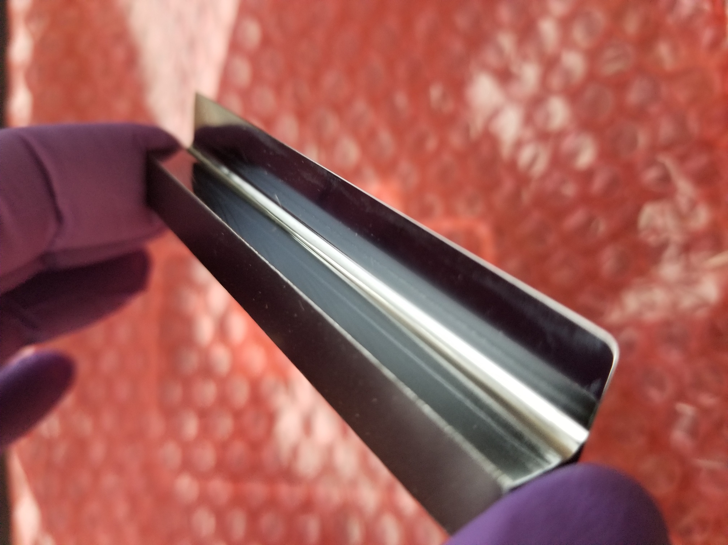
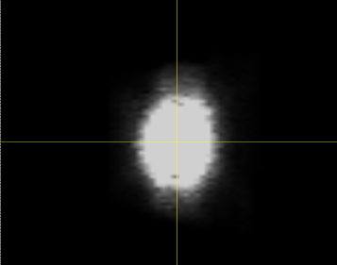
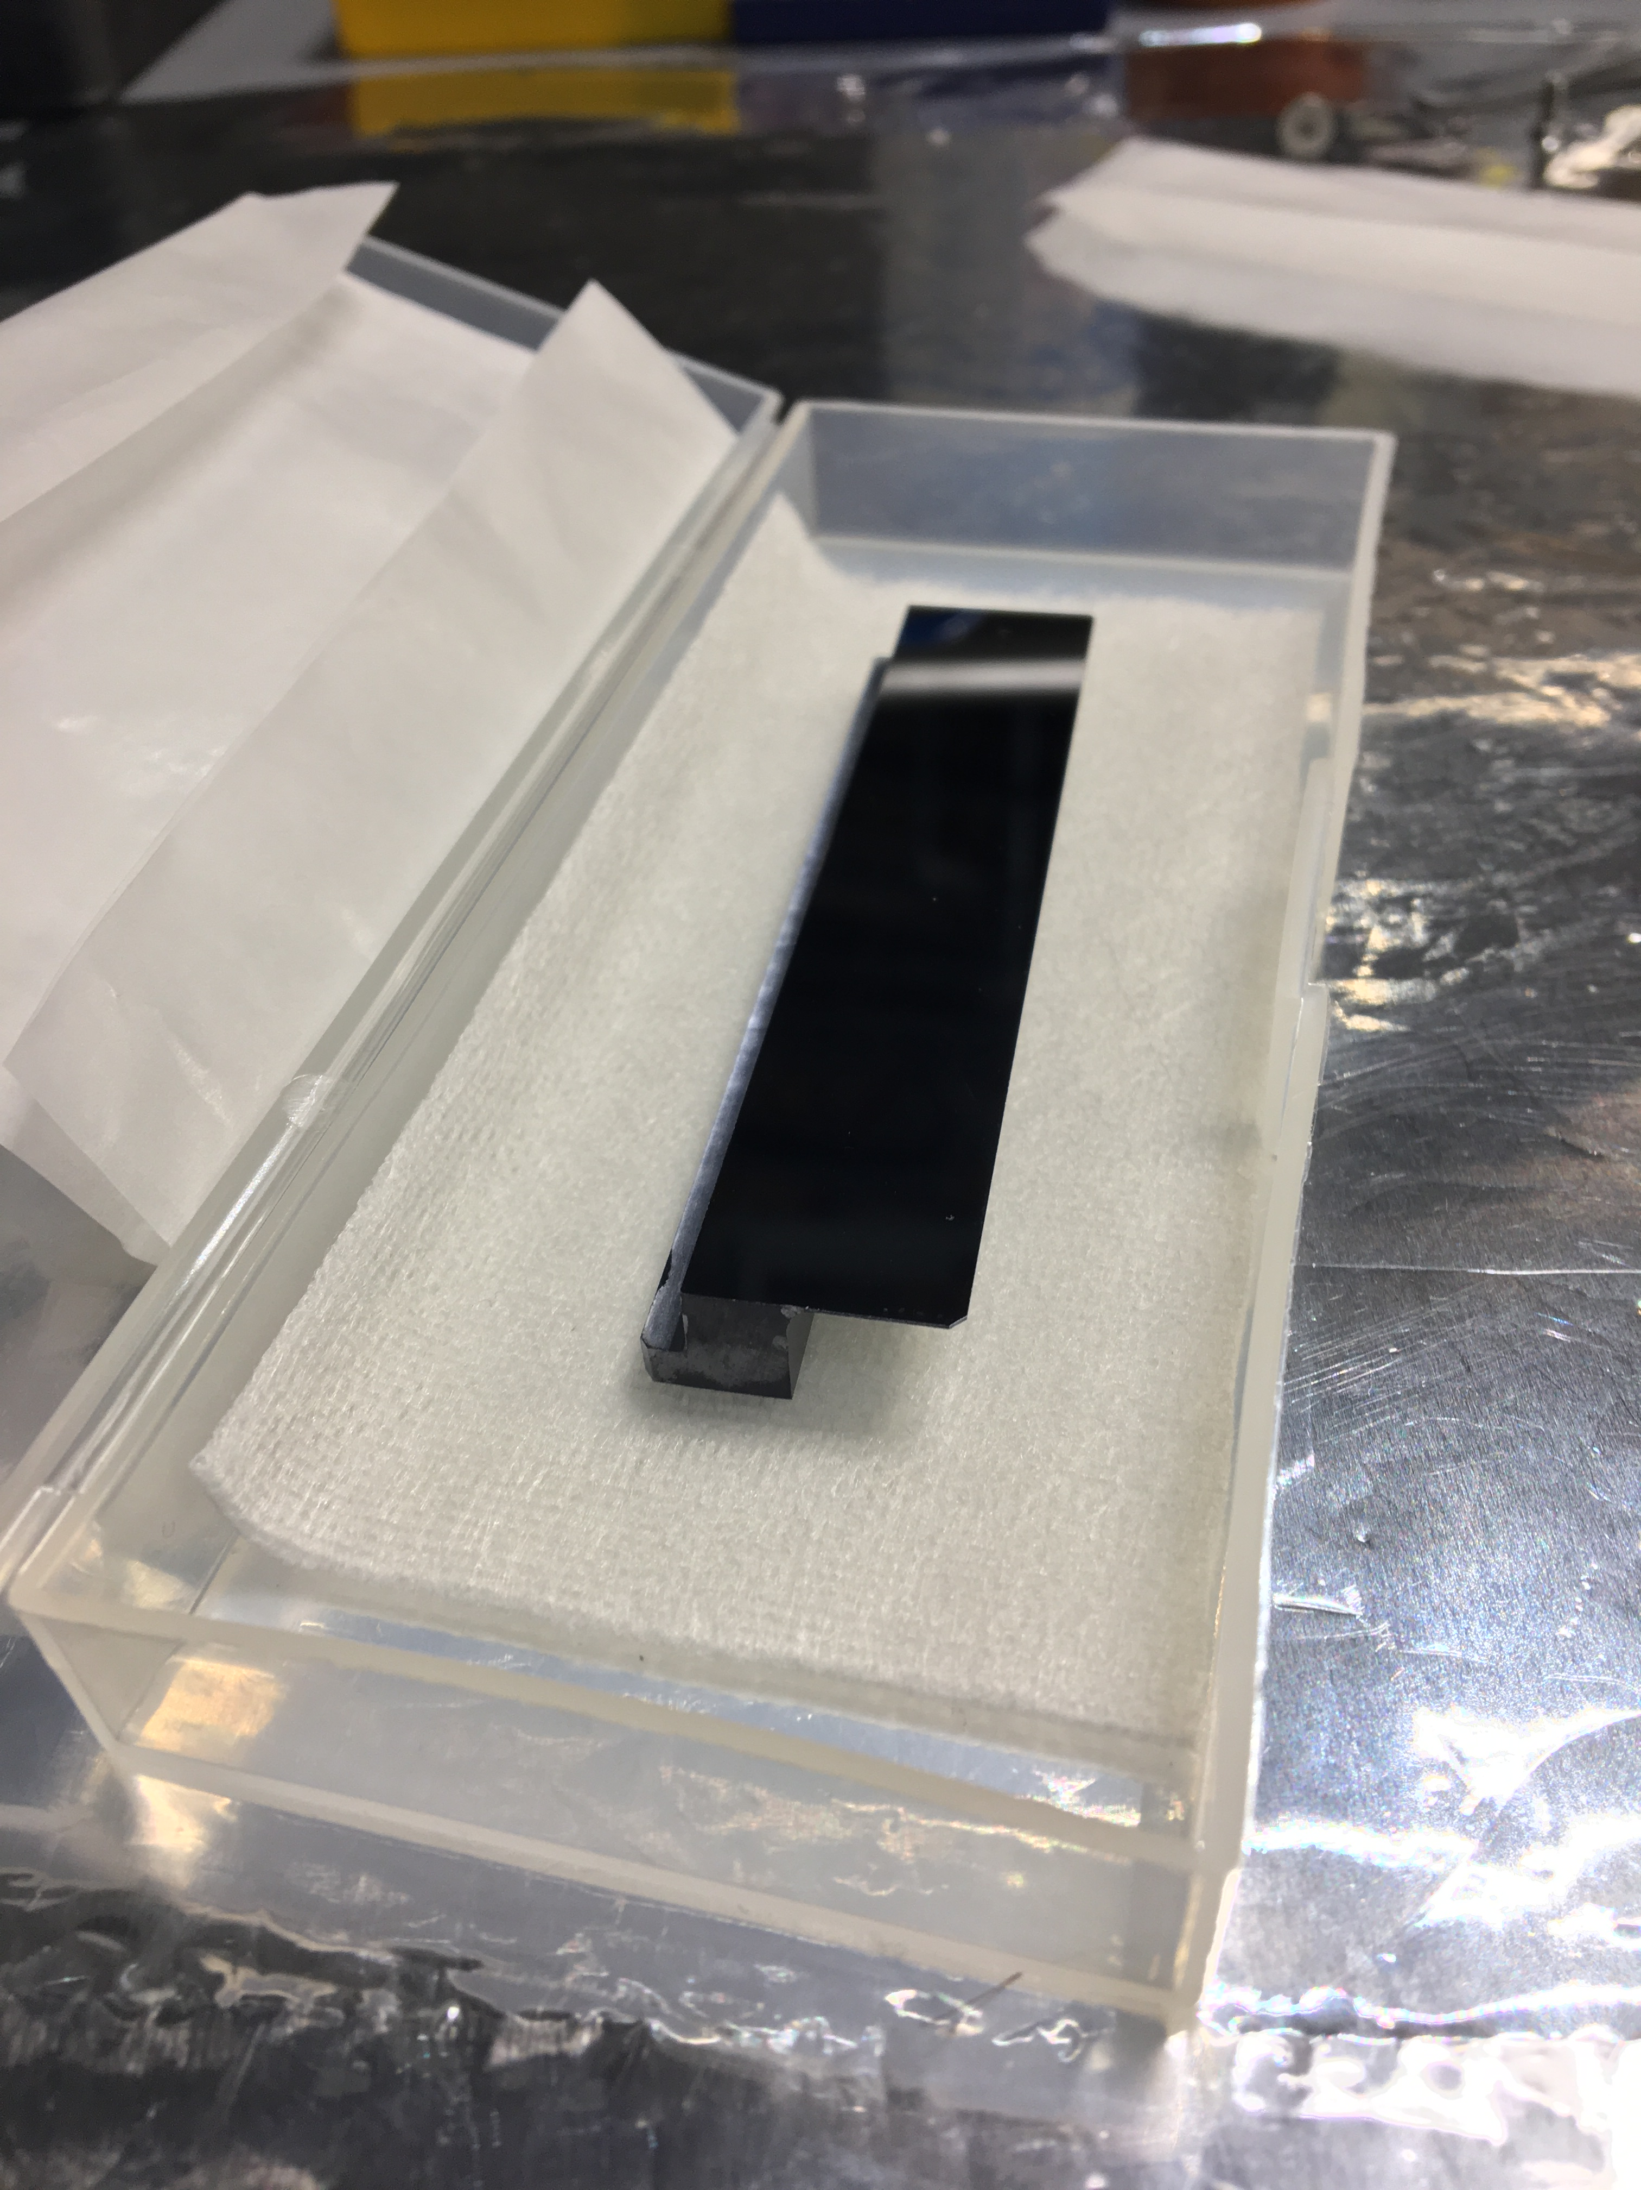
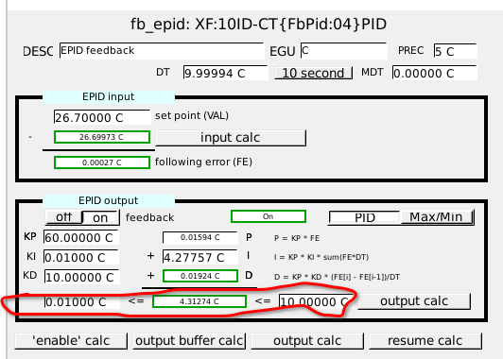
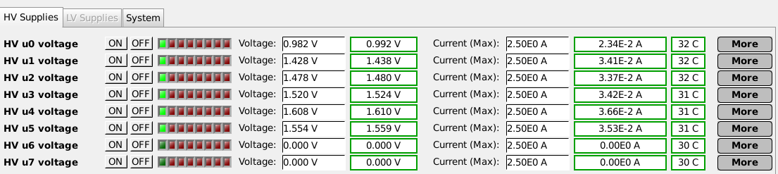
Inelastic X-ray beams from 6 D-crystals
Lambda (Medapix3) 2D detector imaging (right)
Temperature feedback of D-crystals (below)
Blade-type C crystal
D crystal φ de-tuning
With
D1
D3
D5
D2
D4
D6
W/O
Keithley 3706A
seq ioc
ePID

Slide 5
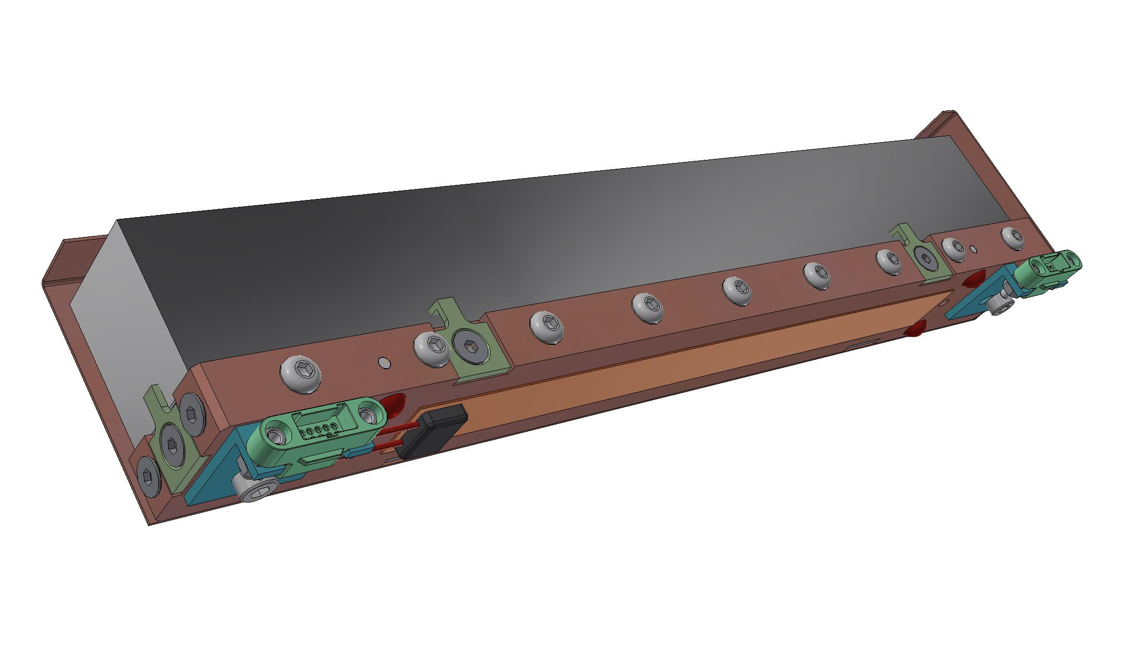
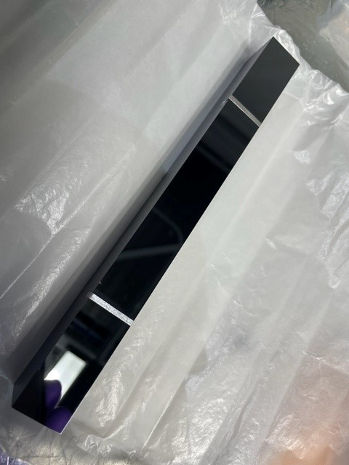
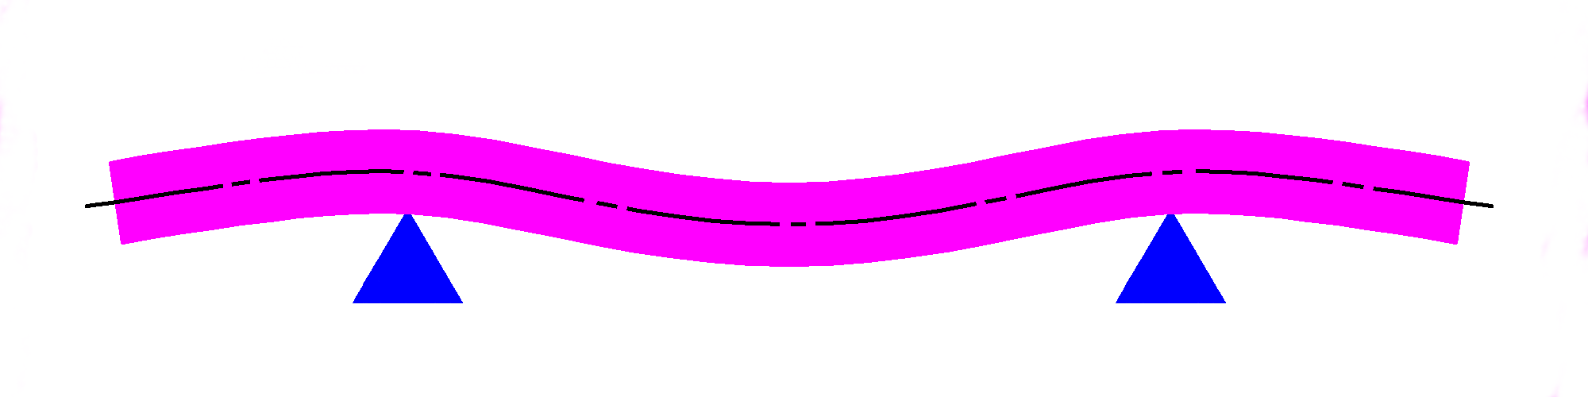
Improving D Crystal Support with T Control
Supporting D crystals at their Airy points reduces lattice bending by gravity.
EPICS-based temperature control achieving stability : ± 1 mK/24hr.
Temperature of all D crystals adjusted to align and maintain diffraction energy and optimize reflectivity
Attached heater
Before
D6
After
D5
D4
D3
Airy Point Support
Temp Control
D2
Energy aligned
by RC adjustment
D1
Energy positions at peak of RC
Current performance limited by crystal quality of the long D crystals.

Slide 6
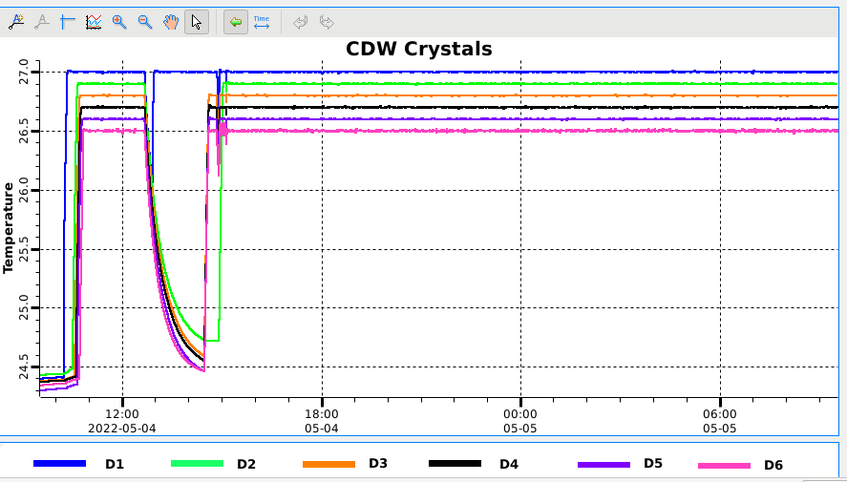
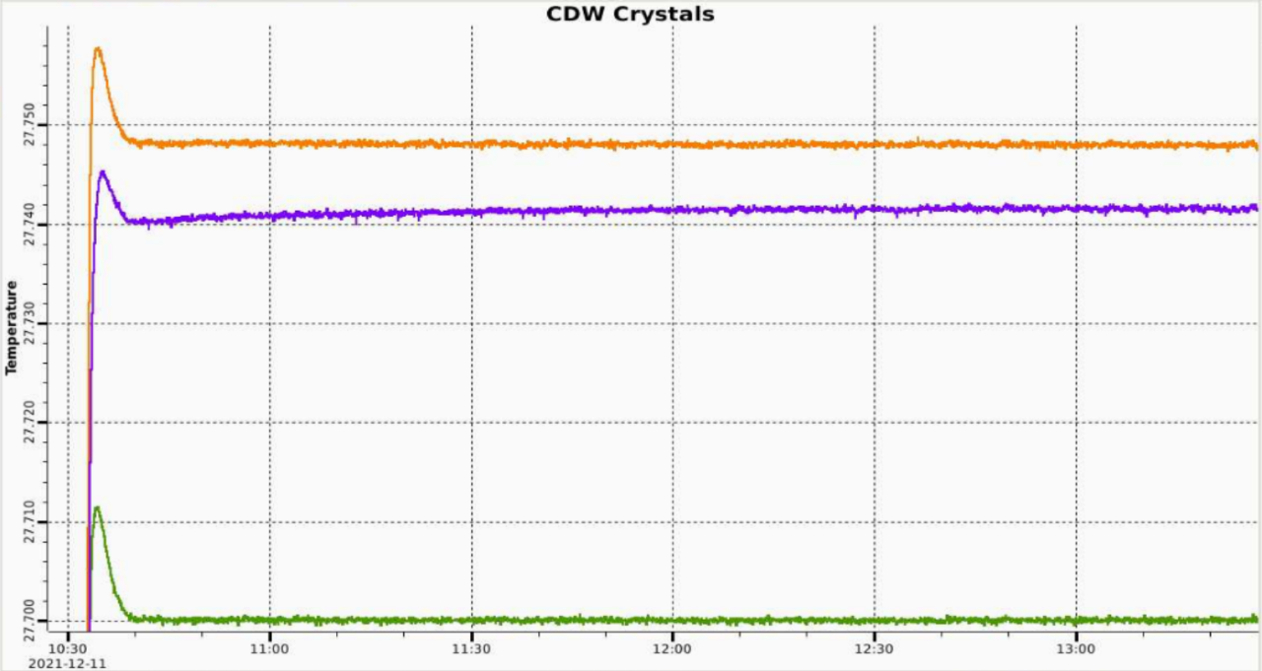
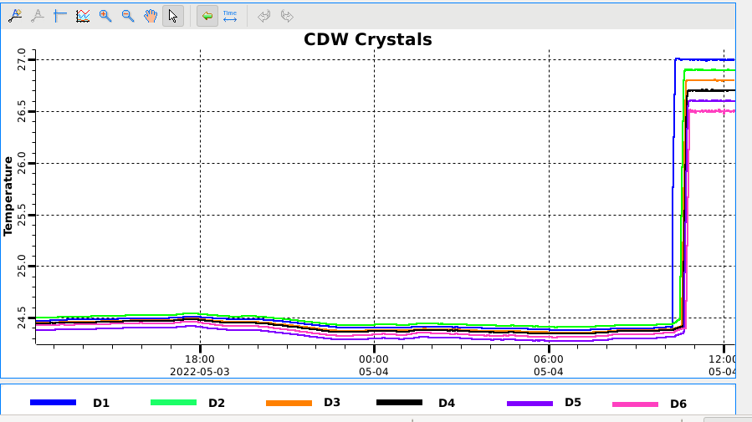
Temperature Response
Right: All 6 D-crystals control PT1000 sensors
Below: One D3-crystal fitted with 3 PT1000 sensors: control PT1000 sensor, and two PT1000 sensors at the crystal ends.

Slide 7
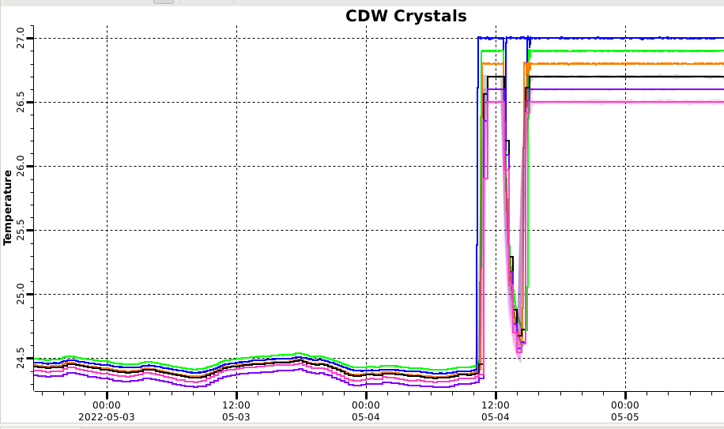
Temperature stability
Required: < 4 mK / 1-week measurement
Before: 100-500 mK
After: ~0.1 mK
Scan: 60 sec
Control sphere | Stability | Contribution
Experimental Hall | +/- 1 K | Day/night cycle; Season and weather cycle
Hutch | +/- 0.5 K | Day/night cycle; Season and weather cycle
Chamber | +/- 0.2 K | Day/night cycle; Season and weather cycle
Crystal | +/- 0.0005K | N/A

Slide 8
Summary
We have improved the data rate of the meV-IXS spectrometer by more than 13 times and a routine energy resolution at 1.7 meV with sharp tails since 2019, allowing soft matter research to be performed with much enhanced count rate and contrast and enabling science previously impossible (notably, on hard condensed matter).
  Temperature stability of the crystal optics analyzer played important role in stability.
Future: Stabilize temperature of crystals for High Resolution Monochromator, using identical system components.

