Slide 1
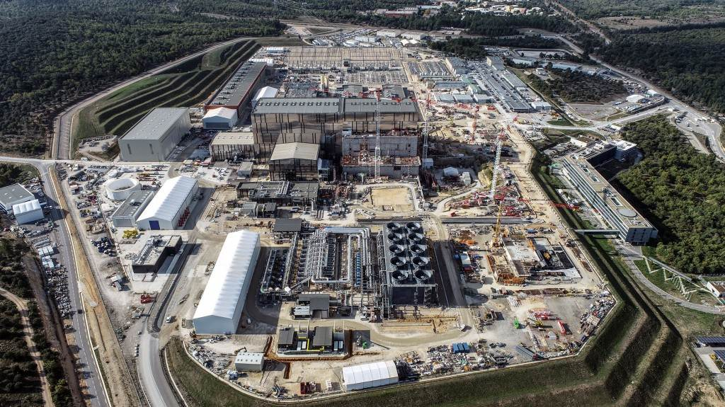
ITER Status
Anders Wallander
Controls Division
ITER Organization
Anders Wallander
Head of Controls Division
ITER Organization Central Team

Slide 2
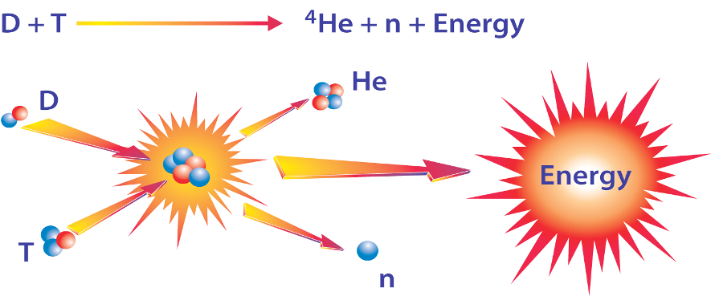
Quick reminder what ITER is about
Demonstrate technical feasibility of nuclear fusion as energy source
Lawson criterion: Temperature * Density * Time > Big Number
ITER is an international project based on in-kind contributions

Slide 3
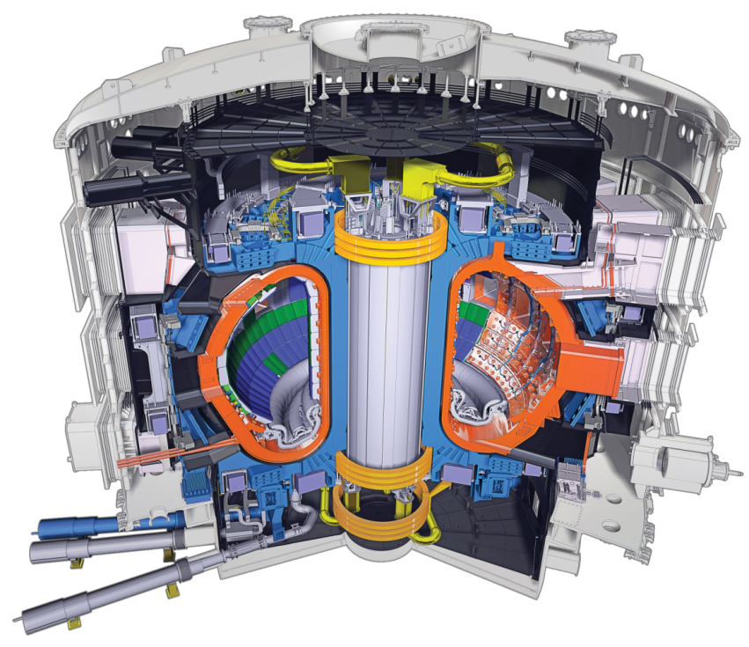
The ITER Tokamak
An intense magnetic field, generated by powerful superconducting magnets, shapes, heats and confines the hot plasma, and keeps it away from the vacuum vessel wall.
Vacuum Vessel: 8 000 t. 850 m³
18 TF Coils: 360 t. 17-m high
1 Central Solenoid: 1 000 t. 13-m high
6 PF Coils: 200-400 t. 8 to 24 m diameter
Cryostat: 30 x 30 m
About 50 % of these components have been delivered on site

Slide 4
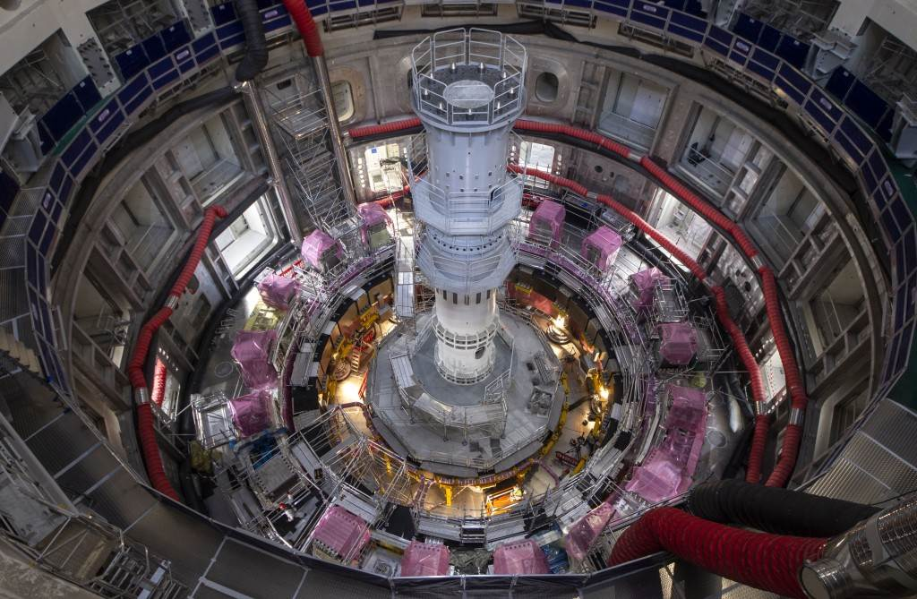
December 2021

Slide 5
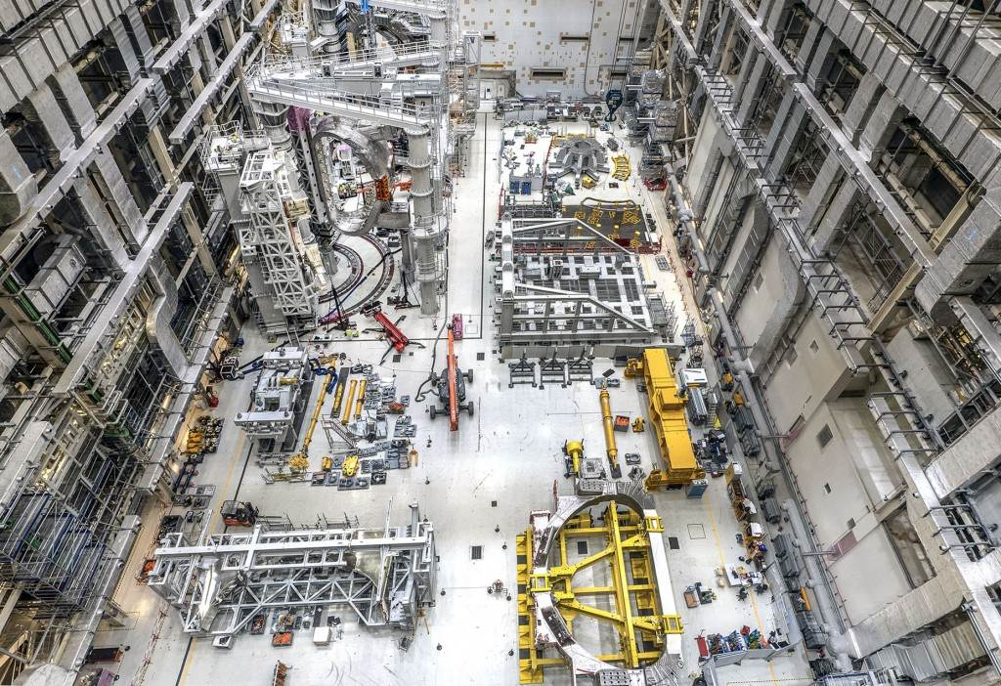
January 2022

Slide 6
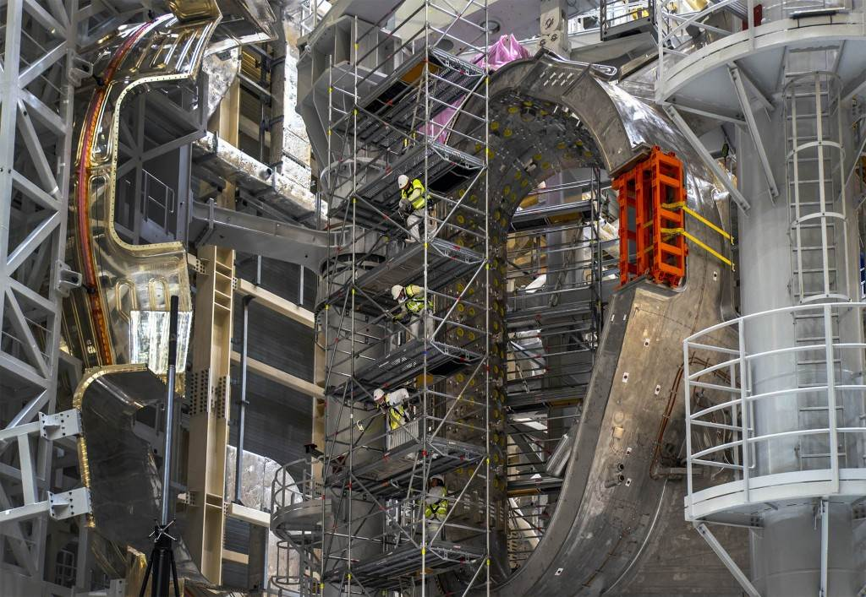
February 2022

Slide 7
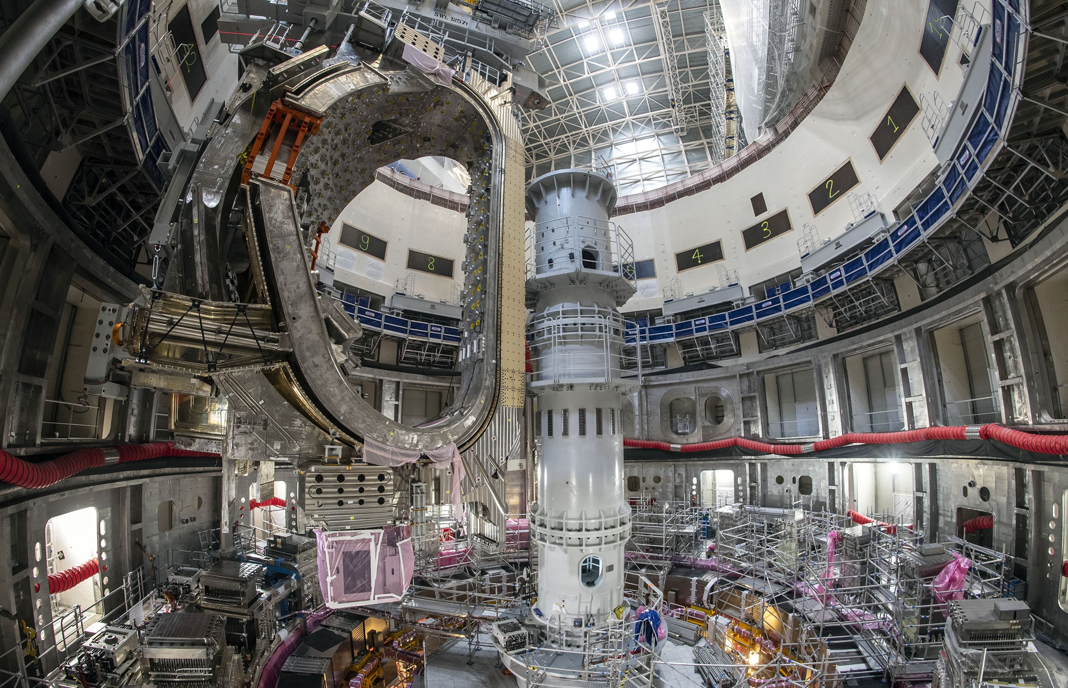
May 2022

Slide 8
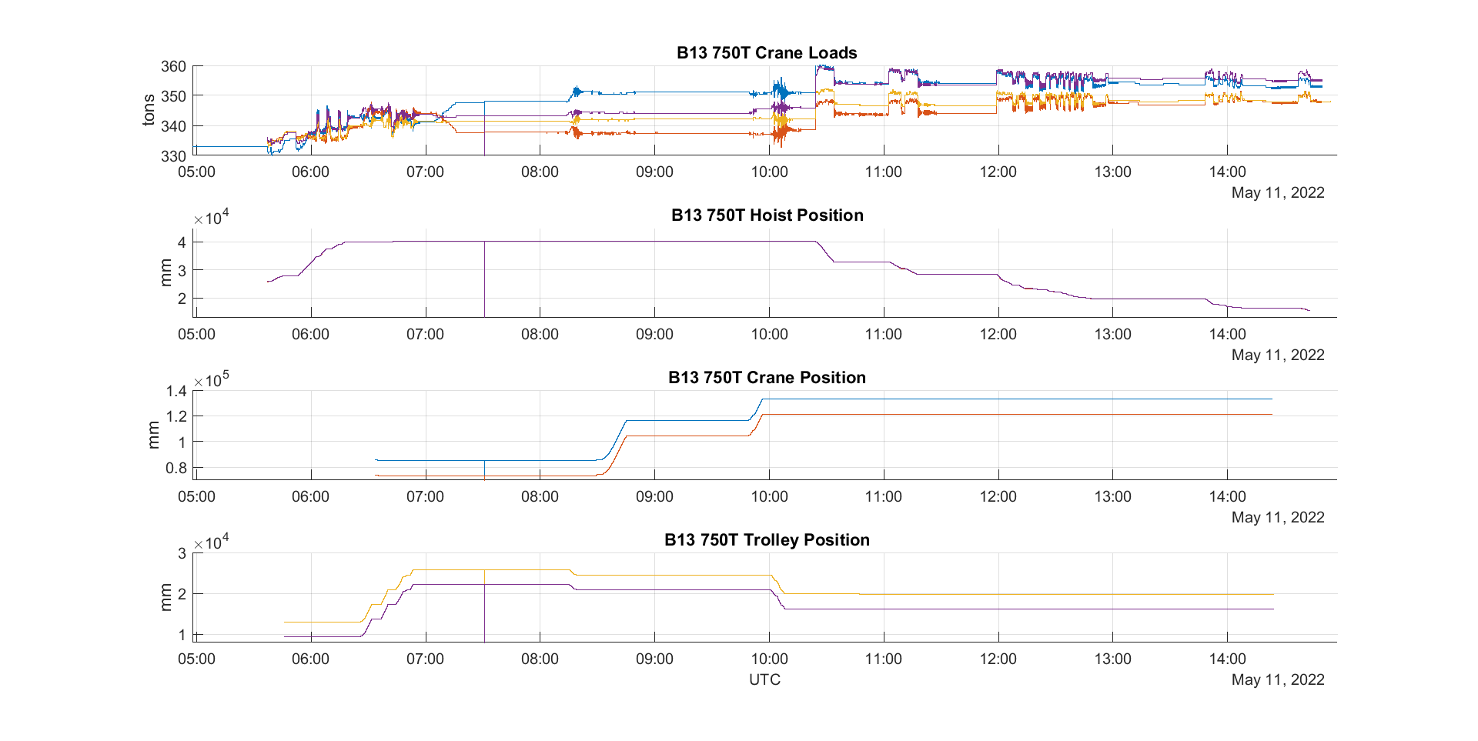
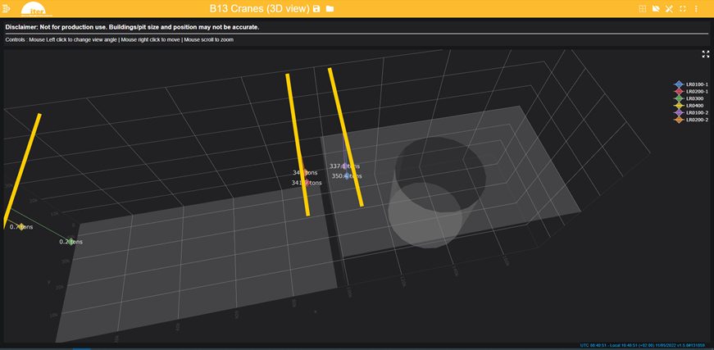
The “Big Lift” May 11, 2022
First out of nine subsectors lifted and installed in the Tokamak Pit
A subsector consists of one 40º vacuum vessel sector with thermal shield and two toroidal field coils weighting 1200 tons
3D real-time display

Slide 9
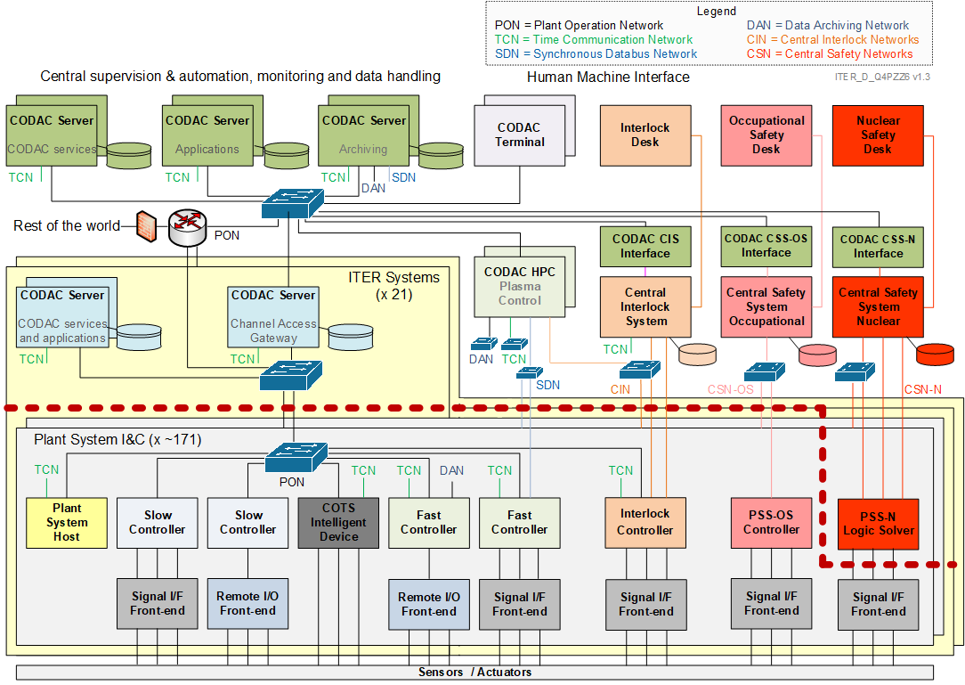
ITER Control System Architecture

Slide 10
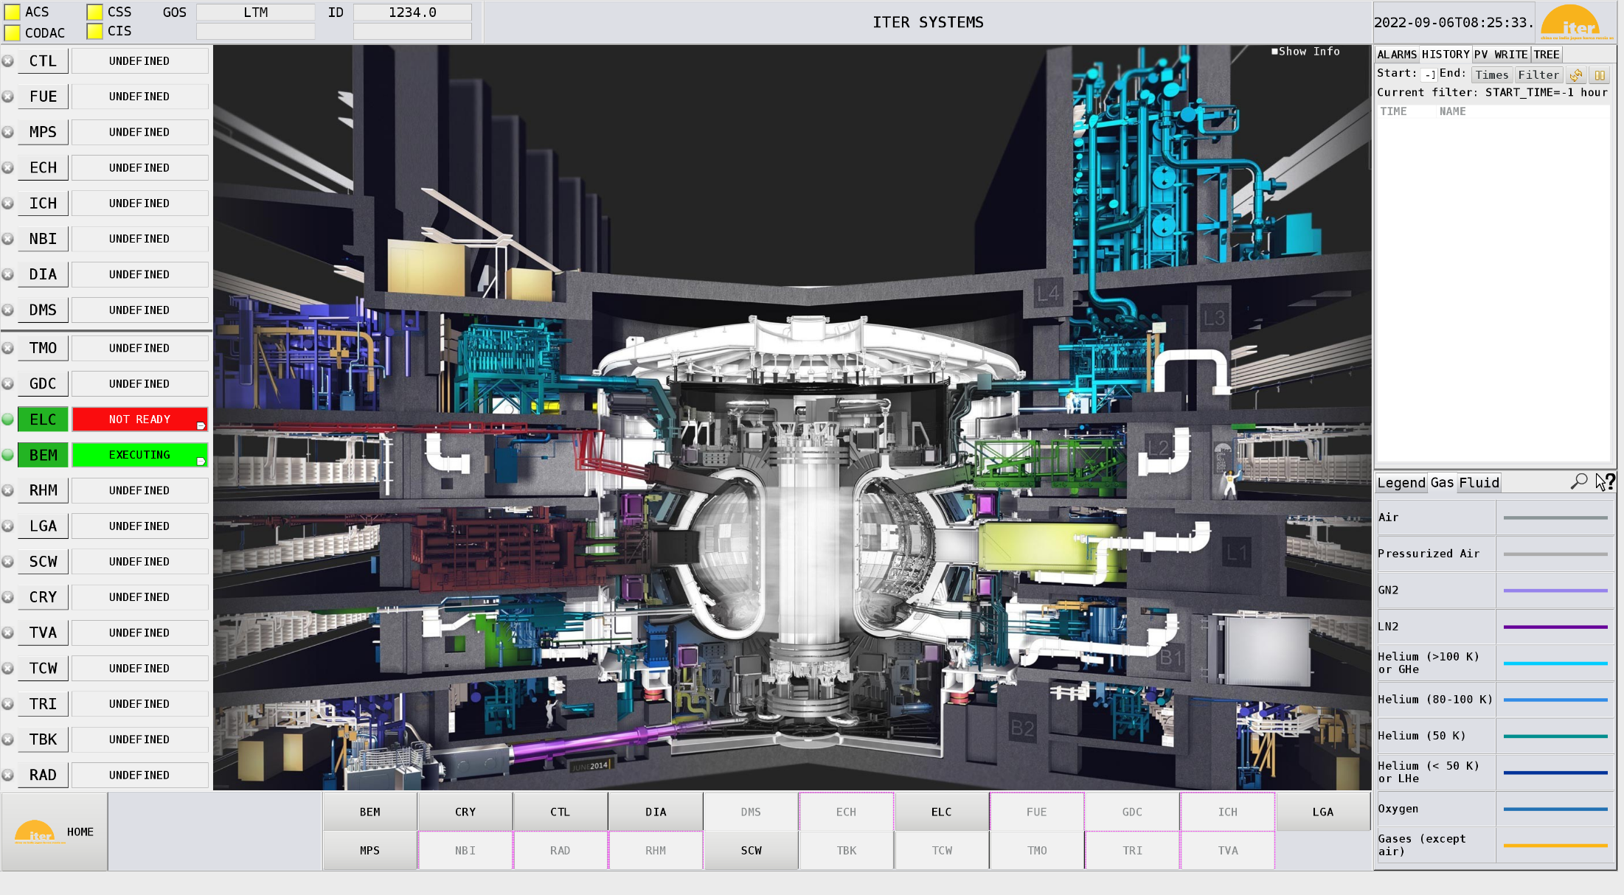

Slide 11
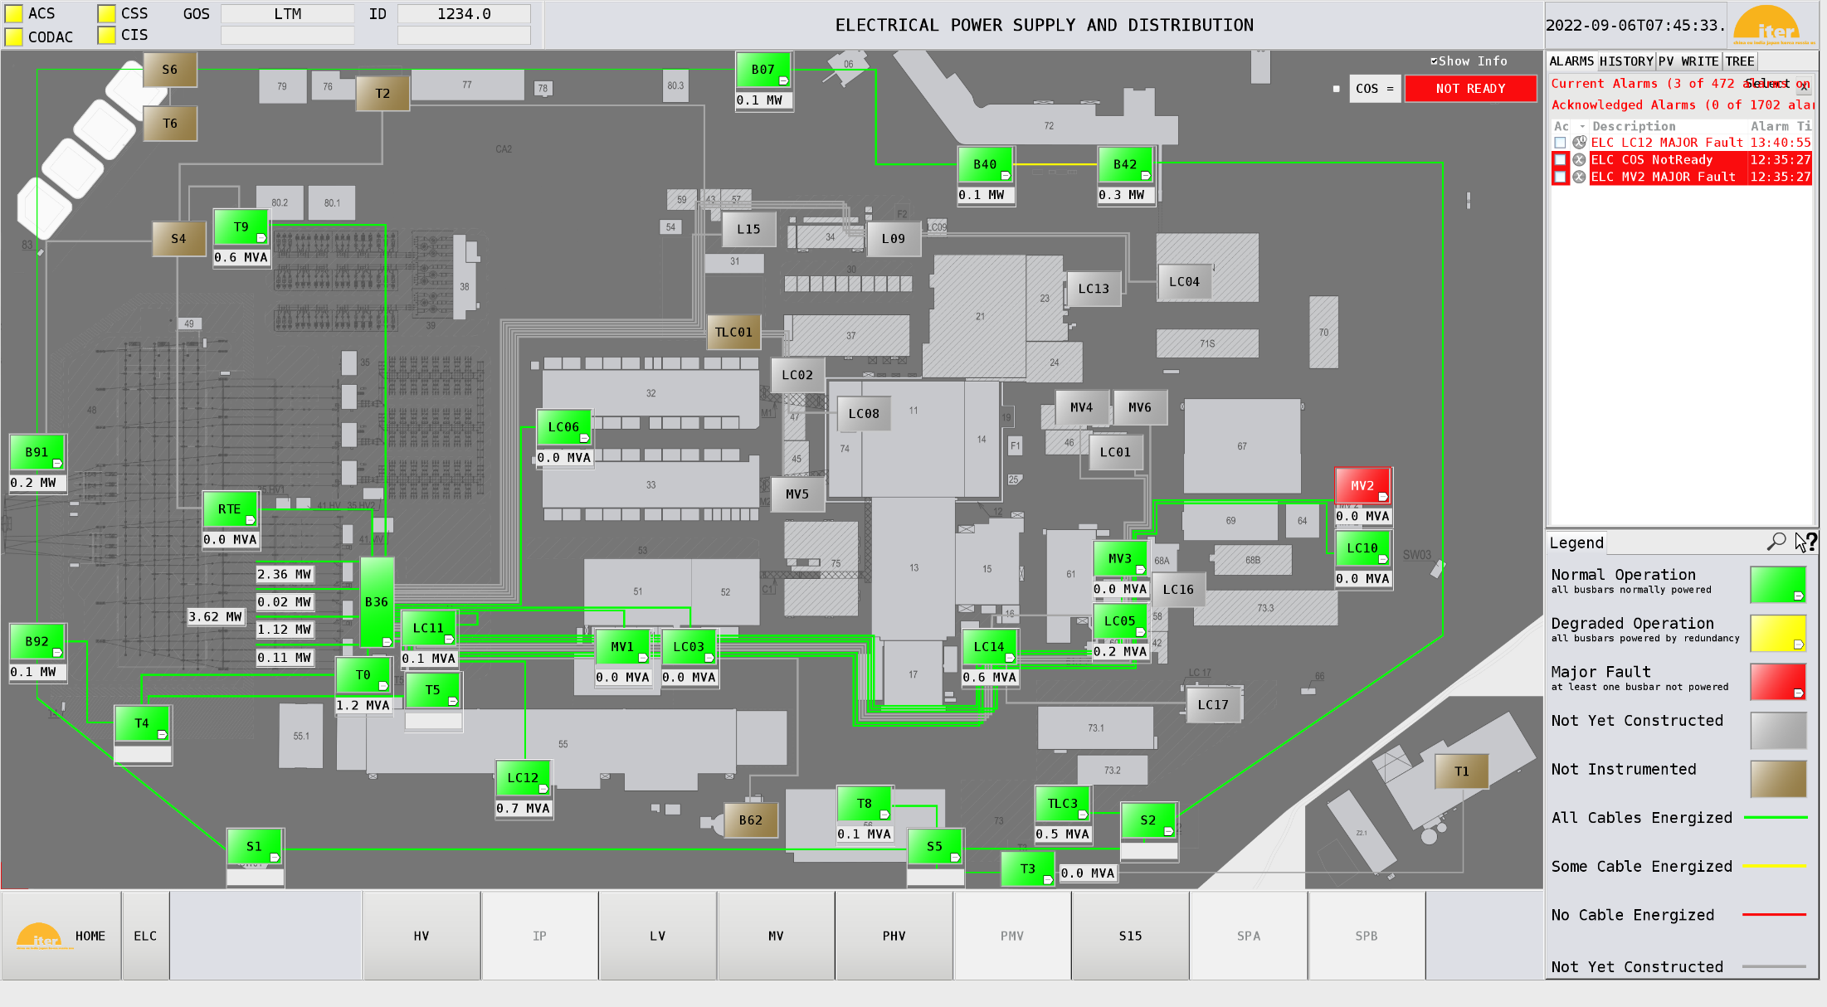

Slide 12
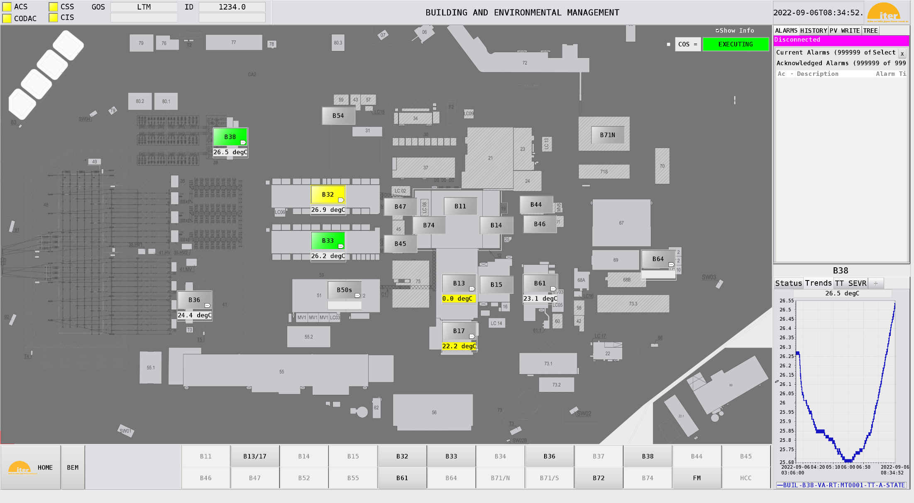

Slide 13
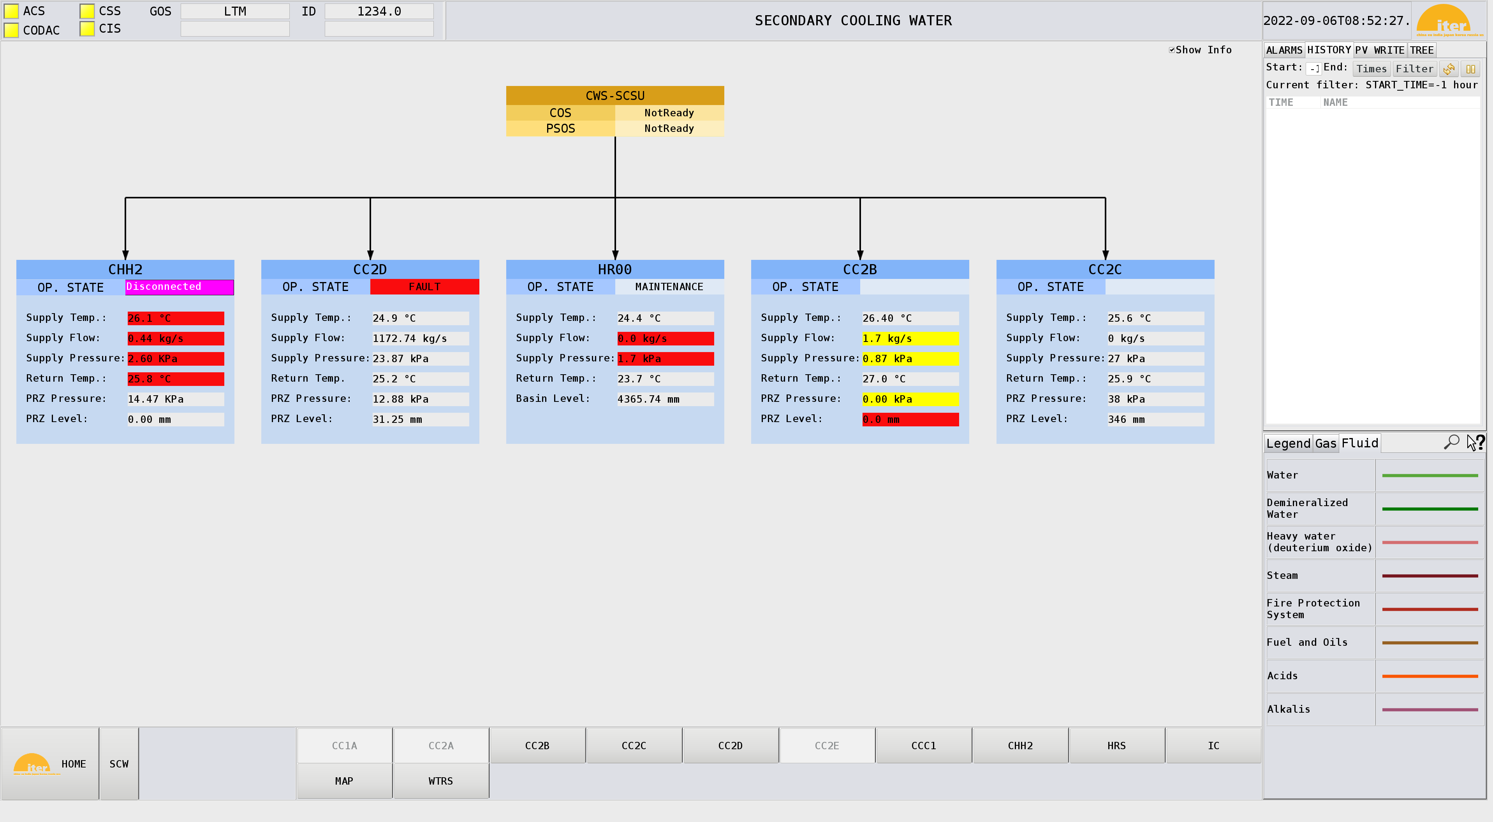
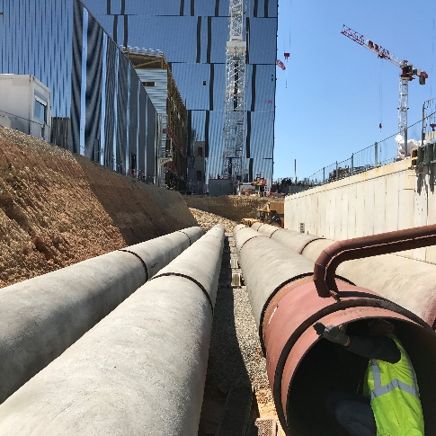
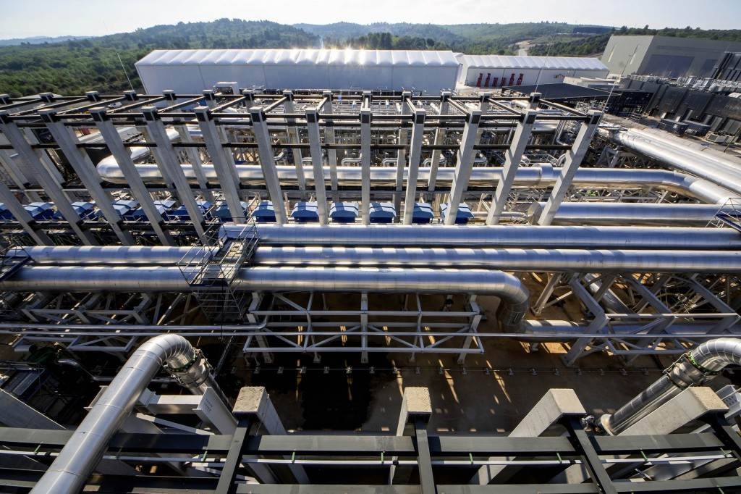

Slide 14
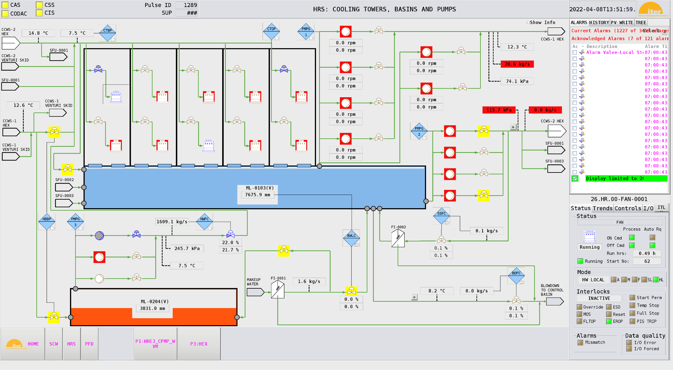
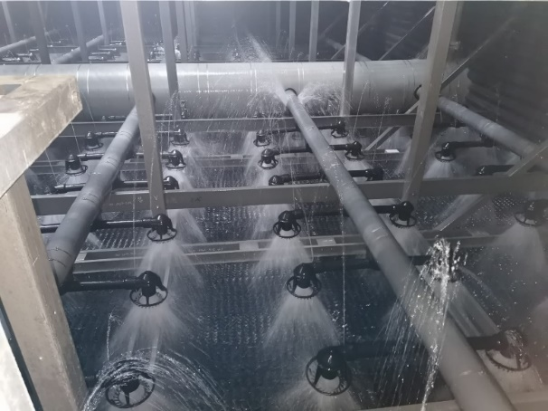
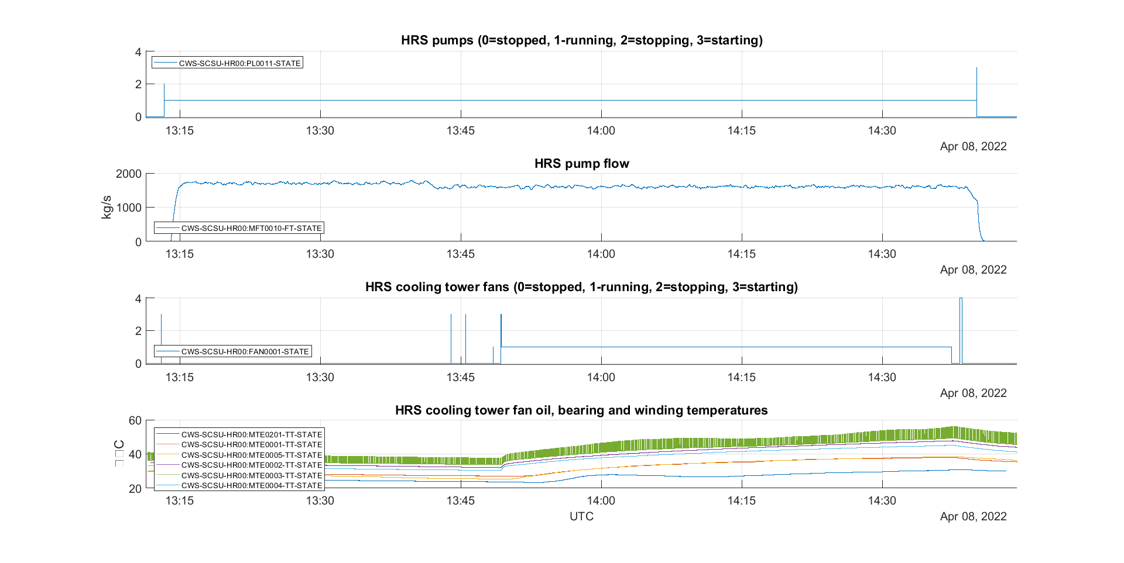

Slide 15
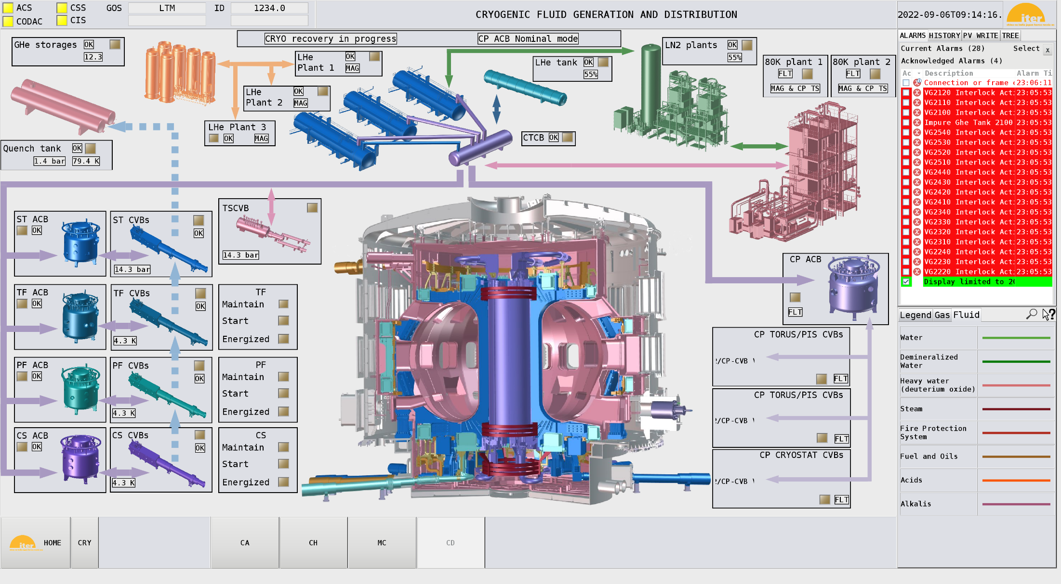
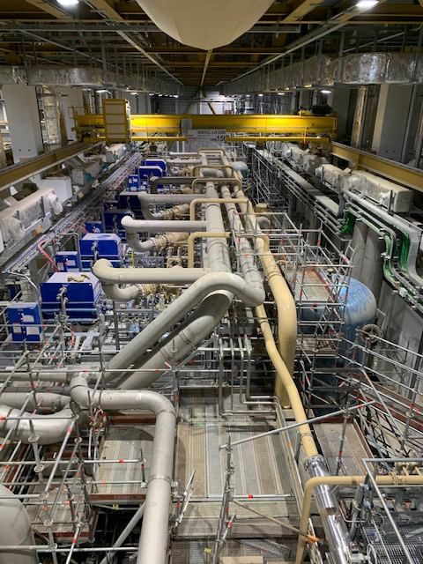

Slide 16
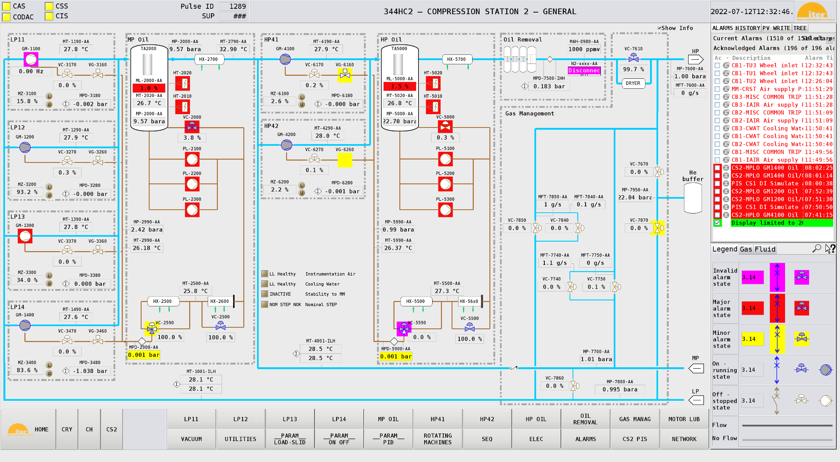
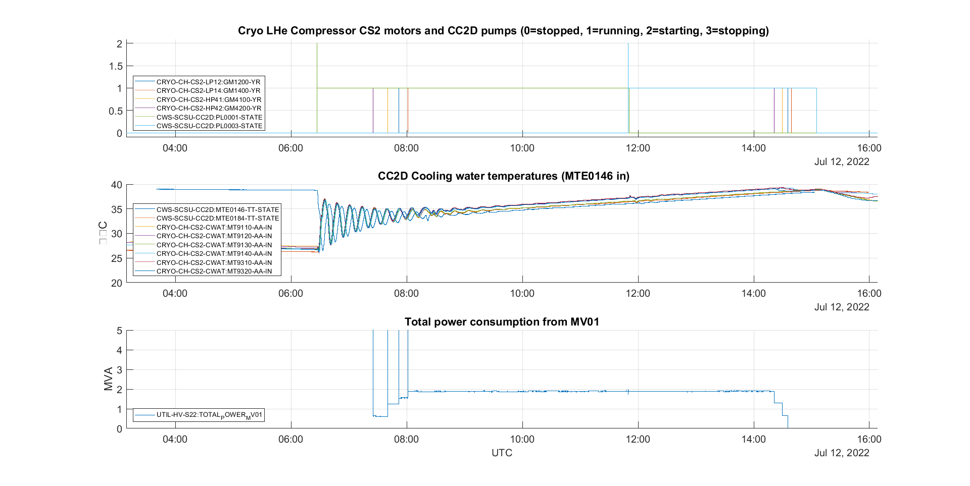

Slide 17
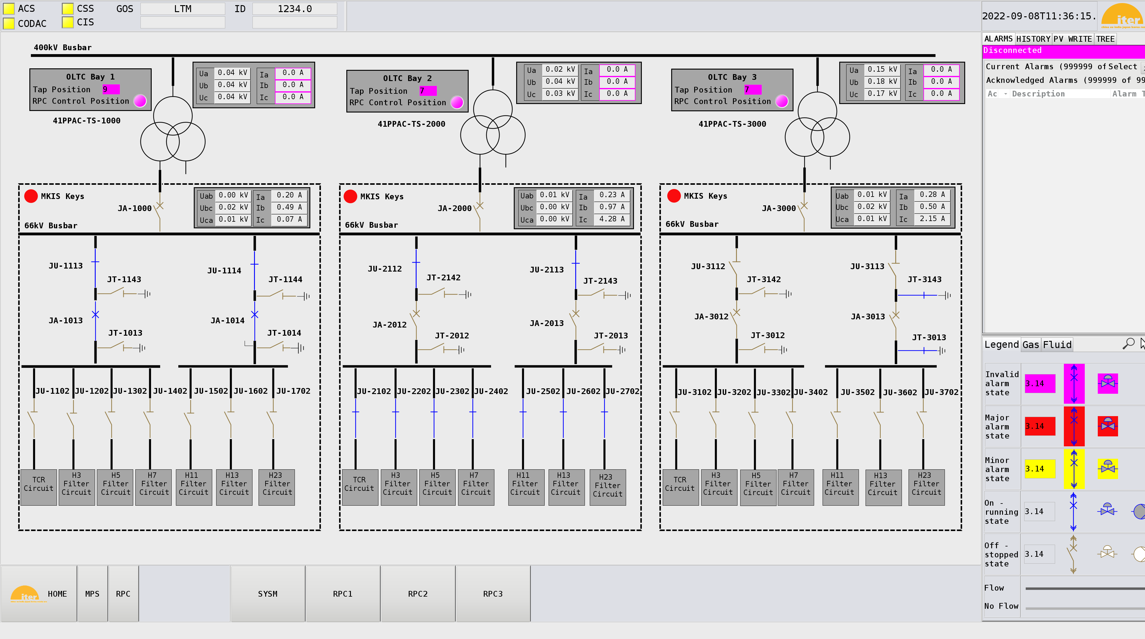
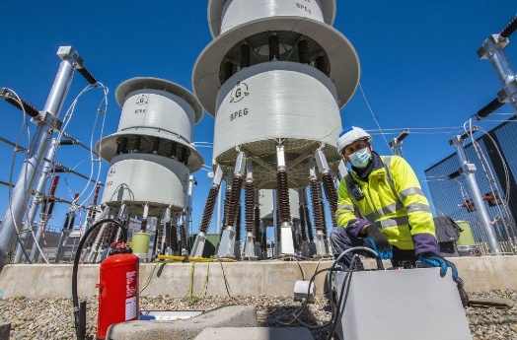
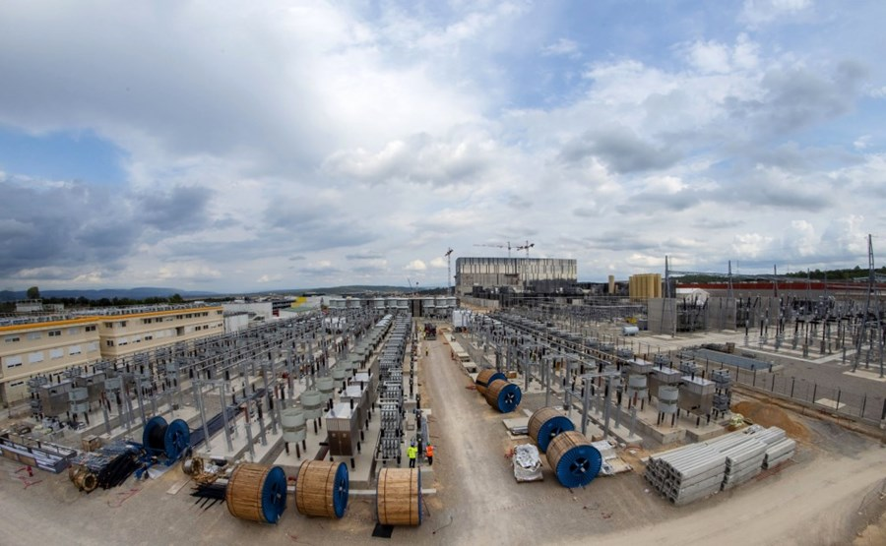
Reactive Power Compensation is the first plant system using fast control (kHz) and high performance networks
Low voltage commissioning is almost complete
This is first part of the magnet power supplies

Slide 18
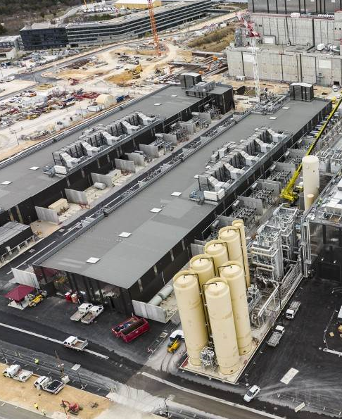
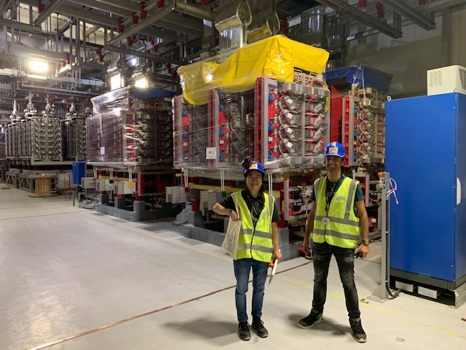
Coming up…
  Magnet Power Supplies
  Electron cyclotron heating
  Vacuum
  Structures
  Magnets
  Fueling
  Diagnostics

Slide 19
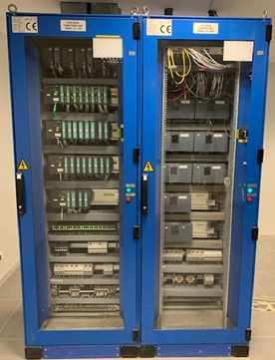
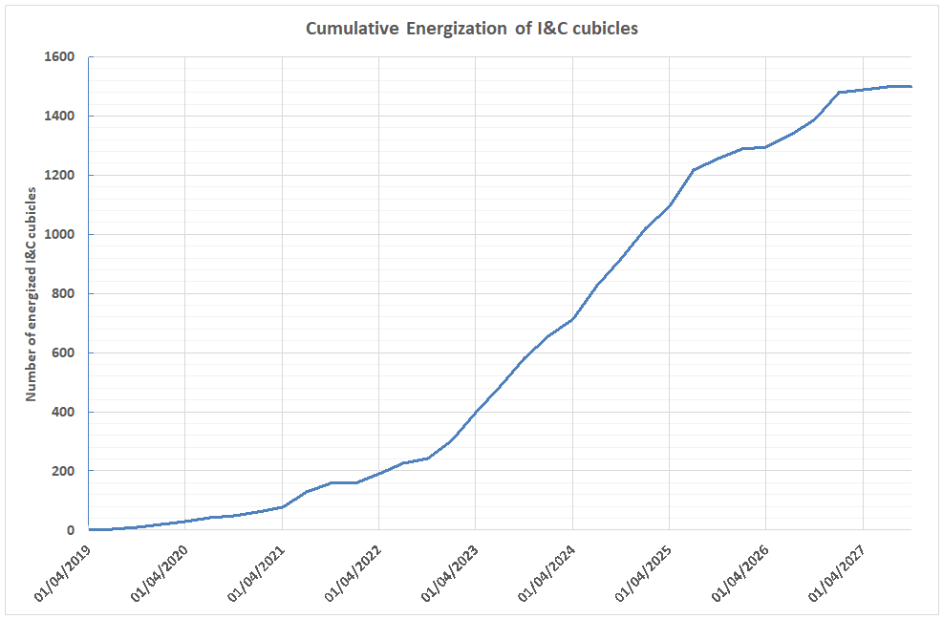
Metrics (hardware)
13% of first plasma integration scope complete
Today
Time

Slide 20
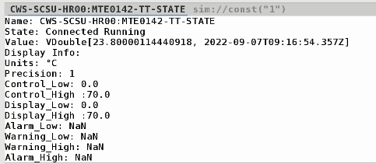
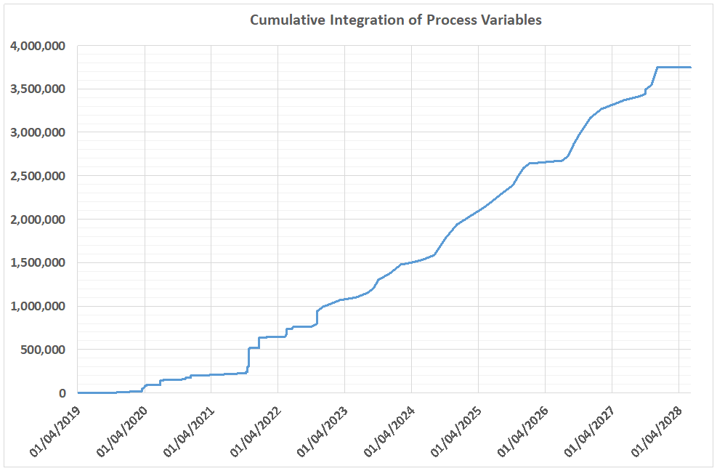
Metrics (software)
20% of first plasma integration scope complete
Today
Time

Slide 21
Integration Lessons Learned
  Integration of in-kind contributions is challenging as expected (but actually worse than we thought)
  Delivered hardware and software is late and of poor quality (with exception of course)
  We need to do a lot of rework to be able to integrate
  Lately, we are doing more and more (software) scope transfer, meaning we take over the responsibility for (sometimes) design, manufacturing and testing (at a cost)
  This is technically a good solution, but we must balance available resources and total scope

Slide 22
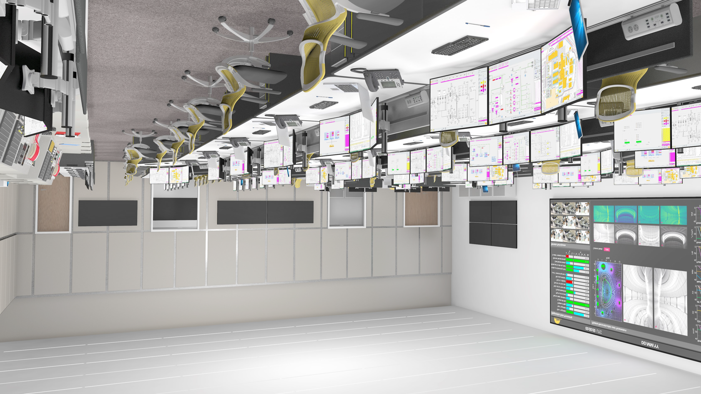
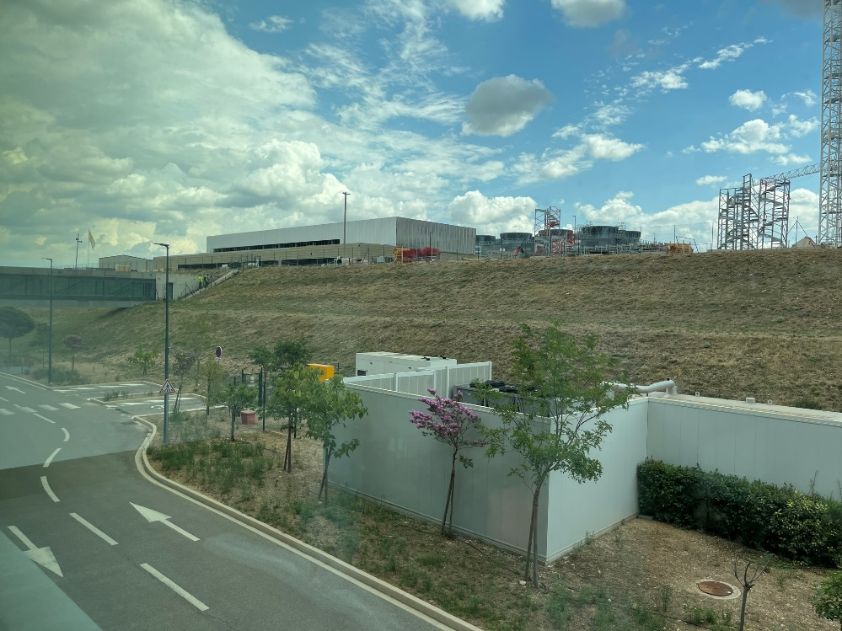
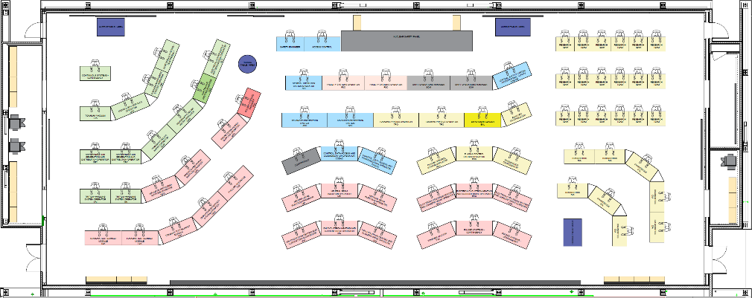
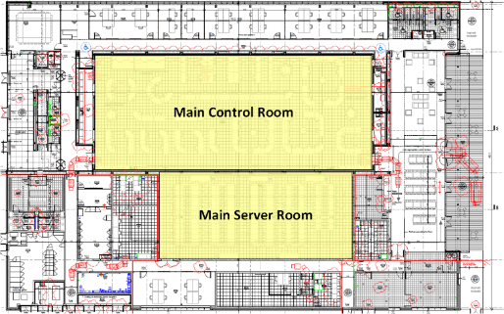
Control Building construction
  Control building construction almost complete and installation of servers and networks starting next month
  Main Control room start of operation in 2024
  Final configuration of control room will have 80 seats

Slide 23
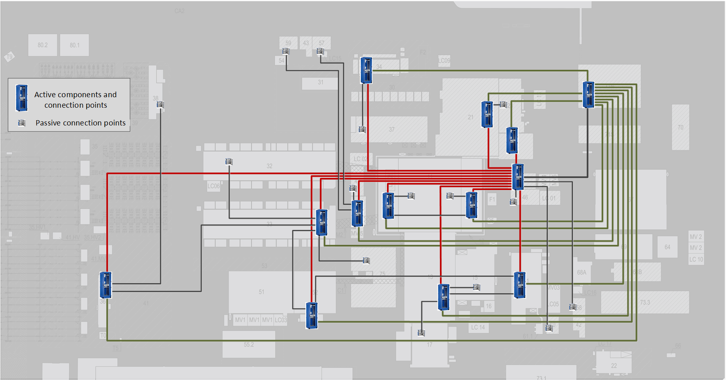
Network Infrastructure construction
174 cubicles
159 connection panels
812 cables
2515 client connections

Slide 24
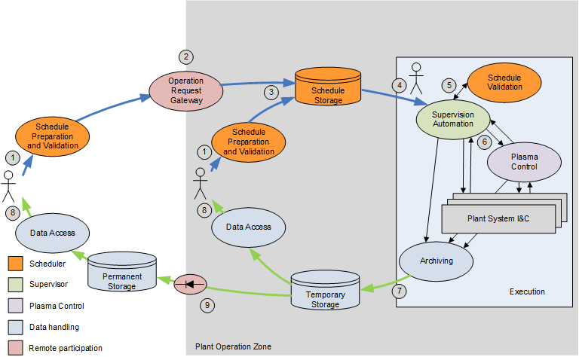
Operation (High-level) Applications
Pulse Schedule Preparation System (PSPS)
  Define parameters, lifecycle management, workflow
Supervisory System (SUP)
  Global states, integration, sequencer, configuration
Plasma Control System (PCS)
  Real-time control of plasma during pulsing
Data Handling (DA)
  Acquire, archive, store and give access
Remote Participation (RP)
  Data transmission, networking to remote sites, virtual collaboration tools
Bob Gunion Wed 12:10 – ITER Operation Applications: Status and Future Development
Leonid Lobes Thu 09:35 – Study on EPICS Communication over Long Distance
Anze Zagar Thu 12:25 – EPICS (pvAccess) Transport Layer for the ITER Real-Time Framework (RTF)

Slide 25
Defence in depth
Safety
PROTECTION
Interlocks
CODAC incl. Plasma Control System
OPERATION
Control & Monitoring
Interlock
Functions
Safety
Functions
Plant Systems

Slide 26
Summary
ITER control system is in construction, commissioning and operation
Integration of in-kind contributions is 15 % complete towards first plasma
Mitigation actions to ease integration are continuously being explored
Final infrastructure construction, with networks, servers and control room, starts now
More and more effort is put in the development of high level operation applications in close collaboration with science and operation

Slide 27
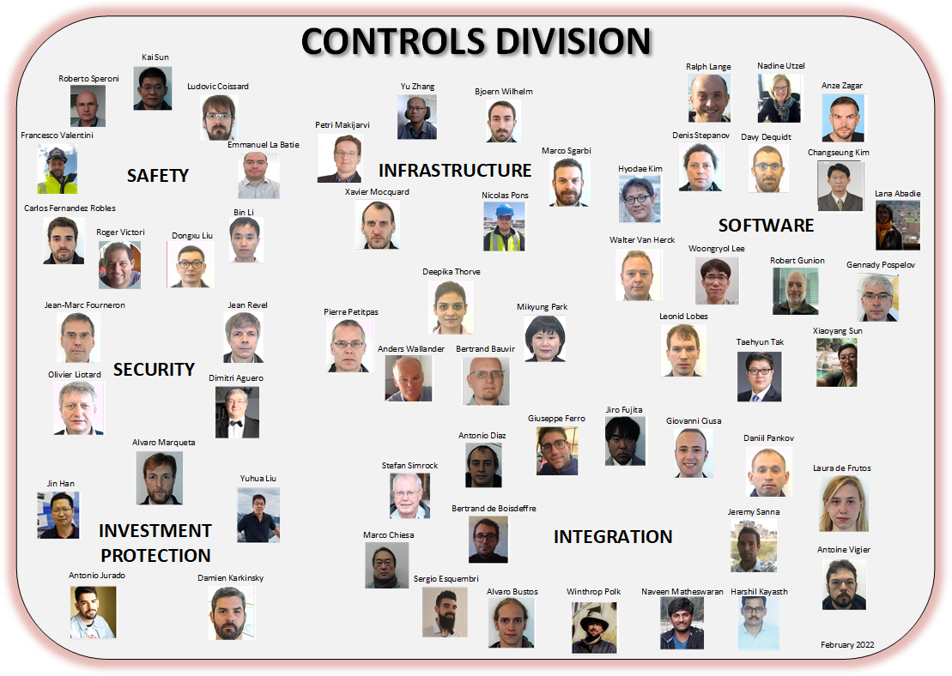
We are always looking for people to join our team to meet the challenges and reap the rewards in the coming years
https://www.iter.org/jobs

