Slide 1
PyDevice – New Features and Updates
Klemen Vodopivec
vodopiveck@ornl.gov
September 22th, 2022

Slide 2
PyDevice Brief Introduction
Extend EPICS records functionality with the power of Python
Integrates into existing IOCs
  Leverage IOC core functionality
  Coexist with EPICS extensions
  Quick and robust adoption
Broad compatibility
  Python2 & Python3
  EPICS 3.14.12.x – EPICS 7.0.x
# Keep running values in Python array
record(ao, "BeamPower:Cache") {
field(DTYP, "pydev")
field(DOL, "BeamPower CP")
field(OUT, "@beampower.append(VAL)")
field(FLNK, "BeamPower:Avg")
}
# Using Python built-in functions for average calc
record(ai, "BeamPower:Avg") {
field(DTYP, "pydev")
field(INP, "@sum(beampower)/len(beampower)")
field(FLNK, "BeamPower:Std")
}
# numpy one-liner for standard deviation
record(ai, "BeamPower:Std") {
field(DTYP, "pydev")
field(INP, "@numpy.std(beampower)")
}
http://github.com/klemenv/PyDevice

Slide 3
Supporting More EPICS Base Records
waveform
lsi / lso
Python excels at processing arrays
Support for most element types
  (U)CHAR, (U)SHORT, (U)LONG, FLOAT, DOUBLE, STRING
Input and output arrays may differ in size but not type
EPICS 3.15 and later
String size inherited from EPICS base, default 65,535
Useful for file paths, URLs

Slide 4
New pycalcRecord
Similar to aSub record but invokes Python for processing inputs
Passing multiple parameters to Python expressions:
  Functions
  Formulas
Selectable input and output field types and size
Python code unaware of record semantics
Generating 1000 samples of quadratic function
record(pycalc, "Quadratic:X") {
field(INPA, "Quadratic:X:LowLimit")
field(INPB, "Quadratic:X:HighLimit")
field(CALC, "list(np.linspace(A,B,1000))")
field(MEVL, "1000")
}
record(pycalc, "Quadratic:Y") {
field(INPA, "2")
field(INPB, "-5.0")
field(INPC, "7")
field(INPH, "Quadratic:X CP")
field(CALC, "list(A*np.array(H)**2+B*np.array(A)+C)")
field(MEVL, "1000")
}

Slide 5

Escaping Fields is Now Optional
Before
After
Does it print 834.2 or 419.5?
pydev("VAL=834.2")
record(ao, "Number:Print") {
field(DTYP, "pydev")
field(VAL, "419.5")
field(OUT, "@print(%VAL%)")
}
pydev("VAL=834.2")
record(ao, "Number:Print") {
field(DTYP, "pydev")
field(VAL, "419.5")
field(OUT, "@print(VAL)")
}
More pitfalls
record(ao, "Equal") {
field(DTYP, "pydev")
field(VAL, "419.5")
field(OUT, "@VAL=%VAL%")
}
record(ao, "Macros") {
field(DTYP, "pydev")
field(OUT, "@print($(HIGH))")
}
Escape with % whenever possible!

Slide 6

Concurrent Record Processing
Allow processing multiple records concurrently
  as long as CPython code releases GIL,
  or runs out of allocated time slice*
  Generally, it runs pretty well!
Configurable number of worker threads
  epicsEnvSet("PYDEV_NUM_THREADS","10")
  All worker threads busy => requests queued in FIFO
* Python 2: sys.setcheckinterval()
Python 3: sys.setswitchinterval()
Records
Queue
David Beazley – Understanding GIL

Slide 7
Simpler Build Mechanism
PyDevice folder
Choose Python version in configure/CONFIG_SITE
PYTHON_CONFIG=python39-config
IOC folder
Add to IOC configure/RELEASE
PYDEVICE=/path/to/PyDevice
Add to IOC iocApp/src/Makefile
include $(PYDEVICE)/configure/CONFIG.PyDevice
ioc_DBD += pydev.dbd
ioc_LIB += pydev

Slide 8
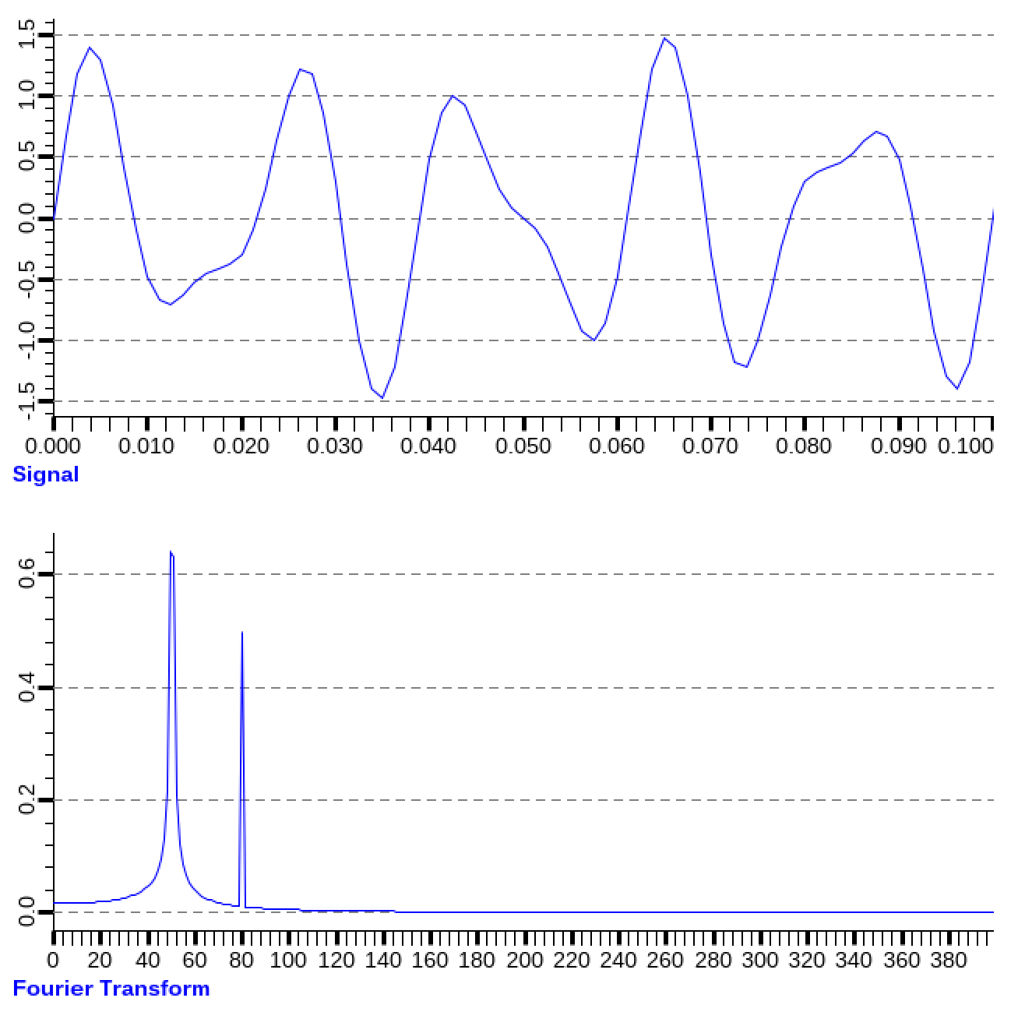
Example – Fast Fourier Transform with scipy
record(waveform, ”Signal:X") {
field(DTYP, "pydev")
field(NELM, "600")
field(FTVL, "DOUBLE")
field(INP, "@np.linspace(0, 0.75, 600, endpoint=False)")
}
record(pycalc, ”Signal:Y") {
field(INPA, ”Signal:X")
field(CALC, "np.sin(100*np.pi*A)+.5*np.sin(160*np.pi*A)")
field(MEVL, "600")
field(FTVL, ”DOUBLE")
}
record(waveform, ”Signal:FFT:X") {
field(DTYP, "pydev")
field(NELM, "300")
field(FTVL, "DOUBLE")
field(INP, "@scipy.fft.fftfreq(600, 0.00125)[:600//2]")
}
record(pycalc, "Signal:FFT:Y") {
field(INPA, "Signal:Y")
field(MEA, "600")
field(CALC, "2.0/600 * np.abs(scipy.fft.fft(A)[0:600//2]")
field(MEVL, "300")
field(FTVL, ”DOUBLE")
}
FFT

Slide 9
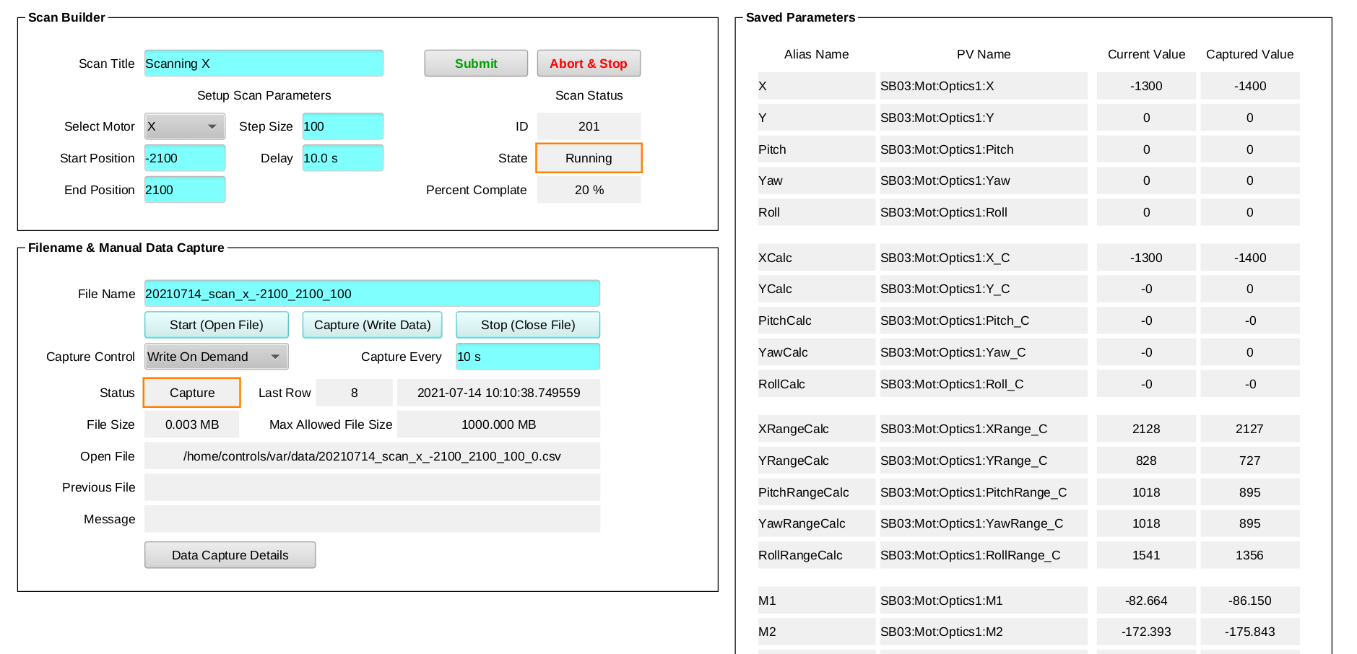
Example – Steerable Optics Evaluation
Builds a series of motor positions and submits the scan to ScanServer
Monitor
motor related parameters for later analysis
Save parameters values to CSV file

Slide 10
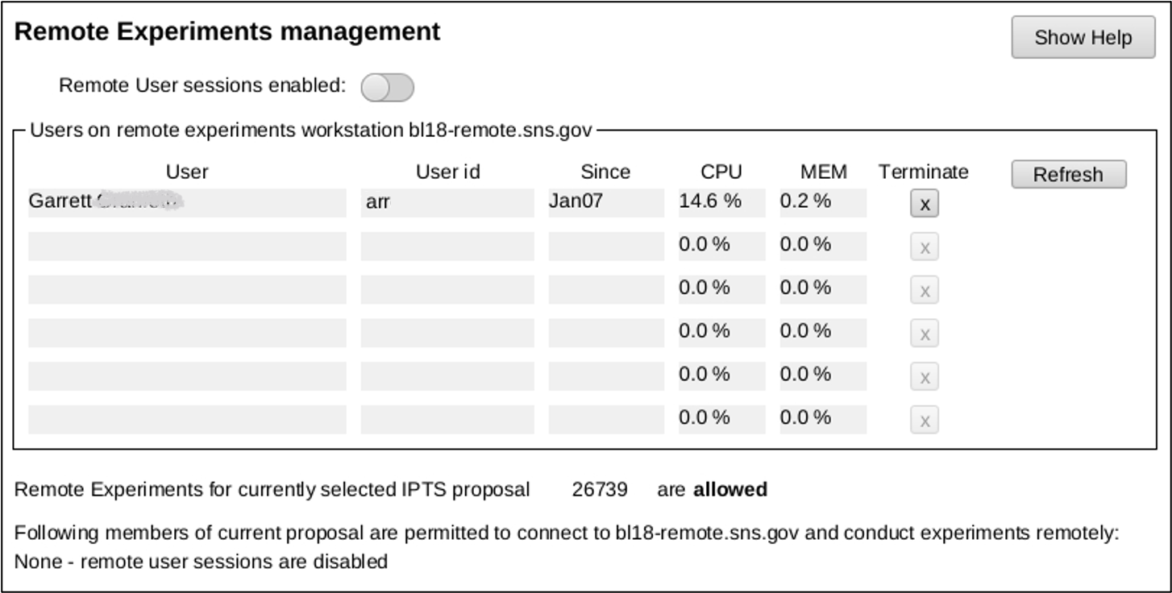
Example – Managing Remote Experiments
Controls Linux PAM authentication and disconnects active sessions when being disabled
Proposal ID is an instrument wide PV controlling data acquisition, sample activation calculation etc.
Currently active users by executing remote SSH commands
Interface with experiment’s proposal database

Slide 11
Time for Questions?
(and answers)

