Slide 1
EPICS (pvAccess) Transport Layer for the ITER Real-Time Framework (RTF)
Anze Zagar
ITER Organization

Slide 2
Operation Applications Overview
Pulse Schedule Preparation System (PSPS)
  Definition of pulse schedules to describe automated operation, with or without plasma*
Supervisory System (SUP)
  Coordinate system state across plant systems*
Plasma Control System (PCS)
  Deterministic control during pulses using the Real Time Framework (RTF)
Data Handling (DA)
  Archiving of POS, SDN data; data visualization
Remote Participation (RP)
  Virtual Collaboration tools for ITER members to participate in experiments**
*Bob Gunion Wed 12:10 – ITER Operation Applications: Status and Future Development
**Leonid Lobes Thu 09:35 – Study on EPICS Communication over Long Distance

Slide 3
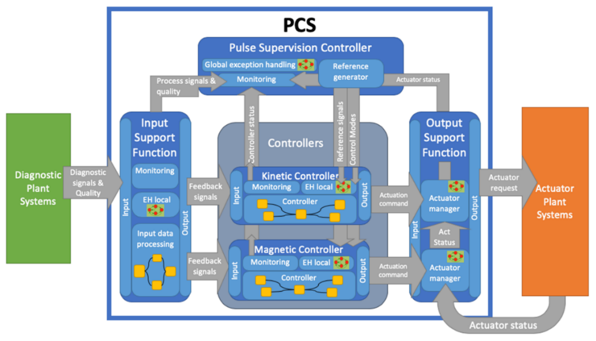
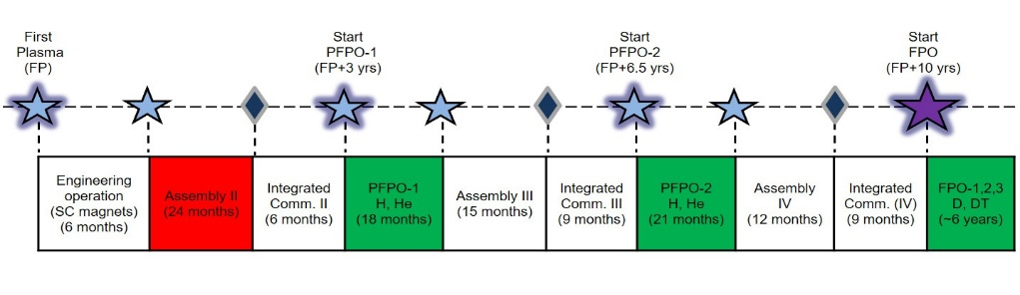
Plasma Control System
Final design for first plasma completed in 2020
Prototype implementation in PCS simulation platform (PCSSP) in Simulink®
Now being implemented in RTF

Slide 4
Real-Time Framework
Software framework for building real-time applications
Applications at ITER: PCS and plasma diagnostics
C++14, RHEL MRG-R real-time kernel
Optimized for real-time performance (minimizing response time and jitter):
  each control loop in its own isolated CPU thread
  synchronization done using busy-wait and atomic operations (no mutexes or semaphores)
  no runtime memory management (memory pre-allocated at initialization time)
  logging and archiving delegated outside real-time threads using lambda expressions and lambda queues
  no redundant memory copying (e.g. for in-thread communication)

Slide 5
RTF Application
Instantiated from XML-based configuration files at the initialization time
Consists of Function Blocks (FB) configurable through parameters and inter-connected with signals and (asynchronous) events
Allows nesting of FBs in Composite FBs
Defines signals and signal groups (internal or external)

Slide 6
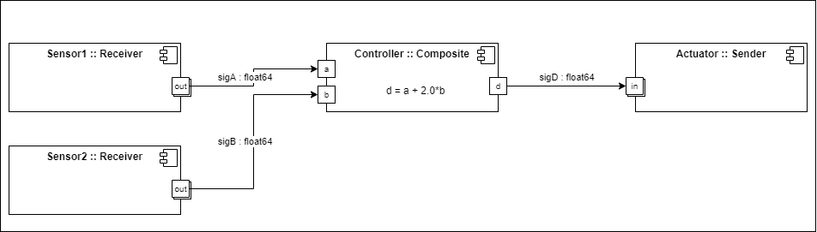
RTF Application

Slide 7
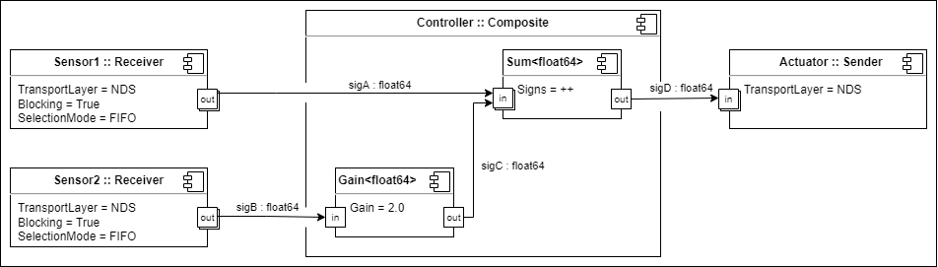
RTF Application

Slide 8
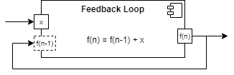
Closed-Loop Transfer Function
Closed-loop transfer functions can be implemented by configuring an input port as “Required=False”

Slide 9
RTF Application Deployment
Configured separately from RTF Application in deployment configuration XMLs
Deployment can be local or distributed
Within the same control loop/thread data is exchanged by sharing the same memory allocation
Inter-thread communication requires gateways implemented with SPMC real-time queues [Enqueuer/Dequeuer FBs]
Inter-process/node communication requires gateways implemented with transport layers [Sender/Receiver FBs]
Gateways are implicitly inserted by the framework

Slide 10
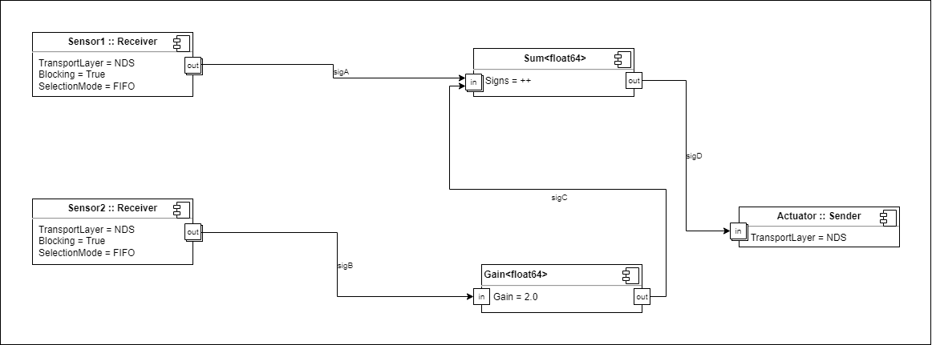
RTF Application Deployment

Slide 11
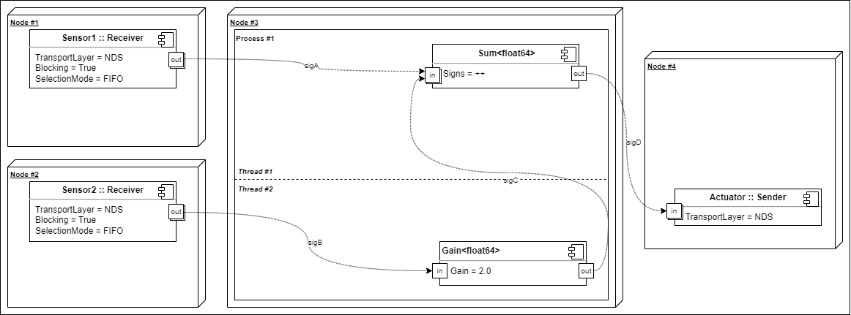
RTF Application Deployment

Slide 12
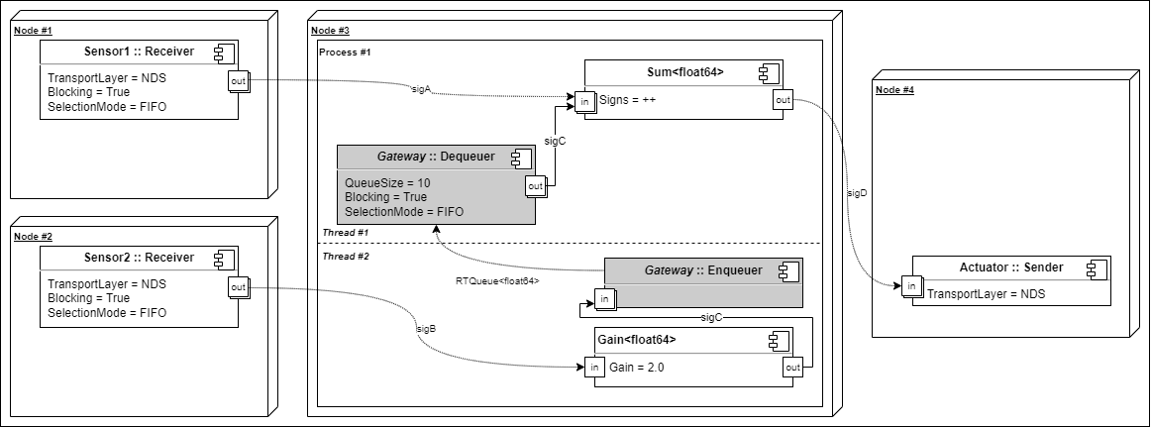
Inter-Thread Gateways

Slide 13
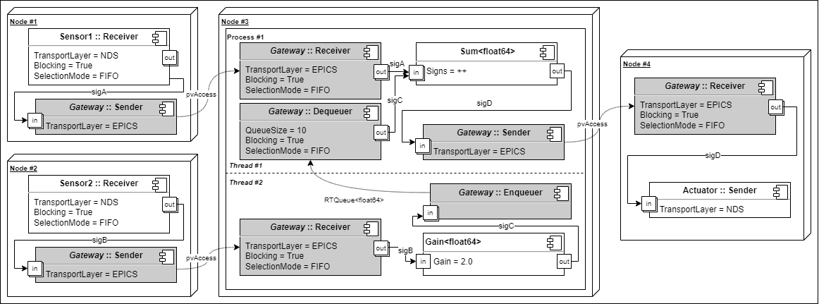
Inter-Process/Node Gateways

Slide 14
Transport Layers
Abstraction layer between communication interface and the RTF
Supports normative and structured data types
Data types must support:
  Introspection to allow structure mapping to be performed at initialization time
  Serialization to allow structure data to be serialized/deserialized at runtime
Available/foreseen implementations:
  Ethernet based TLs: SDN, DAN (publish only), EPICS pvAccess
  Local data exchange TLs: Files, Pipes, Shared memory
  Hardware/DAQ TLs: NDS
  User interaction TLs: Console, GUI screens

Slide 15
EPICS Transport Layer
Originally based on pvAccessCPP but migrated to PVXS in RTF 2.2.4 (March 2021)
Creates EpicsPublisher and EpicsSubscriber objects for Sender and Receiver FBs
Framework recursively climbs the data structure (through introspection) to invoke:
  declare() function implemented by both EpicsPublisher & EpicsSubscriber to declare/validate pvData structure (at initialization time)
  read() function implemented by EpicsSubscriber to read structure data from pvData (at runtime)
  write() function implemented by EpicsPublisher to write structure data to pvData and send() to finally send it (at runtime)

Slide 16
Recursive Structure Type Declaration
struct Sample {
uint64_t time;
size_t quality;
struct {
float64_t x;
float64_t y;
} position;
uint64_t values[10];
}
Sample.time
=> declares “time”, depth 1
Sample.quality
=> declares “quality”, depth 1
Sample.position.x
=> declares “x”, depth 2
Sample.position.y
=> declares “y”, depth 2
Sample.values[10]
=> declares “values”, depth 1

Slide 17
EPICS Transport Layer
EpicsPublisher/EpicsSubscriber::declare(const char* name, const size_t& depth, const std::type_index& data_type, const size_t& size, const size_t& count)
  child = pvxs::Member(pvxs::TypeCode::Struct, convert_name(name))
  child = pvxs::Member(toTypeCode(data_type).arrayOf(), convert_name(name))
  child = pvxs::Member(toTypeCode(data_type), convert_name(name))
  parent.addChild(child);
size_t EpicsPublisher::write(const size_t& position, const void* data, const size_t& count, const size_t& total_size)
  pvxs::client::PutBuilder::set(field[position], *(static_cast<const T*>(data)))
size_t EpicsSubscriber::read(const size_t& position, void* data, const size_t& count, const size_t& total_size)
  std::memcpy(data, field[position].as<T>().data(), total_size);

Slide 18
Conclusion
Transport layers are also used for events (through Event Distribution Service)
Besides for transport layers, pvAccess is also used for RTF process Life Cycle Management Service
  LCMS could ultimately use TLs rather than its own implementation
Transport layers currently provide no configurability for the topic (PV) and structure (pvData) field names

Slide 19
QUESTIONS

