Slide 1
ADTimePix3 areaDetector driver and MiniPix TPX3
Kazimierz Gofron
EPICS Collaboration Meeting
Ljubljana, Slovenia
September 21, 2022

Slide 2
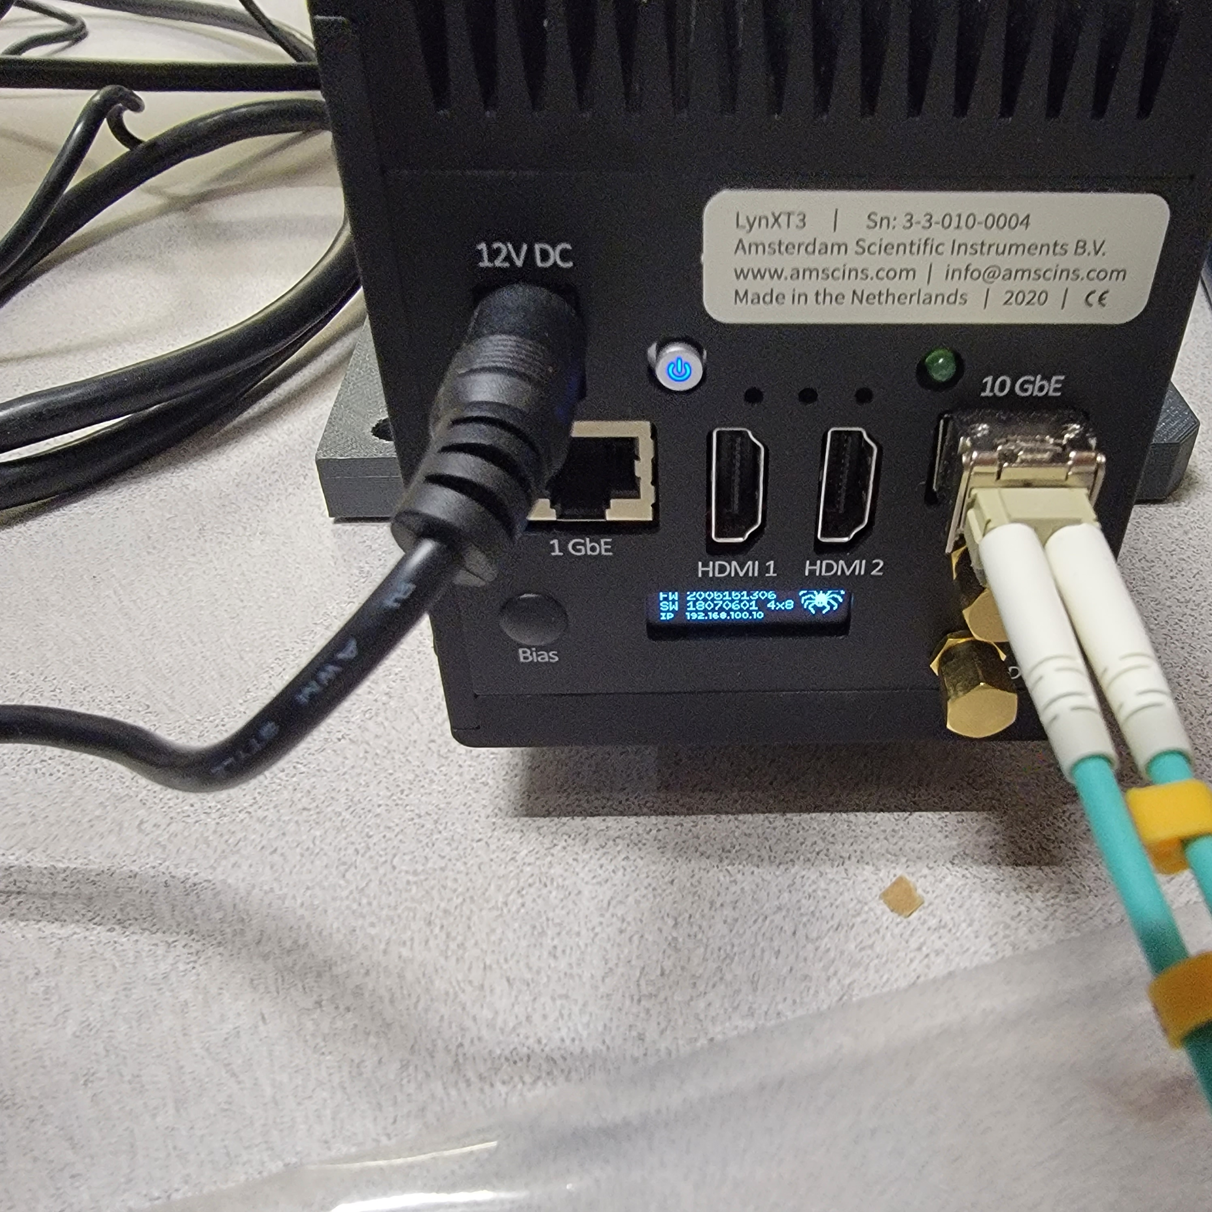
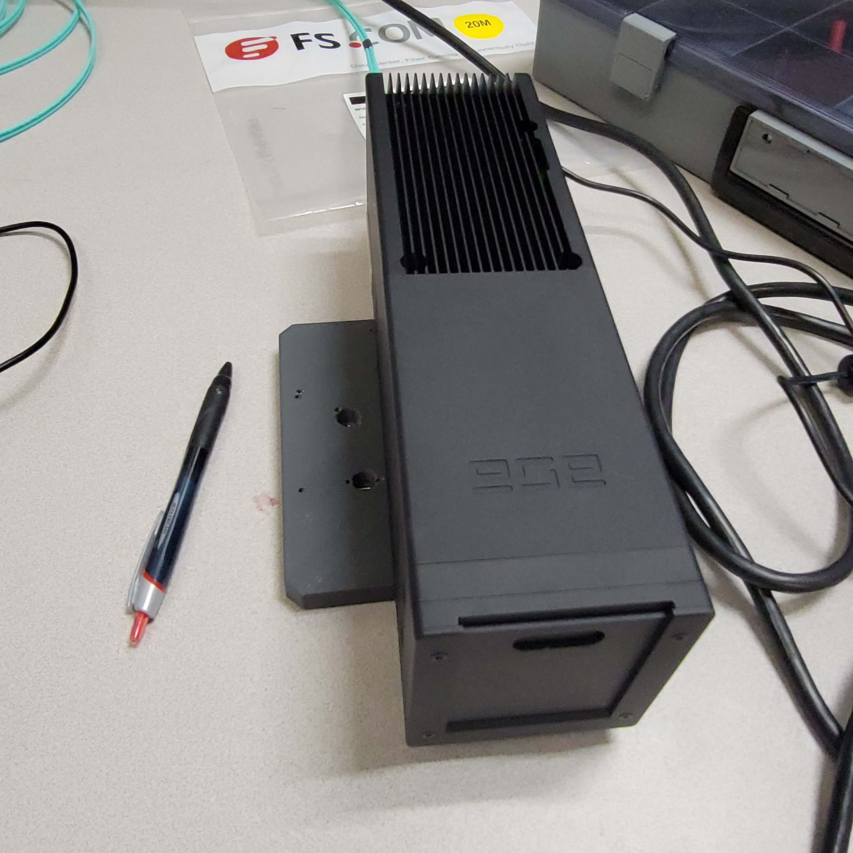
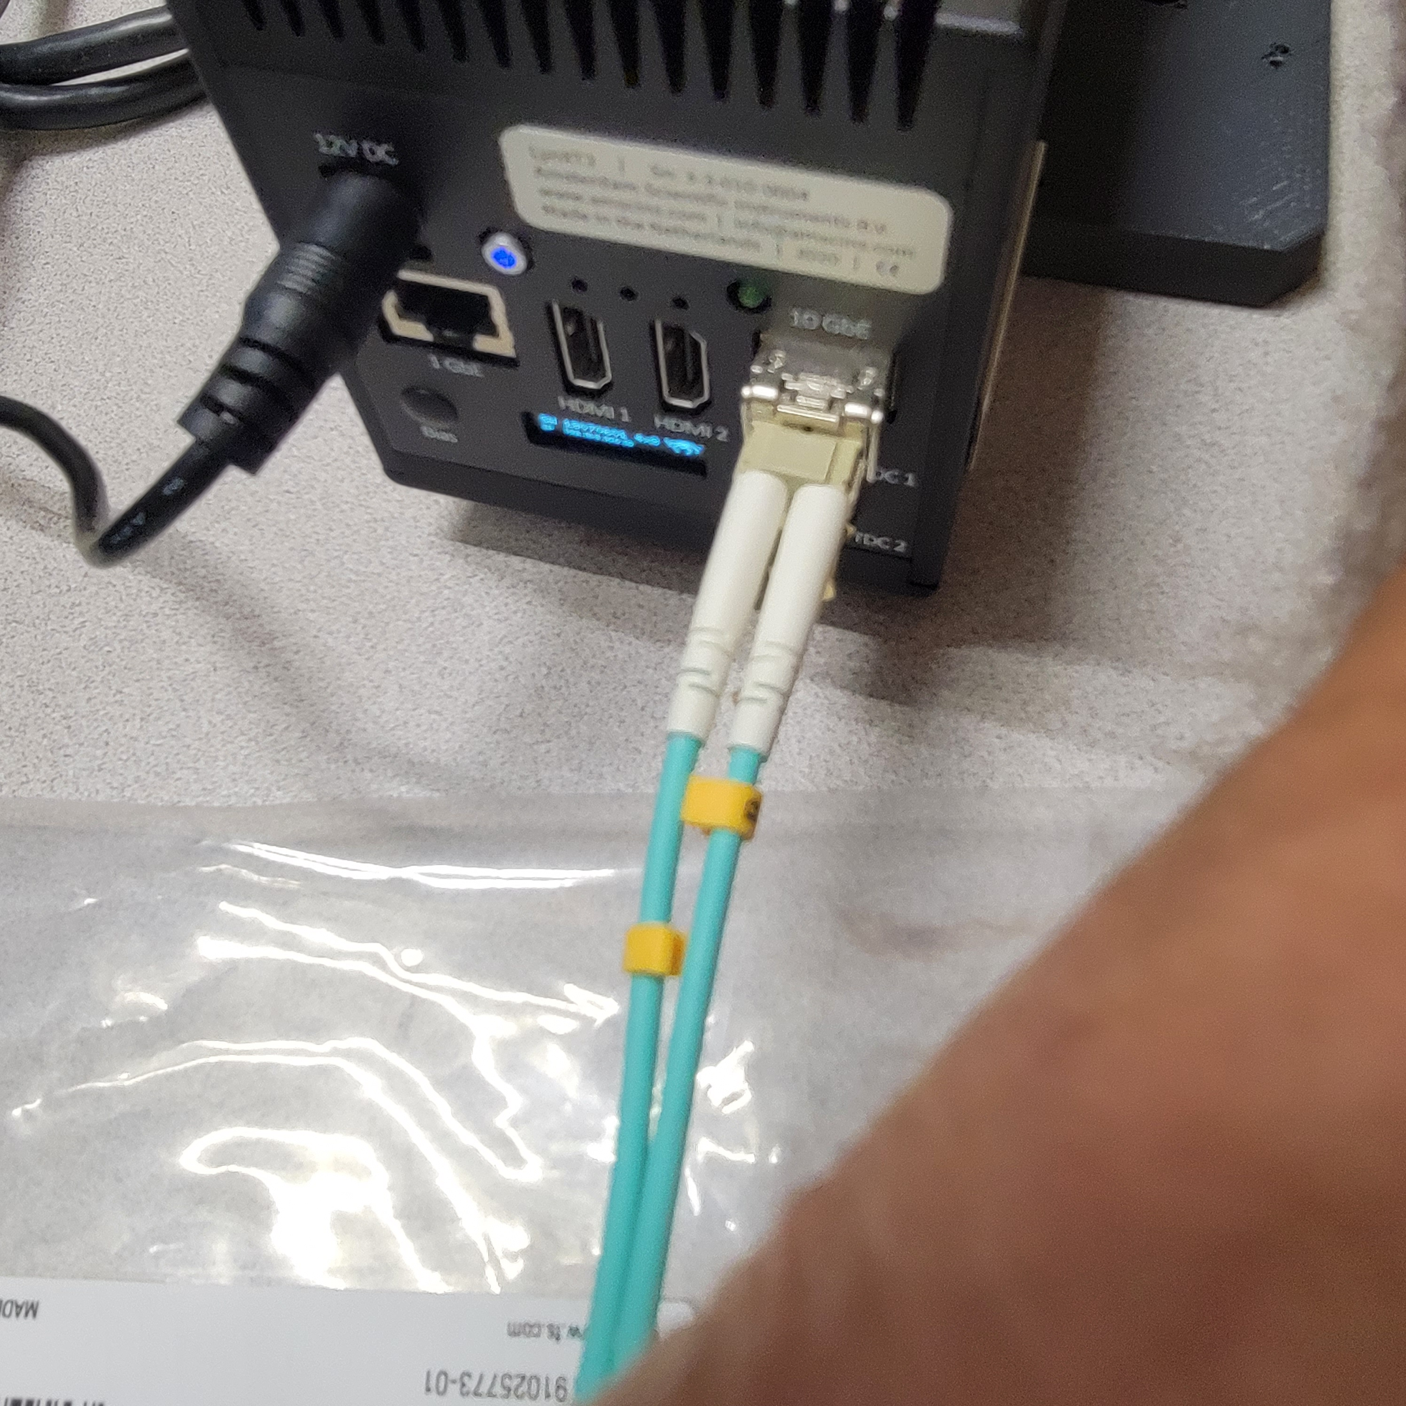
ASC TimePix3
An EPICS areaDetector driver for TimePix3 quad 512 x 512 detector from ASC.
ASC https://www.amscins.com/
NSLS2/CHX – Coherent Hard X-ray Scattering beamline
TDC – Timing from accelerator (260 ps); DIO: 2 x 3 (timing signals)

Slide 3
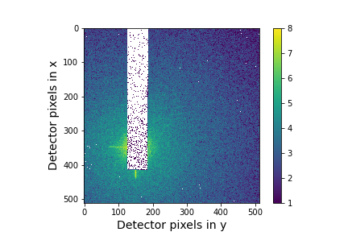
ASC TimePix3 diffraction pattern
X-ray diffraction pattern from a static ceramic sample on the Timepix single photon counting detector. Data was taken with 15 bunch mode with a ring current of 63 mA. Total exposure time = 3 seconds and the image is in log scale.
Courtesy: Chen, Xiaoqian

Slide 4
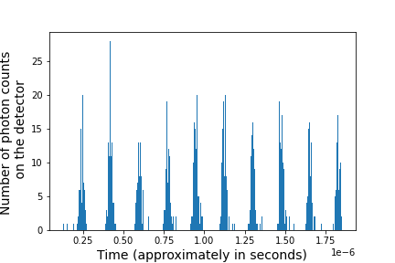
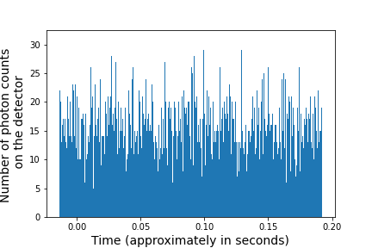
ASC TimePix3 timing pattern
Histograms of time stamps showing statistics of when photons arrive at detector pixels for data in Fig.1. (a) 15 bunch mode with a ring current of 63 mA. (b) Continuous filling mode with a ring current of 68 mA. Courtesy: Chen, Xiaoqian

Slide 5
An areaDetector driver for TimePix3 detector from ASC
Notes
  Depends on the CPR verson 1.9.1.
  Depends on the json version v3.11.2.
  Developed with ADCore R3-11 and ADSupport R1-10 or newer.
  This has only been tested on ubuntu 18.04 and 20.04 Linux 64-bit machines.
  This has only been developed for 2 x 2 chips layout, since that is what I have access to now
  This has only been tested with serval version 3.0.0.
  Driver is specific to Serval version, since features differ.
Dependencies (ADTimePix3/tpx3Support/)
  Compile cpr (https://github.com/libcpr/cpr)
  Clone json (https://github.com/nlohmann/json)

Slide 6
An areaDetector driver for ASC TimePix3 detector
Json C++ library use
std::string config;
config = this->serverURL + std::string("/detector/config");
// Detector configuration file
r = cpr::Get(cpr::Url{config},
cpr::Authentication{"user", "pass", cpr::AuthMode::BASIC},
cpr::Parameters{{"anon", "true"}, {"key", "value"}});
json config_j = json::parse(r.text.c_str());
config_j["BiasVoltage"] = 103;
config_j["BiasEnabled"] = true;
//config_j["Destination"]["Raw"][0]["Base"] = "file:///home/kgofron/Downloads";
//printf("Text JSON server: %s\n", config_j.dump(3,' ', true).c_str());
r = cpr::Put(cpr::Url{config},
cpr::Body{config_j.dump().c_str()},
cpr::Header{{"Content-Type", "text/plain"}});
printf("Status code: %li\n", r.status_code);
printf("Text: %s\n", r.text.c_str());

Slide 7
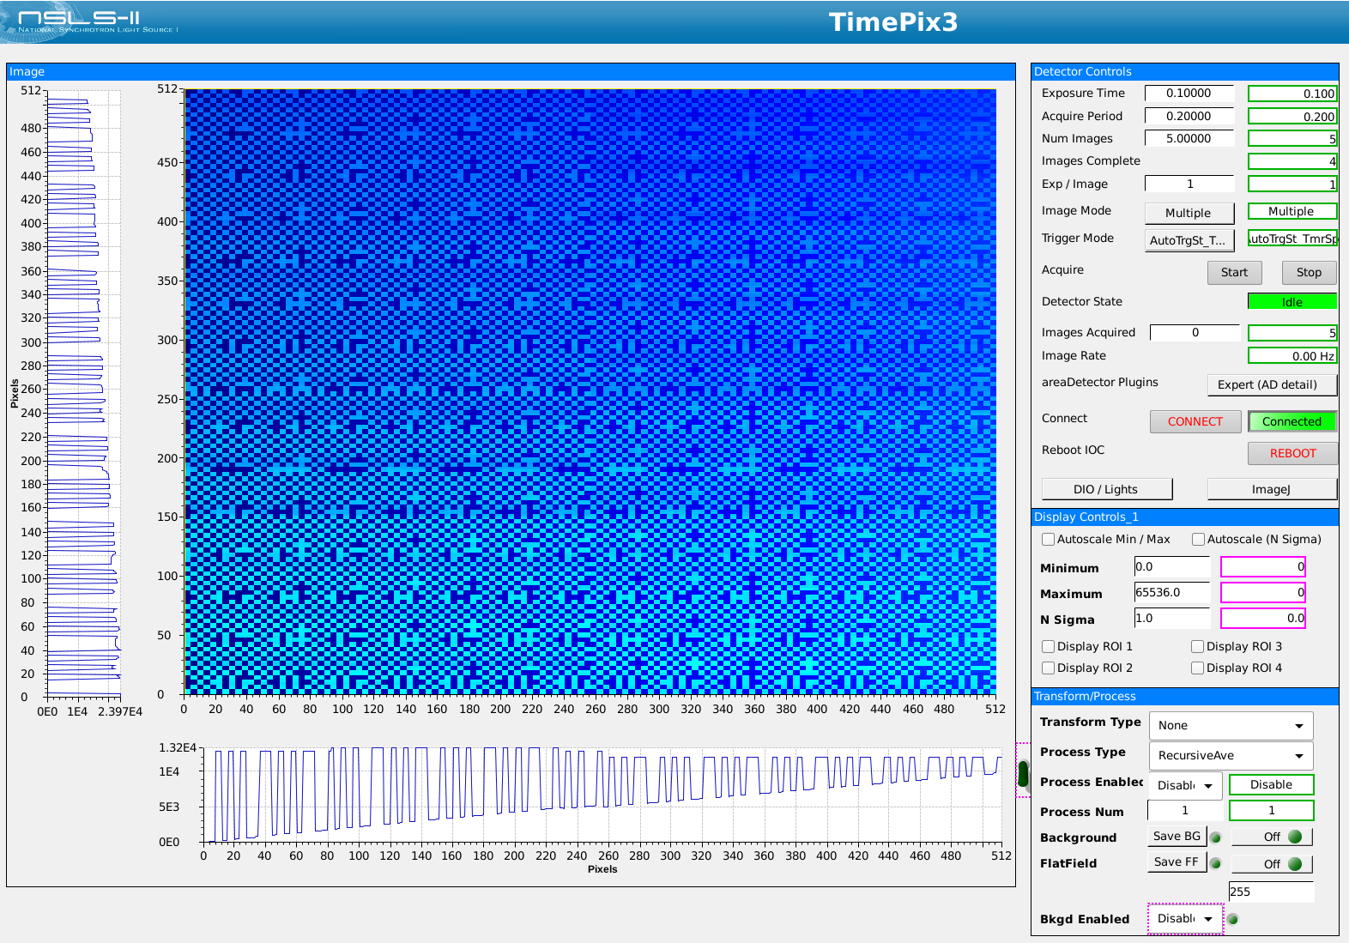
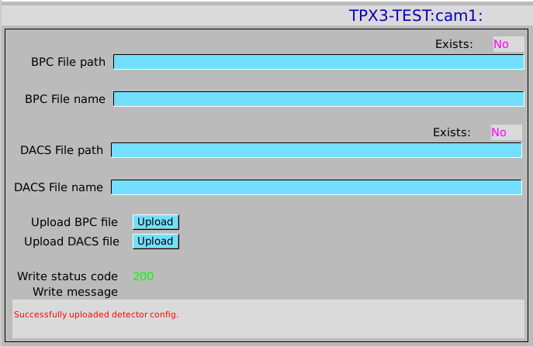
ASC ADTimPix3 opi
Detector requires hardware confiuraiton:
1. Binary Pixel Configuraton file loading from CSS
2. DACS configuration files loading from CSS

Slide 8
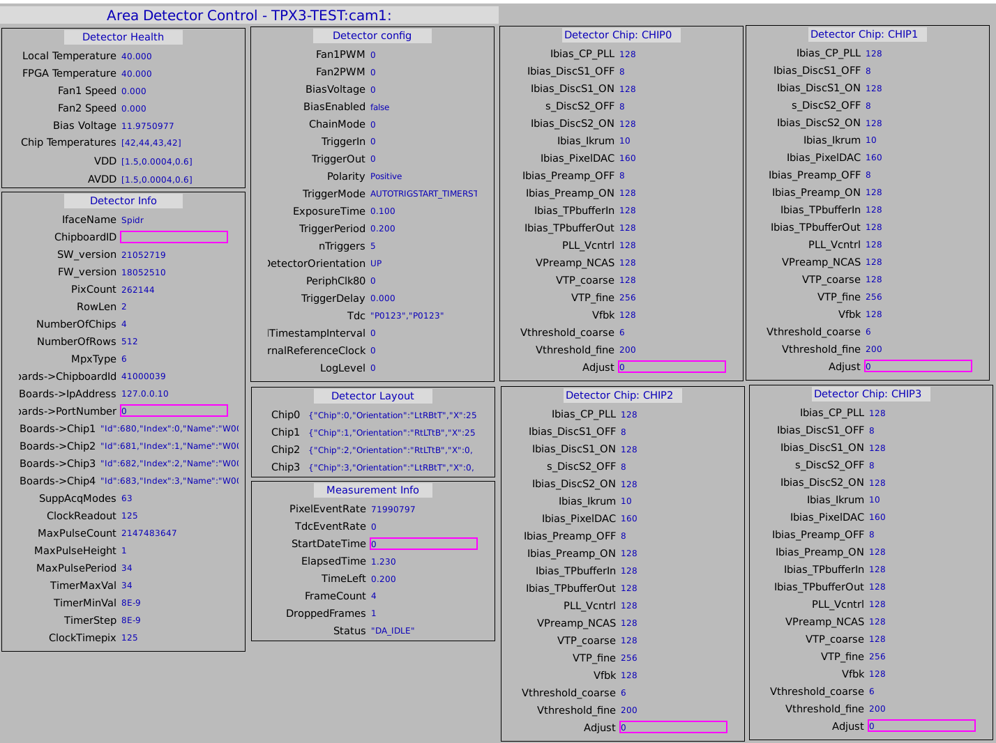
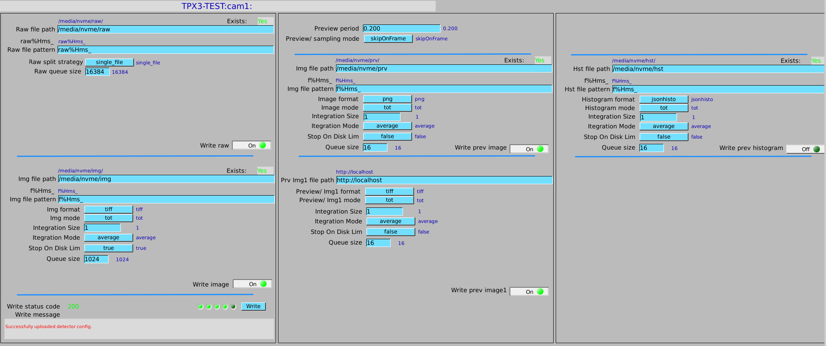
ASC TimePix3 opi
An EPICS ADTimePIx3 detector status, and FileWriter.
FileWriter configuration for channels
Raw
Image
Preview
  Image
  Histogram

Slide 9
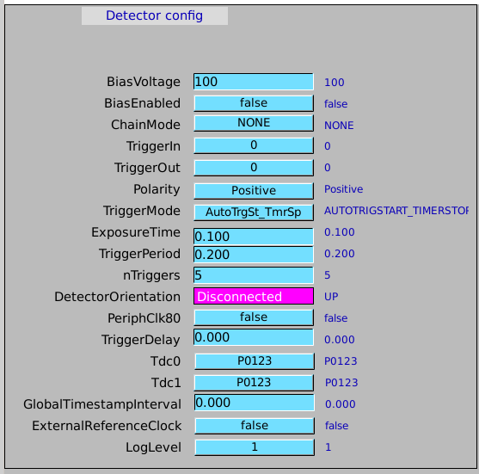
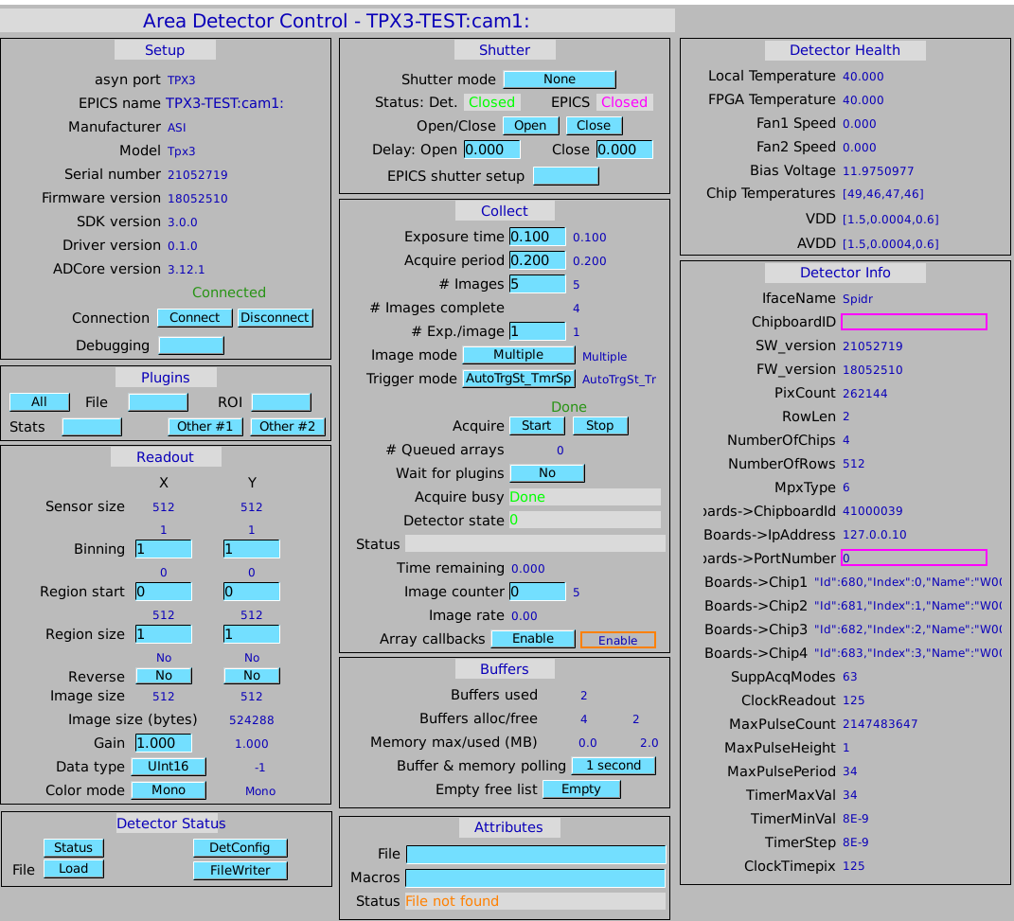
ASC TimePix3 opi
Detector configuration, and controls.

Slide 10
ASC TimePix3 disk data structure
Currently data written to NVME internal disk for performance
NVME
  Raw
  Img
  Prv
    Img
    Hst {Serval experimental version support}
Data write rates (>> 1GB/s)
EPICS channel used for viewing
.tpx3 data format

Slide 11


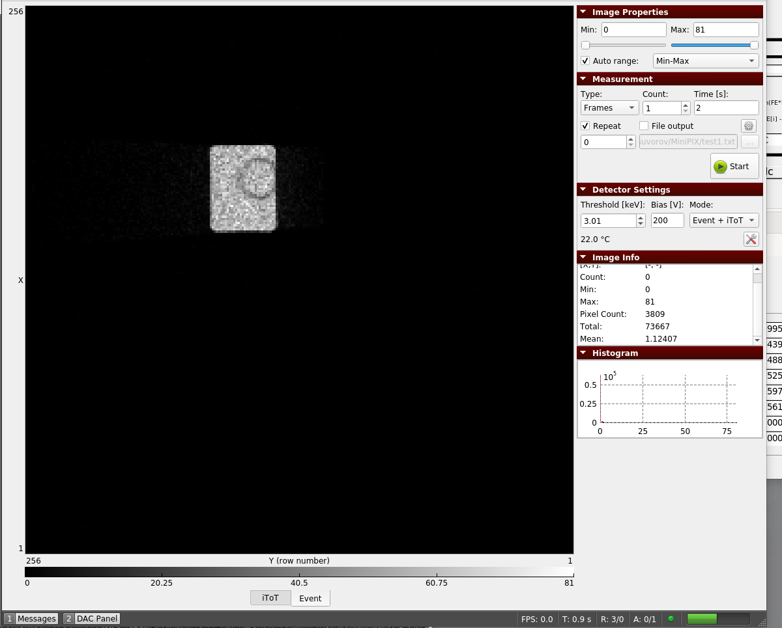
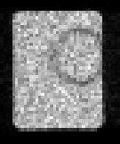
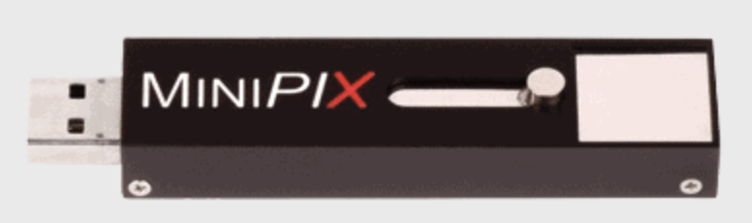
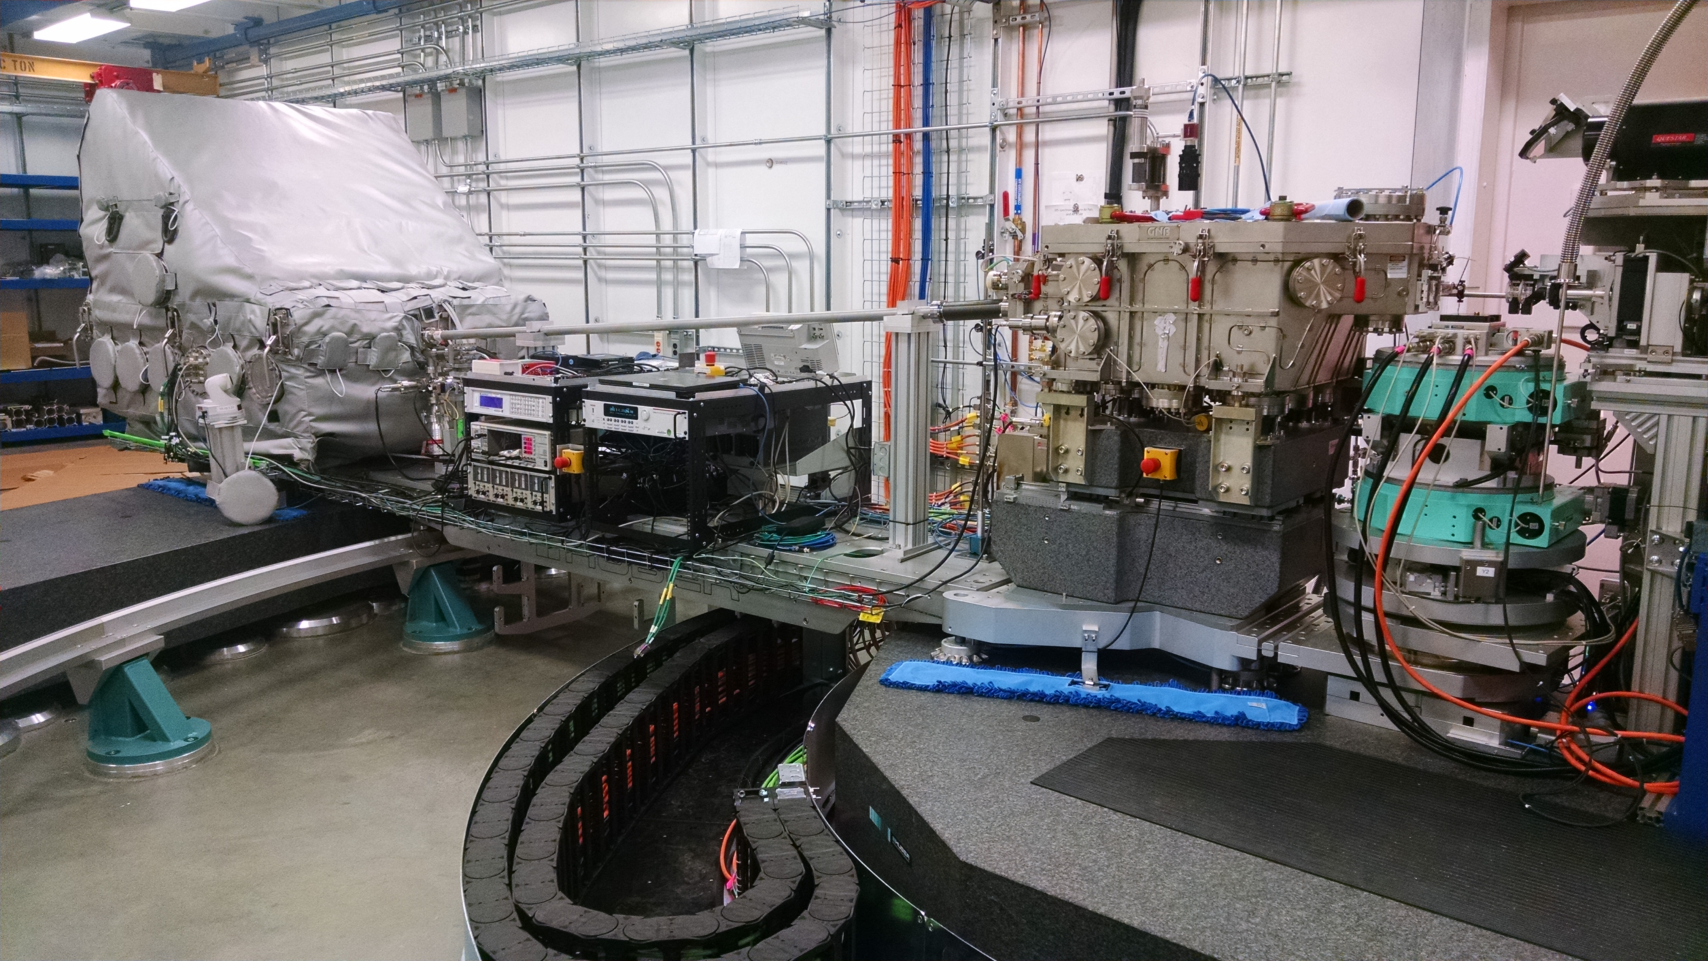
Advacam MiniPix TPX3 (IXS/10ID beamline)
Analyzer Optics
Sample
CDW
Montel Mirror
MiniPix image of inelastic scattered 9.1 keV X-ray beam behind slits mounted in front of Montel Mirror.
Advacam: https://advacam.com/

Slide 12
Summary
An EPICS ADTimePix3 areaDetector driver for 2x2 ASC TimePix3 was developed.
  Uses Curl for human's library
  Uses json library
  Driver features are being added, as beamlines request their use.
  Coordinate with ASC (Serval), and beamline scientists
Advacam MiniPix TPX3 as replacement for ADP detector.

