Slide 1

Introduction to pyProcserv

Slide 2
pyProcServ
Python-based
Platform-Independent
Plug-in replacement for existing procServ

Slide 3
procServ (Recap)
Wraps around a console application, redirects stdio
Pipes stdio through telnet
Handles special keys (arrows, backspace, delete, etc)
  Keypresses at one client are echoed to all
Used extensively at CLS!
VERY convenient
Elegant
Telnet Client
procServ
iocApp
telnet server
Telnet Client
stdio
Telnet Client

Slide 4
Opportunities
Auto-discover (respond to broadcasts)
Broadcast server presence (beacons)
Authentication
Different protocols
  SSH
  SSL/TLS
  Websockets (a la Jupyterlab/Terminado)

Slide 5
Opportunities
procServ “concentrator”
  Task to watch for existing procServ installations
  Connect to them via a telnet client
  Serve those through a single port via ZMQ or other means
  High-level menu:
    Allow client to select one or more procServs
    Dynamically add/delete subprocesses to serve (remotely)

Slide 6
procServ Concentrator
pyProcserv
procServ
Port 10100
ZMQ
Client
Telnet Client
procServ
Port 10200
Port 14000
Client
Telnet Client
procServ
Port 10300
Telnet Client
Client

Slide 7
Status of
Introduction to pyProcserv

Slide 8
Jupyter/Terminado
Terminado does exactly what I want (and more) over websockets.
  Uses Tornado/Asyncio (Server)
    The Tornado 6.0 event loop is now a wrapper around asyncio’s
  Xterm.js (client)
  Seemed a good fit

Slide 9
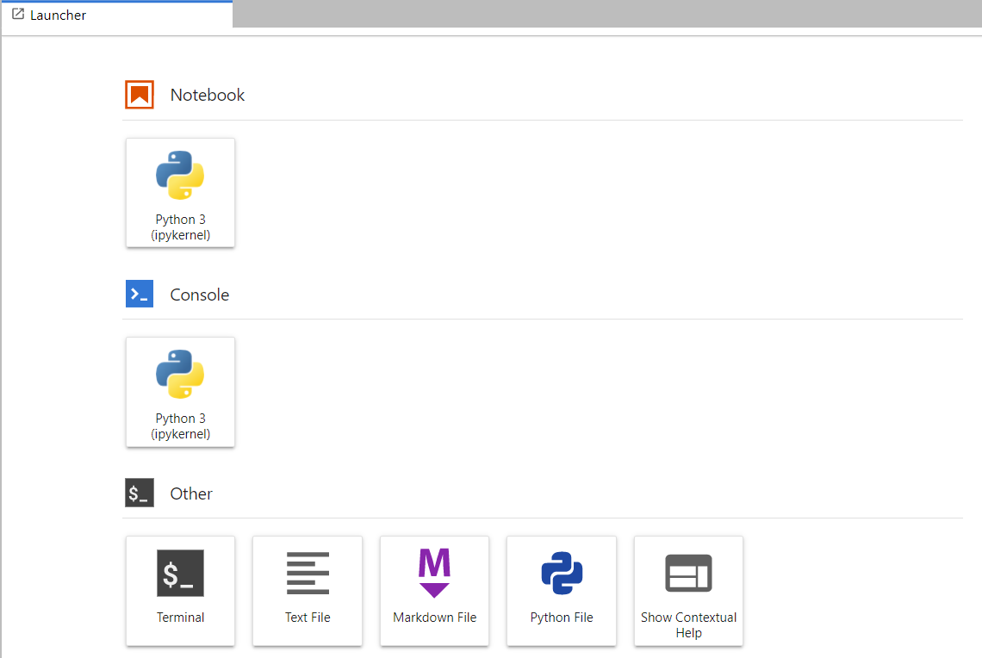
Jupyter/Terminado (Main Screen)

Slide 10
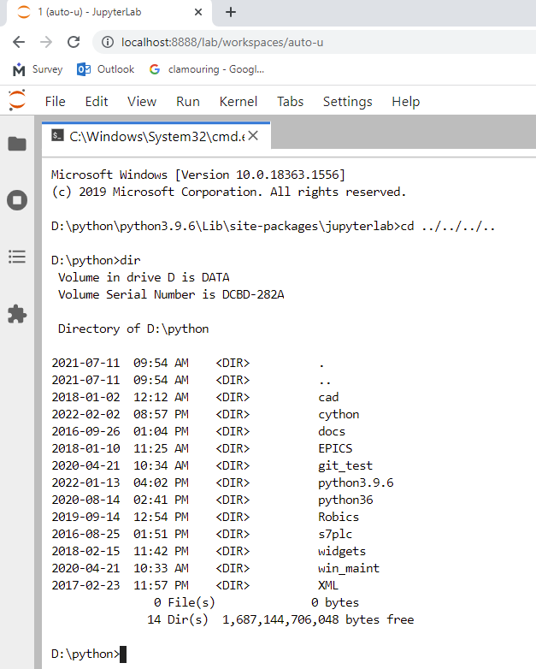
Jupyter/Terminado (Win Terminal)

Slide 11
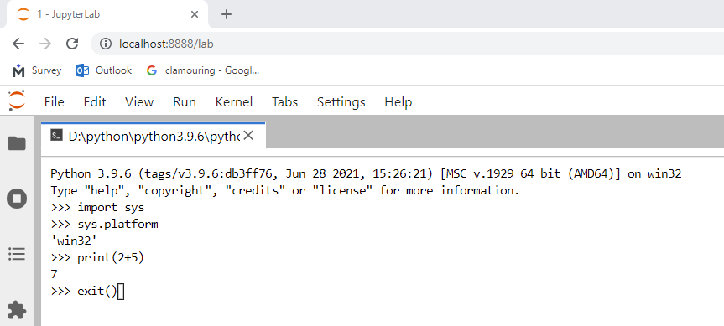
Jupyter/Terminado (Python Console)

Slide 12
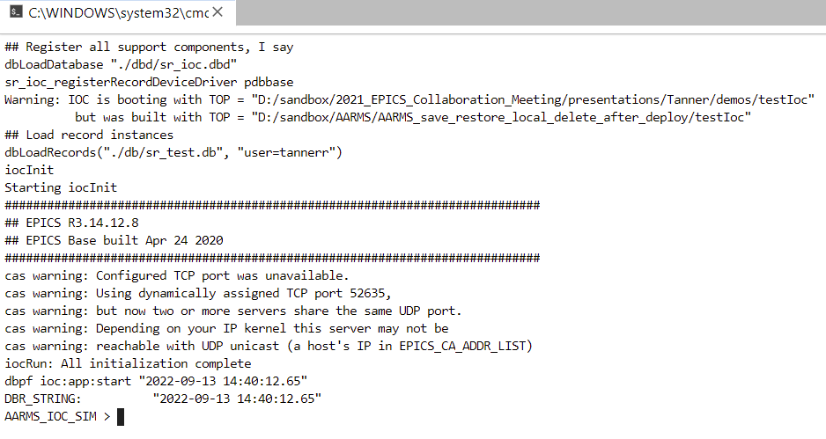
Jupyter/Terminado (iocApp Console)

Slide 13
pyProcServ
Multiple options for wrapping a subprocess in Python:
  subprocess
  multiprocessing
  pywinpty
  Asyncio subprocess functions
…as well as for networking
  socketserver
  asyncio
  Telnetlib3 (asyncio-compatible)

Slide 14
Asyncio
Concurrency in a single thread
Cooperative
Used by PythonIOC
Used by Terminado (Tornado loop v6 wraps asyncio loop)
Telnetlib3 uses asyncio
Great separation between transport and protocol
There is an asyncSSH module

Slide 15
Basic Layout
pyProcServ
PtyProcess (Windows)
PtyProcessUnicode (Linux)
Emulates VT100 (apparently)
stdout
Asyncio Queue
Client Writer
Subprocess
Client Reader
Client Writer
stdin
Client Reader
Client Writer

Slide 16
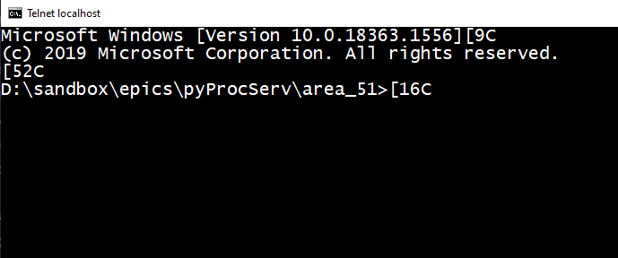
Telnet Output (Sockets)
Microsoft Windows [Version 10.0.18363.1556]
(c) 2019 Microsoft Corporation. All rights reserved.
D:\sandbox\epics\pyProcServ\area_51>

Slide 17
Telnet Output (Socket)
Microsoft Windows [Version 10.0.18363.1556][9C
(c) 2019 Microsoft Corporation. All rights reserved.
[52C
D:\sandbox\epics\pyProcServ\area_51>[16C
didrir
Volume in drive D is DATA[35C
Volume Serial Number is DCBD-282A[27C
[61C
Directory of D:\sandbox\epics\pyProcServ\area_51[12C
[61C
2022-09-13 04:13 PM <DIR> .[21C
2022-09-13 04:13 PM <DIR> ..[20C
2022-09-13 11:51 AM 10,091 pass_through.py[26C
2022-08-30 07:24 PM 22,964 testing_telnet.py[24C
2022-01-27 08:09 PM 11,979 test_subprocess.py[23C
2022-01-13 08:52 PM 2,498 web_term.py[30C
2022-08-10 05:12 PM 4,538 winpsuedoterm.py[25C
2022-08-15 10:07 AM <DIR> __pycache__[30C
36 File(s) 211,074 bytes[35C
4 Dir(s) 1,687,143,002,112 bytes free[27C
0;C:\Windows\System32\cmd.exe
D:\sandbox\epics\pyProcServ\area_51>[44C

Slide 18
Telnet Output (Telnetlib3)
Using telnetlib3
Same output
Noticed a lot more going back and forth (IAC) 0xFF

Slide 19
Under the Hood
x1b[?25lMicrosoft Windows [Version 10.0.18363.1556]
\x1b[9X\x1b[9C\r\n
(c) 2019 Microsoft Corporation. All rights reserved.\r\n
\x1b[52X\x1b[52C\r\n
D:\\sandbox\\epics\\pyProcServ\\area_51>\x1b[16X\x1b[16C\x1b[4;37H\x1b[?25h

Slide 20
Pass-Through Test
Pass Through App (Python)
Telnet Client
procServ
procServ Telnet Client
Telnet Server
Telnet Client
Telnet Client

Slide 21
Conclusion
Any help GREATLY appreciated
  Further reading
  Links
  Other resources
  Guidance
All is not lost:
  Concentrator proof-of-concept

