Slide 1
TimescaleDB for Archived Data
EPICS Collaboration Meeting
Slovenia, Sept. 2022
Kay Kasemir

Slide 2
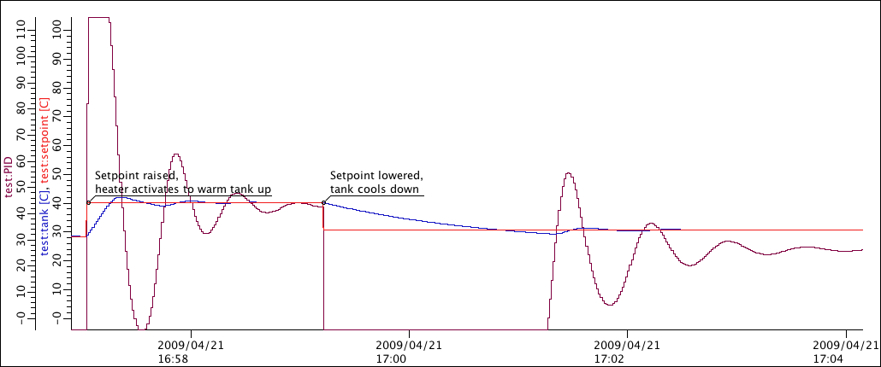
Archive System
Configuration:
Which channels?
How to sample?
Storage
Vast and fast
Sample Engine (Service)
Read PVs,
write to storage
CA, PVA
IOC
IOC
IOC

Slide 3
Storage Options
Custom
Files
Relational Database
Faster
Depends on implementation:
Long-term track record?
What queries are supported?
Patch selected samples?
Slower
Convenient:
Robust for decades
Arbitrary queries
Data management
Pre-aggregation for
long-term reports

Slide 4
CS-Studio RDB Archive Engine
Supports Oracle, PostgreSQL, MySQL
Simple to start with one “sample” table
Data maintenance looks easy, but operations like these can be slow, or fail to recover actual disk space:
  DELETE FROM sample WHERE channel_id = 42;
  DELETE FROM sample WHERE timestamp BETWEEN … AND …;
Channels 1-19999
This month, last month, last year, …

Slide 5
Oracle @ SNS, PostgreSQL @ ITER
Partitioned “sample” table
DIY set of scripts to automate partitioning
and support optimized read-out
This month
Channels 1-9999
Channels 10000-19999
Channels 20000-29999
…
Fast disk
Last month
Channels 1-9999
Channels 10000-19999
Channels 20000-29999
…
Slower disk
…
Last year
Channels 1-9999
Channels 10000-19999
Channels 20000-29999
…
Compressed,
read-only disk
…

Slide 6
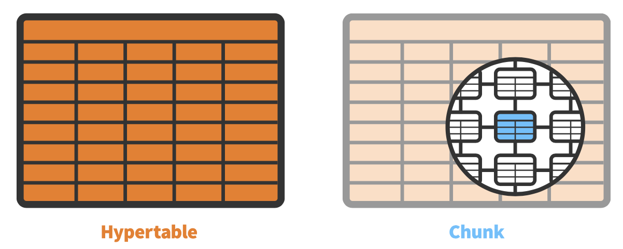
TimescaleDB
https://www.timescale.com
Free, open-source PostgreSQL extension
+ automated partitioning into ‘chunks’
+ additional time-based queries
Chunk by time and channel name/ID
Automated indexing by time, fast access based on chunks
‘time_bucket’ query for retrieval of min/max/average
Compression of older chunks
    Size reduced to ~10%
    Read-only
    Re-arranged by channel for fast access to time slice for channel

Slide 7
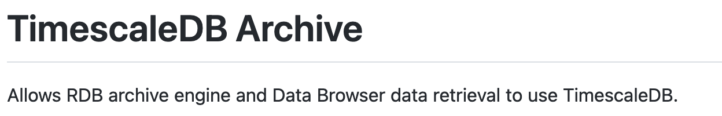
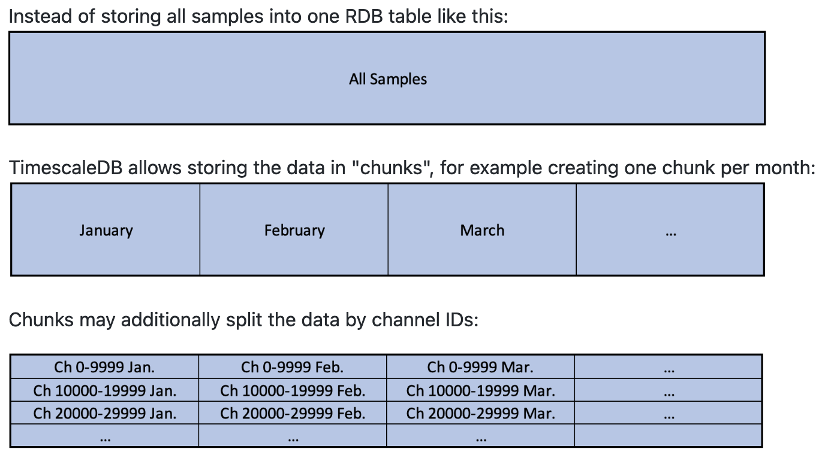
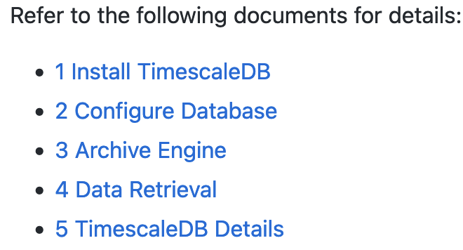
How do I use that?
RDB Archive Engine can write to TimescaleDB without any changes!
CS-Studio Data Browser can read via stored procedure that takes advantage of TimescaleDB chunking
See https://github.com/ControlSystemStudio/phoebus/tree/master/app/databrowser-timescale

Slide 8
Initial Experience
Everything worked as described
Hard to compare with SNS Oracle cluster (different networks, hardware and amount of available data), but performance seems at least as good as our custom partitioning setup
TimescaleDB can be configured to ‘chunk’ by time range and channel ID
  but unclear what the “best” configuration would be
  Time range easy to adjusted at runtime for new data
  Chunking by channel ID cannot easily be changed at runtime
Compression works well, quite easy to automate
Chunks can be placed in dedicated Table Space (disk)
  But lacks Oracle BIGFILE approach where tablespace is a file of up to 128 TB which can be unlinked, backed up, restored, and linked back into database.

Slide 9
TimescaleDB
If you’re about to start an RDB-archive, consider TimescaleDB instead of creating your own partitioning scheme
RDB Archive Engine can write to it just like Oracle, MySQL, plain PostgreSQL
CS-Studio Data Browser can benefit from stored procedure
Details: https://github.com/ControlSystemStudio/phoebus/tree/master/app/databrowser-timescale

Slide 11
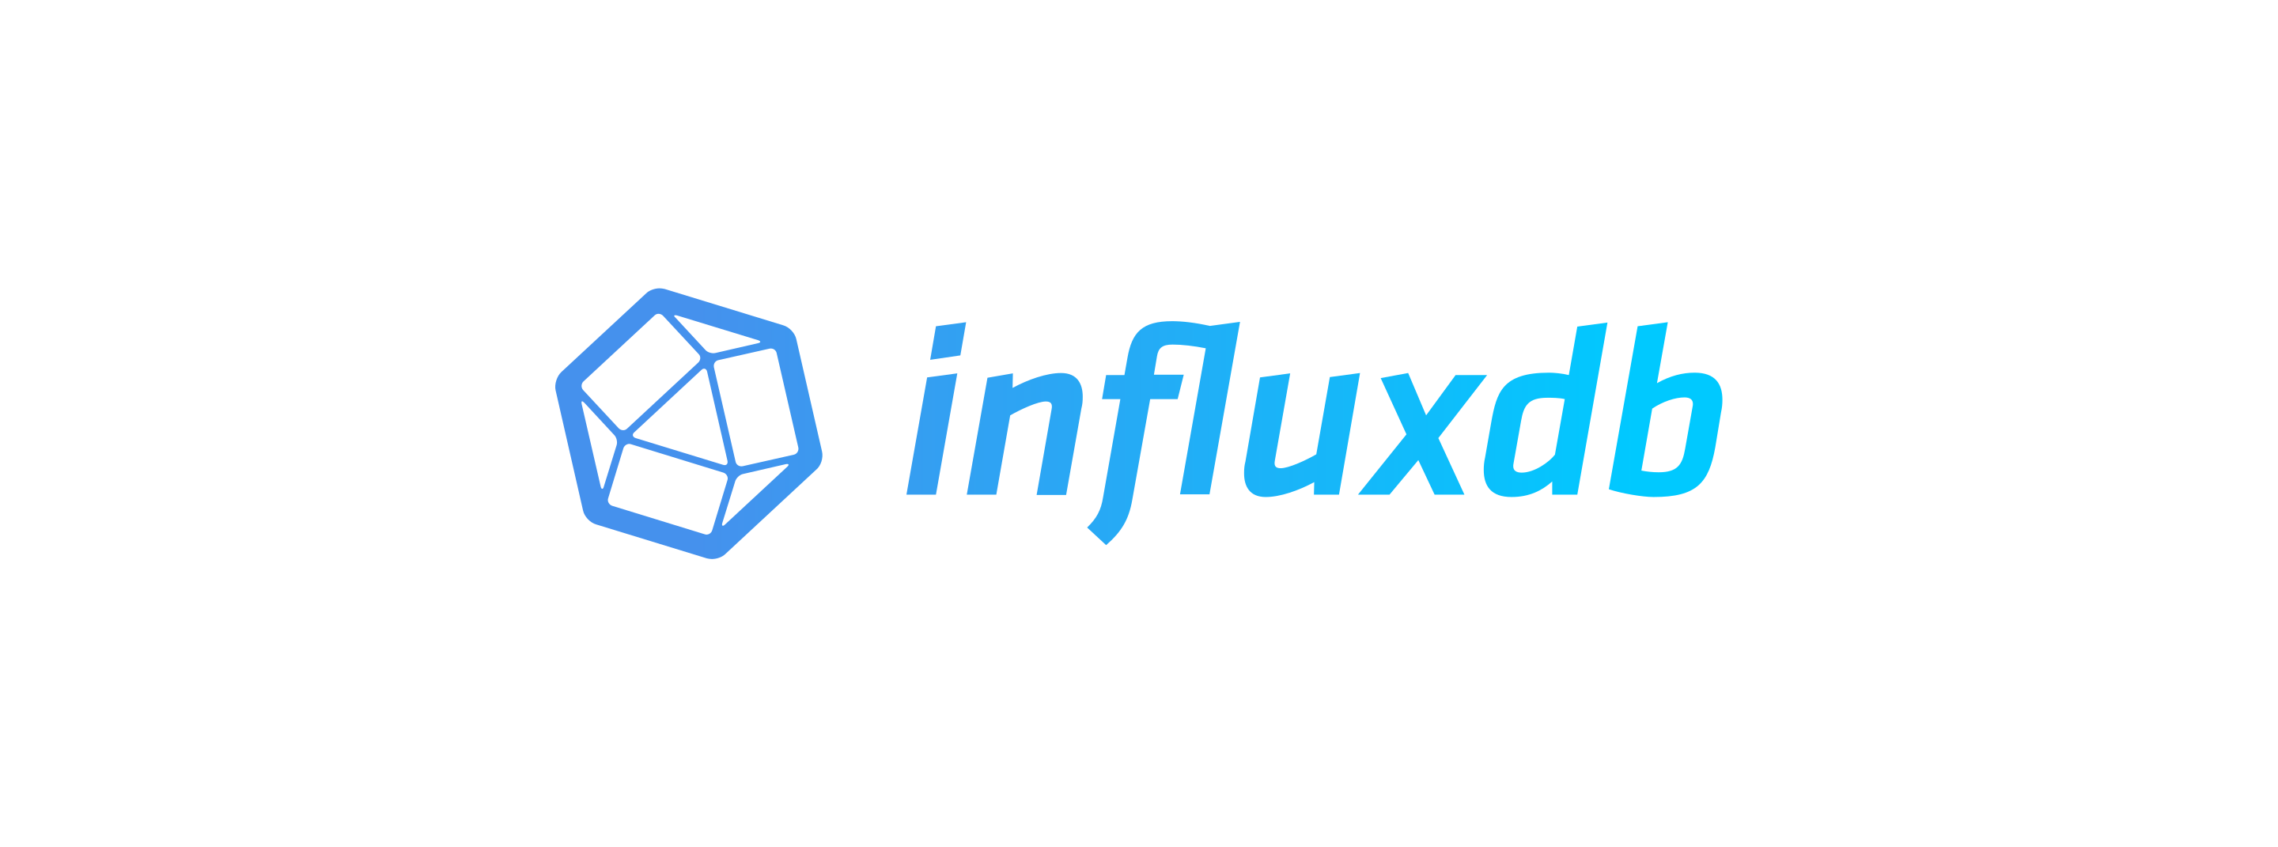
What about InfluxDB for archived data?
Built for time series data
  Implemented in ‘go’
  Since 2013
  Started support in CS-Studio Archive Engine and Data Browser, but..
    ‘NoSQL’, yet we do have fixed data types suitable for schema…
    Issue with ‘long’ vs. ‘double’ distinction because of JSON serialization
    https://github.com/influxdata/influxdb-java/issues/276
    Retention (aging) means different names for current vs. old data
    Clustering is closed-source
Comparison with TimescaleDB:
https://blog.timescale.com/blog/timescaledb-vs-influxdb-for-time-series-data-timescale-influx-sql-nosql-36489299877

