Slide 1
IC@MS with EPICS Tango Bridge
EPICS Collaboration Meeting September 2022
S2Innovation (Poland, Cracow)
Presentation: Mateusz Nabywaniec

Slide 2



EPICS vs Tango
EPICS Controls:
Main unit - IOC
PV – piece of data associated with some device parameter
Tango Controls:
Main unit are Device Servers
Each device server can have
some attrbiutes attributes
Popular support for thousends of devices
https://www.tango-controls.org/developers/dsc/

Slide 3

Solution: EPICS TANGO Bridge
Tool to access Tango Classes via EPICS Channel Access
Server that provides mapping between Tango Attributes and Commands.
Implemented using pcaspy (https://pcaspy.readthedocs.io/en/latest/)
Documentation: https://epics-tango-bridge.readthedocs.io/en/latest/

Slide 4
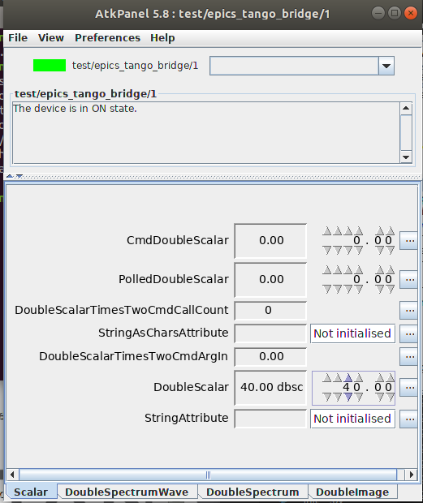
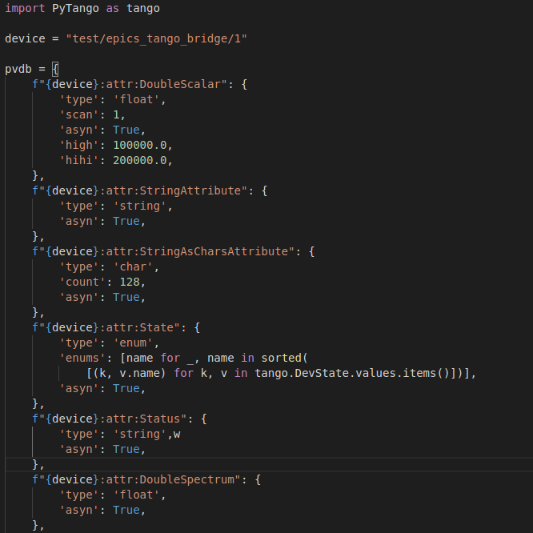
How to use it works? - read
To start IOC you need to provide pvdb.py file defining mapping Tango devices
epics-tango-bridge ./path/to/pvdb.py
Example Tango device
Corresponding pvdb file
$ caget –c „tango:test/epics_tango_bridge/1:atrr:DoubleScalar” -> Return 40

Slide 5



Reading and writing more detaied
Read e.g. caget
value
value
Example Tango
Device Server
with different attributes
and commands
Pcaspy Driver
value
value
Write eg. caput
- manager
- Read and write threads

Slide 6
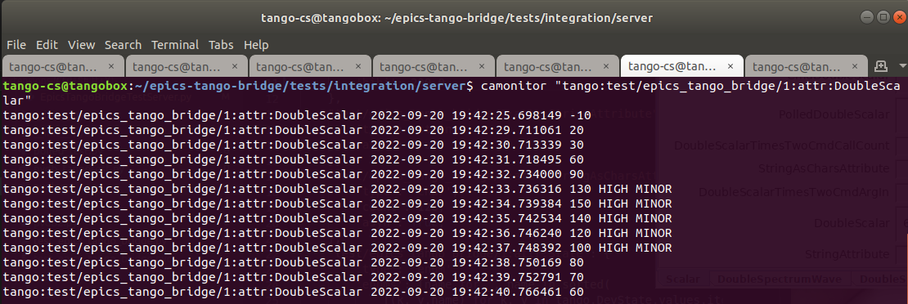
Main advantages
Read and write suport using Channel Access
Support for scalar attributes (normal and polled)
Support for commands
Support for spectrum (one dimensional array), and images (two dimensional array)
Mapping alarms betwen Tango and EPICS

Slide 7
IC@MS

Slide 8

What is IC@MS?
Web application to manage alarms
Integrated
Cloud-ready
Alarm Management System
Aim: increase effectivity during working with unexpected situations
C@MS
IC@MS based on PANIC – Alarm System developed in ALBA Synchotron (Barcelona)
https://panic-training-materials.readthedocs.io/

Slide 9
IC@MS is focused on daily operation
No active (NORM)
Activated
(NACK)
Confirmed
(ACK)
Solved
(RTN)
Personel confirms start of solving the problem
Problem solved
Detection of unusual situation
C@MS

Slide 10
How does it work?
Input data (Tango/ EPICS)
Temperature sensor
IC@MS
Operated at IC@MS
Notification formula (PyAlarm)
If temperature is higher than
50 → trigger alarm.
Processed by PANIC/PyAlarm
notifications
logging
Backend
Web API
MongoDB Cache
Speed up PANIC
Advanced logging

Slide 11

Why IC@MS?
Better user interface for everyday use.
Access from anywhere through web browser.
No need to install on the client’s computer.
Web API.
Multiple access roles.
Integration with Active Directory, AD.
SMS, mobile or mail notifications.
Effective – tested with thousands of alarms.

Slide 12
Main features
Alarms list
Modification of existing alarms
Multiple sources of data: EPICS PV, HTTP, MQTT, …
New alarm definition
Alarms history browser
Multiple searching and filtering options
Documented web API (Swagger)
C@MS

Slide 13
Time for DEMO ☺

Slide 14



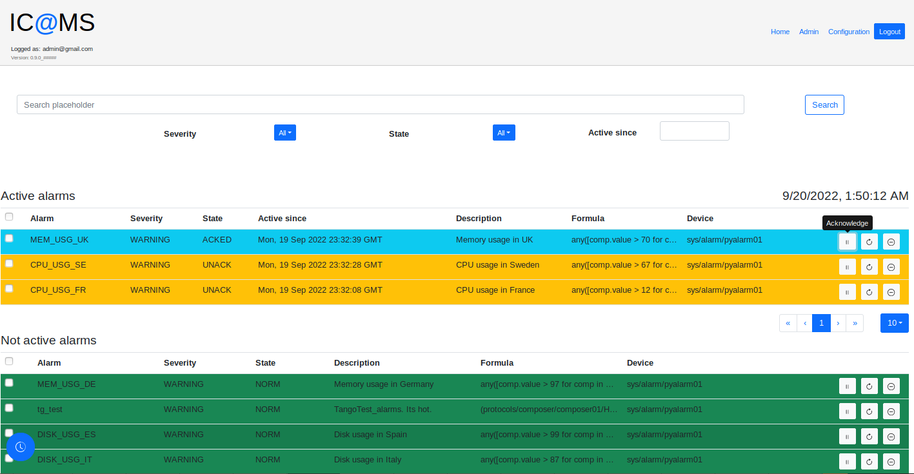



Scenario
PyAlarm DS
EPICS Tango Bridge
Composer DS

Slide 15
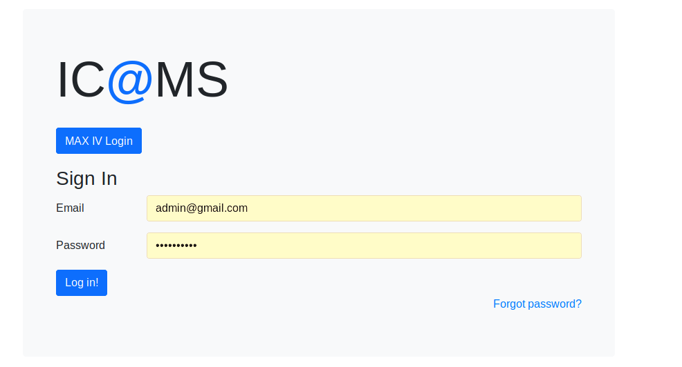
Log in

Slide 16
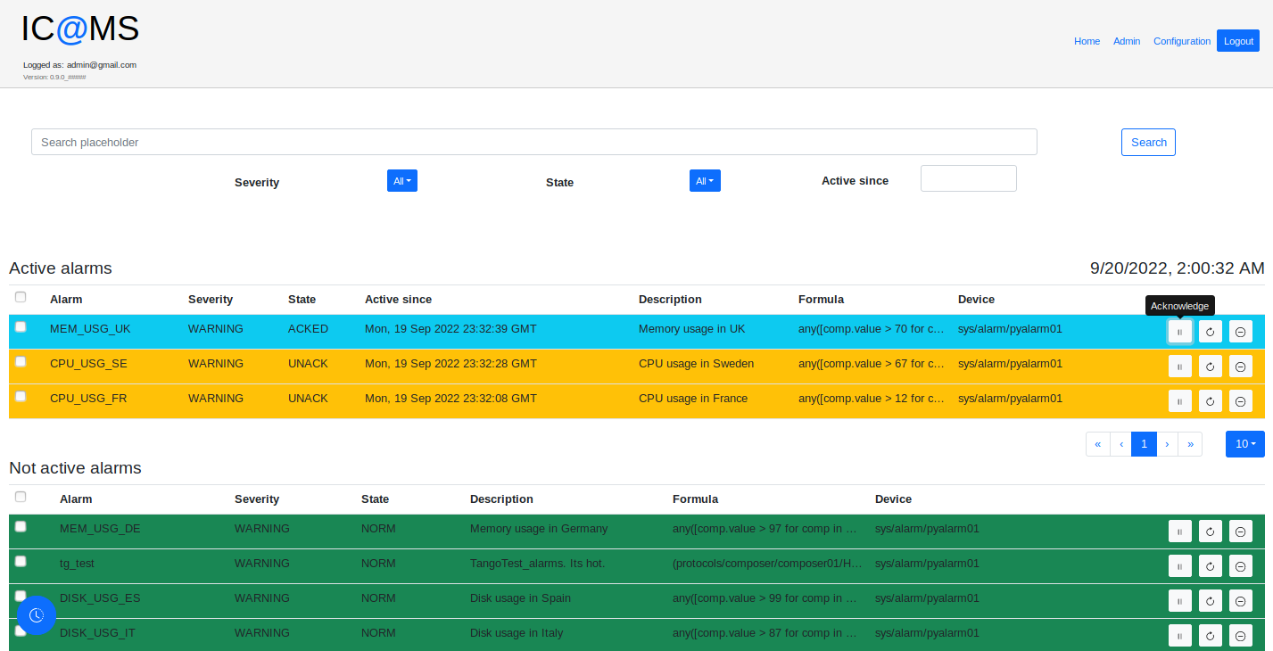
Alarms list – all in one place

Slide 17
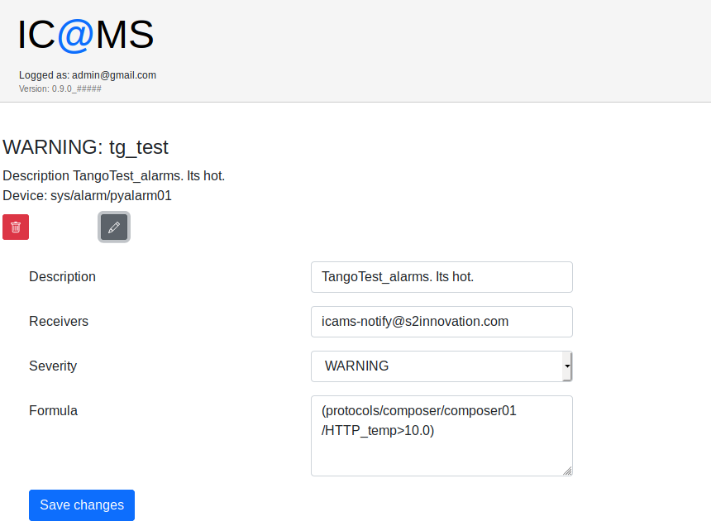
Modification of existing alarm

Slide 18
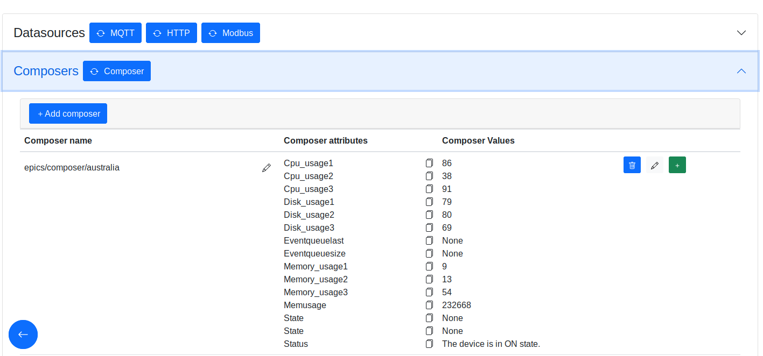
Monitoring values of PVs using EPICS Tango Bridge

Slide 19
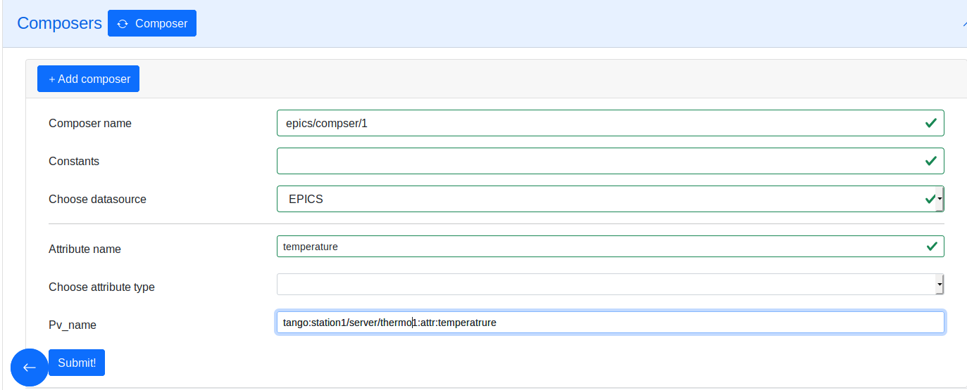
EPICS PV as a new data source

Slide 20
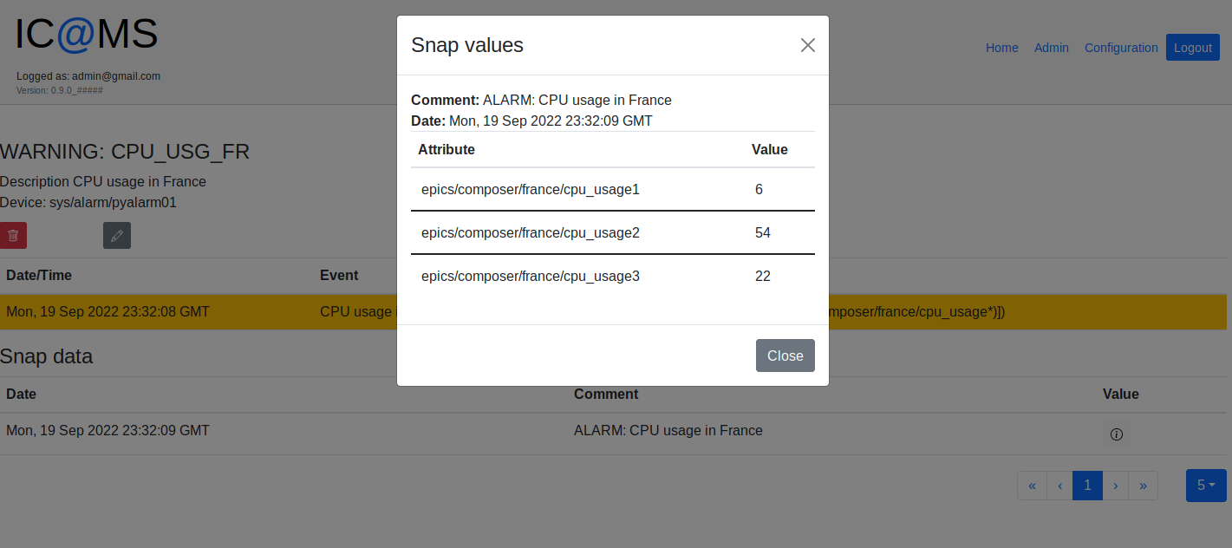
Browsing history of one alarm…
Feature – remember all values for aggregating alarms

Slide 21
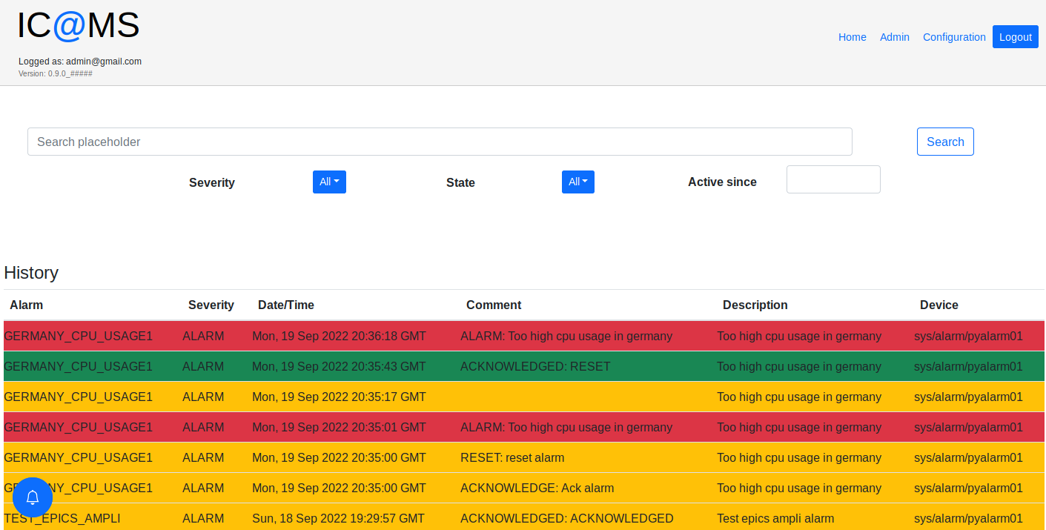
… and history of all alarms

Slide 22
Thank you!
https://s2innovation.com
contact@s2innovation.com
+48 795 794 667, +48 795 794 004

