Slide 1
Study on EPICS Communication over Long Distance
L. Lobes¹, R. Lange², O. Semenov³, D. Stepanov²
¹ Tomsk Polytechnic University, Lenin av. 30, 634050 Tomsk, Russia
² ITER Organization, Route de Vinon-sur-Verdon, CS 90 046, 13067 St. Paul Lez Durance Cedex, France
³ Institution "Project Center ITER", Kurchatov sq. 1, Building 3, 123182 Moscow, Russia

Slide 2
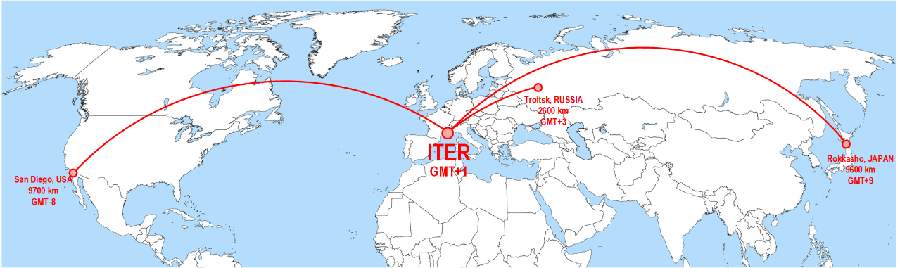
General test algorithm
Already connected Remote participants:
Troitsk, RUSSIA, IPSec VPN, ping around 69 ms
San Diego, USA, IPSec VPN, ping around 160 ms
Rokkasho, JAPAN, L2 VPN, ping around 250 ms
All remote participants will be watchers only, with no control possibility
Mainly tests results presented in this presentation was obtained with Troitsk, RUSSIA and USA San Diego.
Japan in plans in near future.

Slide 3
Program execution sequence
set up the generator. The generator generates files for EPICS and also generates a list of the same PVs in a text file(PV_list.txt) for using by Treader program
Compile simple maven project which contain only one IOC.
Start the IOC and start the reading program
Data analysis and processing

Slide 4
EPICS DB, Control part
EPICS DB consist of configurable number of counters(Timers).
Main control record:
record(mbbo, "MSC:TP") {
field(DESC, "Counters period controll record")
field(OUT, "MSC:T-0.SCAN")
field(ZRST, "off") field(ZRVL, "0")
field(FVST, "2 second") field(FVVL, "5")
field(SXST, "1 second") field(SXVL, "6")
field(SVST, ".5 second") field(SVVL, "7")
field(EIST, ".2 second") field(EIVL, "8")
field(NIST, ".1 second") field(NIVL, "9")
Reset timers value record:
record(bo, "MSC:RESET") {
field(DESC, "reset timers")
field(VAL, "0")
field(ZNAM, "GO")
field(ONAM, "RESET")
}

Slide 5
EPICS DB: Timers part
record(calc, "MSC:T-0"){
field(CALC, "B?0:val+1")
field(SCAN, "5 second")
field(FLNK, "MSC:T-1")
field(INPB, "MSC:RESET")
}
record(calc, "MSC:T-1"){
field(CALC, "B?0:val+1")
field(SCAN, "Passive")
field(FLNK, "MSC:T-2")
field(INPB, "MSC:RESET")
}
Every 4000 PV:
record(calc, "MSC:T-4000"){
field(CALC, "B?0:val+1")
field(SCAN, "Passive")
field(FLNK, "MSC:T-4001.PROC CA")
field(INPB, "MSC:RESET")
}
record(calc, "MSC:T-4001"){
field(CALC, "B?0:val+1")
field(SCAN, "Passive")
field(FLNK, "MSC:T-4002")
field(INPB, "MSC:RESET")
}
Up to 4000 records

Slide 6
Timers reading program(TReader)
TReader is control:
Timers update frequency
Reading time
Number of timers to subscribe
Thread quantity
Only writing to RAM while reading data, no other tasks occur here
The program analyzes data and calculates several metrics

Slide 7
Test Metrics
TReader measure several metrics during the test:
PV value order metric
Connection time – time between star connection and connection complete.
Latency of update MAX – maximum time between the same event on the EPICS server and on the client
Latency of update AVG – average time between the same event on the EPICS server and on the client
Latency of update MIN – minimum time between the same event on the EPICS server and on the client
Server – Server update time MAX AVG MIN – time between update the same PV on EPICS server side
Client – Client update time MAX AVG MIN – time between update the same PV on client side

Slide 8
PV value order metric
The IOC timers is incrementing by 1 in each update, if there is a difference in neighborhood points on client side read data it is marked as an error.

Slide 9
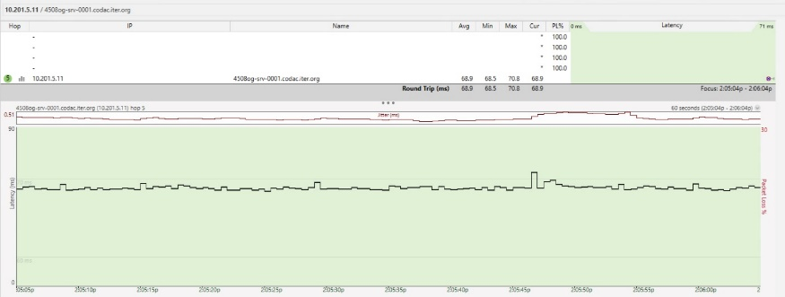
Channel latency compensation algorithm
Channel latency from ITER to RF RPC in used VPN channel is 69 ms.
Latency measured by compare EPICS time stamp is around 34 ms.
record(bi, "MSC:JITTER") {
field(DESC, "time jitter")
field(VAL, "0")
field(ZNAM, "0")
field(ONAM, "1")
}

Slide 10
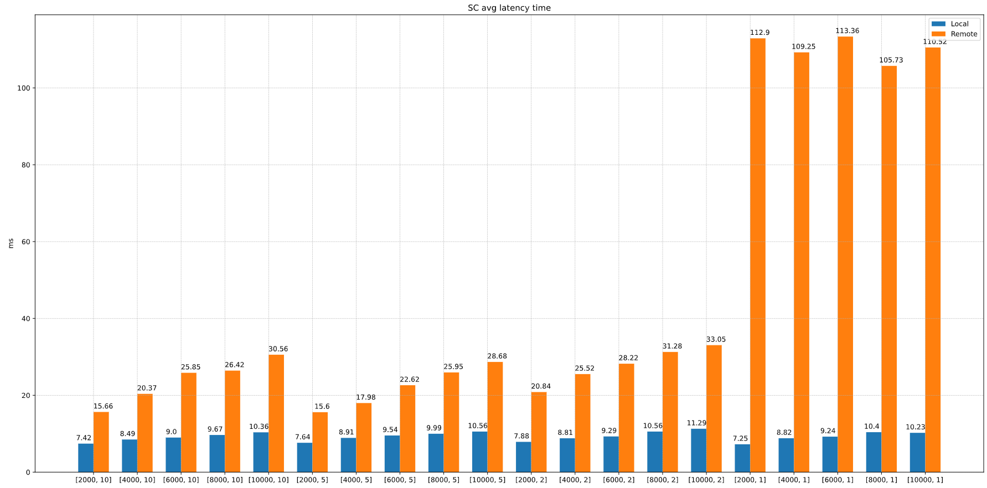
Average Server-Client time latency, Results (1 stream)
Remote channel latency compensated
Time in ms.
[PVs, Freq(Hz)]

Slide 11
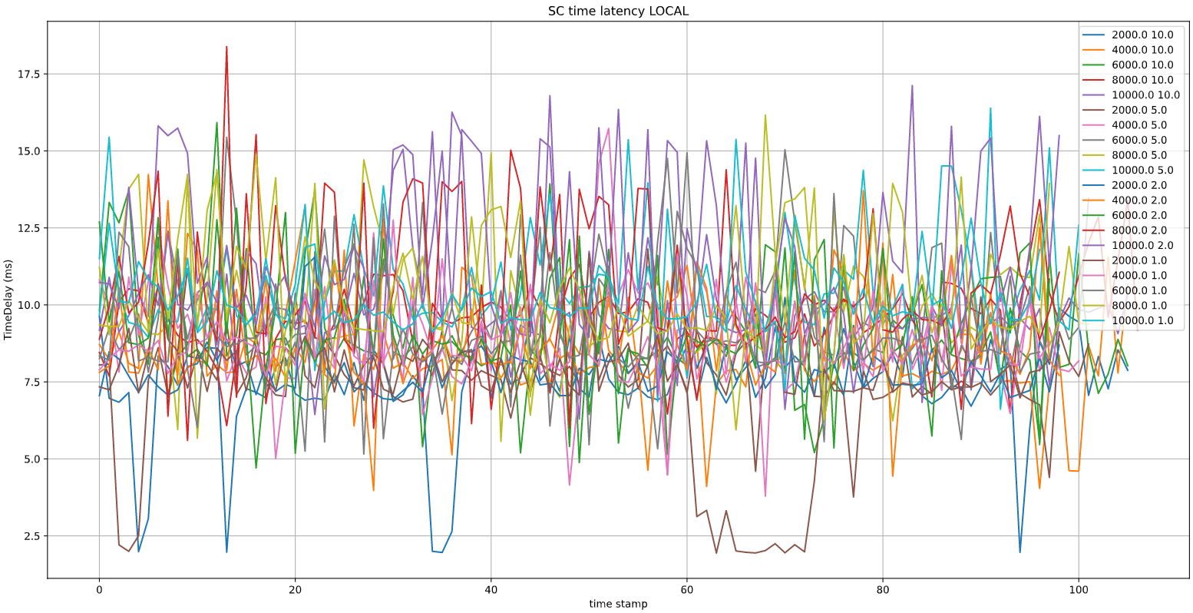
Average Server-Client time latency LOCAL
Time delay ms.
Time stamp.

Slide 12
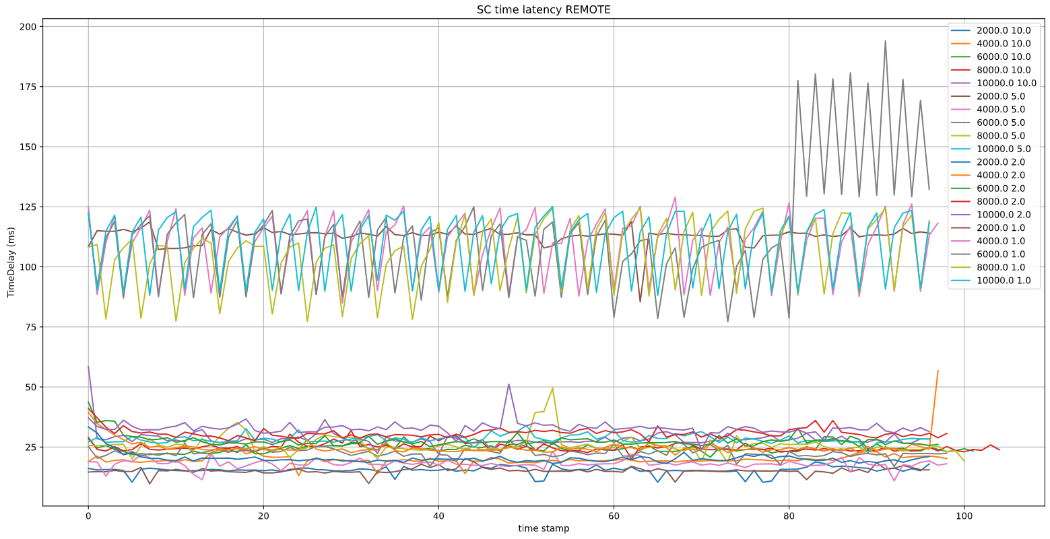
Average Server-Client time latency REMOTE
Remote channel latency compensated
Time delay ms.
Time stamp.

Slide 13
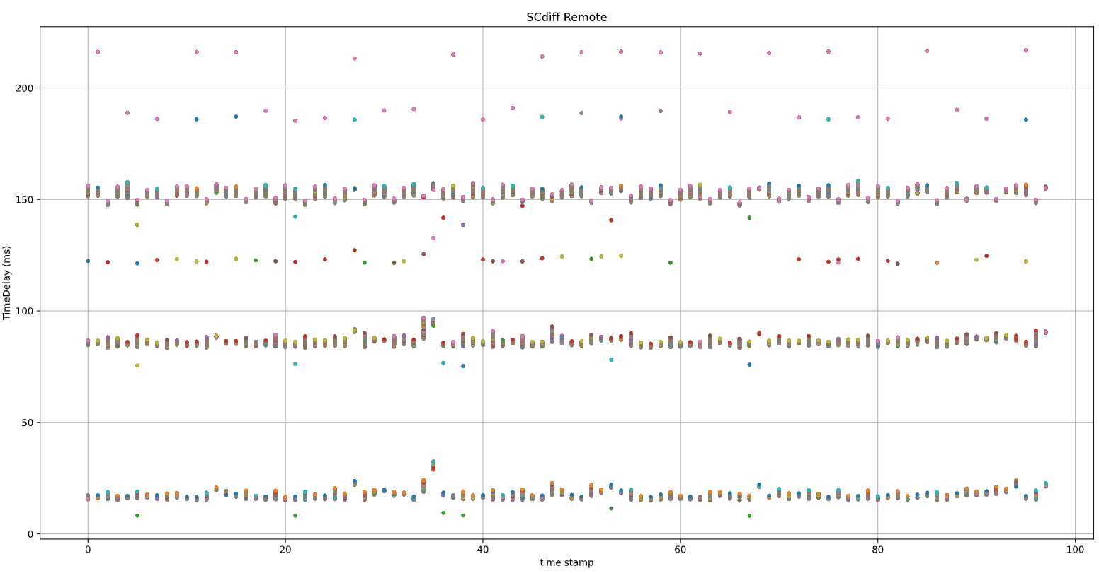
[10000 PV 1Hz] Server Client time latency REMOTE
Time delay ms.
Time stamp.

Slide 14
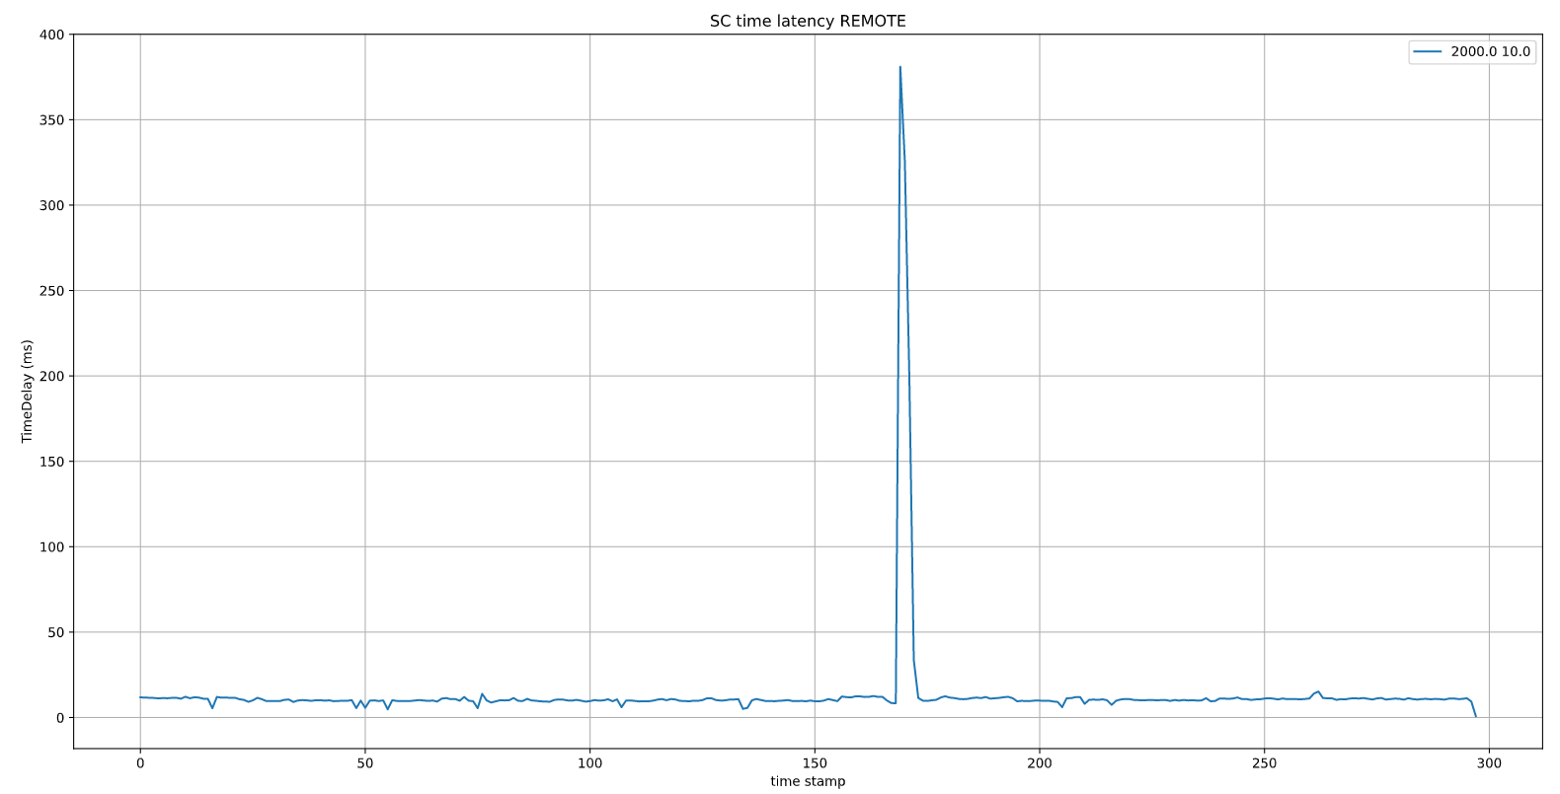
Loss data cases, Server-client time latency chart
data loss here

Slide 15
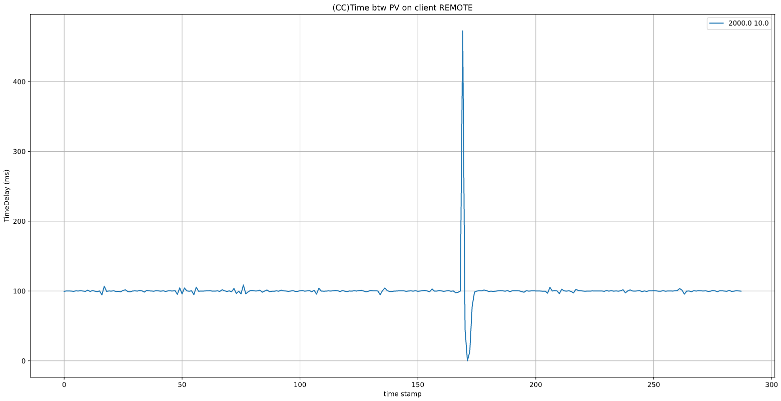
Loss data cases, client-client update time chart
The same place as on the previous slide
Data loss
Everything on time
Everything on time

Slide 16
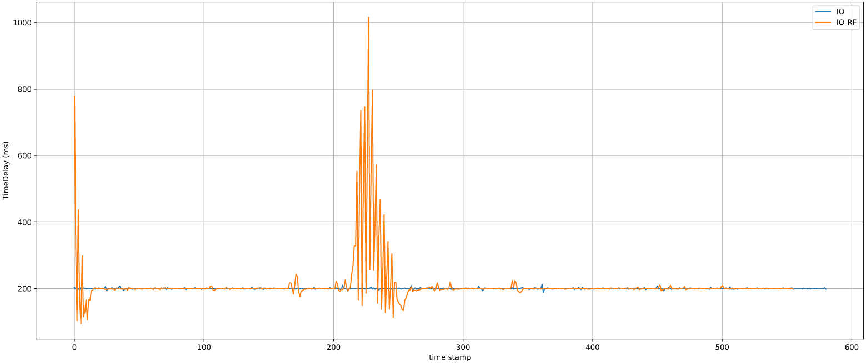
Loss data cases, client-client update time chart
A more serious case [7000 PV, 5Hz ]
Data loss
Everything on time
Everything on time
about 10 seconds of not good user experience in the center and few seconds in the beginning.

Slide 17
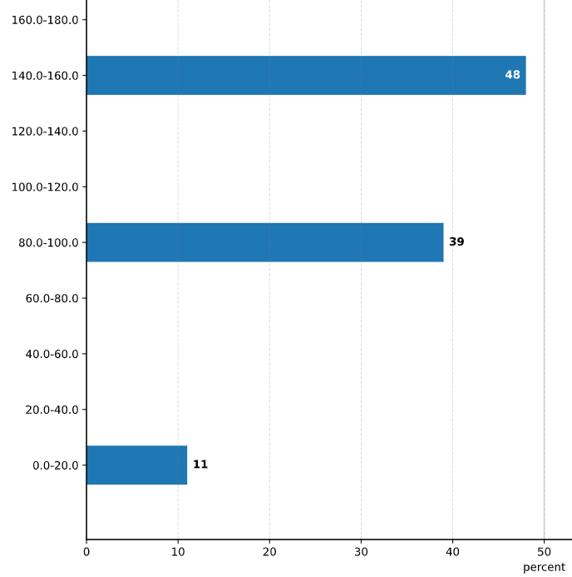
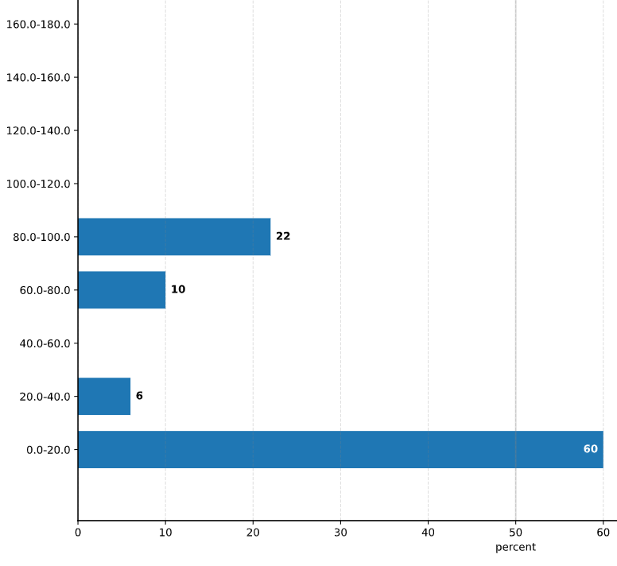
Multithreading effect
8000 PVs, 1 Hz
Time, ms
Time, ms
The rest 2% is upper
The rest 2% is upper
1 Thread
32 Thread

Slide 18
Long term test
Treader-long is control:
Timers update frequency
Reading time
Number of timers to subscribe
Thread quantity
writing to DISK when error event is occur
tracked only PV value order metric

Slide 19
24 Hours EPICS test result, 10 000 PVs 10Hz update rate, 16 reading streams. IO-RF
Long-term EPICS reading test

Slide 20
24 Hours EPICS test result, 10 000 PVs 10Hz update rate, 16 reading streams. IO-US
Long-term EPICS reading test

Slide 21
VPN channel load during the testing

Slide 22
Summary results of long term experiments
 | Maximum PV without major errors events.
Frequency, Hz | IO->RF (less than 5 events per day) | IO->US (less than 5 events per day)
10 | 2 000 | 10 000
5 | 6 000 | 10 000
2 | 10 000 | 10 000
1 | 10 000 | 10 000

Slide 23
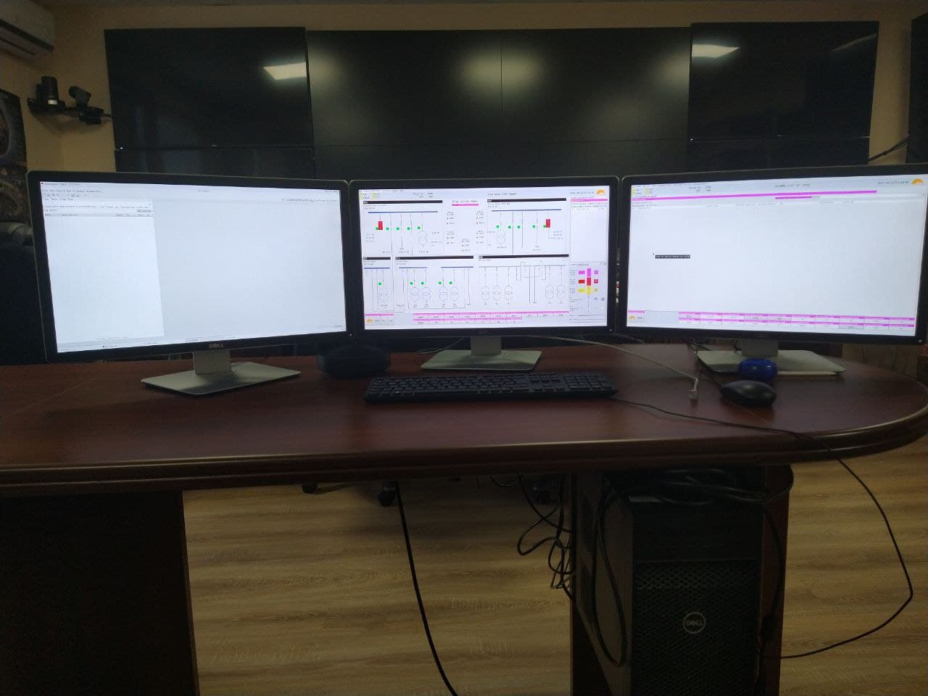
Practical use case
The practical application of the EPICS over long distances is the organization of remote terminals. As part of work on remote participation in ITER, a remote terminal was organized in RF RPC, technically absolutely identical to those that are installed at ITER site. Tests have shown that the user experience is quite identical to what we have on the ITER side, of course, with the remark that the remote operator can only observe.

Slide 24
Summary
Summary result:
During testing, no problems were noticed with the number of PV less than 2000.
Since remote centers cannot control any processes, they can only observe, short-term data loss does not affect much to user experience.
Multithreading gives a good performance boost in terms of latency update time.
Cases of data loss do not depend on the test parameters, and from time to time they occur, which makes it possible to assume that something is happening in the channel.
The latency of updates on the side of the remote participant, adjusted to the static network delay due to distance, was demonstrated to be comparable to the latency of local execution. This suggests that EPICS over long distance is quite usable for the purpose of ITER remotes participation tasks.

