Slide 1
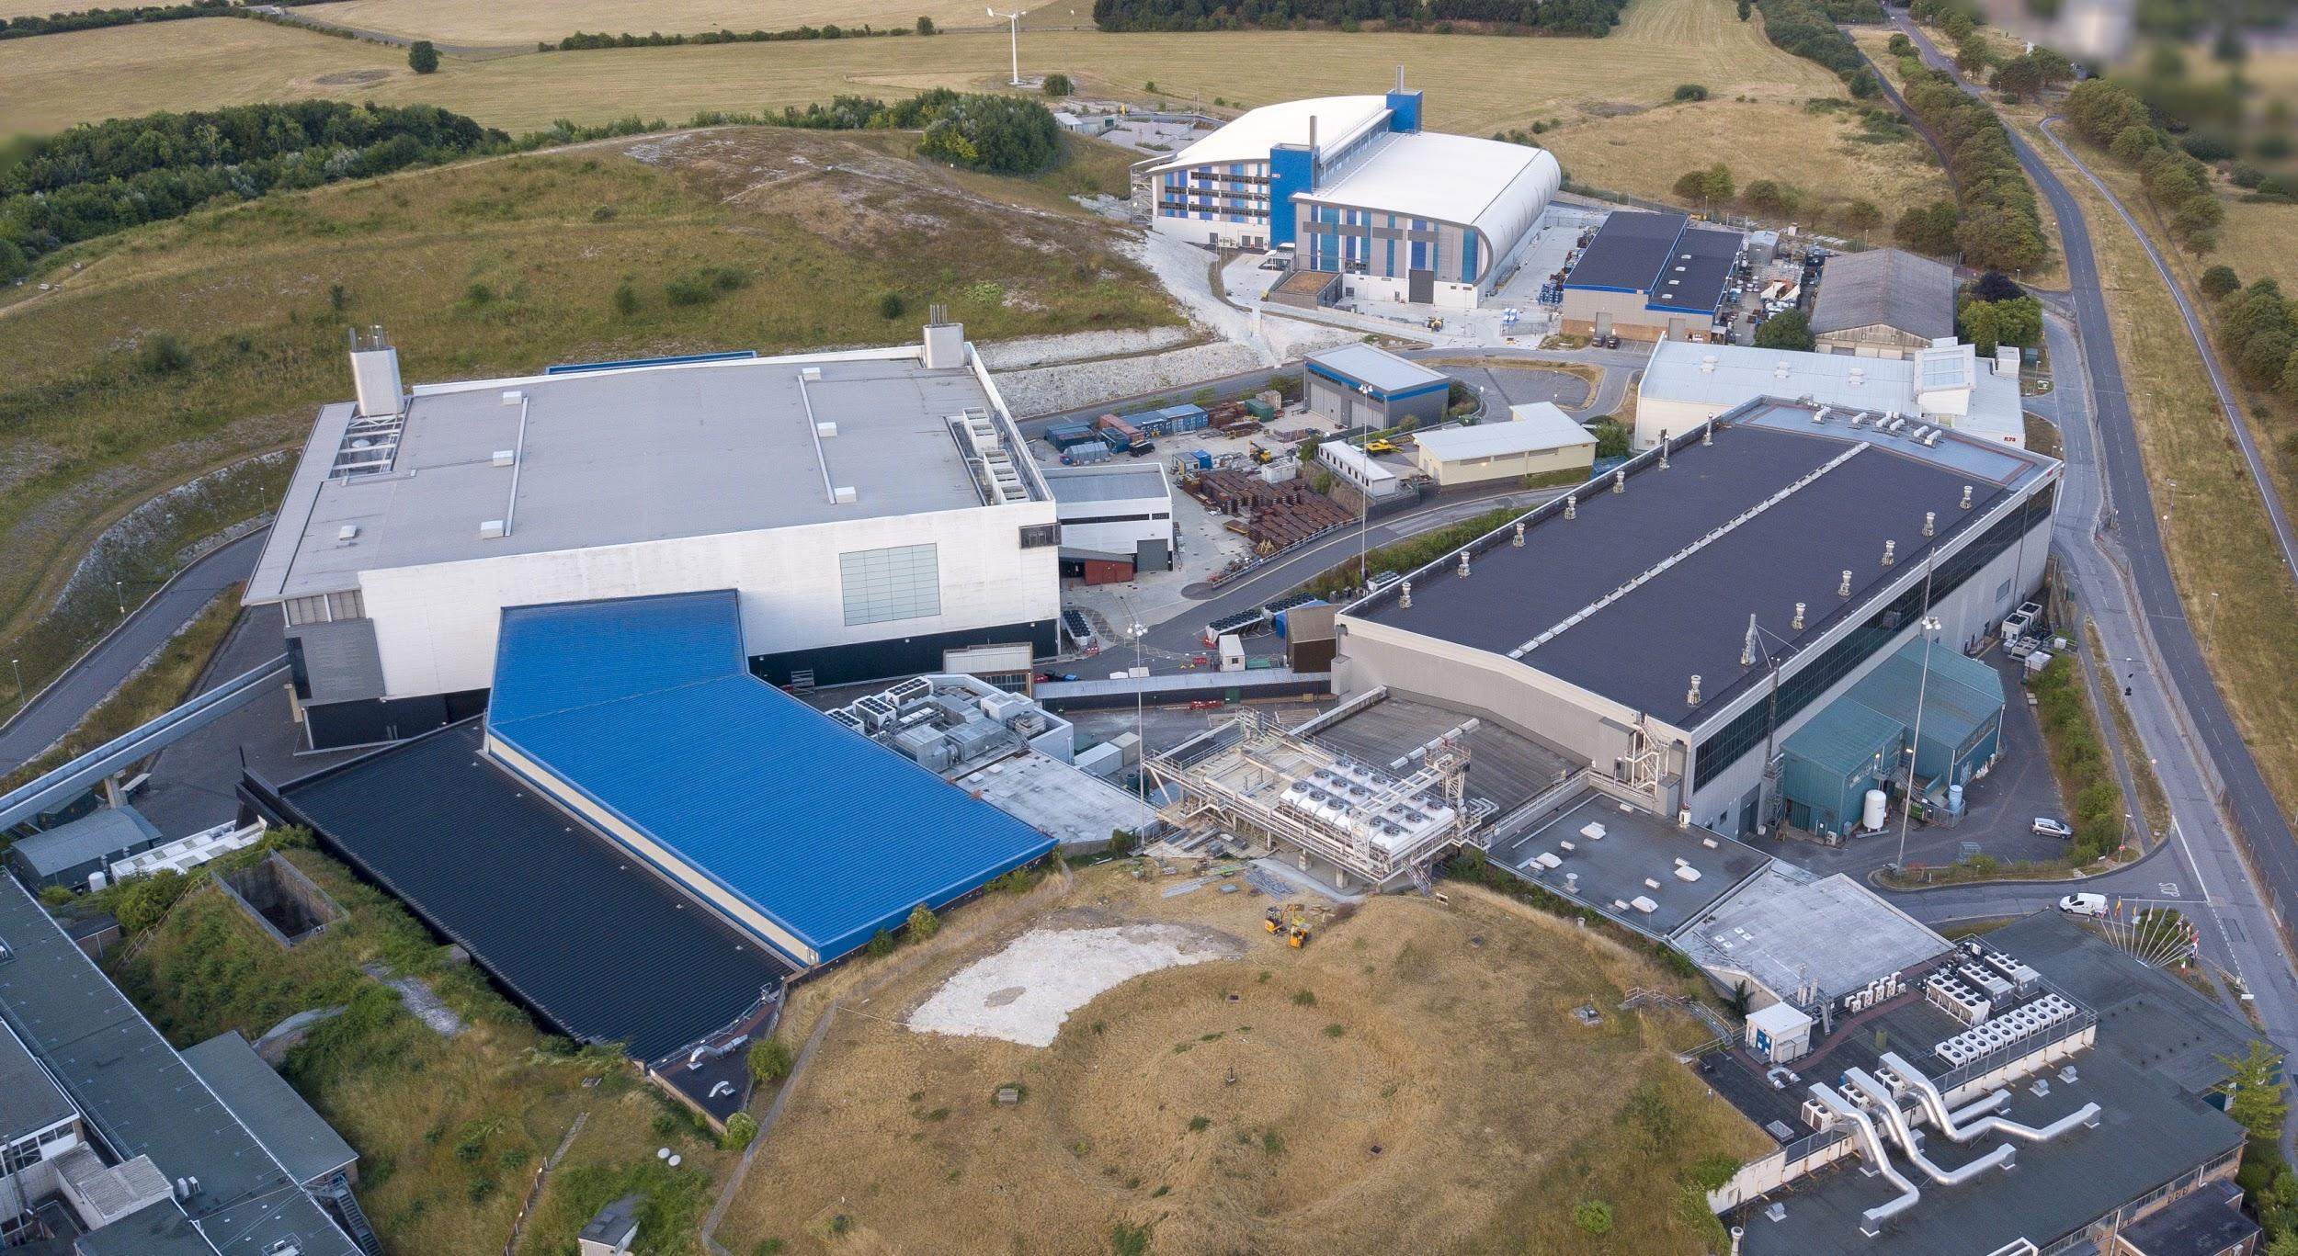


Notes:
To edit the background image, select ‘Format’ from the PowerPoint menu and ‘Slide Background’ from the drop-down menu. Within the new list of options that appears on the right of the screen, select the ‘File’ button under ‘Insert picture from’ and select your image from your file browser. Please remove or amend the image credit if you are using a different image to the one provided.

Slide 2



Python based EPICS interface with CIP enabled devices
EPICS Collaboration Meeting September 2022
Basil Aljamal
Notes:
Good afternoon again, thank you to anyone that has stayed to hear my next talk and welcome to anyone that has just joined. Today I’ll be talking about how we are using EPICS to integrate machine learning into the ISIS Accelerators to improve their performance.

Slide 3
ISIS control system modernization
Intel Itanium ➔ Intel Xeon
OpenVMS ➔ Linux
Bare metal + Xen VMs ➔ Docker containers
Vsystem ➔ EPICS
ABB, Schneider, Omron CX/CJ➔ Omron NX/NJ
FINS ➔ CIP
Notes:
While we’re still in very early days of our machine learning efforts, we do already have some ML projects underway. These include anomaly detection on the liquid methane moderator (prior to the current upgrade of our target station 1) where machine learning was being used to detect anomalies in the temperature stability that previously wouldn’t have been captured by the traditional rule-based detection methods. PVs are monitored and fed into an ML model that classifies the current state as normal or anomalous based on the last hour and a half of data.

Slide 4
CIP vs FINS
CIP (Common Industrial Protocol) | FINS (Factory Interface Network Service)
access memory via tags | access memory via physical memory addresses
complex data structures support | Basic data types
Hard to implement | easy to implement

Slide 5
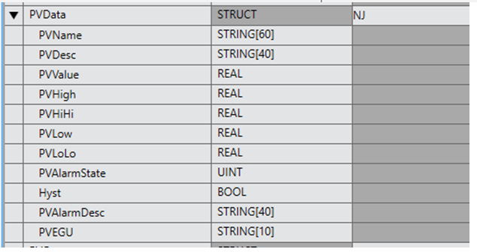
PLC side implementation
Array of structures
Each structure holds all information related to certain process variables including pvname
PLC is the source of truth

Slide 6
EPICS side implementation
Python based PVAserver (using PvaPy library) and cpppo library for CIP communication
Read full array of structures at startup
Read just the value and alarm state every second
Reread full structure every 30 seconds

Slide 7
Lessons learned
CIP has a maximum packet length of 500 bytes for forward open connection and 2000 bytes for large forward open connection
CIP protocol has a feature called “read tag fragmented service” but is not supported by all PLC vendors
Increasing the communication percentage of the PLC processing cycle won’t help
Having a structure of arrays is better than an array of structures

Slide 8





isis.stfc.ac.uk
@ISISNeutronMuon
STFC
Notes:
Continuous tracking of hidden states if we were to use adaptive feedback – this would require constant reading from the control system to continuously update our latent space

