Slide 1
EPICS Deployment at Fermilab
Pierrick Hanlet
21 September 2022

Slide 2
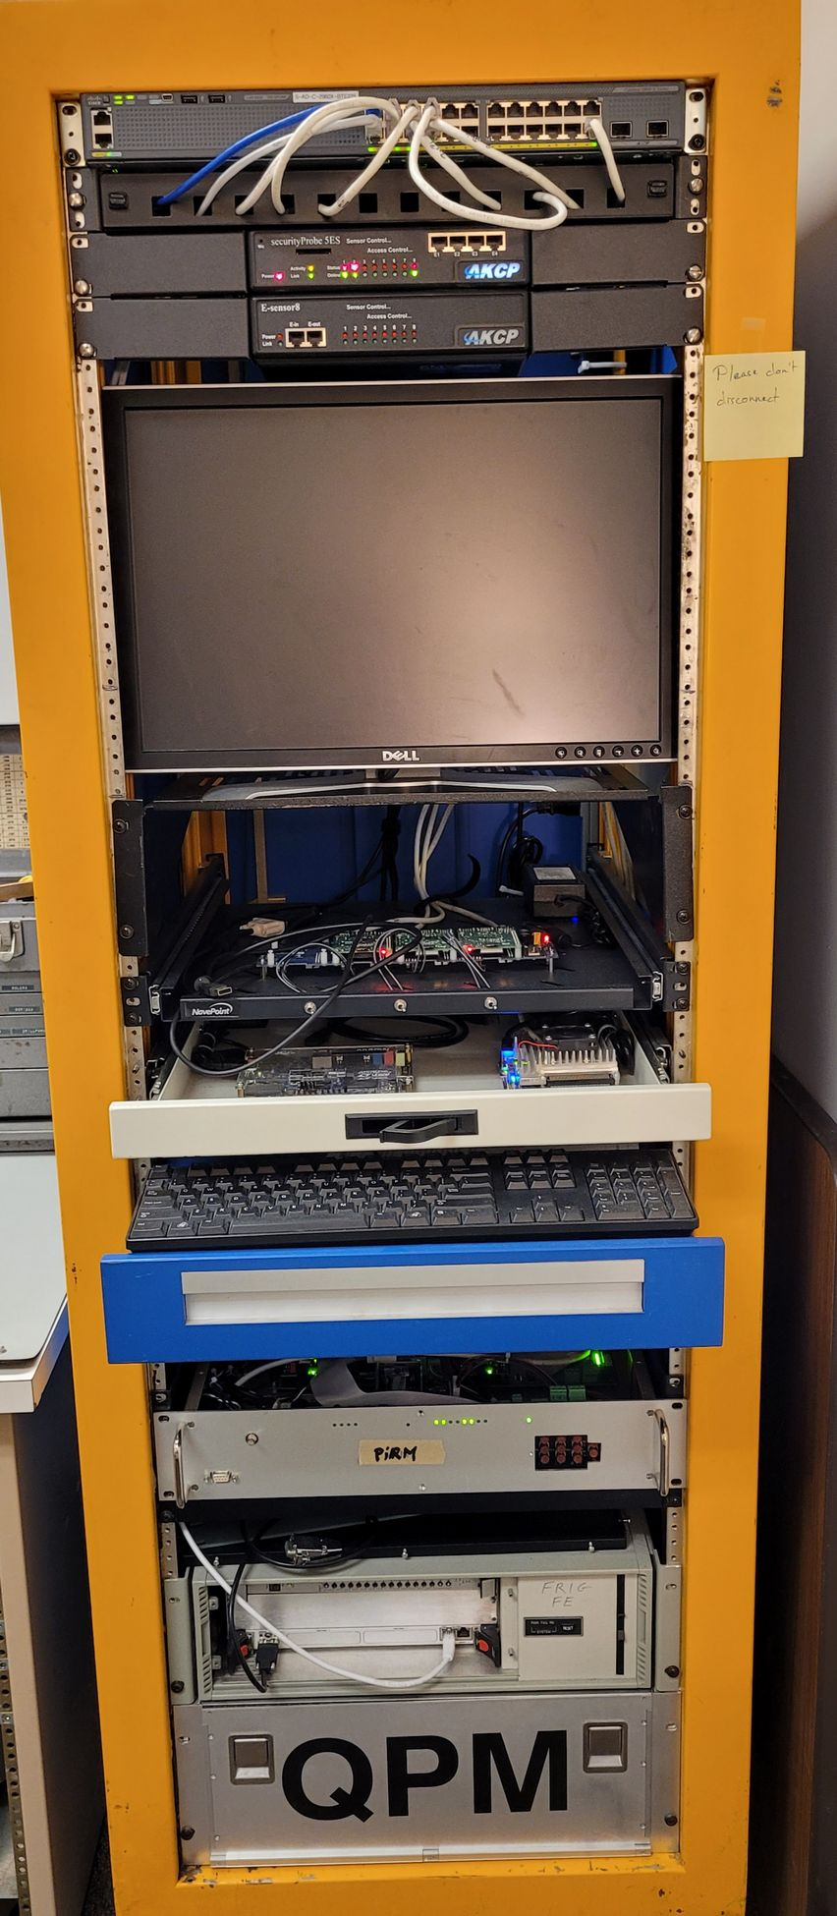
Fermilab Control System Content
Introduction
Motivation
Continuous Integration/Continuous Deployment (CI/CD)
Testing
Template IOCs
IOC Deployment and Monitoring
Security
Present & Future Work
Summary
<number>
21 September 2022

Slide 3
Introduction
Historically, Fermilab is not an EPICS house
  Previous efforts to deploy EPICS
  Some experiments have partial controls using EPICS
  3 years ago, there was a lot of eye-rolling when I mentioned EPICS
Fermilab is building a new proton source and superconducting linear accelerator
  PIP-II
  Early on, the leadership stated that PIP-II’s control system would be EPICS
  Also upgrading the controls infrastructure for the remainder of the complex
  New system will be hybrid (at least for the foreseeable future)
Fermilab controls network has multiple VLANs – use multicast
Little EPICS expertise, so want to make IOC development easy
<number>
21 September 2022

Slide 4
Motivation
Treating EPICS deployment as a green field to simplify deployment for non-experts
  https://ghe-pip2.fnal.gov/epics-controls/
Small controls team, therefore we:
  require robust build of infrastructure
  require automated build procedures
  require extensive testing
  require minimal functionality to automate deployment/monitoring of IOCs
Developed a standard EPICS infrastructure to simplify developing IOCs for new developers
  “base” and “Support” software are built (on all supported platforms) and made available on controls network
  developers start from template IOCs
  template IOCs have minimal basic functionality required of all FNAL IOCs
Automated build for ease and robustness
Standard deployment for ease in maintaining software
Standard deployment to simplify debugging
Options – e.g. containers – kept open for supporting legacy hardware
Implement modern computing practices Continuous Integration/Continuous Deployment (CI/CD)
Use PVXS for instrumentation and high rate/high volume data and CA for slow controls
<number>
21 September 2022

Slide 5
FNAL EPICS code structure
Structure follows conventional EPICS implementations
The Fermilab “standard deployment” of EPICS code assumes a 3-tier build:
  EPICS base – Production code resides in /usr/local/epics/base
  EPICS Support – Production code resides in /usr/local/epics/Support
  EPICS IOCs – Production code resides in /usr/local/epics/iocTops
EPICS base, Support, & iocTops are built for different architectures/platforms
  Presently have builds for: linux-x86_64, arm/Cyclone-V, arm/Arria-10, arm/RasPi2, arm/RasPi3 arm/RasPi4, ppc/mvme8100
Code base is built and tested in Continuous Integration/Continuous Deployment processes
EPICS base, Support, & iocTops are hosted by NFS server
Goal is to have a robust EPICS code base to simplify novice EPICS-developer deployment and to help experts in debugging
<number>
21 September 2022

Slide 6
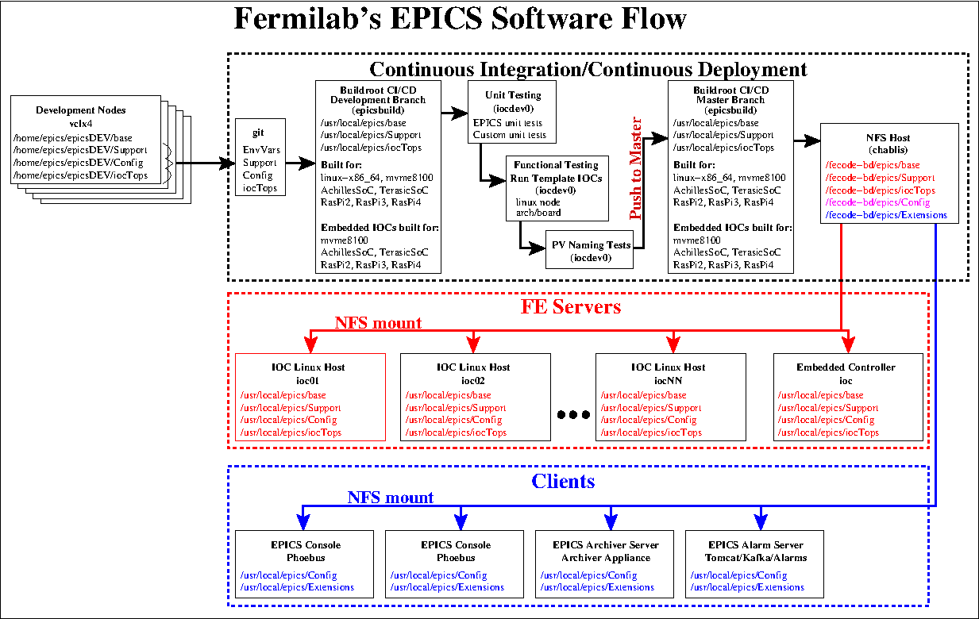
CI/CD – Software Path to Deployment
<number>
21 September 2022

Slide 7

CI/CD – Deployment of New IOCs
Implementation developed by Mariana González.
Using Github for code management, documentation and issue tracking.
Using Github Actions tool to automate building and testing
Using Buildroot for configuring and cross-compiling
Full CI/CD chain is complete and successfully tested
  Code and documentation migrated Github
  Automated build of the 3-tier EPICS in all supported architectures
  Automated unit testing – working for host architecture
  Automated testing:
    Unit tests
    Basic functional tests (based on templateIOC tests)
    Check for duplicate PV names
    Passing tests allows for code to be build, tagged, and pushed to NFS host
  IOC owner must register IOC before deploying
<number>
21 September 2022

Slide 8
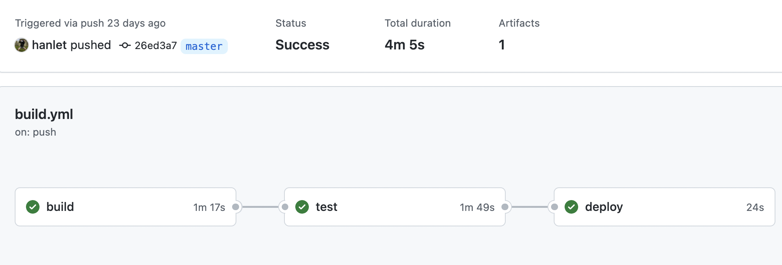
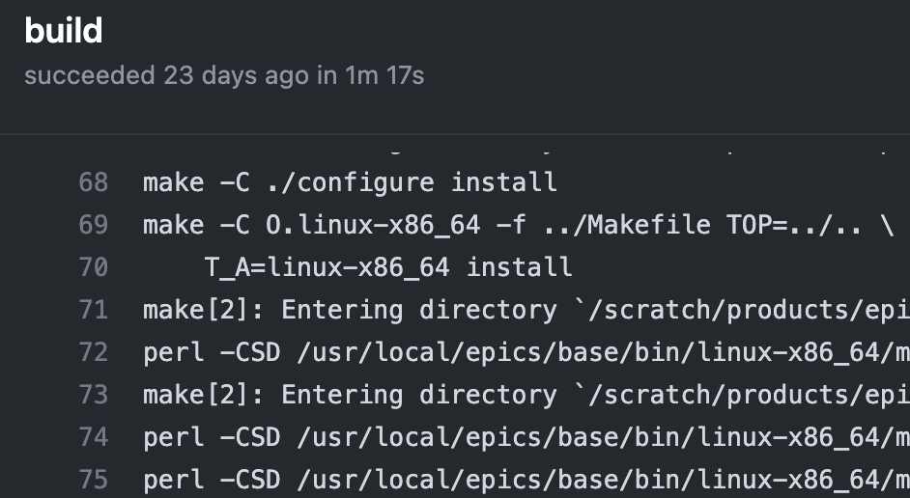
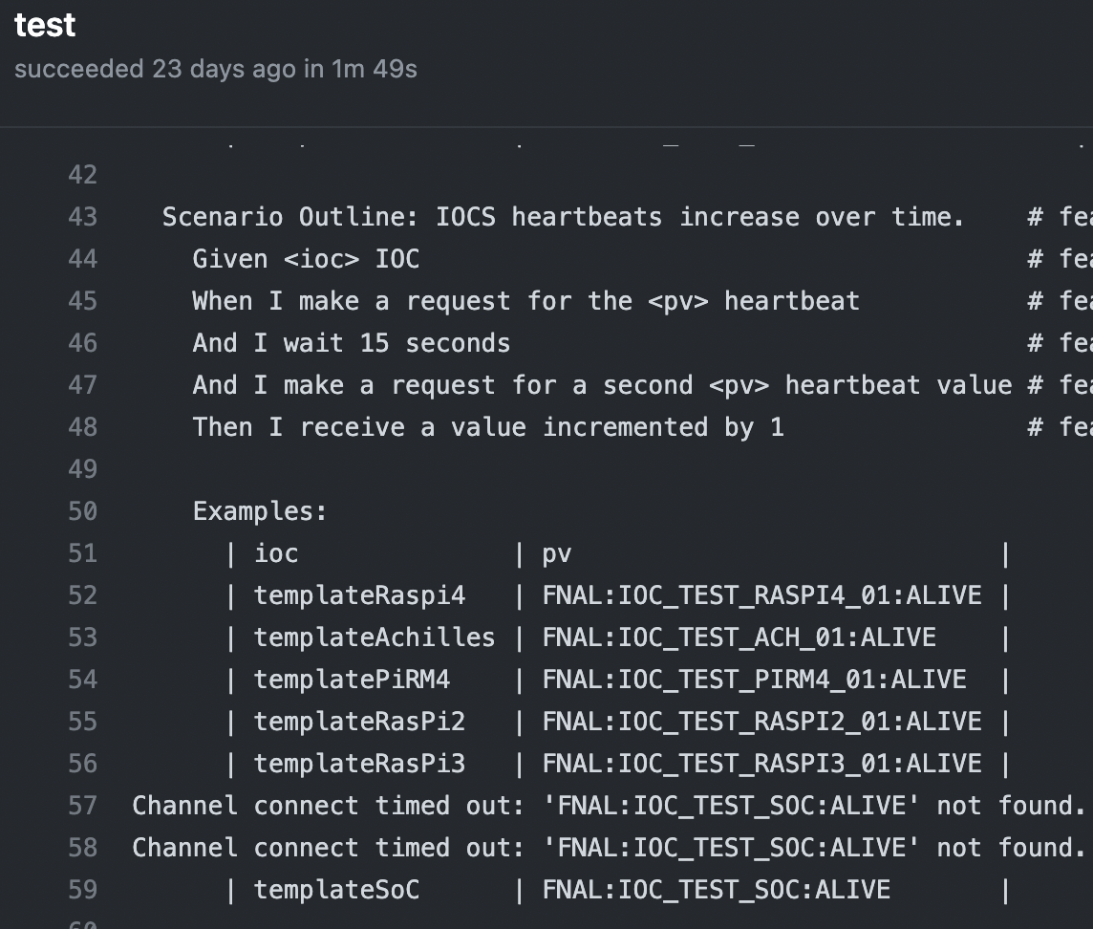
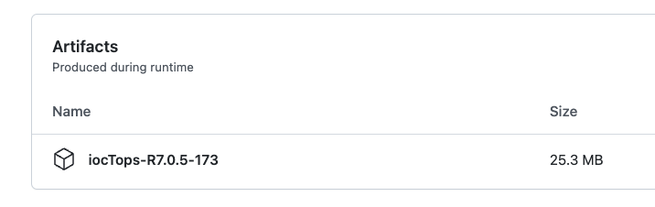
CI/CD – Pipeline
<number>
21 September 2022

Slide 9
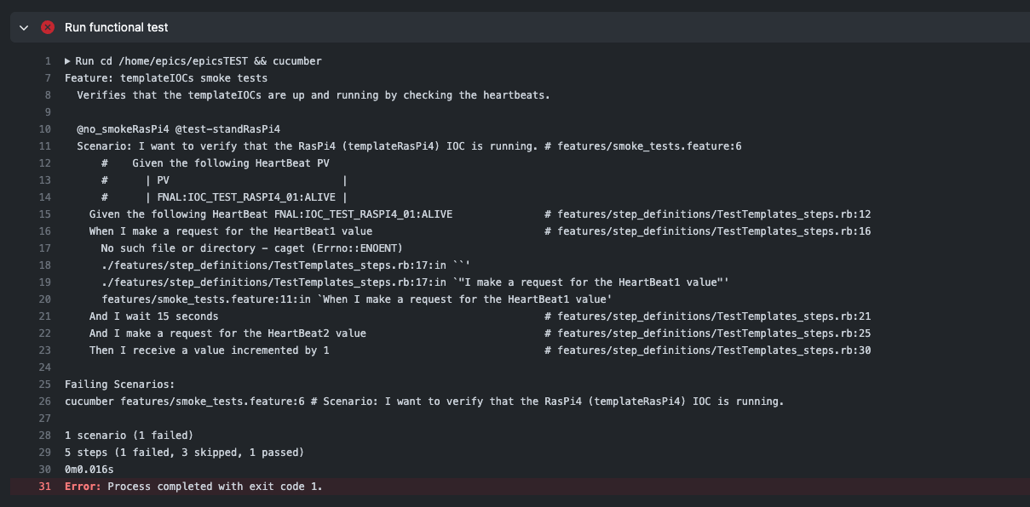
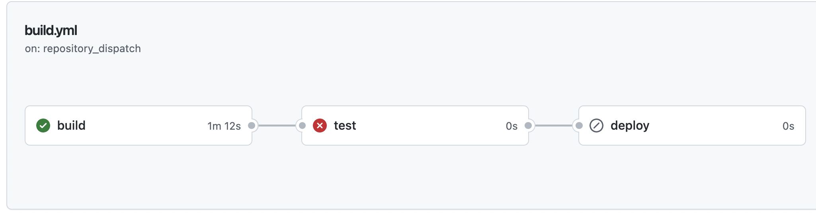
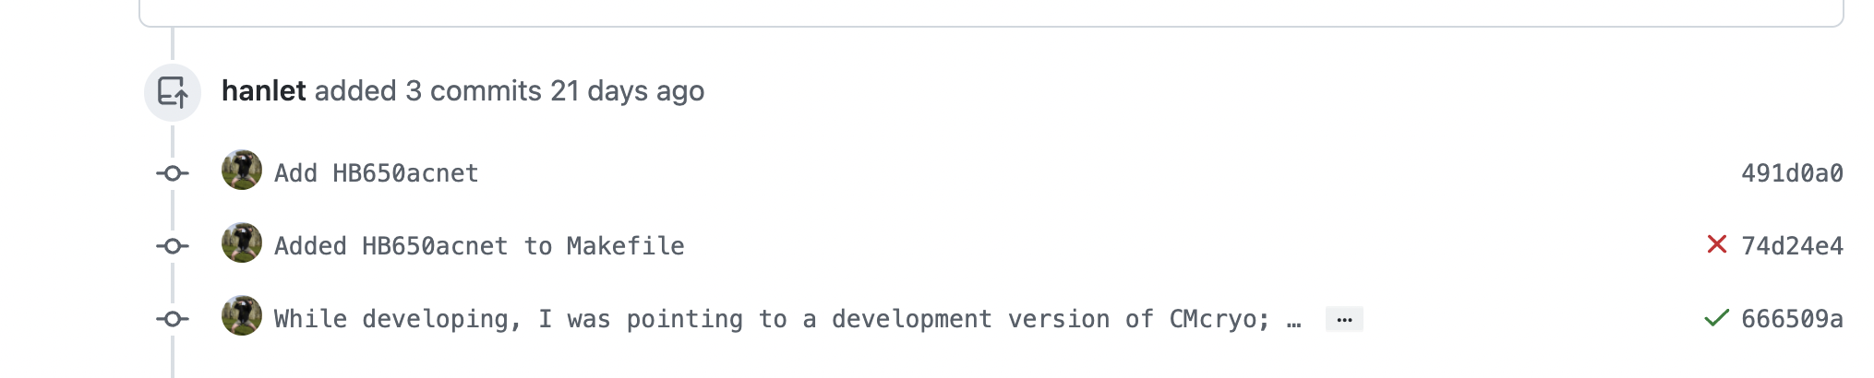
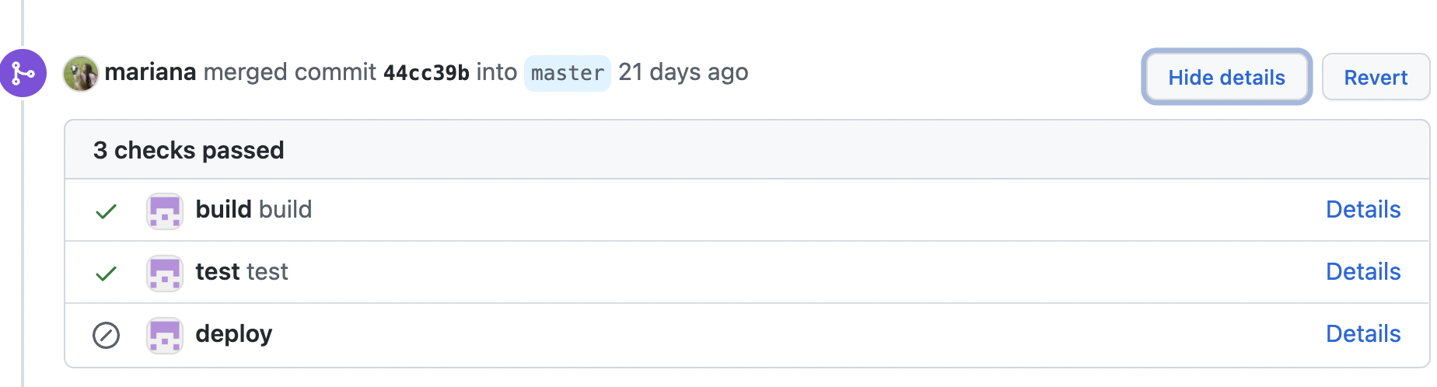
CI/CD – Pipeline
Instant feedback
Trace-ability
<number>
21 September 2022

Slide 10
Template IOCs
Each Fermilab IOC running on the controls network will provide the following:
heartbeat
IOC statistics (CPU usage, memory usage, etc.)
capability of 20 Hz scan rate
use aSub (specific Support module) record for interfacing with IOC specific custom code (C/C++ libraries)
access to acnet (acnetPV wrapper)
reccaster
I propose to use the template in the following steps:
build and use the IOC as is to test connectivity to your embedded system
once established, create IOC specific PVs, code, and link to IOC specific custom libraries
In order to deliver a robust framework for the controls system, the tests we intend to implement are:
Unit tests
Functional tests
Stress tests:
  Check connection loss of NFS host
  Scan rate
  Data transfer bandwidth
Operational:
  Register IOCs when coming online
  Monitor IOC for monitoring registered IOCs
<number>
21 September 2022

Slide 11
Scope of Testing
In order to deliver a robust framework for the controls system, the tests we intend to implement are:
Unit tests
Functional tests
Stress tests:
  Check connection loss of NFS host
  Scan rate
  Data transfer bandwidth
Operational:
  Register IOCs when coming online
  Monitor IOC for monitoring registered IOCs
<number>
21 September 2022

Slide 12
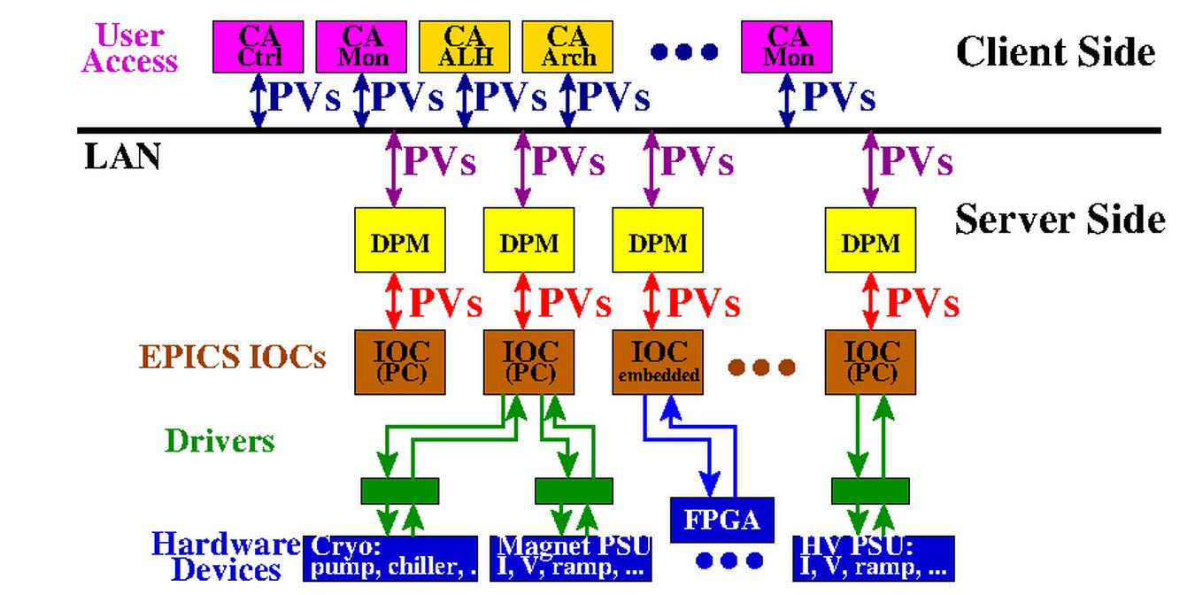
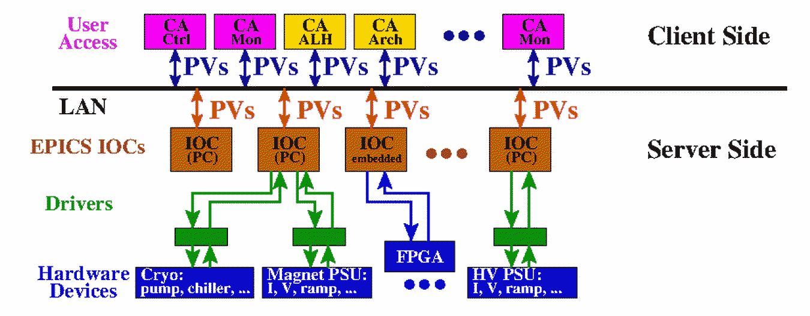
Security
By default, EPICS IOCs, once deployed on the network, make all their PVs accessible to any other EPICS process. We want to limit this capability by restricting access using currently implemented kerberos authentication. To accomplish this:
Use existing EPICS capability – “access security”
Restrict IOCs to single restricted account name
Restrict access to IOCs via DPMs
Access to DPMs require kerberos authentication from client side
<number>
21 September 2022

Slide 13
Documentation and Versioning
Presently documented on Github
Source code versioning in Github
Git Branch model:
  Using a simple branch model
  We consider origin/master to be the branch where the source code always reflects a production-ready state.
  Using Github capabilities of branch protection for master
  Other branches should contain the work of new code, new features and bug fixes and will be merged backinto the master branch when the work is finished and properly reviewed & tested.
Code/configurations and build scripts in Github Actions
Will keep 3 executable versions, change is through softlinks
<number>
21 September 2022

Slide 14
Work in Progress
improve build time (base to iocTops takes ~4 hrs) on a VM
  moving buildroot to a beefier machine – “epicsbuild” – in progress
more functional test content
add security scans
develop tests (post-build - pre-deployment) - I imagine this to continue for years
establish network boot for the raspberrypis and TerasicSoC - complete for the AchillesSoC
more documentation
continue work with SoC/SoM architectures/platforms
  FPGA data to reddis, IOC on external server
  FPGA data to “/dev/mem”, IOC on arm processor
  Presently have EPICS builds for: TerasicSoc (Cyclone V) and Achilles (Arria-10)
Will add Xilinx based SoMs: proposing MiniZed (Zynq 7Z007S), ZedBoard (Zynq-7000), TE0803 (Zynq UltraScale)
<number>
21 September 2022

Slide 15

Summary
Fermilab is finally an EPICS house
Green Field – want robust, reproducible, versioned, and easily maintained
Template IOCs developed to:
  help new EPICS developers
  ensure required basic functionality of all IOCs
Software is built for several architectures/boards
CI/CD path is in place and operational
More tests need developing
<number>
21 September 2022

