Slide 1
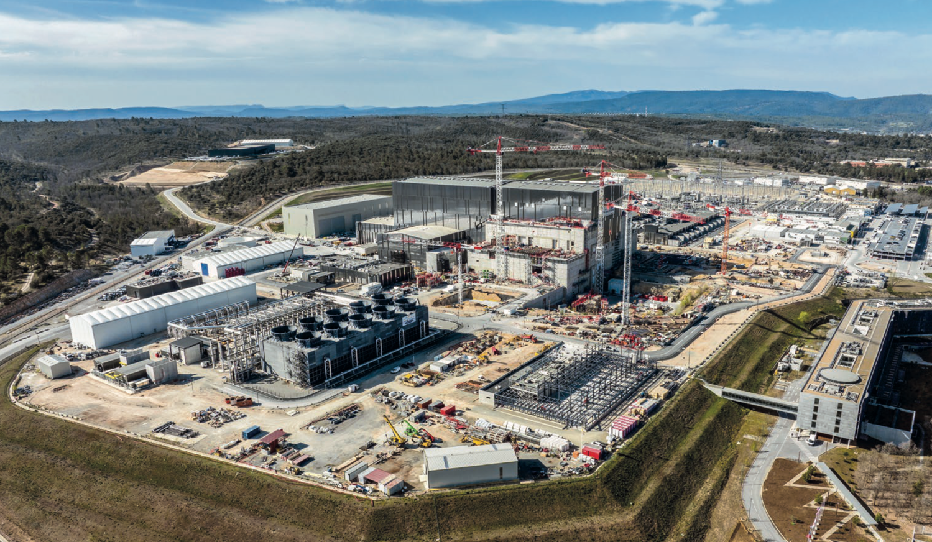
ITER Operation Applications: Status and Future Development
Bob Gunion
ITER Organization

Slide 2
Outline
Operation Applications Overview
Pulse Schedule Preparation System (PSPS)
Supervision System (SUP) Overview
SUP Configuration
SUP Sequencer

Slide 3
Operation Applications Overview
Pulse Schedule Preparation System (PSPS)
  Definition of pulse schedules to describe automated operation, with or without plasma
Supervisory System (SUP)
  Coordinate system state across plant systems
Plasma Control System (PCS)
  Deterministic control during pulses using the Real Time Framework (RTF)*
Data Handling (DA)
  Archiving of POS, SDN data; data visualization
Remote Participation (RP)
  Virtual Collaboration tools for ITER members to participate in experiments**
*Anze Zagar Thu 12:25 – EPICS (pvAccess) Transport Layer for the ITER Real-Time Framework (RTF)
**Leonid Lobes Thu 09:35 – Study on EPICS Communication over Long Distance

Slide 4
Challenges in the ITER Control System
ITER is:
  Large: 3.5 million PVs at first plasma; 5+ at later stages
  Complex: >20 plant systems, each with a unique design
  Diverse: In-kind contributions from 7 members (35 countries) and hundreds of contractors
  Changing: Staged deployment and operations lead to evolving requirements
Addressing these challenges:
  Automate procedures as much as possible
  Decouple individual plant systems by overlaying a consistent interface
  Validate, verify, and trace configurations and machine state
  Provide comprehensive monitoring tools
  Ensure proper authentication and approval policies
  Retain flexibility to change procedures and parameters over time
  Coordinate operational plans through pulse schedules
-> PSPS and SUP solve these by providing a well-controlled, but flexible, solution

Slide 5
Pulse Schedule Preparation System
Integrated PSPS/SUP/PCS Demonstrations:
Purpose:
  Allow experiment leaders to define pulse schedules for automated operation of the entire ITER system
  Provide an approval workflow to ensure pulse schedules match ITER scientific goals, equipment states, plant system requirements, etc.
  Allow remote creation/editing of pulse schedules
  Validate configurations through CVVF
  Execute pulse schedules via integration with SUP
Currently in early development
  Initial pulse schedule lifecycle management service has been implemented (C++17)
  Early prototype of GUI (based on MVVM framework with Qt/C++)
We conduct demonstrations regularly with our future users (physics, operations, plant systems) and our CODAC colleagues
Dec. 2021
Read PS, navigate sections, basic authorization
Transmit to SUP
April 2022
Realistic plant system config, XML and database serialization, validation & transformation
Transmit complete plant system config to SUP
July 2022
PCS configuration, validation in both PSPS and SUP
Full control chain PSPS -> SUP -> PCS
Nov. 2022
PS Editor GUI

Slide 6
PSPS Plans
Add features to core functionality
  LDAP-based authentication and authorization
  Version control of pulse schedules
  Web-based API
  Complete workflow support
PS Editor User Interface
  Demonstrate prototype in Qt/C++ based on MVVM framework
  Explore web-based UI (React, Angular, ...)

Slide 7
Supervisory System (SUP) Overview
Provides Operations with a central control interface to the entire ITER machine
Integration | Provides abstraction of plant system states Common interface for configuration, control and monitoring (common functions)
Automation | Functions for automated activities Control actions based on status monitoring Handle concurrent activities
Operability | Achieve robust and repeatable operation Configure plant system from scratch Access to bare signals
Protection | Lowest tier in defense-in-depth hierarchy Provides permit/inhibit behavior
Key Components:
Configuration (CVVF)
Sequencer
Monitoring
Pulse Counter
Timing

Slide 8
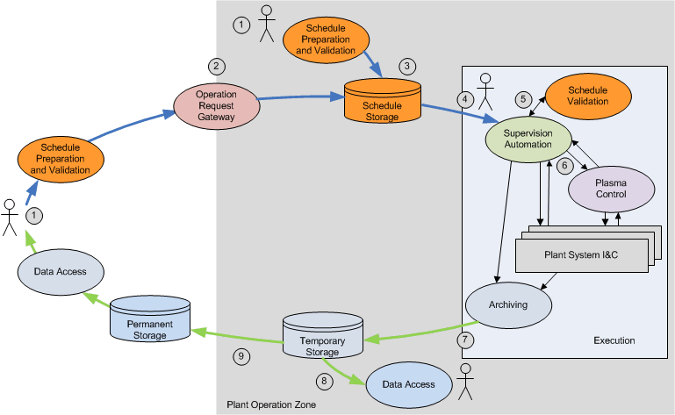
SUP Configuration: Validation
SUP
PSPS
Primary use case: pulse execution
Validation must be performed at all stages of pulse schedule development and execution
All validations must use the same code to ensure consistency

Slide 9
Addressing Configuration Challenges
Provided solution must be capable of:
  Executing arbitrary codes after approval by appropriate experts
    Multiple languages (C++/Python/Matlab)
    Arbitrary datatypes, including structured/array data
  Linking disparate systems with a common interface
  Deterministic operations when necessary
  Parallel execution when appropriate
RPC service with flexible interface is an ideal solution
Meanwhile, EPICS is already the established control system
-> Solution: Configuration, Verification and Validation Framework (CVVF) with PVAccess transport layer

Slide 10
Development Status of CVVF
CVVF is in active use
2018: First release as part of CODAC Core 6.0 including:
  Minimized dependencies on C++11 (compiler support, ?’s about stability)
  PVAccess-based RPC transport
  bool Execute(const char* function_name, const AnyValue& config, const AnyValue& input, AnyValue& output);
2022: Refactoring to address shortcomings of initial implementation:
  Unnecessary dependencies on CODAC infrastructure
  Non-intuitive API leads to frustration and confusion among developers
  Passing everything by reference, including the reliance on a custom shared pointer implementation, leads to unexpected exceptions
Refactoring begins with a new AnyValue implementation

Slide 11
Changes to CVVF
 | Old | New
LOC | 8k | 5k
EXPECTs | 300 | 2300
New AnyType/AnyValue implementation
  No more need to avoid C++11
  Adopt pass-by-value to avoid ownership/reference problems
  Adopt a more intuitive API, including templated methods
  Passes quality gates: HICPP, cognitive complexity, memcheck, coverage
Next: replace the RPC implementation
  Remove dependency on CODAC Core
  Still using PVAccess, as it’s been very successful

Slide 12
SUP: Sequencer
<?xml version="1.0" encoding="UTF-8"?>
<Procedure xmlns="http://codac.iter.org/sup/sequencer" version="1.0"
name="Procedure for configuration of system and running a test scenario"
xmlns:xs="http://www.w3.org/2001/XMLSchema-instance"
xs:schemaLocation="http://codac.iter.org/sup/sequencer sequencer.xsd">
<RegisterType jsontype='{"type":"TestSUPPlugin::types::FilterSettings/v1.0", ...
<Plugin>libsequencer-sup-cfg.so</Plugin>
<Sequence name="Main sequence">
<CVVFClient name="Verify filter settings through CVVF"
service="test-sup-plugin@cvvf-service"
function="TestSUPPlugin::cvvf::VerifyFilter/v1.0"
input="config"
output="result"/>
<Fallback name="Verification succeeded or override">
<Equals lhs="result" rhs="true"/>
<Sequence>
<Input output="override" description="Override verification result?"/>
<Equals lhs="override" rhs="true"/>
</Sequence>
</Fallback>
<LoadConfiguration name="Load configuration for filter"
service="test-sup-plugin@cfg-service"
configName="TestSUPPlugin::Filter0::settings"
input="config"/>
<Include name="Execute test" file="TestScenarios.xml" path="FilterTests.test01"/>
</Sequence>
<Workspace>
<Local name="config" type='{"type":"TestSUPPlugin::types::FilterSettings/v1.0"}'
value='{"lowercutoff":20.0,"uppercutoff":11000.0,"mode":2}'/>
<Local name="result" type='{"type":"bool"}'/>
<Local name="override" type='{"type":"bool"}'/>
<Local name="true" type='{"type":"bool"}' value="1"/>
</Workspace>
</Procedure>
The Sequencer is a tool for the creation, adaptation, approval and execution of operational tasks
Coordinates multiple services for integrated tasks including commissioning, maintenance, etc.
  Generally uses PVAccess for remote communications
Based on a behavior tree model
All steps of a task can be defined in a procedure, saved as an XML file
Sequencer GUI is provided as an HMI for defining, debugging and running procedures
Behavior Tree
Example

Slide 13
Sequencer GUI
Same Application Model, different ViewModel’s
Based on MVVM concept of GUI software architecture
C++17, Qt5, CMake
Multiple views of the same model allow user to select the most appropriate interaction
Graphical view of behavior tree nodes allows drag/drop, auto-arranging, etc.

Slide 14
Conclusions
Operation Applications development is active and ongoing
  Use of PVAccess is widespread
PSPS development getting off to a good start
CVVF has proven to meet its design goals
  But, improvements are possible
  Refactoring of the underlying data objects will ensure greater robustness and performance
  PVAccess has proven to be easy to use, flexible, and performant
SUP Sequencer provides a flexible and robust solution for automated task execution
SUP Sequencer GUI provides an intuitive UI for users’ benefit

Slide 15
Backup Slides

Slide 16
Roadmap for Operation Applications
Yearly releases
Dec. 2022
  Pulse Schedule Editor with CVVF support
  Sequencer, Pulse Counter, GOS management, documentation
Dec. 2023
  PS Editor: integrated plant system commissioning, segments, PCS configuration
  SUP: Coordinated configuration, implementation of operational tasks
Dec. 2024
  PS Editor: Full workflow support
  SUP: Completion of all SUP related HMIs

Slide 17
SUP Components
PSPS
Provide homogeneous structured interface
Transformation, Verification and Validation
Transactional configuration of I&C
PVAccess (and in some cases CA) used throughout for various purposes
SUP
Automation:
GOS/COS
Operational Tasks
Configuration
Plant System I&C
CVVF
HMI
Monitoring
PCS
Control (auto)
Sequencer
Monitor the ITER plant (GOS, COS, health, …)
Support Central & Local Procedures (goals, conditions)
Decoupling functions
Manage GOS substates
Execute Operational Tasks (GDC, Venting, etc.)
Coordinate Local Procedures (compatibility of goals, decoupling functions, activity identifiers, …)
Execute Pulse (control handover/handback, countdown timers, etc.)
Control I&C (control functions, COS)
Support Central & Local Procedures (goals, commands)
Decoupling functions

Slide 18
Data Transport Objects

Slide 19
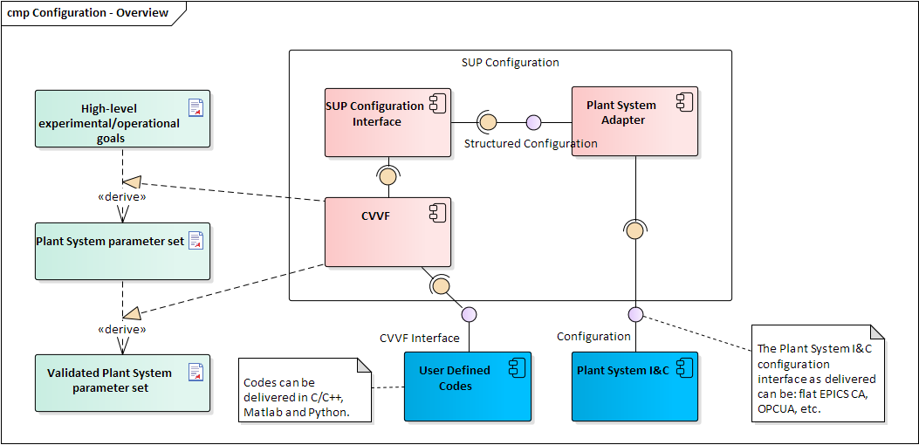
CVVF Information flow

Slide 20
SUP Components
SUP Configuration provides a common interface to all plant systems
SUP Automation provides central coordination of automated tasks
SUP Pulse Counter provides a unique ID for each pulse
SUP Timing records and publishes pulse countdown, start, end times
SUP Monitoring coordinates GOS/COS (Global/Common Operating States) across plant systems
Interfaces with PSPS to execute pulse schedules
Hands over control to PCS (Plasma Control System) during pulse execution
Software Integrity Level 1

Slide 21
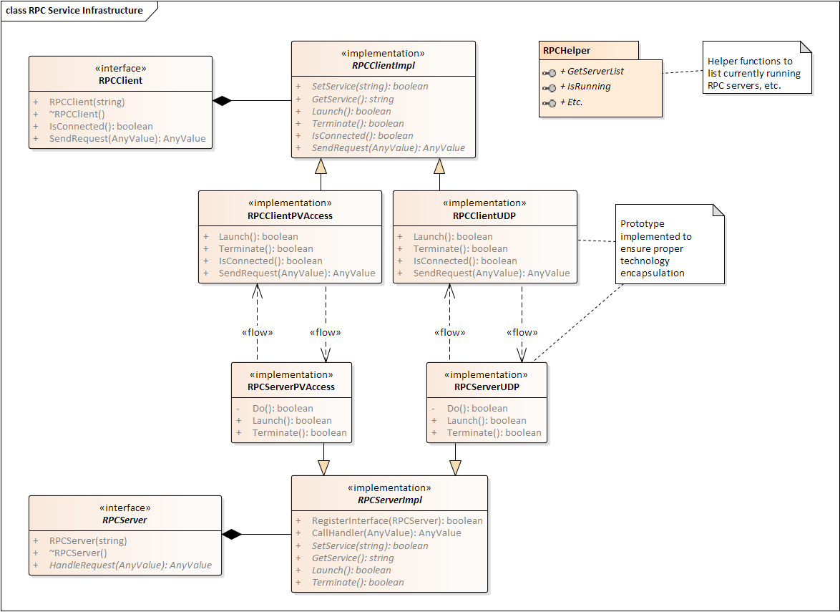
RPC design
PVAccess transport
UDP transport (prototype)

Slide 22
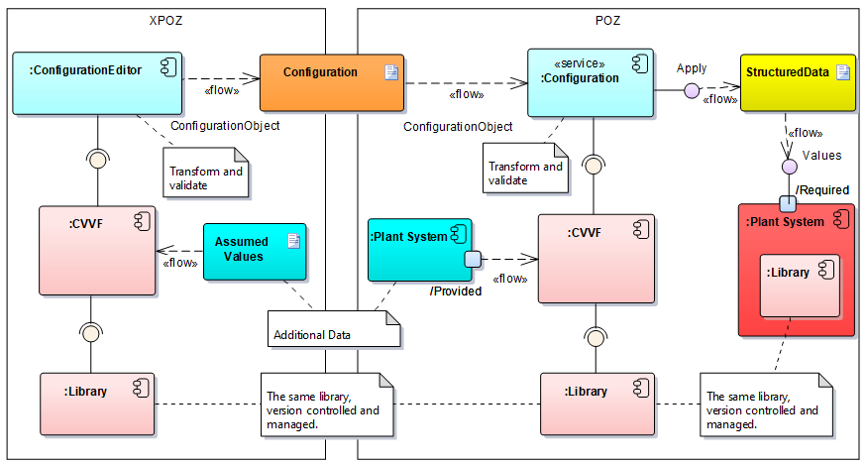
Multiple Environments
All validations should run the same code

