Slide 1
EPICS driver development of HBM MGCPlus DAQ
Lange Ralph
Mohor Gartner
Jernej Podlipnik
Notes:
My name is Jernej Podlipnik and I will do a brief talk about how we integrated the MGCPlus DAQ system to EPICS.
I wanted to present it to you, since the approach is quite interesting with using two different interfaces for one device.

Slide 2
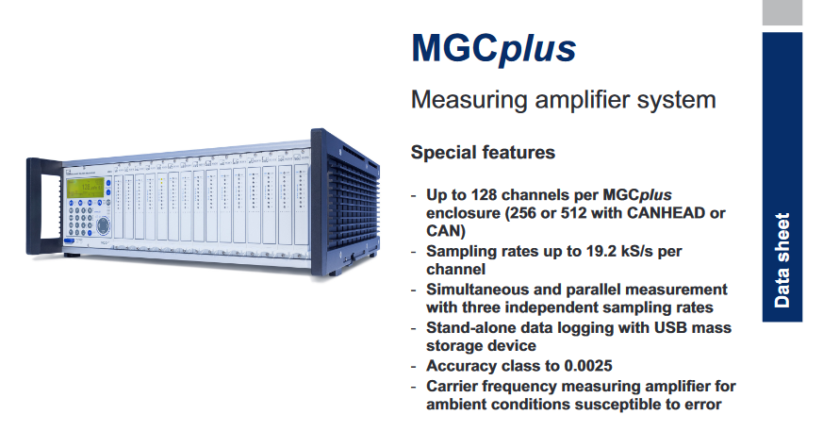
The hardware setup (1/2)
Notes:
From their datasheet
A desktop enclouse or 19“ rack frame. The biggest desktop enclosure and 19“ rack frame has up to 16 input slots

Slide 3
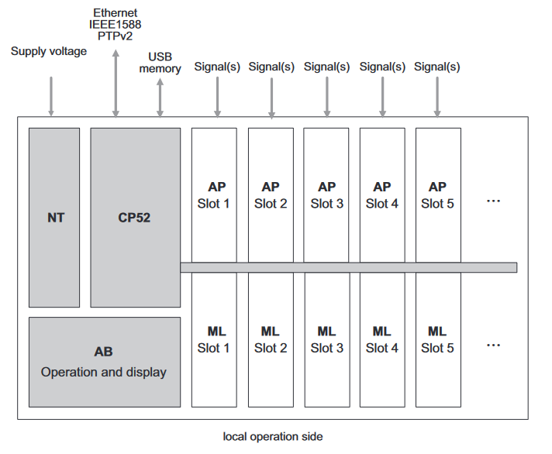
The hardware setup (2/2)
Notes:
The number of slots is actually 2x 16
AP = Connection board
ML = Measurement card or digitizer card
CP52 = CPU unit
We counted each measurement card as a channel and each input as a subchannel.
For some setups there is 1 connection board (with 1 or multiple inputs) to 1 measurement card
For some setups there are 2 connection boards (with multiple inputs) to 1 measurement card
We had two setups. One with AP01i connection board and ML30B measurement card. (1 input to 1 card)
The other setup was with AP402i connection board and ML801B measurement card. (2 connection boards, 4 inputs each to 1 card)
The last setup is for temperature measurement - thermocouples with ML801B measurement card and AP809 connection board

Slide 4
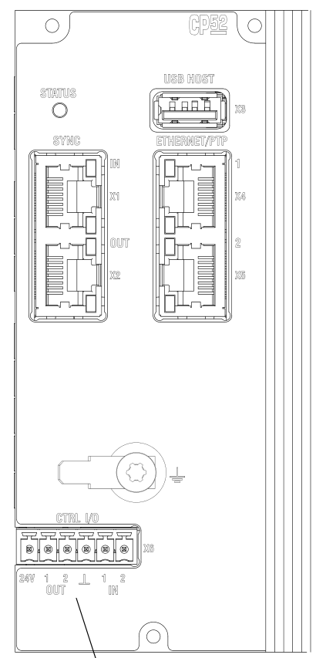
About the interface
Ethernet interface
USB Host
USB Device (USB to RS232 converter)
RS232, RS485/422
Also supports PTP time synchronization
Notes:
Multiple options, we used ethernet.
The device hosts a SCPI interface server on port :7
(Skip if noboady asks) About SYNC on the left, this is for sychronization of multiple MGCPlus devices, with one master
(skip if nobody asks) about CTRL on the bottom, it could be trigger input. For the output it can be either disk is full or system is up and running

Slide 5
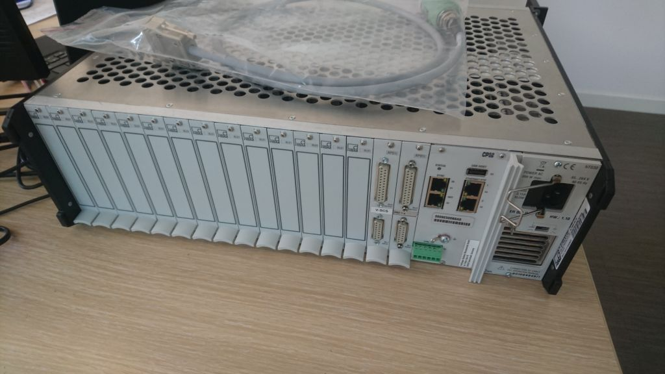
Notes:
How the device looks in flesh

Slide 6
Commands to the device
The device supports ASCII interface to configure it
We used the programmers manual and the HBM Assistant program in order to understand all commands and the order they shall be sent out
The device supports two ways of acquiring the data from the device
  Via request – response
  Via autonomous data publishing from the device (over UDP)
Configuration of the device
  Part of the configuration is for the whole device
  Part of the configuration is specific for each channel
  Part of the configuration is specific for each subchannel
Notes:
Request response is only good for debugging
Data publishing is good for fast data acquisition
Data publishing we used was done over UDP, we had a listener on our PC and then we had to split the data
We used two interfaces
For controlling the device using stream device
For readout using a custom asyn driver

Slide 7
Data received from the device
Sending ASCII commands and queries is simple using the StreamDevice
Parsing the measurement data from the device is a bit more complicated
  We do the message parsing using the asyn port driver
  Packet consists out of subchannel data from first channel to the last channel
  If there is a card missing, this is not visible through the received data
  At the end there is also the timestamp
Notes:
With our setup, we had 2 types of packets:
Each subchannel data is 4 bytes, timestamp is 8 bytes

Slide 8
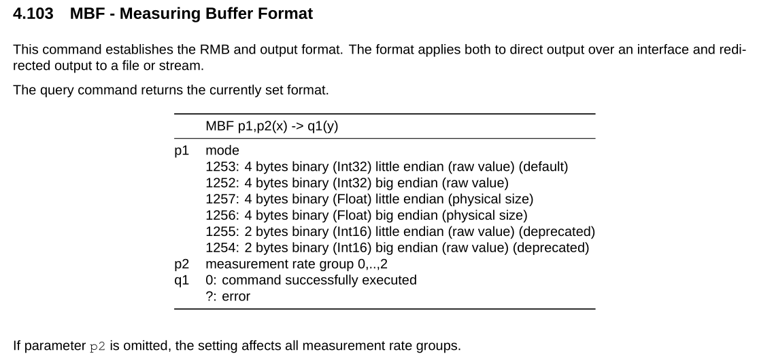
Notes:
Message format, we selected the default one

Slide 9
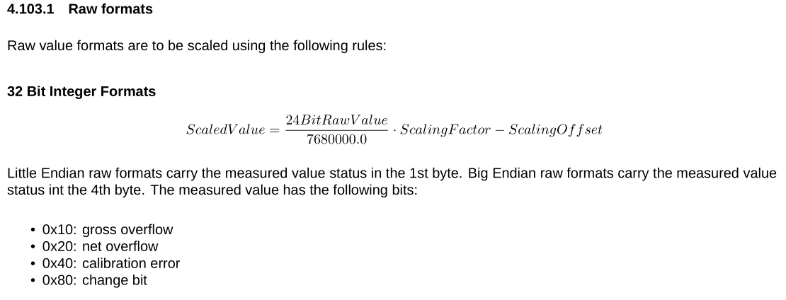
Notes:
The 32 bits of the message are actually split to; 24 bits of value and 8 bits (actually only 4) with status

Slide 10

How the received message looks like
ML30B
ML801B
Notes:
On the top we have the data we expect from the setup of ML30B, on the bottom the data we expect from ML801B. Each square is 4 bytes, timestamp is 8 bytes
You can also use a chassis that is not fully utilized, but channel number is full.
In order to have an extendable setup, we always assume the subchannel number will always be full (1 in case of 30B, 8 in case of 801B).

Slide 11
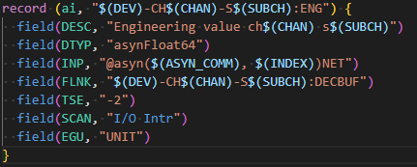
Notes:
This is how the record looks like to acquire the value for one subchannel
You can see the $(INDEX) macro, which has the actual offset and has to be set by the developer when creating the substitutions file.
Maybe skip?: Number of channels in the message is calculated from the first message received from the device.

Slide 12
Device application at ITER
Strain measurement
  Using up to 16 ML30B cards, up to 16 subchannels at 2400 Hz
Displacement measurement
  Using up to 8 ML801B cards, up to 64 subchannels at 300 Hz
Temeprature measurement
  Using up to 16 ML801B cards, up to 128 subchannels at 1 Hz

Slide 13
Ralph Lange
Mohor Gartner
Jernej Podlipnik

