Slide 1
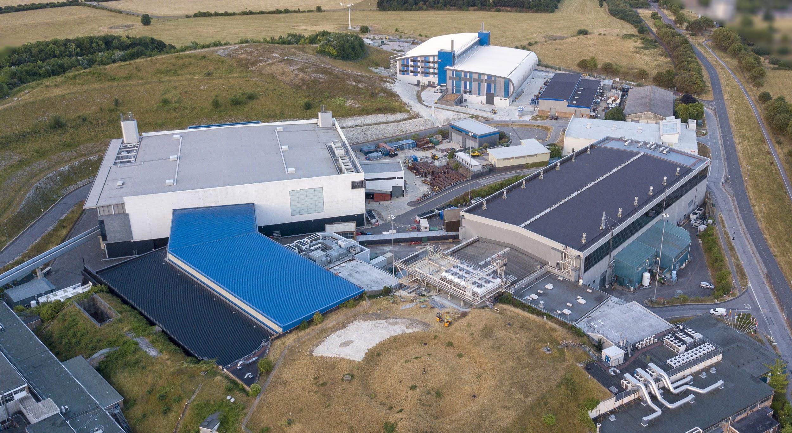


Notes:
To edit the background image, select ‘Format’ from the PowerPoint menu and ‘Slide Background’ from the drop-down menu. Within the new list of options that appears on the right of the screen, select the ‘File’ button under ‘Insert picture from’ and select your image from your file browser. Please remove or amend the image credit if you are using a different image to the one provided.

Slide 2



Using EPICS to facilitate Machine Learning (ML) at ISIS
EPICS Collaboration Meeting September 2022
Kathryn Baker

Slide 3
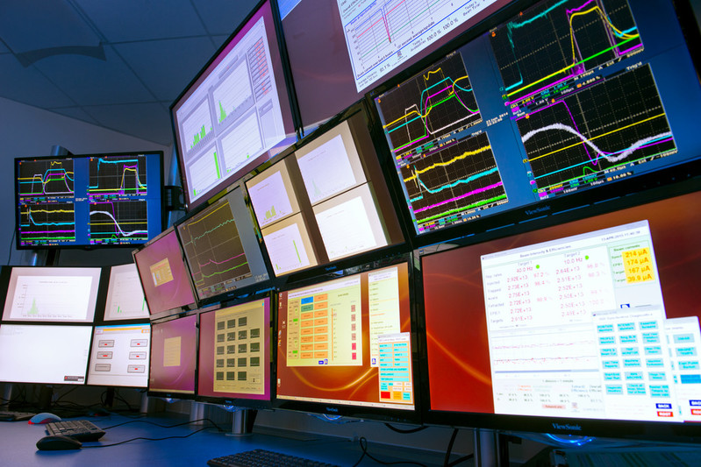

ML in the ISIS
Accelerators
The transition to EPICS to control the ISIS accelerators presents an opportunity for us to integrate Machine Learning into our operations for a variety of reasons:
- Linux is easier to interact with than OpenVMS
- Extensive Python libraries make it easy to get and set values in EPICS
Notes:
If anyone who wasn’t at my last talk isn’t aware, the ISIS Accelerators are being migrated from Vsystem to EPICS as their primary control system. This has presented us with more opportunities to integrate machine learning into our operation to improve performance of the accelerator. This is not only because EPICS on Linux is easier to interact with than anything on OpenVMS, but also because the host of python libraries available for interacting with EPICS PVs make it easy to combine live data from these PVs with python based machine learning models because EPICS is much easier to use than Vsystem.

Slide 4
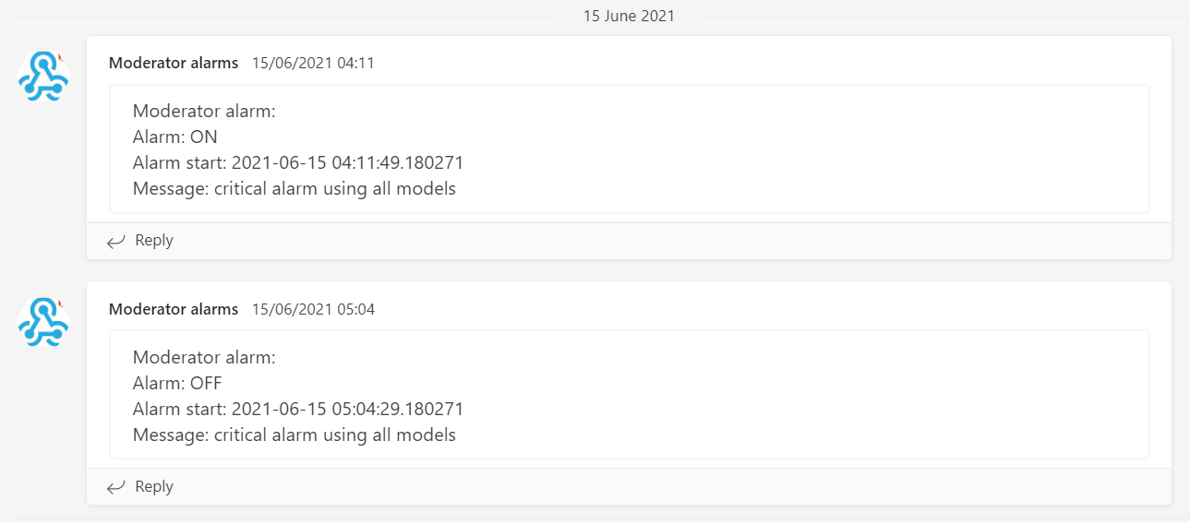
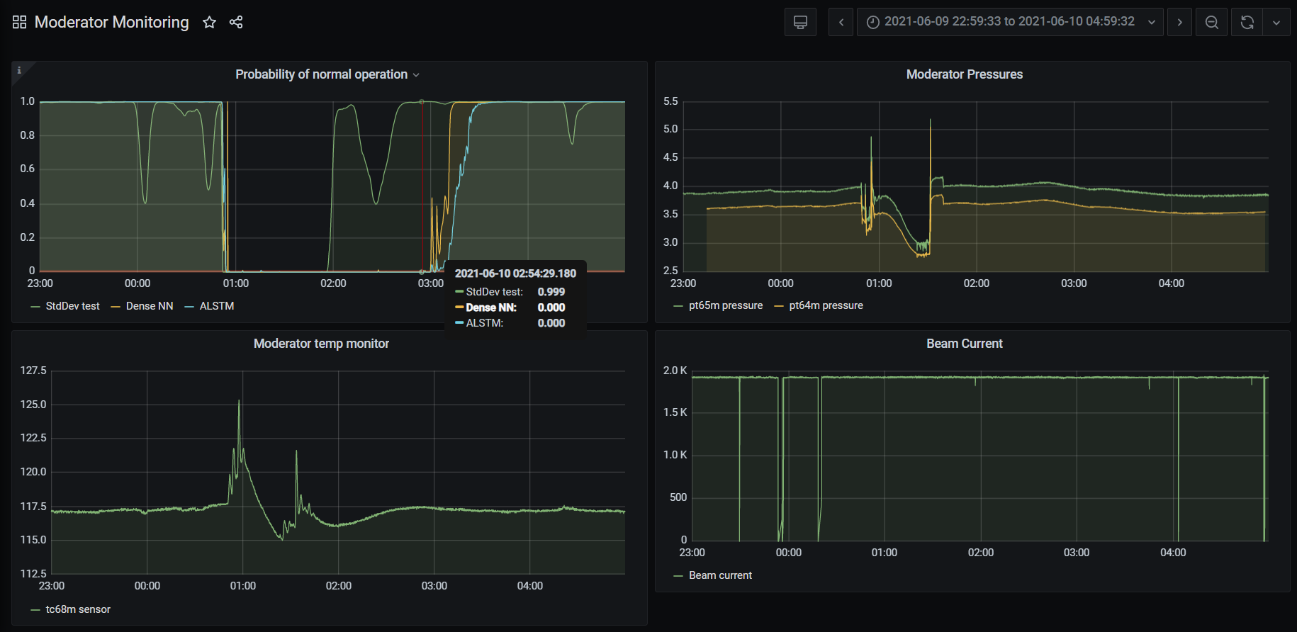
Current Projects – Anomaly Detection
Although in early days, we have a number of projects currently ongoing at ISIS that make use of Machine Learning and optimisation.
Notes:
While we’re still in very early days of our machine learning efforts, we do already have some ML projects underway. These include anomaly detection on the liquid methane moderator (prior to the current upgrade of our target station 1) where machine learning was being used to detect anomalies in the temperature stability that previously wouldn’t have been captured by the traditional rule-based detection methods. PVs are monitored and fed into an ML model that classifies the current state as normal or anomalous based on the last hour and a half of data.

Slide 5
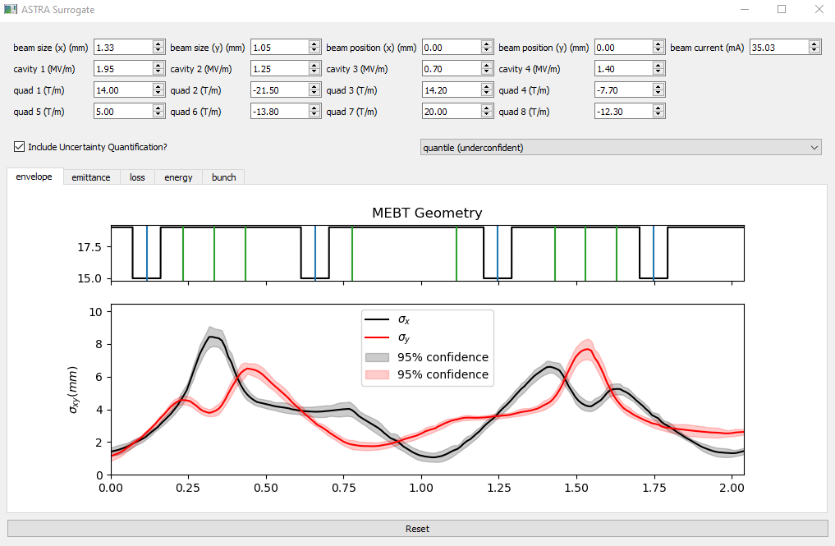
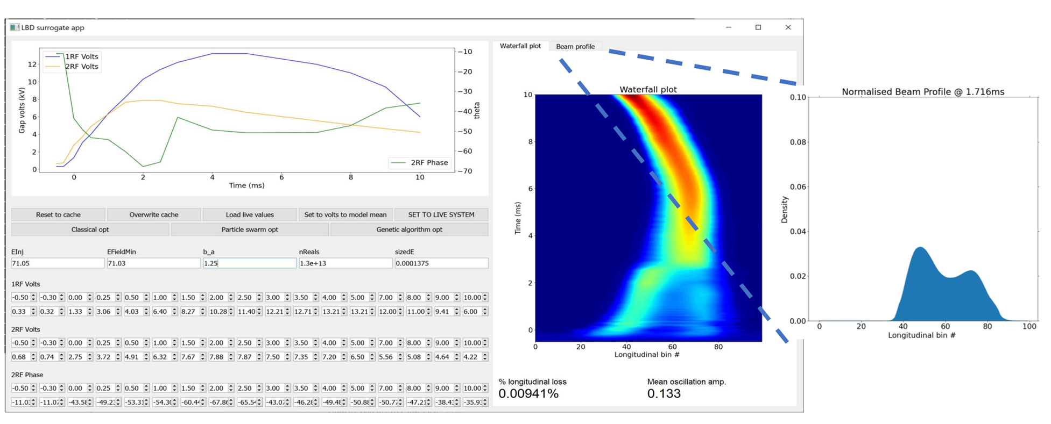
Current Projects – Virtual Diagnostics
Although in early days, we have a number of projects currently ongoing at ISIS that make use of Machine Learning and optimisation.
Notes:
Other ML work has involved the development of virtual diagnostics for both longitudinal injection, which produces a waterfall plot of the evolution of team intensity from injection to extraction, and for estimates of the key beam parameters along the length of the new MEBT basic on input machine settings

Slide 6
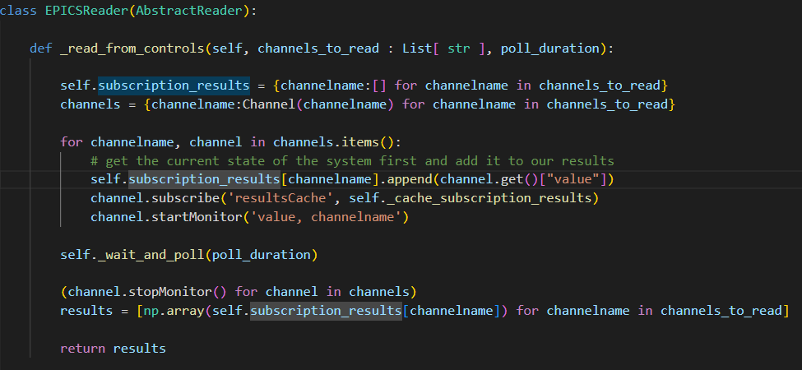
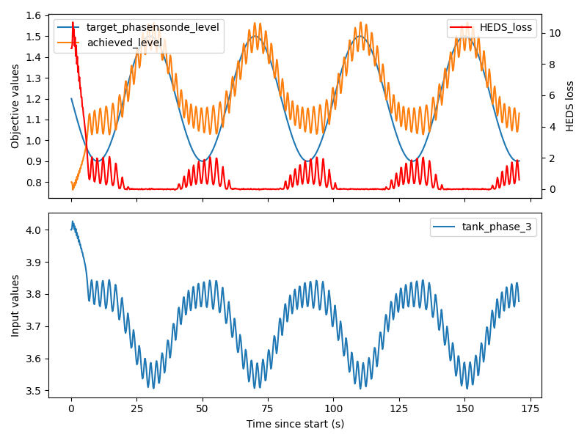
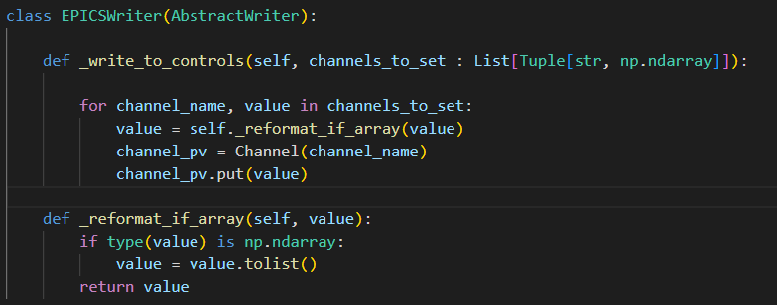
Current Projects - Optimisation
Although in early days, we have a number of projects currently ongoing at ISIS that make use of Machine Learning and optimisation.
Notes:
We are also actively developing an optimization interface that we can use to automatically tune particular components of the accelerator
The first case study we’ve used is the tuning of the energy difference between the final tank of the LINAC and the synchrotron main magnet at injection.
Here we need to account for multiple losses around the machine while tracking and correcting for short term fluctuations in the desired energy level
This requires continuous monitoring and setting of PVs throughout the optimisation

Slide 7
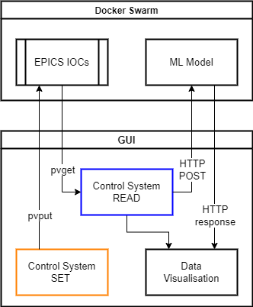
EPICS Integration
Notes:
Here I’ve presented a general overview of how our interfaces and GUIs will interact with EPICS.
The IOCs hosting the EPICS PVs will sit within our Docker swarm. As mentioned in my previous talk about PVEcho, these may be newly migrated EPICS PVs or mirrored versions of our channels that are still connected to hardware through Vsystem.
The ML models themselves will be hosted on a tensorflow server, also within the docker swarm, that allows communication with the models through HTTP requests, allowing our GUIs to be slimmed down
The GUI code is responsible for reading the live values from EPICS using PvaPy because this is the library with which we have most experience
Those live values are then processed into a format suitable for the ML model to use and the model generates an output
This data is then visualized within the GUI and if the user is happy with the resulting values, for example after an offline optimization, they then have the option to set the calculated values back to the control system

Slide 8
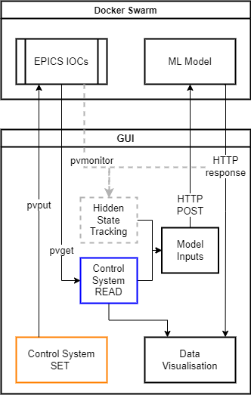
EPICS Integration (Future)
Notes:
Often when training surrogate models using simulation data, we include variable inputs that cannot be measured in real life, which we refer to as hidden states in this diagram
In theory, we can monitor some of the measurable outputs from the machine and compare these with the model’s prediction
The difference between the two can then be used to feed back into inputs that can’t be measured in real time using adaptive feedback
This will require continuous monitoring of the EPICS PVs and evaluation of the model, which should help to cope with the effect of long term drift in our models but isn’t something that we have implemented yet

Slide 9
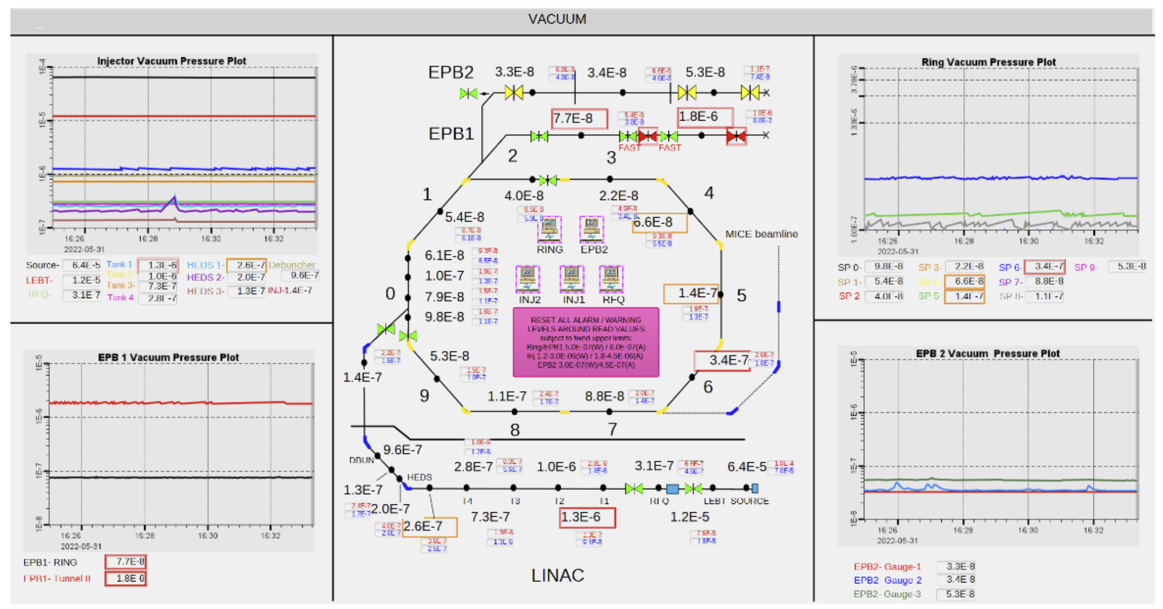
Deployment?
Still not sure how to deploy them…
PyQt GUIs – simple but requires developer effort to create
Web based control screen – a chance to adopt something new?
Phoebus (or alternative?) screen – great ‘out-of-the-box’ solution but unknown how to integrate ML models
Notes:
One of the main decisions we need to make in the near future is how to actually deploy these models in a control room.
This is where I would like ot appeal to others fro help and advice!
Currently our development effort has involved individual PyQt GUIs that are completely separate to the control system (primarily because we don’t have anything integrated yet)
However, we want to change that going forward and need to start thinking about how we want to manage these applications going forward
This is only one option, others we are considering are:
PyQt GUIs as I have mentioned
Web based framework, although I don’t know how well this works with control systems and authentication for accessing and setting PVs etc
Phoebus screens but we would then need to work out the best way for integrating our models into the control system somehow through soft IOCs
I would therefore welcome any advice that anyone has for how might be best to do this!

Slide 10





isis.stfc.ac.uk
@ISISNeutronMuon
STFC
Notes:
Continuous tracking of hidden states if we were to use adaptive feedback – this would require constant reading from the control system to continuously update our latent space

