Slide 1
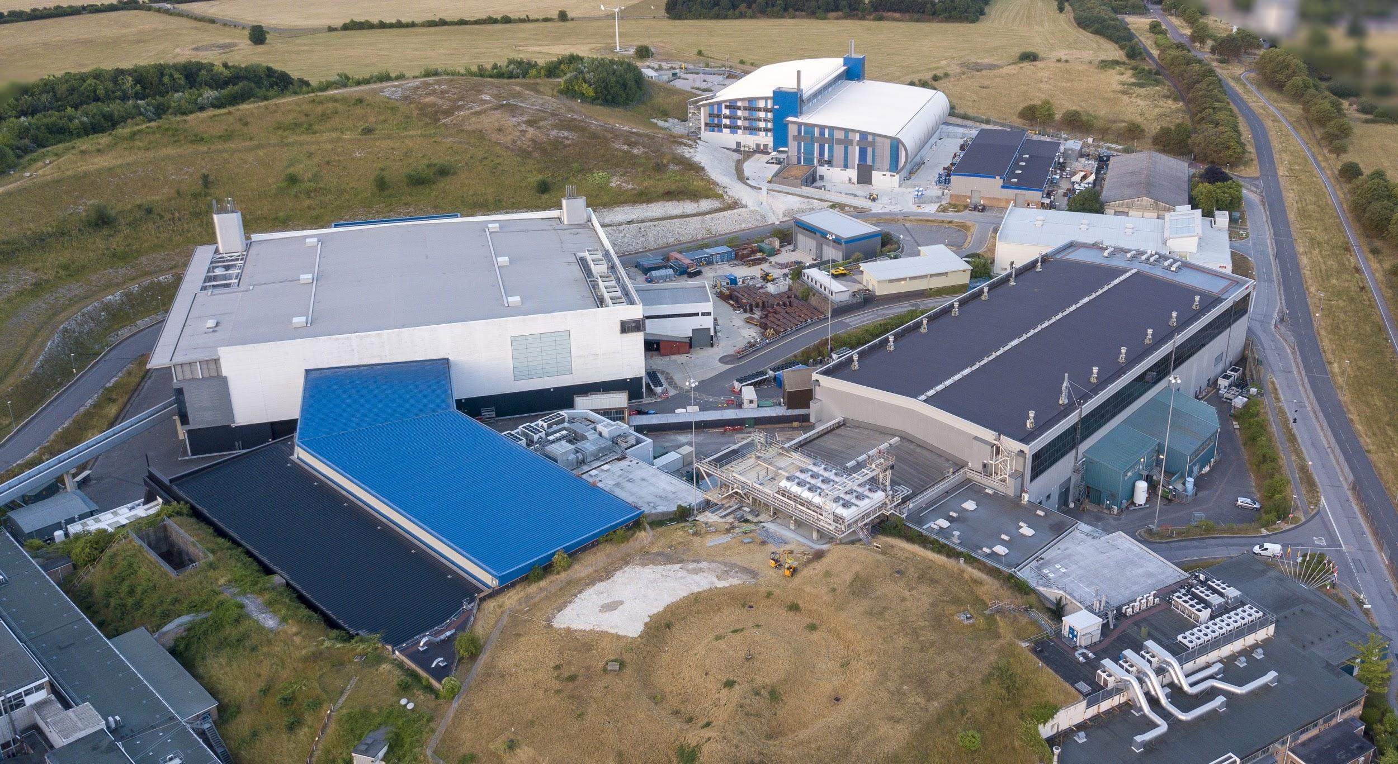


Notes:
To edit the background image, select ‘Format’ from the PowerPoint menu and ‘Slide Background’ from the drop-down menu. Within the new list of options that appears on the right of the screen, select the ‘File’ button under ‘Insert picture from’ and select your image from your file browser. Please remove or amend the image credit if you are using a different image to the one provided.

Slide 2



PVEcho:
Using PvaPy in the construction of the Vsystem/EPICS Bridge to facilitate the migration of the ISIS Accelerators Control System
EPICS Collaboration Meeting September 2022
Kathryn Baker

Slide 3
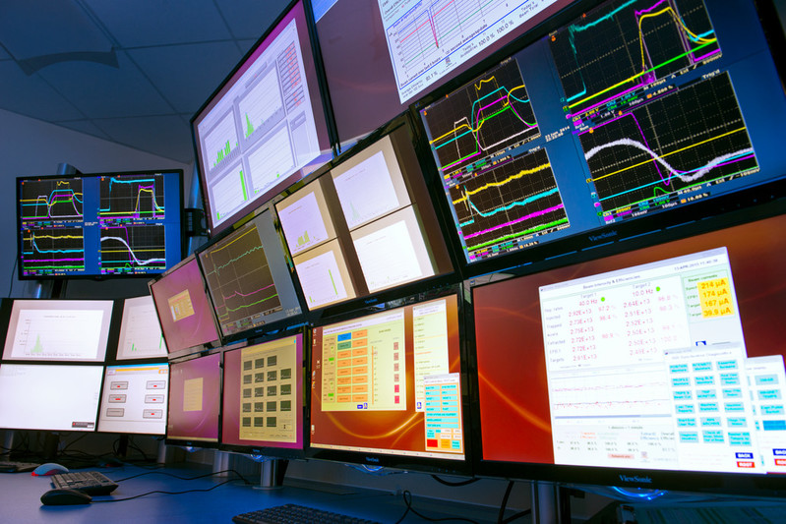

EPICS Transition
For a number of reasons, the ISIS Accelerators’ control system will be migrated from proprietary Vsystem to EPICS which is open source.
In order to minimize the impact on business-as-usual, the migration will involve a phased porting of control of hardware. This requires bridging software to mimic the old control system in EPICS.
Notes:
For a number of reasons outlined in other talks by my colleagues, the ISIS accelerators are migrating from the proprietary Vsystem control system to the open source EPICS control system.
We plan to do this in a phased manner, gradually porting control of hardware from Vsystem to EPICS.
This requires a bridging software to be developed, allowing us to mimic both existing Vsystem channel information in EPICS as well as migrated EPICS controlled hardware in Vsystem.

Slide 4
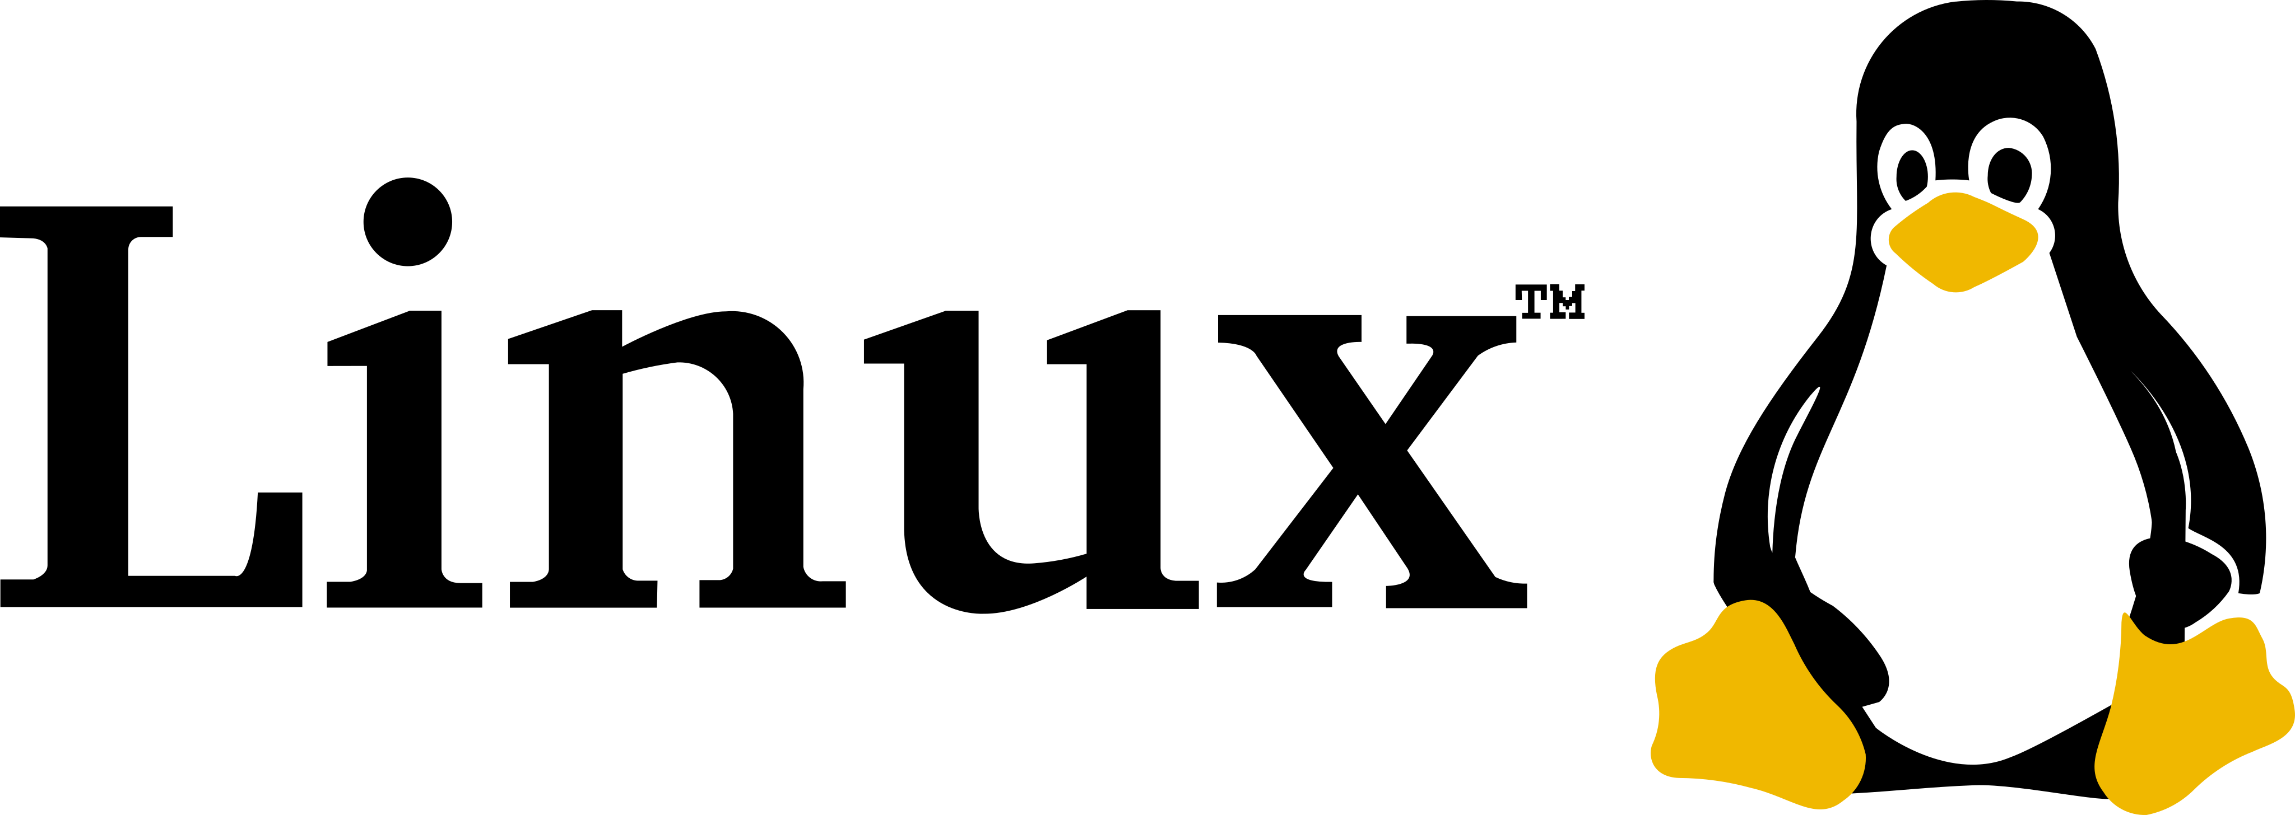
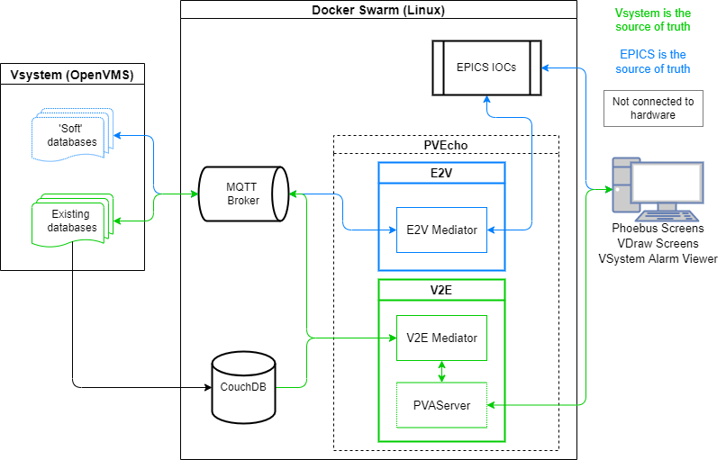

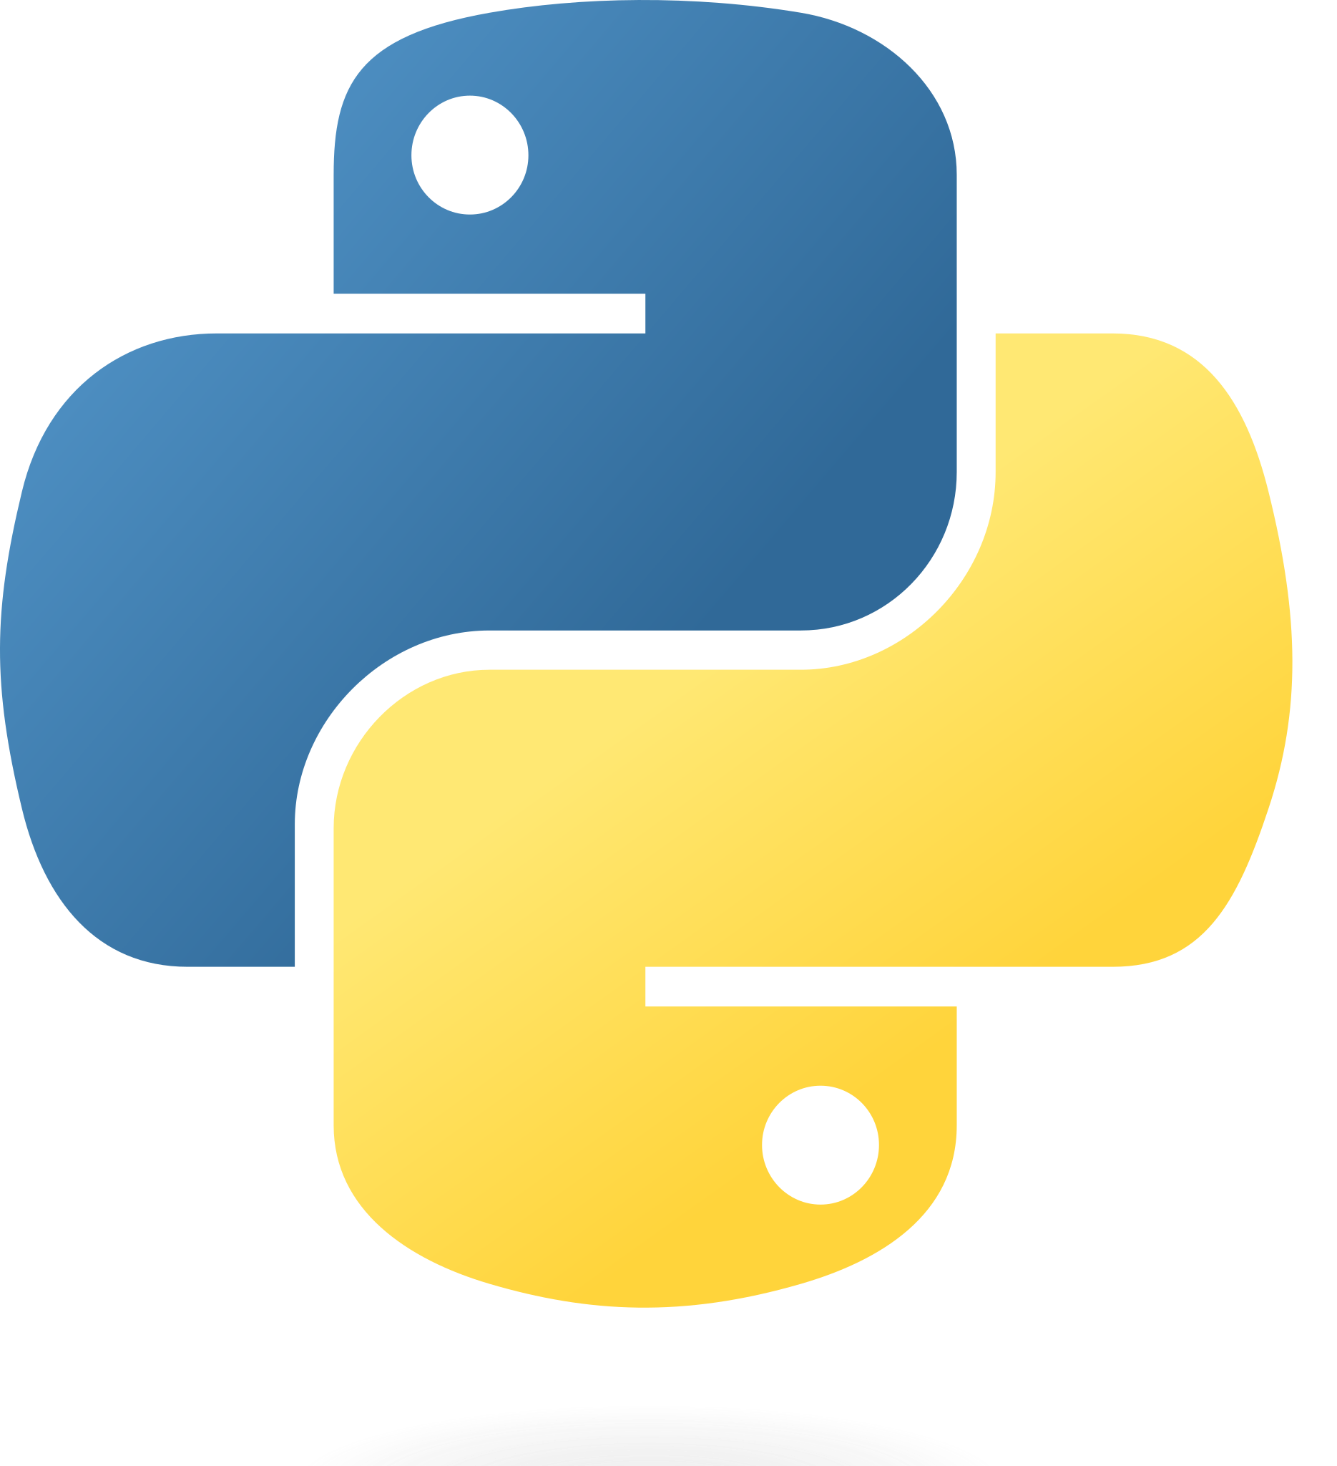
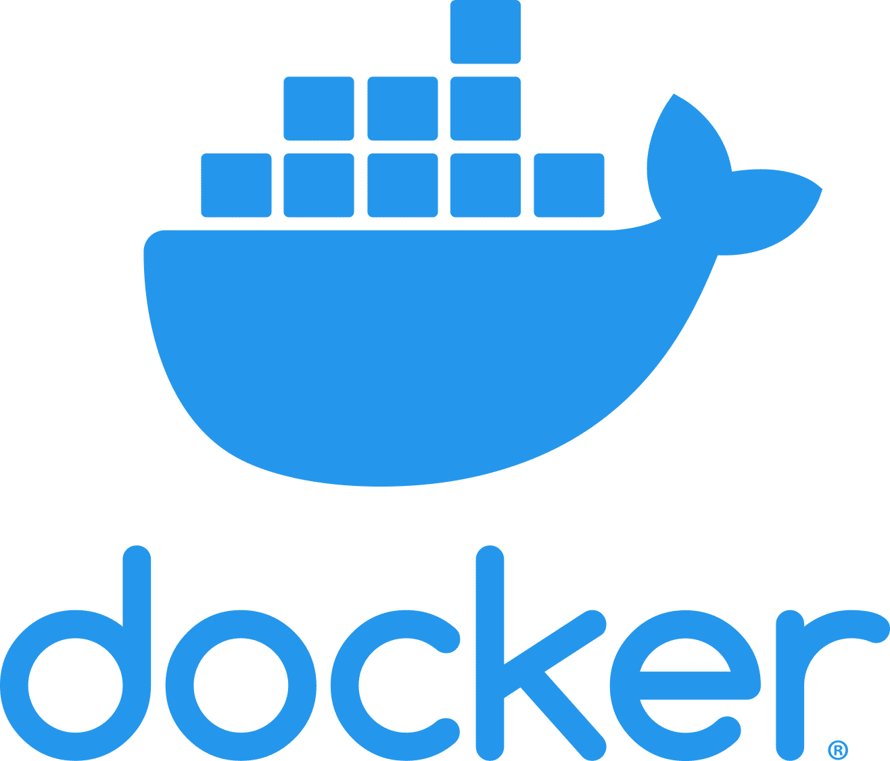


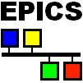

PVEcho
PVEcho is the ‘bridge’ between our existing control system (Vsystem) and EPICS.
It will allow us to have hardware operating with both systems, as well as the option to interact with the hardware through Vsystem or EPICS control screens.
It is built entirely in Python to be deployed in Docker containers.
Notes:
We refer to this bridging software as pvecho.
It consists of two components, which are hosted as their own individual containers within our Docker swarm.
Vista to EPICS (v2e) is the component that takes the Vsystem channel data as the source of truth and propagates updates to the channels through to EPICS PVs in real time
EPICS to Vista (E2V) acts in reverse, taking newly migrated EPICS PLC data and transferring the updates across to ‘soft’ Vsystem channels that aren’t connected to any hardware.
Both components of the software interact with existing services in the ISIS controls software stack, including an MQTT messaging broker service that is used to interface with Vsystem and our CouchDB database that stores metadata associated with Vsystem channels.

Slide 5
Why PvaPy?
PVAccess for created PVs but PVA or CA for Channels
PvaServer and creation of custom PvObjects
Addition and removal of PVs from the server ‘on the fly’
Actively being developed
Responsive, helpful developers
Extensive documentation
Notes:
I’m aware there are a lot of different python libraries available to talk to EPICS so I thought I should spend some time explaining why we chose PvaPy over pyepics or p4p for example.
This was primarily down to a number of requirements that we had for PVEcho:
We have opted to use the EPICS 7 PVAccess protocol for most of our PVs but some external PLCs may require channel access to be used – therefore we needed the library to allow connection via channel and pvaccess
In order to enable V2E, we needed to be able to construct and serve our own PvaServer
We wanted to be able to add and remove PVs from this server on the fly as we migrated hardware across to EPICS
PvaPy was one of the few libraries that allowed us to do all of this within the same library, to reduce code complexity
The other benefits included the fact that it is still being actively developed
We started writing pvecho with version 4.6.0 and have since upgraded to use version 5.0 with minimal changes
The developers are also very responsive with issues (big thank you to them for their help)
The documentation is also extensive which made the library relatively easy to use

Slide 6
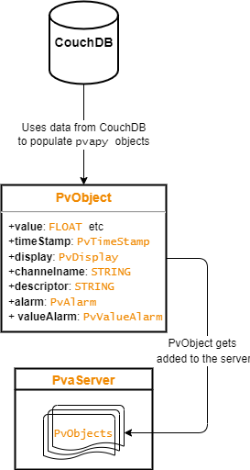
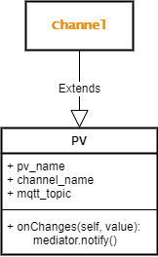
PvaPy in PVEcho
VISTA to EPICS (V2E)
EPICS to VISTA (E2V)
Error Handling
FieldNotFound
InvalidDataType
PvaException - Timeout
Notes:
In V2E, we create our own PVs using metadata from our COuchDB database
The PVs are constructed to follow an NtScalar or NtScalarArray structure making use of the PvObjects in pvapy such as PvTimeStamp and PvValueAlarm
These PVs are then added to our own PvaServer that exists within the Docker Swarm
In E2v, we extend their Channel class that connects to PVs and allows the ‘getting’ and ‘putting’ of values. We use the class’s monitor feature to propagate changes in the PV through to our MQTT broker (and Vsystem)
As PvEcho will operate during cycle, it is imperative that is is reliable. We therefore make use of the Exceptions built into PvaPy to deal with errors as and when they arise to keep the program running continuously

Slide 7





isis.stfc.ac.uk
@ISISNeutronMuon
STFC
Notes:
The abstract pattern can be removed or repositioned if required. Be careful to ‘Send to Back’ so that it does not obscure any important information.

