Slide 1
SNS Status Report
Karen S. White
SNS Control Systems Section Head
EPICS collaboration Meeting Fall 2022
09/21/2022

Slide 2
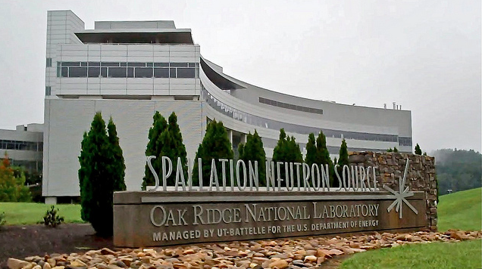
About the Spallation Neutron Source
Accelerator based neutron source in Oak Ridge, TN, USA
DOE user facility for neutron scattering research
Built by a partnership of six DOE laboratories
Completed in 2006, began user program in 2007
The SNS now operates ~4500 hours per year and has 20 instruments available for users
Two facility upgrade projects in progress
  PPU – will increase machine power from 1.4 MW to 2.8 MW by 2024
  STS – Will build a second target station with a new suite of instruments for users; beam will be shared on a pulse-by-pulse basis CD-1

Slide 3
How the Control System was built
Partner labs delivered sub-systems with controls based on SNS standards
Controls group at SNS was responsible for global systems and integration and long-term operations and maintenance
Selected standards included:
  EPICS framework and tools
  Allen Bradley PLCs
  Motorola VME IOCs w/ VxWorks
EPICS used to integrate controls based on a diverse set of hardware platforms, giving the operators a common view

Slide 4
Control System Architecture

Slide 5
Control System Growth
 | 2006 | 2022
VME IOCs | 168 | 167
Linux IOCs | 46 | 152
µTCA | 0 | 9
Windows IOCs | 248 | 170
PLCs | 100 | 189
MPS inputs | 923 | 1000
PVs | 395000 | 603000

Slide 6
Upgrading control system on an operational facility
Post commissioning, upgrades:
  Address performance/availability issues
  Add controls for new devices as needed for other subsystems
  Develop better operational tools
  Mature processes
A few years later
  Hardware and software obsolescence
  Upgrades to timing and machine protection
More recently
  Project driven upgrades
    Currently PPU
    Future STS

Slide 7
Upgrading control system an operational facility
Challenge - No longer possible to have the control system down for an extended period so upgrades must be phased in during scheduled outage periods
Staying ahead of obsolescence requires work on most systems
Upgrades limited by labor resources and procurement funds
Many things need to done, important to prioritize
Staff turnover requires the development of early career staff

Slide 8
Global Systems
Timing
New distribution hardware
New master
New software
Completed 2019
MPS
New field nodes
New master
Firmware, software, testing progress
Infrastructure
Network and computing technology refresh
Upgrade from 32 to 64-bit Linux and environment
Network requires segmentation for additional growth
Migrate from servers to virtualization cluster

Slide 9
EPICS, Services and Back-end tools
EPICS
Upgrade to EPICS 7
EPICS 3 systems peacefully co-exist with EPICS 4 systems
Run Channel Access and PV Access
First converting soft IOCs to EPICS 7 (20%)
Services
Developed new in CS-Studio
New archive engine
New alarm handler
Subsequent refactoring from Eclipse RCP to Phoebus
Soft IOCs
Increasing use of Linux based soft IOCs:
For systems that do not need a direct hardware connection
To create composite or calculated PVs
Tools
Developed tools in CS-Studio, provides interoperability and common look/feel/behavior
Archive Browser
Alarm Display
Display manager
Web Display

Slide 10
Front-end systems
Slow Controls
Allen Bradley PLCs
Upgraded processors in 2009 due to manufacturing issues
Need to convert slow, obsolete ControlNet and DeviceNet communications to Ethernet
VME
Increasingly difficult to get VME modules, many obsolete
Some VME based systems don’t need high performance and can be converted to PLC based systems (e.g. motor controls)
Real-time systems upgrade path is µTCA
µTCA
Used for new real-time systems
Ring/Linac LLRF
Kicker Waveform Generation and Monitoring
MPS
BPLS

Slide 11
Upgrades for PPU
PPU increases SNS machine power from 1.4 to 2.8 MW by adding 7 cryomodules, additional magnets and a new type of target
Control system upgrades to include integration of additional devices; changing designs due to obsolescence where required
  Cryomodule controls, obsolete VME motor control design replaced with PLC design
  Beamline and cryomodule vacuum controls, extended, replicated
  HPRF controls replicated
  LLRF developed new system due to obsolescence and to support STS two beam flavor operations
  Network, MPS, timing extended
  PPS adds new Beam Power Limiting System, first use of FPGA for a credited control at SNS
  Target controls upgrades for new target utility systems
  CF controls added for system capacity upgrades

Slide 12
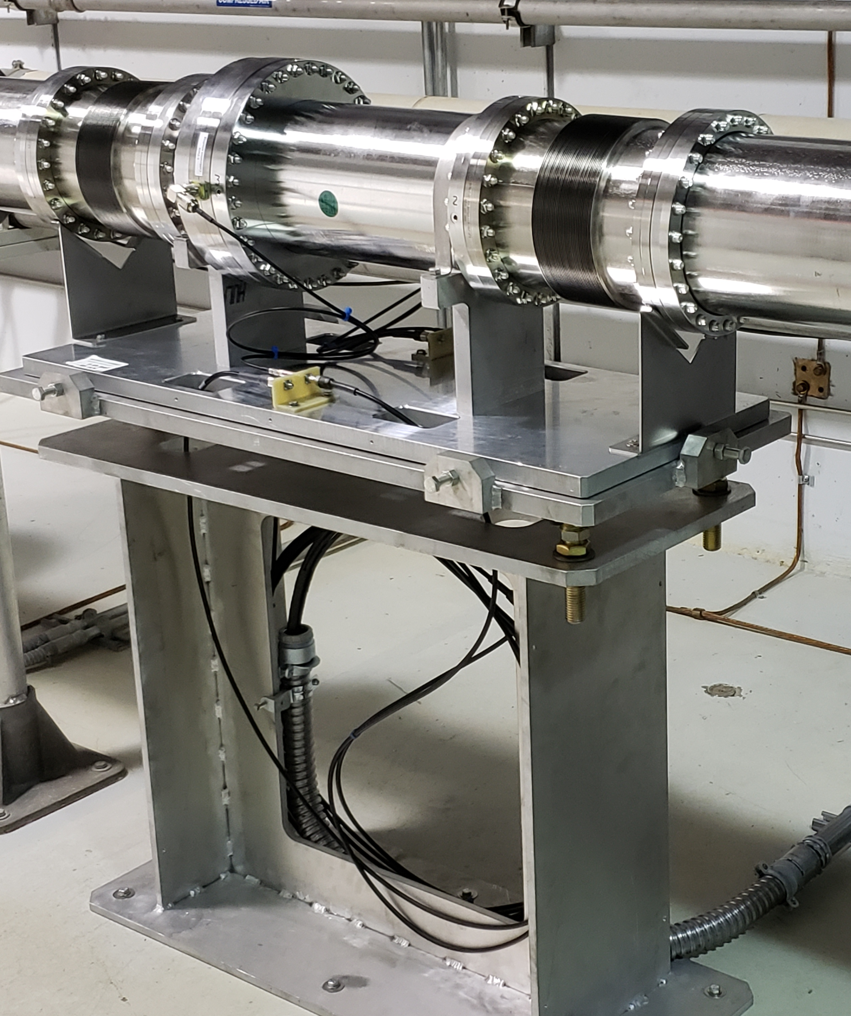
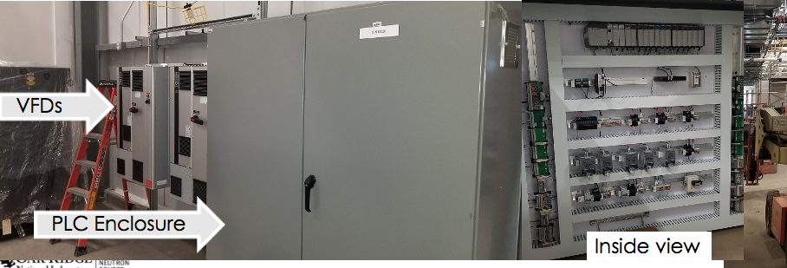
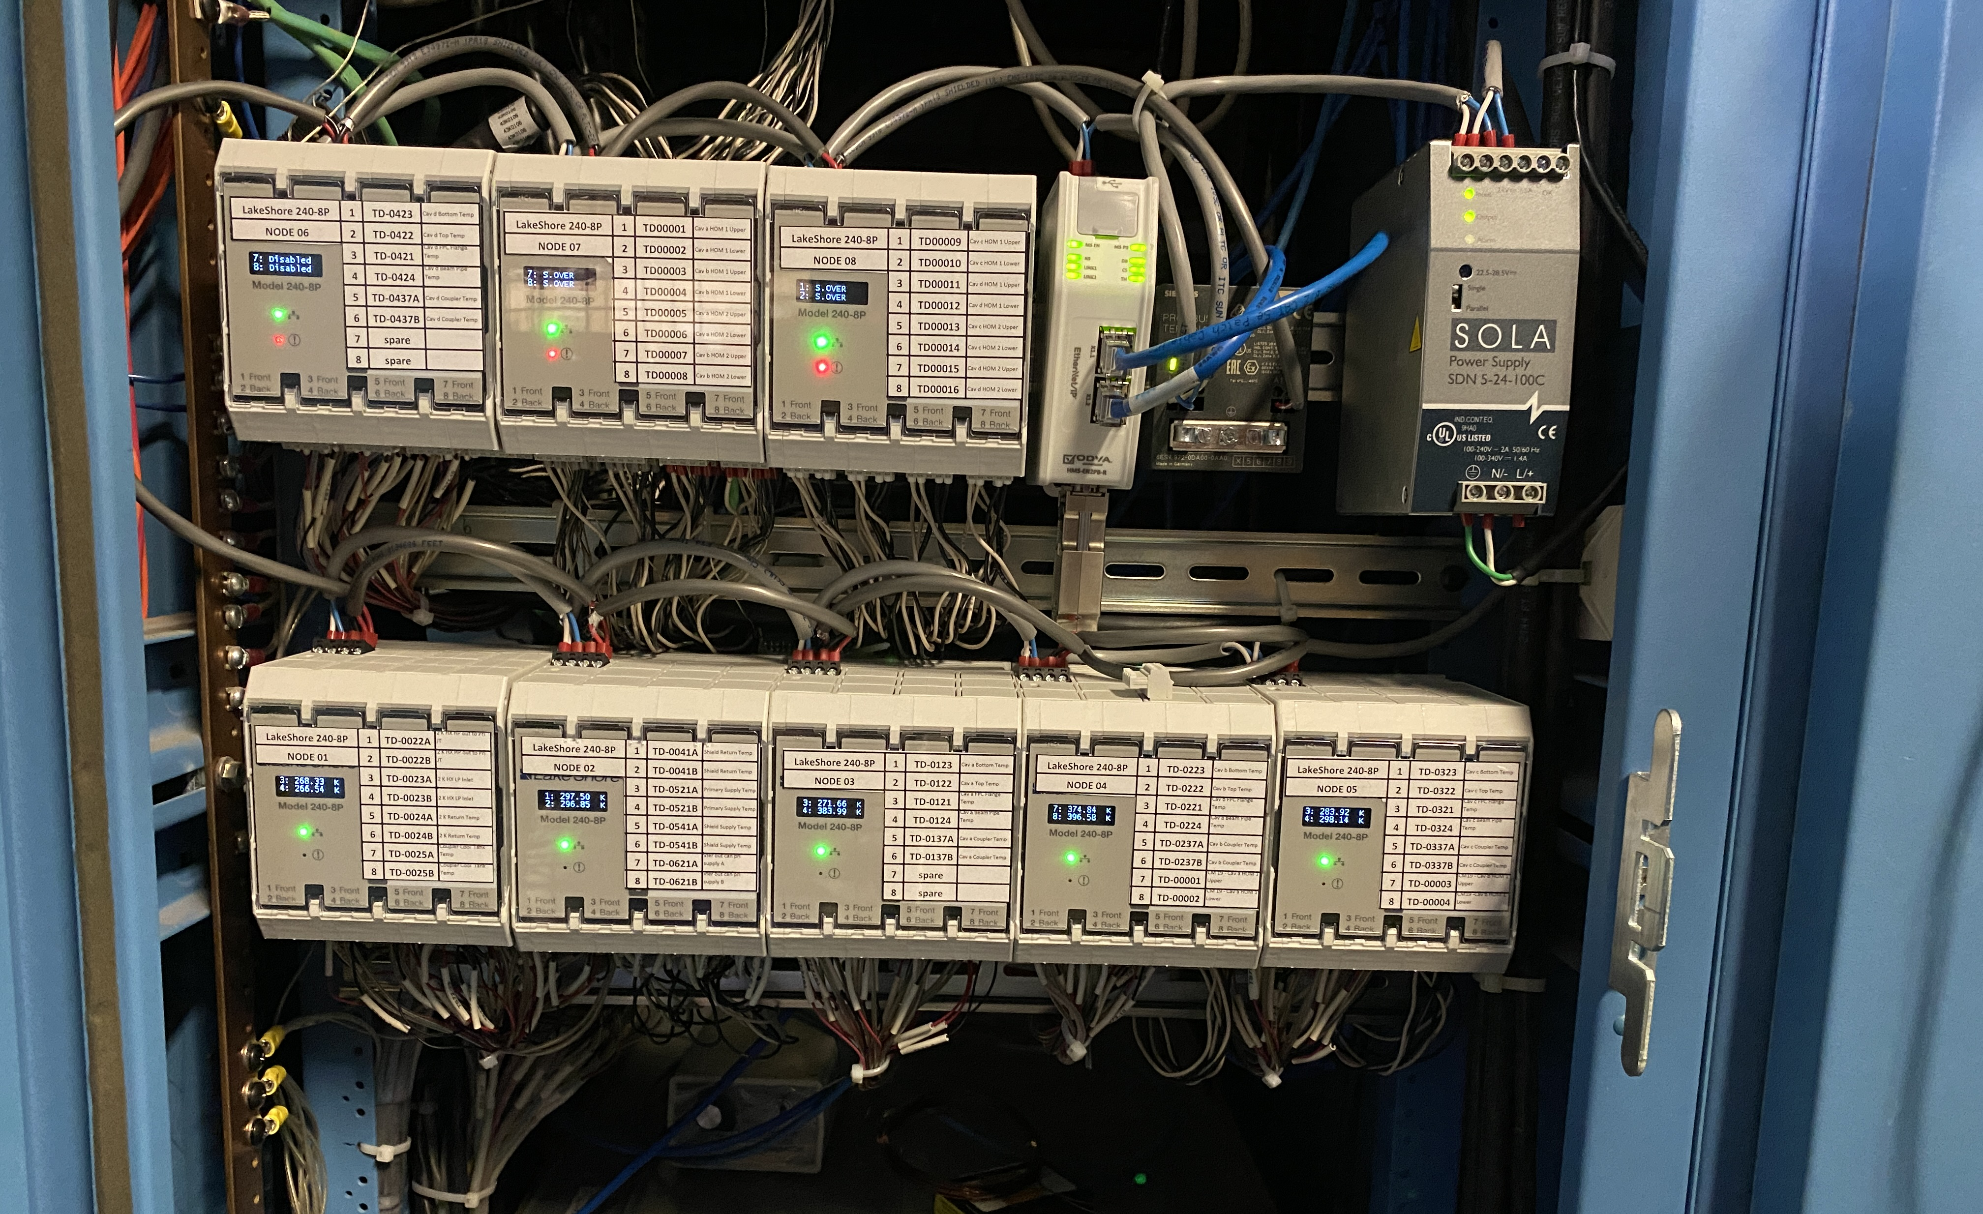
Controls challenges for PPU
As usual, some systems are very late providing requirements leaving little time for control work to meet schedule
Some vendors did not deliver working controls per contract and SNS controls personnel had to complete these systems
Supply chain issues put some controls delivery at risk of missing schedule deadline
BPLS
Cryomodule PLCs

Slide 13
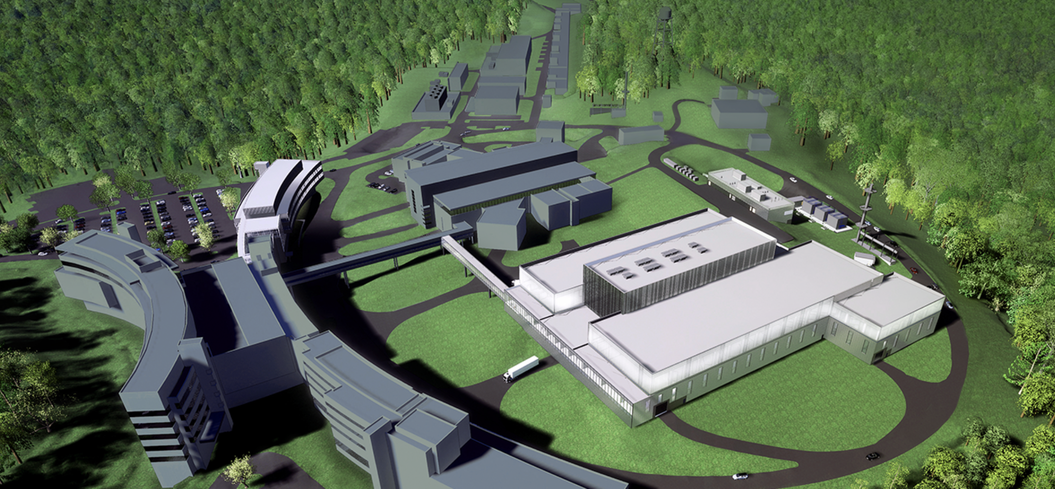
Upgrades for STS
STS will add a new target station doubling scientific output potential
Accelerator will continue to operate at 60 Hz with every fourth pulse directed to STS, deliver beam to either target station or both
Builds on the existing architecture of the SNS machine and instrument control systems using EPICS 7 and CS-Studio
  Extends accelerator control system for new beam transport line
  Original LLRF system will be replaced with new design from PPU
  Modify LLRF, timing, kickers, MPS, etc. for two beam operation
  Develop new Run Permit System to manage two beam operations
  Develop target and CF controls for new target station and buildings
  PPS add a credited control to limit beam power to target
  Instruments follow existing EPICS based controls and data acquisition
Credit Steven Hartman

Slide 14
Conclusions
The SNS control system has been growing, evolving since original machine commissioning
Controls is particularly vulnerable to vendor technology cycles causing obsolescence
Current challenges with supply chain and staff turnover
Original control room tools were basic, needed improvement and were replaced by the CS-Studio services and tools
Changes need not be disruptive due to the EPICS based architecture; it has proven reliable, extensible and sustainable
No shortage of work
Contact: ksw@ornl.gov

Slide 15
Thanks
Thanks to the many people who have contributed to the construction, maintenance and upgrades of the SNS control system over the last twenty years!
Contact: ksw@ornl.gov

