Slide 1




CHIMERA Project
Status Report
Ian Gillingham, Philip Taylor
Observatory Sciences Ltd, UK
www.observatorysciences.co.uk
Presented to EPICS Collaboration meeting,
Ljubljana, September 21-23 2022.

Slide 2

CHIMERA Project
CHIMERA
(Combined Heating and Magnetic Research Apparatus) is being constructed by Jacobs Clean Energy Ltd. under contract to the UK Atomic Energy Authority (UKAEA).

Slide 3
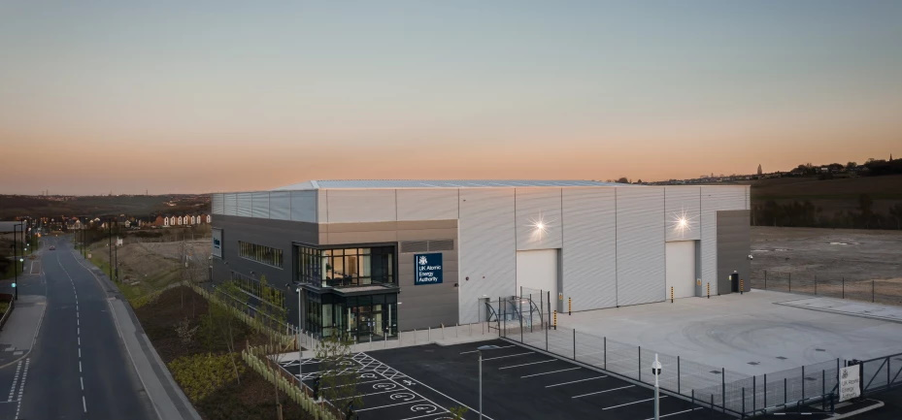
CHIMERA Project
Located at the new UKAEA Fusion Technology Facility in South Yorkshire, UK (seen above).
CHIMERA: A unique test facility
Notes:
CHIMERA will be the only machine in the world able to test components in the combination of high temperatures, magnetic fields and vacuum expected in a fusion power plant – conditions that will be faced in large fusion devices such as ITER, and in future commercial plants.

Slide 4
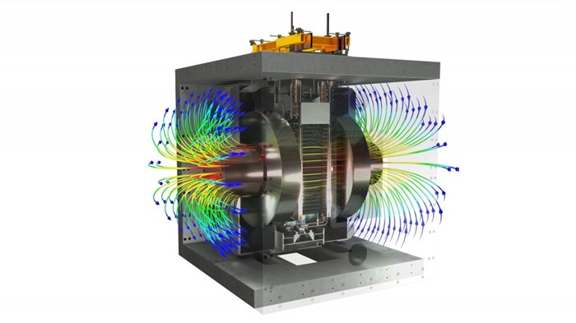
CHIMERA OPERATION
CHIMERA will simultaneously subject components to simulated fusion environment conditions.
Components will be analysed for 3D surface deformations and damage.
Notes:
Fusion environmental conditions include:
High temperatures
High heat flux
Static and pulsed magnetic loads
Thermal cycling, fatigue, creep and other failure modes
Under vacuum, air or inert gas
Component analysis will be by:
Optical digital image correlation
Laser metrology

Slide 5
CHIMERA CONTROLS
Standards adopted from ITER CODAC.
Siemens S7-1500 PLCs used for most subsystems (SIMATIC Step 7/TIA software).
EPICS for high-level (SCADA) controls.
Each subsystem will have dedicated IOC computer
DAQ will run on National Instruments PXIe-8861
OPC UA Communications Protocol (Modbus & Serial also used).
EPICS IOCs running V7.0.6.1 on RHEL 8.
Operator workstations running CSS-Phoebus (Windows 10)
Notes:
CODAC: Control, Data Access and Communication
Lays out good industry software and user interface design practices.
Siemens PLCs – already have significant EPICS support.
Dedicate system computers:
7 x Amplicon Impact-D100 (Intel ATOM) embedded PC
Amplicon Impact 3104 (DAQ EPICS IOC)
3 x Dell PowerEdge rack servers (NAS and central servers)
OPC-UA Comms:
OPC UA EPICS support from ITER with Unified Automation Client SDK.
DAQ uses LabVIEW OPC UA Toolkit

Slide 6
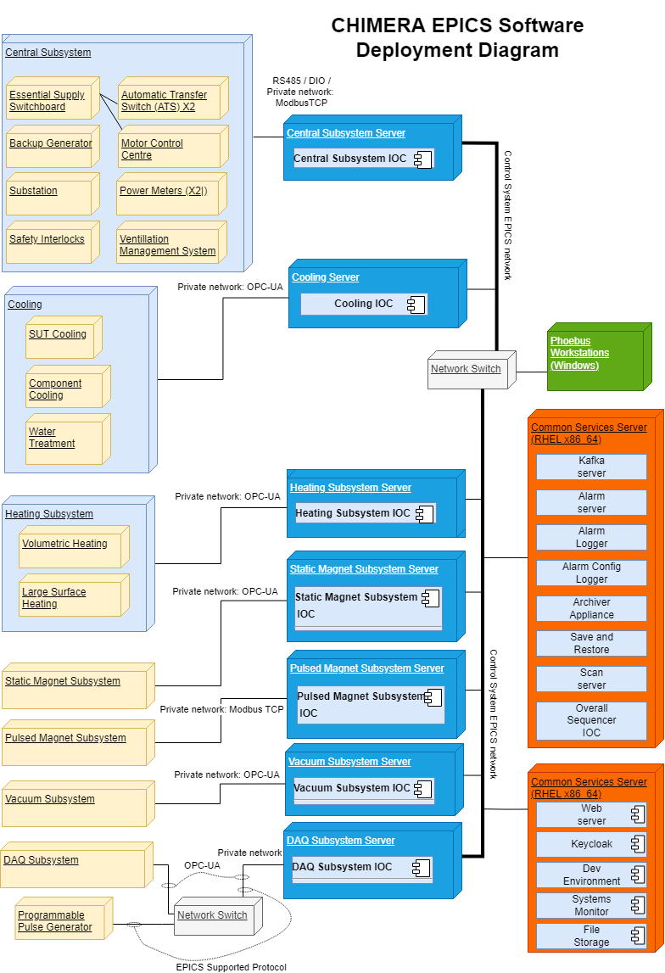
CHIMERA CONTROLS
Subsystem IOCs
2 x Common Service Servers
Operator workstations
Notes:
Subsystem IOCs
Cooling IOC:
SUT Cooling
Component Cooling
Water Treatment
Heating IOC:
Volumetric Heating
Large Surface Heating
Static Magnet IOC
Pulsed Magnet IOC
Vacuum IOC
DAQ IOC
Central IOC

Slide 7
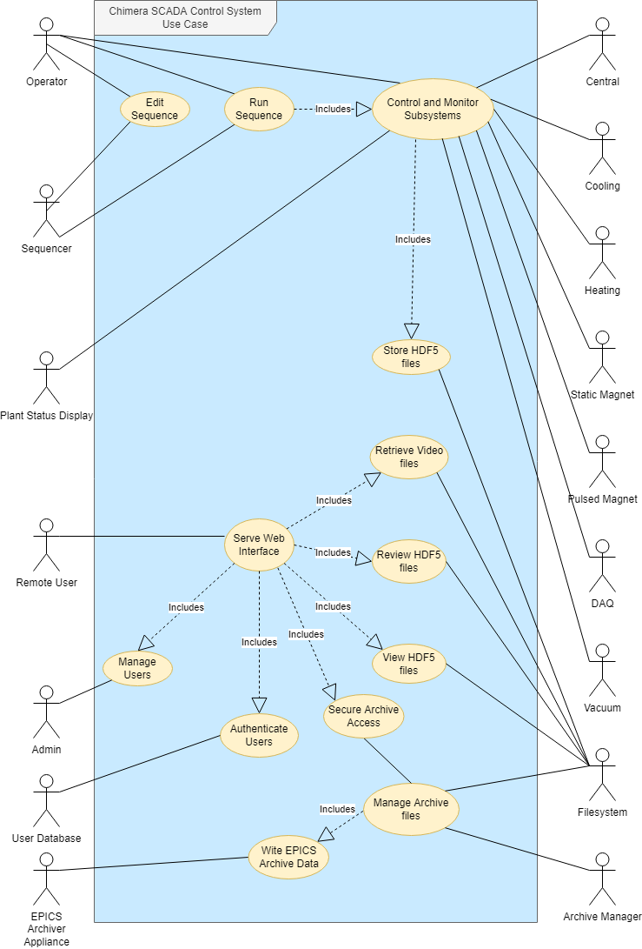
CHIMERA CONTROLS
Use Case
Notes:
This Use Case diagram shows the context of ‘users’ of the Chimera EPICS system.
Much of the underlying complexity is abstracted away from the operators.
The relationship between subsystems and details of the control logic is not shown at this level.
Quickly walk through the use cases…

Slide 8
CHIMERA
EXPERIMENT SEQUENCING
The scan system
will automate Chimera experiments
Scan Server
Scan Editor
Scan Monitor
Provided by Phoebus Scan System
Notes:
A single instance of the Scan Server will run on a dedicated Linux (RHEL) server.
Experiment sequences can be monitored, paused or halted, potentially from any workstation.
1) It can define a set of setpoints, waiting at each step until conditions are met and experiment data has been taken.
2) A high-level sequencer will provide automation of slow plant functions.
3) Sequences will be defined using a spreadsheet and run on the Scan Server, with Scan Editor instances available on the operator workstations.

Slide 9
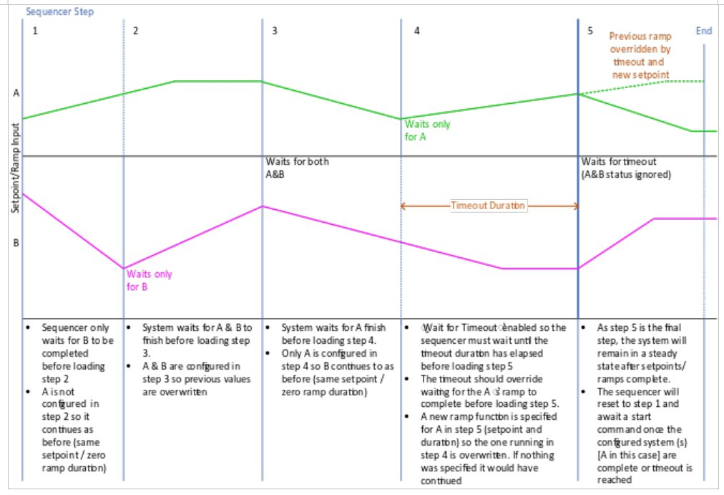
CHIMERA
EXPERIMENT SEQUENCING
Notes:
This diagram is an example of the steps of an experimental sequence.
A step will establish setpoint conditions.
The next step in the sequence will be loaded either when the previous step setpoints have been attained or a timeout condition is met.
Experimental sequences will be designed offline, possibly using spreadsheets, then loaded into the Chimera SCADA Control System when required.

Slide 10
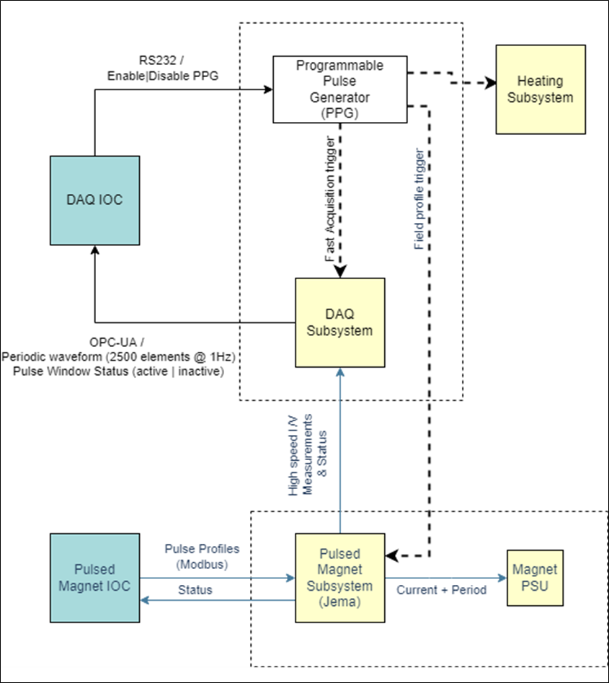
CHIMERA
DATA ACQUISITION
Notes:
The National Instruments DAQ system will capture and time-stamp experimental / scientific data at fast and slow acquisition rates: 2,500 Hz for non-thermocouple sensors and 10 Hz for thermocouples.
High speed data acquisition is performed for a set period of -2 to +10 seconds relative to the magnet pulse.
Data from all DAQ system channels will be recorded continuously by the common plant archiver at 10 Hz. This includes high speed channels which will be down sampled to a lower rate 10 Hz (1 of 250 samples) for recording in the archiver.
High speed data captured by the DAQ system will only be saved during specific time windows such as surrounding a magnetic pulse, to optimise storage usage. Long periods between magnetic pulses are unlikely to contain any significant events where high-speed data would be useful.
The window for saving high-speed data capture surrounding magnetic pulses, will be two seconds before and ten seconds after a magnetic pulse is triggered, as shown in Figure 12. When no magnetic pulses are triggered, only low speed data recording will occur.

Slide 11
CHIMERA
DATA ACQUISITION
High-speed data acquisition
2500 Hz
Low-speed (archived)
10 Hz
Timing controlled by a Programmable Pulse Generator
Notes:
The Programmable Pulse Generator is a Quantum Composer 9530, which already has EPICS device support.
High speed data acquisition:
National Instruments PXIe system @ 2500 Hz.
Transferred to DAQ IOC via OPC UA
EPICS areaDetector driver writes to HDF5 files.

Slide 12

CHIMERA
Secure file access
Two types of remote data access required
HDF5 files
Archiver Appliance data
HDF5
Archived data
Notes:
HDF5 Files: Need filesystem browsing and file download capability.
Archiver Appliance Data: Need access to the Archiver Appliance user interface.

Slide 13
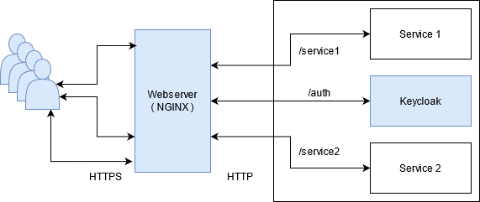
CHIMERA
Secure file access
NGNIX Reverse Proxy
Keycloak (Open Source)
OpenResty.
will be used as the identity and access management solution.
Notes:
NGNIX Provides a single access point using the HTTP protocol, providing a simple solution to this problem.
NGNIX Reverse Proxy:
OpenResty.
support for OpenID-Connect auth can directly interact with Keycloak
An open source application that provides good performance, reliability and security.
Supports OpenID-Connect authentication
Can directly interact with Keycloak.
Keycloak (Open Source) will be used as the identity and access management solution.

Slide 14
CHIMERA
PPG & Pulse Sequencer
A pulse sequencer for the pulsed magnet system will allow automated execution of a simple list of pulse profiles in order.
Notes:
Sitting underneath the overall experiment sequencer (mentioned earlier) is a magnet pulse sequencer.
The hardware is a bespoke subsystem designed and delivered by a third-party supplier.
This facilitates the execution of a simple list of magnet pulse profiles, in order.
A pulse profile consists of up to 10 points, each defined with a current and time value.
The current value will have been derived from the desired magnetic flux for each step.
The pulsed magnet controller will run each pulse profile on receiving a trigger signal from the programmable pulse generator.
The pulse sequencer will load the next step/pulse profile, immediately after the pulsed magnet controller has finished running the previous profile.
Pulse sequences will be pre-designed and loaded into the CSCS (Chimera SCADA Control System) via spreadsheet (Python script).

Slide 15
CHIMERA
Pulse Sequencer User interface
Controls
Pulse Period
Start Sequence
Stop Sequence
Mode
Auto
Manual
Manual Step Selection
Pause Sequence
Notes:
Pulse Period: Allows the user to define the period between pulsed magnet pulses via the programmable pulse generator.
Start: The pulse profile for the selected step is sent to the pulsed magnet controller.
Mode: Running mode for the sequencer
Auto: The sequencer will automatically run through all configured steps from the selected step. A new step will be loaded immediately after completing the pulse from the previous step.
Manual: The sequencer will run the selected step only. The pulse generator should be disabled after sending a single pulse.
Manual Step Selection: Allows an initial step to be selected for automatic or manual running. The value will increment if a given step is completed. It will default to step one and be reset to one when a sequence completes.
Pause Sequence: The sequence will be stopped, and the pulse generator output disabled after the pulse for the currently running step has been completed. The start button will resume the sequence from the next step.
Stop Sequence: The sequence will be stopped, and the pulse generator output disabled after the pulse for the currently running step has been completed. The sequencer will be reset to step one.

Slide 16
CHIMERA
Pulse Sequencer User interface
Monitoring
Overall Progress Bar
Current Step
Pulse Time Elapsed
Pulse Status
Notes:
Overall Progress Bar: Indicates progress through the list of configured steps.
Current Step: Indicate the current step in progress and the total number of steps.
Pulse Time Elapsed: Displays the time elapsed since the last magnet pulse was triggered.
Pulse Status: Reflects the status indicators from the pulsed magnet controller to indicate pulse progress.

