Slide 1
EPICS Web Services
at the
Canadian Light Source
Michael Bree
Controls & Instrumentation Group
EPICS Collaboration Meeting - ITER
June 2019

Slide 2
Web Services Definition
  machine to machine communication via WWW
  web protocols: e.g., http, https, etc.
  response: XML, JSON, etc.

Slide 3
REST (Representational State Transfer) APIs
  architectural style for web services (RESTful APIs)
  uniform, predictable URIs
  stateless
  scalable
  standard HTTP methods (GET, POST, etc.)

Slide 4
RESTful EPICS Web Services at the CLS
  There are some, but…
  Very rudimentary (i.e., prototype level)
  We are here to learn

Slide 5
Architecture
Browser
Browser
Python
Python
Tornado
web services
Tornado
(JSON)
DB
CA_PROTO_SEARCH
Beacons
Network

Slide 6
CLS RESTful APIs
https://epicsgateway.clsi.ca
/get_pv/<pv_name>
/list_pvs
/list_iocs
/list_clients
/list_requests
/list_beacons

Slide 7
CLS RESTful APIs
/list_pvs
/list_pvs/?count=<X>&offset=<Y>
/list_pvs/?count=<X>&offset=<Y>&sort=<mode>
/list_pvs/?count=<X>&offset=<Y>&search=<regex>
/list_pvs/?count=<X>&offset=<Y>&ioc=<id>
/list_pvs/?count=<X>&offset=<Y>&app=<id>
/list_pvs/?count=<X>&offset=<Y>&invalid
/list_pvs/?count=<X>&offset=<Y>&duplicate
/list_pvs/?count=<X>&offset=<Y>&ioc=<id>&search=<regex>&sort=<mode>

Slide 8
Example: PV Monitor
  List EPICS PVs
      all / host / IOC / applications
      lost / duplicate / invalid names
      most requested
      search
  List EPICS IOCS
      apps / beacons / PVs
  List Requesting Clients

Slide 9
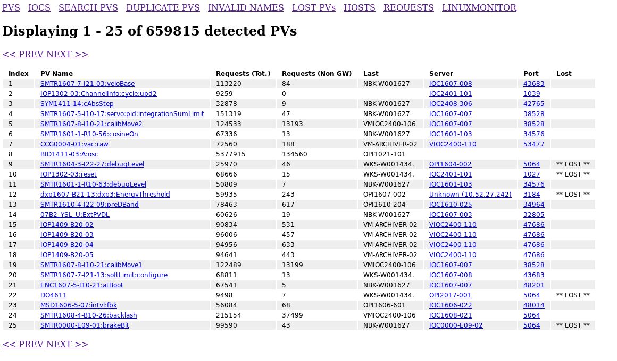

Slide 10
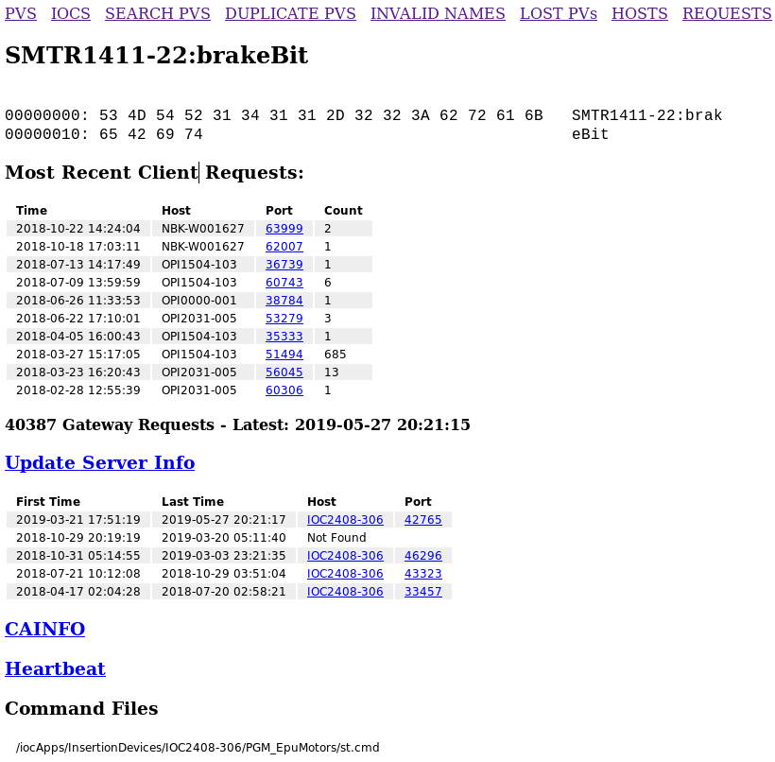

Slide 11
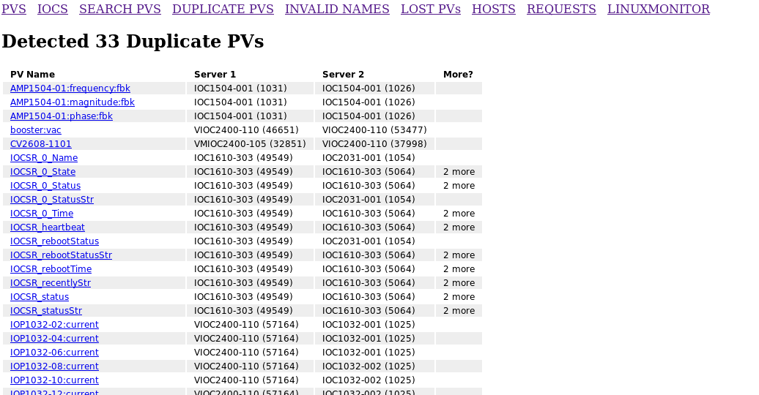

Slide 12
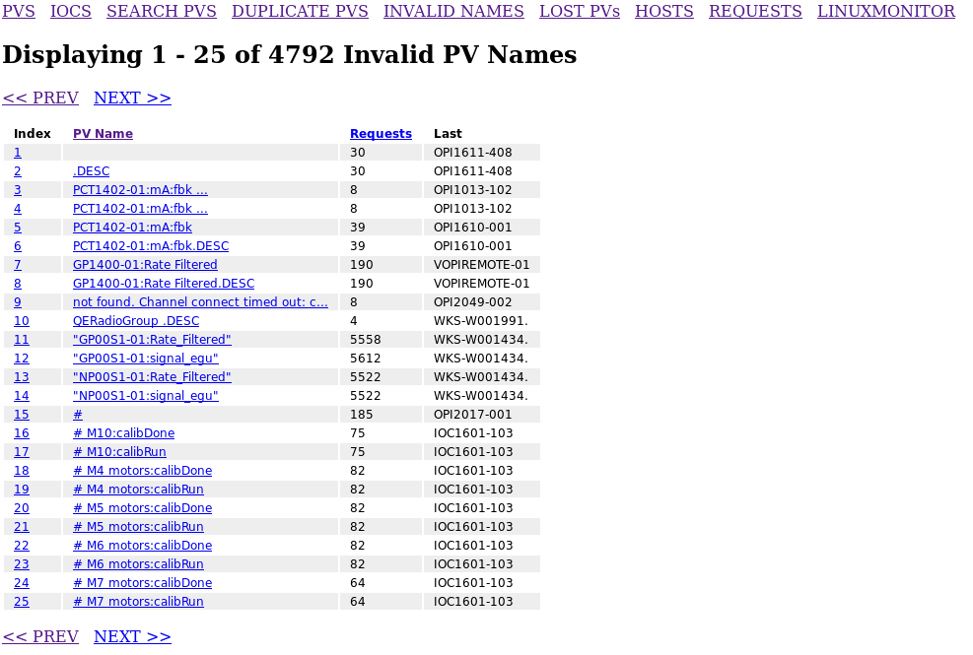

Slide 13
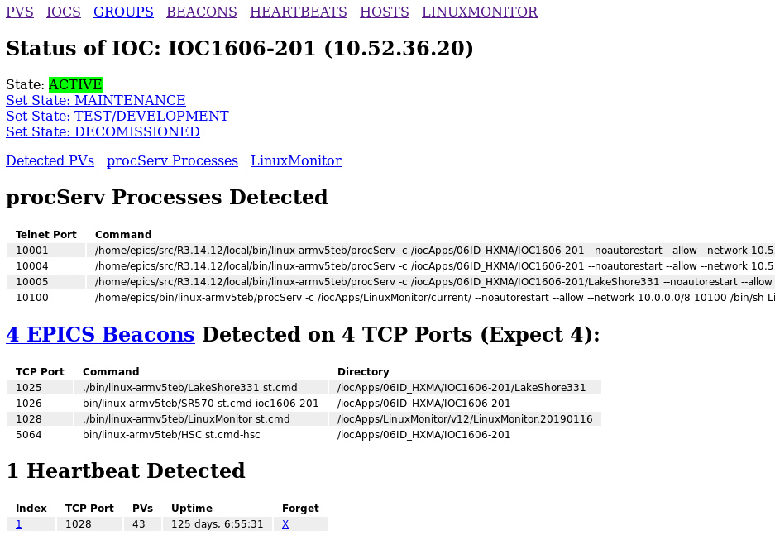

Slide 14
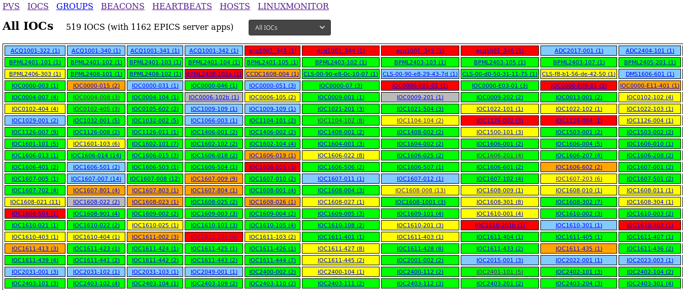

Slide 15
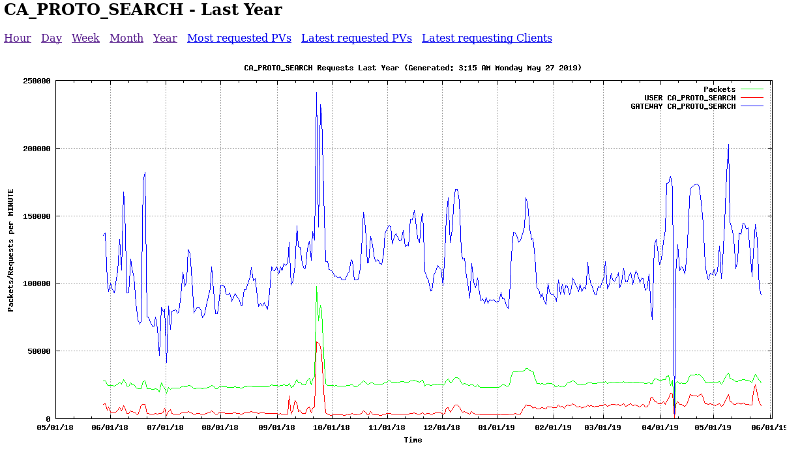

Slide 16
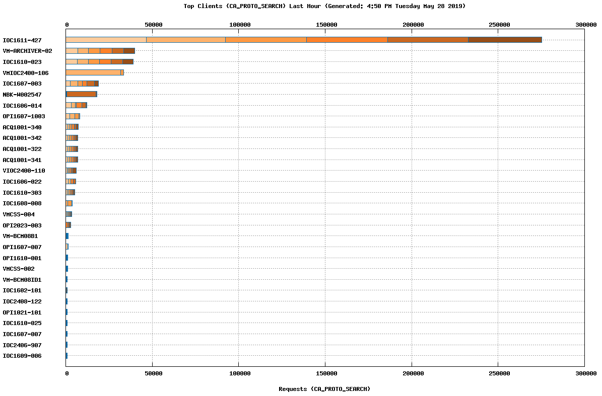

Slide 17
Lessons Learned
  Enforces modularity
  Separates logic and presentation
  Legacy is difficult
  Develop with testability in mind

Slide 18
Possible Future Goals
  OAUTH
  API Keys (permissions & roles)
  More clients (not just PV Monitor)
  More APIs:
    Archiver
    Alarms & Notifications
    Data Visualization?

