Slide 1
ITER Needs for EPICS & Web
D.Stepanov
ITER Organization
Disclaimer: The views and opinions expressed herein do not necessarily reflect those of the ITER Organization

Slide 2
Scope
Web tools are nowadays ubiquitous and can be found in both development (configuration) and runtime environments
This presentation is about run-time and “post-runtime” data presentation and dissemination, not about configuration tools

Slide 3
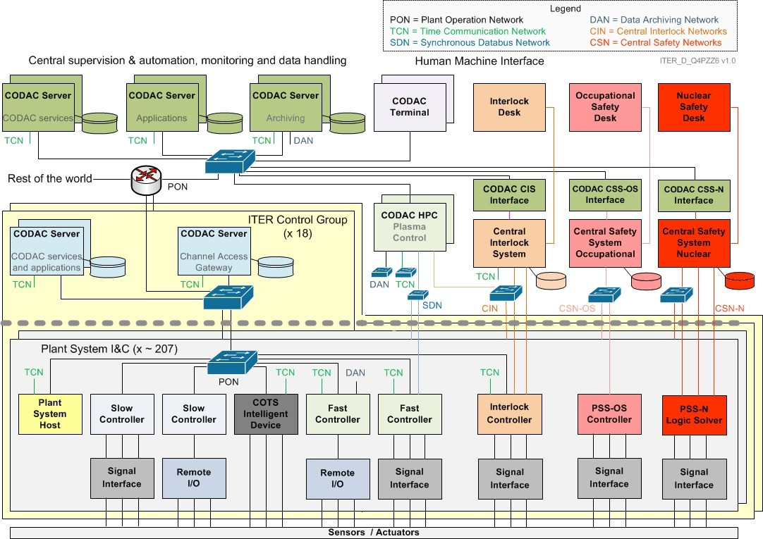


Place of EPICS & Web in Architecture

Slide 4
ITER Constraints
Nuclear plant network segregation
Role-based access
Remote participation

Slide 5
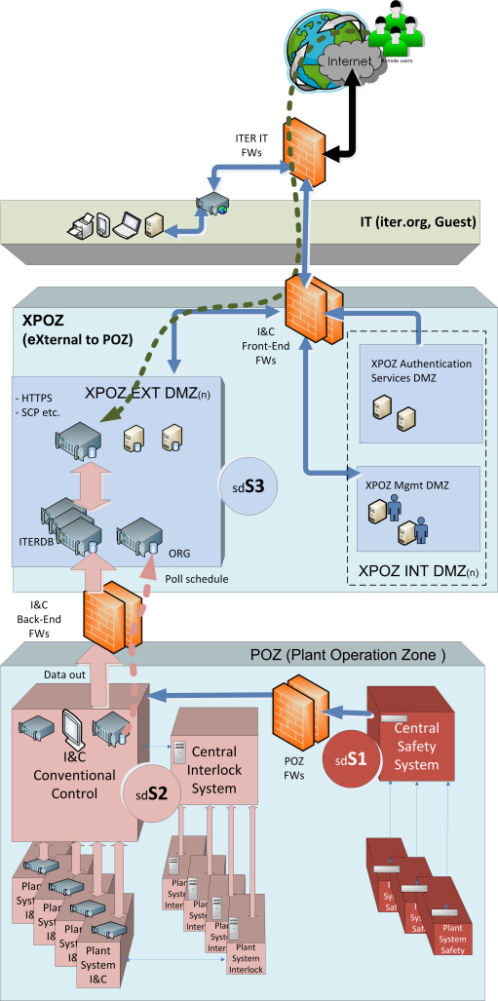
Network Zoning & Security Degrees
IEC 62645 mapping:
S1 – Safety systems (POZ)
S2 – Conventional controls & interlocks (POZ)
S3 – XPOZ
Other – IT
Each zone may have multiple specialized networks. Networks can be structured in subnets.

Slide 6
Classes of Remote Users
Off-site Research
  Access to ITER internal resources (IDM, CAD, …)
  Access to UDA
  Access to Scientific Data Center
  Access to experiment status data for non-operators
  Limited access to live data
Off-site Remote Participation Center
  Access to ITER via dedicated VPN
  Access to XPOZ (remote participation segment)
  Access to live data
  Remote control room setup replicating main control room
On-site (ITER IT network)
  (treated same as “off-site research”)

Slide 7
Why Web Tools?
Server-side intelligence – easier to control / modify
No software to manage on user side
Low learning effort; use out of the box
Functionality nearly equal to standard desktop environment
Use of standard protocols / ports – simplifies network setup
Established mechanisms for user authentication
…

Slide 8
ITER Basic Requirements
Live access to run-time data
Easy access to archived data
Screen designing capabilities, dashboards
Rich drawing interface, basic operations
Scalability
…
… if possible, avoid writing a yet another tool

Slide 9
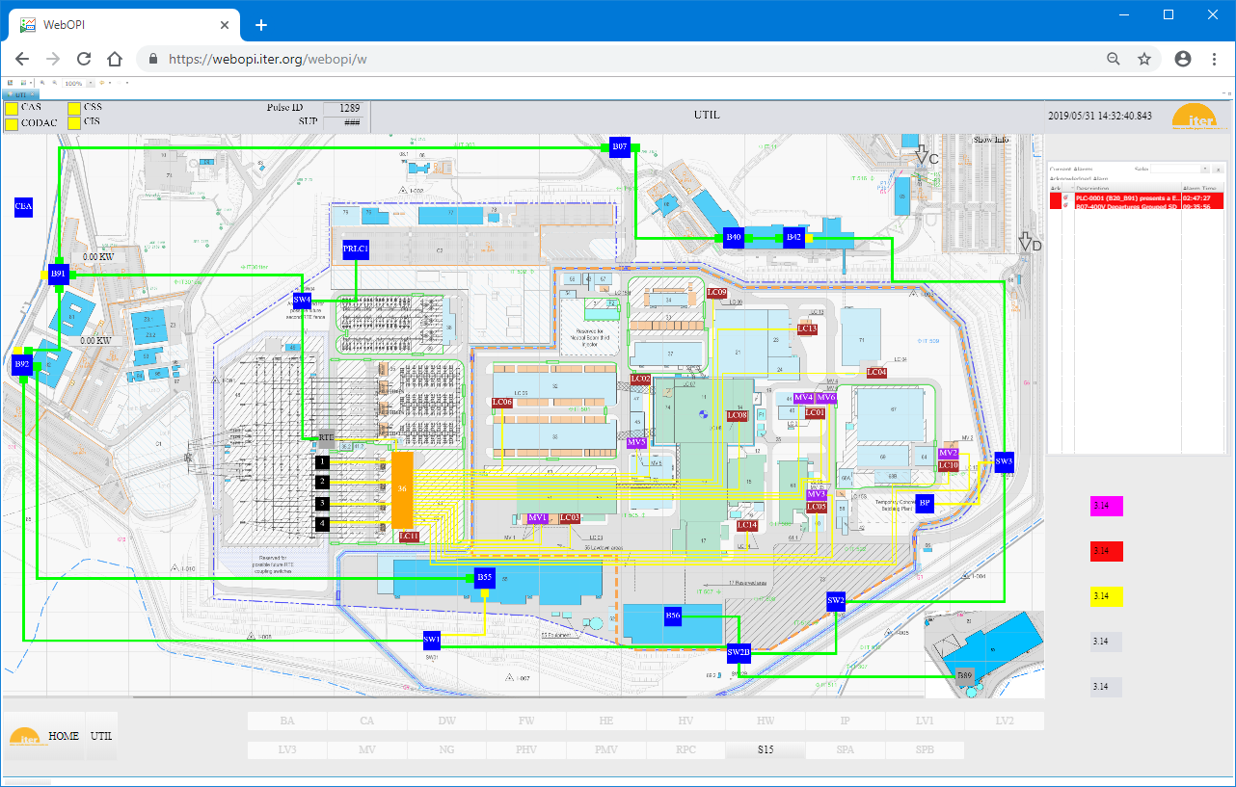
CS-Studio Web OPI

Slide 10
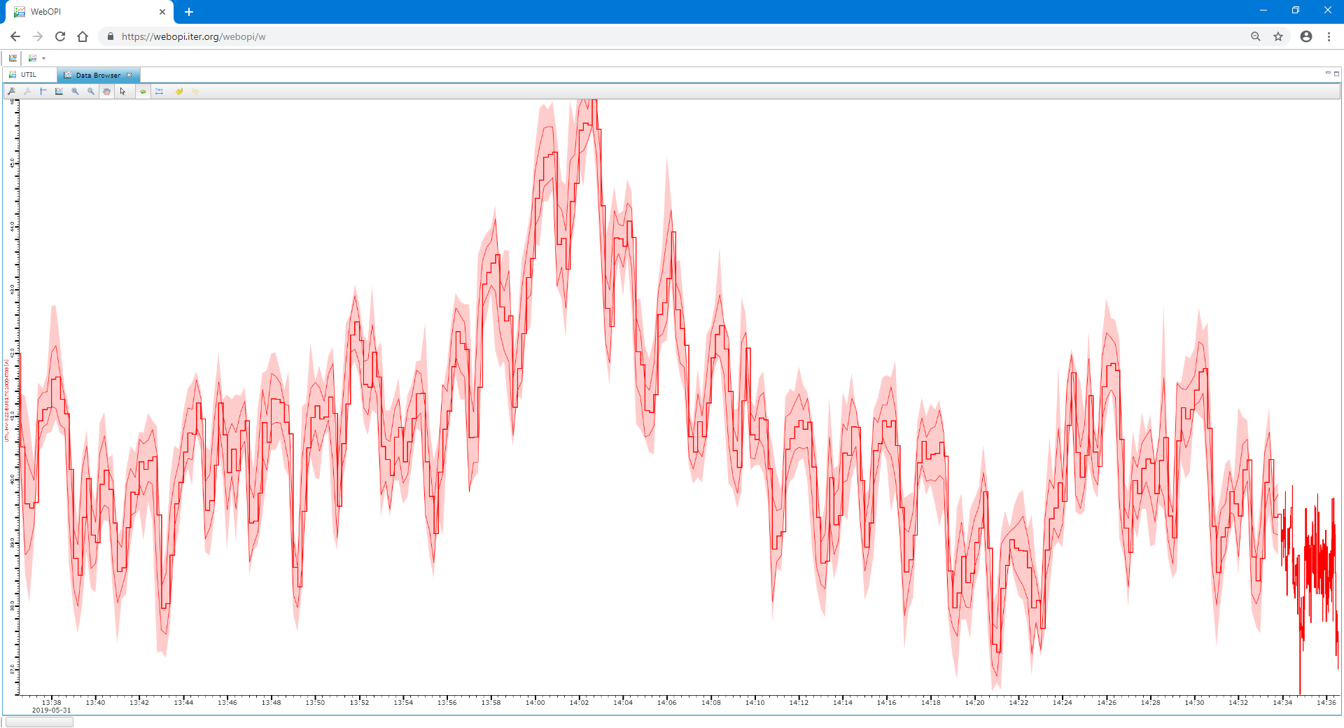
CS-Studio Web Data Browser

Slide 11
CS-Studio Web Tools
(+) Part of standard CODAC software stack
(+) Reuse of existing screens (some tweaks are needed)
(+) EPICS connection out of the box
(+) Access to source code + community
(?) Too operator-oriented, no dashboards
(?) Scalability
(?) Support and future. ITER has to maintain its own branch and fixes
Status: baseline, but needs to be complemented with other functions

Slide 12
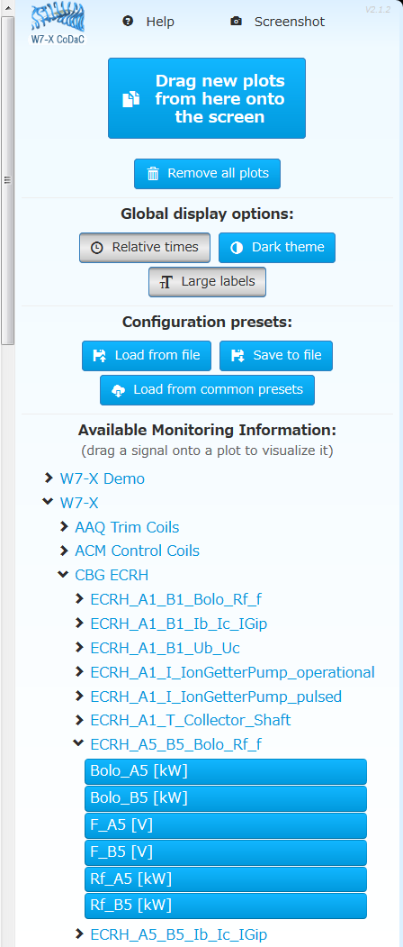
W7-X DAVInCI
Image credit: Dumke, 11th IAEA TM on Control, DAQ & RP, 2017

Slide 13
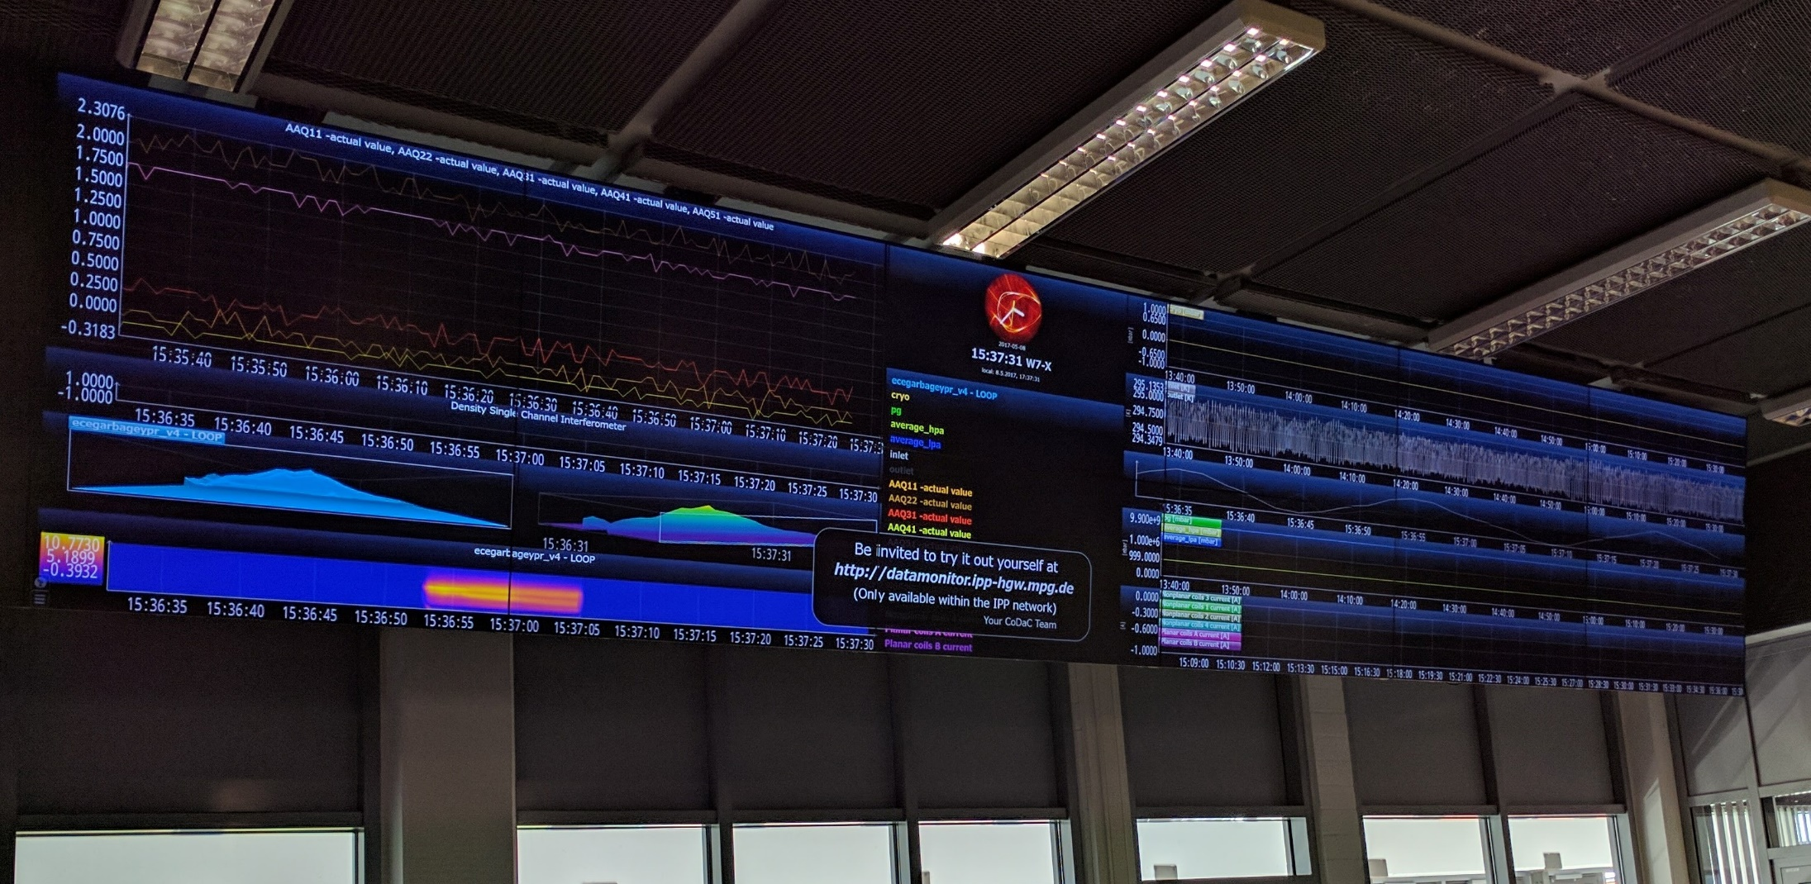
W7-X Screens

Slide 14
W7-X Tools
(+) Modern, nice look & feel
(+) Functionality, user-defined screens
(+) Scalability
(?) No EPICS or UDA connectors
(?) Portability
(?) Access to source code
Status: demo version installed at ITER, evaluation on-going

Slide 15
Other Candidates?

Slide 16
Conclusion
Web tools to navigate EPICS and other machine data are clearly needed
CS-Studio is a baseline but has limitations
Studies ongoing

