Slide 1




PVInfo: A simple and remarkably useful tool for the ALS
Bob Gunion
Accelerator Controls, Advanced Light Source
Lawrence Berkeley National Laboratory
Berkeley, California USA
June 2019

Slide 2
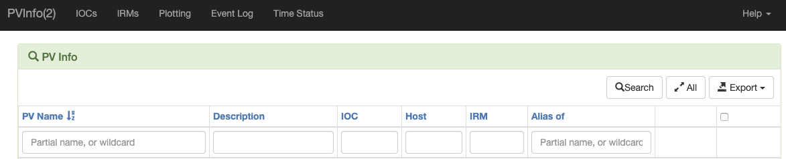
PVInfo(2)
https://controls.als.lbl.gov/pvinfo2
PHP/MySQL using the Yii2 framework
Search for PVs by name, IOC, etc.
Monitor real-time values
Possibly the most-used application in the control room
Could be easily adapted to other sites

Slide 3
PVInfo Under the covers
IOCs write output of epicsEnvShow to a common directory
cron job reads these files to discover env. variables, find startup decks
cron job then parses the startup decks to find PVs, including various fields
also adds metadata (e.g. hostname, ioc name)
All this info is saved to a MySQL database for later lookup by pvinfo

Slide 4
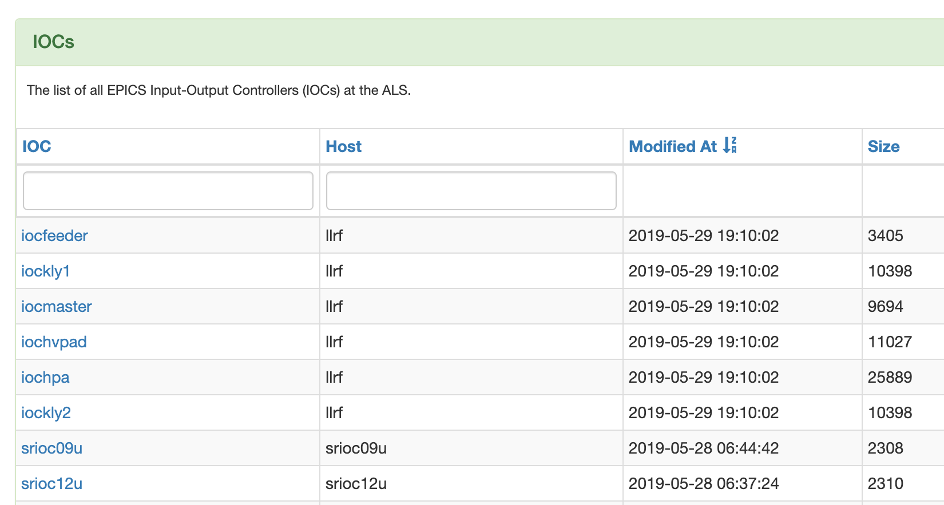
All IOCs are listed
Additional info is available
Click on an IOC name to list its PVs

Slide 5
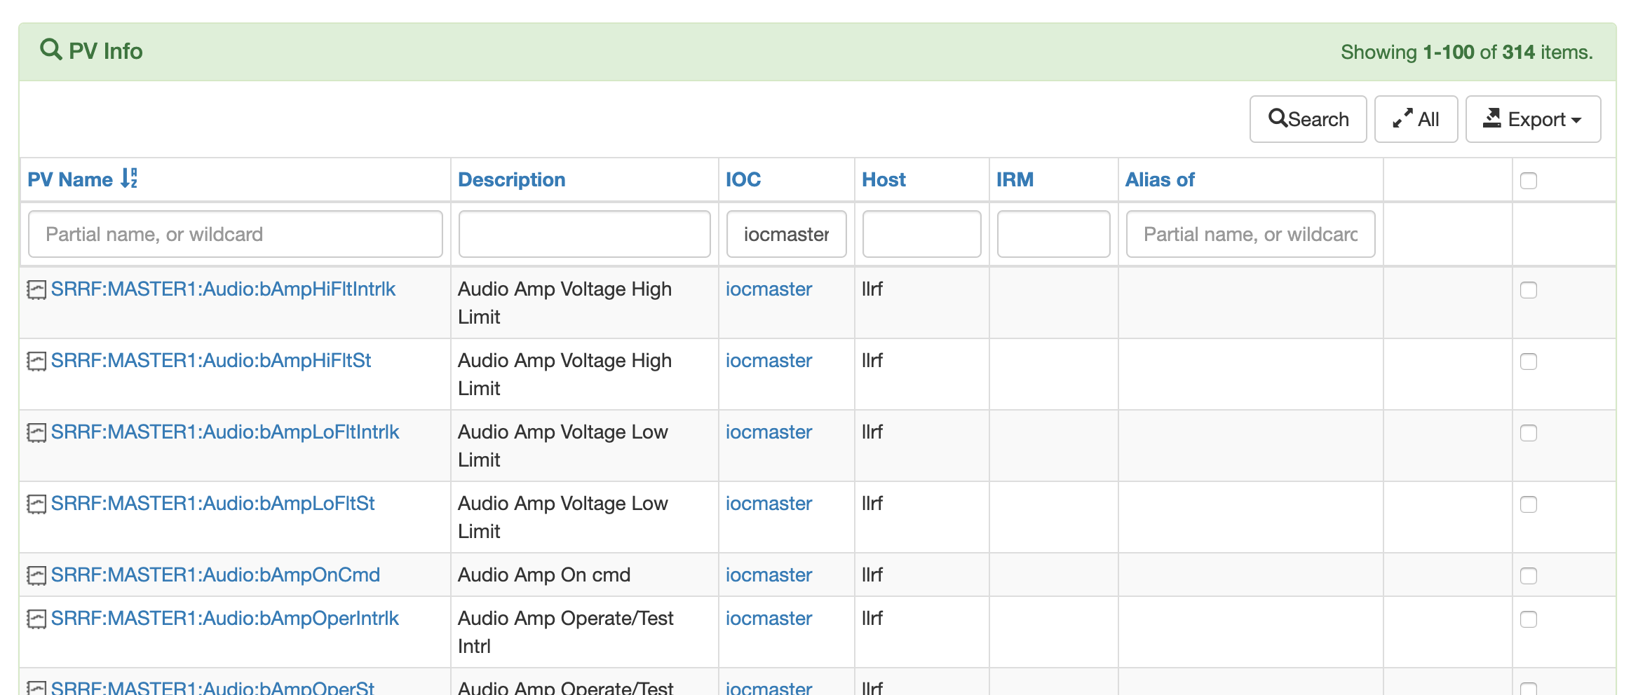
PV Search page
Checkbox allows displaying live values of individual PVs or all at once
Search by name, desc, IOC, host, ...

Slide 6
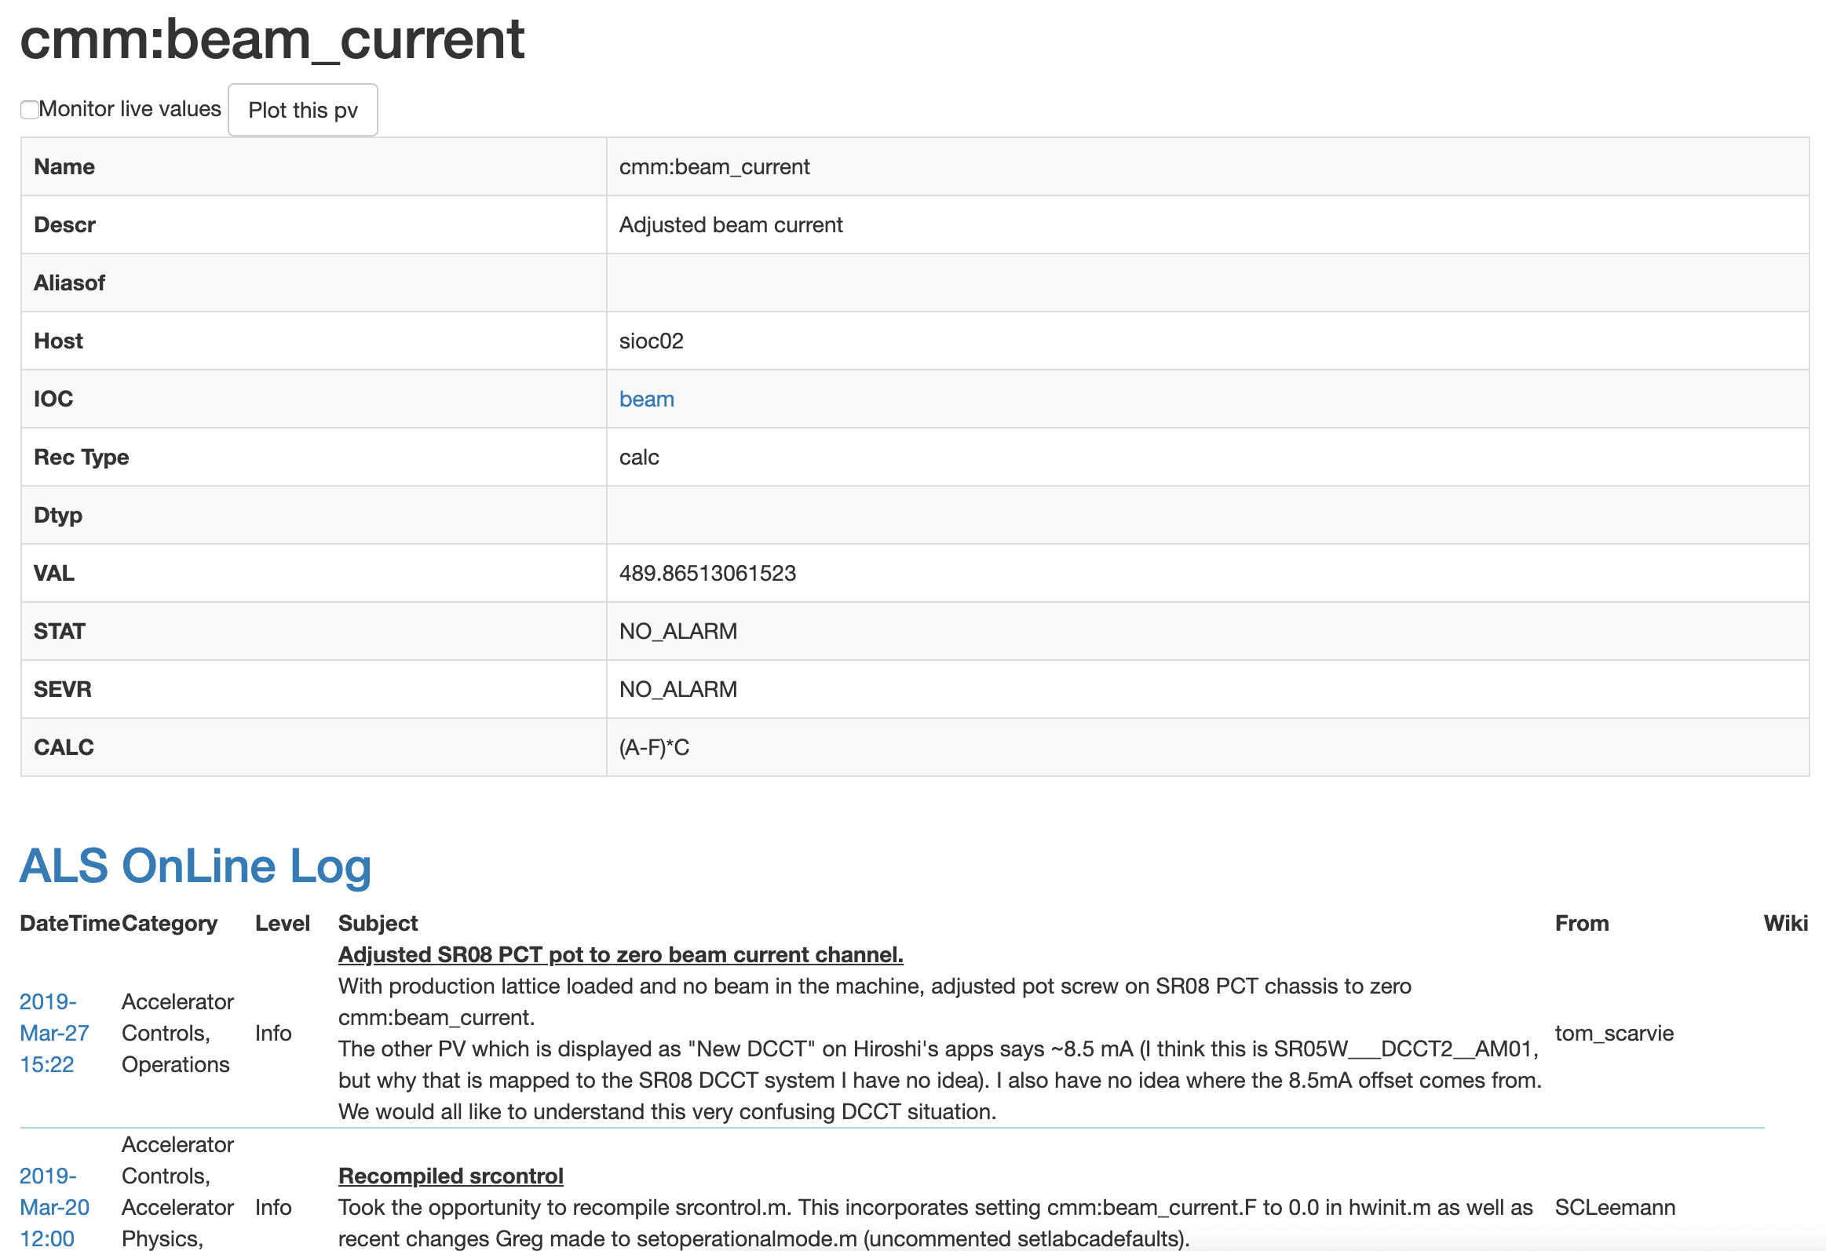
Click on a PV name to see details
Monitor live values
..or plot this pv

Slide 7
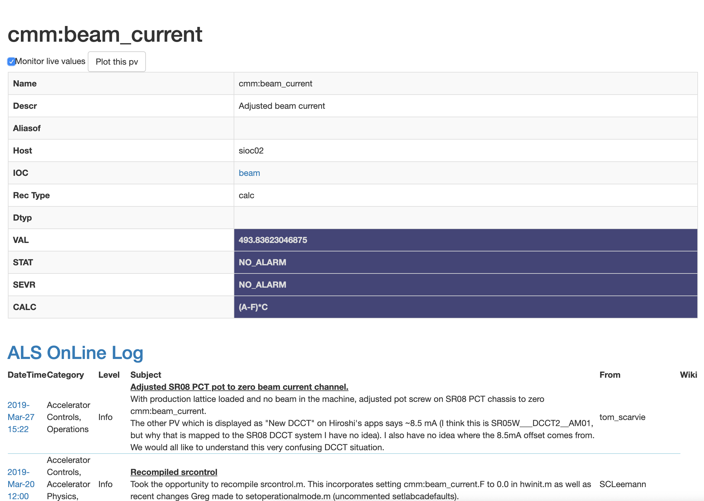
Monitoring Live Values

Slide 8
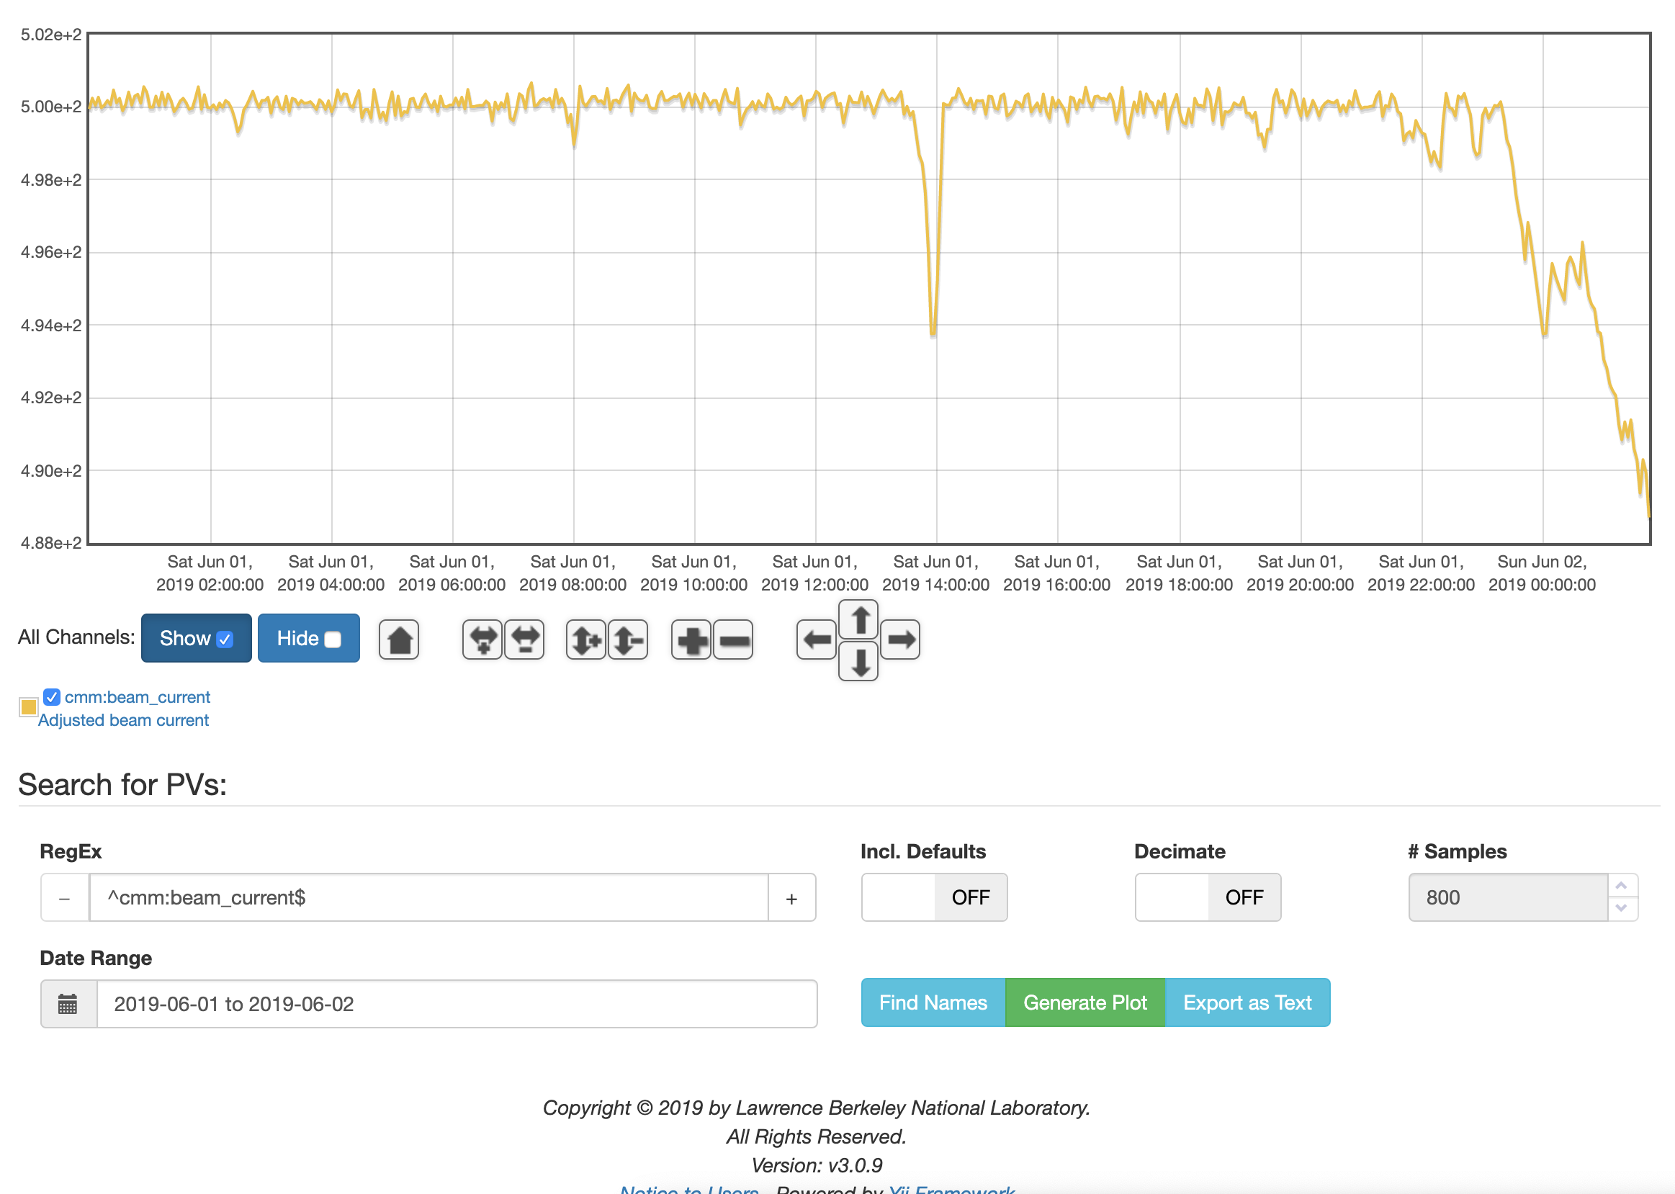
Plotting

Slide 9
Event Log
Discrete PV values are recorded via CA monitors
Users can search by regexp, time/date range
Eases investigation of root causes of beam dumps
Flexible search interface for many troubleshooting tasks

Slide 10
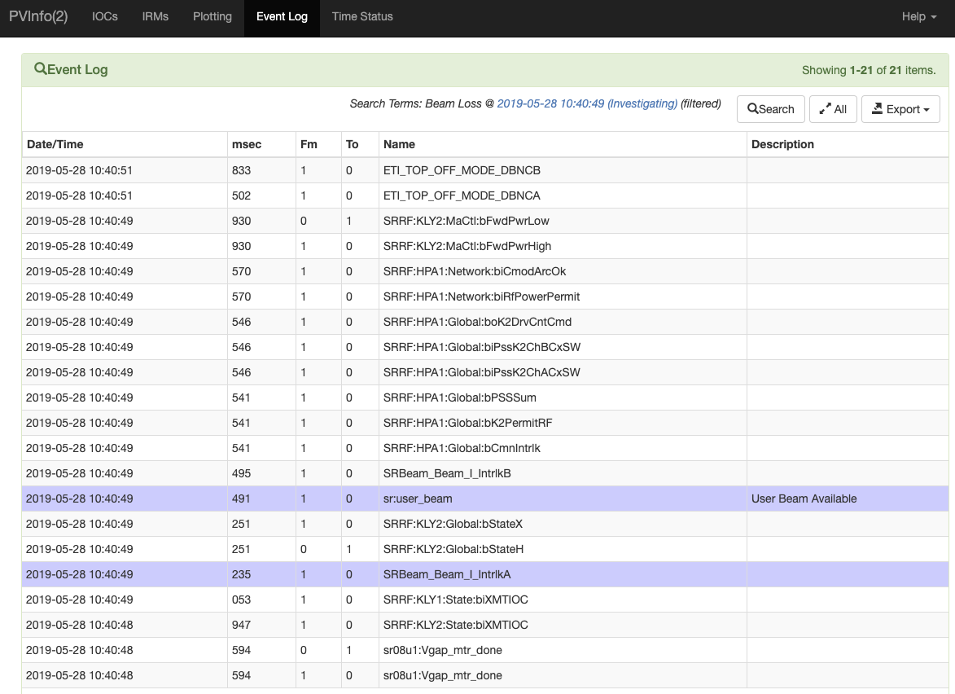

Slide 11
Conclusion
PVInfo is a relatively simple tool
Has proven to be incredibly useful
  Go-to tool for operators, physicists, engineers, etc.
Does have some flaws
  PHP/MySQL – rewrite?
  Plotting interface is a little clunky

