Slide 1
ESS Integrated Control System Progress Report
Timo Korhonen, for the ESS ICS division
Chief Engineer
European Spallation Source ERIC
2019-06-04

Slide 2
Overview
Recap of ESS
Project status update (pictures)
ICS organisation
ICS technologies
EPICS activities
Tools and status
About growing pains
Summary and outlook

Slide 3
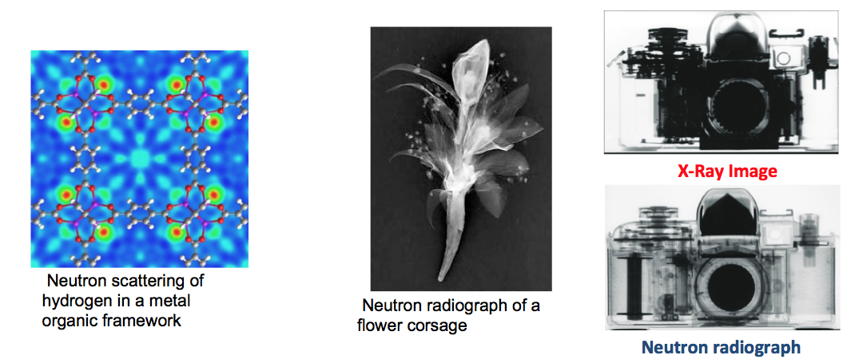
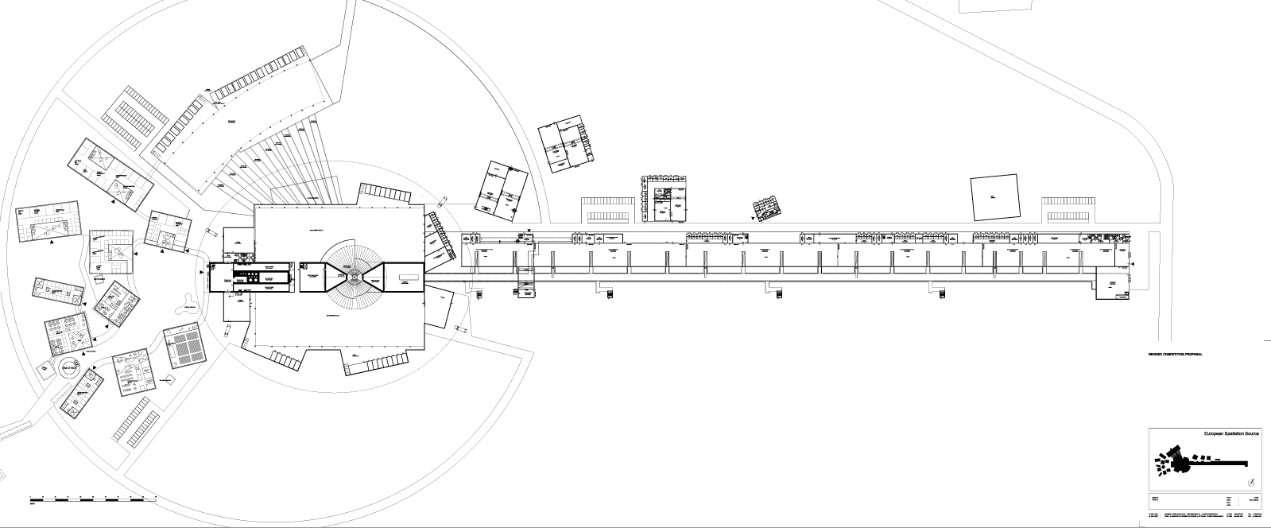
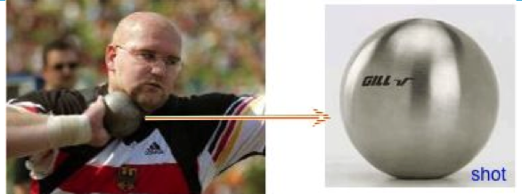
The European Spallation Source
ESS is a neutron spallation source for neutron-based multi-disciplinary science.
Neutron scattering can reveal the molecular and magnetic structure and behavior of materials:
  Structural biology and biotechnology, magnetism and superconductivity, chemical and engineering materials, nanotechnology, complex fluids, etc.
  Often complementary to light sources
The European Spallation Source (ESS) consists of :
  a pulsed accelerator that shoots protons into
  a rotating metal (tungsten) target to produce neutrons
  (up to ) 22 neutron instruments for various experiments
The European Spallation Source (ESS) will house the most powerful proton linac ever built.
  When we (one day) reach the specification: one beam pulse has the same energy as a 7.2kg shot traveling at 1100 km/hour (Mach 0.93). 14 times a second.

Slide 4
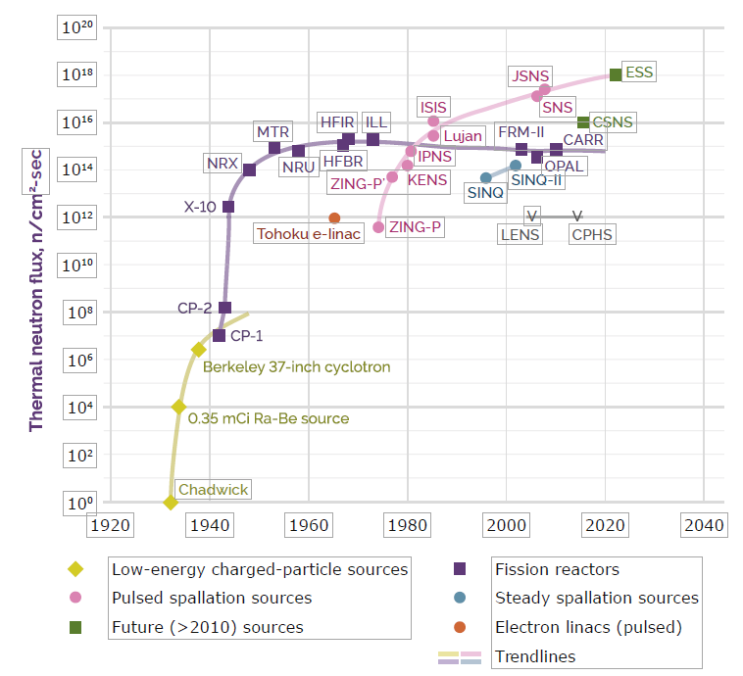
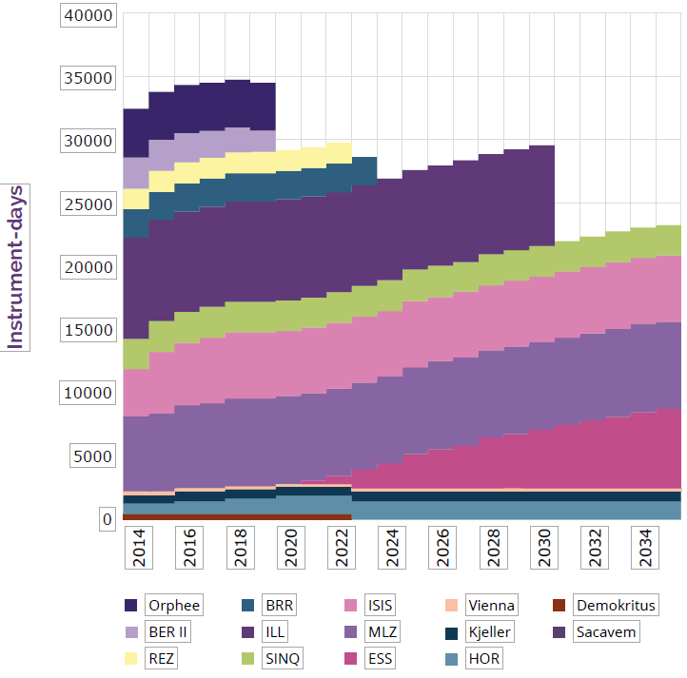
Why is ESS being built?
Neutrons for science in Europe

Slide 5
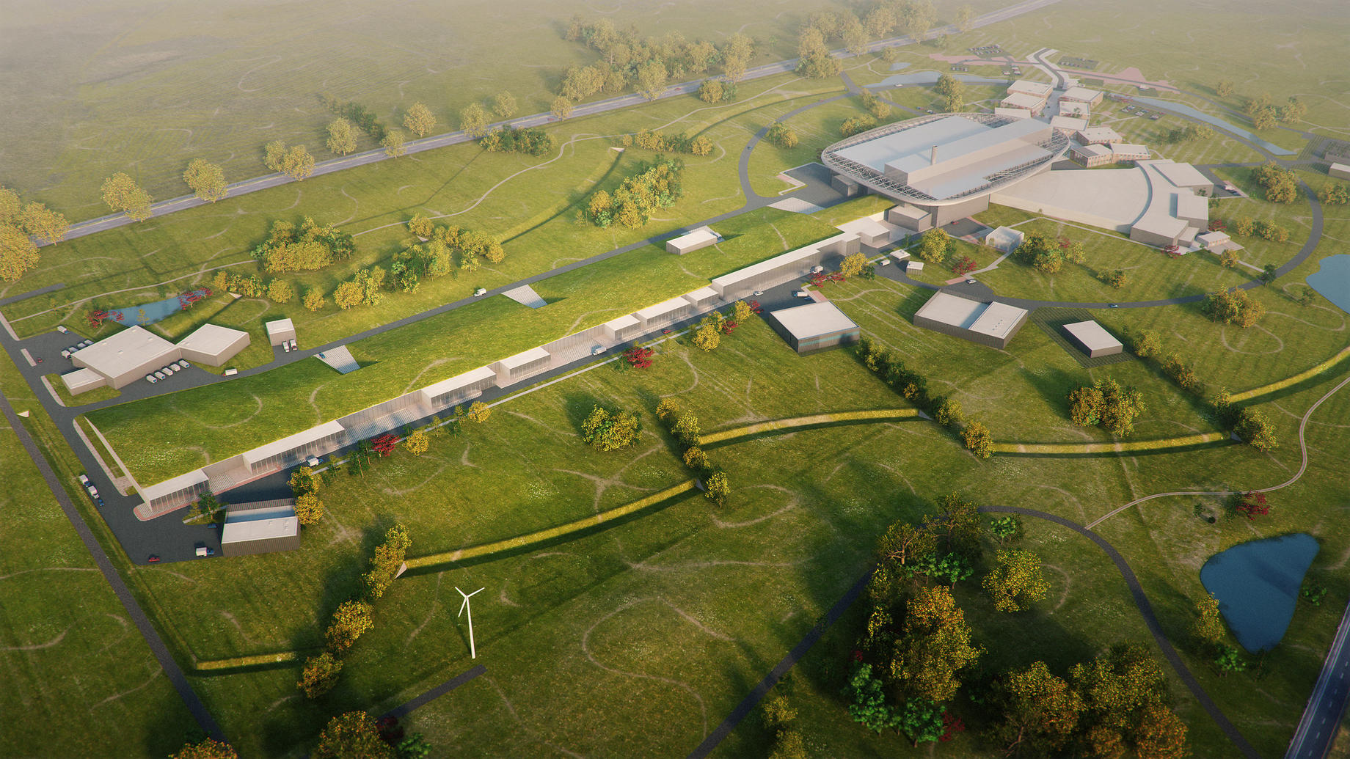
The European Spallation Source
Artist’s view…

Slide 6
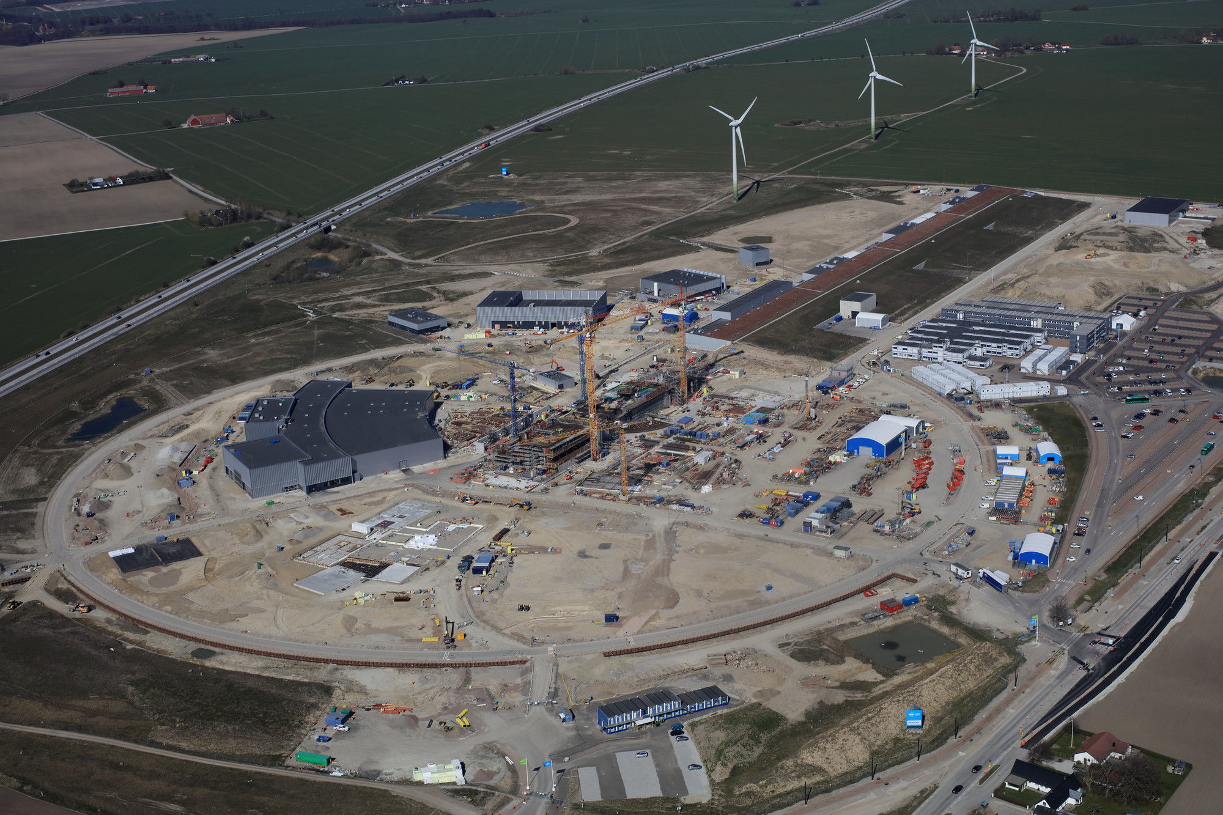
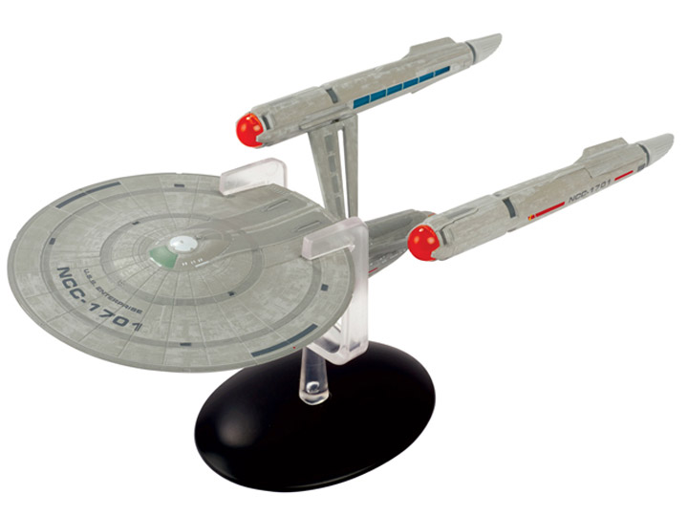
ESS Site, a recent aerial photo
For some reason always brings to my mind this…

Slide 7

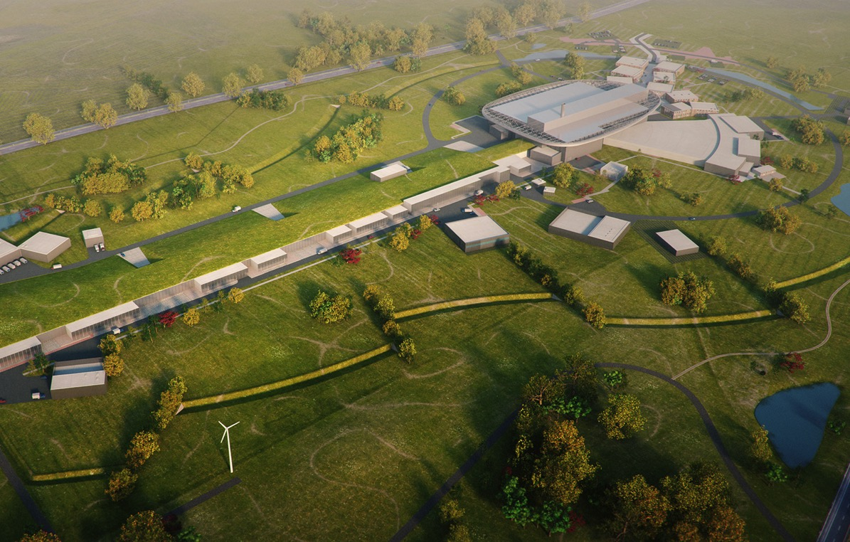
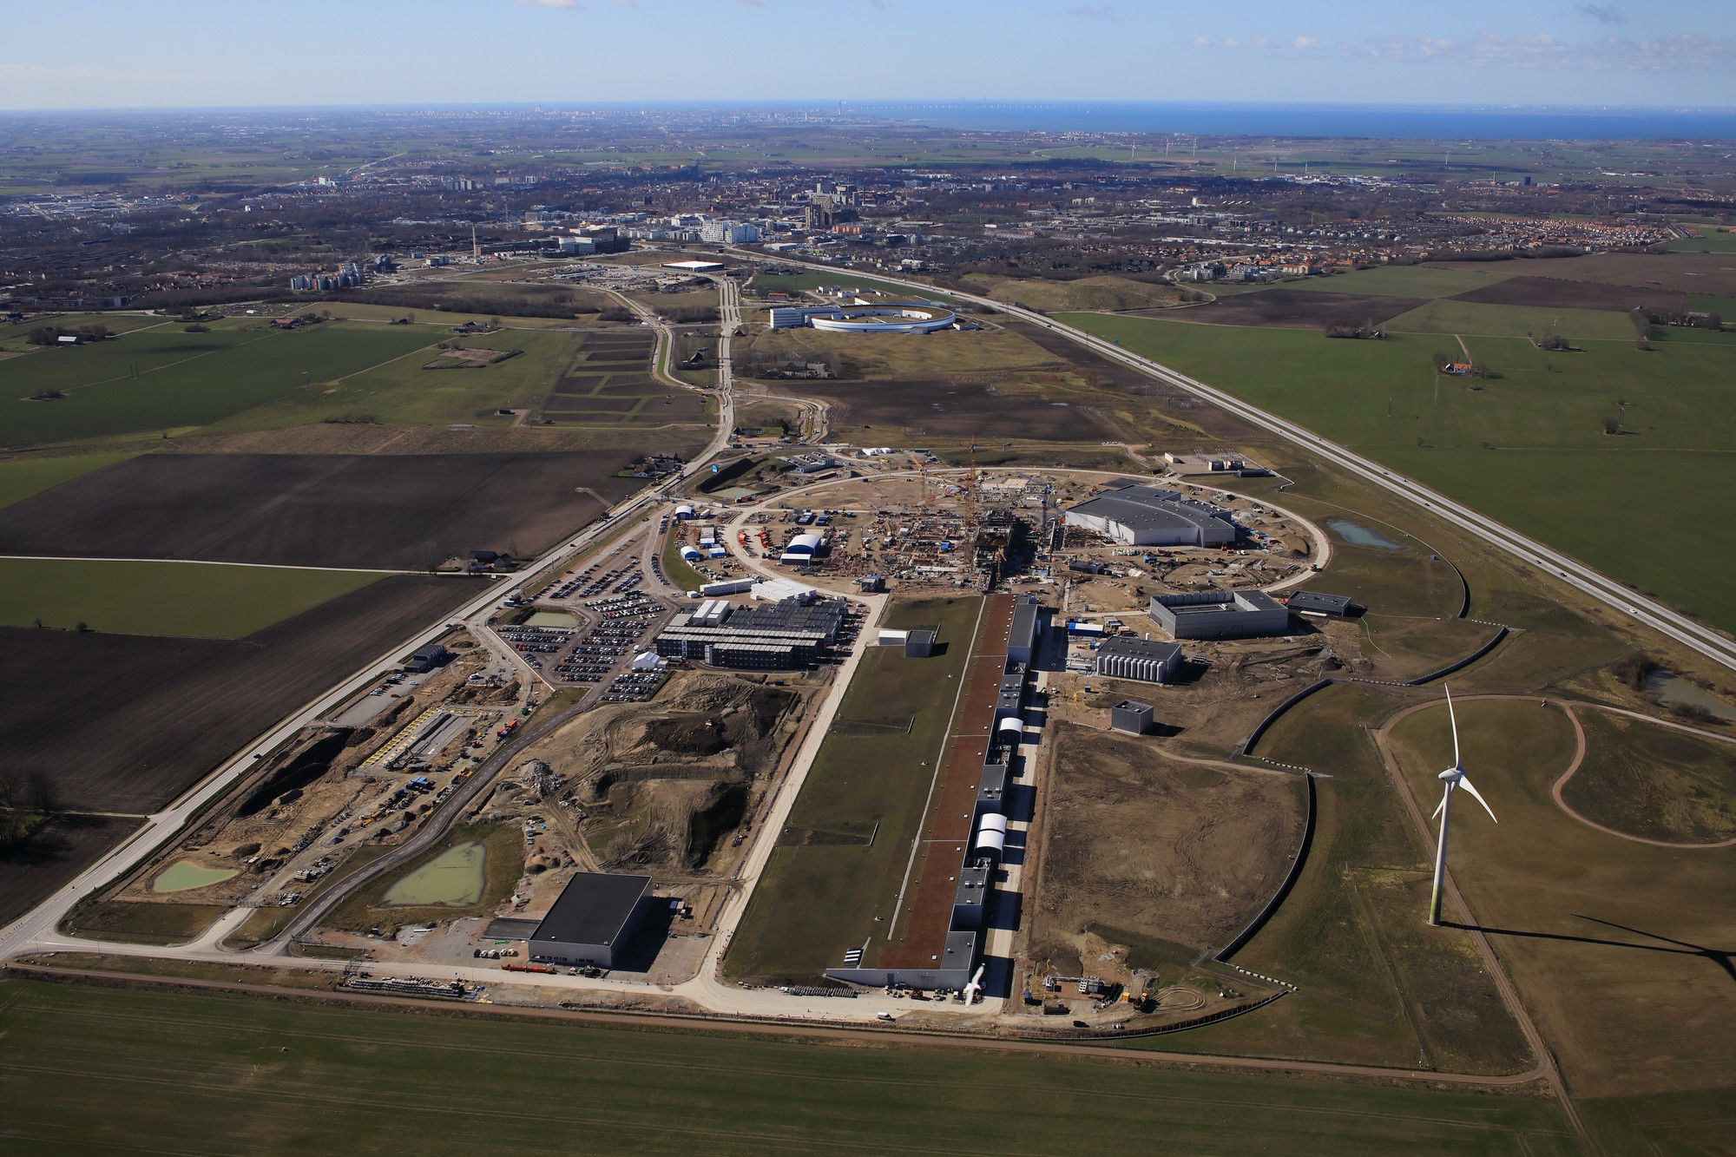
Timeline for the ESS facility
A few years old picture, just needed a very small update to show that we are still on track.
2067
Decommissioning
2025
ESS construction complete
2014
Construction work starts on the site
2023
ESS starts
user program
2009
Decision: ESS will be built in Lund
2019
First beam on target
2012
ESS Design Update phase complete
2003
First European design effort of ESS completed
Notes:
In between 2012 and 2014 we were facing a challenge…

Slide 8
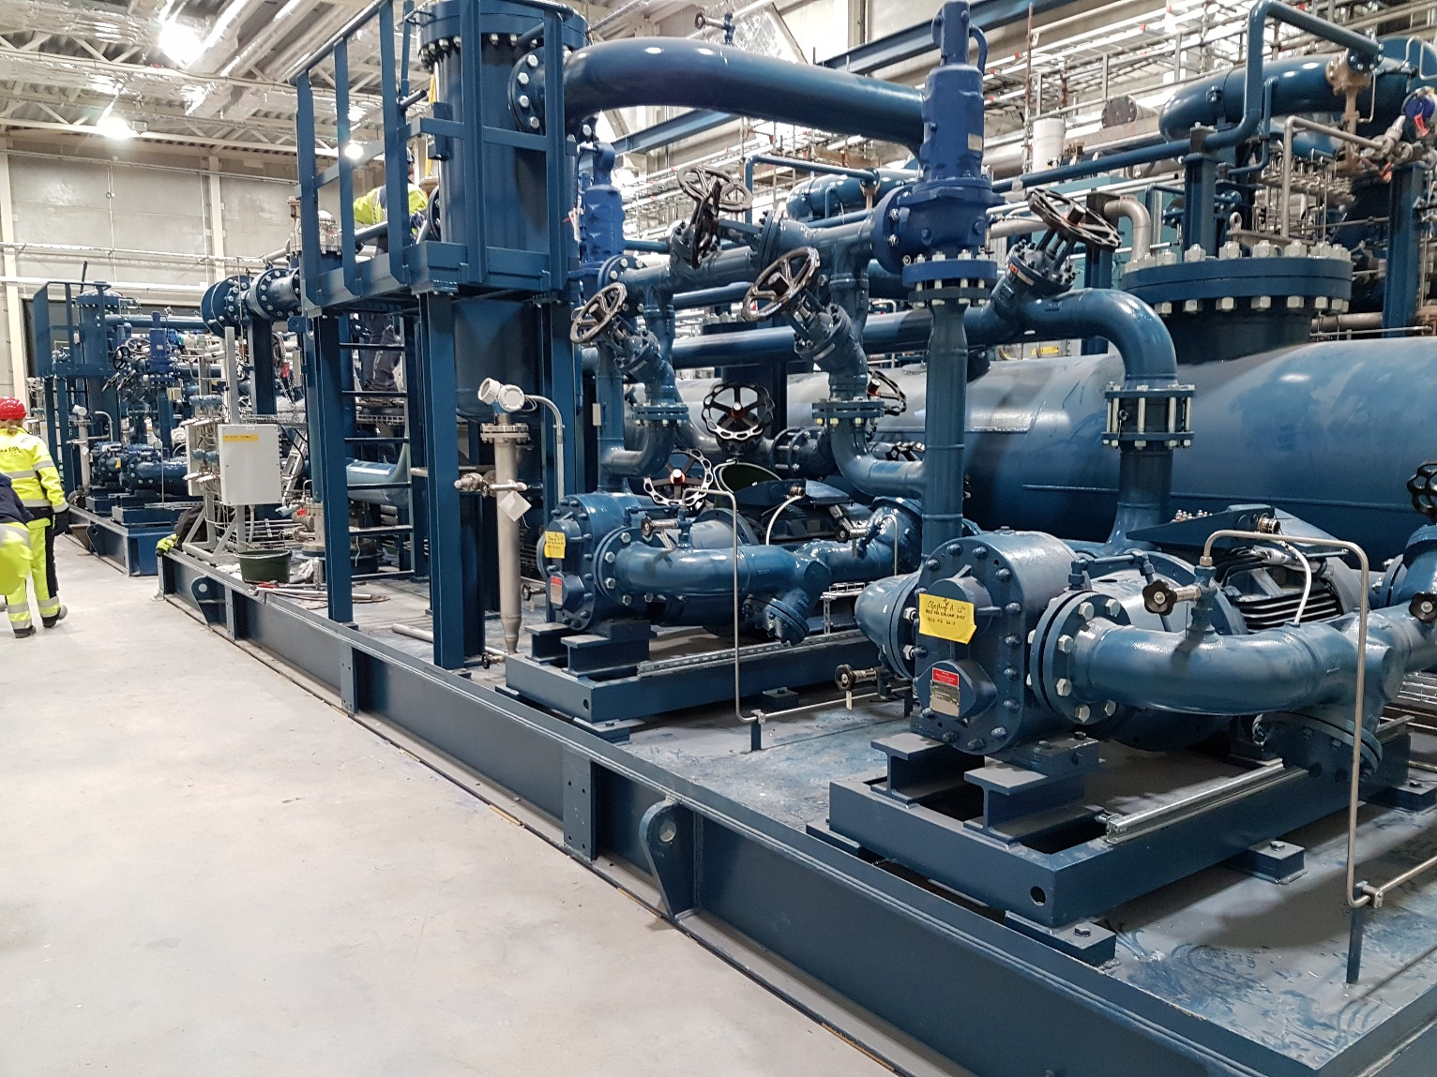
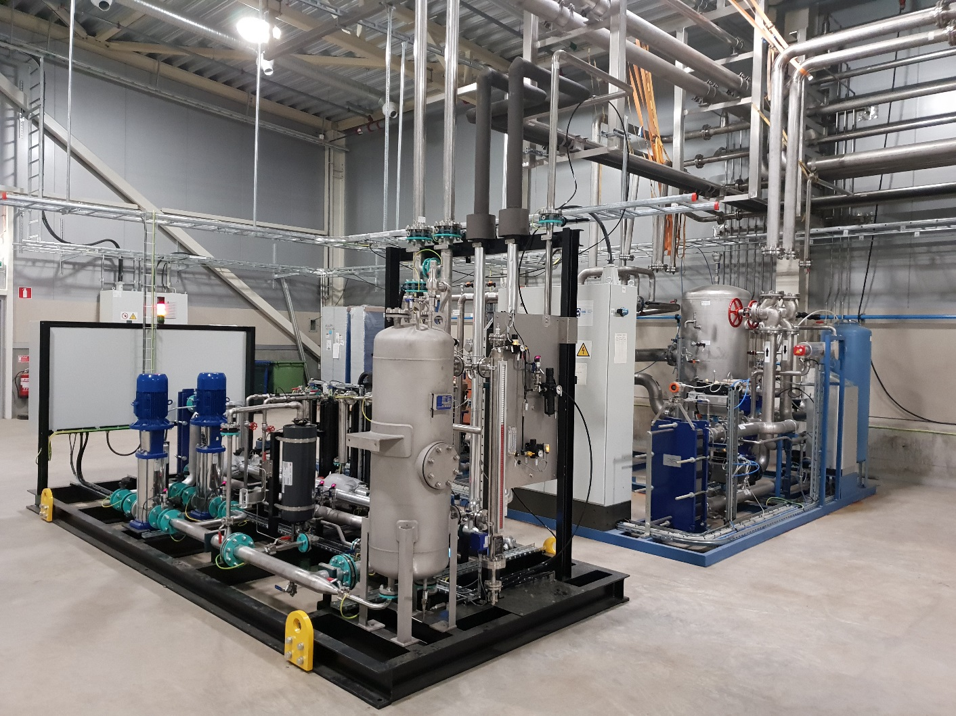
A lot of equipment arriving and installed…
Cryogenic plants delivered, installed and commissioned

Slide 9
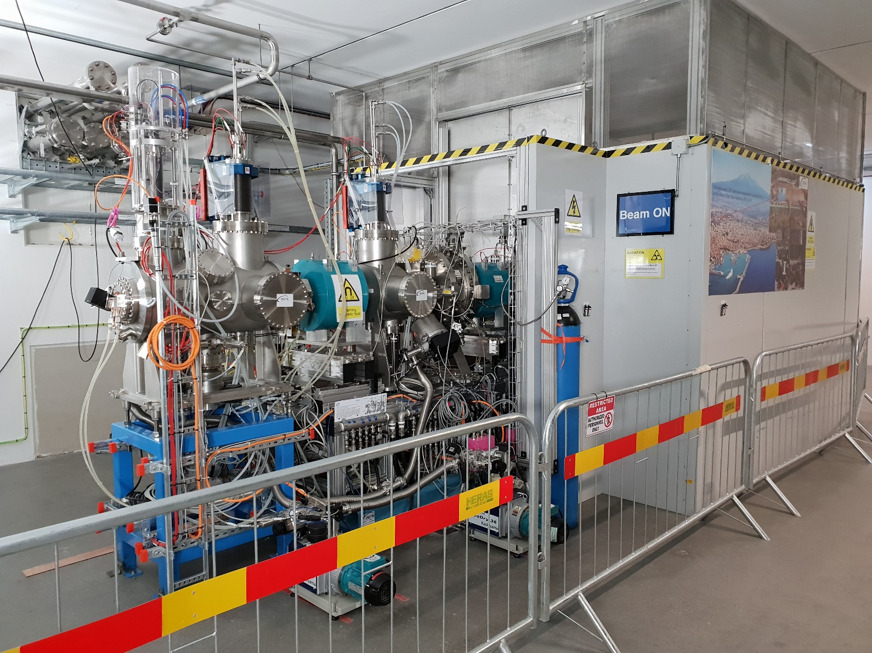
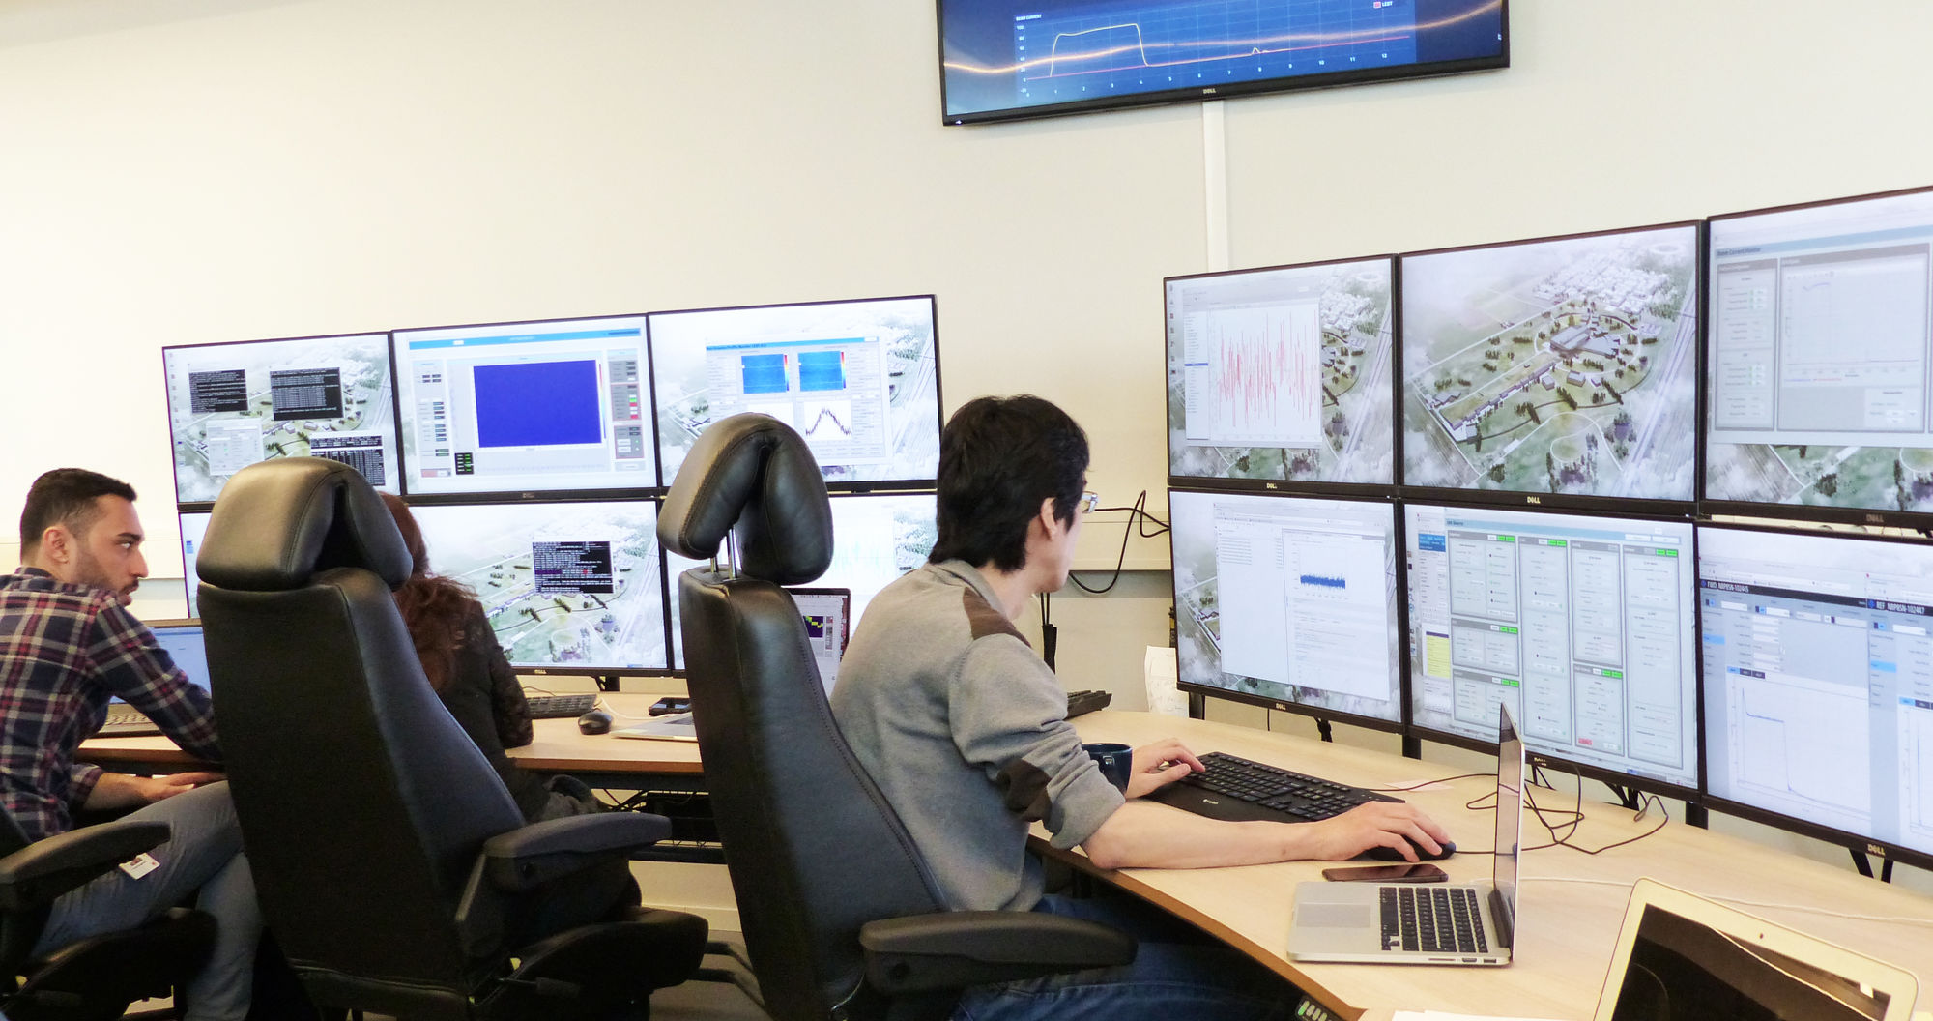
Commissioning the first parts of the accelerator
Temporary Control Room
(Final control room will be in target building, not ready yet)
Ion Source & Low Energy Beam Transport (ESS, INFN Catania and CEA Paris collaboration)

Slide 10
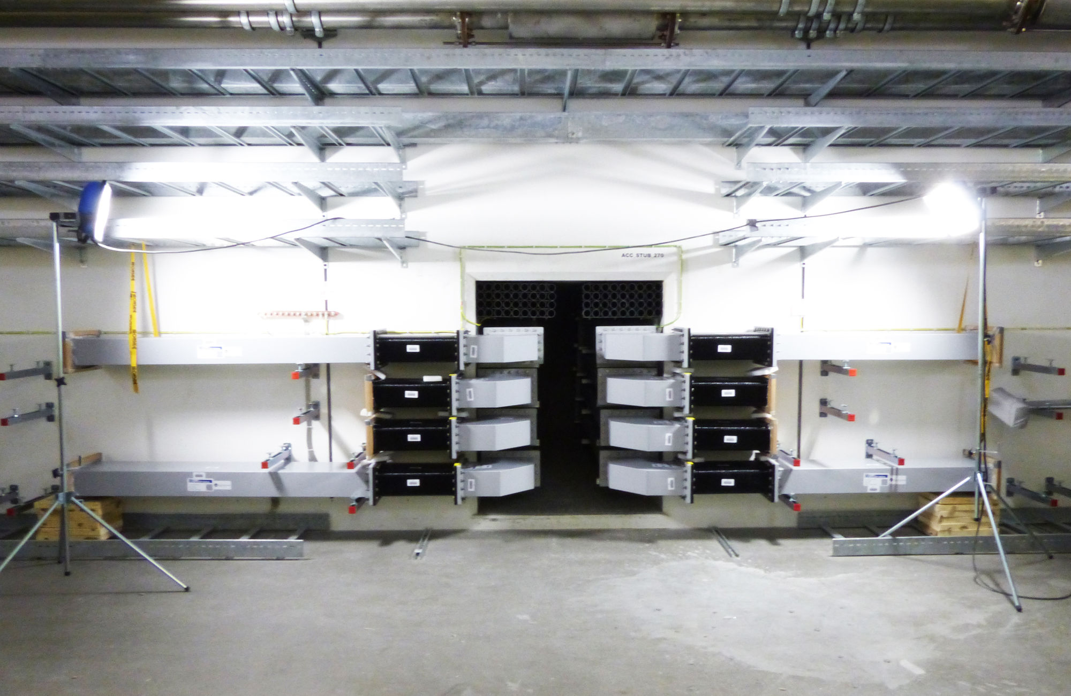
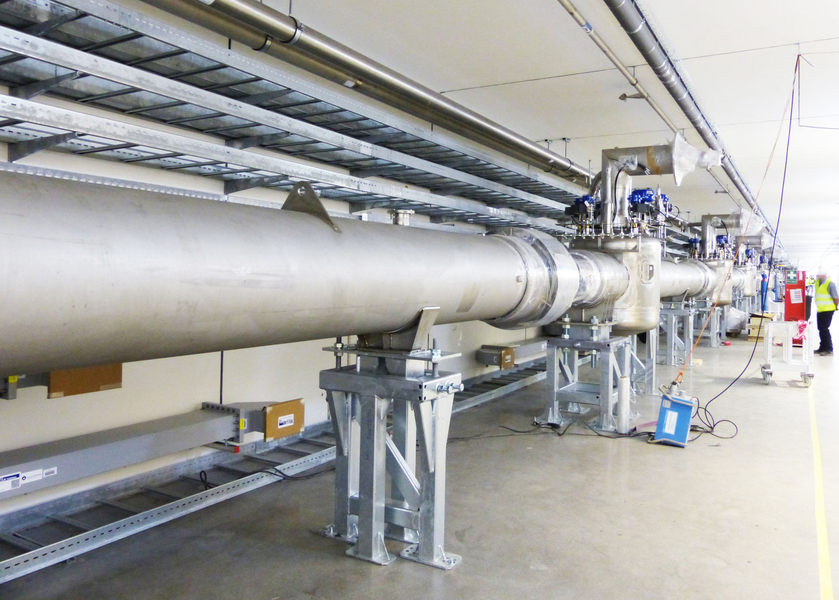
Tunnel installations
Waveguides installed in stubs. Many concerns (space, installation, etc.) but the end result looks quite neat.
Cryo distribution lines being installed. The tunnel starts to feel tight…

Slide 11
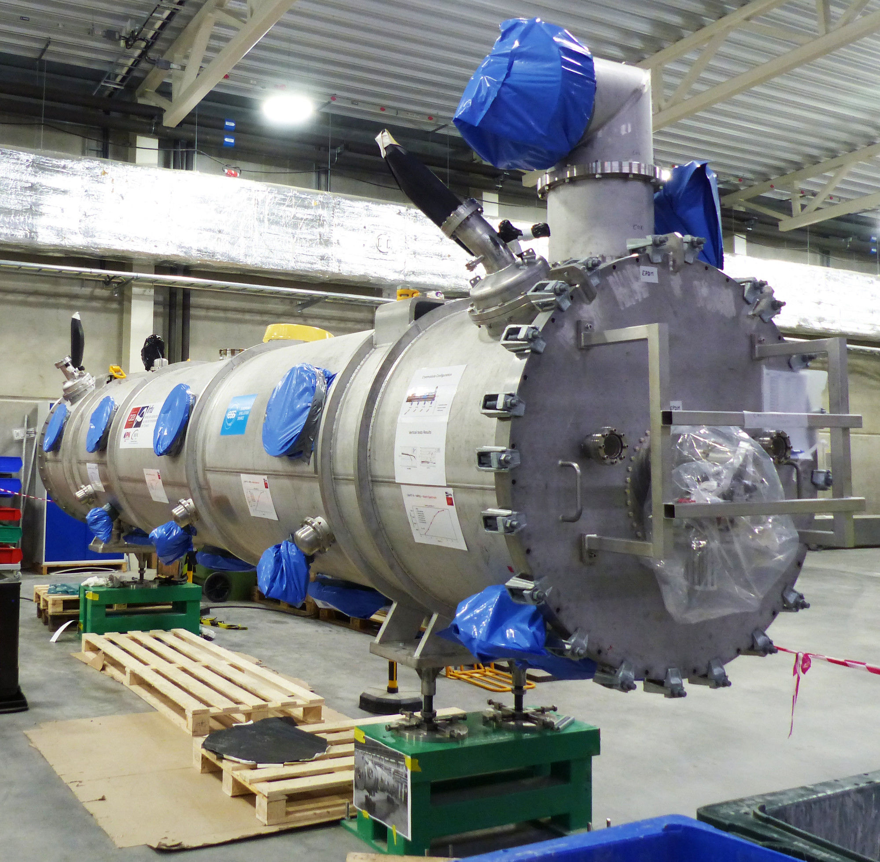
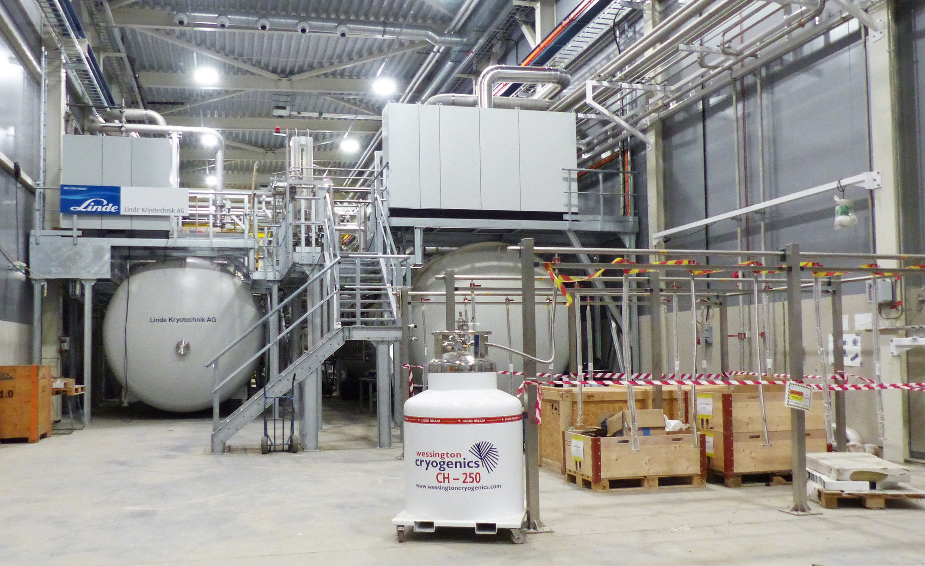
Cool stuff
Coldboxes of the cryogenic systems.
Cryomodules also start to arrive
(first unit)

Slide 12
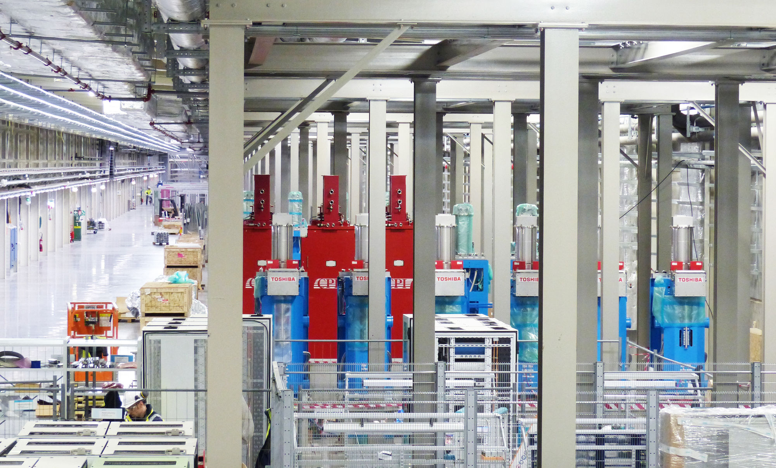
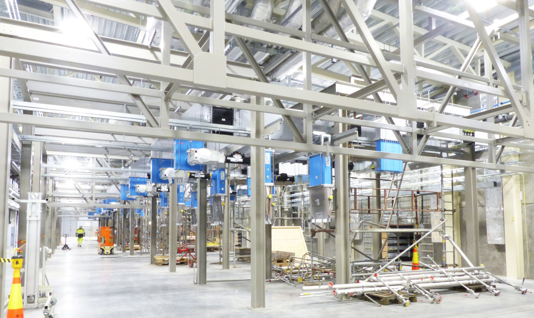
Klystron Gallery installations
Klystrons waiting for test and installation.
RF Waveguides and loads are being installed

Slide 13
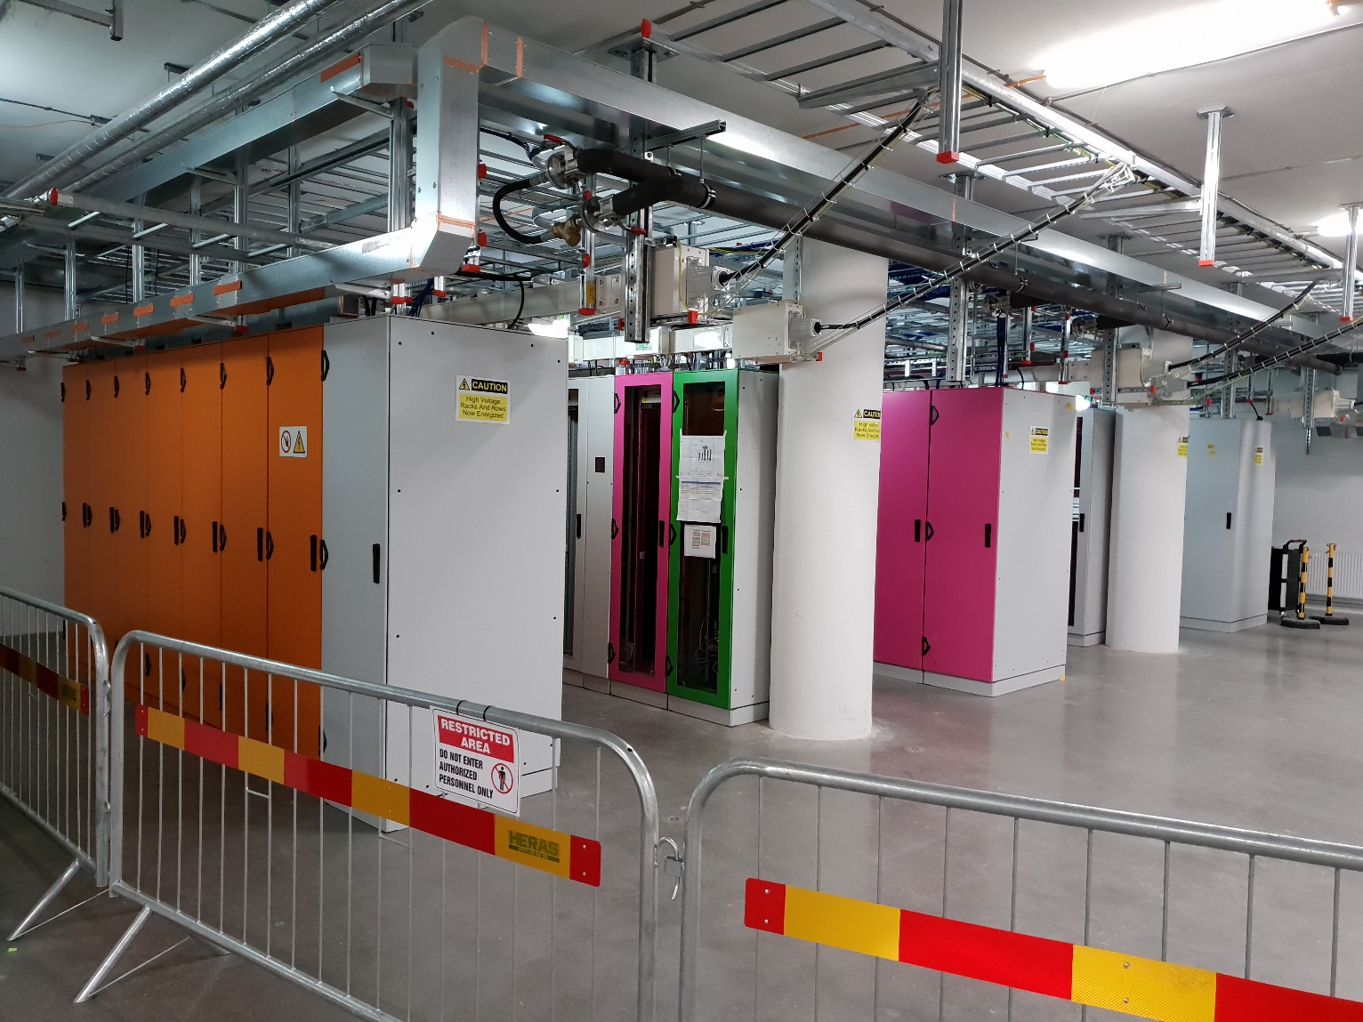
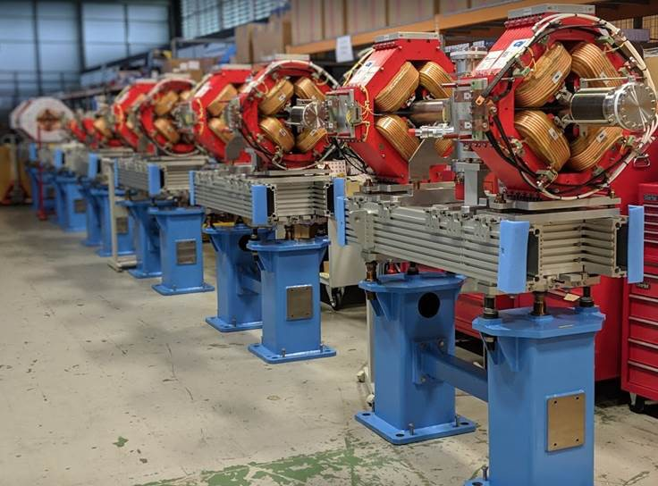
Not only RF…
Equipment racks installed and populated
Pre-assemblies of “linac warm units”
with magnets.

Slide 14
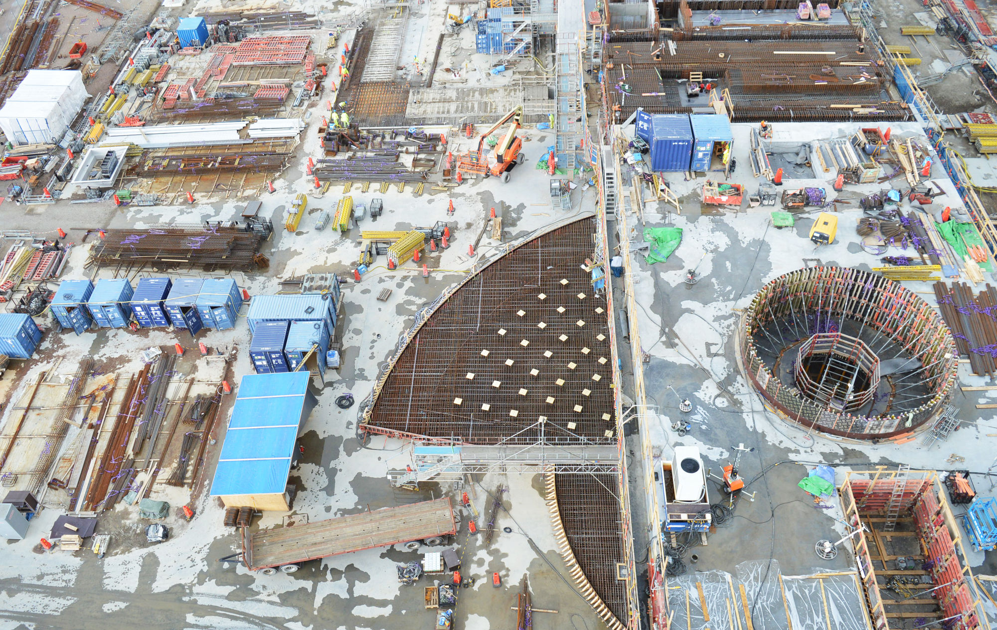
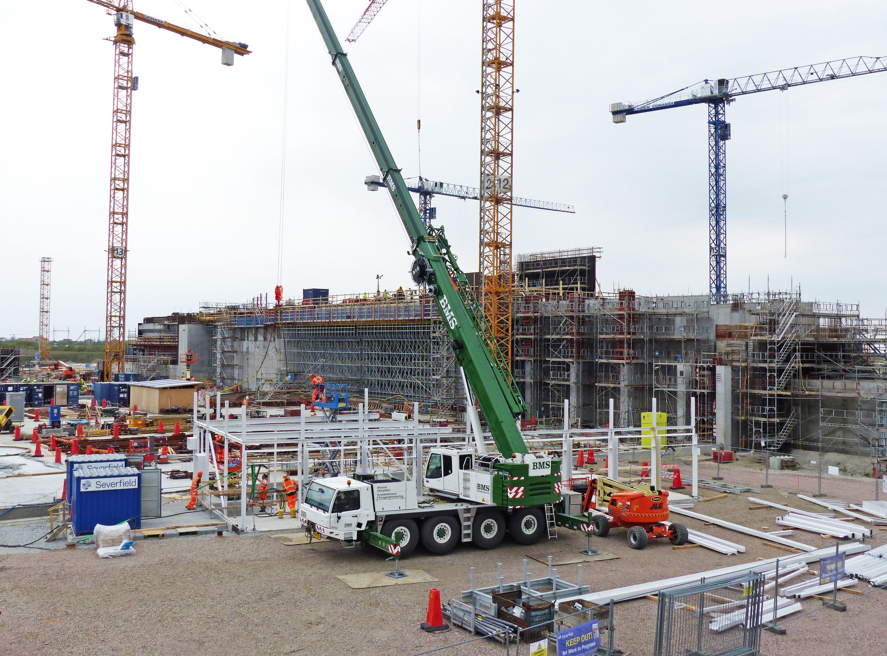
The massive target station

Slide 15
Integrated Control System (division)
Is responsible for all control system integration for
  The accelerator
  Target station
  Neutron instruments (up to, but not including experimental data processing)
  Conventional Facilities integration (water, power, HVAC, etc.)
Provides EPICS integration for subsystems in all of the above
Provides facility-wide services
  Timing system, machine protection, networking, archiving, configuration services, etc.
  Also Personnel Protection systems
Is a division in the ESS Machine Directorate (Accelerator, Target)
  But also serves the Science Directorate (for neutron Instruments integration)

Slide 16
ICS Organization
2019-05
Employee
Consultant
Position under consideration
Henrik Carling
Division head
Joakim Söder
Electrical engineer
Thilo Friedrich
Systems engineer
Karin Rathsman
Accelerator scientist
Temporary employee
Consultant off-site
Remy Mudingay
Controls infrastructure
Anna Gillberg
Team assistant
Annika Nordt
Protection systems
Karl Vestin
Hardware and integration
Hector Novella
Deputy project manager
Susanne Regnell
Controls Software
Timo Korhonen
Chief engineer
Benjamin Bertrand
Software engineer
Alberto Toral
PSS technician
David Sanchez
MPS engineer
Antoni Simelio
Integrator
Evan Foy
Integrator
Claudio Rosati
Software engineer
Banafsheh Hajinasab
Software engineer
Johan Christensson
Infrastructure technology engineer
Denis Paulic
DGL, PSS engineer
Enric Bargalló
MPS engineer
Angel Monera
FPGA Engineer
Jeong Han Lee
Integrator
Emanuele Laface
Accelerator physicist
Dirk Nordt
Software engineer
Stephane Armanet
System reliability engineer
Fernando Carrasco
MPS technician
Manuel Zaera-Sanz
Senior engineer MPS
Faye Chicken
Technician
Joao Martins
Integrator
Fredrik Söderberg
Software engineer
Georg Weiss
Software engineer
Alessio Curri
System administrator
Javier Cerejo
PhD Student
Martin Carroll
MPS engineer
Mattias Eriksson
PSS technician
Jerzy Jamroz
Integrator
Juan Esteban Müller
Software scientist
Jan-Åke Persson
Senior software engineer
Amir Forsat
Network reliability engineer
Anders Harrisson
Software configuration manager
Morteza Mansouri
PSS engineer
Stuart Birch
Senior engineer PSS
John Sparger
Integrator
Julen Etxeberria
Junior controls engineer
Ricardo Fernandes
Control system software architect§
Lars Johansson
Software engineer
Te-Hung Tsen
Junior devops engineer
Peter Holgersson
PSS senior technican
Viktor Fred
MPS engineer
Saeed Haghtalab
Integrator
Peter van Velze
Technician
Consultants
Open position
Stephane Gabourin
MPS engineer
Tomasz Brys
Integrator
Thomas Fay
Integrator
Yong Kian Sin
Integrator
Attila Horvath
Integrator
Douglas Bezerra
Integrator
Mehdi Mohammednezhad
Embedded systems engineer
Open position
Szandra Kövecses
MPS engineer
Felipe Torres
Embedded systems engineer
Miklos Boros
Integrator
Ahmed Abujame
ICS Installation coordinator
Samuel Crossland
PSS industrial automation
Paulina Skog
PSS documentation expert
Philippe Rabis
Work package manager
Oliver Talevski
Embedded engineer
Fabio dos Santos
Embedded systems engineer
Johannes Gustafsson
MPS engineer
Meike Rönn
PSS documentation expert
Gabriel Fedel
Integrator
∑=84
Michael Beck
Work package manager
Johannes Kazantzidis
Integrator
Marino Vojneski
Integrator
Maria Romedahl
Technical coordinator
Nicklas Holmberg
Integrator
Wojtek Fabianowski
Work unit manager
Consultants
ESS-0081625

Slide 17
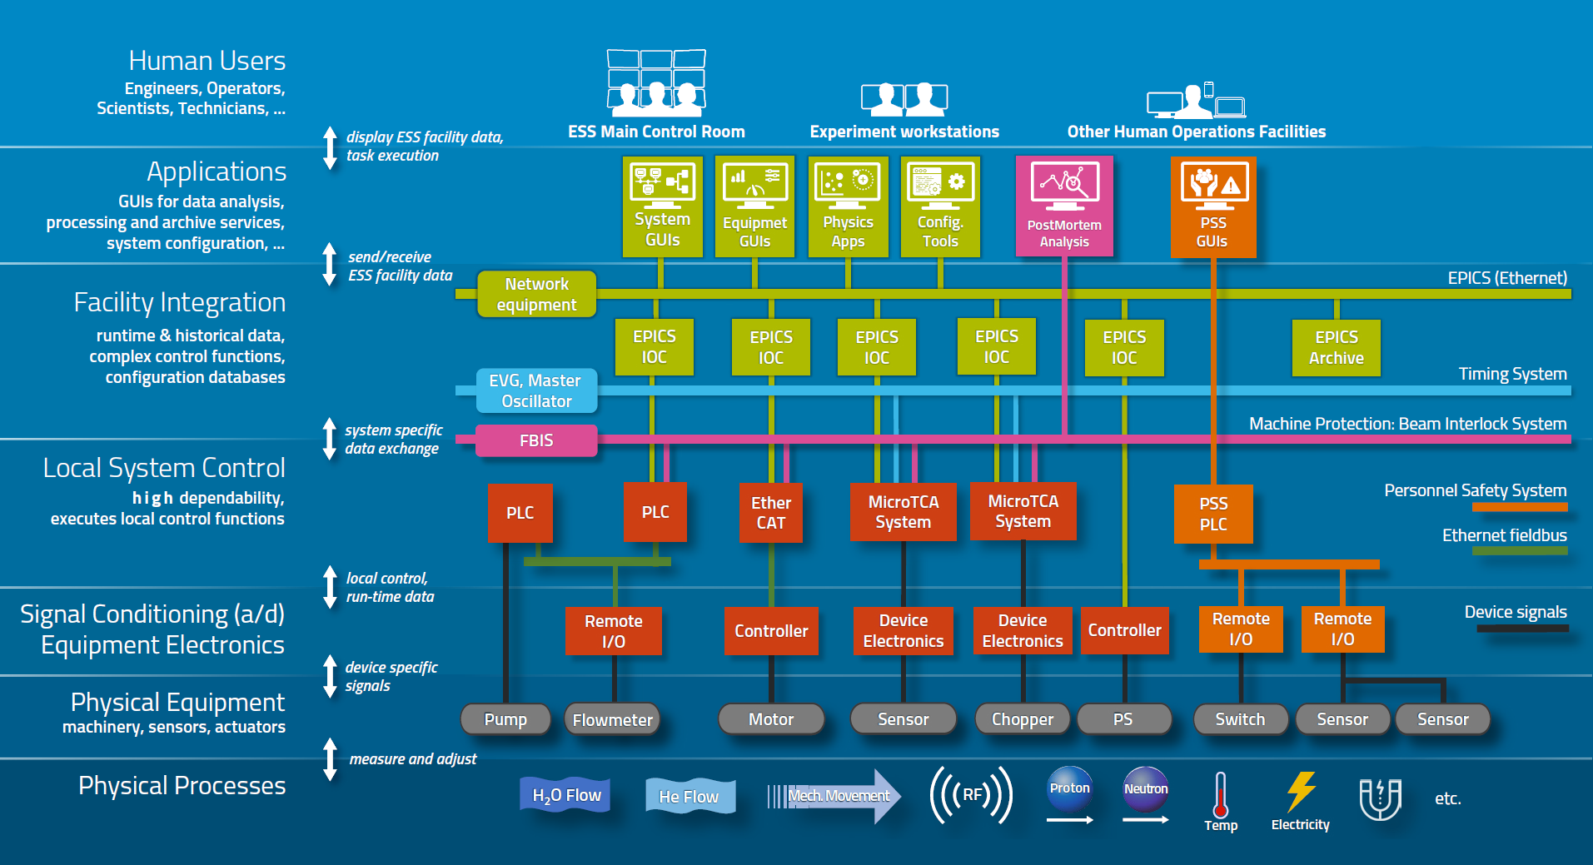
Control system overview
This is roughly the scope of ICS

Slide 18
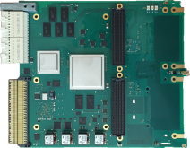

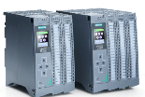
Three layer strategy - control systems hardware at ESS
Signal speed
MicroTCA boards with a powerful FPGA. A FPGA framework constitutes the development environment. The CPU board runs EPICS
ICS has adopted a three layer strategy for implementing the control system based on signal speed
  A custom made platform based on microTCA for applications with data acquisition exceeding 100 kHz
  Fast data processing happens in FPGA, augmented by ample CPU power. Timing included in every system.
  For slower signals, EtherCAT will be used as a real-time fieldbus with good price/performance ratio
  Synchronization and event information are key for applications where a full custom platform solution would be too costly
  Low speed signals are handled with commercially available PLC systems from Siemens
  This is a cost-effective solution that addresses ESS reliability and maintainability requirements
  The PLCs will be connected to EPICS for further integration into the control system
10 MHz
1 MHz
100 kHz
Digital controls platform
10 kHz
1 kHz
EtherCAT I/O modules that are connected to commercial or open-source EtherCAT master controllers which are in turn connected to EPICS
100 Hz
EtherCAT
10 Hz
Slower signals are handled by industrial automation (PLC) for reliability and cost reasons. The standardized platform for ESS applications comes from Siemens
1 Hz
0.1 Hz
Industrial automation (PLC)

Slide 19
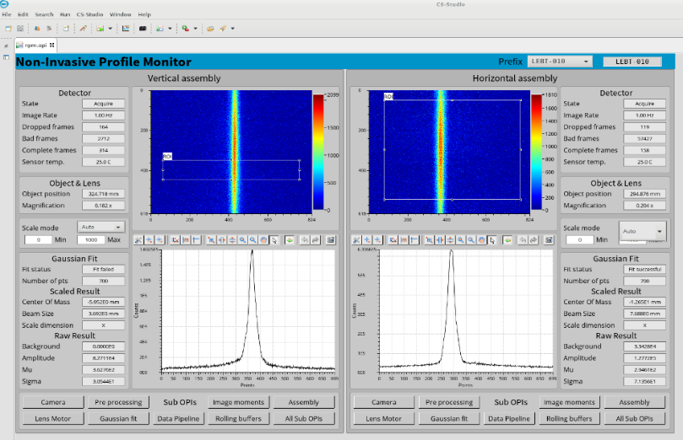
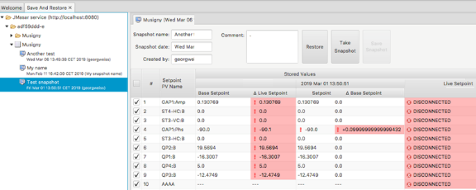
Software components/tools/services
EPICS, of course
Archiving: Archiver Appliance
Control System Studio
  Display Builder, etc.
  Going for Phoebus (replacing Eclipse RCP)
Channel Finder
  Starting to put this in real use – now that we have hardware to control
OpenXAL for accelerator physics modelling
Calibration service
  Handling of unit conversions – measurement data to conversion coefficients
    Actual conversion happens in the IOC (obviously)
Configuration management tools (databases, EAM)
Logbook
Etc.

Slide 20
EPICS at ESS
Committed to use EPICS 7 with pvAccess fully throughout the facility
  IOCSs, even 3.15 are equipped with PVA modules
    even if people often forget this…education needed.
    More education needed to start using the new features – this is underway
  All tools support pvAccess
    CS-Studio tools all support PVA
    Archiver Appliance can archive Normative Types
    Channel Finder supports PVA
    OpenXAL (our accelerator physics code) has (basic) PVA support built-in
    pvaPy is our official Python interface
Supported EPICS versions in our (E3) environment, as of now
  Base 3.15.5 / 3.15.6
  Base 7.0.1.1 / 7.0.2 / 7.0.2.1

Slide 21
EPICS activities at ESS – Community and internal
Development and deployment tools (Thursday talk on “E3”)
Control System Studio
  Display Builder, etc. Active participation in development group
EPICS7 development - support
  Funding projects to support developments in EPICS Core
    Project funds will not last forever, though…
  ESS Developers working on core technologies (pvAccess)
  We plan to organize a “Documentathon”, in ~August this year
    To address documentation “debt” that has accumulated
    Please consider joining if you would like to contribute – for your own or the community’s sake

Slide 22
Configuration Tools
Like every self-respecting EPICS project, we also have ambitious configuration tools
  CCDB (Controls Configuration Database), CableDB
  IOC Factory, PLCFactory
While there are challenges with these tools, I keep claiming they will eventually pay off, provided that:
  We keep our expectations realistic
  Tools will only get us so far; do not even try to fully cover the EPICS setup
  Do not let the tools limit use of EPICS good features
    Herein lies the biggest challenge
  EPICS database is a programming tool. Auto-creating algorithms is still beyond our skills.
Jury is still out. Final verdict will be in a few years
  But “IOC management by emacs” is not going to be realistic either…

Slide 23
Growing pains
Building up a new lab from the ground…
Steep learning curve, project-wide
  Most of the project staff is building their first accelerator – and a big one
  Many different backgrounds – people have to learn to work together
Complicated project setup
  Many in-kind activities to be supported and followed up, and finally integrated
Staff increase has been really fast
  Which is a good thing but not unproblematic
EPICS “awareness”
  Not many people know EPICS when they start at ESS
  Available possibilities of EPICS and related tools not realized or utilized – or even misunderstood.
First commissioning experience has started to bring the teams together
  In ICS but also (and more importantly) from different organizations.

Slide 24
Summary and outlook
ESS has become an accelerator lab – from a paper lab. Real beam, real issues.
ESS, including ICS division has grown very rapidly. With its pros and cons.
Hardware is appearing at the site, at a growing speed
  Nice but sometimes very hectic.
We are still on the learning curve in many issues
  But situation is constantly improving – even if we tend to forget it.
ESS has a strong will and commitment to work with the community
  But (even) our resources are limited – we need the community to reach our goals.
Next couple of years will be very busy – but exciting!

