Slide 1
Generating EPICS Databases from Enterprise Architect UML Models
D.Stepanov
ITER Organization
Disclaimer: The views and opinions expressed herein do not necessarily reflect those of the ITER Organization

Slide 2
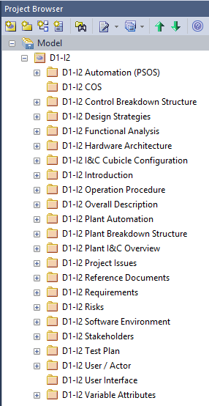
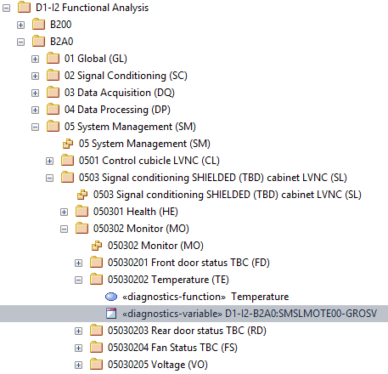
Enterprise Architect vs EPICS
Enterprise Architect (EA) is a UML / SysML modeling tool
ITER defined UML profiles to describe certain I&C concepts (components, functions, variables) in more detail
“Diagnostics variable” profile was influenced by EPICS and has a few properties which can be mapped directly to EPICS

Slide 3
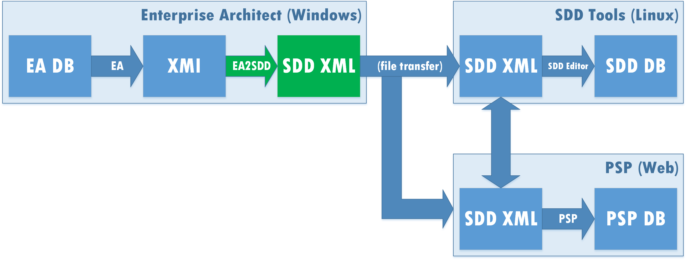
EA2SDD Workflow
XSLT 1
PostgreSQL
MS Access
UML 2.1
SDD 6.0
(EPICS inside™)
MS SQL

Slide 4
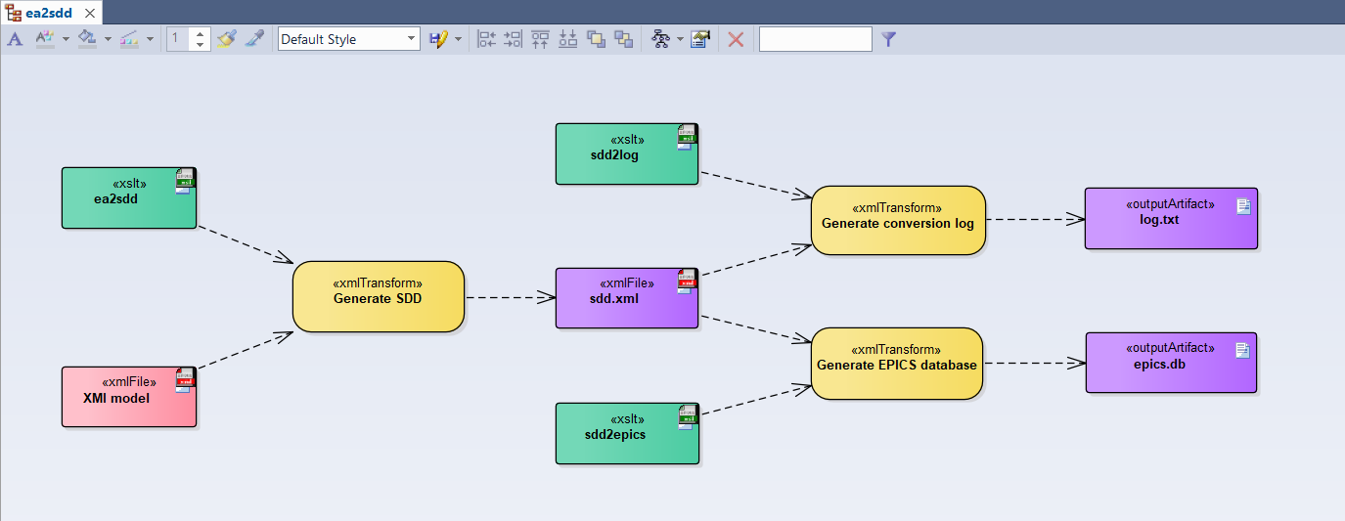
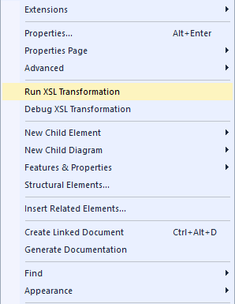
XML Pipeline

Slide 5
Generation Example
# PVs on controller 550000-PSH-1202
record(ai, "D1-I2-B2A0:SMSLMOTE00-GROSV") {
field(DESC, "Cubicle Internal Temperature (°C)")
field(EGU, "deg C")
field(LOPR, "10")
field(HOPR, "50")
field(HIHI, "45")
field(HHSV, "MAJOR")
}
…
Records | Fields
ai / ao | DESC
bi / bo | EGU
mbbi / mbbo | LOPR / HOPR
 | LOW / LOLO
 | HIGH / HIHI
 | LSV / LLSV
 | HSV / HHSV

Slide 6
Caveats
No reverse workflow
No concept of templates (aka substitution files)
Main usage is to avoid retyping information
Essential things to be entered on top to get a working IOC (e.g., device support details or PV links) – see SDD
EPICS-specific limitations (lengths or combinations of fields) are partially implemented or not known in the UML model
XSLT 1 limitations (e.g., cannot produce multiple files)

Slide 7
Conclusion
Direct link from UML world to EPICS DB configuration
Converter is small, fast and simple to run (3 XSL scripts of 90 kB total)
Generation is incomplete for run-time, but gives a good start for a project

