Slide 1
Polina Pipp
Overview of EPICS drivers for DAQ boards
polina.pipp@cosylab.com

Slide 2
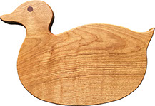
Overview
DAQ boards
Requirements
Framework
Driver implementation
Graphical interfaces
Summary

Slide 3

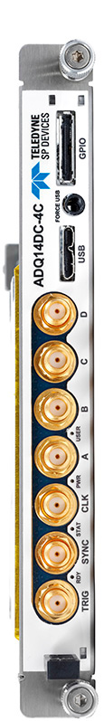
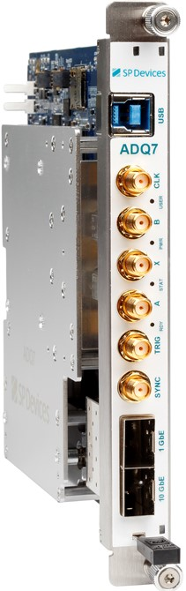
DAQ boards
Gigasample digitizers
ADQ7
  1-2 14-bit channels
    Up to 10 GSPS
ADQ14
  Up to 4 14-bit channels
    Up to 2 GSPS

Slide 4

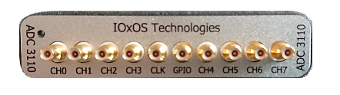
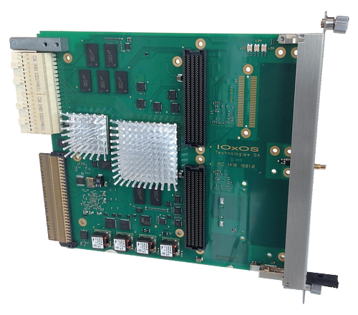
DAQ boards
High-speed digitizer on all-in-one board
ADC3110 FMC on IFC1410
  8 16-bit channels
    250 MSPS

Slide 5

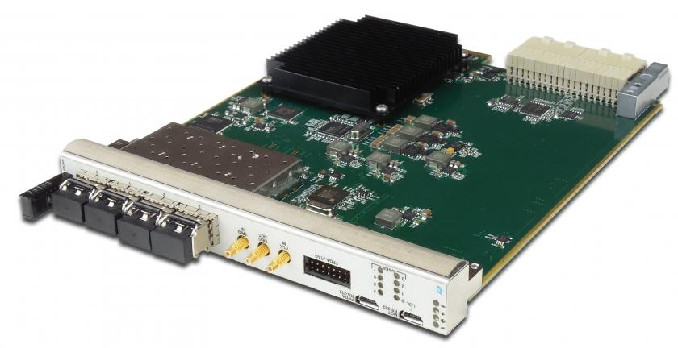
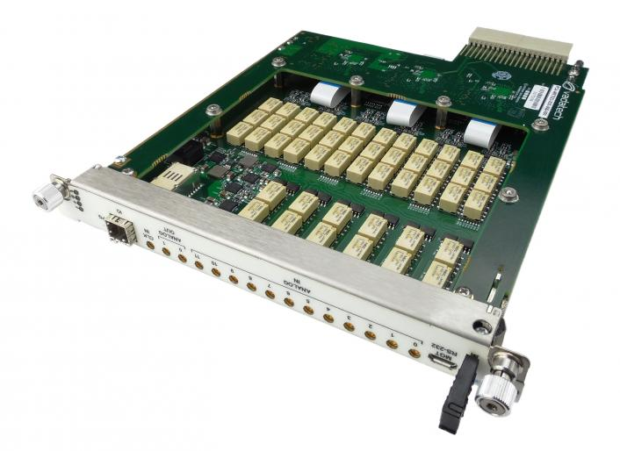
DAQ boards
High-speed ADC/DAC module
AMC523 with MZ523B on MRT523
  12 ADC 16-bit channels
    125 MSPS
  2 DAC 16-bit channels
    250 MSPS

Slide 6
DAQ boards
Added support for MRF protocol in the firmware:
  direct link to EVM through SFP on the front panel
  supported functionality:
    synchronize time with MRF to provide timestamping
    trigger acquisition on event, generate pulse on event
  standard trigger on the backplane is still supported if an EVR is present in the crate

Slide 7
DAQ boards
There are many different DAQ boards but…
…they share a common use-case:
digitizing analogue signals.

Slide 8
Requirements
Driver provides full support for main and board-specific functionalities:
Software support | Driver supports a specific board model no matter what hardware interface it has.
Automatic startup | Communication with DAQ board established automatically.
DAQ modes | Any available DAQ mode can be chosen.
DAQ parameters | DAQ can be configured with various available parameters.
Trigger modes | DAQ can be triggered with any available source.
Channel mask | Number of active channels is configurable.
Support documentation has a standardized structure.

Slide 9

Framework
Driver is based on community version of NDS3
Three layered software application
End user interacts with IOC application or GUI
User
EPICS IOC
NDS3
HW API

Slide 10
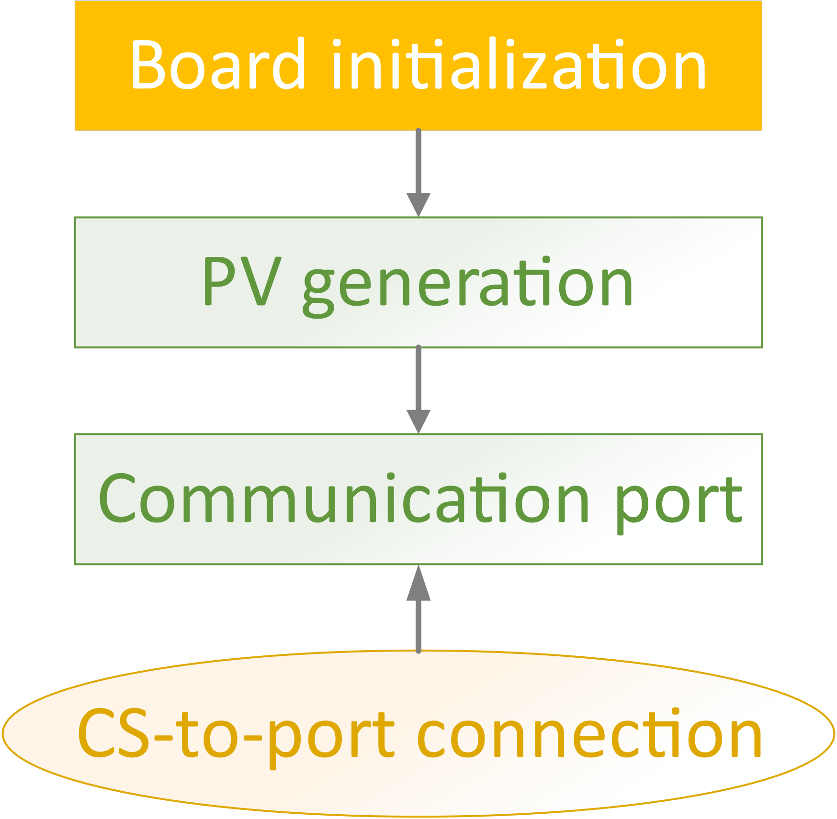
Driver implementation

Slide 11
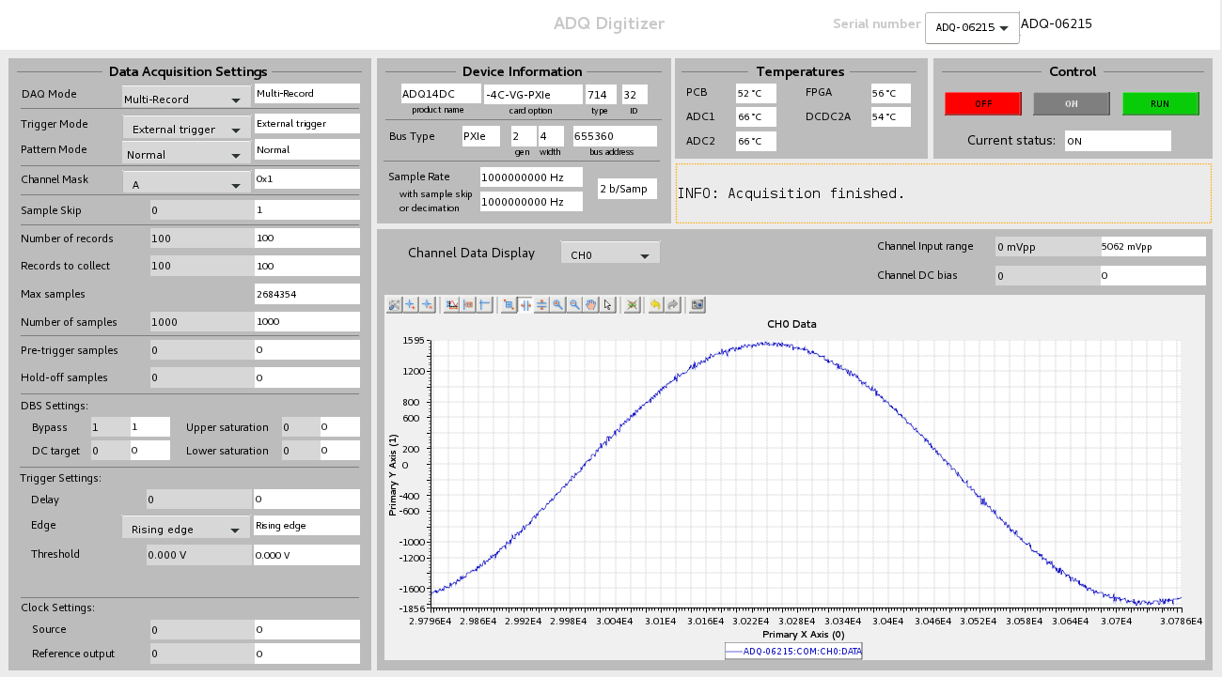
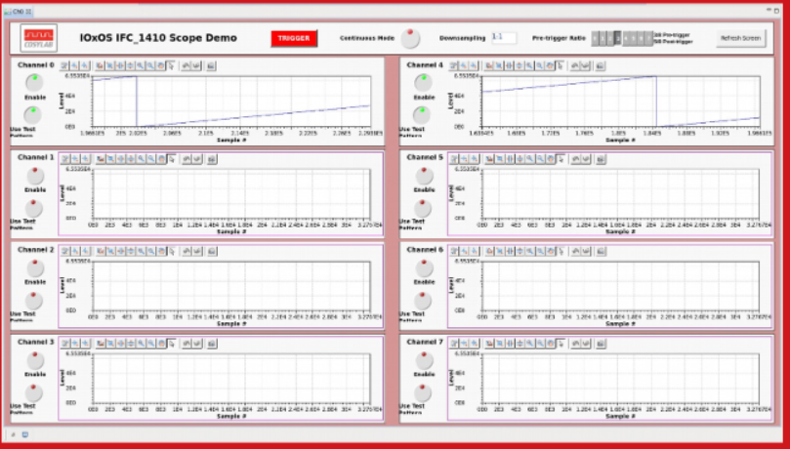
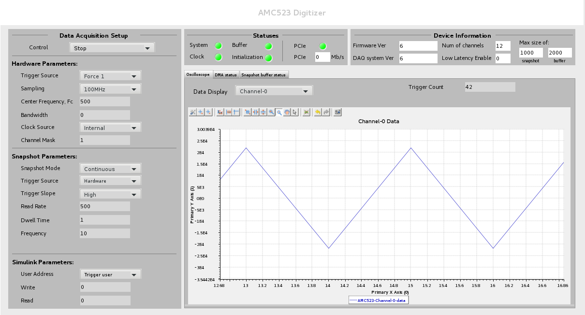
Graphical interfaces

Slide 12
Summary
During the past year we have got a lot of experience with different DAQ boards, also of MTCA.4 form factor.
And despite the wide variety of DAQ boards, they can be operated in a unified way…
…A way, that can be developed and maintained with community supported software.

Slide 13
Thank you!
Polina Pipp
COSYLAB
Web: www.cosylab.com

