Slide 1





Virtual reality and particle accelerators
Master
Fun outreach
project
Adelaide.grimaud@cosylab.com
EPICS collaboration meeting
June 2019

Slide 2
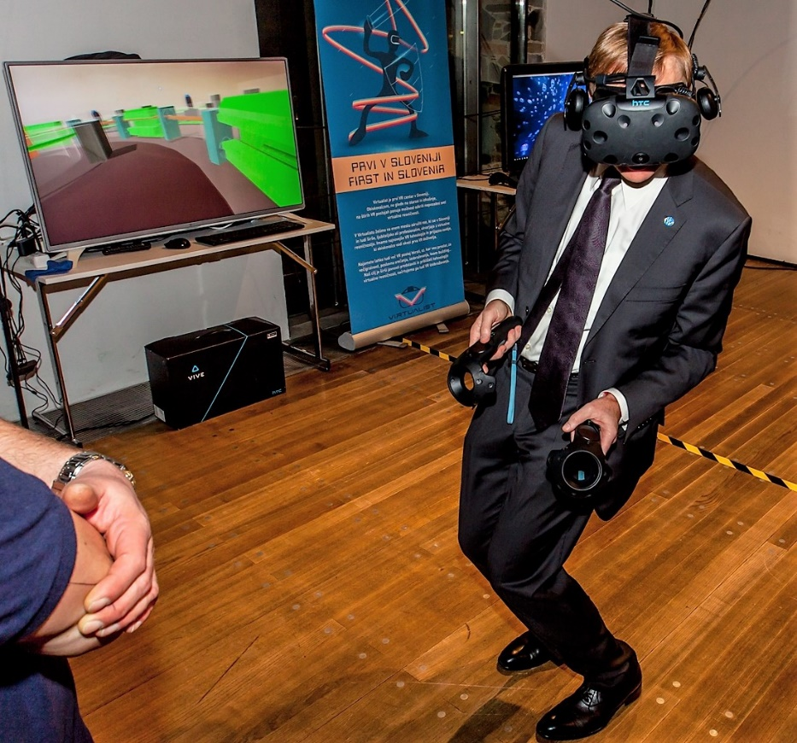
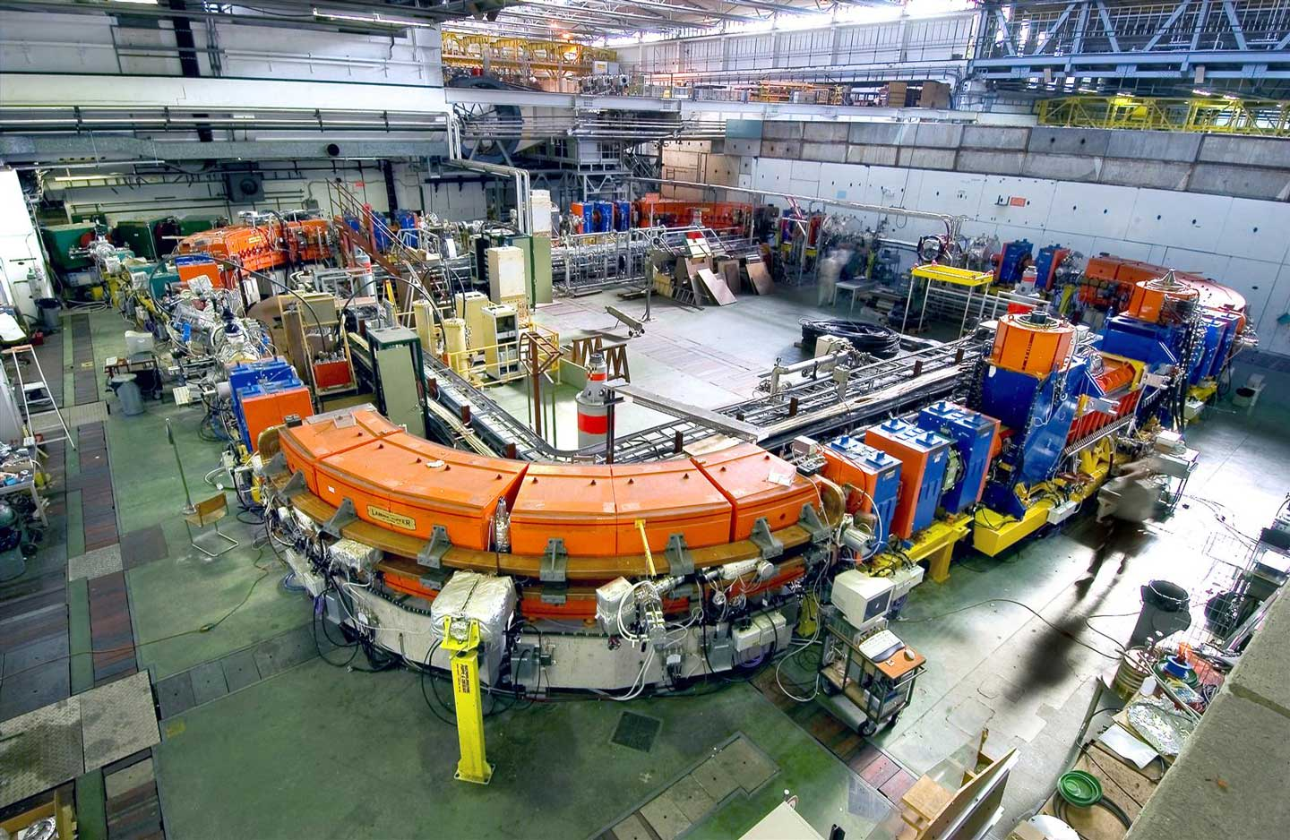
For outreach
LEIR CERN
VR demonstration

Slide 3
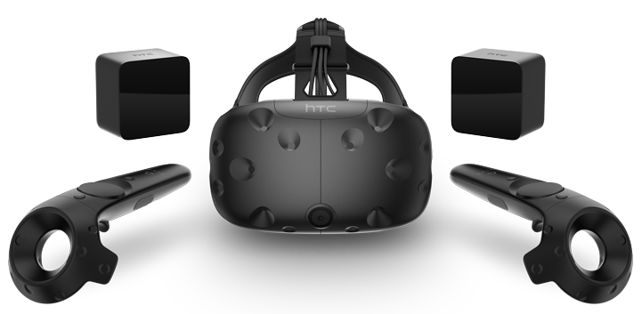
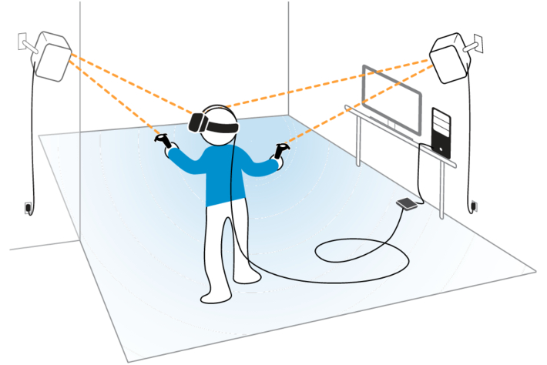
System
HTC Vive [1]
Synchrotron 3D model
HTC Vive tracking system [2]
[1] https://www.vive.com/eu/
[2] https://www.techradar.com/news/wearables/thinking-of-getting-a-htc-vive-check-that-your-room-is-this-size-first-1314450

Slide 4
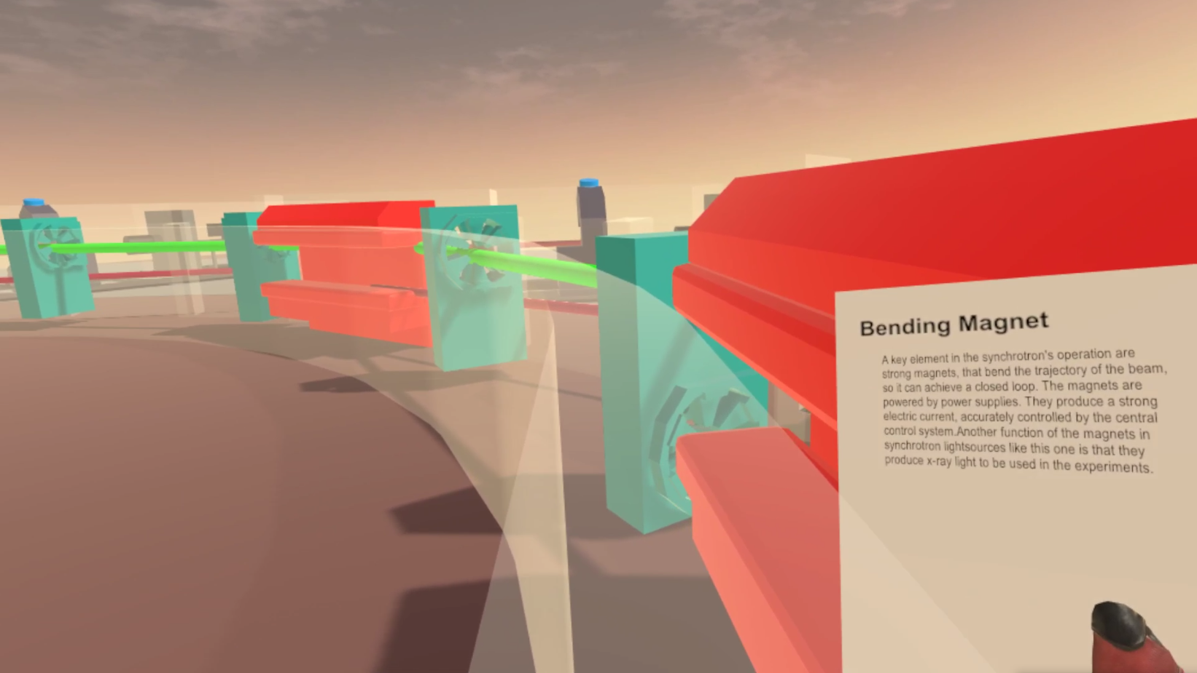
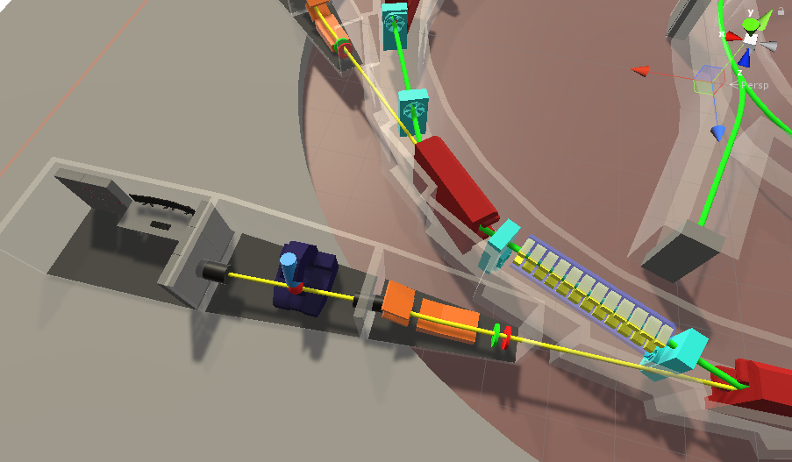
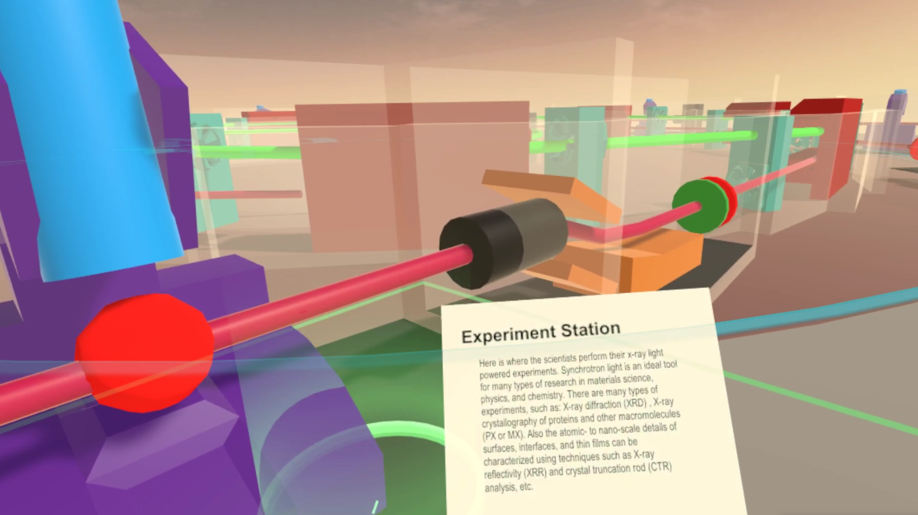
Exploration
Point of interest: bending magnet
Point of interest: experiment station
Global view

Slide 5
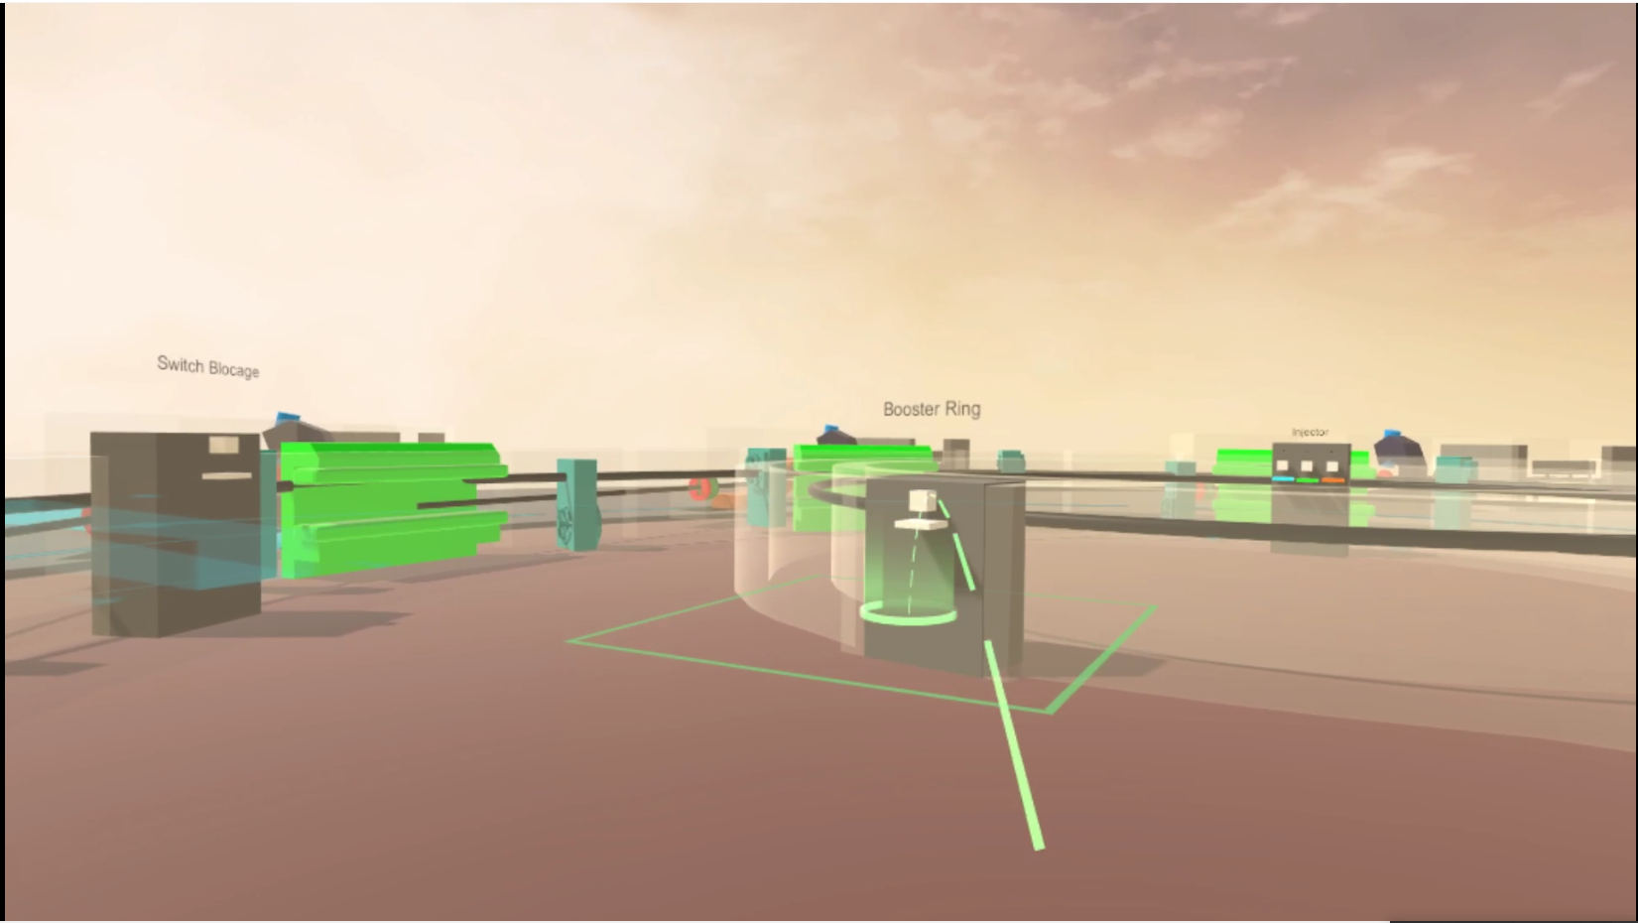
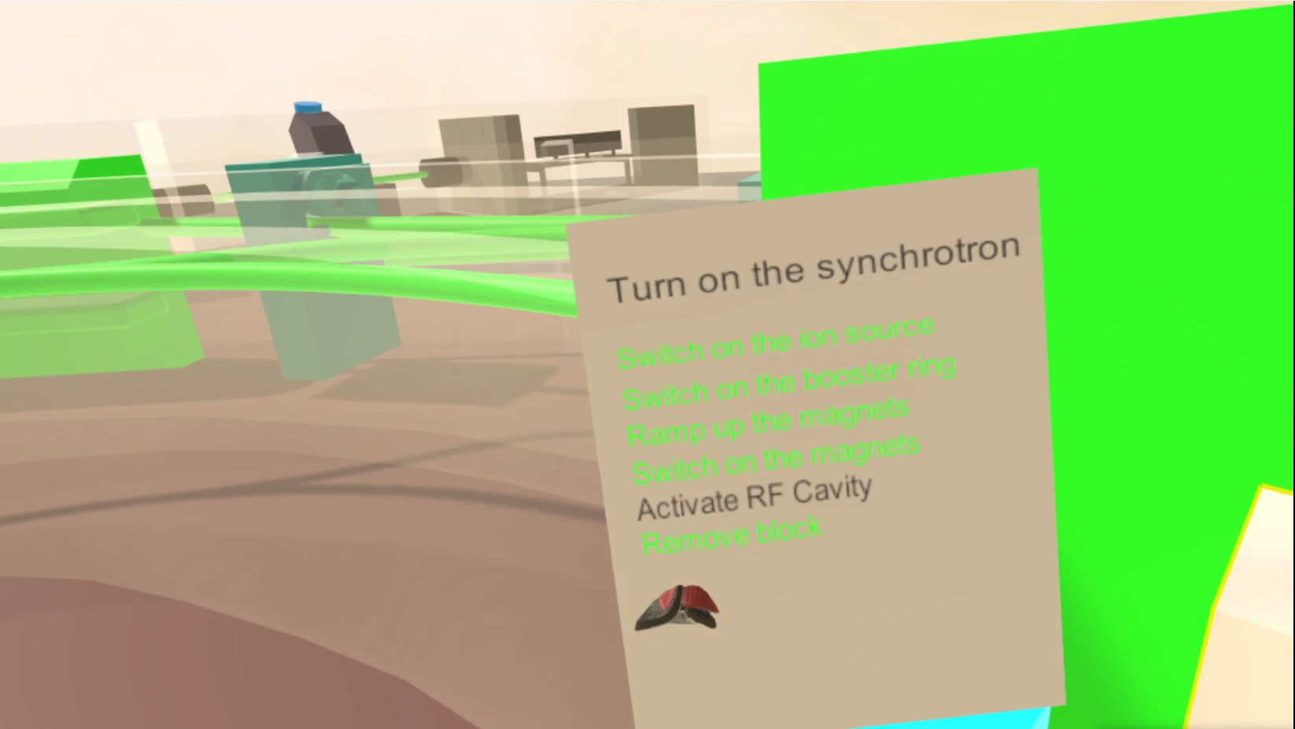
Scenario game
To-do list
Teleportation

Slide 6
Thank you!
Adélaïde Grimaud
COSYLAB
Web: www.cosylab.com

