Slide 1
A Two-Tier PV Gateway for Channel Access from J-PARC Office Network to the Accelerator Control Network
Shuei Yamada
KEK/J-PARC Center
Accelerator Control Group

Slide 2
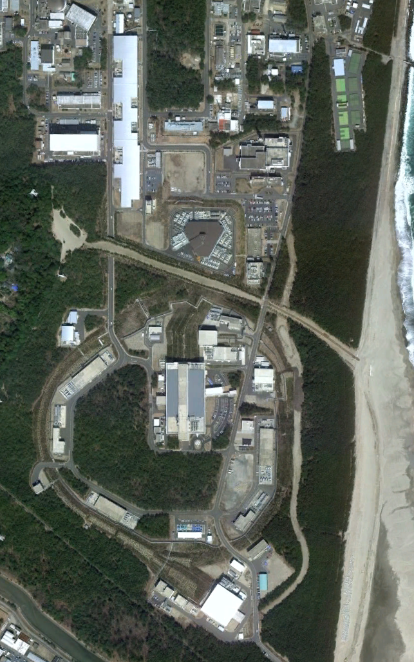
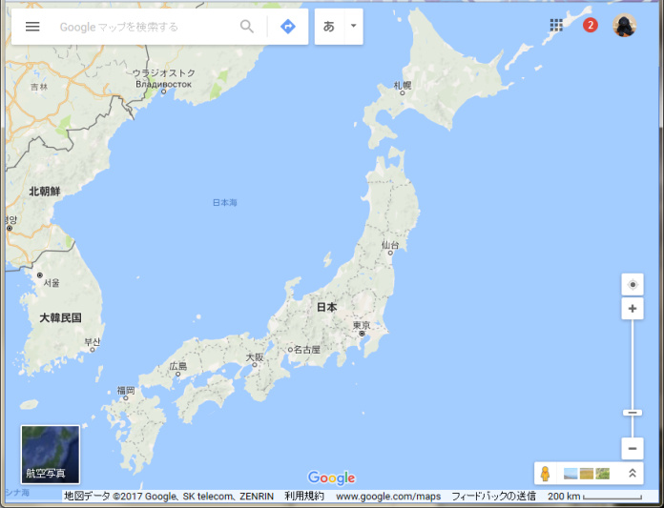
J-PARC
LINAC
400 MeV/c
@ 25Hz
Japan Proton Accelerator Research Complex
Joint project of :
KEK (High Energy Accelerator Research Organization)
and
JAEA (Japan Atomic Energy Agency)
RCS
3 GeV/c
@ 25Hz
Neutrino
Experiment
Facility
Main Ring
30 GeV/c
@ 2.48 sec
(FX to NU)
@ 5.52 sec
(SX to HD)
Materials and
Life Science
Facility
KEK
J-PARC
(in site of JAEA)
Hadron
Experiment
Facility
Tokyo
©google

Slide 3


Motivation : Network and Policy in J-PARC
I’d like to monitor our Acc. from my office
I wish I could use the same app. as control LAN
⯲Allowed
(NAT)
⯲Allowed
(routing)
Acc. Control LAN
DMZ
Office LAN
⯰ Forbidden ⯰
Acc. Equipment
(EPICS IOCs)
The Internet

Slide 4
Idea : 2-Tier Gateway
CA
Gateway #1
CA
Gateway #2
⯲Allowed
(NAT)
⯲Allowed
(routing)
Acc. Control LAN
DMZ
Office LAN
⯰ Forbidden ⯰
Acc. Equipment
(EPICS IOCs)
Requirements from J-PARC IT section:
Operation of any devices in the control LAN shall be prohibited from the office LAN

Slide 5
Implementation
CA
Gateway #1
(NAT)
CA
Gateway #2
CA w/
TCP-only mode
Acc. Control
LAN
DMZ
Office LAN
Acc. Equipment
(EPICS IOCs)
Both gateways are configured to be read-only
Access control by iptables on both gateway

Slide 6
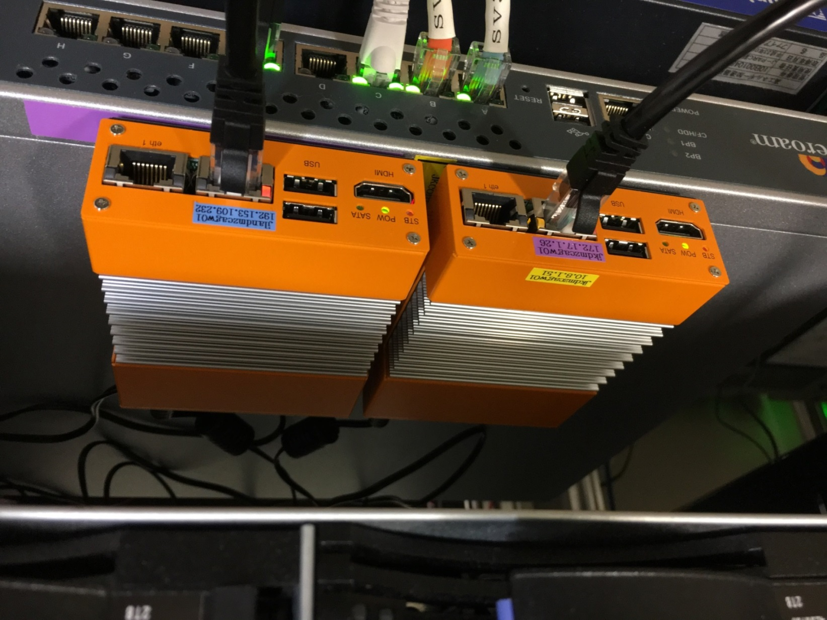
Hardware
PiNON sabataro®
  Celeron J1900 (4 cores @ 2.4GHz) / 8GB
  SL6 + EPICS base R3.15.5 + Gateway R2.1.0

Slide 7
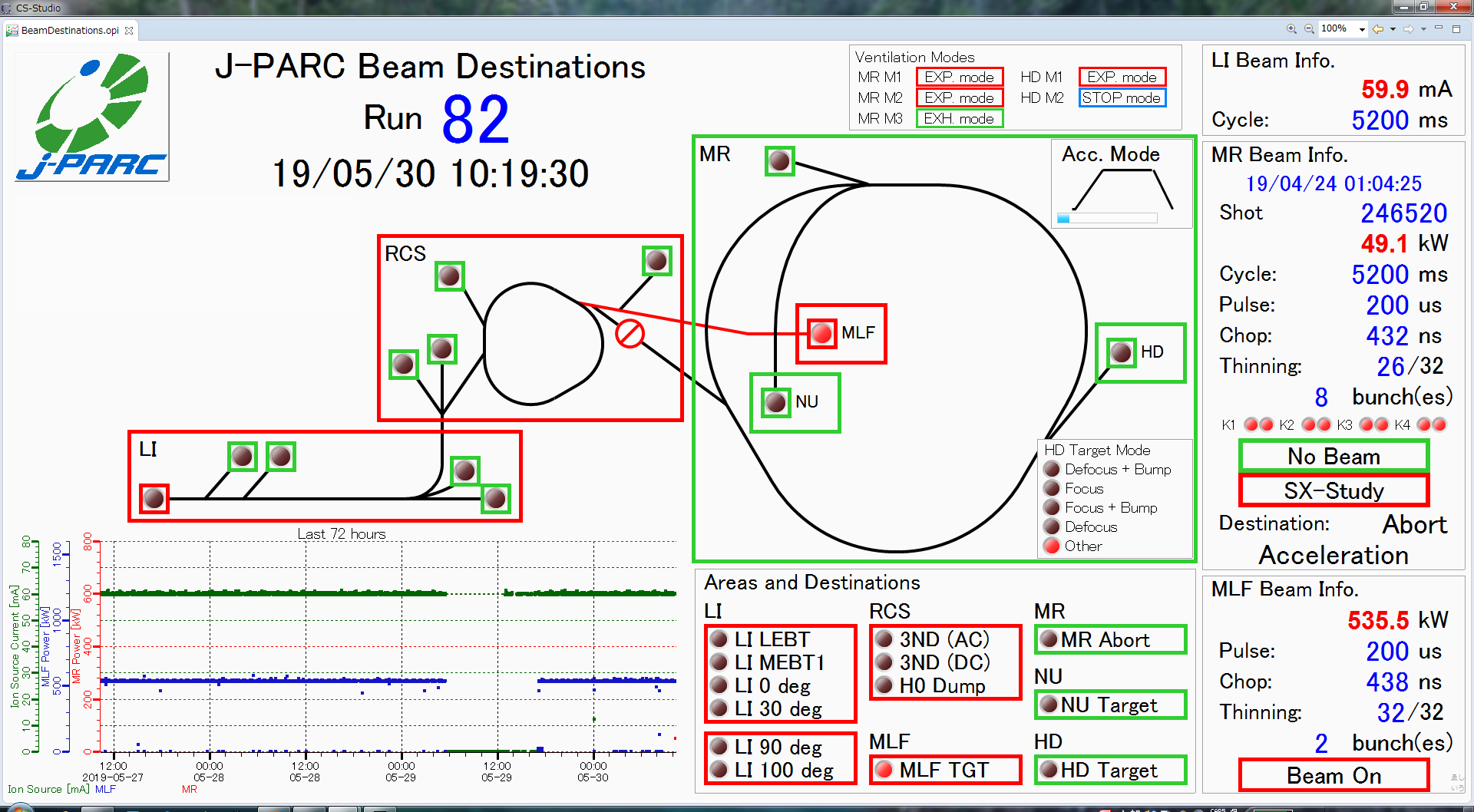
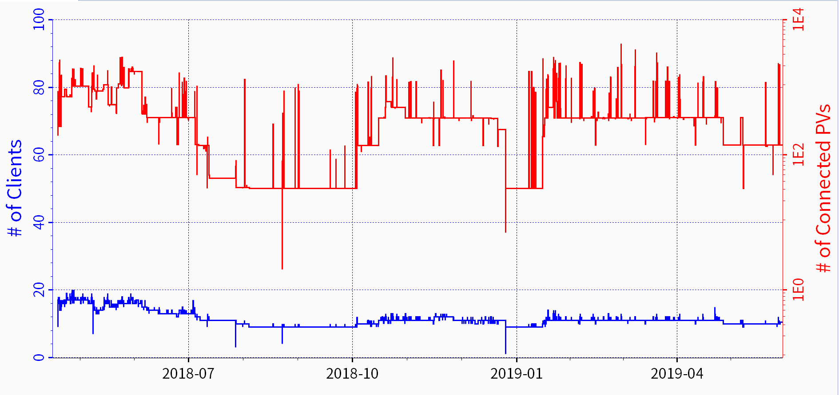
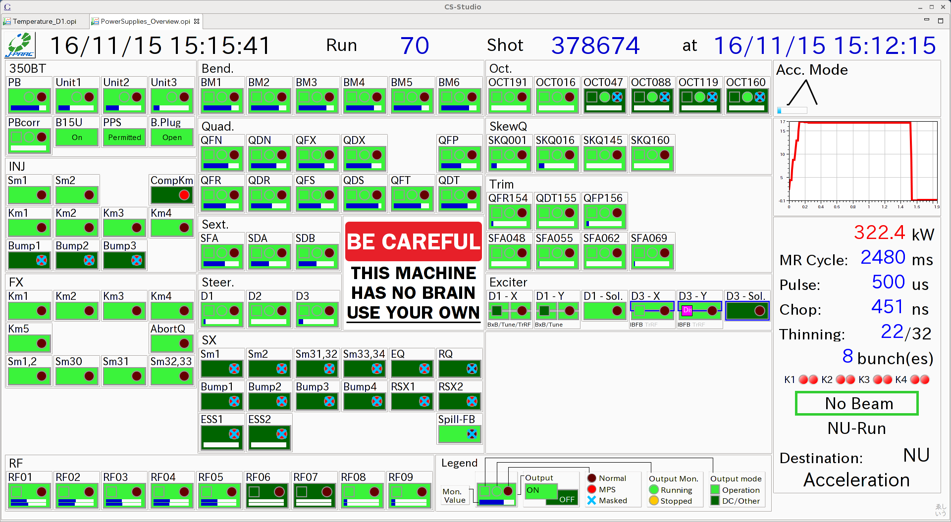
Summary
An one-way gateway system was constructed,
which allows Channel Access thru two-layer firewall
It has been in operation since Apr 2018

