Slide 1
ITER Plant Configuration System
Experience with using EPICS 7 at ITER
B. Bauvir (CSD)
A. Neto (F4E)
Disclaimer: The views and opinions expressed herein do not necessarily reflect those of the ITER Organization

Slide 2
Outline
Context
Objectives and architecture
Successes and difficulties
Conclusions and future work

Slide 3
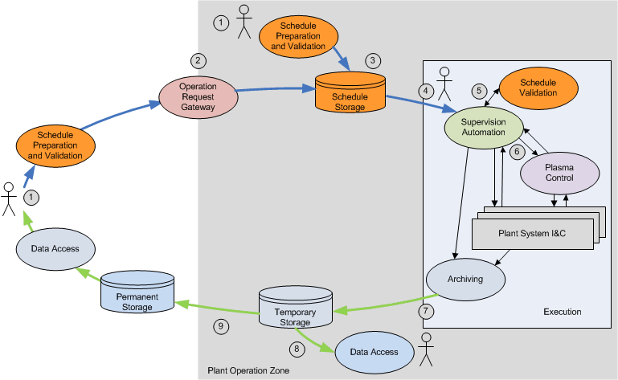
Context

Slide 4
Context

Slide 5
Context
Plant configuration as part of the pulse preparation
  Derivation of machine parameters from physics/operations’ goals
    Adaptation of the domain of machine operations to the technical domain of the Plant System I&C without requiring manual translation by an expert
    Adaptation to the current condition of the machine, reduced availability due to broken parts
  Verification incl. potentially complex code and simulation (operating instructions, scarce resource budget planning, etc.)
    Non-trivial validation, consistency of parameters across the machine
  Providing Machine Operations with support to manage complexities
    Detect and notify inconsistencies across the machine, limit conditions, etc.
    Obviously Machine Operations are empowered to ignore, override, etc.

Slide 6
Objectives
Further and enhance current methods, tools, interface for Plant System configuration
  Plant system configuration from Central I&C should adhere to defined Quality of Service criteria
    Ensure data integrity through to remote controllers
    Provide exception handling and reporting mechanism
Manage interfaces with data repositories, with Plant Systems
  Plant System manufactured and delivered without information about central services
    Data must be delivered to Plant Systems in the form they expect
Provide means to accommodate changes with affordable resources

Slide 7
Architecture
Middle-layer services atop delivered Plant System I&C interfaces
  Domain and interface adapters
Separate services for chain data processing, and User-supplied code execution
  Compiled code (at least strict version controlled) vs. interpreted workflow logic (adapt to current User, intended use), diverse languages
Asynchronous/concurrent execution model
  Capability of executing User-supplied code which might take longer time to execute
Synchronous transaction model to load plant system
  Atomic load operation, parameters acceptance/rejection en-bloc

Slide 8
Configuration data model
Domain-specific language describing a chain of data processing
  Variables and named data types of any complexity
  Relationships though named transformation code
    E.g. ‘55a0::cvvf::ComputeBestIPWeights/v1.0’
  Verified through named code
  Satisfied through interfaces
    Text files, databases, data archive, process variables (pvAccess, Channel Access), etc.

Slide 9
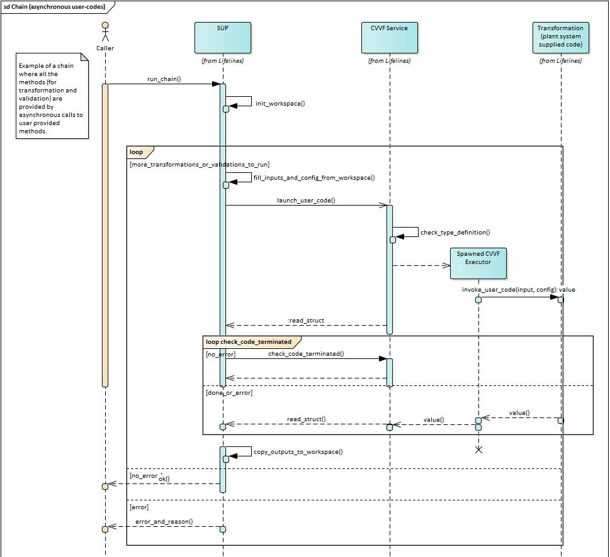
Chain workflow executor
MARTe2 (https://vcis.f4e.europa.eu/marte2-docs/master/html)
  Data-driven configuration
  Perfect architecture match
    Processing organized along the variable
    dependency path
  Strong decoupling
    Between signals and data processing
    .. and with data providers
  Support for built-in code execution
    Data types transformation, composition
    Simple verification (e.g. within bounds, etc.)

Slide 10
Remote Procedure Call (RPC) services
Named RPC services providing
  Dynamic services discovery (TBD)
  Introspection of data types and function prototypes
  Asynchronous/concurrent execution model

Slide 11
Code delivery and execution
Code encapsulation, no dependency to any framework
Promote usage of programming language native types
  C/C++, Matlab and Python

Slide 12
Code delivery and execution
C/C++ code and structures require additional introspection capabilities, e.g.
  Parsing mark-up in header files
  Generated from Plant System Self-
  Description Data (SDD) model

Slide 13
Plant System interface
Plant System architecture
  Large systems composed of distributed devices and controllers
  Complex hierarchies and compositions, mutable assemblies
  Both top-down or bottoms-up views of the plant system favour a structured representation of the data model
Plant Operation Network (PON) interface
  EPICS IOC and records database are deployed as mailboxes between CODAC and remote controllers (PLC, RTC, DAQ, FPGA)
  Concerns about the data integrity through to remote controllers

Slide 14
Plant system interface
RPC service providing
  Named data sets (discriminate
  between devices, life-cycle phases)
  Introspection of data types
  Synchronous transaction model
  Support for integrity verification
  Exception handling
Adapters required and foreseen
  Serialization to EPICS records
  .. to OPC UA servers
  And bespoke implementations

Slide 15
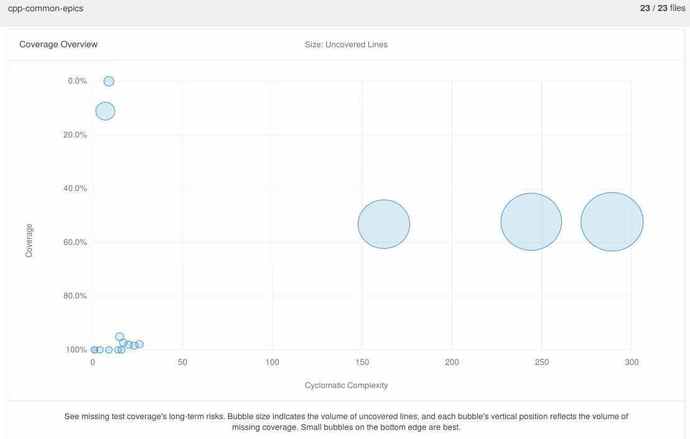
Successes
EPICS 7 (pvAccess) matches very well the need
  Support for structured data of any complexity
  Dynamic discovery of services
  Built-in data type introspection
Able to implement a representative scale
proof of concept in about 4 man-months
  Incl. tests and intensive code coverage
    Handling PVArray is challenging
  C/C++ and Matlab code encapsulation

Slide 16
Difficulties
Documentation
Multiple interfaces available
  Concerns about evolutions, maintainability
    ‘epics::pvAccess::RPCClient’ vs ‘epics::pvaClient::PvaClientRPC’
Arrays of structure
  Command line tools, CS-Studio (pvmanager) do not support addressing beyond reaching array
  Concerns about evolutions, pvAccess support at large in the EPICS ecosystem, mismatch between intended and actual use

Slide 17
Forecast
EPICS 7 full part of CODAC Supervision and Automation (SUP) components
  Middle-layer services atop delivered Plant System I&C interfaces
    Domain and interface adapters, homogenization of interfaces, automation
  Careful with technology adoption
    Full encapsulation, no implementation detail to transpire through to the application code
  Attentive to evolutions in the EPICS ecosystem (CS-Studio)
Objective
  Homogeneous handling of structured variables in application code
    Identical application-side API, whether PON, or SDN, or ..

Slide 18
Thank you for your attention

Slide 19
Back-up slides

Slide 20
Architecture goals
Operability
  Run experiments according to a robust and well-established format
Automation
  Run autonomously with minimal human intervention; robust, routine and repetitive procedures are automated
  Limit the need for human involvement to high added value tasks, e.g. definition of the experiment schedule, analysis of data, investigation and recovery of failures

Slide 21
Architecture goals
Containment of complexity
  Provide abstraction mechanisms, manageable information and control means
Scalability
  Support integration of new components with limited impact on existing ones
Changeability
  Adapt to changing requirements with affordable resources
Robustness
  Prevent propagation of failures through the control system

Slide 22
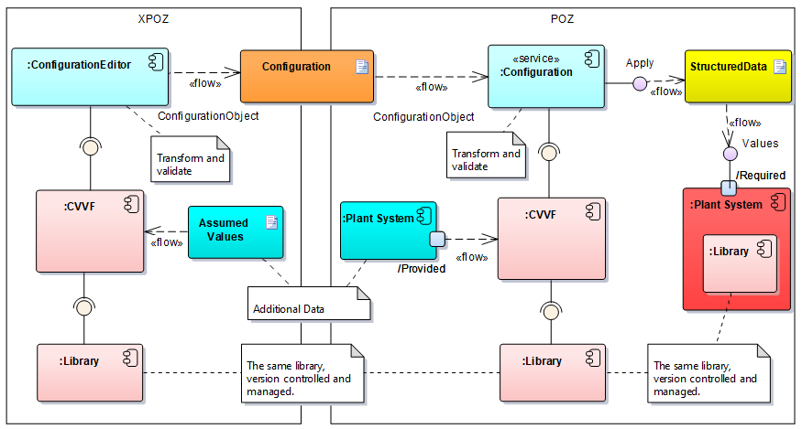
POZ and XPOZ

