Slide 1
Phoebus Alarm System
Micro Services for Logging and Management.

Slide 2

Alarm Philosophy
B. Hollifield, E. Habibi,
"Alarm Management:
Seven Effective Methods for Optimum Performance", ISA, 2007
A good alarm system is one which helps users take correct actions
Identify the problems
&
the corrective actions
ca
Alarm
System
  Manageable alarm rate <150/day
pva
Help locating useful information
Notify subject matter expert
Determine patterns & trends

Slide 3
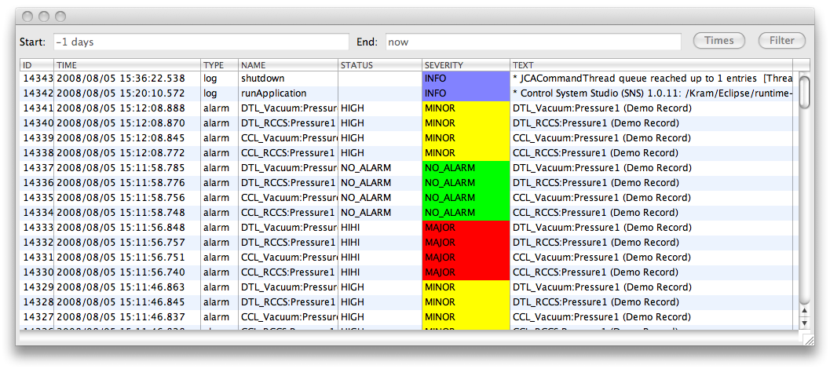
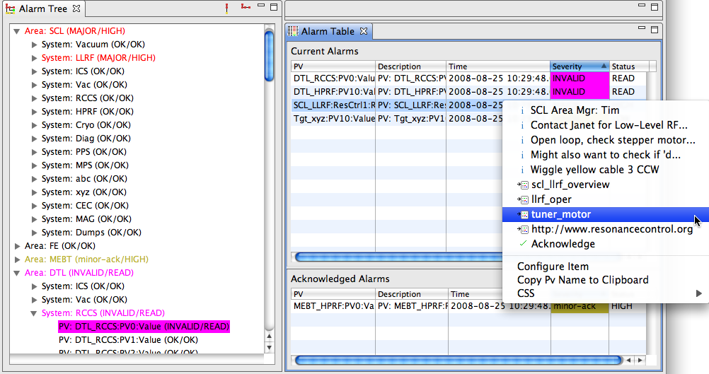
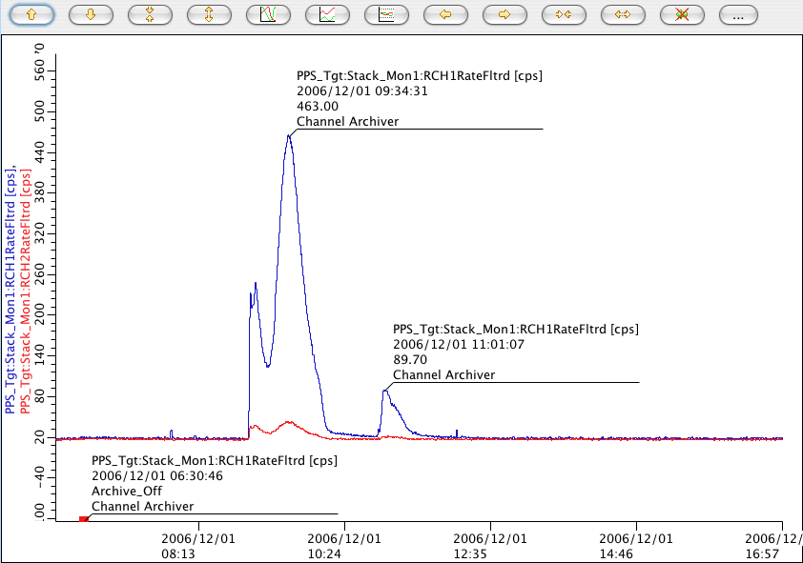
BEAST
IOCs
PV Updates (Channel Access, …)
Alarm Server
Current Alarms: Acknowledged? Transient? Annunciated?
Tomcat
Reports
Log Messages
Annunciations
Alarm Updates
Ack’; Config Updates
JMS
Alarm Cfg & State
RDB
LOG
TALK
ALARM_SERVER
ALARM_CLIENT
JMS
2
RDB
JMS
2
Speech
Alarm Client GUI
Message
RDB
CSS Applications

Slide 4

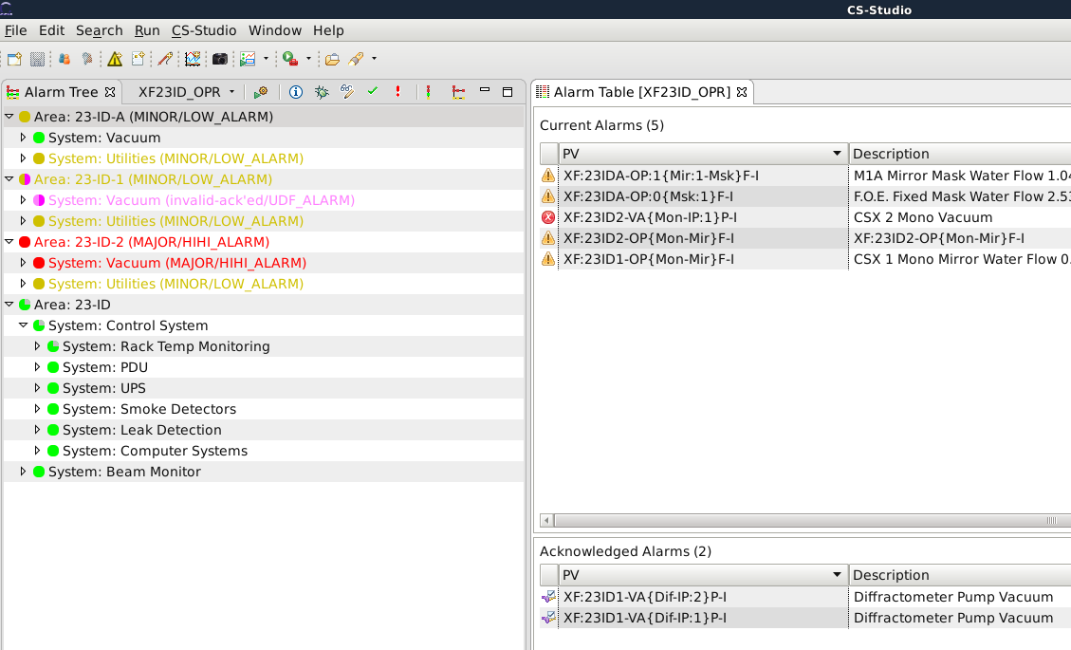

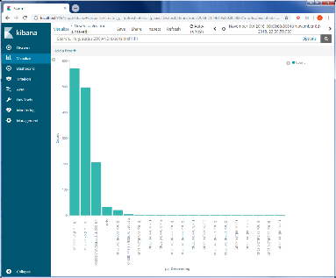
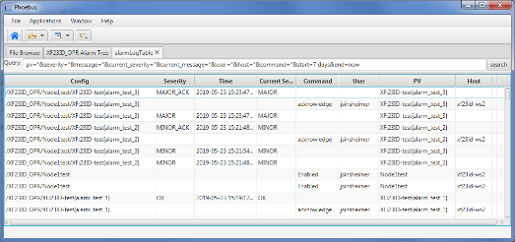




Alarm
Clients
CS-Studio
…
Alarm micro services
Alarm
Server
Alarm
Configuration
Server
Alarm
Message
Logger
Control
Systems
Channel
Access
IOC
PVA
IOC
…

Slide 5
Alarm Logger Service

Slide 6
Alarm Message Logger
Motivation
To create a archive of all alarm state changes and associated actions
Discover alarm patterns and trends
Generate Statistical reports on alarms
Debug the alarm system
Alarm
Message
Logger

Slide 7
Alarm Message Logger
The alarm message logger subscribes to all
Configuration changes
  adding/removing or enabling/disabling
State changes
  e.g. alarm state changes from OK to MAJOR
Commands
  e.g. user actions to Acknowledge an alarm
All the above changes and commands are logged into a dedicated elastic index
Alarm Configuration
Alarm State
Alarm Command
Alarm
Message
Logger

Slide 8
Architecture
Elasticsearch is a distributed, RESTful search and analytics engine.
An analytics and visualization platform called Kibana
Build and Run
git https://github.com/shroffk/phoebus.git
cd services/alarm-config-logger
mvn exec:java
Alarm
Message
Logger
Notes:
Elasticsearch is a search engine based on the Lucene library.

Slide 9
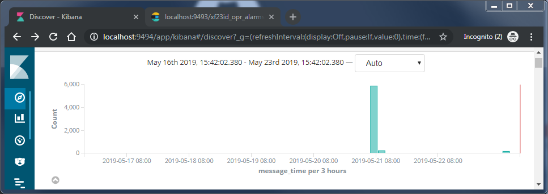
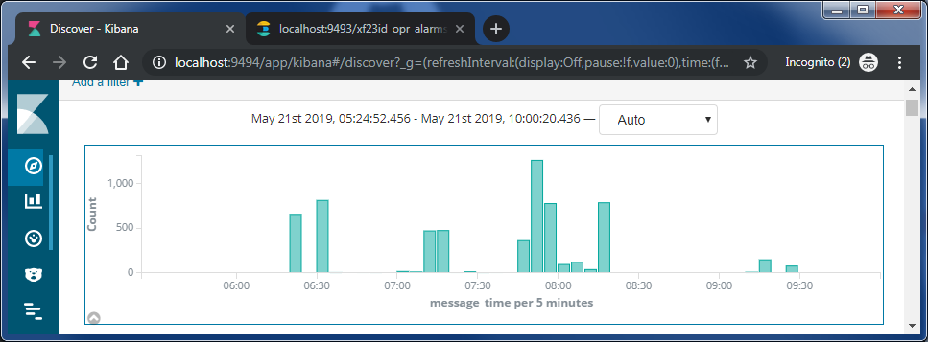
kibana client
A Timeseries view of phoebus alarm server messages.
Filtered:
pvname
node/system
alarm serverity
Notes:
Machine learning and AI can help to systemize and identify alarm problems that is not so easily
detected by simple visualisation and statistics. Areas where machine learning can be particularly useful
are
1) identify false and missing alarms
2) root cause analysis of alarms.
Machine learning can be used to identify false alarms. Alarms can be classified in: A true event giving
a correct alarm or no event giving no alarm. This is the wanted behaviour of the alarm system. But the
alarm system can also give an alarm when there is no event and a true event can give no alarm. The
classification of an imaginary example with 21 alarms can be illustrated in the following confusion
matrix:
Figure 2: A confusion matrix showing number of positive and negative alarms paired with positive
and negative events.
Alarms can be classified from what type of alarm it is from the confusion matrix. Machine learning can
then be trained to recognize the different type of alarms and to build models that can be used to
identify new alarms in the different categories.
Root cause analysis of alarms can be complicated. A paper from (Abele, et al., 2013) [5] describes how
root cause analysis of alarms can be performed using machine learning and knowledge management.

Slide 10
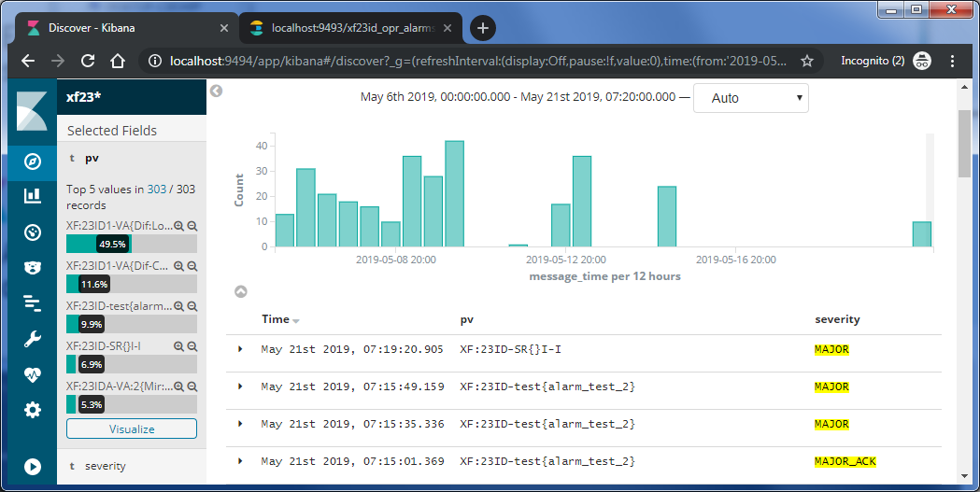
kibana client
Notes:
Machine learning and AI can help to systemize and identify alarm problems that is not so easily
detected by simple visualisation and statistics. Areas where machine learning can be particularly useful
are
1) identify false and missing alarms
2) root cause analysis of alarms.
Machine learning can be used to identify false alarms. Alarms can be classified in: A true event giving
a correct alarm or no event giving no alarm. This is the wanted behaviour of the alarm system. But the
alarm system can also give an alarm when there is no event and a true event can give no alarm. The
classification of an imaginary example with 21 alarms can be illustrated in the following confusion
matrix:
Figure 2: A confusion matrix showing number of positive and negative alarms paired with positive
and negative events.
Alarms can be classified from what type of alarm it is from the confusion matrix. Machine learning can
then be trained to recognize the different type of alarms and to build models that can be used to
identify new alarms in the different categories.
Root cause analysis of alarms can be complicated. A paper from (Abele, et al., 2013) [5] describes how
root cause analysis of alarms can be performed using machine learning and knowledge management.

Slide 11
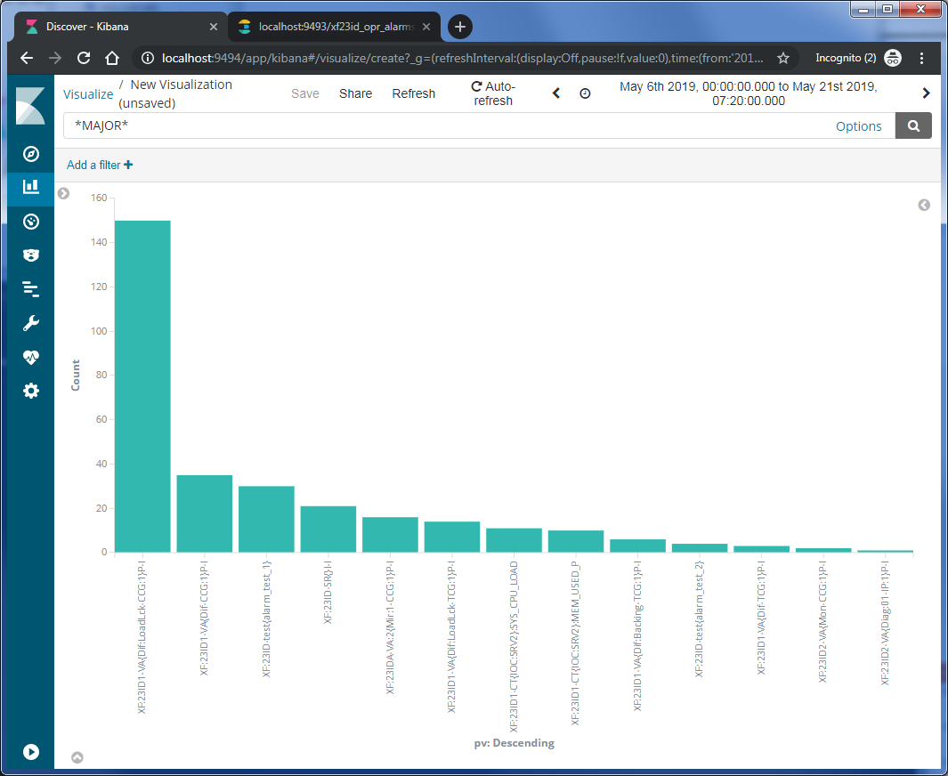
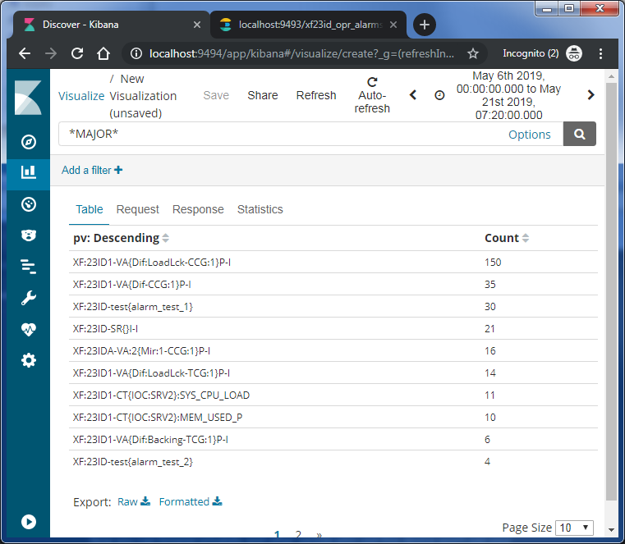
kibana client
Notes:
Machine learning and AI can help to systemize and identify alarm problems that is not so easily
detected by simple visualisation and statistics. Areas where machine learning can be particularly useful
are
1) identify false and missing alarms
2) root cause analysis of alarms.
Machine learning can be used to identify false alarms. Alarms can be classified in: A true event giving
a correct alarm or no event giving no alarm. This is the wanted behaviour of the alarm system. But the
alarm system can also give an alarm when there is no event and a true event can give no alarm. The
classification of an imaginary example with 21 alarms can be illustrated in the following confusion
matrix:
Figure 2: A confusion matrix showing number of positive and negative alarms paired with positive
and negative events.
Alarms can be classified from what type of alarm it is from the confusion matrix. Machine learning can
then be trained to recognize the different type of alarms and to build models that can be used to
identify new alarms in the different categories.
Root cause analysis of alarms can be complicated. A paper from (Abele, et al., 2013) [5] describes how
root cause analysis of alarms can be performed using machine learning and knowledge management.

Slide 12
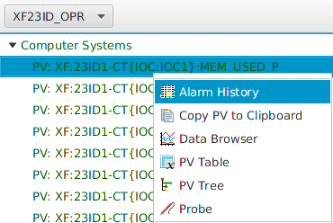
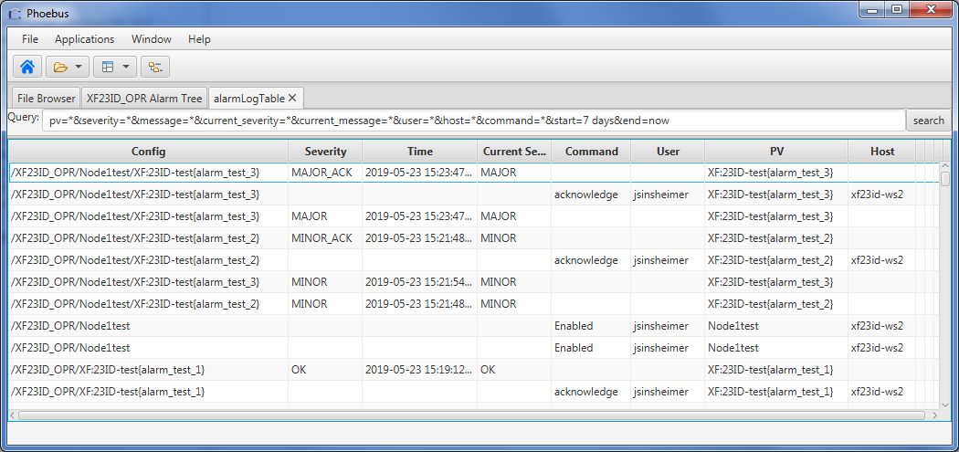
CS-Studio/Phoebus client
Notes:
Machine learning and AI can help to systemize and identify alarm problems that is not so easily
detected by simple visualisation and statistics. Areas where machine learning can be particularly useful
are
1) identify false and missing alarms
2) root cause analysis of alarms.
Machine learning can be used to identify false alarms. Alarms can be classified in: A true event giving
a correct alarm or no event giving no alarm. This is the wanted behaviour of the alarm system. But the
alarm system can also give an alarm when there is no event and a true event can give no alarm. The
classification of an imaginary example with 21 alarms can be illustrated in the following confusion
matrix:
Figure 2: A confusion matrix showing number of positive and negative alarms paired with positive
and negative events.
Alarms can be classified from what type of alarm it is from the confusion matrix. Machine learning can
then be trained to recognize the different type of alarms and to build models that can be used to
identify new alarms in the different categories.
Root cause analysis of alarms can be complicated. A paper from (Abele, et al., 2013) [5] describes how
root cause analysis of alarms can be performed using machine learning and knowledge management.

Slide 13
Alarm Data Management
The server can be configured to create a new index every day, week, month, or year
Searches can be performed across multiple indexes
Elastic Curator
An Index Lifecycle Management tool which manages the cleanup and deletion of cold indices
# The units of the indices date span: Days (D), Weeks(W), Months(M), Years(Y).
date_span_units=M
# The value of the indices date span.
# An integer value to be combined with the units. For example, if months were selected and the value set to 2, each index would span 2 months.
date_span_value=1
http://localhost:9493/xf23id_opr_alarms_config_*/_search

Slide 14
Alarm Configuration Service

Slide 15
Alarm Configuration Service
Alarm Configuration Messages
Log all the configuration changes made to the alarm server configuration
Build and Run
git https://github.com/shroffk/phoebus.git
cd services/alarm-config-logger
mvn exec:java
Alarm
Configuration
Server
Subscribe,
Filter,
Timestamp,
Process

Slide 16
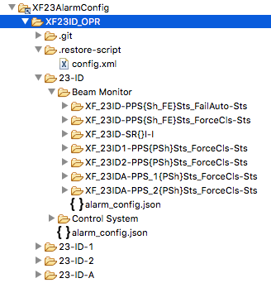
Alarm Configuration Tree
Notes:
Mapping of the alarm tree to the file structure

Slide 17
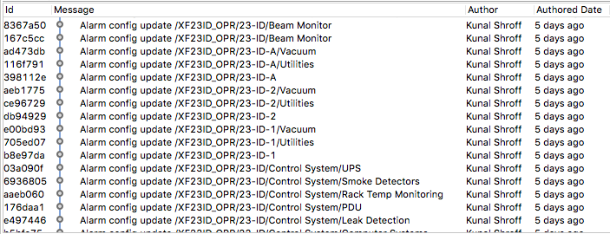
Configuration History

Slide 18
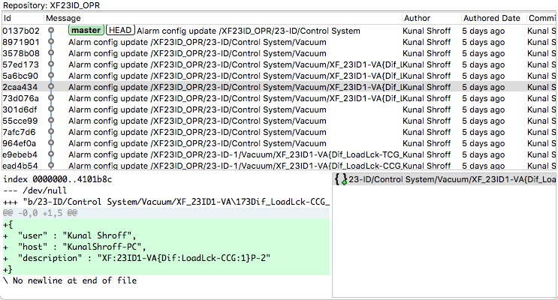
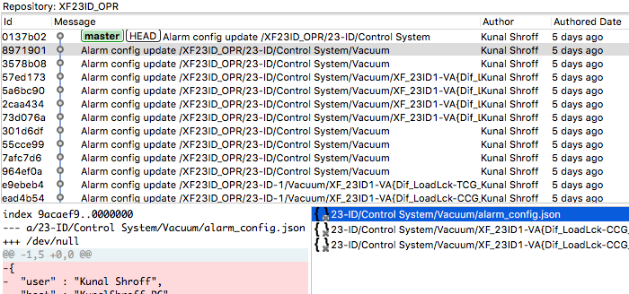
Configuration events

Slide 19
Restore Scripts
Each alarm configuration change results in the creation or an update to the config.xml file.
The config.xml can be directly imported into the alarm server to restore it to the alarm configuration to that instant.

Slide 20
Questions

