Slide 1
CS-Studio & Phoebus Status

Slide 2
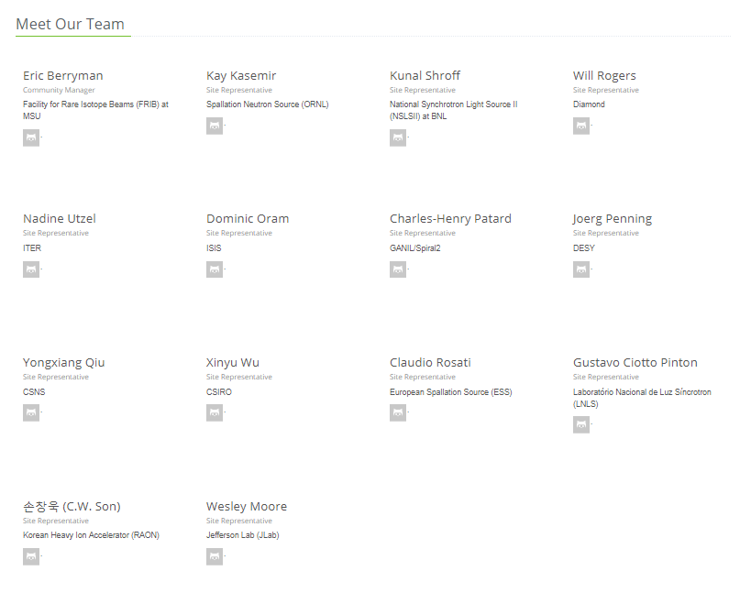
CS-Studio Collaboration
14 Sites which package site specific CS-Studio products
Additionally, many users who do not create their own products.

Slide 3
CS-Studio 4.6 requirements
“When it works, I like it.”
“right click -> send PV name to another plug-in saves me a lot of time”
“I like the concept of a well integrated set of tools that can share data.”
“Integration of the olog, channel navigator, and chart/archiver features are useful.”
“Everything in one place”
“Easy to create GUI's that interact with EPICS PV’s”
“When it does not work, I hate it.”
“slow, clumsy, hard to understand”
“BOY leads to crashes way too often”
“I am having real problems building our own CSS distribution starting from Eclipse Mars RC2”
“Big labs seem to have their experts but I'm under the impression that smaller labs are struggling and so am I when "my expert" is not available.”
“Spend a long time to start a product in Eclipse and Export it.”
Feedback link:
https://docs.google.com/spreadsheets/d/11_nwz0tiSJO4Zs71UI5vD-SRLrHvmd__NjbFEzk_6js/edit#gid=0

Slide 4
CS-Studio 4.6
Summer 2019
Upgrades to the underlying infrastructure
  OpenJDK 11.0.2
  OpenJfx
  Eclipse 2018-12
Phoebus framework
  Development of phoebus services and new core modules
  phoebus & eclipse integrations
New Application features and Bug fixes
Notes:
Significant improvement in performance on linux GTK 3
Renders well…
BOY intensity graph interpolation
Databrowser Axis
Bug fixes for multi state leds
Bug fixes for edm and medm converters

Slide 5
“Phoebus”
Phoebus (Greek for “bright”)
As we step out of the shadow of
To improve user experience
A framework for well integrated control system tools and software
To reduce the barrier of entry for new developers
A simple Build
A development environment that is easy to setup and use
Use generic tools and technologies available as part of the java ecosystem

Slide 6
June 2019: CS-Studio on eclipse & phoebus
JavaFX
SWT
BOY
Display Builder
Display Builder
Display Builder
Data Browser
Data Browser
Data Browser
Data Browser
PV Tree
PV Tree
PV Tree
PV Tree
Probe
Probe
Probe
Probe
PV Table
PV Table
PV Table
PV Table
Alarms
Alarms
Alarms
Alarms
Channels
Channels
Channels
Channels
Scan
Scan
Scan
Scan
… more …
… more …
BOY
… more …
Eclipse
Eclipse
Eclipse
Phoebus
Java 8
Java 9,10
Java 11
Java 11
CS-Studio, 2010
Since ~2016
2019

Slide 7
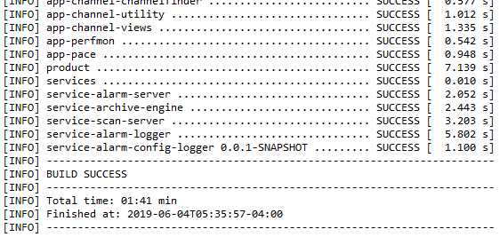
Fast & Simple Build
# clone the sources
git clone https://github.com/shroffk/phoebus.git
# build using maven
mvn clean install
# or build using ant
ant clean run
Eclipse build: 30+ mins
Phoebus build: ~3 mins

Slide 8
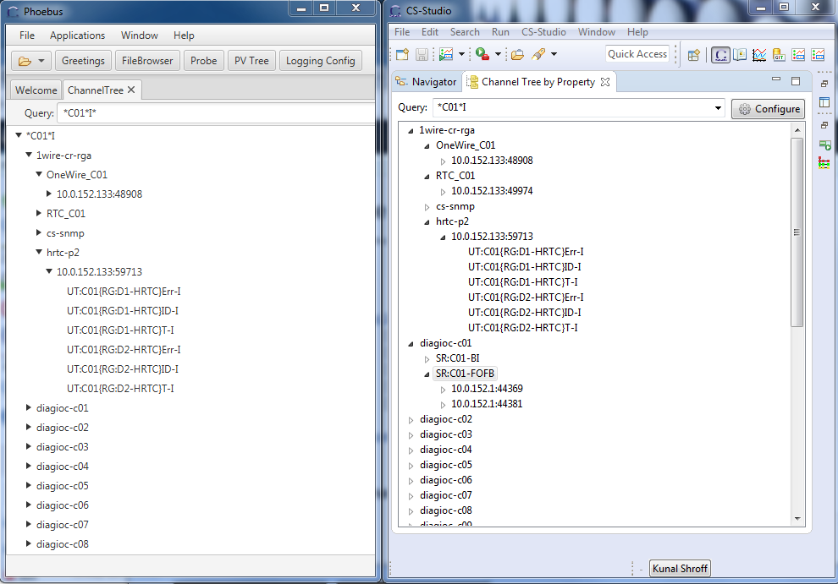
Less code
Eclipse based
Channel Finder Tree w/t
Lazy loading
11.2k Loc
Phoebus based
Channel Finder Tree w/t
Lazy loading
4.5k Loc

Slide 9
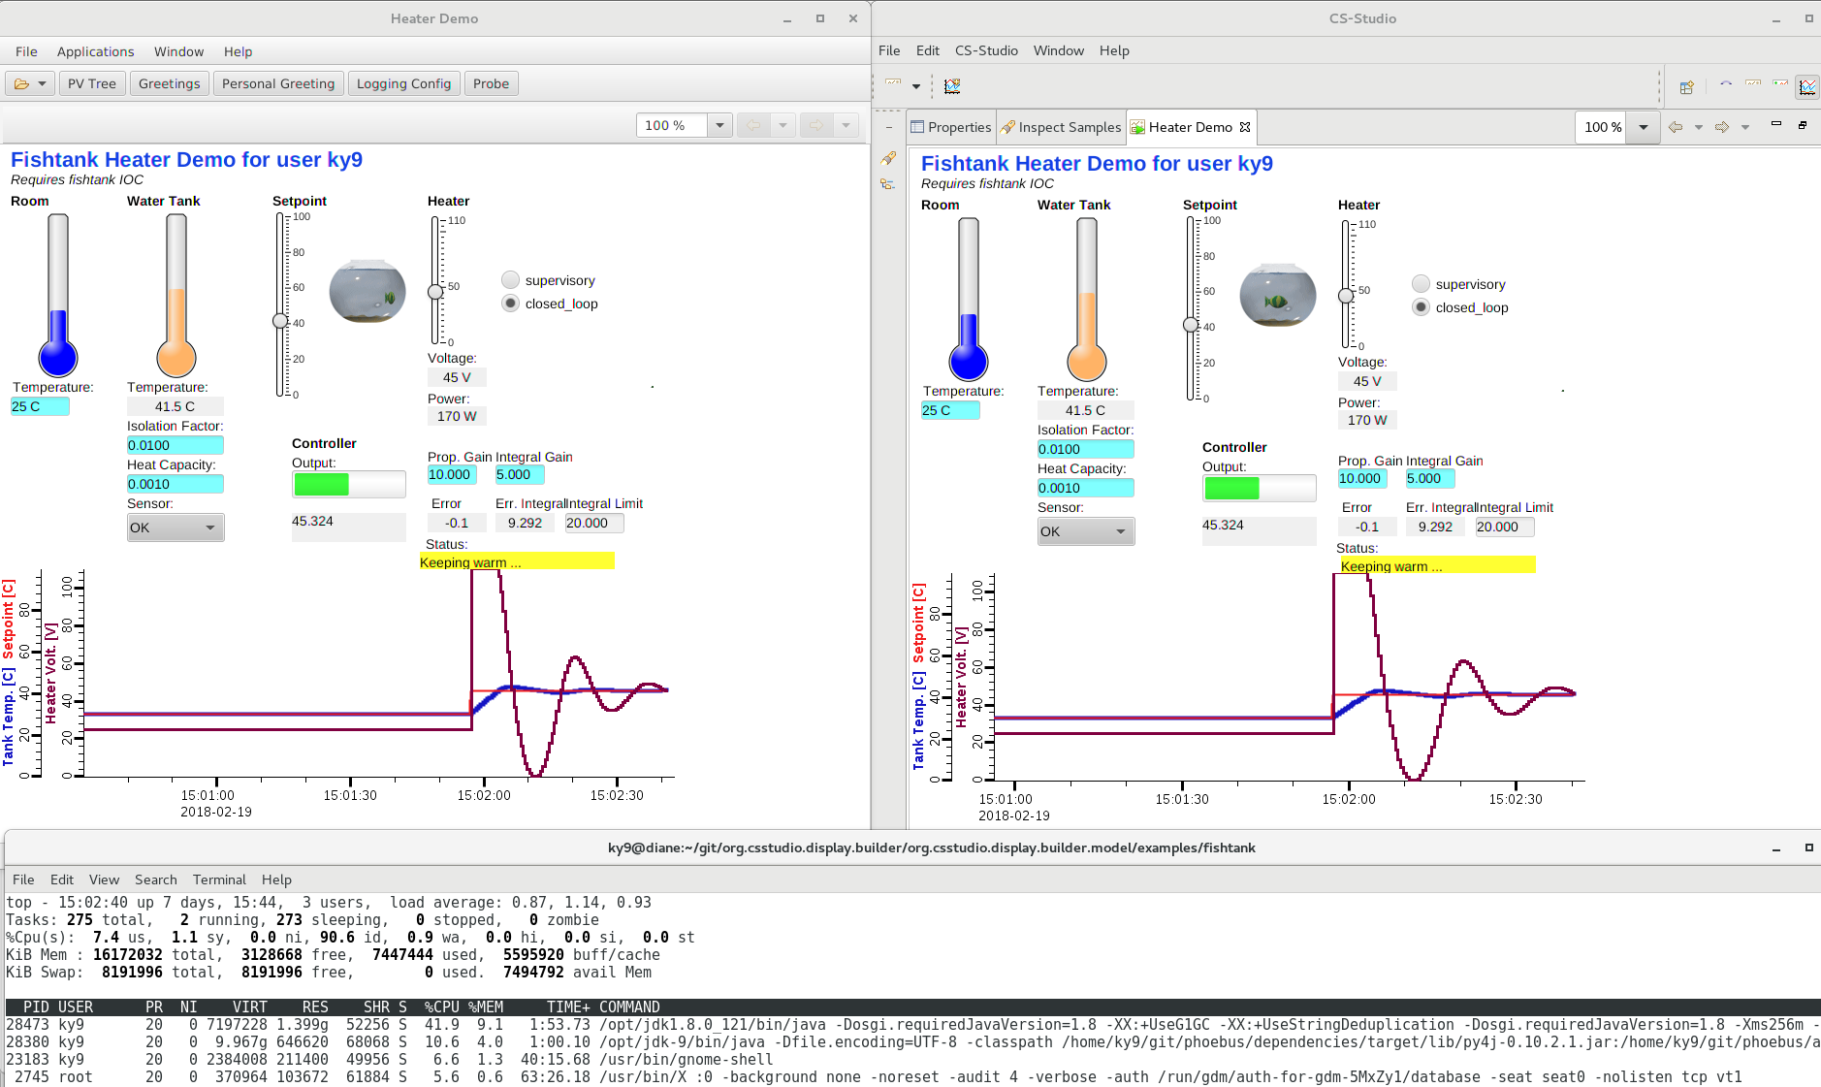
Better Performance
Phoebus:
¼ CPU,
½ Memory
CS-Studio with Eclipse

Slide 10
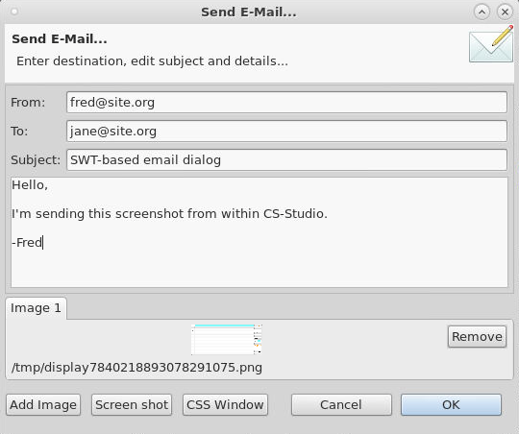
SWT vs. JavaFX
SWT used to be better than AWT
AWT/Swing caught up,
SWT now only used by Eclipse
➔ JavaFX is the latest Java-based UI

Slide 11
Development Activity
June 2018 to June 2019
https://github.com/ControlSystemStudio/cs-studio
Issues 116 closed and 42 opened
https://github.com/shroffk/phoebus
Issues 476 closed and 30 opened

Slide 12
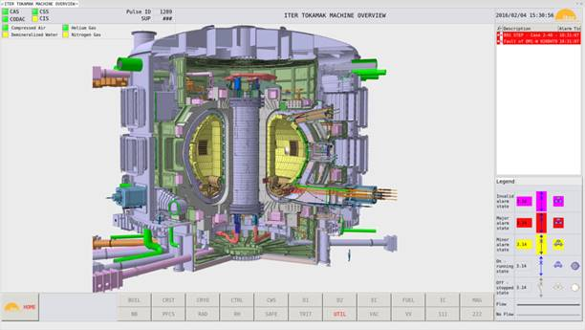
ITER
Notes:
These release notes are targeting the developers, not the development required for the integration. The main improvement in this area was the support of multi beast datasources. This allows us to show the top level screen for ITER with aggregated alarms from all plant systems as illustrated below where the navigation shows that UTIL plant system is in major state, and the alarm pane shows the alarm composite root:
OPIs flashing à “introduction of a delay before showing a PV as disconnected”
- Bug - Multistate symbol widget doesn't show string values correctly
- “opibuilder: avoid bogus activation of widgets when clicking to empty area of a Linking Container”
- The message history view does not show the seconds and milliseconds of the event time

Slide 13
European Spallation Source (ESS)
Display Builder is the preferred OPI tool at ESS with existing BOY screens imported or manually upgraded.
Display Builder essentially JavaFX-based.
  Integration with SWT-based application like eclipse cs-studio has unwanted side effects.
ESS will gradually migrate to Phoebus-based CS Studio applications, strong focus on Display Builder (edit mode and runtime).
  Key driving factor is improved performance in Phoebus-based CS Studio applications.
Current work includes migration of save-and-restore application to Phoebus
  UI in Phoebus is a port of current save-and-restore in CS Studio, with some improvements and bug fixes. Adding a new Phoebus-based application is very easy.

Slide 14
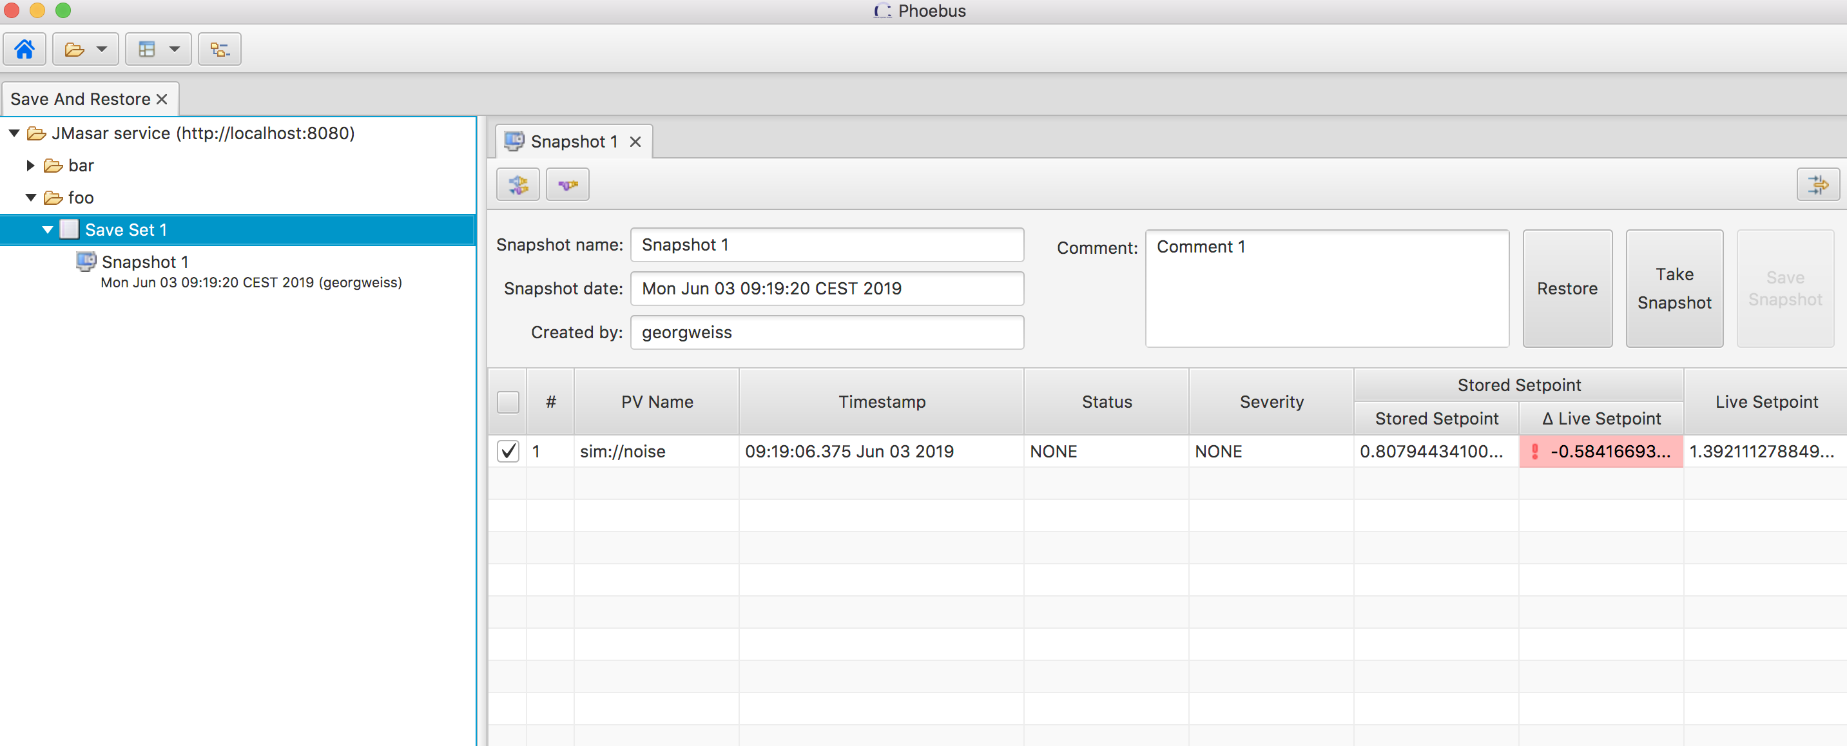
save set application

Slide 15
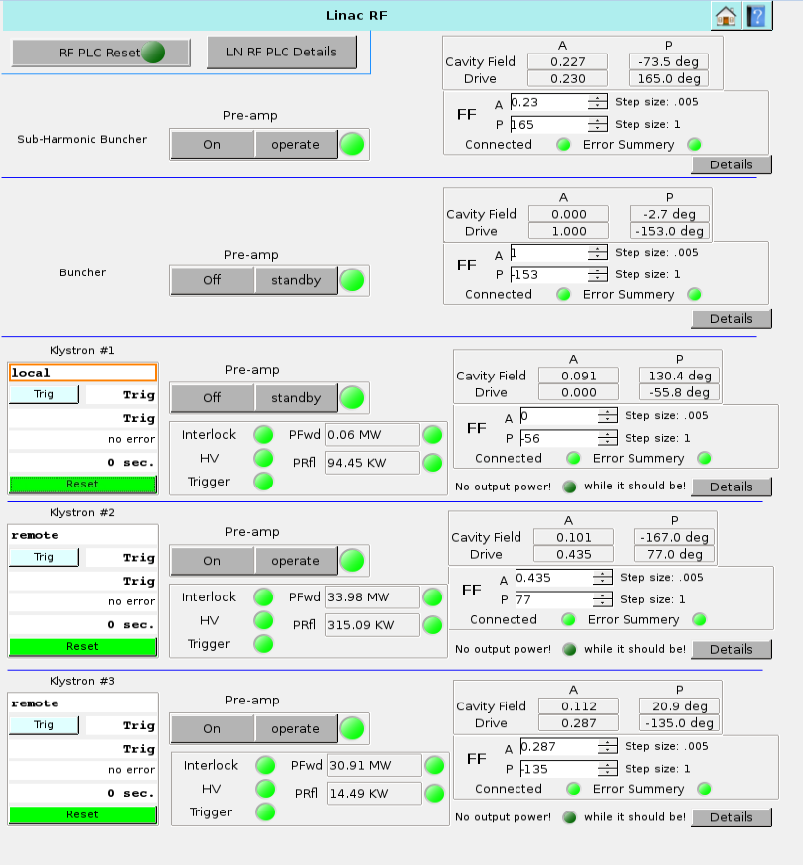
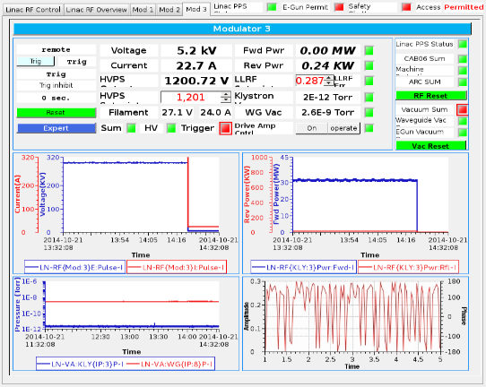
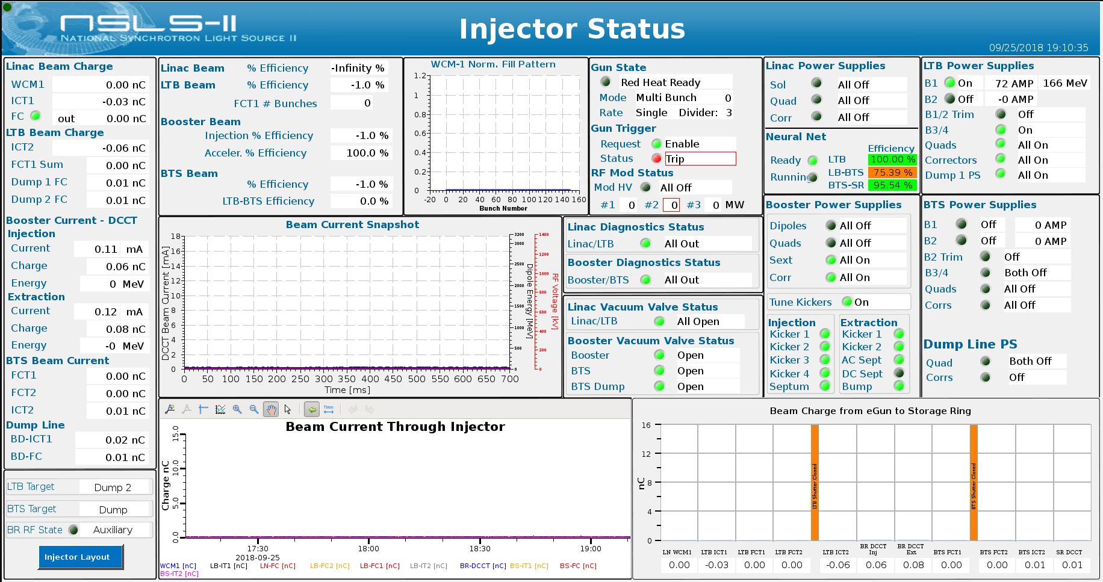
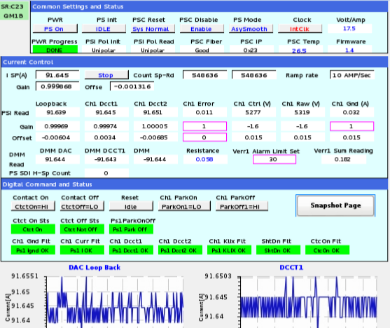
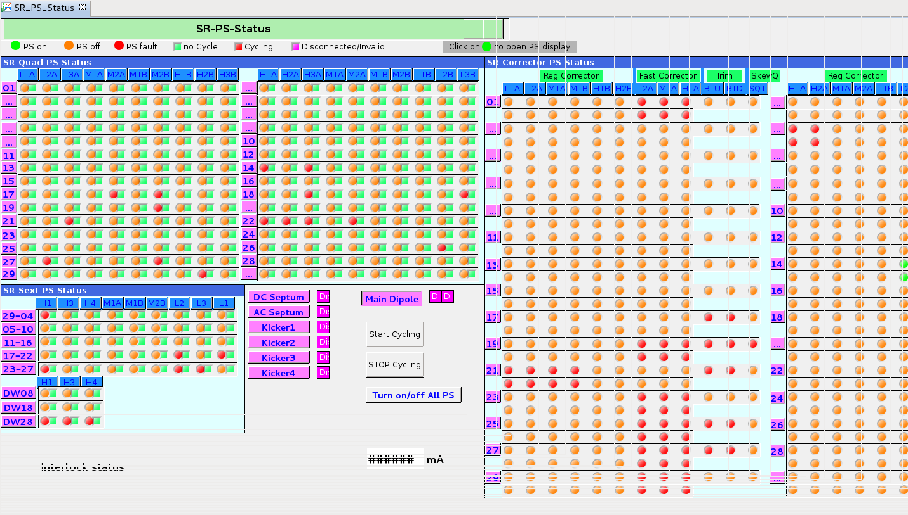
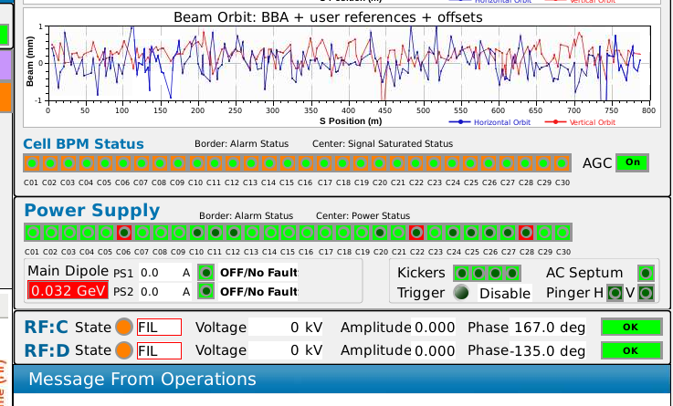
NSLS II
Engineering Controls
Physics Pages
Operations Controls
Created by controls engineers, each working on a specific system
Designed by a small number of people, prior to commissioning
Created by ‘operations controls’ (former operators) and current operators
LN RF
LN RF
LN RF
SR PS
SR PS
SR PS

Slide 16
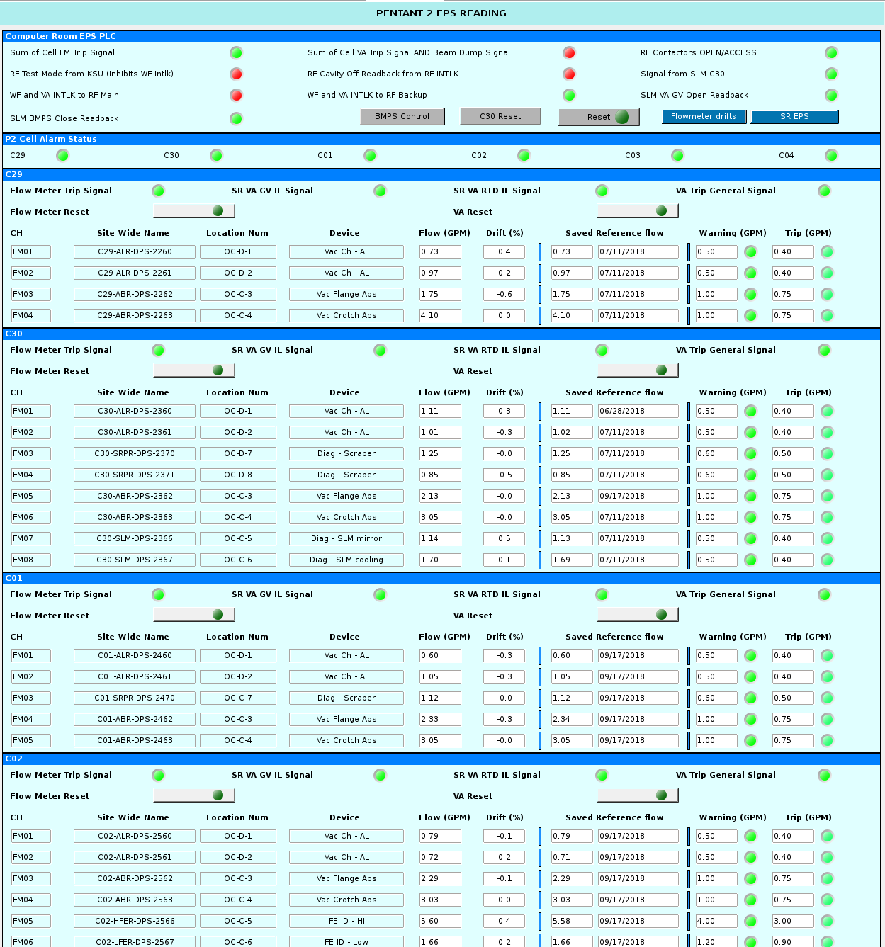
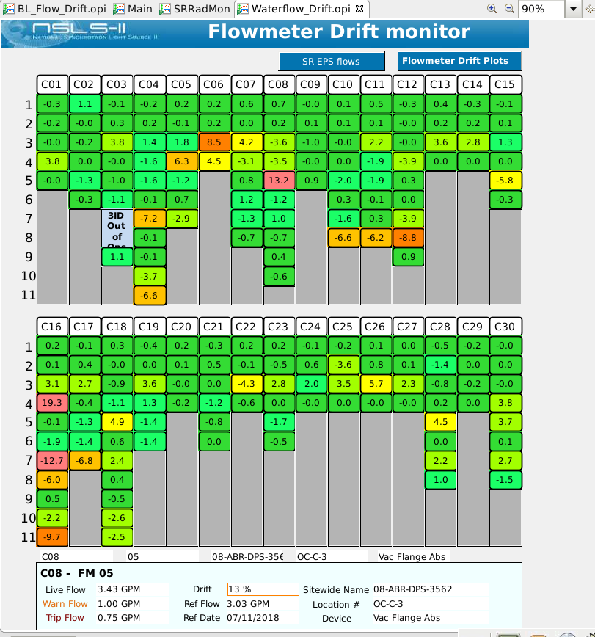
NSLS II
Created by ‘operations controls’ (former operators) and current operators
Notes:
About 200 flowmeters
No good indicator of small changes
Warning/Trip Alarms, but do not track drifts
Distributed over 5 pages
Utilities engineer spent 30-60 min per day on monitoring flow numbers & graphs (for SR)
References kept on handwritten notes
Work based on “is it close to alarm level?”; identified problems would often cause downtime before work could be done.
Flowmeter Drift Plot
IOC and CSS page that convert 200 flow readings into a colored button display of drifts.
Process and Anatomy
IOC
Saved setpoint-value PVs (w timestamp)
Make new value of % live/saved
CSS
Shows each FM as an LED
Color changes as a gradient from green to red as drift % increases
Info panel shows details for each FM with one click
Info displayed from Engineer parameters, reference flow/timestamp, device location, and engineering ID.

Slide 17
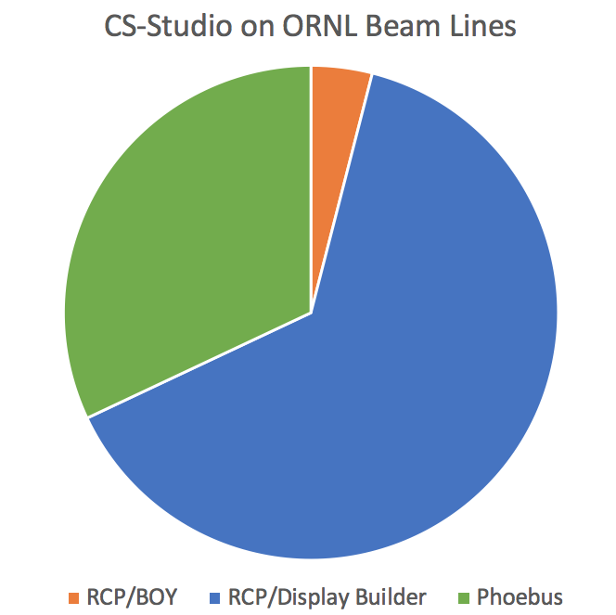
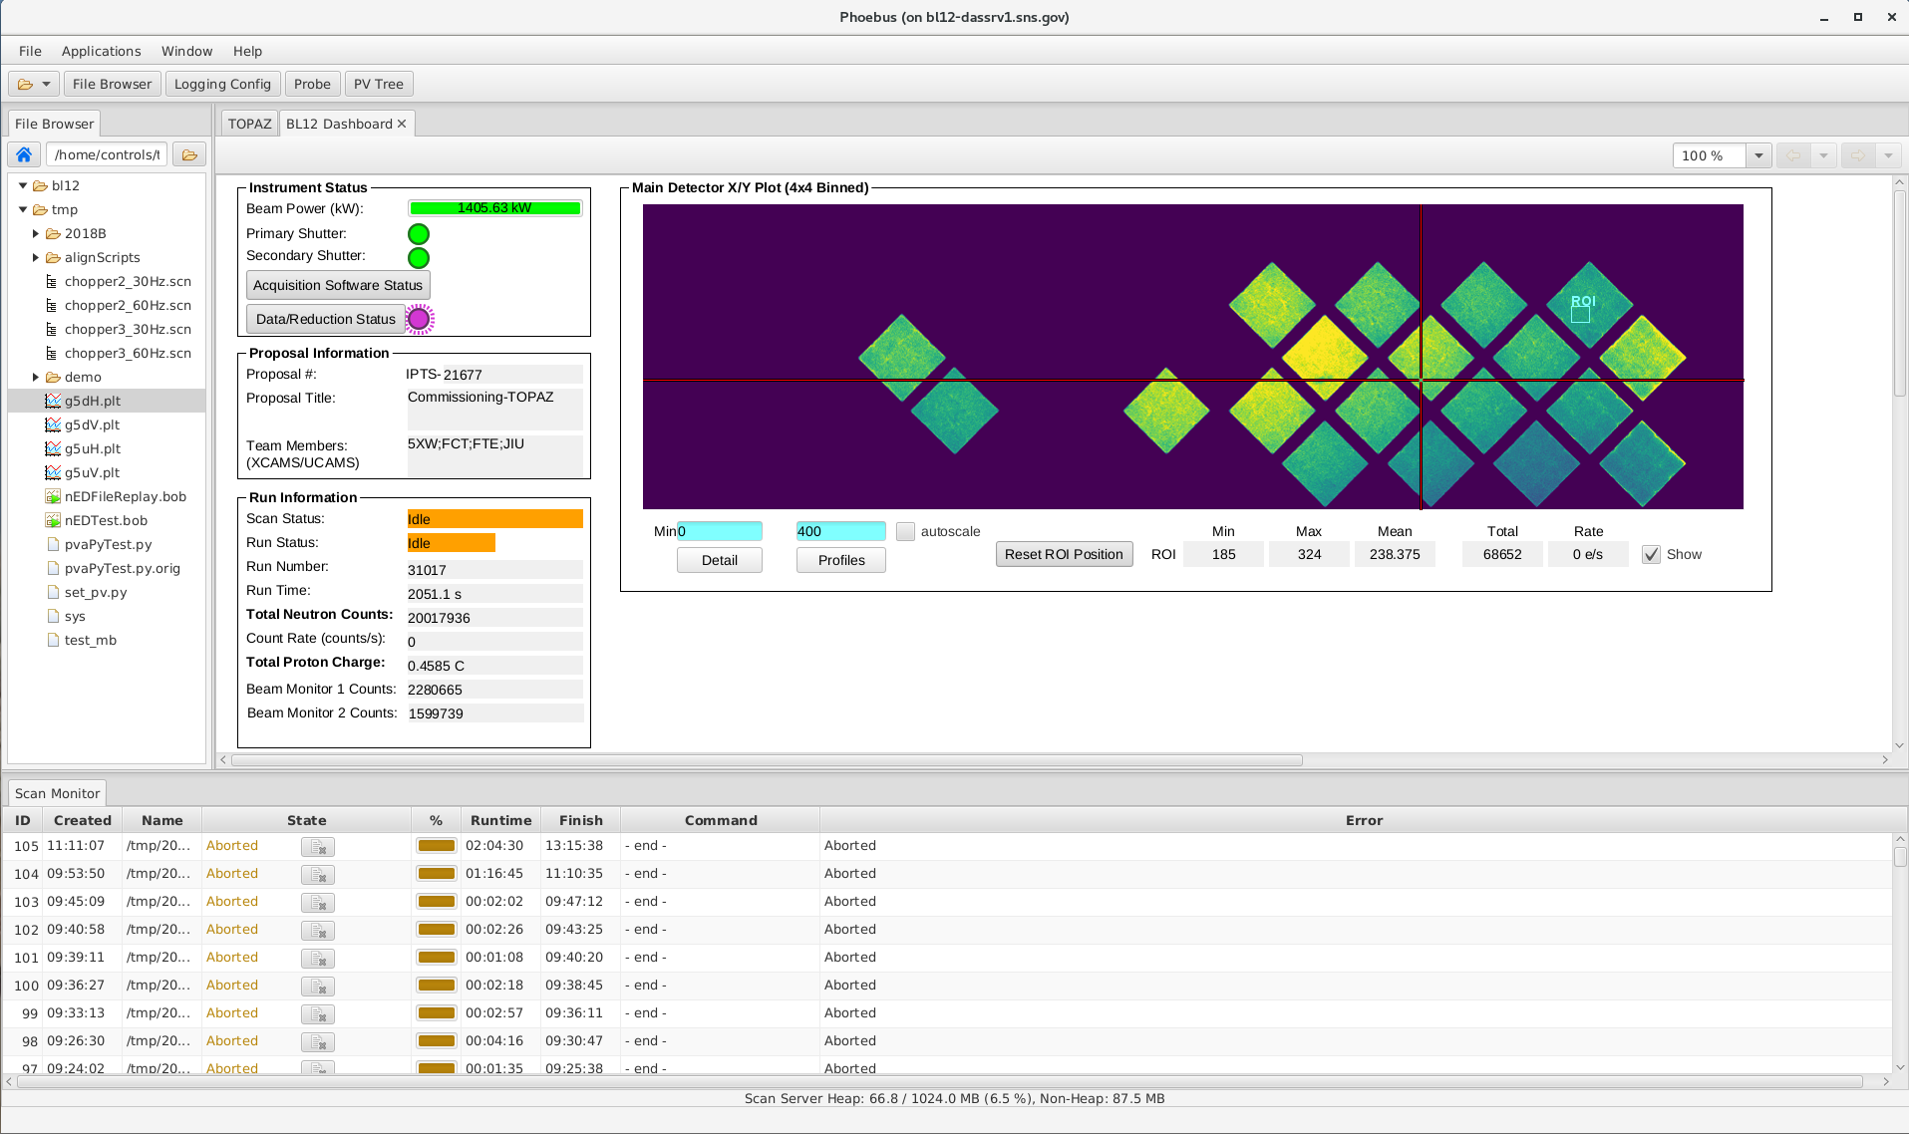
ORNL
SNS Accelerator
  RCP CS-Studio on 32 bit Linux for alarms & archive access
  (Displays: EDM)
SNS & HFIR Beamlines
  21 Beam lines on CS-Studio for displays, archive,
  alarms, automation

Slide 18
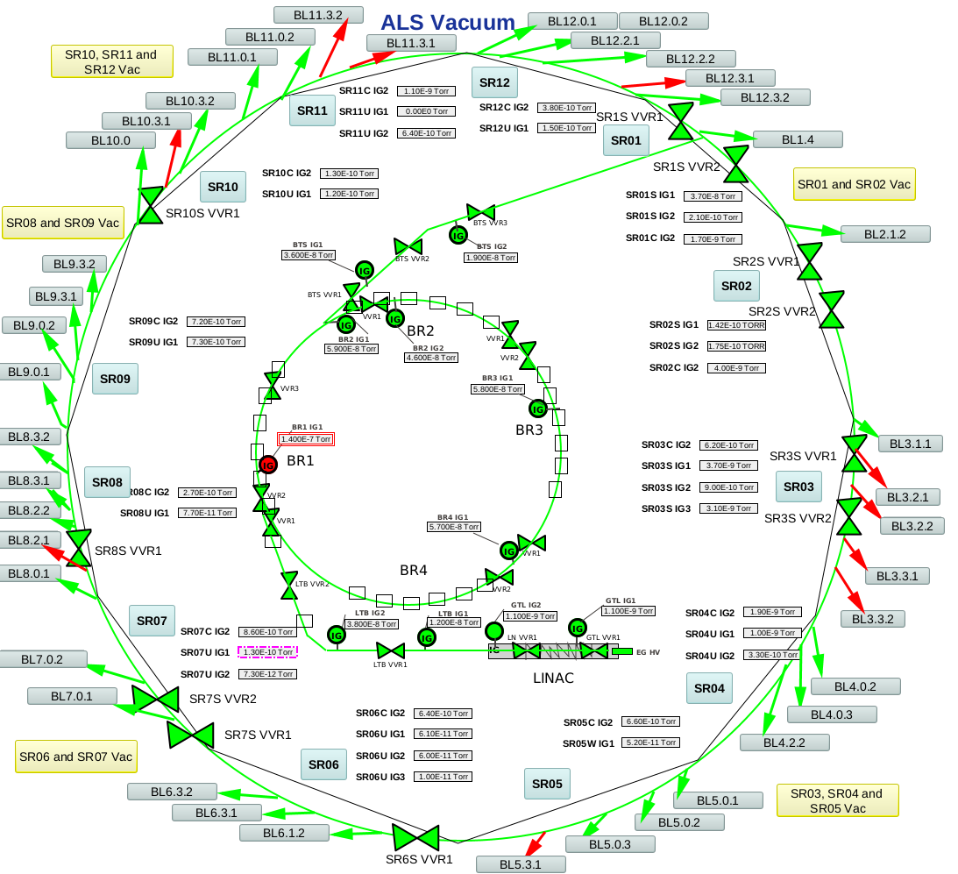
ALS at LBL
Building an ALS phoebus product
Converting edm screens and created new opi screens using phoebus
Notes:
The back ground on that display as I understand it:
Beam lines currently use Labview program to interface PLC's that have touch screens for BL operators to interface.
If they want to open a hutch or reset an alarm, they would use labview.
Bob Gunion wants to get away from Labview for various reasons. Thus the Allen Bradley PLC's were partly chosen b/c of available EPICS
support. Combined with Phoebus we are able to move away from Labview and have a reliable open source system running Linux or Windows clients.
Hanjing Harris

Slide 19
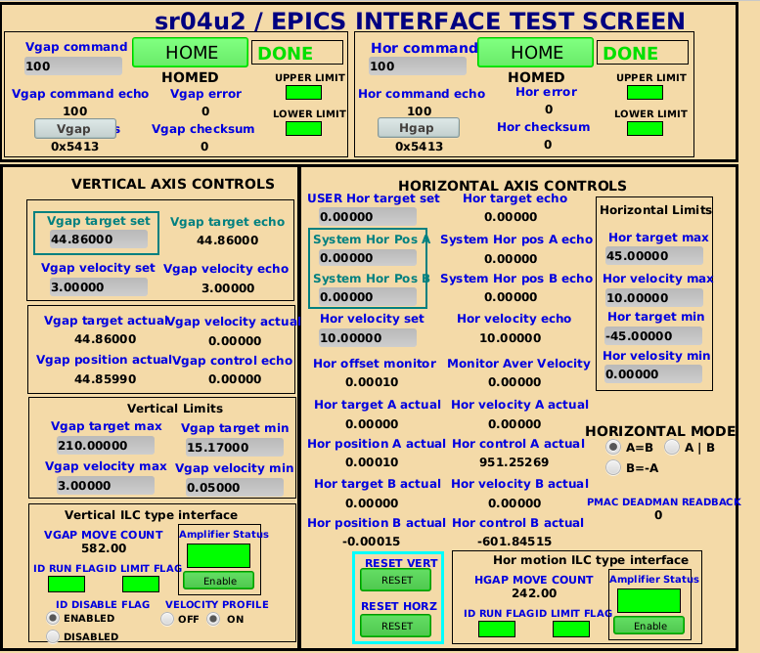
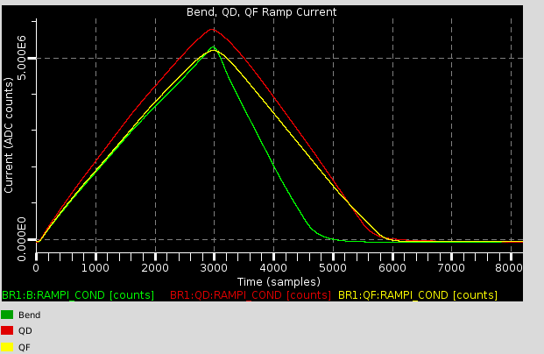
ALS at LBL

Slide 20
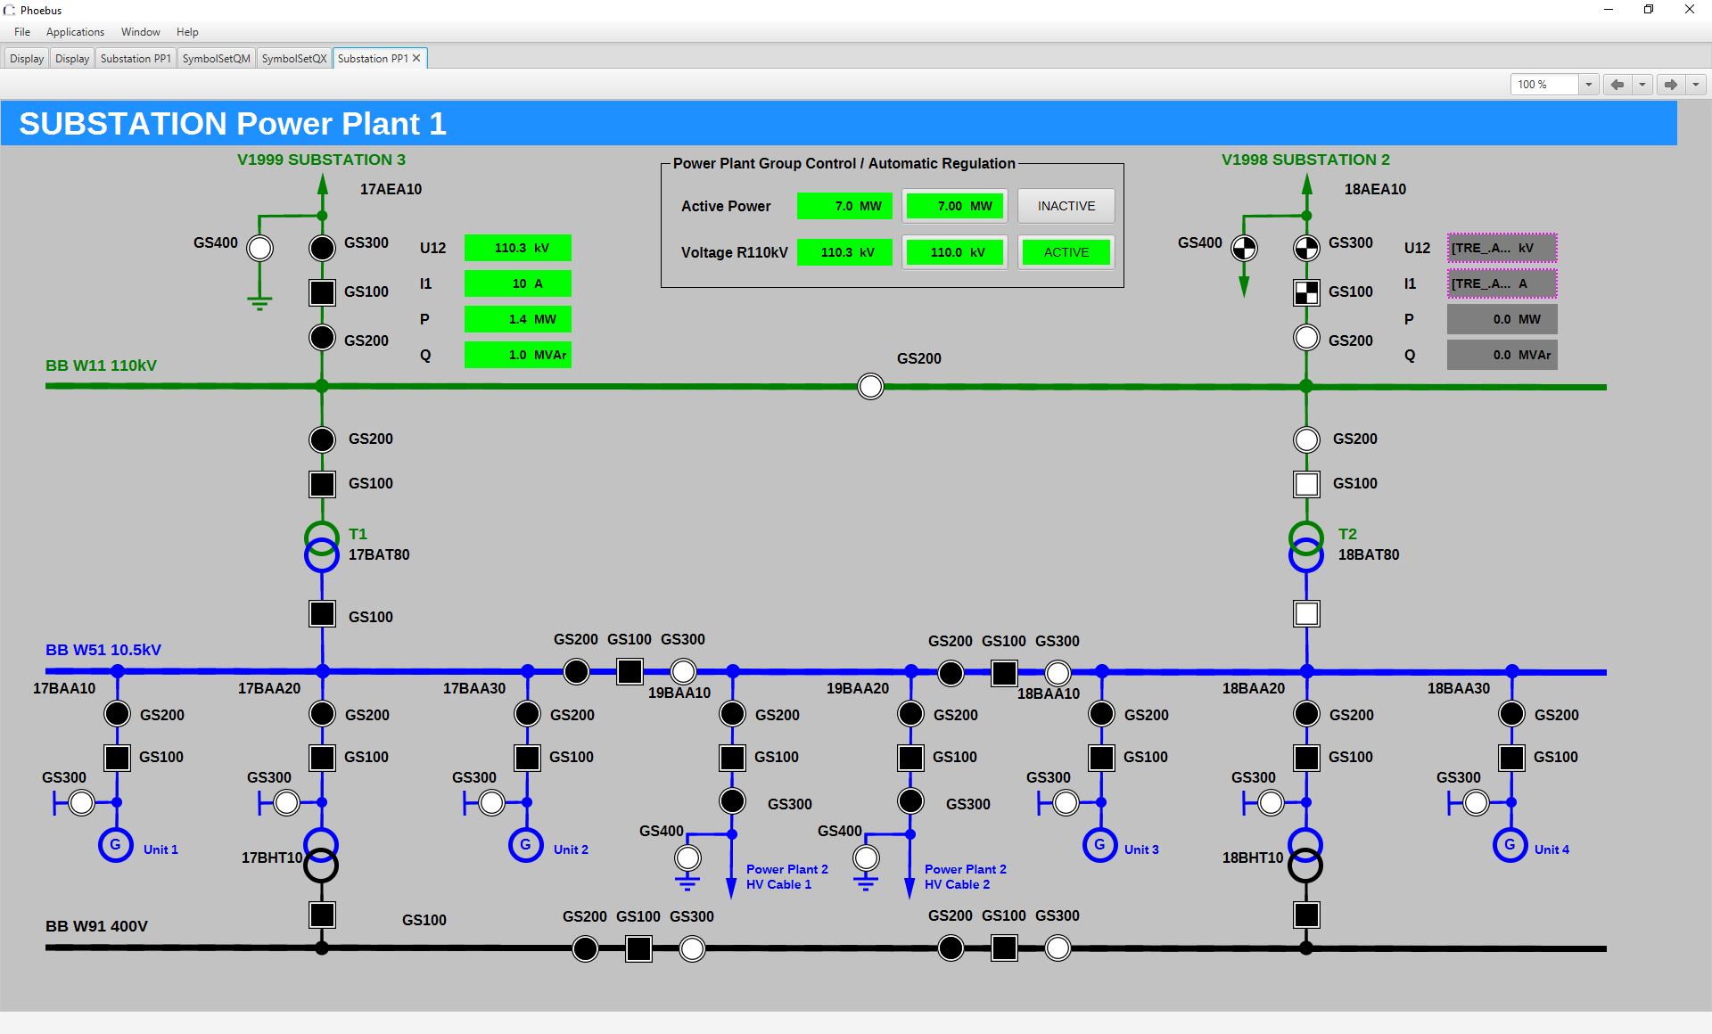
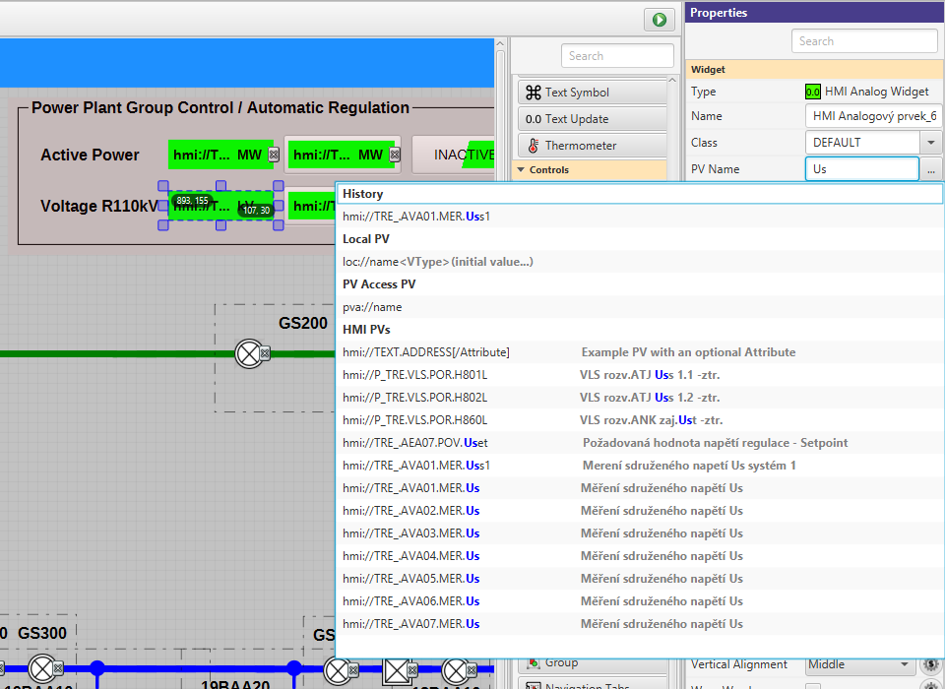
Phoebus beyond EPICS
Builds on MQTT support
Custom Additions:
  PV Name Completion
  Context menu entries
  Widgets
Contributed numerous bug fixes to common repository!
Status: Evaluating, ~10 000 PVs
Pavel Charvat,
https://sourceforge.net/u/pavel-ch/profile/
https://github.com/pavel-ch
Notes:
In fact I had intentions to use RCP CSS and BOY in the same manner already some 5 years ago.
You can see a relict repo on my Github. But the RCP handling and Eclipse UI have been that discouraging that I left it in an early stage.
Phoebus opened the way. There are still some isolated items which I feel that have to be worked on or enhanced. I am trying to contribute step by step in this field.
Generally I would say that Phoebus is a solid piece of software and a good basement for the next development. It was relatively easy for me as a non professional programmer and even a non Java programmer to set the development environment up and begin to develop a set of extensions.

Slide 21
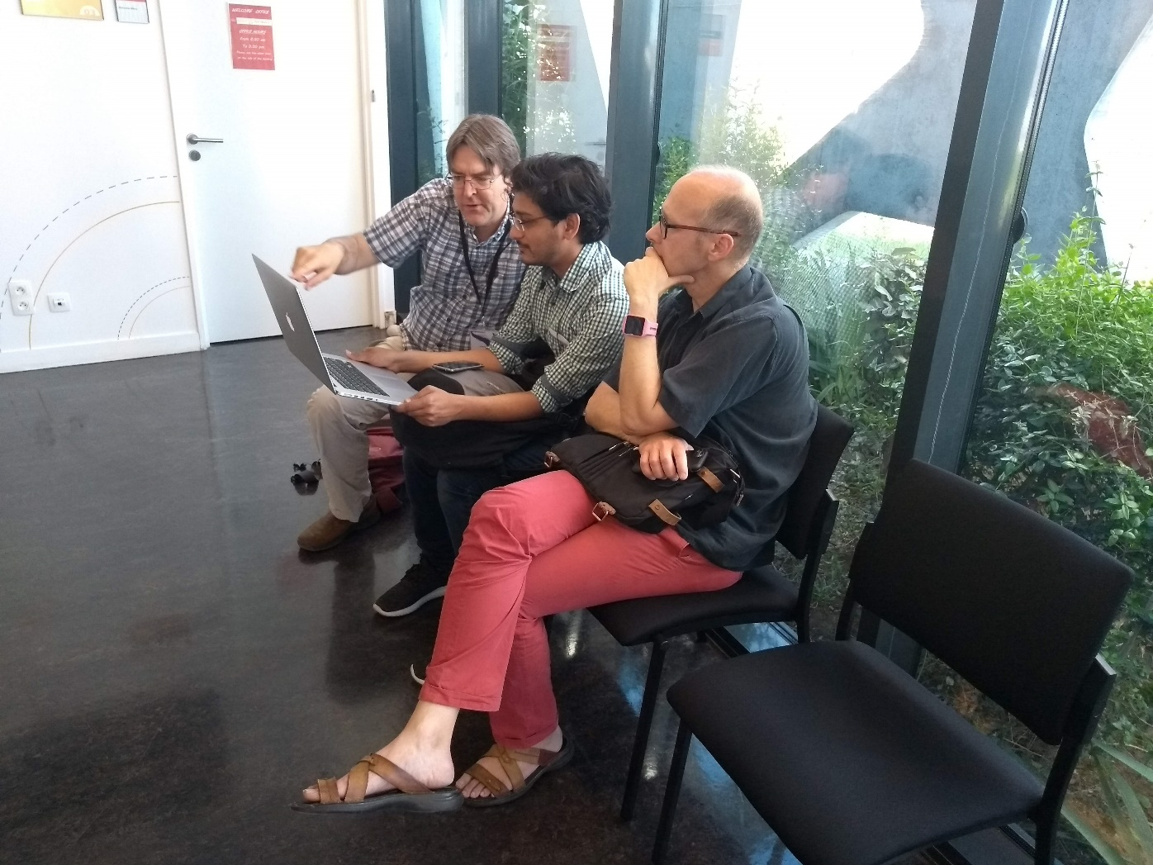
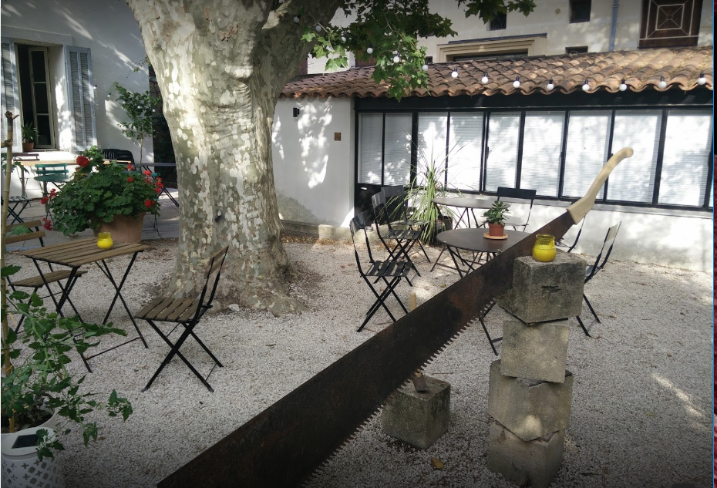
CS-Studio Developers meeting
Aix-en-provence 2019
Meeting Highlights
  UI testing using Testfx
  Java modules
  Cs-studio product packaging
  - embedded jdk
  - eclipse + phoebus applications
  EPICS 7 support
  - handling structured data
  - epicsJava libraries
Meeting Minutes :
https://docs.google.com/document/d/1lyfA1ZaLIxfFpJ972TTl_2r_n4--V7tJuzLhp53ZOOg/edit#heading=h.7jjdypgltu4f

Slide 22
C-Studio using Eclipse & Phoebus
Minimize the disruption
The migration from eclipse to Phoebus will be a multi year process
  Each application will be migrated individually.
  Both the eclipse and phoebus based applications will be supported by the cs-studio community.
  Each site will have the flexibility to define their time lines
Notes:
The migration from eclipse to Phoebus will be a multi year process
Each application will be migrated individually.
Both the eclipse and phoebus based applications will be supported by the cs-studio community.
Each site will have the flexibility to define their time lines

Slide 23
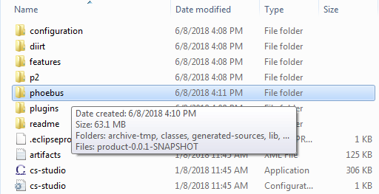
Moving from Eclipse to Phoebus
A easy transition
JavaFX
SWT
Display Builder
Display Builder
Data Browser
Data Browser
PV Tree
PV Tree
Probe
Probe
PV Table
PV Table
The Phoebus applications can be packaged with the existing eclipse applications into a single CS-Studio product
Developers can package the appropriate versions of each application to satisfy their site needs
Alarms
Alarms
Channels
Channels
Scan
Scan
BOY
… more …
… more …
Eclipse
Phoebus
Java 11
Java 11
Composite Product CS-Studio 4.6

Slide 24
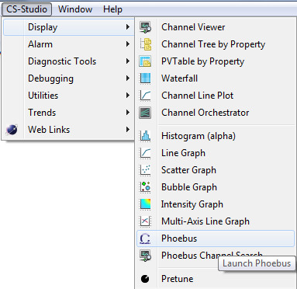
Phoebus Integration in
Existing eclipse products
Launch various phoebus applications via
CS-Studio menu or toolbar actions
Notes:
org.csstudio.phoebus.integration
A plugin which provides a service with methods for launching CS-Studio phoebus applications from inside existing CS-Studio/eclipse products
Launch various phoebus applications via
CS-Studio menu or toolbar actions
CS-Studio context menu actions using the selection
When a users launches an application or a tool, the details of weather it a swt/javafx based eclipse application or a javafx based phoebus applications are transparent to the user.
e.g. The “send an email” or “create a log entry” will open the associated phoebus apps in a new window instead of the eclipse based ones.

Slide 25
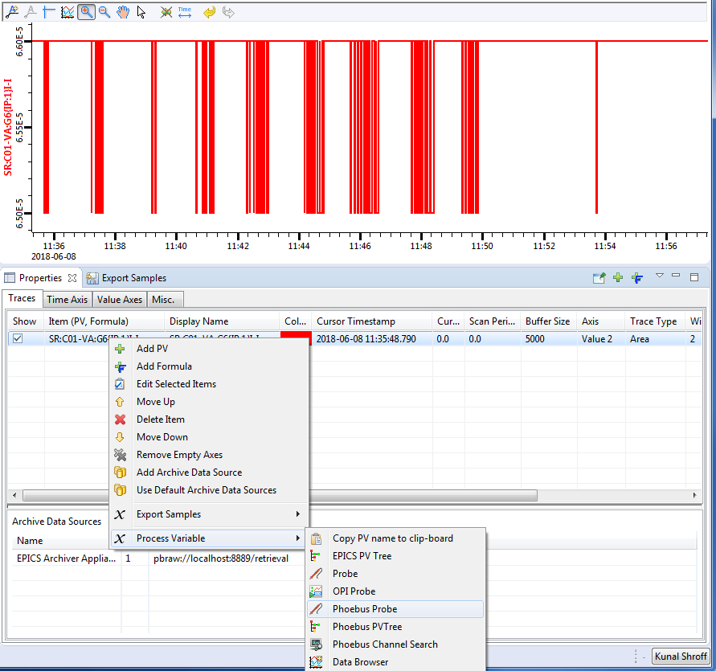
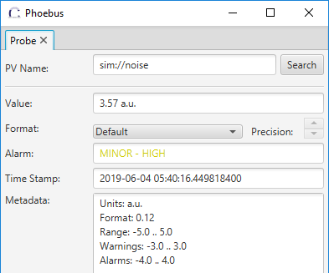
Phoebus Integration in
Existing eclipse products
Launch various phoebus applications via CS-Studio context menu
The phoebus application is launched with the selection data.
Notes:
org.csstudio.phoebus.integration
A plugin which provides a service with methods for launching CS-Studio phoebus applications from inside existing CS-Studio/eclipse products
Launch various phoebus applications via
CS-Studio menu or toolbar actions
CS-Studio context menu actions using the selection
When a users launches an application or a tool, the details of weather it a swt/javafx based eclipse application or a javafx based phoebus applications are transparent to the user.
e.g. The “send an email” or “create a log entry” will open the associated phoebus apps in a new window instead of the eclipse based ones.

Slide 26
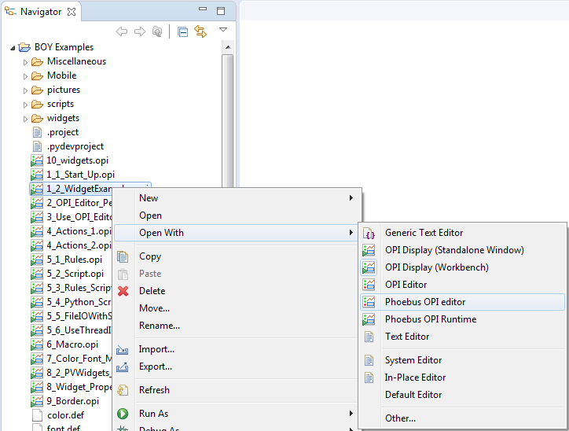
Phoebus Integration in
Existing eclipse products
phoebus applications can be registered as the editors for cs-studio configuration files like .opi, .bob, .plt
Notes:
org.csstudio.phoebus.integration
A plugin which provides a service with methods for launching CS-Studio phoebus applications from inside existing CS-Studio/eclipse products
Launch various phoebus applications via
CS-Studio menu or toolbar actions
CS-Studio context menu actions using the selection
When a users launches an application or a tool, the details of weather it a swt/javafx based eclipse application or a javafx based phoebus applications are transparent to the user.
e.g. The “send an email” or “create a log entry” will open the associated phoebus apps in a new window instead of the eclipse based ones.

Slide 27
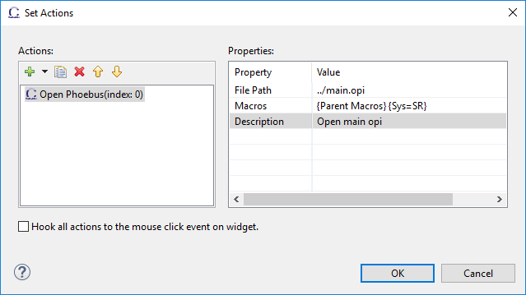
Phoebus Integration in
Existing eclipse products
“Open Phoebus” action
BOY actions buttons, menu buttons, other widgets can open resources in cs-studio phoebus applications.
Notes:
org.csstudio.phoebus.integration
A plugin which provides a service with methods for launching CS-Studio phoebus applications from inside existing CS-Studio/eclipse products
Launch various phoebus applications via
CS-Studio menu or toolbar actions
CS-Studio context menu actions using the selection
When a users launches an application or a tool, the details of weather it a swt/javafx based eclipse application or a javafx based phoebus applications are transparent to the user.
e.g. The “send an email” or “create a log entry” will open the associated phoebus apps in a new window instead of the eclipse based ones.

Slide 28
Phoebus Integration
Under the hood
org.csstudio.phoebus.integration
A plugin which provides a service with methods for launching CS-Studio phoebus applications from inside existing CS-Studio/eclipse products
Notes:
org.csstudio.phoebus.integration
A plugin which provides a service with methods for launching CS-Studio phoebus applications from inside existing CS-Studio/eclipse products
Launch various phoebus applications via
CS-Studio menu or toolbar actions
CS-Studio context menu actions using the selection
When a users launches an application or a tool, the details of weather it a swt/javafx based eclipse application or a javafx based phoebus applications are transparent to the user.
e.g. The “send an email” or “create a log entry” will open the associated phoebus apps in a new window instead of the eclipse based ones.

Slide 29
How to Contribute
Fork us on Github
  https://github.com/ControlSystemStudio/cs-studio
Create Issue tickets for feature request / bugs
Point out missing documentation

Slide 30
How to get free Beer
Pick an issue/feature or make one
  https://github.com/ControlSystemStudio/cs-studio/issues
Create a branch in your fork with the fix or feature
Make a Pull Request with the issue number in the title
Attend meetings, know the release schedule, subscribe to mailing list

Slide 31
Attend Meetings
We use Google Hangouts to share our progress and discuss issues
  Meetings are posted (viewable after being added to group)
  First Wednesday of the month (9am EST)
  Project groups meet once a week when actively developing

Slide 32
Useful links
CS-Studio
https://github.com/ControlSystemStudio/cs-studio
https://github.com/shroffk/phoebus
http://phoebus-doc.readthedocs.io/en/latest/
CS-Studio Phoebus Integration
https://github.com/ControlSystemStudio/cs-studio/issues/2437

Slide 33
Questions?

