Slide 1
Interfacing MARTe2 to the EPICS Channel Access and pvAccess protocols
EPICS Collaboration Meeting
André Neto, Filippo Sartori, Bertrand Bauvir & MARTe community
June, 2019
Notes:
Use preferably the corporate colours
Use the Calibri or Arial fonts
Don't centre text. All body text should be aligned left.
Don't enlarge pictures beyond their actual size/resolution
Make sure you understand how bulleted lists work.

Slide 2





MARTe?
Multi-platform C++ real-time control middleware
  Simulink-like way of describing the problem
Modular development and execution environment for control systems
Ensures and monitors real-time
Facilitates test & commissioning
MARTe2 – the QA version
  Documentation
  Static code analysis – MISRA
  Testing
    Full functional
    > 90 % coverage

Slide 3

Main features
Modular
Clear boundary between algorithms, hardware interaction and system configuration
Reusability and maintainability
Simulation
Agnostic of the operational environment
  Different profiles of people can develop in parallel
    Interfaces to hardware
    Algorithms
    Interfaces to CODAC
  Develop and test in different platforms
    Deploy the same source
https://vcis.f4e.europa.eu/marte2-docs/master/html/

Slide 4




Modularity (GAMs)
Define boundaries
  Algorithms and hardware don't mix!
  Modules do only what they advertise
  No interdependence or a priori knowledge
Generic by design
  Same goals, same module
  Reusability and maintainability
Simulation
  Replace actuators and plants with models
  Keep all the other modules untouched
Hardware
Models
Persistence
Algorithms
Debug
Decision
Scheduling
Information

Slide 5
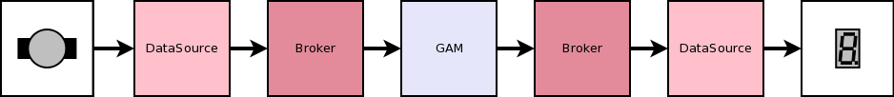
DataSources
Interface between GAMs and the outside world
  Bridge data into/from DDB signals
    Using MARTe high level drivers
Connect to hardware
  ADCs
  DACs
  DIOs
  Networks
  Filesystems
  …

Slide 6
Data-driven components
...
+ThreadStats1Struct = {
Class = IntrospectionStructure
Thread1C = {
Type = uint32
}
Thread1H = {
Type = uint32
NumberOfElements = 10
}
...
+FalconAppStatsStruct = {
Class = IntrospectionStructure
Offpulse = {
Type = ThreadStats1Struct
}
Ready = {
Type = ThreadStats1Struct
}
...
Structured syntax
  Defines common language
  Simple
    Human readable configuration
  Provides built-in validation
  Allows for a clear way of expressing the problem
XML and JSON also supported
Classes are automatically instantiated
Configuration is validated by the created object
Asserting and parsing functions available
Support for user-defined data types
...
+Control = {
Class = ControlGAM
Controller = {
NoPlasmaVelocityGain = 0.0
NoPlasmaCurrentGain = 40.0
IPWaveform = {
Times = {0 120}
Amplitudes = {0.5 0.5}
Rounding = 50
}
...

Slide 7
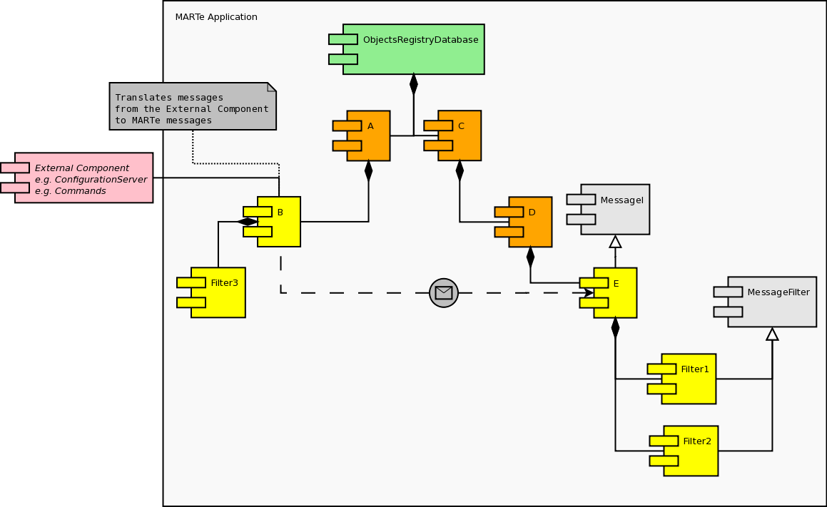
Messages
Change the behaviour of an application based only on configuration data
  i.e. without requiring any code recompilation.
Provide a generic interface between MARTe components and any components and protocols that live outside a MARTe application
  Deployment of applications into new plants without changing code
Typically used for non real-time activities, such as configuration and state management

Slide 8

Interfacing with MARTe
State machine
Logger Server
HTTP Server
MARTe
Any other
Object N
Configuration
provider
Data retrieval
facility

Slide 9
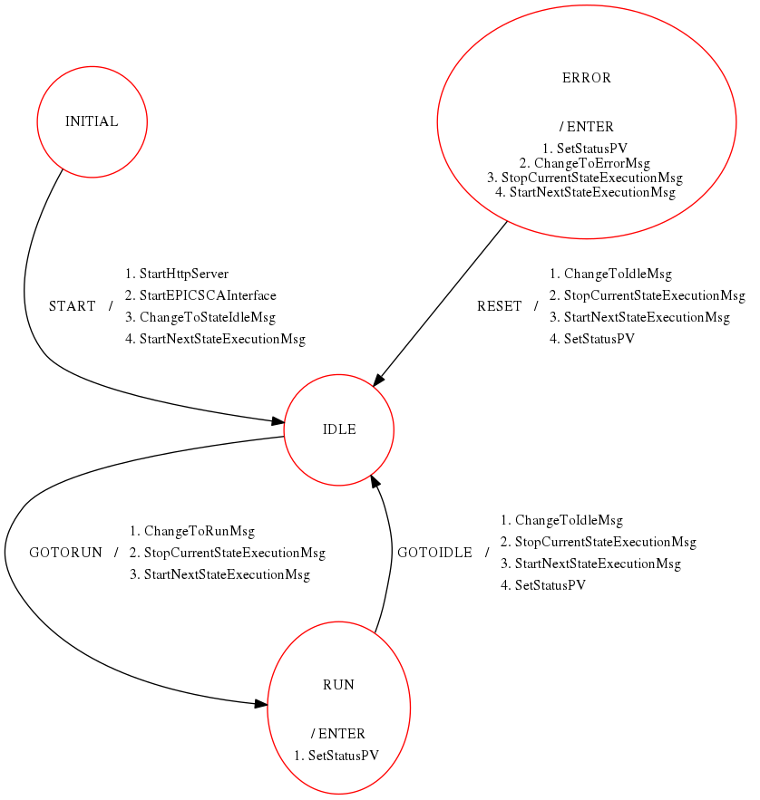
Channel Access - Objectives
Monitoring
  Asynchronously query value of a given set of variables
Commands
  Proxy PV value change into Messages
E.g. change the state-machine state
Input/output data source
  Typically non-real-time
  ITER => SDN for real-time networking

Slide 10


EPICSCA DataSources
Asynchronous w.r.t. to real-time threads
ca_context_create(ca_enable_preemptive_callback) ...
ca_create_channel(&pvs[n].pvName[0], ...
ca_create_subscription(pvs[n].pvType, ...
ca_put(pvs[n].pvType, ...
+EPICSCAInput_1 = {
Class = EPICSCA::EPICSCAInput
StackSize = 1048576
CPUs = 0xff
Signals = {
PV1 = {
PVName = My::PV1
Type = float32
NumberOfElements = 10
}
...
}
}
+EPICSCAOutput_1 = {
Class = EPICSCA::EPICSCAOutput
StackSize = 1048576
CPUs = 0xff
IgnoreBufferOverrun = 1
NumberOfBuffers = 10
Signals = {
PV1 = {
PVName = My::PV1
Type = uint32
}
...
}
}
https://vcis-jenkins.f4e.europa.eu/job/MARTe2-Components-docs-master/doxygen/classMARTe_1_1EPICSCAInput.html
https://vcis-jenkins.f4e.europa.eu/job/MARTe2-Components-docs-master/doxygen/classMARTe_1_1EPICSCAOutput.html

Slide 11
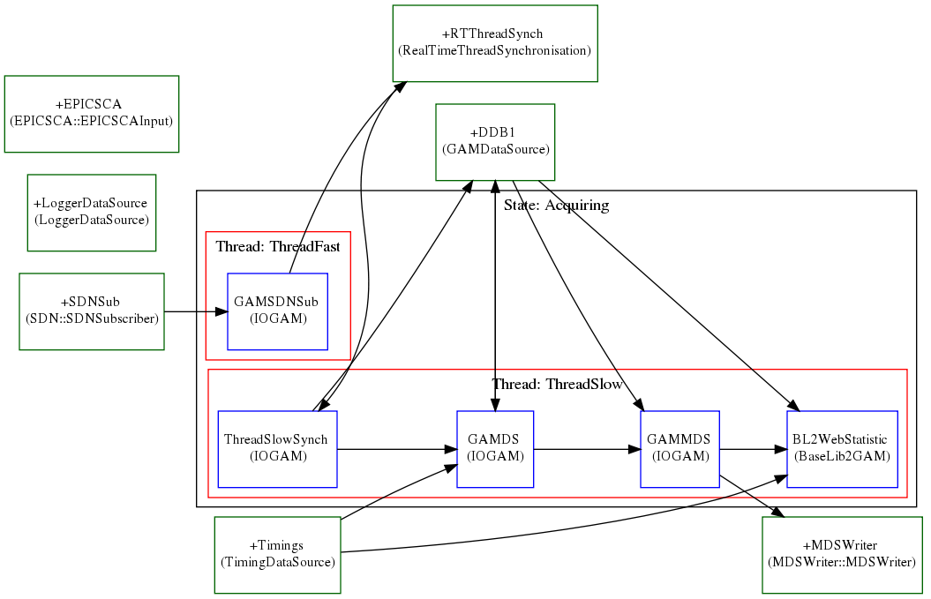
e.g. Falcon PON sampler
Synchronously store the value of all plant PVs based on SDN tick

Slide 12


EPICSCAClient
caput/caget the value of any registered PV
+EPICS_CA = {
Class = EPICS::EPICSCAClient
StackSize = 1048576
CPUs = 0x2
AutoStart = 0
+PV_STATUS = {
Class = EPICS::EPICSPV
PVName = "FDAQ:Fast_Status"
PVType = uint32
}
+PV_COMMAND = {
Class = EPICS::EPICSPV
PVName = "FDAQ:Fast_Status_CMD"
PVType = uint32
Event = {
Destination = StateMachine
PVValue = Function
FunctionMap = {{"1", "MAKEREADY"}, {"0", "GOOFFPULSE"}}
+StateMachine = {
Class = StateMachine
...
+ONLINE = {
Class = ReferenceContainer
+ENTER = {
Class = ReferenceContainer
+SetStatusPV = {
Class = Message
Destination = "EPICS_CA.PV_STATUS"
Function = CAPut
+Parameters = {
Class = ConfigurationDatabase
param1 = 1
}
}
}
+StartNextStateExecutionMsg = {
...
https://vcis-jenkins.f4e.europa.eu/job/MARTe2-Components-docs-master/doxygen/classMARTe_1_1EPICSPV.html
https://vcis-jenkins.f4e.europa.eu/job/MARTe2-Components-docs-master/doxygen/classMARTe_1_1EPICSCAClient.html

Slide 13
pvAccess - Objectives
Monitoring
  Asynchronously query value of a given set of (structured) variables
PV Database
(RPC) Messages
  Commands
  Configuration changes
Input/output data source
  Typically non-real-time
  ITER => SDN for real-time networking

Slide 14

PVAStructuredDataI
Wraps StructuredDataI as a PVStructure
  Allows to use PVStructures directly with any MARTe components
Can be used to e.g.
  Serialise/deserialise MARTe over the network
  Bootstrap MARTe applications from a PVStructture
Perfect match with MARTe structured types
  Navigation of arrays of structures were difficult to implement
bool MARTe::Object::Initialise(StructuredDataI &data)
EPICSPVAStructureDataI test;
test.InitStructure();
bool ok = test.CreateAbsolute("R");
ok &= test.CreateAbsolute("R.A");
ok &= test.CreateAbsolute("R.A.C[0]");
ok &= test.Write("a", 0);
ok &= test.CreateAbsolute("R.A.C[1]");
ok &= test.Write("a", 0);
ok &= test.CreateAbsolute("R.B");
ok &= test.Write(“d", 1.0);
structure R
structure A
structure[] C
structure
int a
structure B
float d
...
virtual bool Initialise(MARTe::StructuredDataI &data) {
bool ok = Object::Initialise(data);
if (ok) {
ok = data.MoveAbsolute(“R.A.C[0]”);
if (ok) {
ok = data.Read(“a", gain1);
...
https://vcis-jenkins.f4e.europa.eu/job/MARTe2-Components-docs-master/doxygen/classMARTe_1_1EPICSPVAStructureDataI.html

Slide 15

PVA Database
EPICSPVARecord server.
+EPICSPVADB = {
Class = EPICSPVA::EPICSPVADatabase
StackSize = 1048576
CPUs = 0x2
AutoStart = 0
+FalconFastControllerStatistics = {
Class = EPICSPVA::EPICSPVARecord
Alias = "Falcon:Fast:Statistics"
Structure = {
value = {//name for pvget
Type = FalconAppStatsStruct
}
}
...
...
+ThreadStats1Struct = {
Class = IntrospectionStructure
Thread1C = {
Type = uint32
}
Thread1H = {
Type = uint32
NumberOfElements = 10
}
...
+FalconAppStatsStruct = {
Class = IntrospectionStructure
Offpulse = {
Type = ThreadStats1Struct
}
Ready = {
Type = ThreadStats1Struct
}
...
[netoa@next-4 Configurations]$ pvget Falcon:Fast:Statistics
Falcon:Fast:Statistics structure
FalconAppStatsStruct value
ThreadStats1Struct Offpulse
uint Thread1C 1447
uint[] Thread1H [0,0,0,0,0,0,0,0,0,37628]
uint Thread2C 0
uint[] Thread2H [37628,0,0,0,0,0,0,0,0,0]
ThreadStats1Struct Ready
uint Thread1C 0
uint[] Thread1H [37628,0,0,0,0,0,0,0,0,0]
…
https://vcis-jenkins.f4e.europa.eu/job/MARTe2-Components-docs-master/doxygen/classMARTe_1_1EPICSPVADatabase.html

Slide 16


PVADataSource
As EPICSCA DataSources but with structured data
+EPICSPVAInput_1 = {
Class = EPICSPVADataSource::EPICSPVAInput
StackSize = 1048576
CPUs = 0xff
Signals = {
RecordIn1Value = {//Record name if no Alias
Alias = "alternative::channel::name"
Field = "value" //If not set "value" is assumed
Type = MyStruct1
}
RecordIn2 = {
Field = "test"
Type = uint32
...
+AGAM = {
Class = MyGAM1
InputSignals = {
MySignal1 = {
DataSource = EPICSPVAInput_1
Alias = "RecordIn1Value.A.B"
Type = float32
}
RecordIn2 = {
DataSource = EPICSPVAInput_1
}
…
https://vcis-jenkins.f4e.europa.eu/job/MARTe2-Components-docs-master/doxygen/classMARTe_1_1EPICSPVAInput.html
https://vcis-jenkins.f4e.europa.eu/job/MARTe2-Components-docs-master/doxygen/classMARTe_1_1EPICSPVAOutput.html

Slide 17
e.g. protocol proxy
EPICS CA to PVA
EPICS PVA to CA
EPICS PVA to OPCUA
OPCUA to EPICSPVA
…
+EPICSPVAInput_1 = {
Class = EPICSPVADataSource::EPICSPVAInput
StackSize = 1048576
CPUs = 0xff
Signals = {
RecordIn1Value = {//Record name if no Alias
Alias = "alternative::channel::name"
Field = "value" //If not set "value" is assumed
Type = MyStruct1
}
...
+OPCUAOut_1 = {
Class = OPCUADataSource::OPCUADSOutput
Address = "opc.tcp://localhost.localdomain:4840"
Signals = {
RecordIn1Value = {
NamespaceIndex = 1
Path = "value"
Type = MyStruct1
}
...

Slide 18


EPICSRPCClient & EPICSRPCServer
Relay messages
  EPICSPVAStructuredDataI serializes messages as PVStructures
  Structure sent using an epics::pvAccess::RPCClient
Can be used to e.g.
  Command a remote application
  Key component in SUP demo
Container of MARTe Objects that implement the epics::pvAccess::RPCService interface
Can be used to e.g.
  Reconfigure an application based on a PVStructure
  Query the current configuration as a PVStructure
  Send messages to a running application
https://vcis-jenkins.f4e.europa.eu/job/MARTe2-Components-docs-master/doxygen/classMARTe_1_1EPICSRPCServer.html
https://vcis-jenkins.f4e.europa.eu/job/MARTe2-Components-docs-master/doxygen/classMARTe_1_1EPICSRPCClient.html

Slide 19
Conclusions & lessons learned
CA & PVA data sources and interfaces integrated in the MARTe official release
  Fully tested (coverage > 90 %)
  Static code analysis
  Documentation
Components are already deployed in operational plants
  Everything very stable once deployed
Structures are extremely useful and key to the design of complex/scientific ITER plant systems
Concerns about the PVA API
  Not always clear what are the best practices to implement a given functionality
  Arrays of structures were painful to implement

Slide 20





Thank you for your attention
Follow us on:
www.f4e.europa.eu
www.twitter.com/fusionforenergy
www.youtube.com/fusionforenergy
www.linkedin.com/company/fusion-for-energy www.flickr.com/photos/fusionforenergy

Slide 21
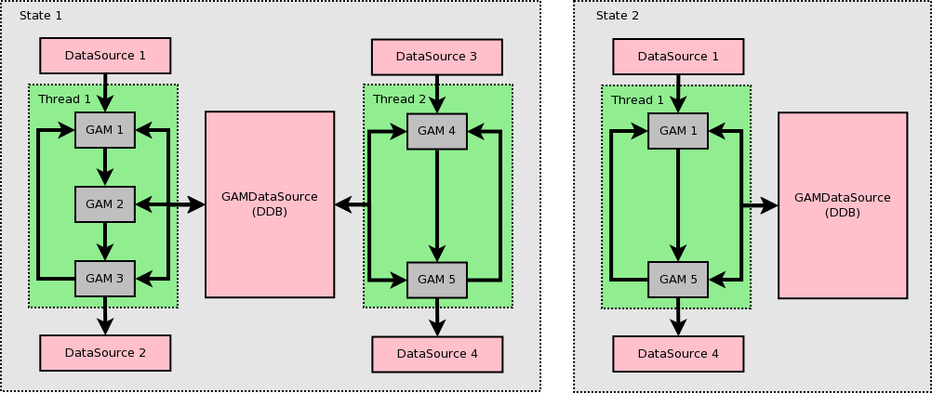
GAMDataSource (aka DDB)
GAMs share data through a memory bus
MARTe guarantees coherency between requested and produced signals
Set of GAMs allow to stream data to different MARTe systems
  Distributed control systems

Slide 22
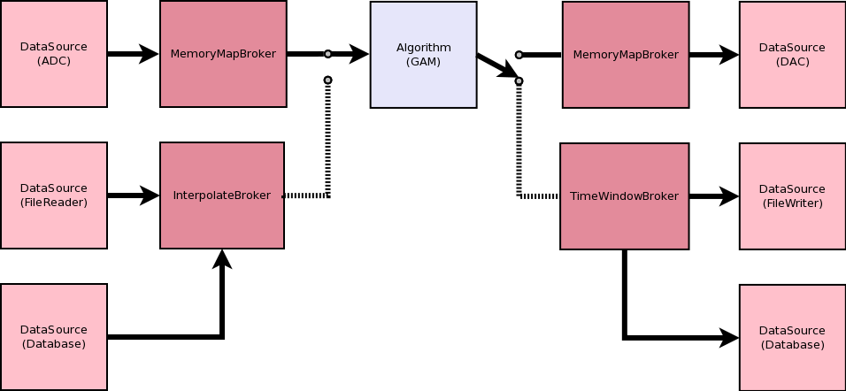
Brokers
Interface between the GAMs memory and the DataSource hardware data (typically memory).
Broker selected by DataSource based on GAM requirements (e.g. time base period)

Slide 23
Source code ptrs
https://vcis-gitlab.f4e.europa.eu/aneto/MARTe2-components/blob/master/Source/Components/Interfaces/EPICSPVA/EPICSPVAStructureDataI.cpp
https://vcis-gitlab.f4e.europa.eu/aneto/MARTe2-components/blob/master/Source/Components/Interfaces/EPICSPVA/EPICSPVAHelper.cpp
https://vcis-gitlab.f4e.europa.eu/aneto/MARTe2-components/blob/master/Source/Components/Interfaces/EPICSPVA/EPICSRPCClientMessageFilter.cpp
https://vcis-gitlab.f4e.europa.eu/aneto/MARTe2-components/blob/master/Source/Components/DataSources/EPICSPVA/EPICSPVAInput.cpp
https://vcis-gitlab.f4e.europa.eu/aneto/MARTe2-components/blob/master/Source/Components/DataSources/EPICSPVA/EPICSPVAOutput.cpp
https://vcis-gitlab.f4e.europa.eu/aneto/MARTe2-components/blob/master/Source/Components/Interfaces/EPICSPVA/EPICSRPCServer.cpp
https://vcis-gitlab.f4e.europa.eu/aneto/MARTe2-components/blob/master/Source/Components/Interfaces/EPICSPVA/EPICSPVADatabase.cpp
https://vcis-gitlab.f4e.europa.eu/aneto/MARTe2-components/blob/master/Source/Components/Interfaces/EPICS/EPICSPV.cpp
https://vcis-gitlab.f4e.europa.eu/aneto/MARTe2-components/blob/master/Source/Components/Interfaces/EPICS/EPICSCAClient.cpp
https://vcis-gitlab.f4e.europa.eu/aneto/MARTe2-components/blob/master/Source/Components/DataSources/EPICSCA/EPICSCAInput.cpp
https://vcis-gitlab.f4e.europa.eu/aneto/MARTe2-components/blob/master/Source/Components/DataSources/EPICSCA/EPICSCAOutput.cpp

Slide 24
And the numbers are…
Item | Lines of code
Core | 47 k
Core (test) | 138 k
Official components | 28 k
Official components (test) | 122 k
For every unit of development expect:
  ~4.5x of QA
  ~0.3x of QA review
For every new release expect:
  1 day of QA

