Slide 1

PV’s and Google Home
Propogating PV’s with Free Web Tools to a Smart Home Device
Gillian Black
Canadian Light Source
Notes:
Look at the audience

Slide 2
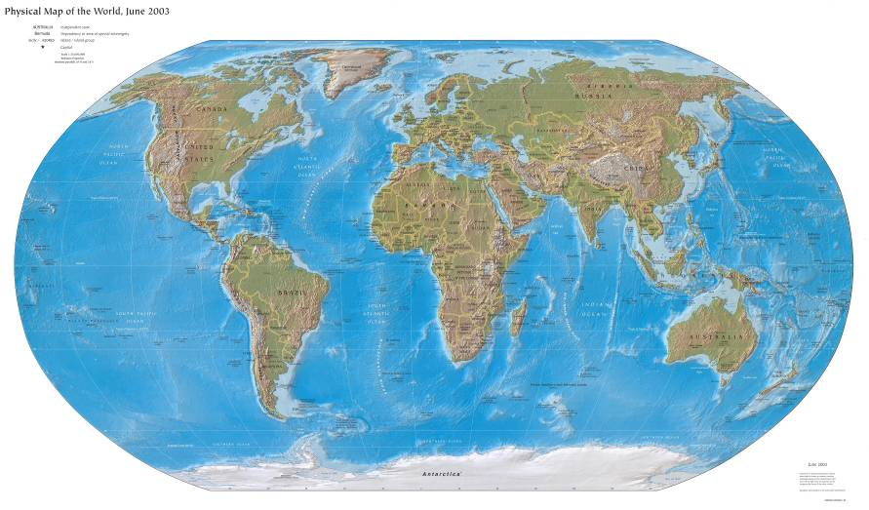

Synchrotrons Around the World
Canadian Light Source
Synchrotrons currently in operation
Synchrotrons under construction or in planning phase
Notes:
The only synchrotron in Canada

Slide 3
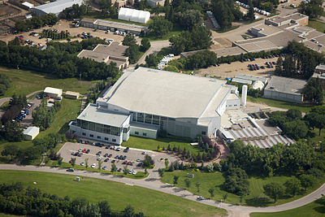
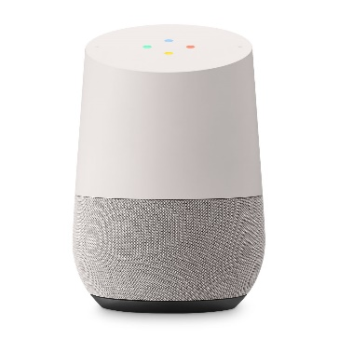
Google Home
Canadian Light Source
Notes:
Ostensible Reason:
Sometimes when the beam goes down it trips the Far IR spectrometer and scanning stops.
At the time the Far IR staff scientist did not own a cell phone.
Actual Reason: because I wanted to see if I could

Slide 4
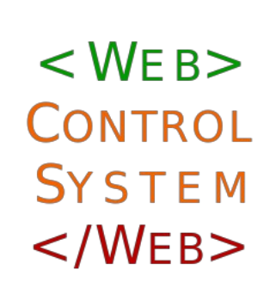
Problem #1: Get the Information Out of the Building
Notes:
Service developed by Dylan Maxwell for monitoring the EPICS Distributed Control System.

Slide 5
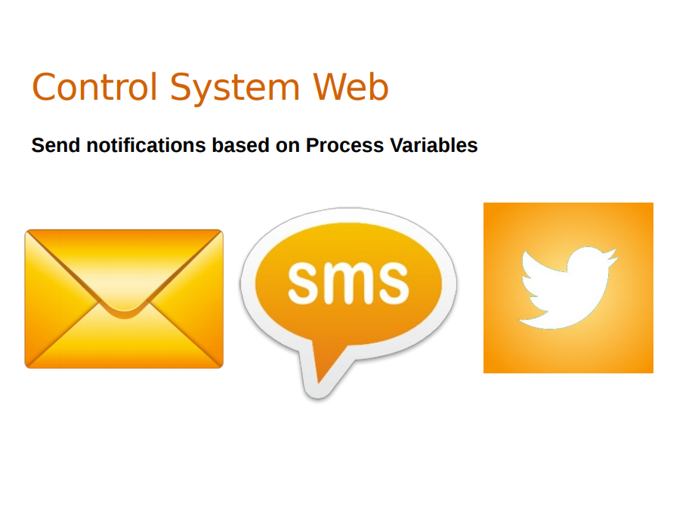

Slide 6
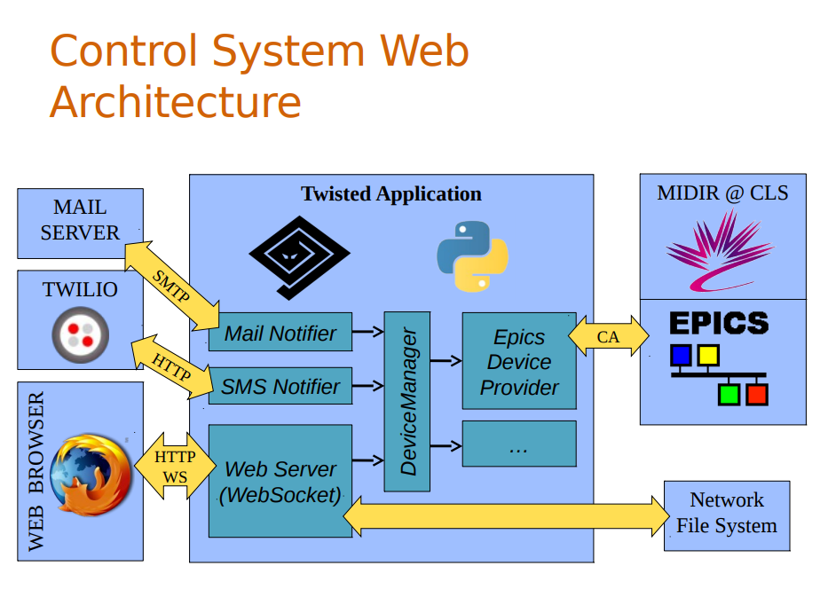
Notes:
So, what does the PV monitor look like?

Slide 7
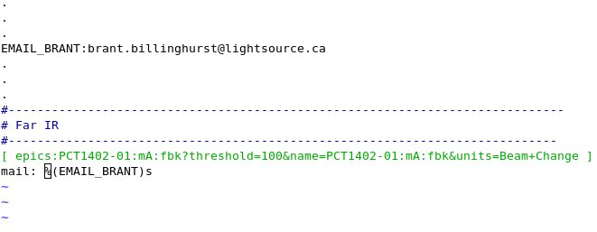
Config File for Control System Web
Notes:
In practical terms this means you just need to add three lines to a config file, which CSWeb will pick up automatically.

Slide 8

Problem #2: Get Google Home to Speak the Contents of the Email
Notes:
A visual tool for connecting hardware, APIs and online services part of the Internet of Things.
Node-RED is a flow-based programming tool, originally developed by IBM’s Emerging Technology Services team and now a part of the JS Foundation.
It’s a visual tool for connecting hardware, APIs and online services part of the Internet of Things.
Node-RED consists of a Node.js-based runtime that you point a web browser at to access the flow editor. Within the browser you create your application by dragging nodes from your palette into a workspace and start to wire them together. With a single click, the application is deployed back to the runtime where it is run.
Node.js is an opensource javascript runtime environment that lets you run javascript outside of a browser.

Slide 9
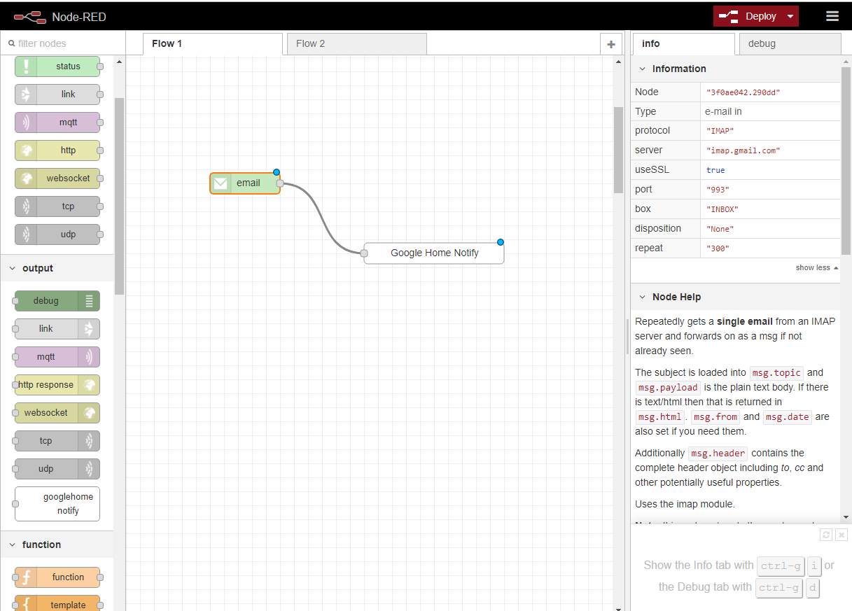

Slide 10
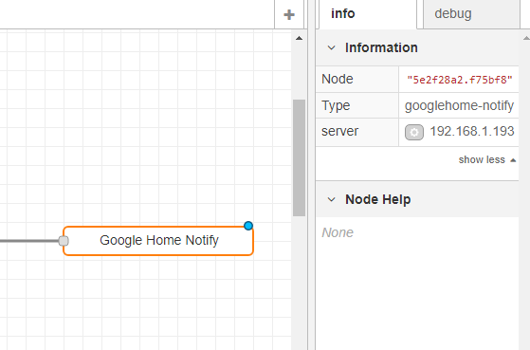

Slide 11
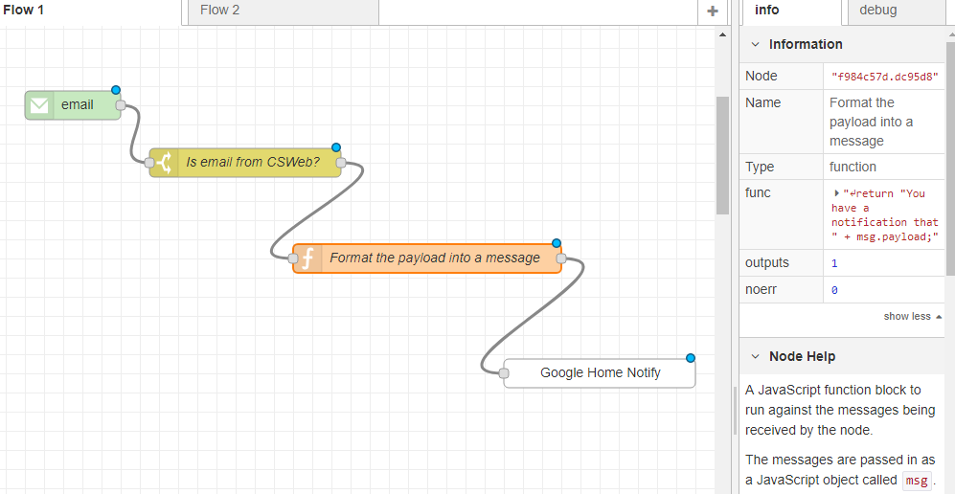

Slide 12
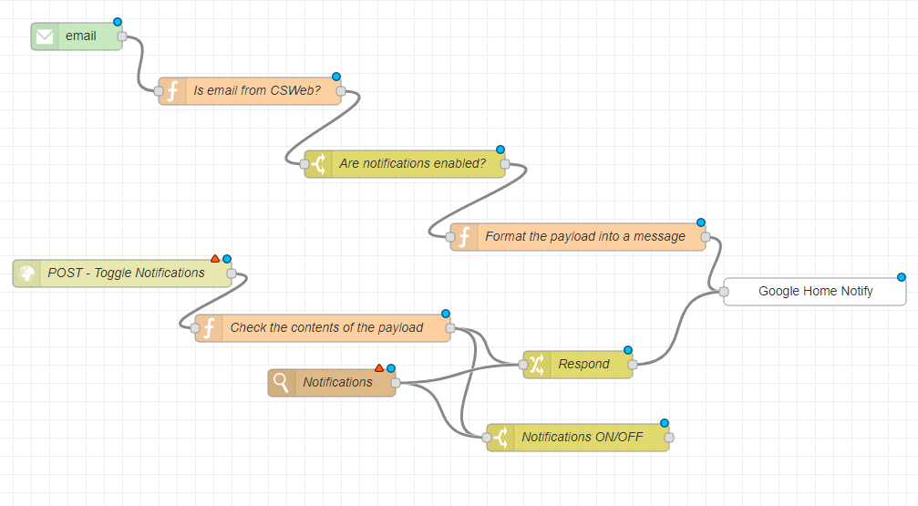
Problem #3: Turn Notifications on and Off

Slide 13
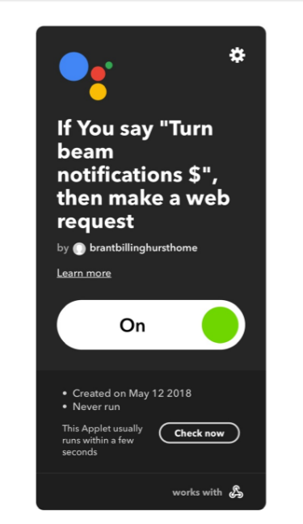

Problem #4: Pass the POST Request to Node-RED
Notes:
IFTTT is a free web-based service to create chains of simple conditional statements, called applets. An applet is triggered by changes that occur within other web services such as Gmail, Facebook, Telegram, Instagram, or Pinterest.

Slide 14
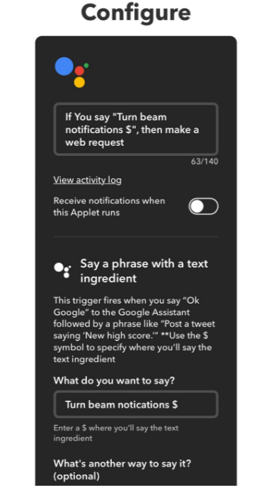
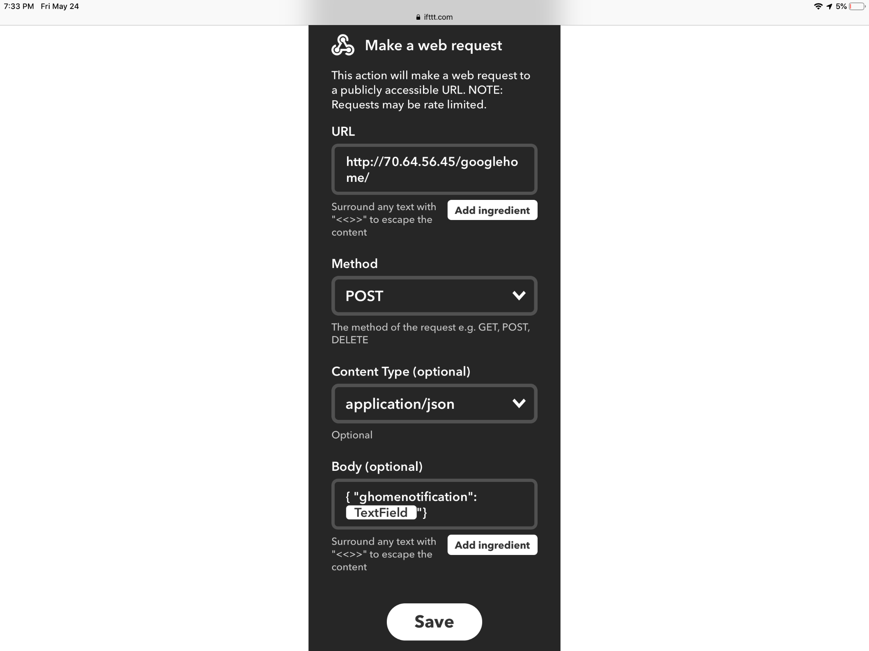

Slide 15





Flowchart
Changes in PV’s
Control System Web
Beam has gone down.
Hey Google, please allow beam notifications

Slide 16
Thank you!

Slide 17








Operating Funding Partners

