Slide 1
Monitoring EPICS Beacons
Michael Bree
Canadian Light Source
June 2019 EPICS Collaboration Meeting

Slide 2
IOC
APP
A
> 1200 Apps
IOC
APP
B
IOC
APP
B
IOC
APP
C
IOC
APP
C
~ 400 Hosts
IOC HOST
IOC HOST
IOC HOST

Slide 3
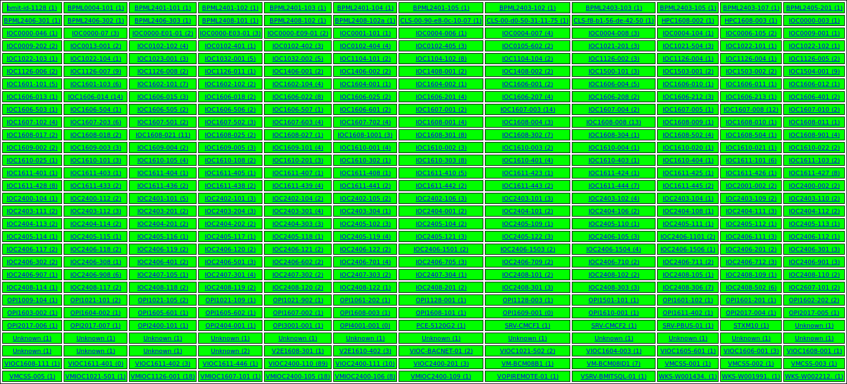

Slide 4
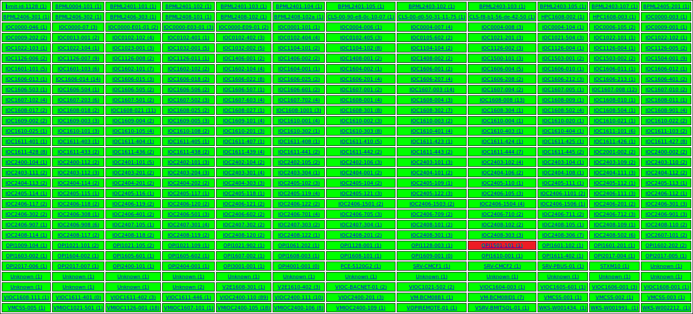

Slide 5
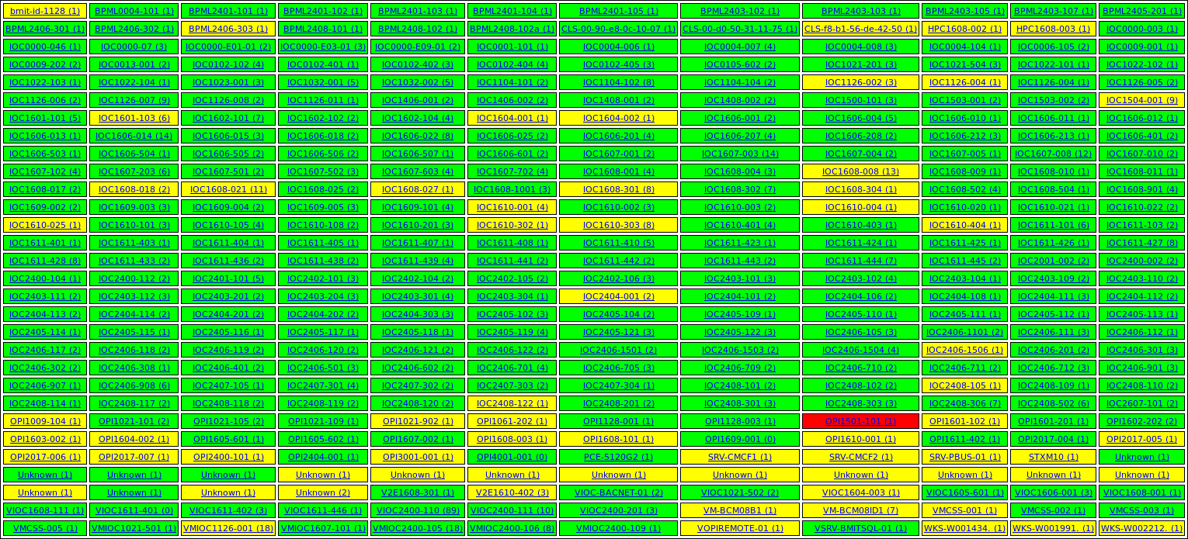

Slide 6
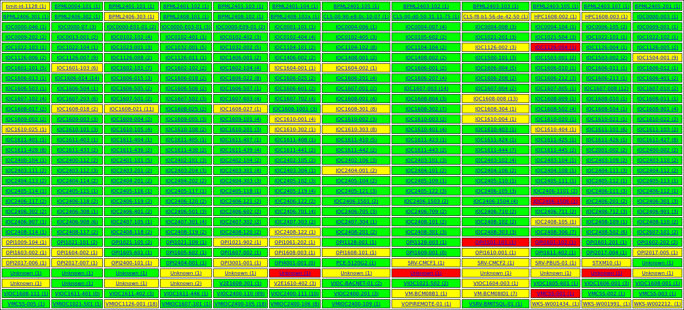

Slide 7
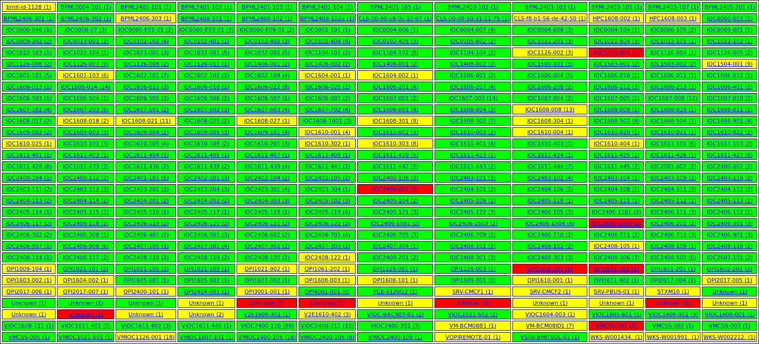

Slide 8
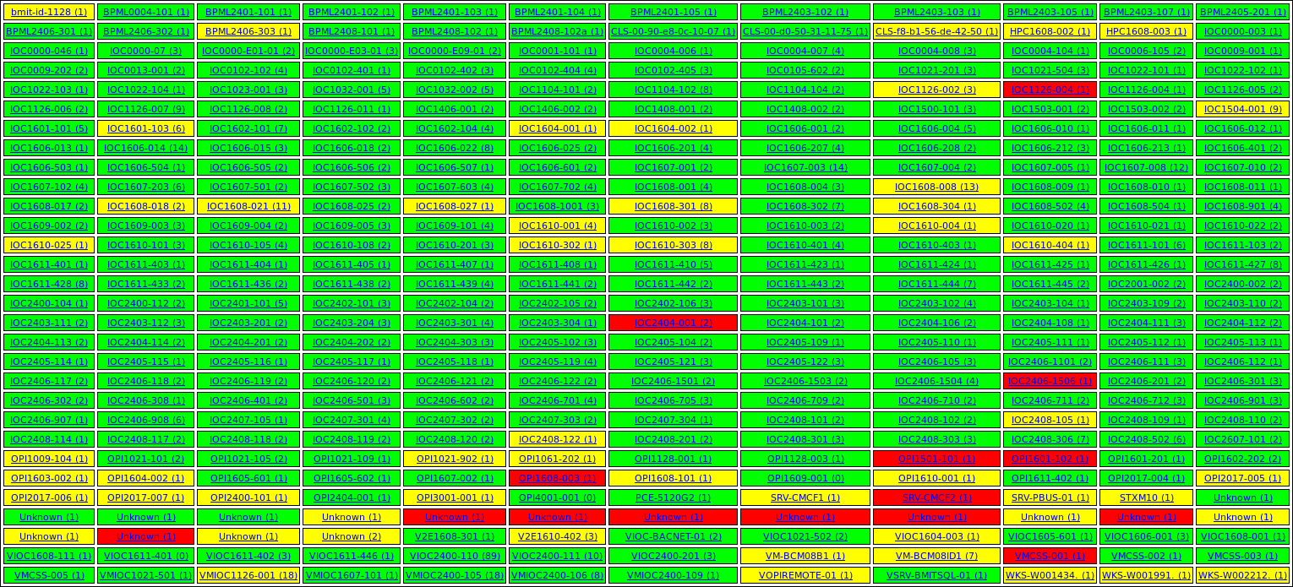

Slide 9
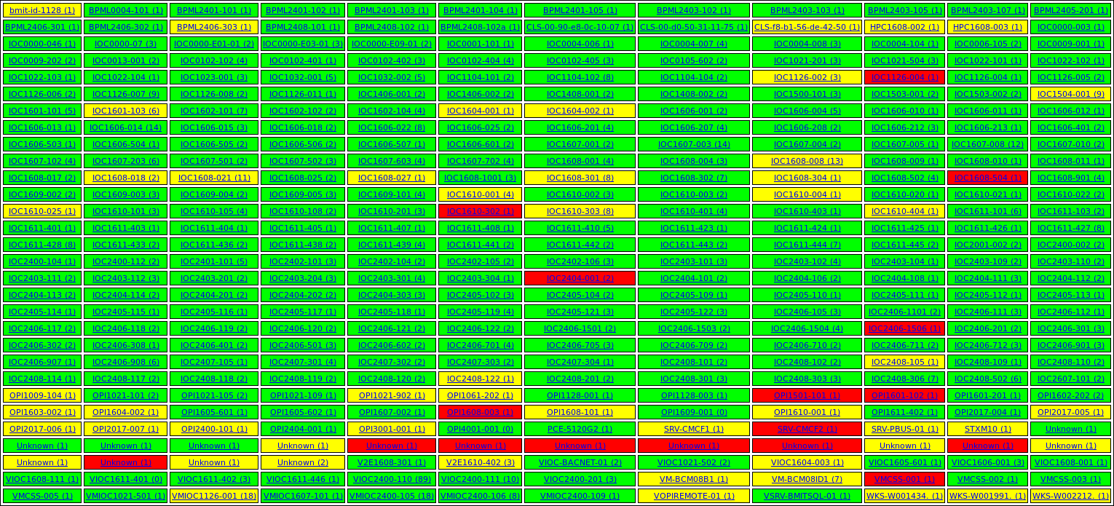

Slide 10
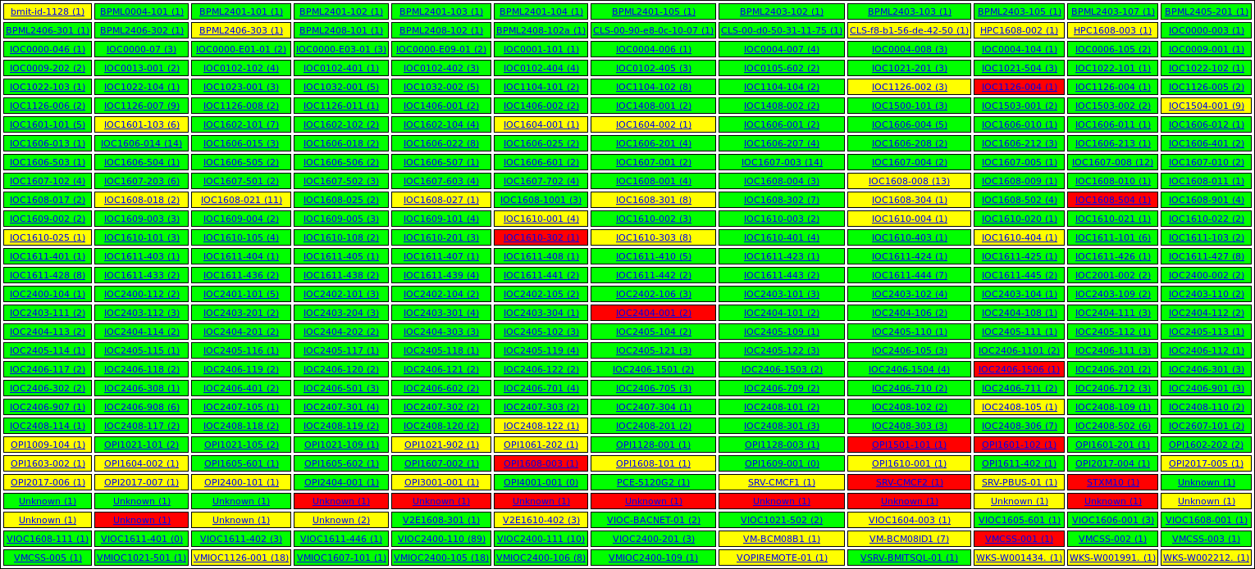

Slide 11
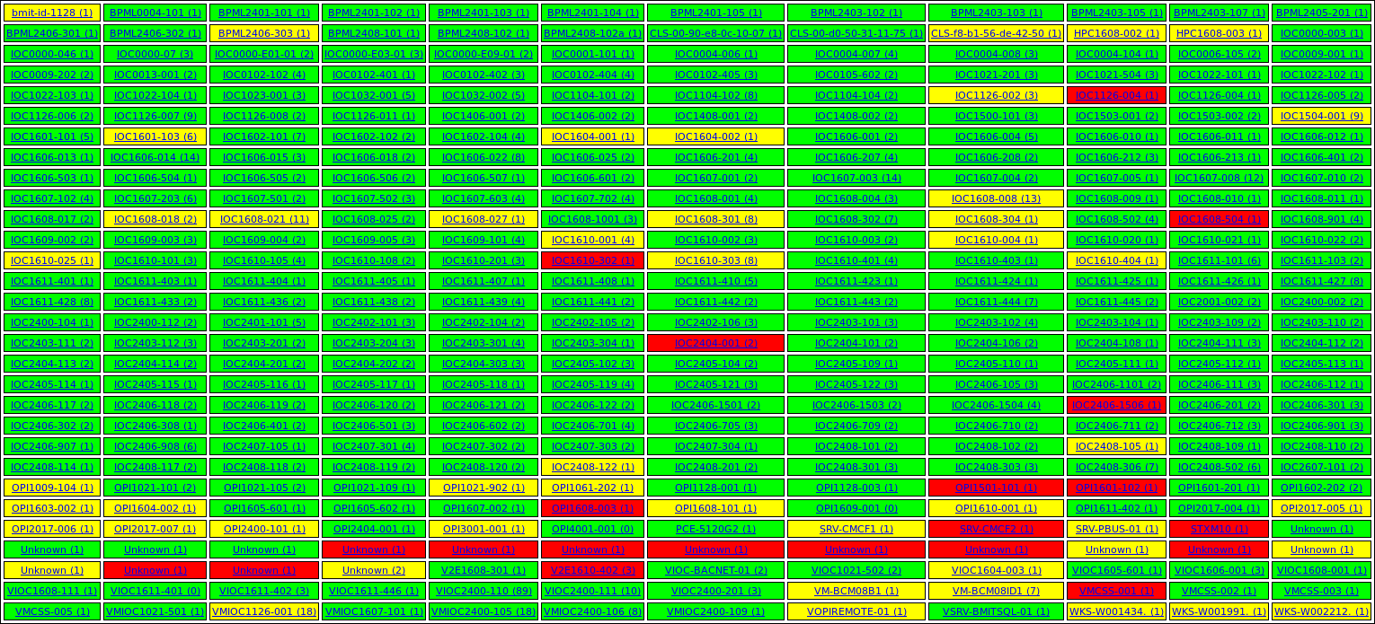

Slide 12
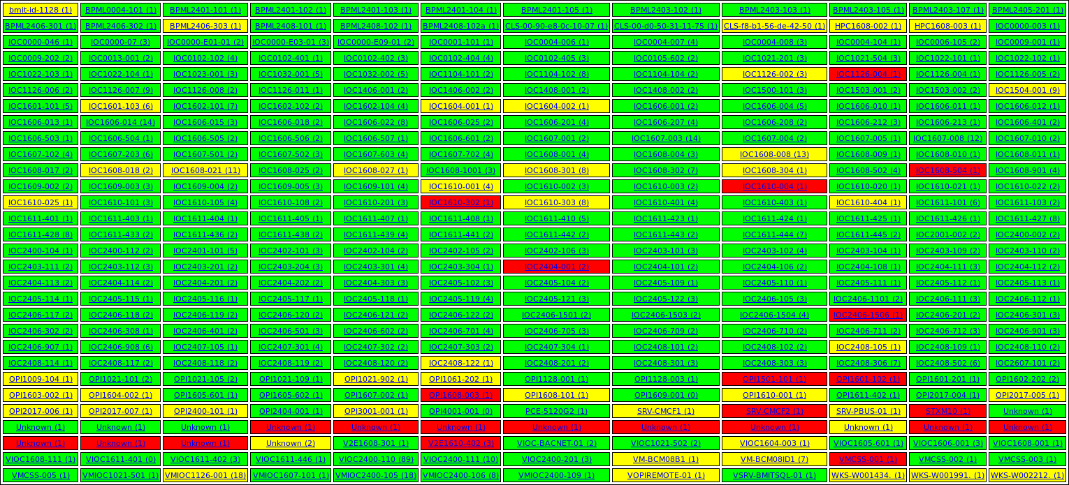

Slide 14
What is the Problem?

Slide 17
Classic Chicken & Egg
Messy because users* ignore it
Users* ignore it because it’s messy
* includes me

Slide 18
Partial Solution
Strict policy – fix immediately

Slide 21
Partial Solution
Strict policy – fix immediately
Display prominently – Control Room*
* can’t… it’s to messy

Slide 22
Real Problem
If users won’t use the tool,
the problem is with the tool,
not the users

Slide 23
IOC
APP
A
Ambiguous
Beacons
IOC
APP
B
IOC
APP
C
IOC HOST
IOC HOST
IOC HOST
IOC HOST
IOC HOST
IOCAPP

Slide 24
Ambiguous Beacons
Can’t distinguish between:
Restarts and lost beacons
New and moved beacons
Critical apps and temporary apps

Slide 25
Key
A
EPICS Heartbeat
Enhanced Beacon
Key = CWD + CMDLINE (/proc)
IOC HOST
heartbeat();
Legacy!! < 40% deployment
Key
B

Slide 26
LinuxMonitor
Based on PCMON (PSI)
IOC App runs on (almost) all IOC Hosts
Returns IOC host status PVs
One image – restart deploys updates

Slide 27
LinuxMonitor (Enhanced)
UDP Query:
Client: Send IOC App beacon port
LinuxMon: IOC App PID from port (/proc)
Key
A
LinuxMon: Key = CWD + CMDLINE (/proc)
LinuxMon: Return Key

Slide 28
IOC
APP
A
IOC
APP
B
LinuxMonitor
Enhanced
IOC
APP
C
IOC HOST

