Slide 1

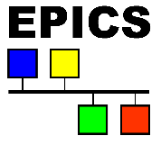

Pilar Gil, A. Miguel López (1)
Collaborators: Iván Moya, Antti Jokinen (2)
Álvaro Marqueta (3)
(1 Seven Solutions, 2 Fusion for Energy 3 ITER)

Slide 2
General overview of LIPAc
General overview of White Rabbit
LIPAc and Interlocks
Historical Interlocks
Future Developments
Disclaimer: The present work has been performed in the framework of the LIPAc project through the Broader Approach Agreement. The content of this presentation has been carried out under the on-going framework contract F4E-OFC-0935 between F4E and Seven Solutions.
Views and opinions expressed herein do not necessarily reflect those of Fusion for Energy or the involved Parties.

Slide 3
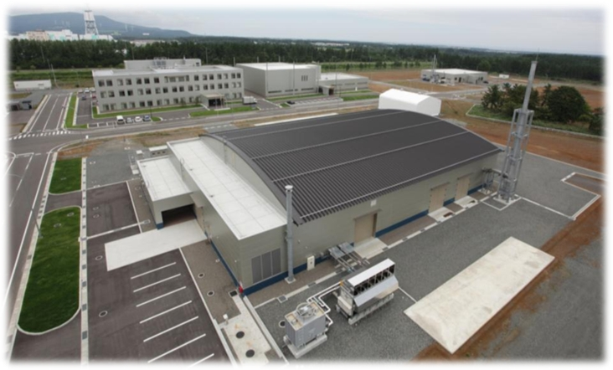
1. General overview of LIPAc
LIPAc ( Linear IFMIF Particle Accelerator )
International Fusion Materials Irradiation Facility
Rokkasho, Aomori, Japan
★
Notes:
LIPAc is one of the pieces of the IFMIF/EVEDA project. This facility is located in a remote place, almost in the middle of nowhere in the Aomori prefecture in Japan. I don’t want to extend too much this introduction since my colleague Antti Jokinen explained this yesterday on his presentation about the LIPAc status, but just in case I think is necessary put this into perspective to understand the aim of this presentation.
LIPAc, is a linear accelerator composed of this elements showed in the image. Up to now, in the current phase, the project has been commissioned until the diagnostic plate located between the RFQ and the SRF module, and with a low power beam dump. But, one of the most important parts of the line, the RFQ, is, at this point accelerating protons and deuterons to the low power beam dump.

Slide 4
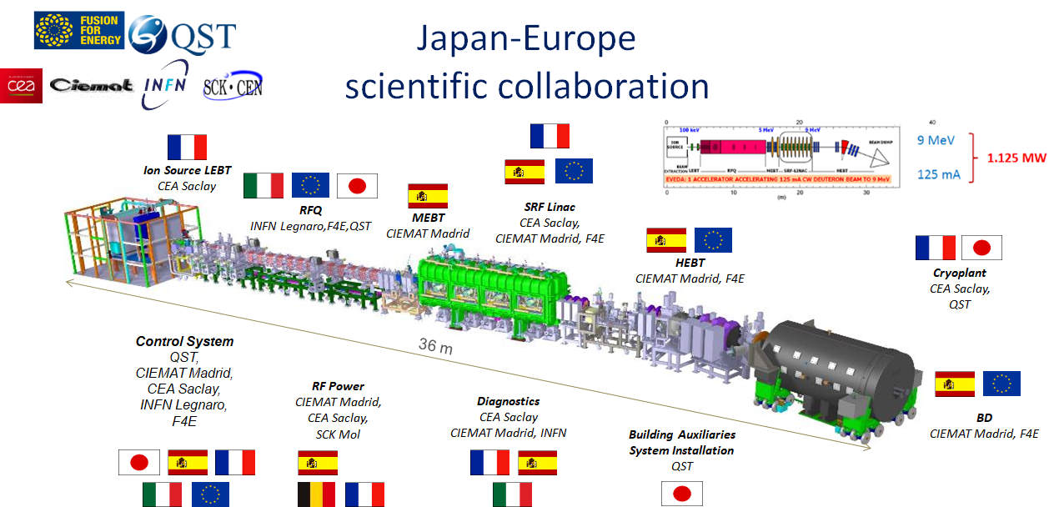
1. General overview of LIPAc
Notes:
LIPAc is one of the pieces of the IFMIF/EVEDA project. This facility is located in a remote place, almost in the middle of nowhere in the Aomori prefecture in Japan. I don’t want to extend too much this introduction since my colleague Antti Jokinen explained this yesterday on his presentation about the LIPAc status, but just in case I think is necessary put this into perspective to understand the aim of this presentation.
LIPAc, is a linear accelerator composed of this elements showed in the image. Up to now, in the current phase, the project has been commissioned until the diagnostic plate located between the RFQ and the SRF module, and with a low power beam dump. But, one of the most important parts of the line, the RFQ, is, at this point accelerating protons and deuterons to the low power beam dump.

Slide 5
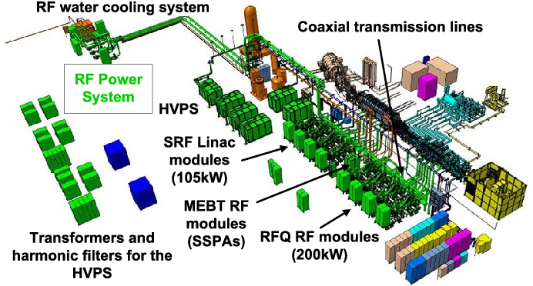
1. General overview of LIPAc
8x RF Chains for the RFQ Cavity, controlled by 4 LLRF (1 Master + 7 Slaves)
2x RF Chains for 2 independent Buncher Cavities, controlled by 1 LLRF

Slide 6
General overview of LIPAc
General overview of White Rabbit
LIPAc and Interlocks
Historical Interlocks
Future Developments

Slide 7

2. General overview of White Rabbit
White Rabbit?…An extension of Ethernet.
It was born at CERN for time and frequency dissemination up to 1000 nodes
Ultra-synchronization: Sync-E & PTP (IEEE-1588v2)
  Sub-nanosecond time accuracy
  Clock RMS jitter ~2 ps (1Hz – 1MHz)
Accurate timestamps
Thousand of nodes: compatible with standard Eth. nodes
Distance range over 80 km
Robustness & redundancy
Self-calibration over long distances
Notes:
Seven Solutions has developed the White Rabbit technology to bring sub-nanosecond time precision in close collaboration with the European Organization for Nuclear Research located near Geneva and other scientific and industrial instrumentation.

Slide 8
2. General overview of White Rabbit
White Rabbit in LIPAc
First Low Level RF based on White Rabbit
Frequency distribution in different locations with synchronized phase, data logging and fast interlock system
Clock distribution: Sub-nanosecond timestamping through the beam line → Same notion of time in all the modules → Monitoring and post-mortem analysis are correlated between LLRFs

Slide 9
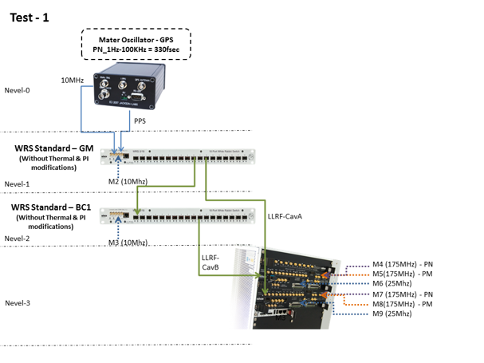
2. General overview of White Rabbit
RF and clock distribution system:

Slide 10
General overview of LIPAc
General overview of White Rabbit
LIPAc and Interlocks
Historical Interlocks
Future Developments

Slide 11
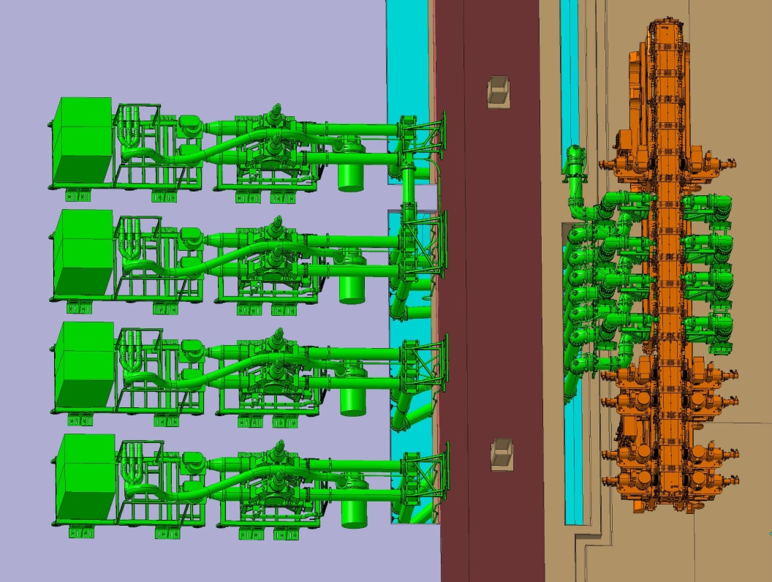
3. LIPAc and Interlocks
RF System for RFQ
RF Area
Vault
LLRF 4
Cav. 4B (Slv)
Cav. 4A (Slv)
LLRF 3
BEAM
Cav. 3B (Slv)
Cav. 3A (Slv)
LLRF 2
Cav. 2B (Slv)
Cav. 2A (Slv)
LLRF 1
Cav. 1B (Slv)
Cav. 1A (Mst)

Slide 12
3. LIPAc and Interlocks
Why WR Based Interlock Correlation?
  In LIPAc there are many dependent RF modules and an interlock situation in one of them usually propagates the interlock to other modules (i.e. Reflected power peaks)
  When a module triggers an interlock is difficult to detect which one has been the first → Difficult to detect where is the problem!!
  Conditioning time reduction!!

Slide 13
General overview of LIPAc
General overview of White Rabbit
LIPAc and Interlocks
Historical Interlocks
Future Developments

Slide 14
4. Historical interlocks
WR and EPICS provide a common sense on time in all the LLRF included in the system → All PVs are correlated!!
EPICS PV and CSS-BOY GUI used for displaying the historical of interlocks
Waveforms are used for saving interlocks and timestamps →
  PV data available for analysis and archiving purposes
Interlock historic data is also used for post-mortem analysis
Provide an easy and visual way to show the sorted interlock occurrence in one or between multiples RF Modules/Chains

Slide 15
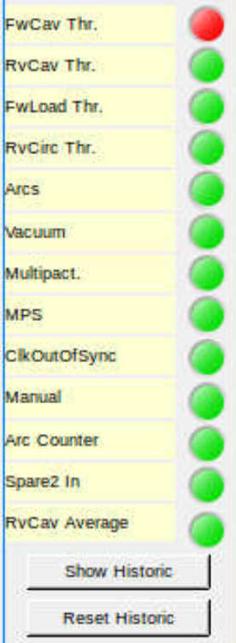
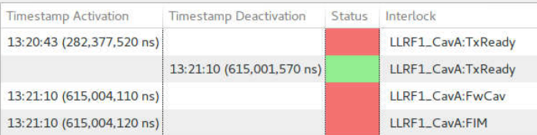
4. Historical interlocks
Individual Historic
Actual interlock status
Detects the occurrence of interlocks with nanosecond precision!!!
Enables the view of the
Historic of interlocks

Slide 16
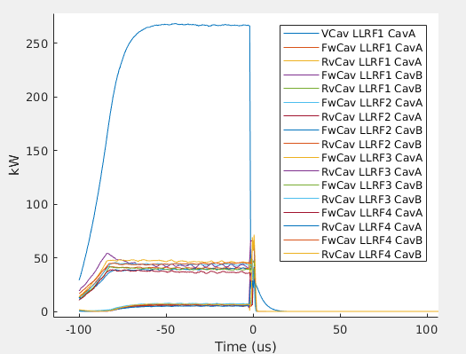
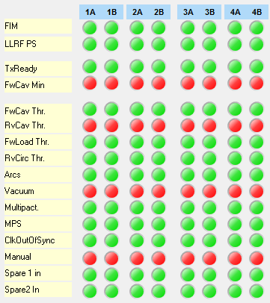
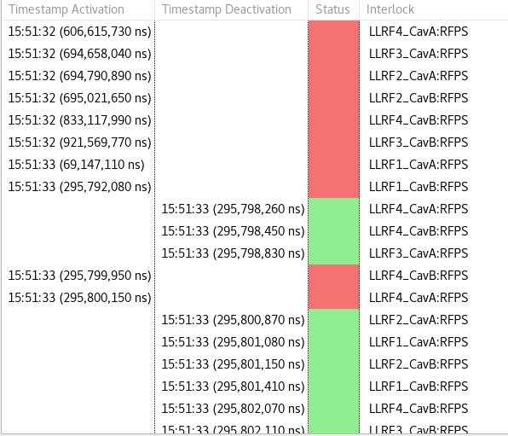
4. Historical interlocks
Easy to detect which Module/Chain has been the first one triggering an interlock
The accuracy provided is better as the one provided in the EPICS PVs timestamp
Data are integrated in the Post-mortem information → Correlated event occurrence

Slide 17
4. Historical interlocks
Results/Improvements in LIPAc
Detection of recurrent problems/misconfigurations in the circulators
Problems detected on the pre-amplifiers
Creation of an statistics database which
Improvement of the LLRFs increasing its robustness

Slide 18
General overview of LIPAc
General overview of White Rabbit
LIPAc and Interlocks
Historical Interlocks
Future Developments

Slide 19
5. Future Developments
Integration of WR time into the PV timestamp instead of using the host time (NTP)
Machine learning for detection of critical points
Server system status warnings using Telegram! → Easy to monitor the alarms in the system from anywhere
Notes:
En vez de decir que no es sufucientemente accuracy, que ser’ia mejor usar el stamping de EPICS.

Slide 20
5. Future Developments
Thanks for your attention!!
Any questions??
Notes:
En vez de decir que no es sufucientemente accuracy, que ser’ia mejor usar el stamping de EPICS.

