Slide 1
Development of Software Frameworks for LLRF Applications based on EPICS
Zheqiao Geng
June 05, 2019
EPICS Collaboration Meeting, ITER

Slide 2
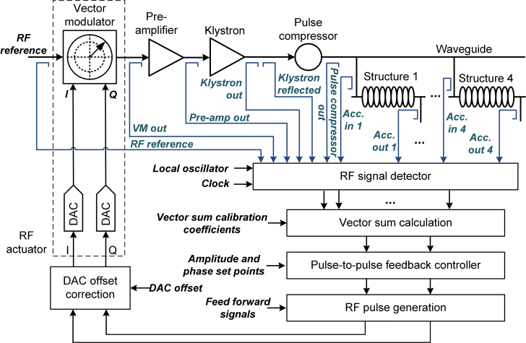
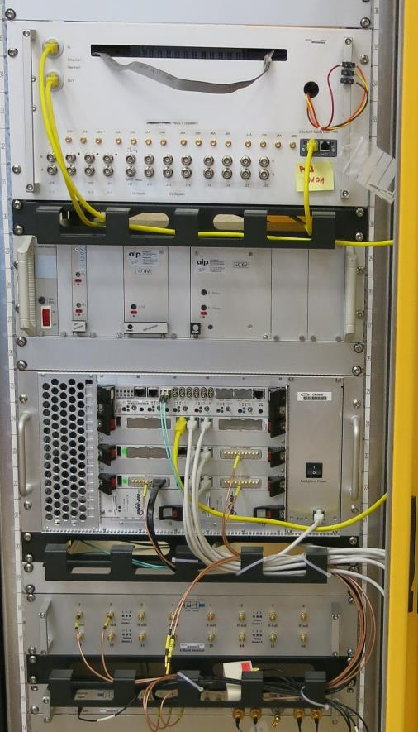
LLRF System and Software Challenges
Interlock Box
Power Supply
VME Crate
Functions of LLRF application software:
RF system setup, calibration and optimization (e.g. set klystron working point, calibrate acc. voltage and beam phase, optimize RF for good stability)
RF control (e.g. feedback, adaptive feed forward)
Automation (e.g. high power RF conditioning, RF station startup, fault recovery, procedure to apply on beam)
Down Converter
LO & Clock Generator
Expected Features of the Software Framework based on EPICS:
Allow developing EPICS software without knowing much about EPICS (e.g. record/device/driver supports)
Easily get or set values of multiple PVs in a function executed by a private thread
Possibly be able to automatically generate EPICS database and other configuration files (e.g. autosave request)
Implement a general architecture which should fit to different applications

Slide 3
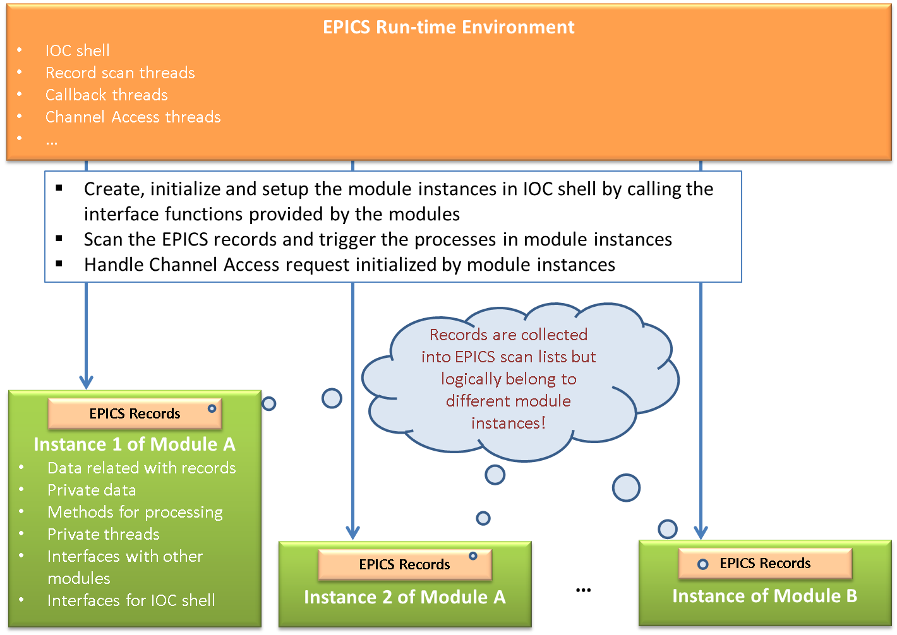
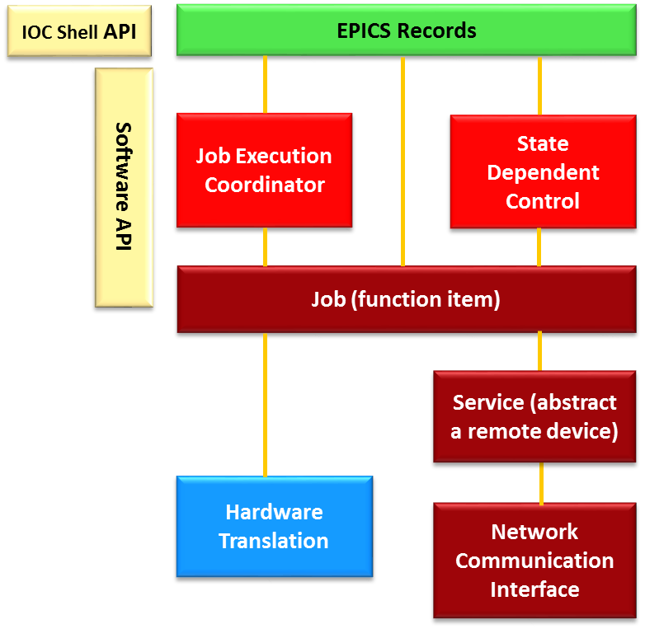
A General Software Architecture
Types of EPICS modules:
Control Device Module (module for control of instrument inserted by the control system designer)
Domain Device Module (module for control of physical device essential for the function of system )
Application Module (implements functions to handle data from domain device modules and perform other middle layer functions)
The user codes can be grouped into modules. A module contains items:
EPICS records to configure the parameters of the module and display the results
Function blocks to process the data and perform logical controls
Maybe a thread to actively do its job
Interfaces with other modules
Interfaces for IOC shell to create, initialize or setup the module instances
Typical architecture of EPICS modules

Slide 4
Base Classes of the Framework
Yellow blocks are base classes

Slide 5
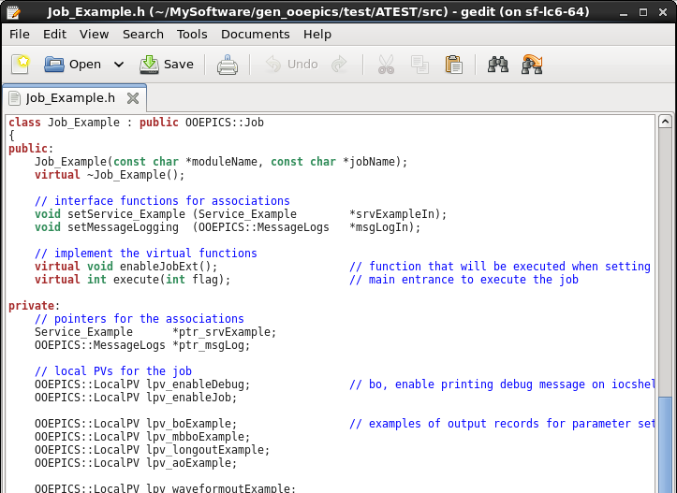
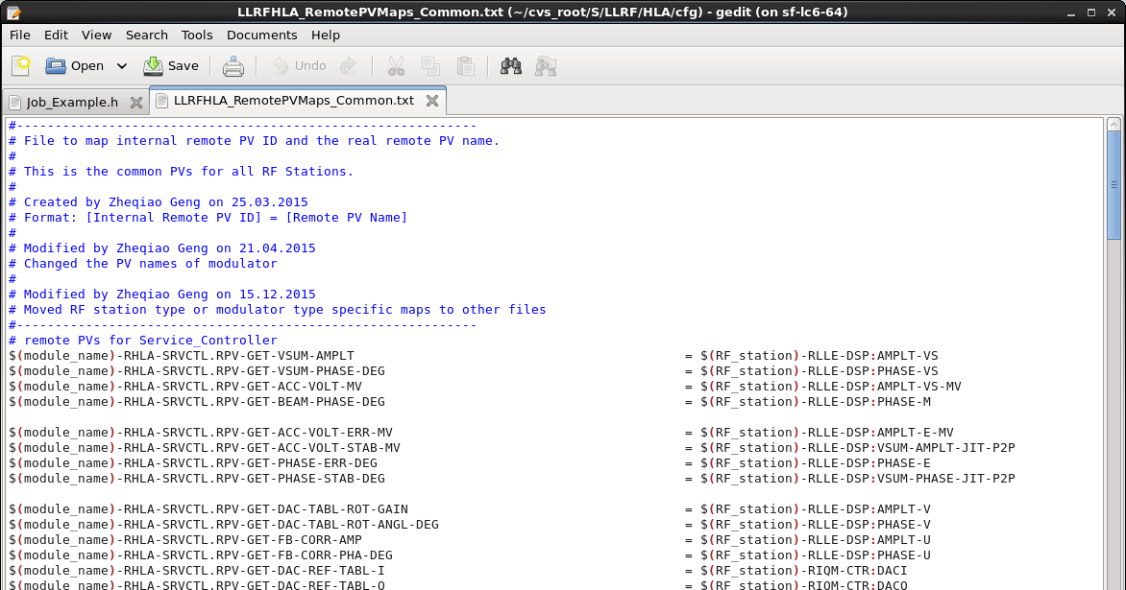
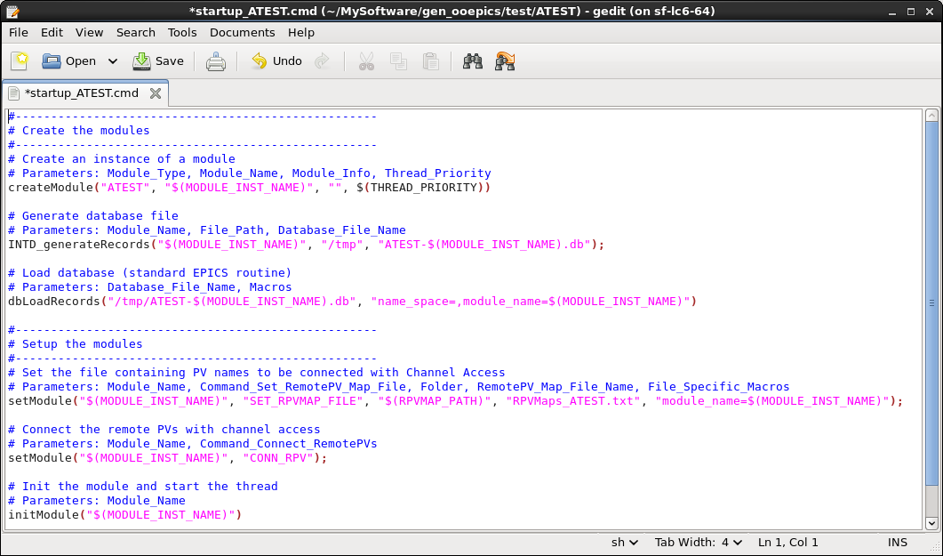
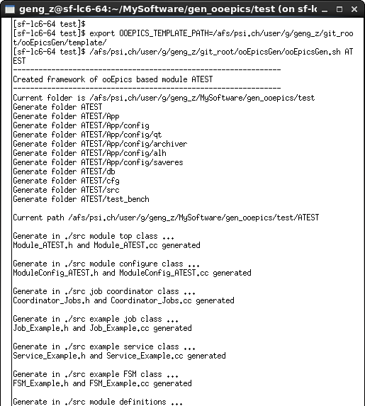
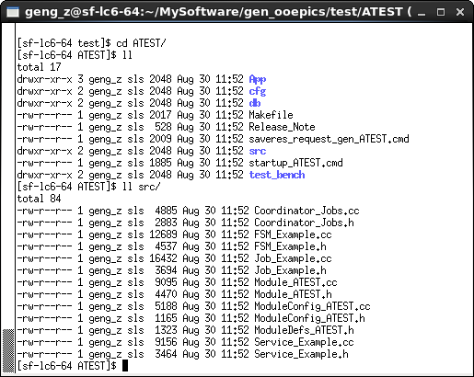
C++ Implementation: ooEpics
Features of ooEpics:
EPICS database can be created by creating objects of LocalPV in user code.
Basic channel access functions (e.g. caget, caput, camonitor, w/o callbacks …) are wrapped by the RemotePV class. The remote channel names can be managed by a configuration file.
Provide base classes to implement finite state machines.
Provide general iocShell functions to create, initialize or setup a module instance.
Template for module skeleton code generation.

Slide 6
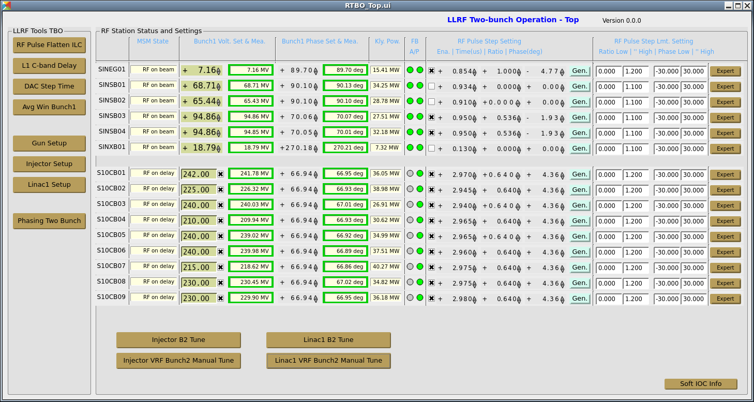
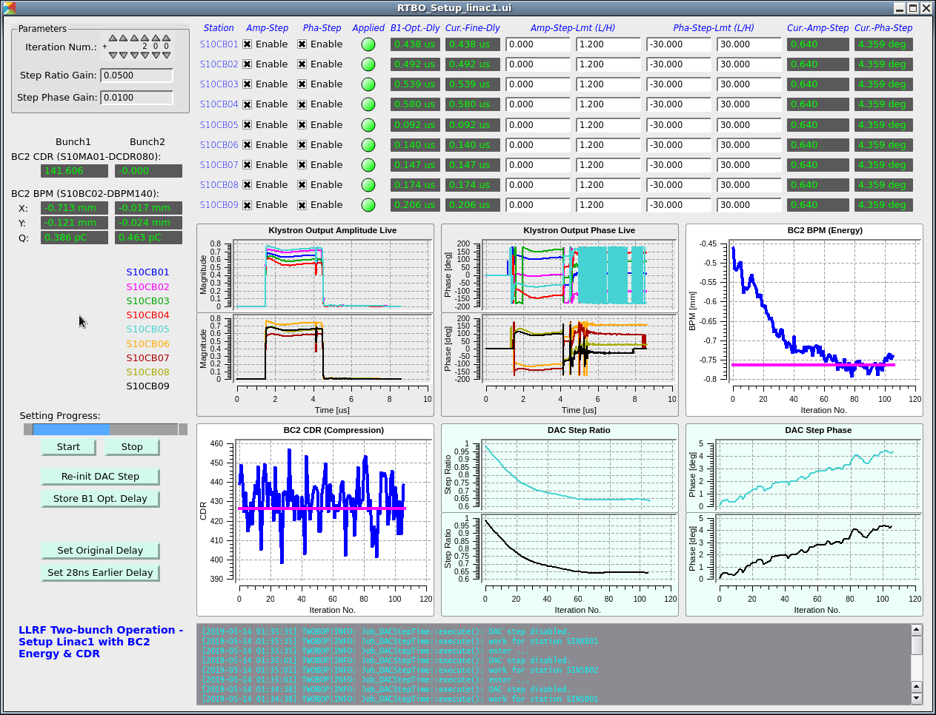
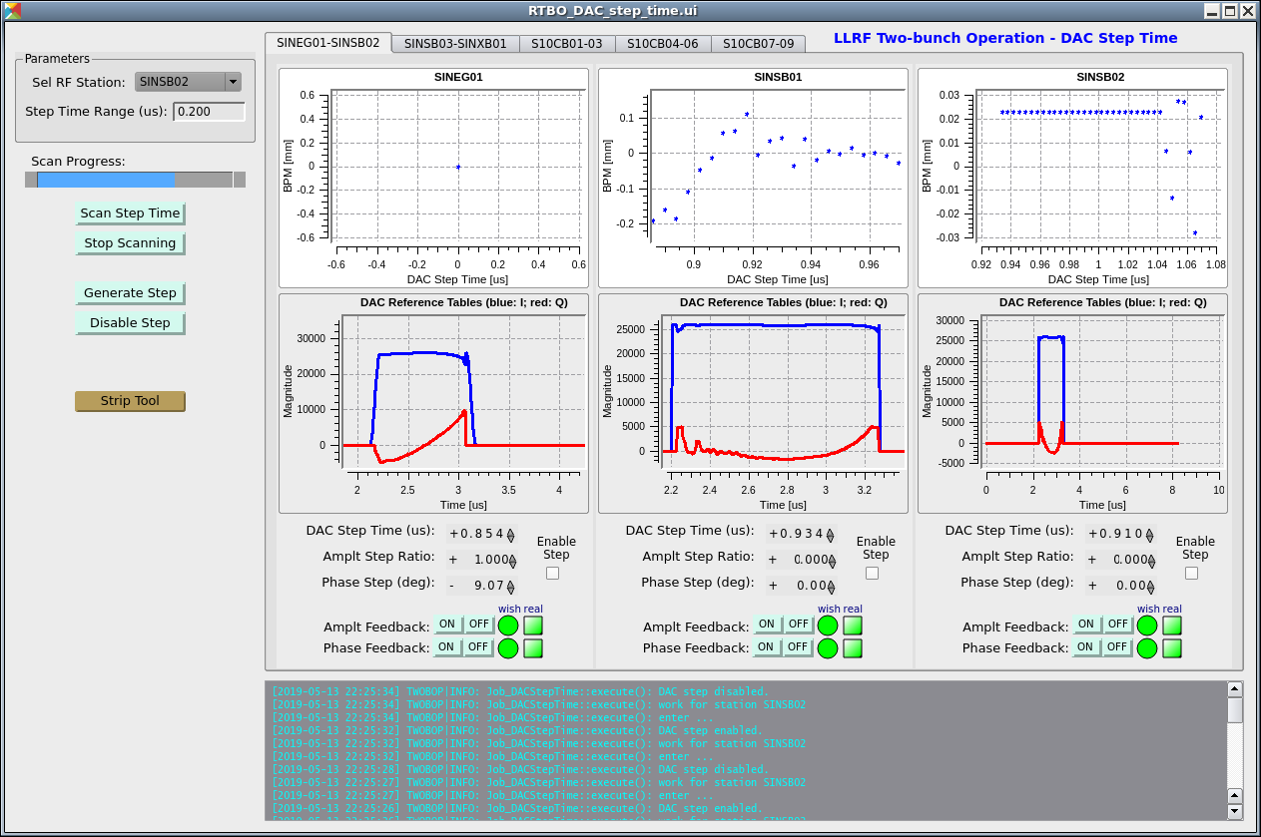
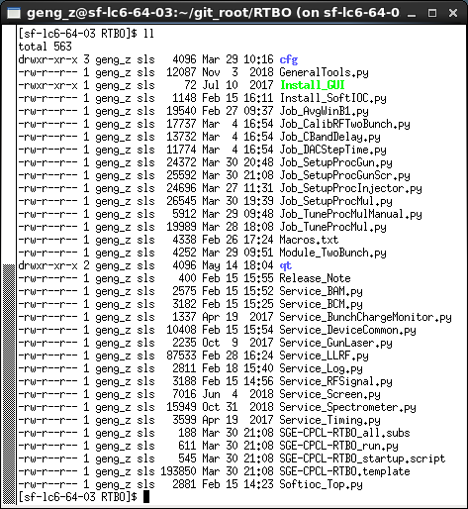
Python Implementation: ooPye
Features of ooPye:
Fully Python based, no compilation against EPICS base needed. Use as much as possible the environment provided by the controls
Automatic generation of EPICS database and the soft IOC, hide details of EPICS for programming
A sort of pattern of software architecture that can be applied on many different systems

Slide 7
Questions?

