Slide 1
Early Experiences in Adopting EPICS
Ivan Finch
ISIS Accelerator Controls

Slide 2
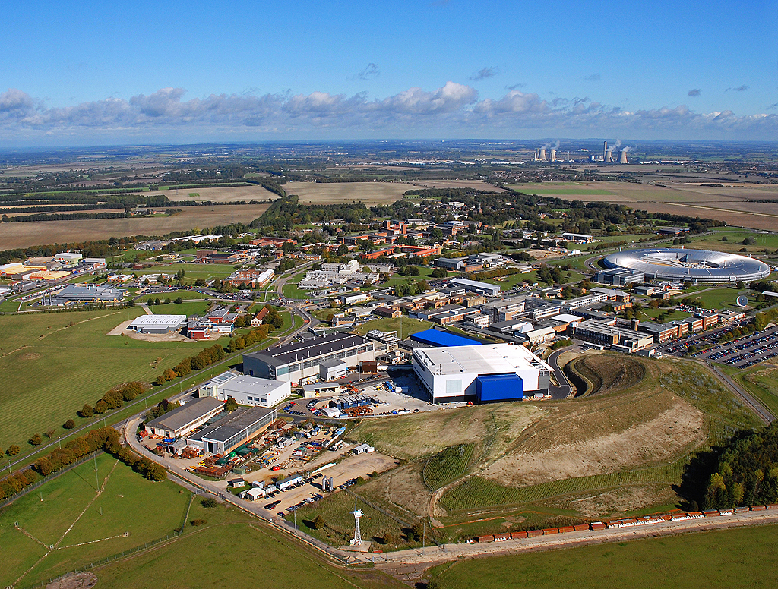
ISIS (and Diamond)
Diamond
ISIS

Slide 3
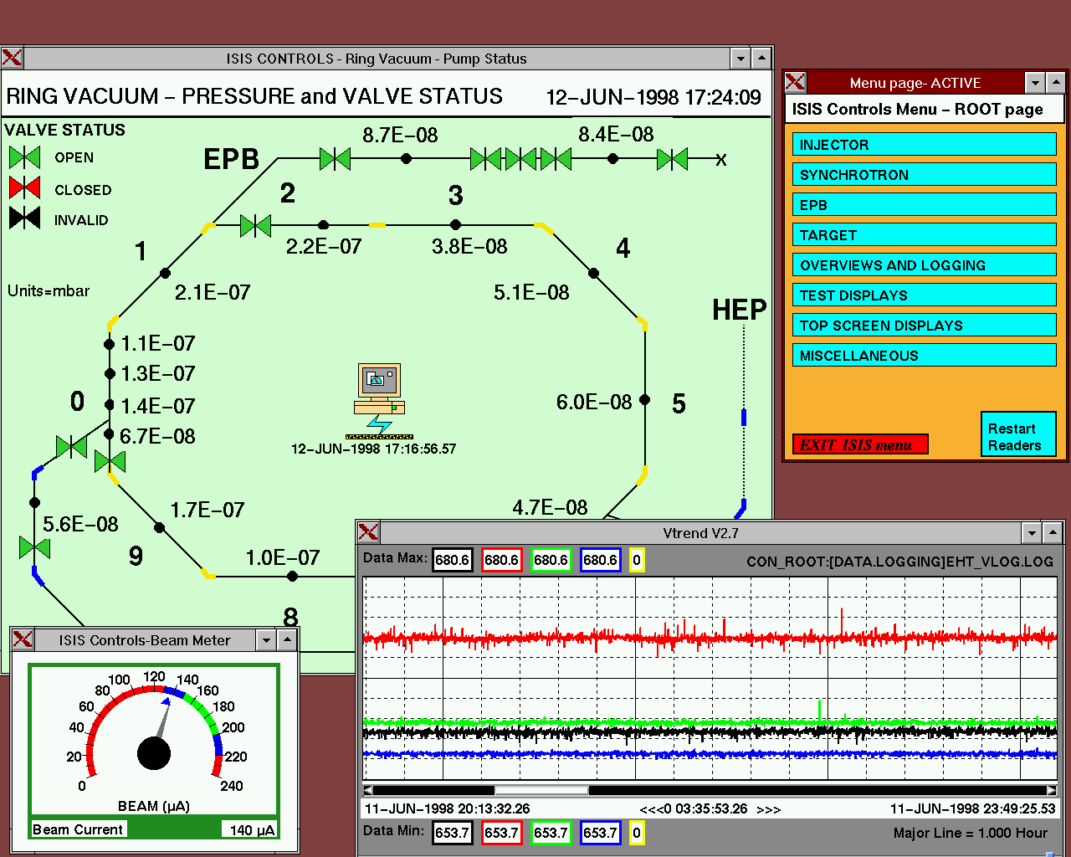
Accelerator Controls
Vsystem is a commercially supported package, related to EPICS.
Vsystem is installed on the OpenVMS operating system on Intel Itaniums.

Slide 4
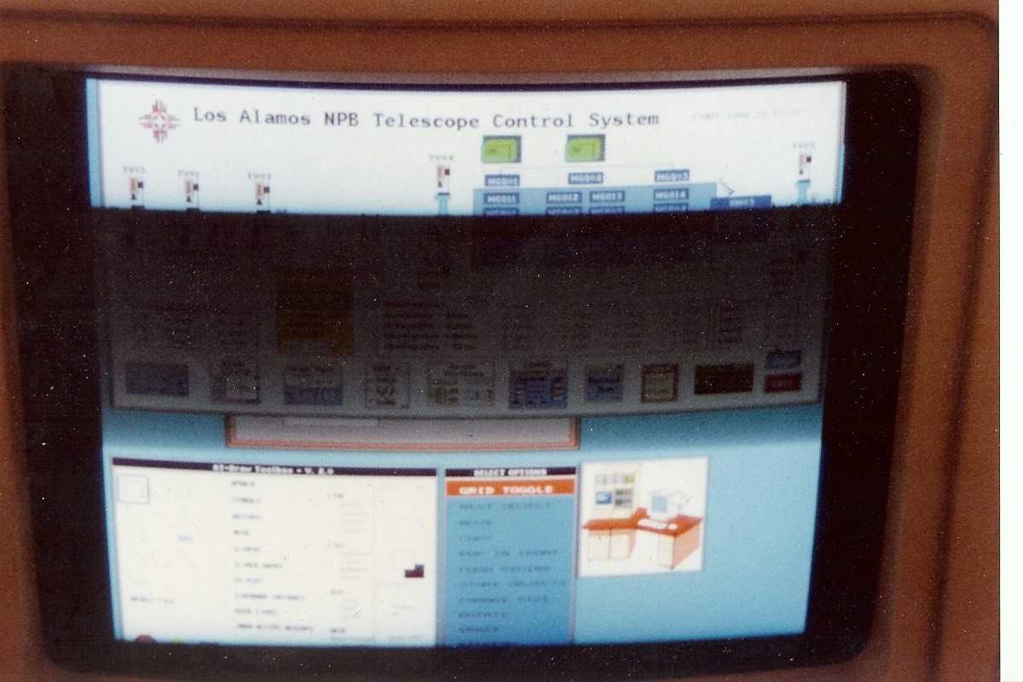
Separated at Birth

Slide 5
The Future at the ISIS Accelerator
Test deployment of EPICS on a limited subset of equipment (FETS).
Parallel deployment with existing Vista Controls system, potentially moving database by database.

Slide 6
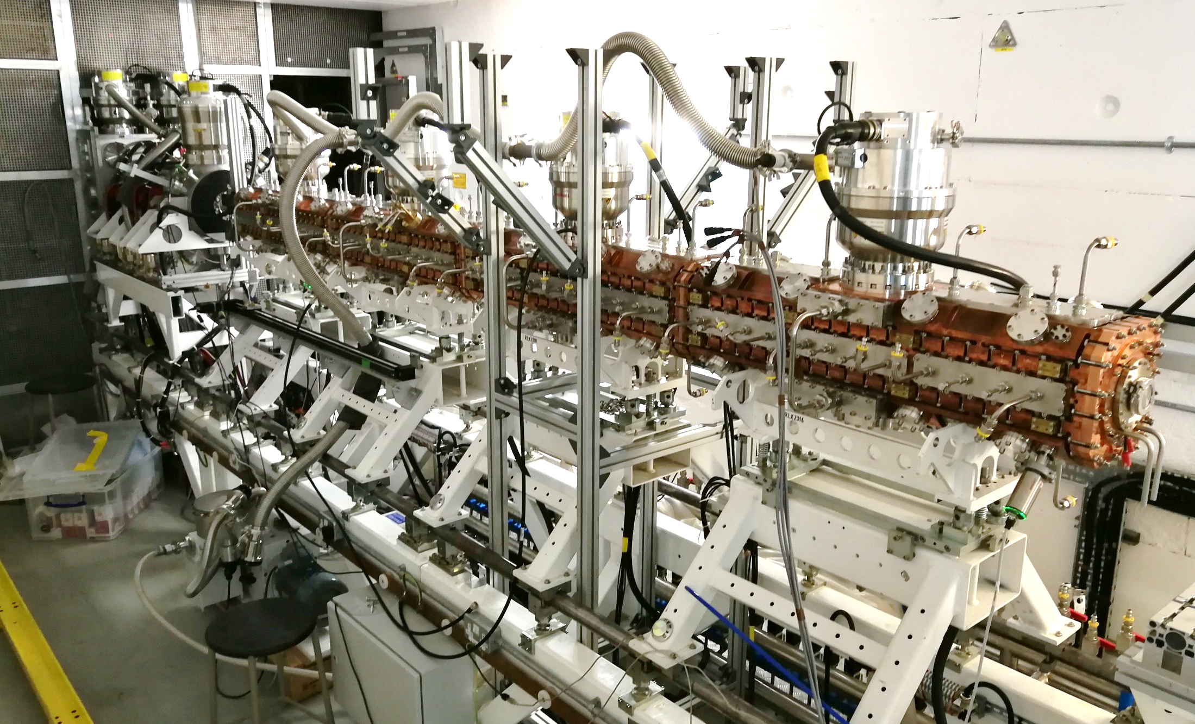
The Science Bit – Front End Test Stand (FETS)

Slide 7
Current Development
MQTT being used to read live data from existing Vista control system
Next shutdown MQTT used to write data to existing Vista control system
Implemented bridge between MQTT and EPICS using pvDatabase. Thus soon interface to existing hardware.

Slide 8
Conclusion
ISIS Accelerator Controls piloting conversion to EPICS.
Say hello and tell me what you’d do if you were starting your EPICS deployment from scratch. (I am!)
Feedback from a new EPICS7 developer: Simple example code needed as well as complex

Slide 9
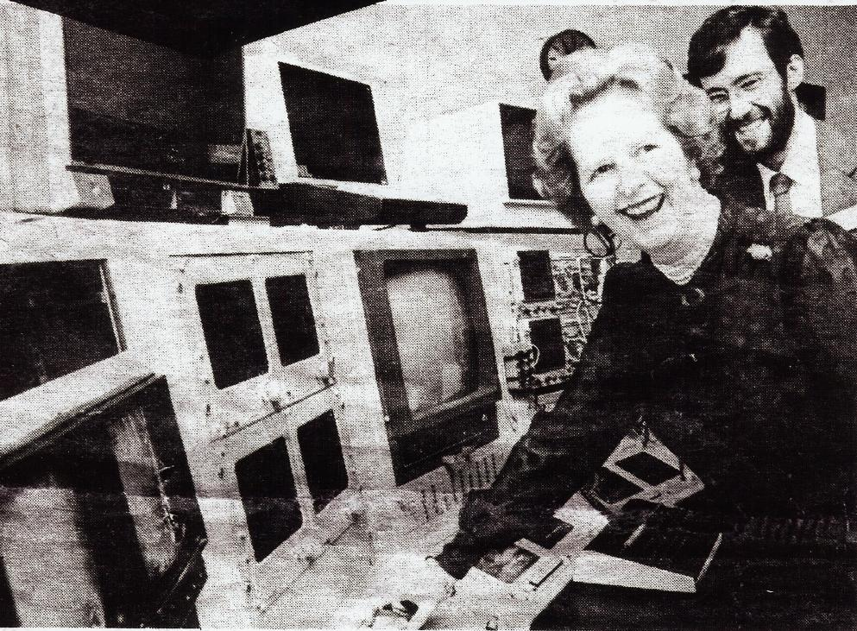
The Past
The original ISIS Main Control Room in 1985, shortly after first neutron beam. The user interface was based on the CERN SPS system but was ported to GEC 4000 series computers.
The control screens used touchscreens and programmable hardware knobs to allow user input.

