Slide 1
Phoebus Alarm System:
Alarm Server
Kay Kasemir,
Kunal Shroff,
June 2019 EPICS Meeting

Slide 2
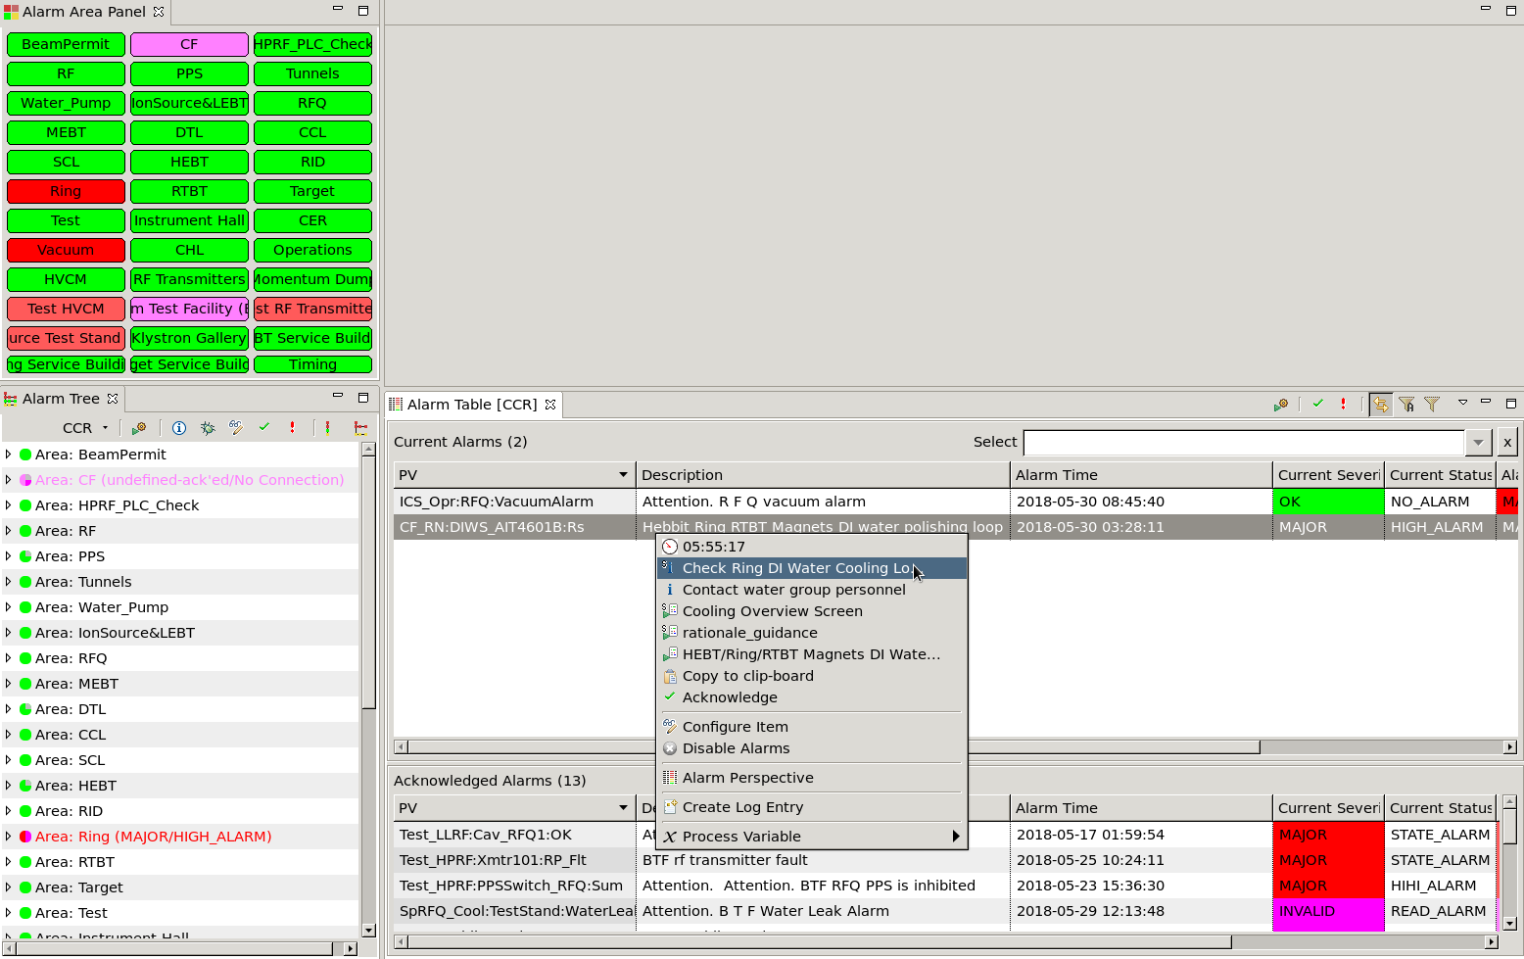
Alarm System
Alarm Server
  Monitor PVs
  Track alarms,
  acknowledgement
Alarm UI
  Configure
  (add PVs,
  guidance,
  links to displays)
  Show current state
  Acknowledge alarms
  Open guidance,
  related displays,
  email, log, ..

Slide 3
June 2018: Port to Phoebus
JavaFX
SWT
BOY
Display Builder
Display Builder
Data Browser
Data Browser
Data Browser
PV Tree
PV Tree
PV Tree
Probe
Probe
Probe
PV Table
PV Table
PV Table
Alarms
Alarms
Alarms
Channels
Channels
Channels
Scan
Scan
Scan
… more …
… more …
… more …
Eclipse
Eclipse
Phoebus
Java 8
Java 8
Java 9, 10, 11
CS-Studio, 2010
Since ~2016
2018

Slide 4
Reconsidered Original Architecture
/Accl/Vacuum: Guidance “…”
/Accl/Vacuum/PV1: Latch,
last severity MINOR,
time of last change, ..
‘Static’ Relational Database
  Configuration
  Persists last state
  Cannot get updates
‘Dynamic’ Message Service
  Send acknowledgements
  Get State updates
  Cannot get configuration
/Accl/Vacuum/PV1: Acknowledged
/Accl/Vacuum/PV1: Severity now MINOR_ACK
/Accl/Vacuum: Guidance was changed
All tools need to interface both APIs and ‘merge’ information

Slide 5
Message Streaming Platform
Send message and forget
Persist messages until disk is full
‘Compact’ messages to only keep most recent update
Combines ‘static’ RDB and ‘dynamic’ message service.
One API for all tools.

Slide 6
Clients tend to only need the most recent item state
Assume state updates from beginning of time
…
/Accl/Vacuum/PV1: {“severity”:”MINOR”, …}
/Accl/Vacuum/PV1: {“severity”:”MINOR_ACK”, …}
/Accl/RF/PV2: {“severity”:”MINOR”, …}
/Accl/Vacuum/PV1: {“severity”:”OK”, …}
Time
/Accl/RF/PV3: {“severity”:”MAJOR”, …}
*
/Accl/RF/PV2: {“severity”:”OK”, …}
*
/Accl/Vacuum/PV1: {“severity”:”MINOR”, …}
/Accl/Vacuum/PV1: {“severity”:”MINOR_ACK”, …}
/Accl/Vacuum/PV1: {“severity”:”OK”, …}
*
…

Slide 7
Kafka Message Store
New ‘segment’ for example every 10 seconds
…
/Accl/Vacuum/PV1: {“severity”:”MINOR”, …}
/Accl/Vacuum/PV1: {“severity”:”MINOR_ACK”, …}
/Accl/RF/PV2: {“severity”:”MINOR”, …}
‘Compact’:
Keep most recent message
for each item.
/Accl/Vacuum/PV1: {“severity”:”OK”, …}
Time
/Accl/RF/PV3: {“severity”:”MAJOR”, …}
*
/Accl/RF/PV2: {“severity”:”OK”, …}
*
/Accl/Vacuum/PV1: {“severity”:”MINOR”, …}
/Accl/Vacuum/PV1: {“severity”:”MINOR_ACK”, …}
/Accl/Vacuum/PV1: {“severity”:”OK”, …}
*
…

Slide 8
Compacted Kafka Message Store
Keeps single older segment with last value for each item]
Active segment for new messages
…
New clients get at least one message with most recent state for each item.
Maybe a few more recent updates from ‘active’ segment.
From then on, updates as state changes.
/Accl/RF/PV2: {“severity”:”MINOR”, …}
old
/Accl/Vacuum/PV1: {“severity”:”OK”, …}
Time
/Accl/RF/PV3: {“severity”:”MAJOR”, …}
*
/Accl/RF/PV2: {“severity”:”OK”, …}
*
/Accl/Vacuum/PV1: {“severity”:”MINOR”, …}
/Accl/Vacuum/PV1: {“severity”:”MINOR_ACK”, …}
active
/Accl/Vacuum/PV1: {“severity”:”OK”, …}
*
…

Slide 9
Kafka w/ compacted topics
May add a few extra messages on startup, but
One API replaces RDB and message service
Faster than reading initial state from RDB

Slide 10
Initial Tests
2010 Test (PosgreSQL, JMS)
Load hierarchy with 50000 PVs into RDB
  5 minutes
Show config in new Alarm Tree
  Nothing shown until all loaded
  after 30 seconds
Handle Alarm Updates
  10 per second
2018 Test (Kafka)
100000 PVs into Kafka
  3 seconds
  Shows growing tree for 10 seconds
  500 per second

Slide 11
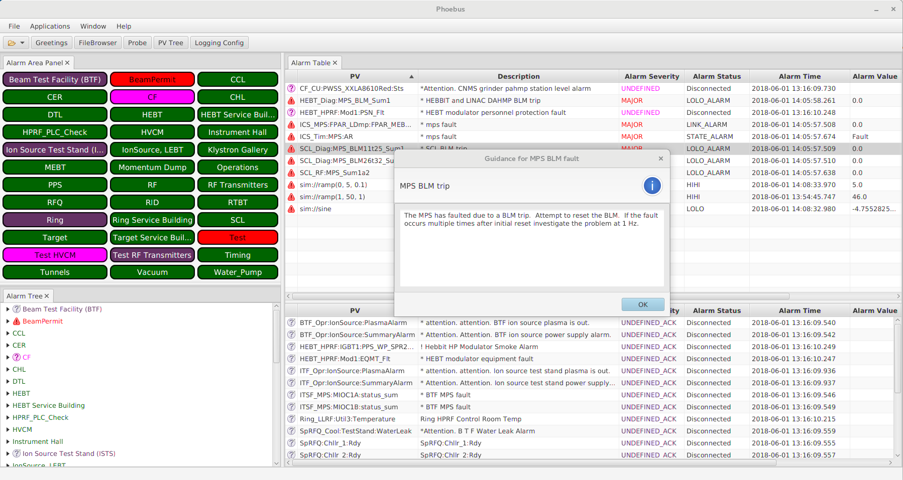

Alarm Ecosystem
Alarm configuration
Alarm State updates
Acknowledgement
Alarm
Server
Live control system data
Channel
Access
IOC
PVA
IOC

Slide 12
Alarm System Update for Phoebus
RDB & JMS →
Same XML
import/export
Similar UI
Operational
@ SNS beam
lines since
Jan. 2019
Performance
headroom

