Slide 1

中国科学院高能物理研究所
INSTITUTE OF HIGH ENERGY PHYSICS, CAS
A Bunch-by-Bunch Beam Position Monitor
Fang Liu
Institute of High Energy Physics, Chinese Academy of Sciences
2019-6-5

Slide 2

Introduction
Normal BPM
——Turn-by-Turn Measurement
——Fast Acquisition Measurement
——Slow Acquisition Measurement
doing Bunch-by-Bunch measurement
ADC Frequency &Accuracy Improved
Digital Signal Processing
Research&
Methodology
Deeping &Sufficient
High Precision
Bunch-by-Bunch Beam Position Monitor
Available
Goal：Resolution of Bunch-by-Bunch : 5um
Based Research
Reserch of Inter-Bunch Beam Dynamics
Hardware platform of Bunch-by-Bunch Feedback system，Bunch-by-Bunch Beam Current Monitor；Diagnosing Beam Lost and Catching Tune of Beam

Slide 3
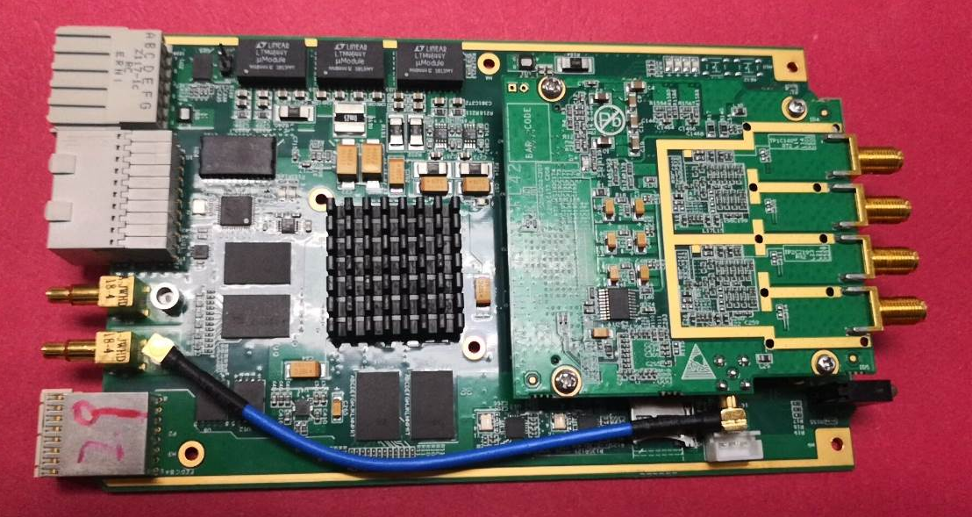
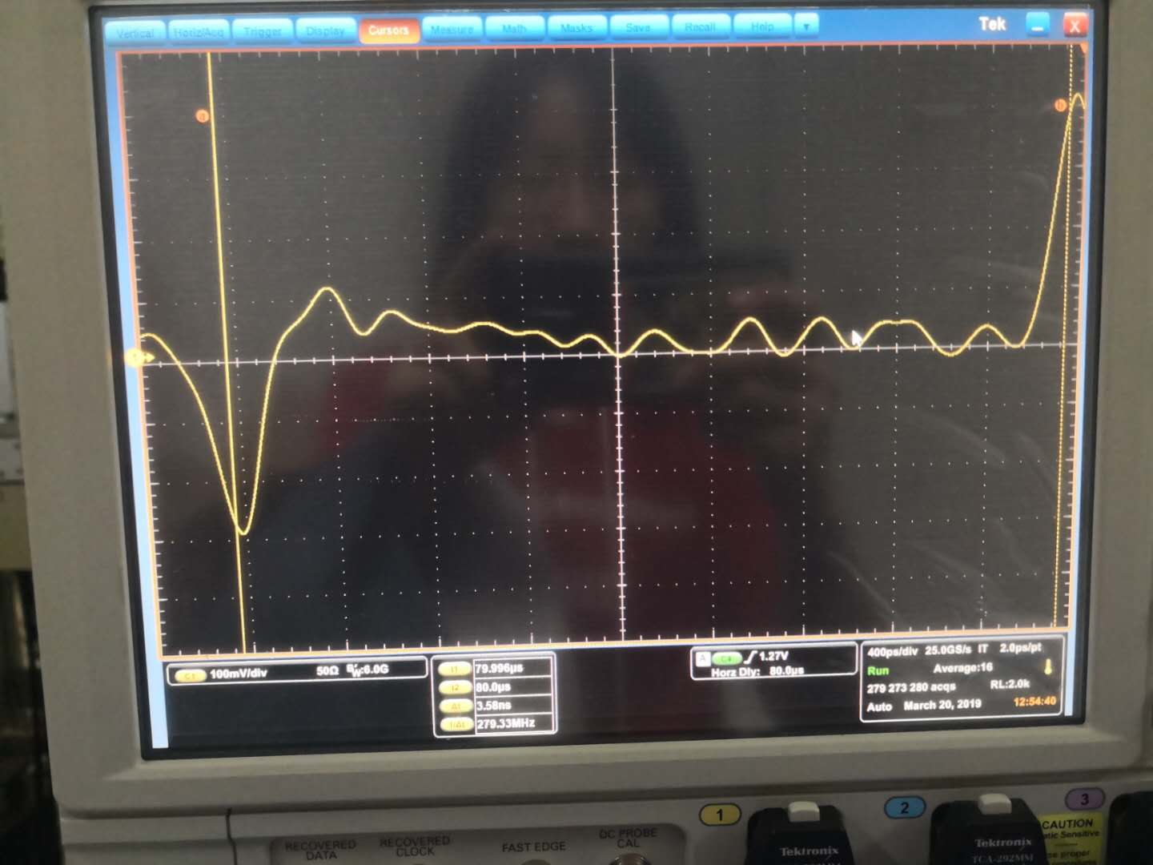
A Bunch-by-Bunch BPM
Electronic System
ZYNQ7035
dual-core ARM Cortex-A9&Kintex®-7 ZYNQ7035
4 Channels 500MSPS 14bit ADC
AD9684, 2 channels
1GB DDR3
100/1000Mbps ETHERNET
PCIE GEN2 X4
e+ , e-
Peak:300mV
Input Analog Band Width: 10MHz-2GHz
A Four Button Pickup
The signals from the pickups of BEPCII are enough for directly data sampling of ADC
Delay Module
Adjust to the time to guarantee ADC can get the peak of the Button Signal
Notes:
Using CIC and FIR to achieve non aliasing filtering and decimation.
Use the CORDIC module to calculate the magnitude
Use digital automatic gain controller to adjust the signal amplitude, so that let the FA and SA to get more effective bit

Slide 4
Development state
R&D Plan: A ZYNQ Based, Four channels 500Msps ADCs, Bunch-by-Bunch System
2018
2019
2020
2021
Complete
Already Down
Need to Do
Hardware：Circuit Design, Soldering and Debugging.
Develop：Embedded Linux and EPICS on ZYNQ ARM
Firmware：ADC control, Clk control, DDR ,Ethernet
Bunch-by-Bunch Algorithm
Improvement: Upgrade Hardware and Firmware
Soft in ZYNQ ARM：Initialization of Ethernet, ADC and Clk. Data Acquisition Control.
Furthermore: Embedded Timing ?....

Slide 5
Hardware
Architecture
DDR3
PCIE
ADC1
AD9684
FMC
ADC2
clk processing
ZYNQ-7035
ADC3
AD9684
ADC4
TRIGGER
ETHERNET
CLK
CLK Management
Base board and FMC Carrier
ZYNQ7035 FPGA and 4 channels 500MSPS 14bit ADC
2 DDR3: one for Data Storage, one for ARM
10/100/1000Mbps Ethernet
PCIE GEN2 X4: backplane
Notes:
Using CIC and FIR to achieve non aliasing filtering and decimation.
Use the CORDIC module to calculate the magnitude
Use digital automatic gain controller to adjust the signal amplitude, so that let the FA and SA to get more effective bit

Slide 6
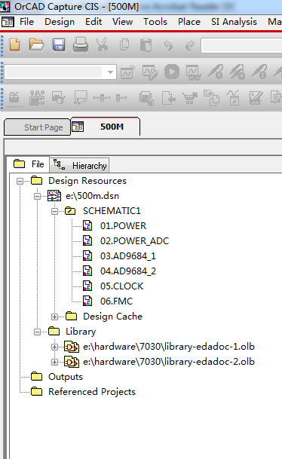
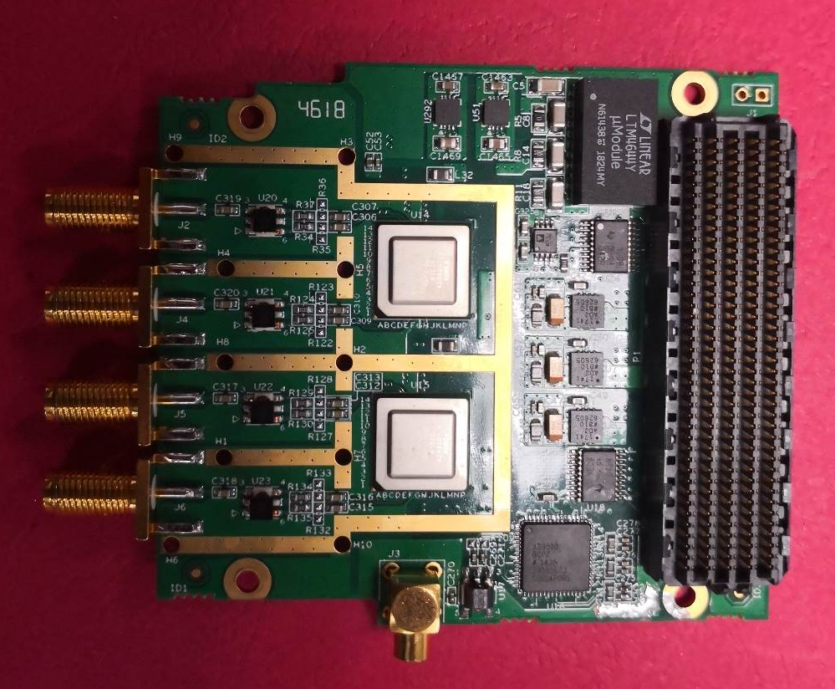
Four Channel 500MSPS ADC FMC Card

Slide 7
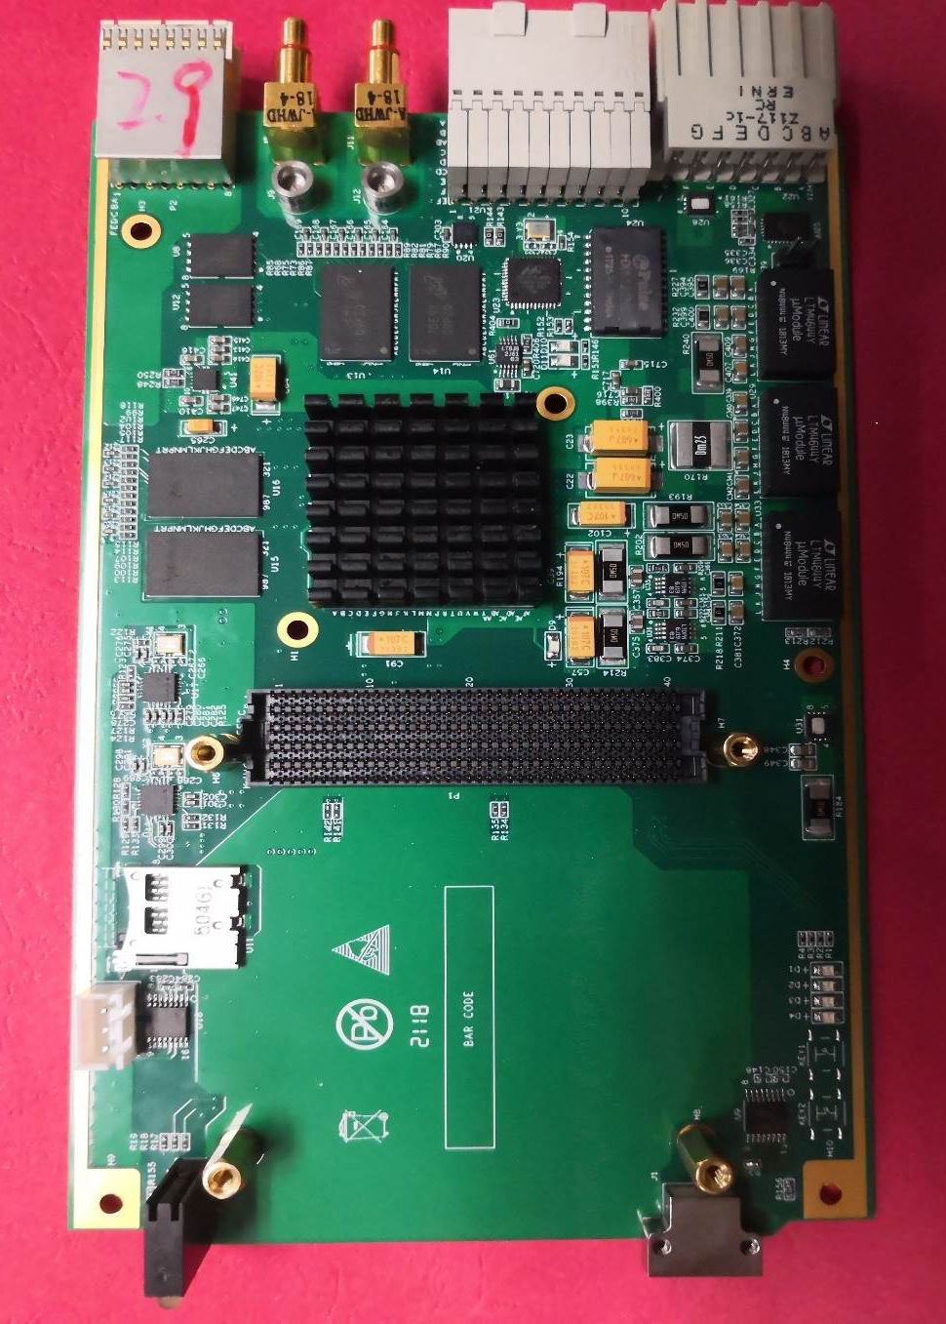
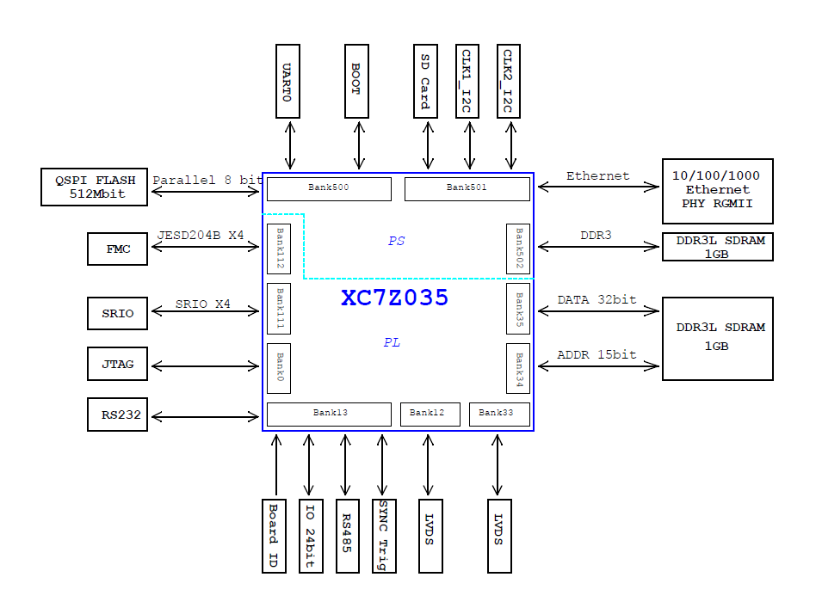
Base Board: ZYNQ7035

Slide 8
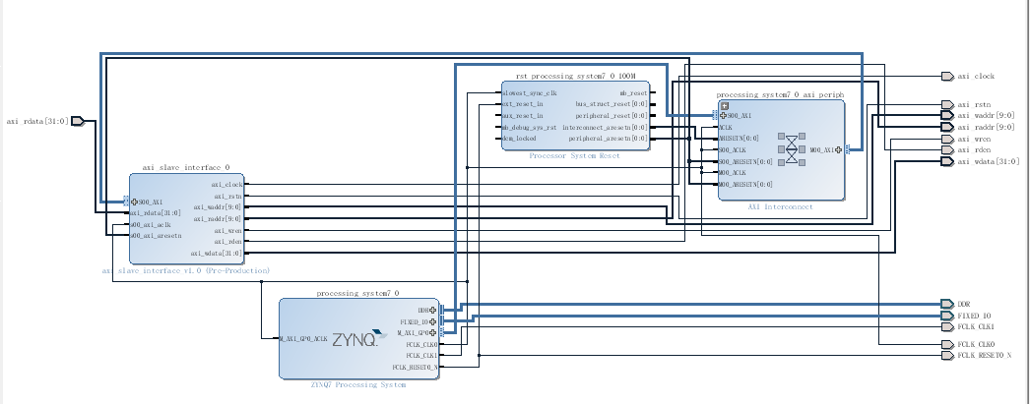
ARM Core Construction

Slide 9
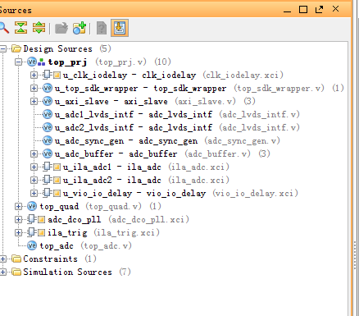
FPGA Logical in ZYNQ PL

Slide 10
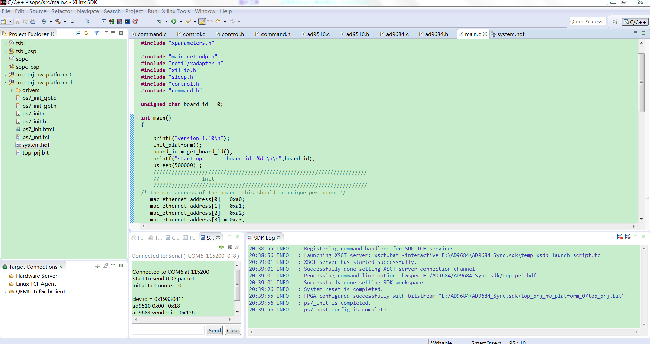
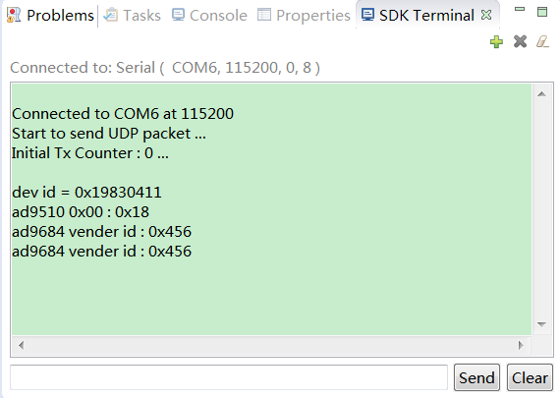
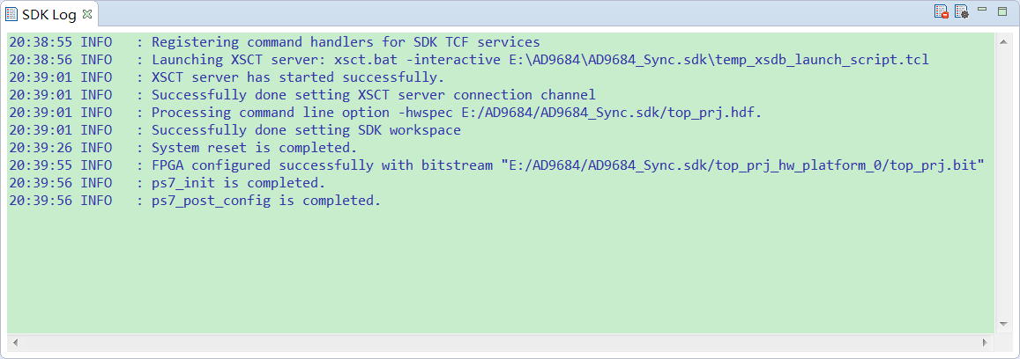
Using PS code configure FPGA

Slide 11
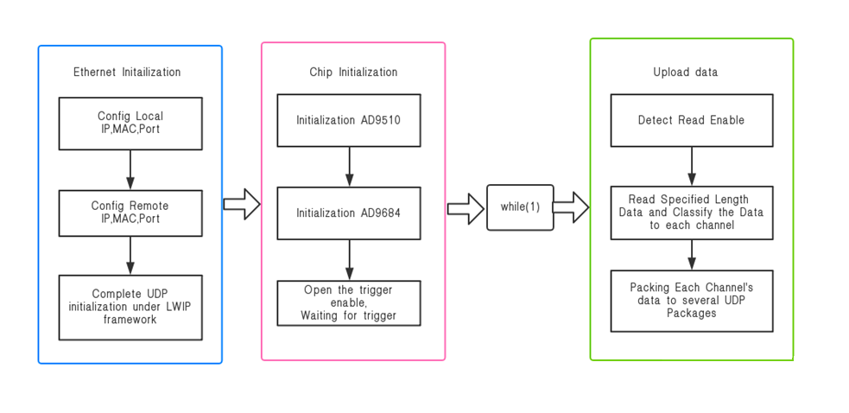
ARM Code in ZYNQ PS

Slide 12
Test in Lab

Slide 13
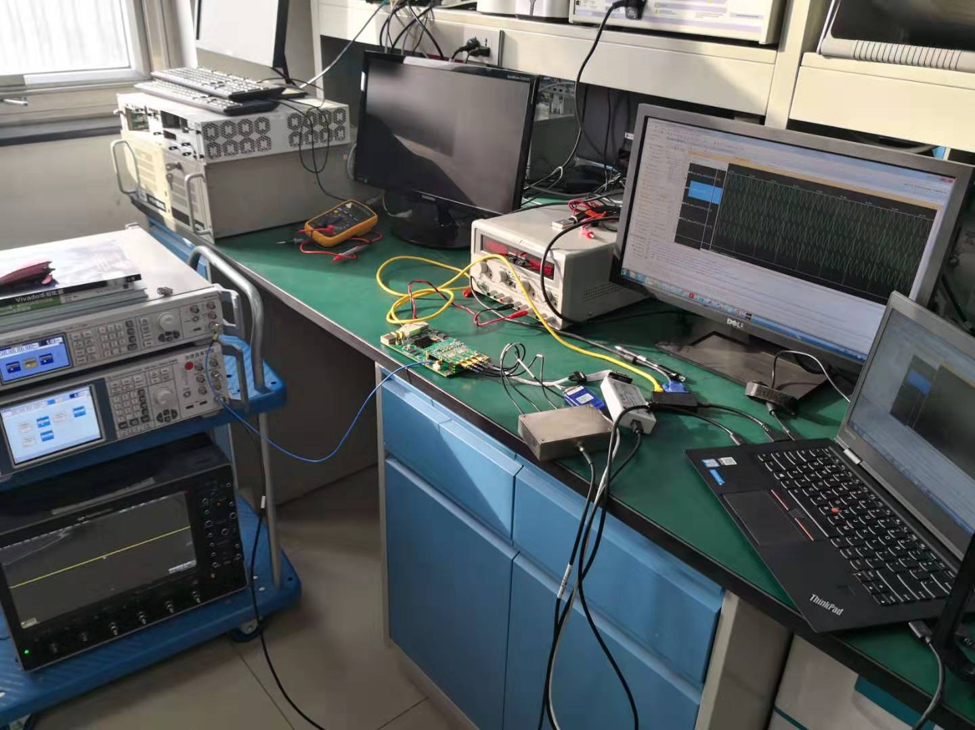
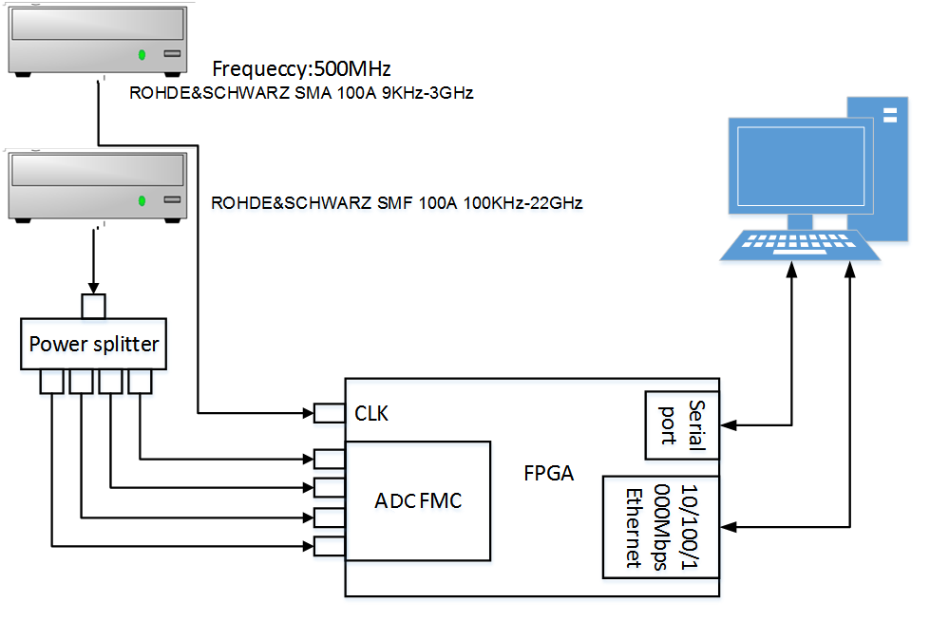
Test Environment
ADC CLK：500MHz （Convenient to synchronous two signal generator）
（CLK：From ROHDE&SCHWARZ SMA 100A 9KHz-3GHz）
Four Channel ADC Input：One to Four Power Splitter, Signal Source： (ROHDE&SCHWARZ SMF 100A 100KHz-22GHz)

Slide 14
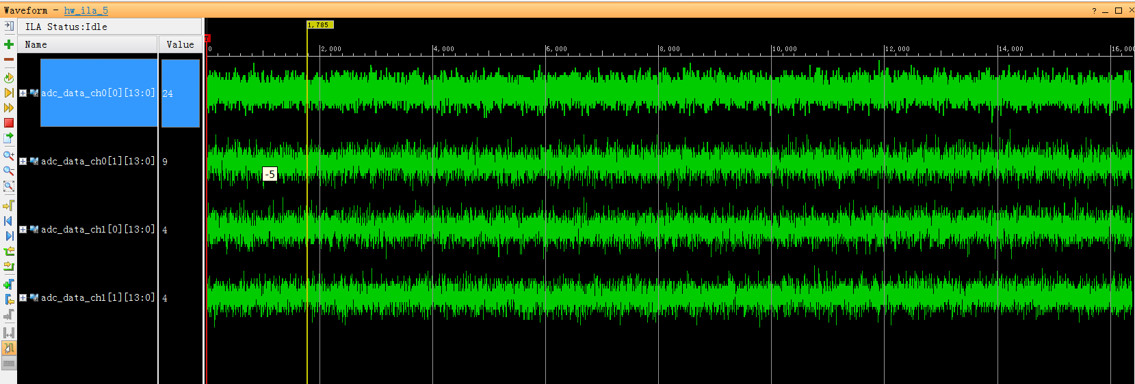
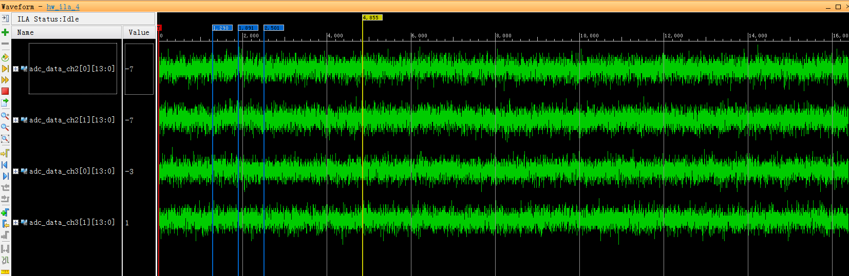
No Input, ADC Raw data
Peak to Peak:15
Maximum: ±8192 (14bit)

Slide 15
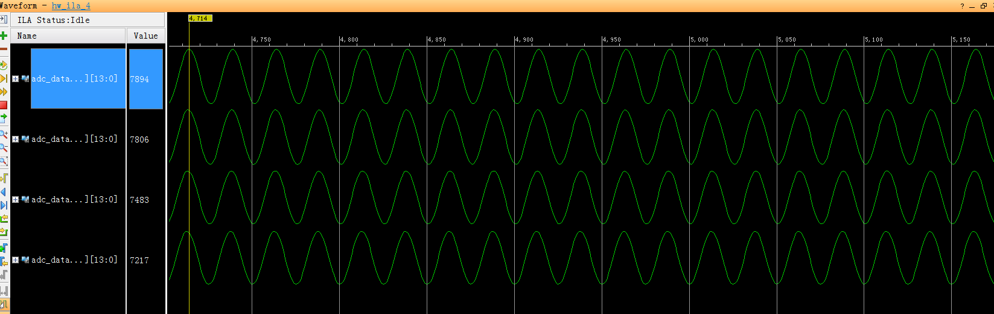
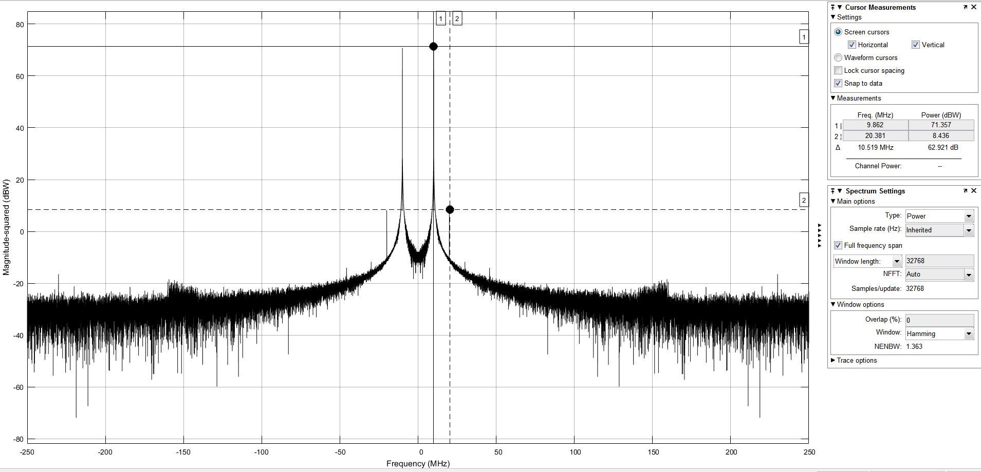
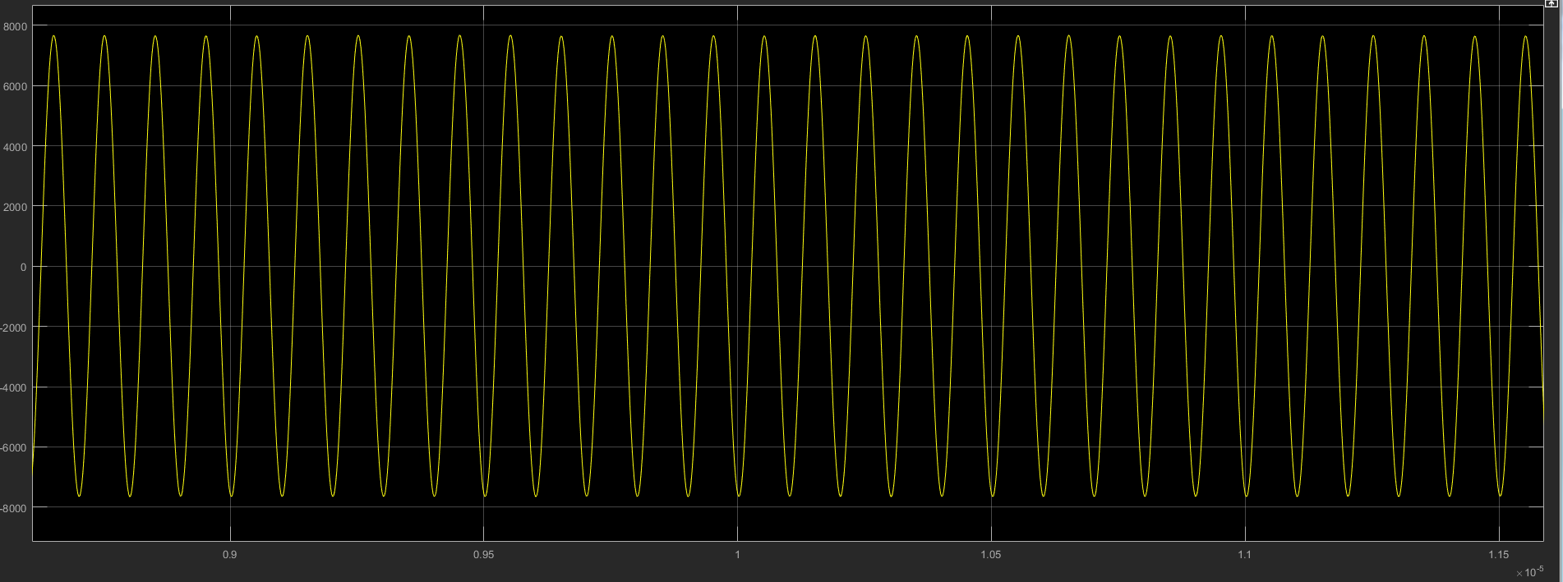
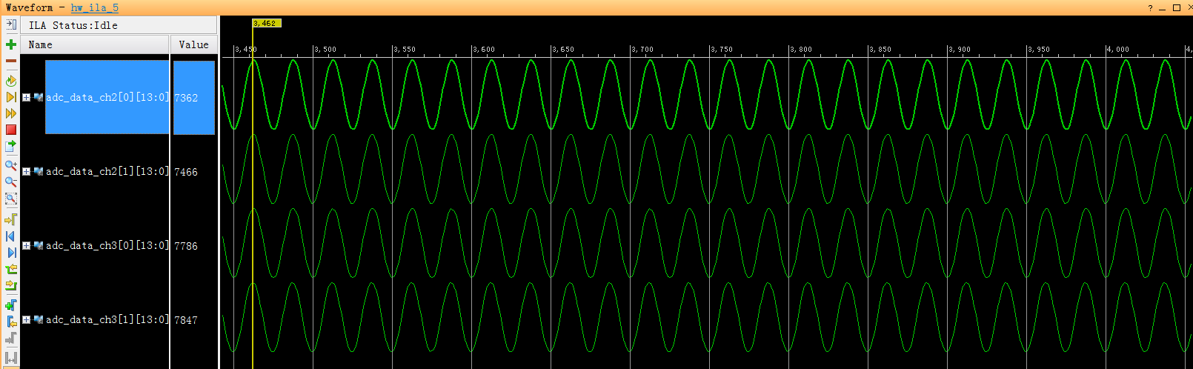
10MHz Input

Slide 16
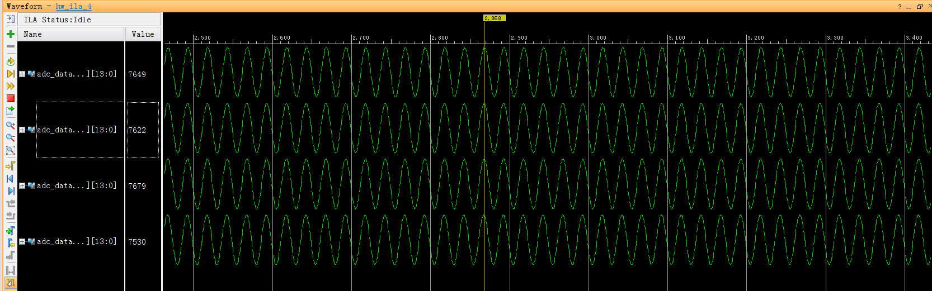
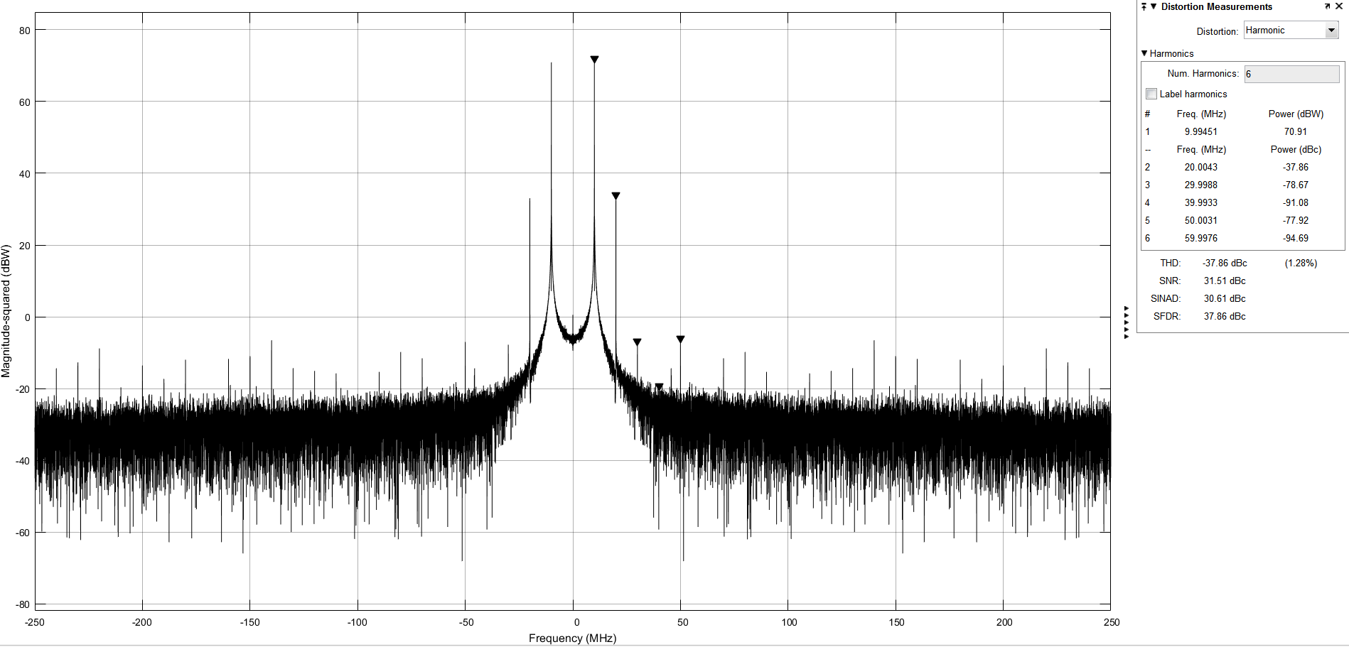
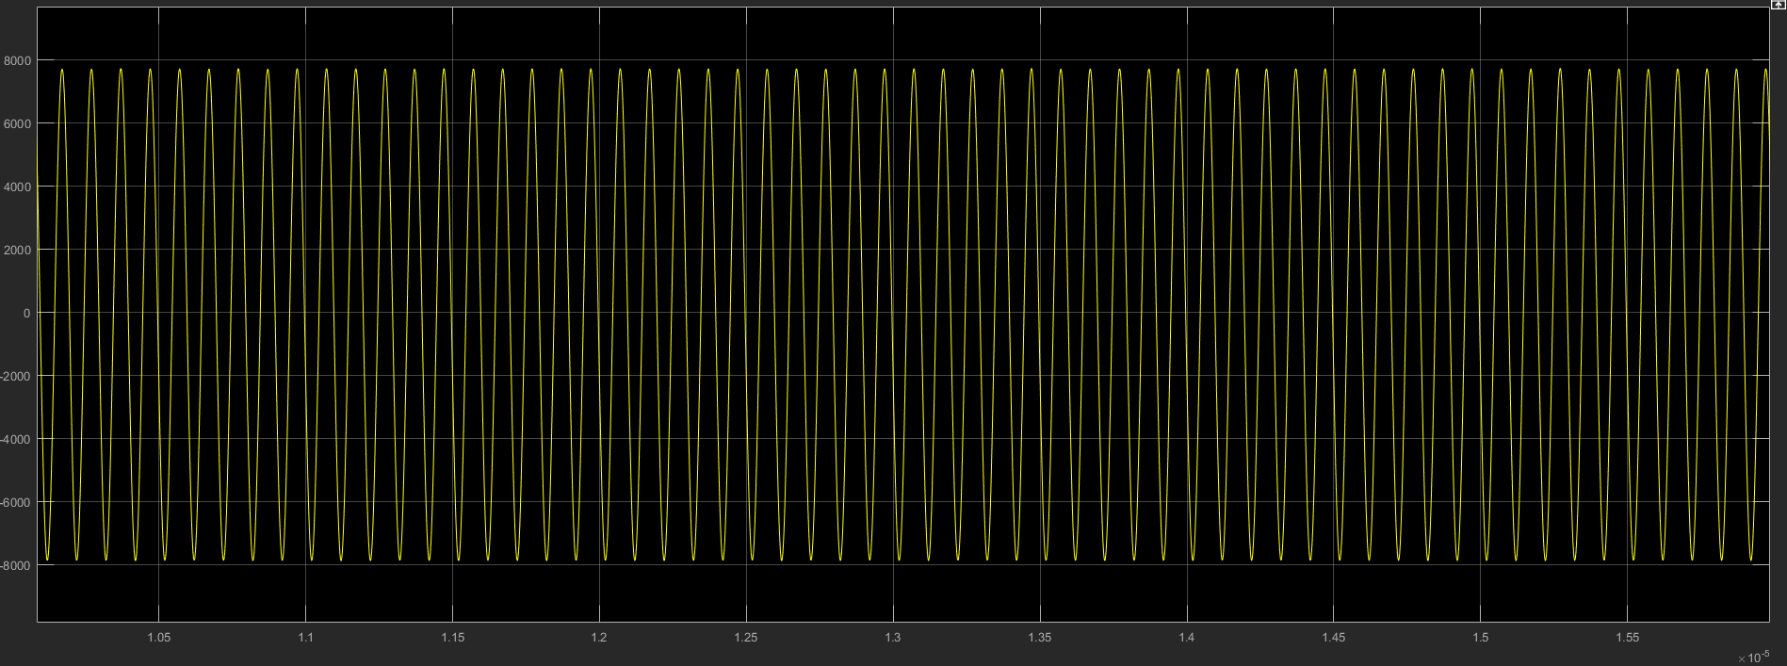
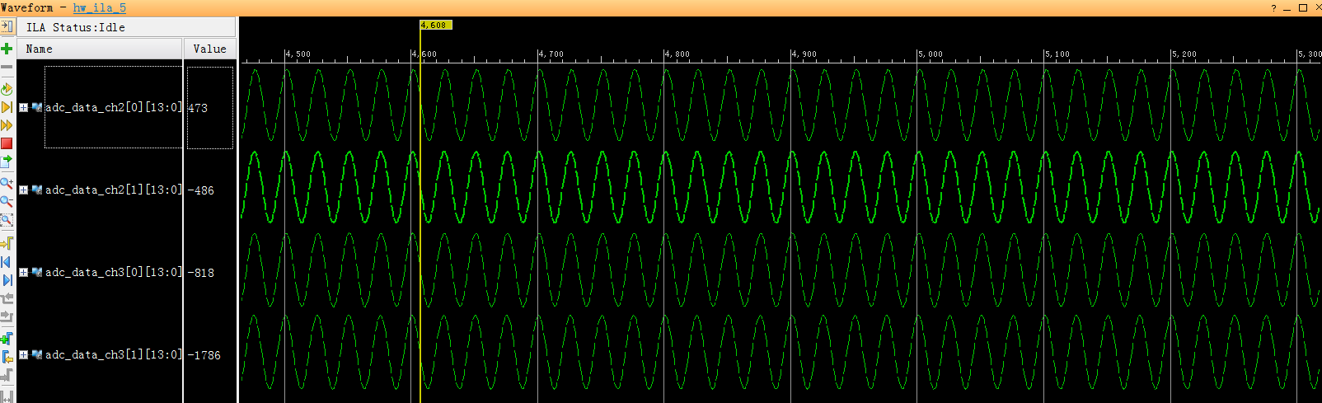
490MHz Input

Slide 17
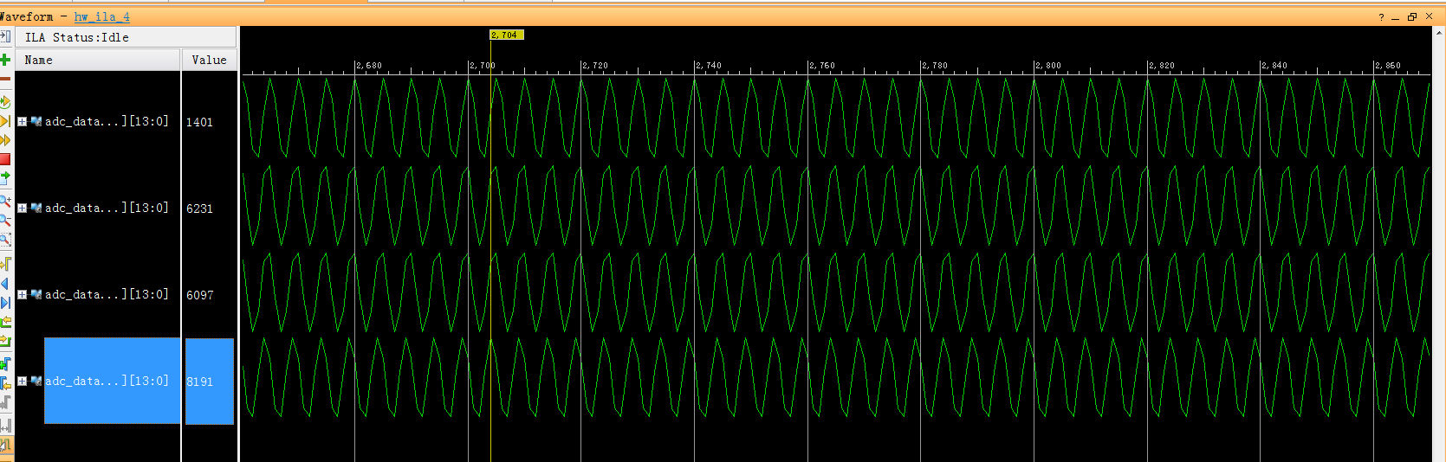
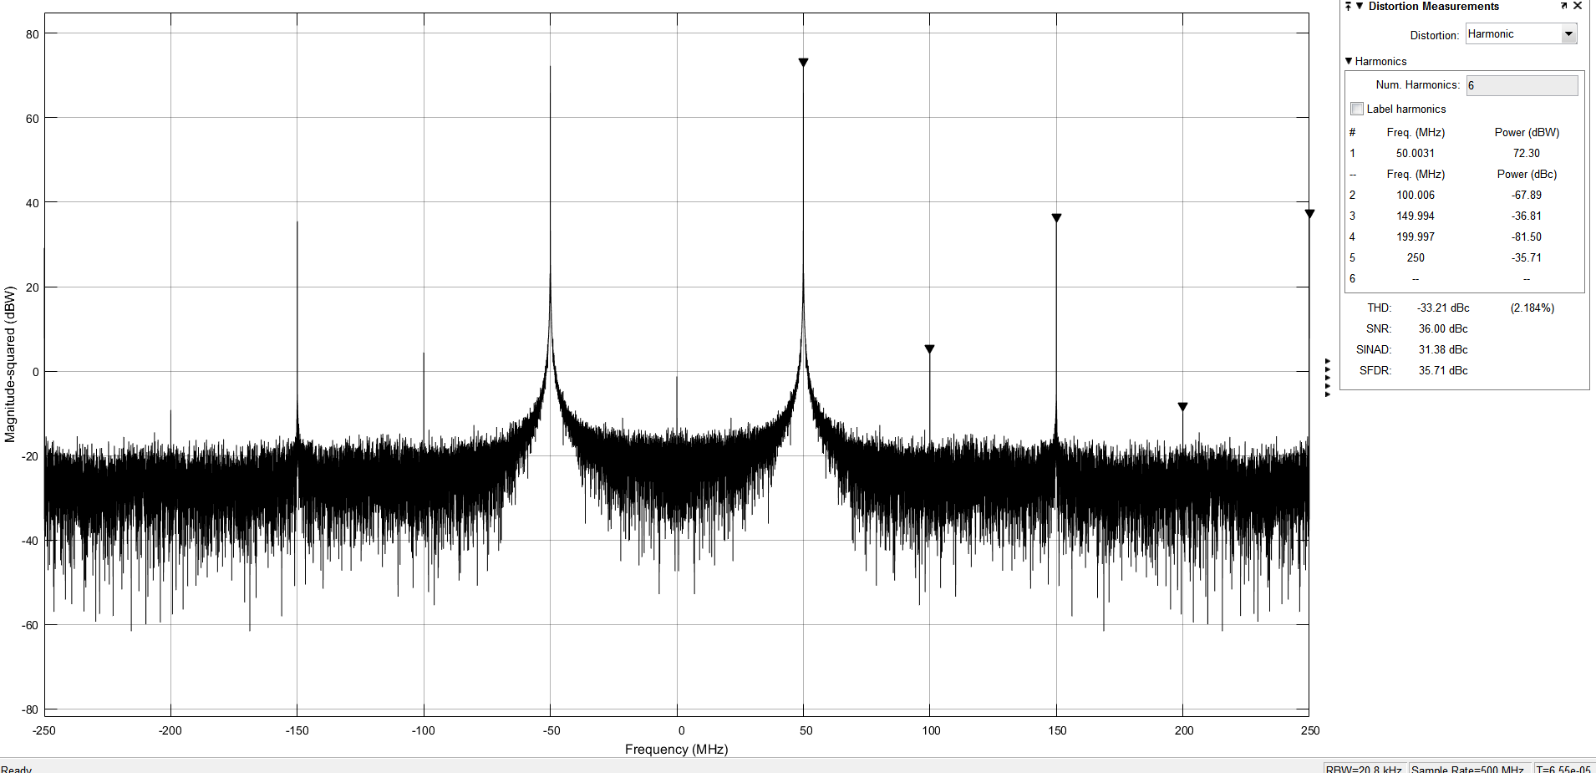
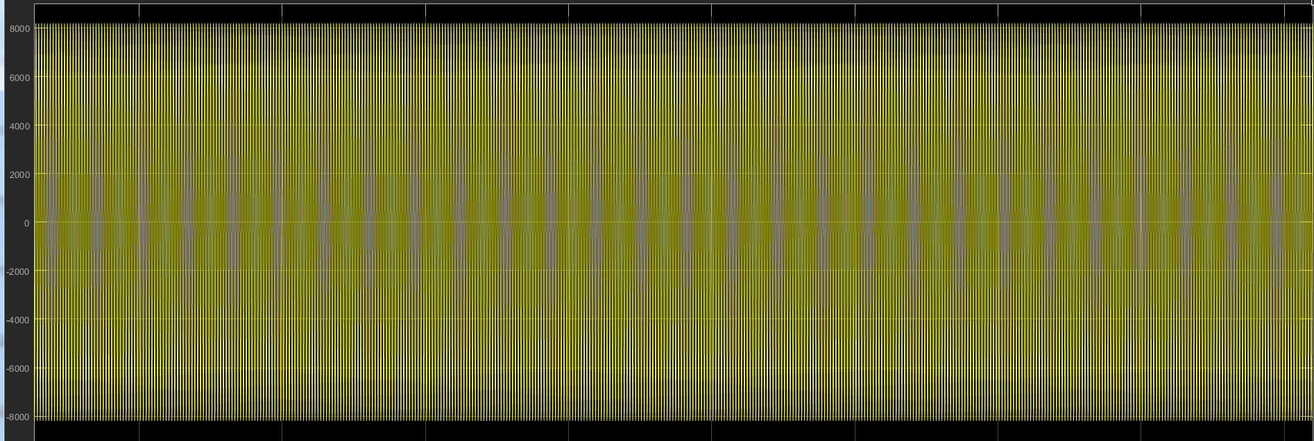
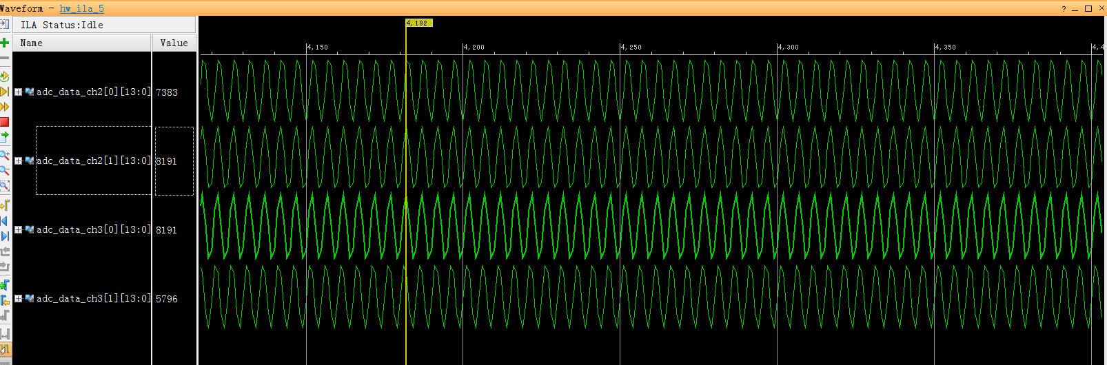
950MHz Input

Slide 18
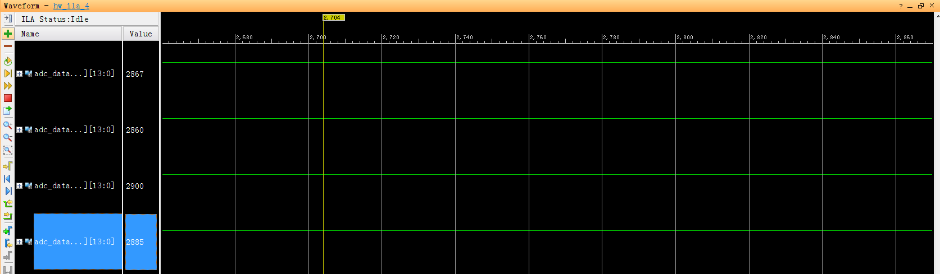
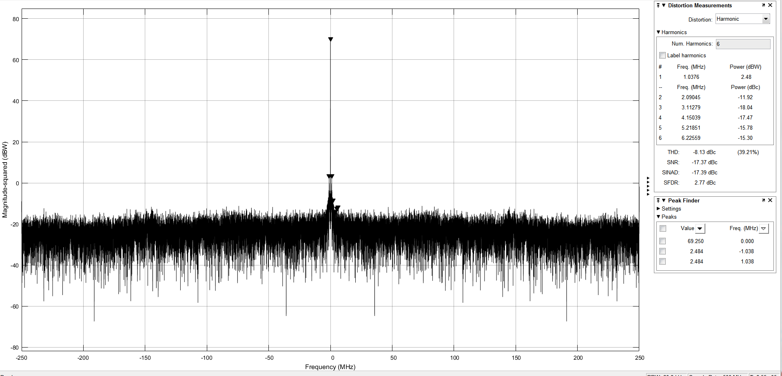
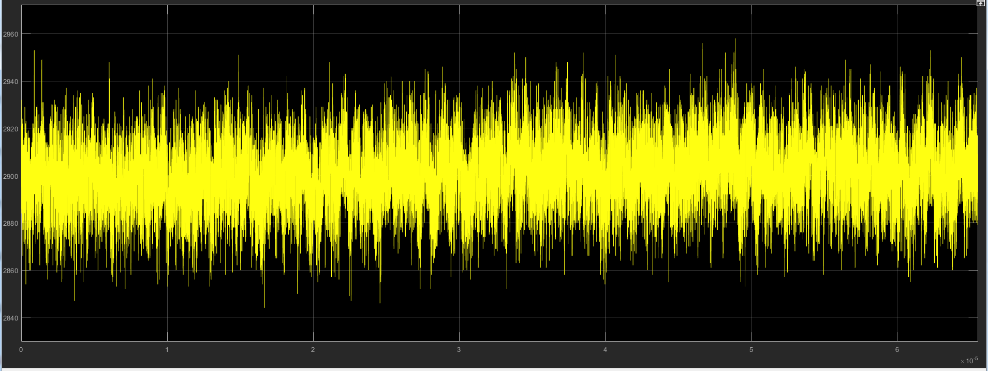
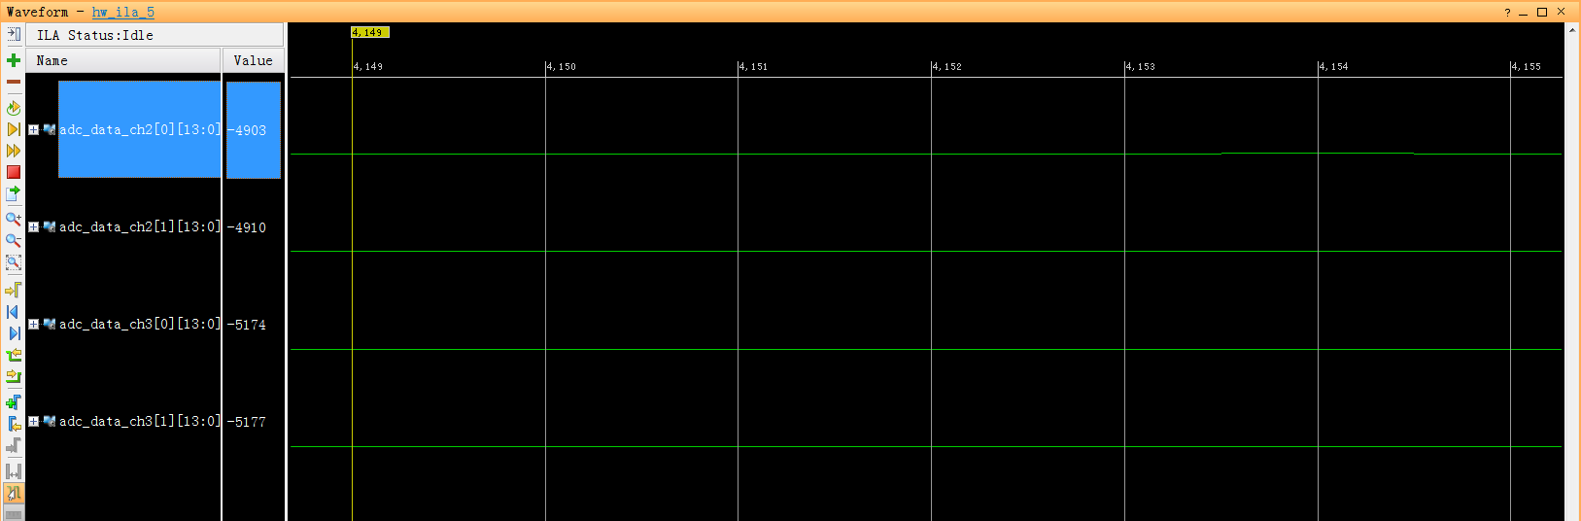
1.5GHz Input

Slide 19
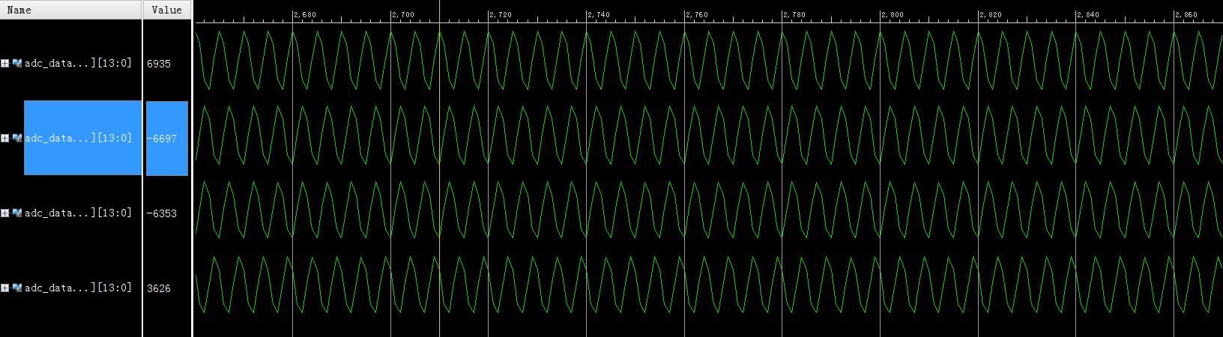
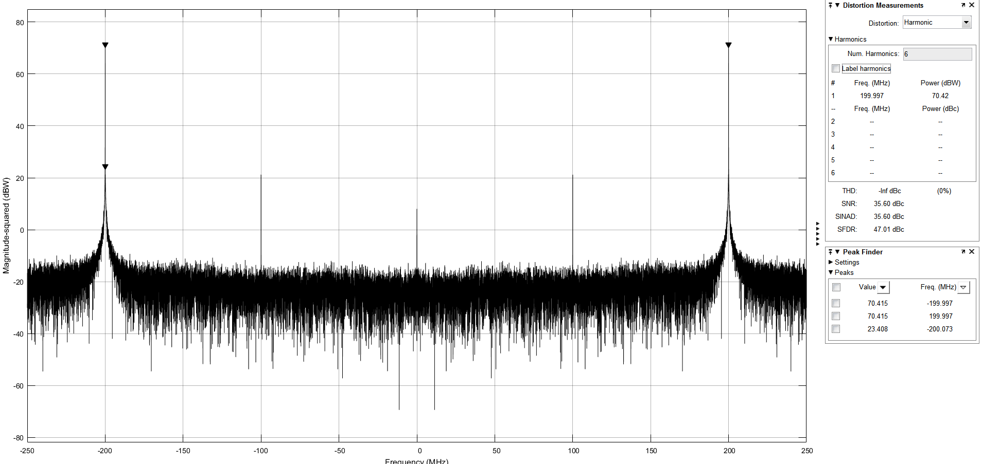
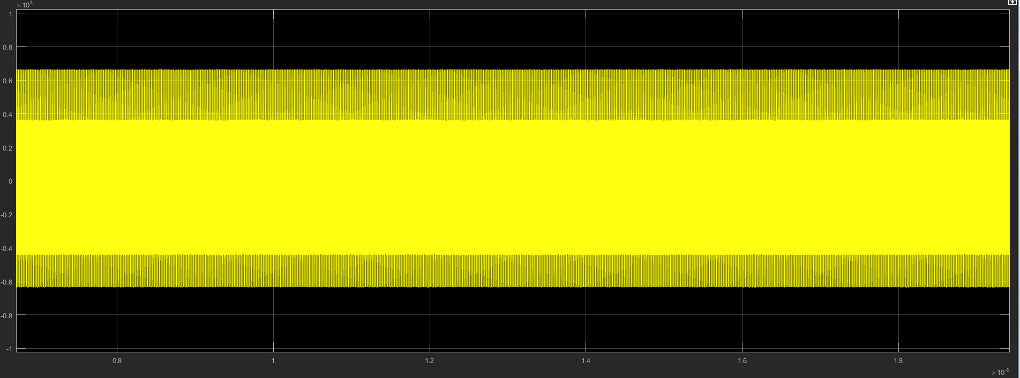
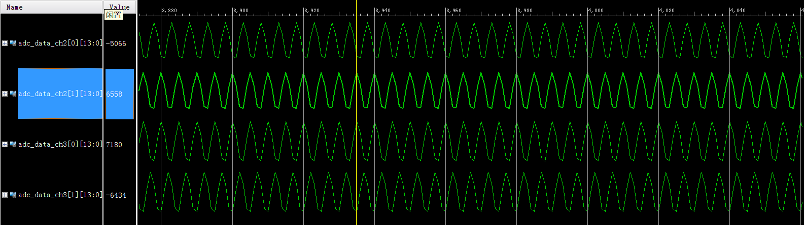
1.8GHz Input

Slide 20
Summary
Bunch-by-Bunch BPM system has been designed.
Prototype circuit board has been made.
Initial board tests have started.
Improvement: Upgrade of Hardware and Firmware
Next Step:
Develop：Embedded Linux and EPICS on ZYNQ ARM
Furthermore: Upgrading Hardware and firmware, adding embedded Timing module…

Slide 21
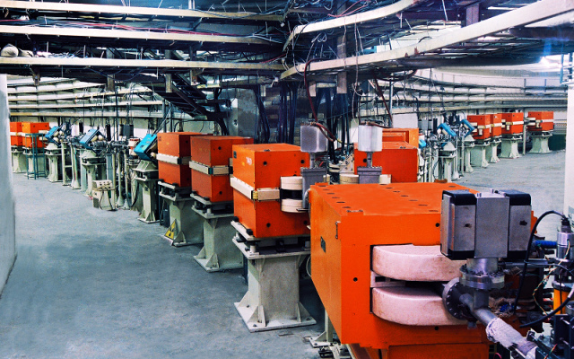
Thank you！

