Slide 1


Linear IFMIF Prototype Accelerator (LIPAc) commissioning and LCS integration in CCS
Antti Jokinen
Cadarache – 4.6.2019

Slide 2
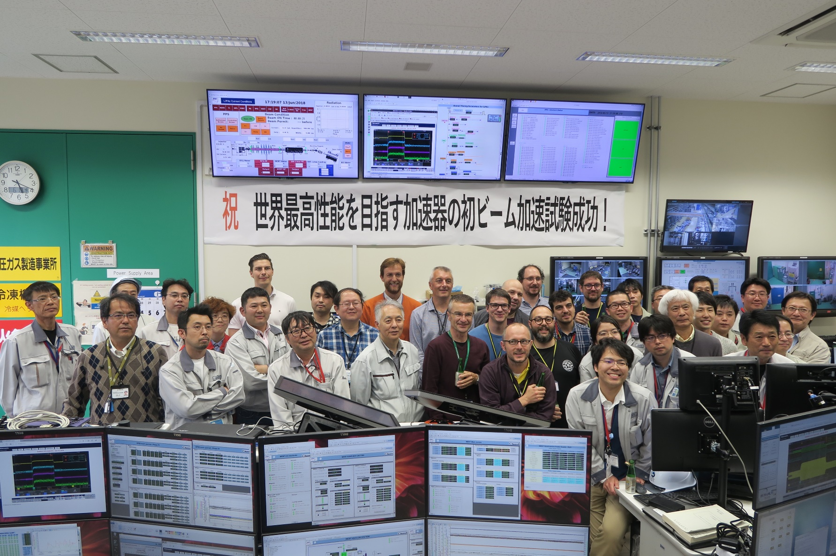
Index
Linear IFMIF Prototype Accelerator (LIPAc) commissioning and LCS integration in CCS
  What and where is LIPAc?
  Control Tasks at LIPAc
  Control Tools Development
  LCS Integration
  Next Steps
  Summary
13.6.2018 – First beam

Slide 3
What and where is LIPAc?

Slide 4

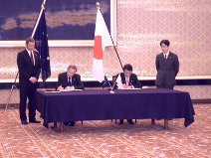
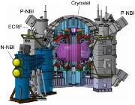
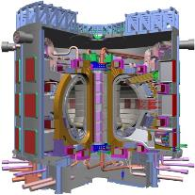
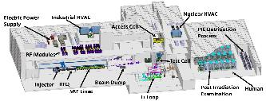

What is LIPAc?
ITER
Agreement
Broader Approach
Agreement
JT60-SA
21 November 2006
1 June 2007
IFMIF/EVEDA
Linear IFMIF Prototype Accelerator (LIPAc)
Mission: Test the feasibility of technology.
ITER
IFERC

Slide 5





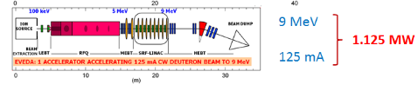


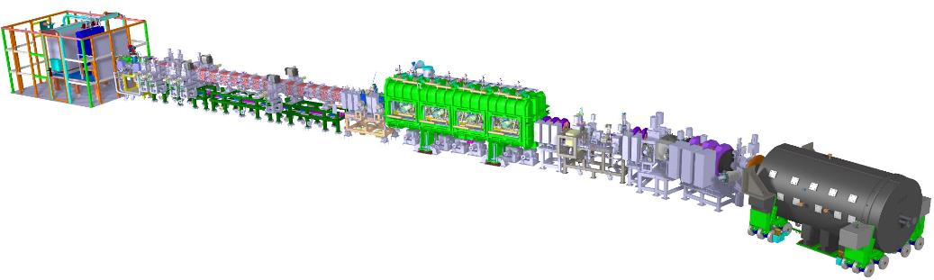
What is LIPAc?
Japan-Europe
scientific collaboration
Ion Source LEBT
CEA Saclay
RFQ
INFN Legnaro,F4E,QST
MEBT
CIEMAT Madrid
SRF Linac
CEA Saclay,
CIEMAT Madrid, F4E
HEBT
CIEMAT Madrid, F4E
Cryoplant
CEA Saclay,
QST
Control System
QST,
CIEMAT Madrid,
CEA Saclay,
INFN Legnaro,
F4E
36 m
RF Power
CIEMAT Madrid,
CEA Saclay,
SCK Mol
Diagnostics
CEA Saclay
CIEMAT Madrid, INFN
BD
CIEMAT Madrid, F4E
Building Auxiliaries
System Installation
QST

Slide 6
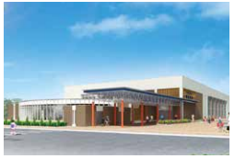

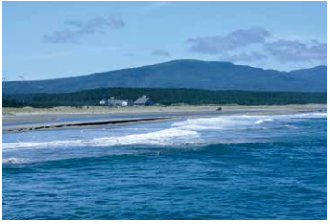
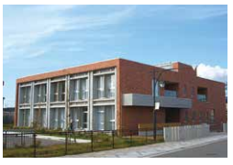
Where is LIPAc?
Gym/Pool
★
Rokkasho
International School

Slide 7
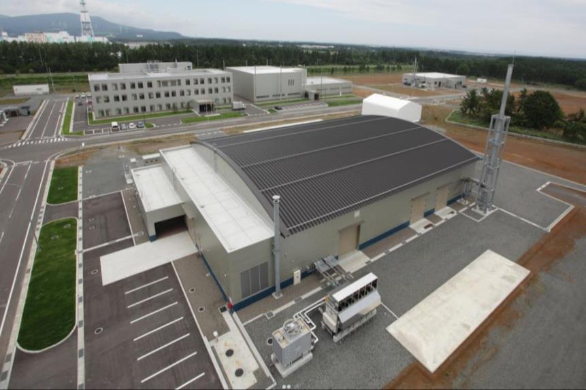


Where is LIPAc?
Administration &
Research Building
Computer Simulation &
Remote Experimentation Building
DEMO R&D Building
IFMIF/EVEDA
Accelerator Building

Slide 8
Control Tasks at LIPAc

Slide 9
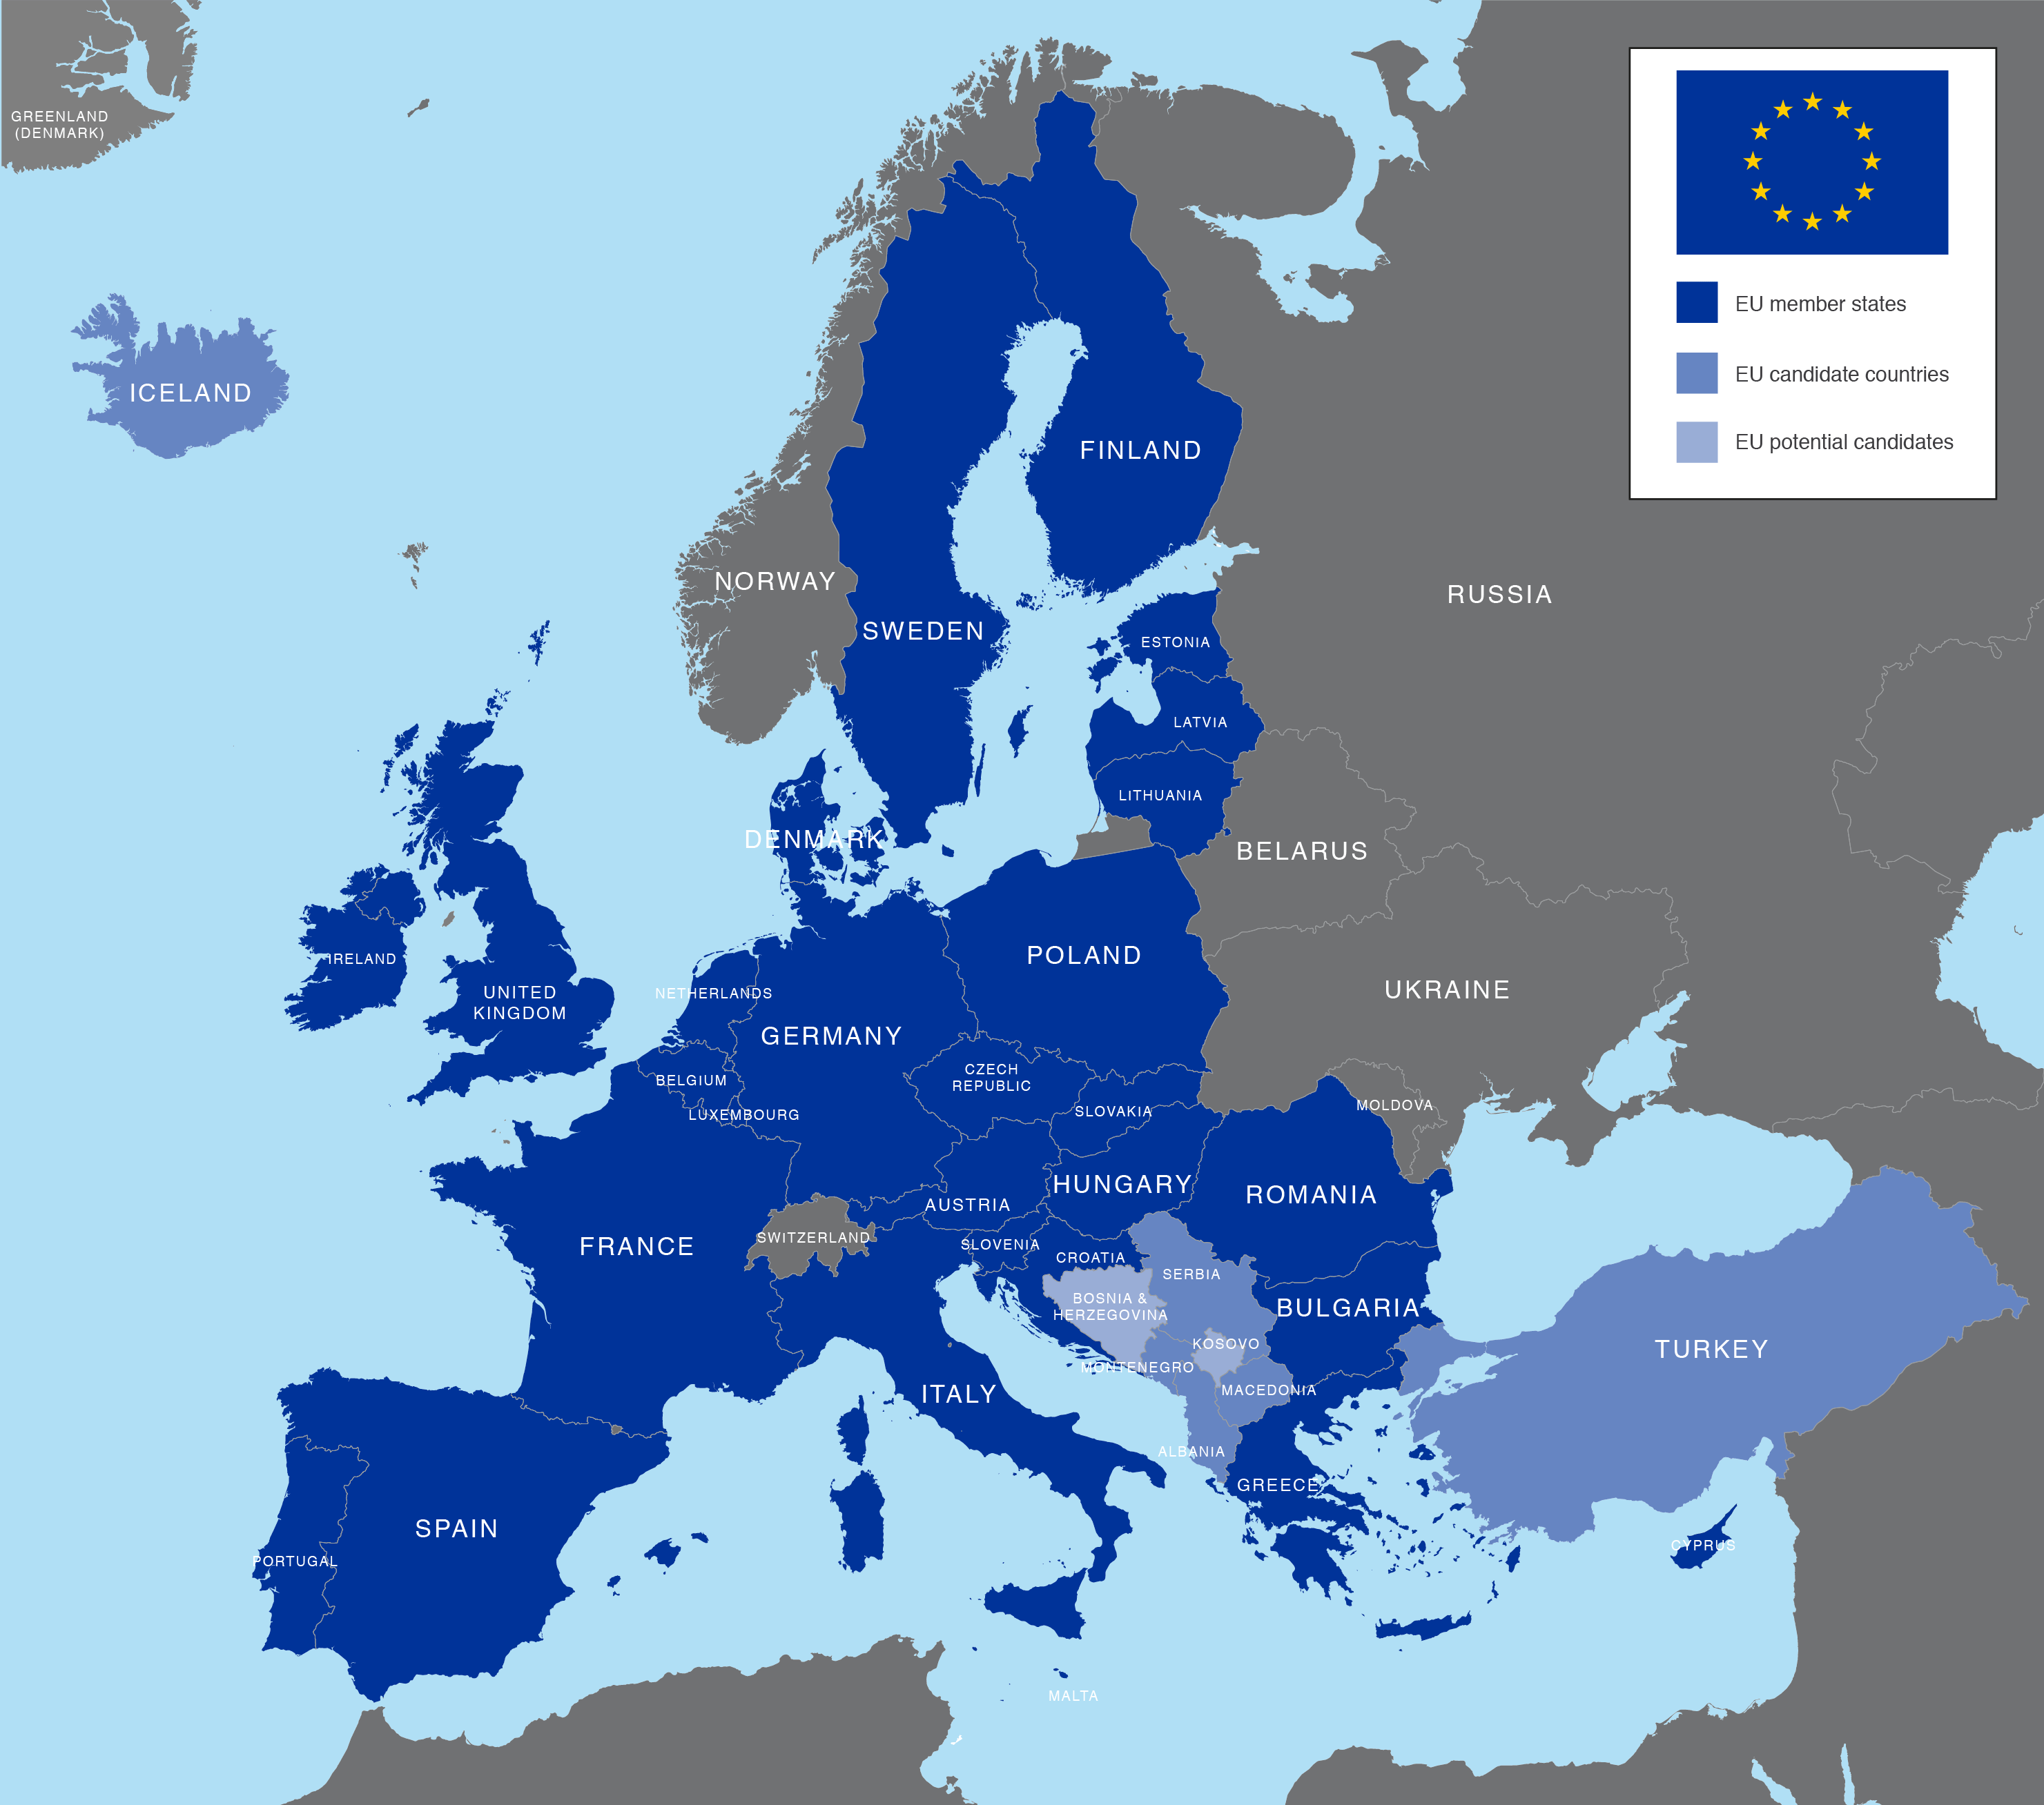

Control Tasks at LIPAc
EU Contribution - Local control systems (LCS):
Injector
RFQ
MEBT
Diagnostics
SRF LINAc
HEBT
Beam Dump
RF power system
Cooling systems
LCS at a glance:
Typically PLC based (a lot of S7-300) but we also have VMEs / VxWorks systems.
Typically we have industrial PCs interfacing with EPICS via Siemens S7 PLC driver.
Microboxes.
OPIs.
Interface
JA Contribution - Central control system (CCS):
Machine Protection System
Personal Protection System
Timing System
Archivers
All these interfacing with CCS.

Slide 10
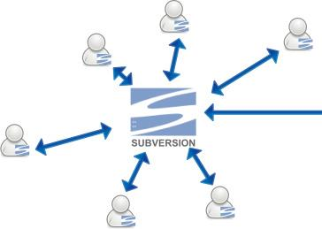


Control Tasks at LIPAc
LIPAc controls in glance:
Common System Platform: EPICS v.3.14.12, CSS4.5.0, CentOS7
PV count: ~60 000 PVs alive
Archiver data/day (@EPICS archiver appliance): ~10GB / day
IOC count: ~70 IOCs in operation @ ~100 DBs
Top repositories centralized – IOCs distributed
  topIFMIF_INJ
  topIFMIF_RFQ
  topIFMIF_MEBT
  topIFMIF_SRF
  topIFMIF_SoftIOC
  topIFMIF_OPI
  …
  …
Services on DMZ for version control:
SVN in use since 2015
Gitlab in use since 2019

Slide 11
EPICS Control Tools Development

Slide 12
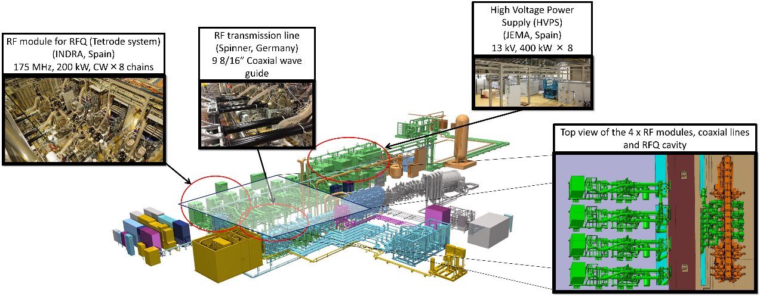
Control Tools Development
LLRF automatic rearming tool developed using pyEPICS:
RFQ cavity needs conditioning -> 8 x 200kW chains.
LLRF units control the power and react to interlocks.
The rearming tool allows the RF chains to restart automatically from “safe” interlocks.

Slide 13
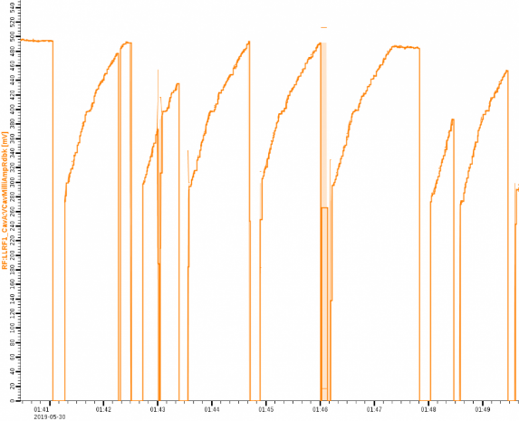
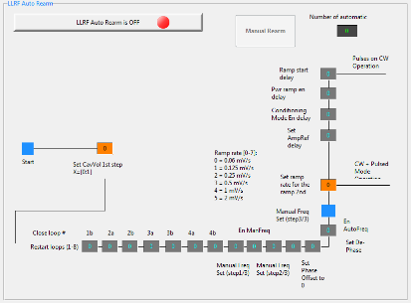
Control Tools Development
LLRF rearming tool workflow (main points only):
In a case of a safe interlock - Stop the RF system.
Save the previous cavity voltage and frequency.
Reset interlocks.
Start the master LLRF chain at low cavity voltage value.
Restore previous frequency mode.
Start other LLRF chains.
Set ramps and ramp to the previous cavity voltage in two steps.
First ramp
Interlocks
Second ramp
Plateau
Interlocks

Slide 14
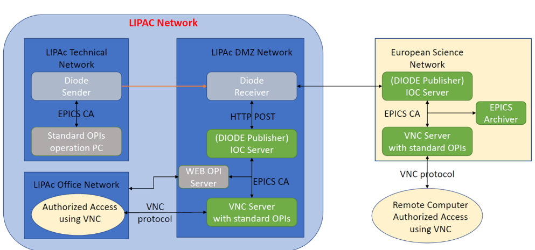
Control Tools Development
Remote participation (EU to JP) and sharing the experimental data. Data-share scheme has been developed:
Database cloning -> share archived data.
Data-diode -> share Live PV data.
Schedule:
Internal tests started in 2018 (WebOPI).
Trials to share with Europe scheduled in June 2019.

Slide 15
LCS Integration

Slide 16
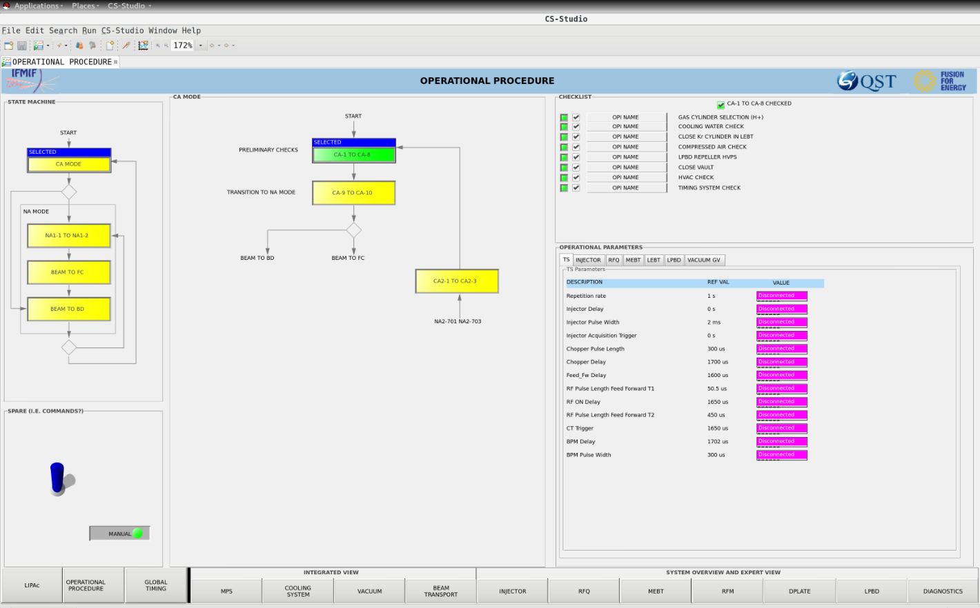
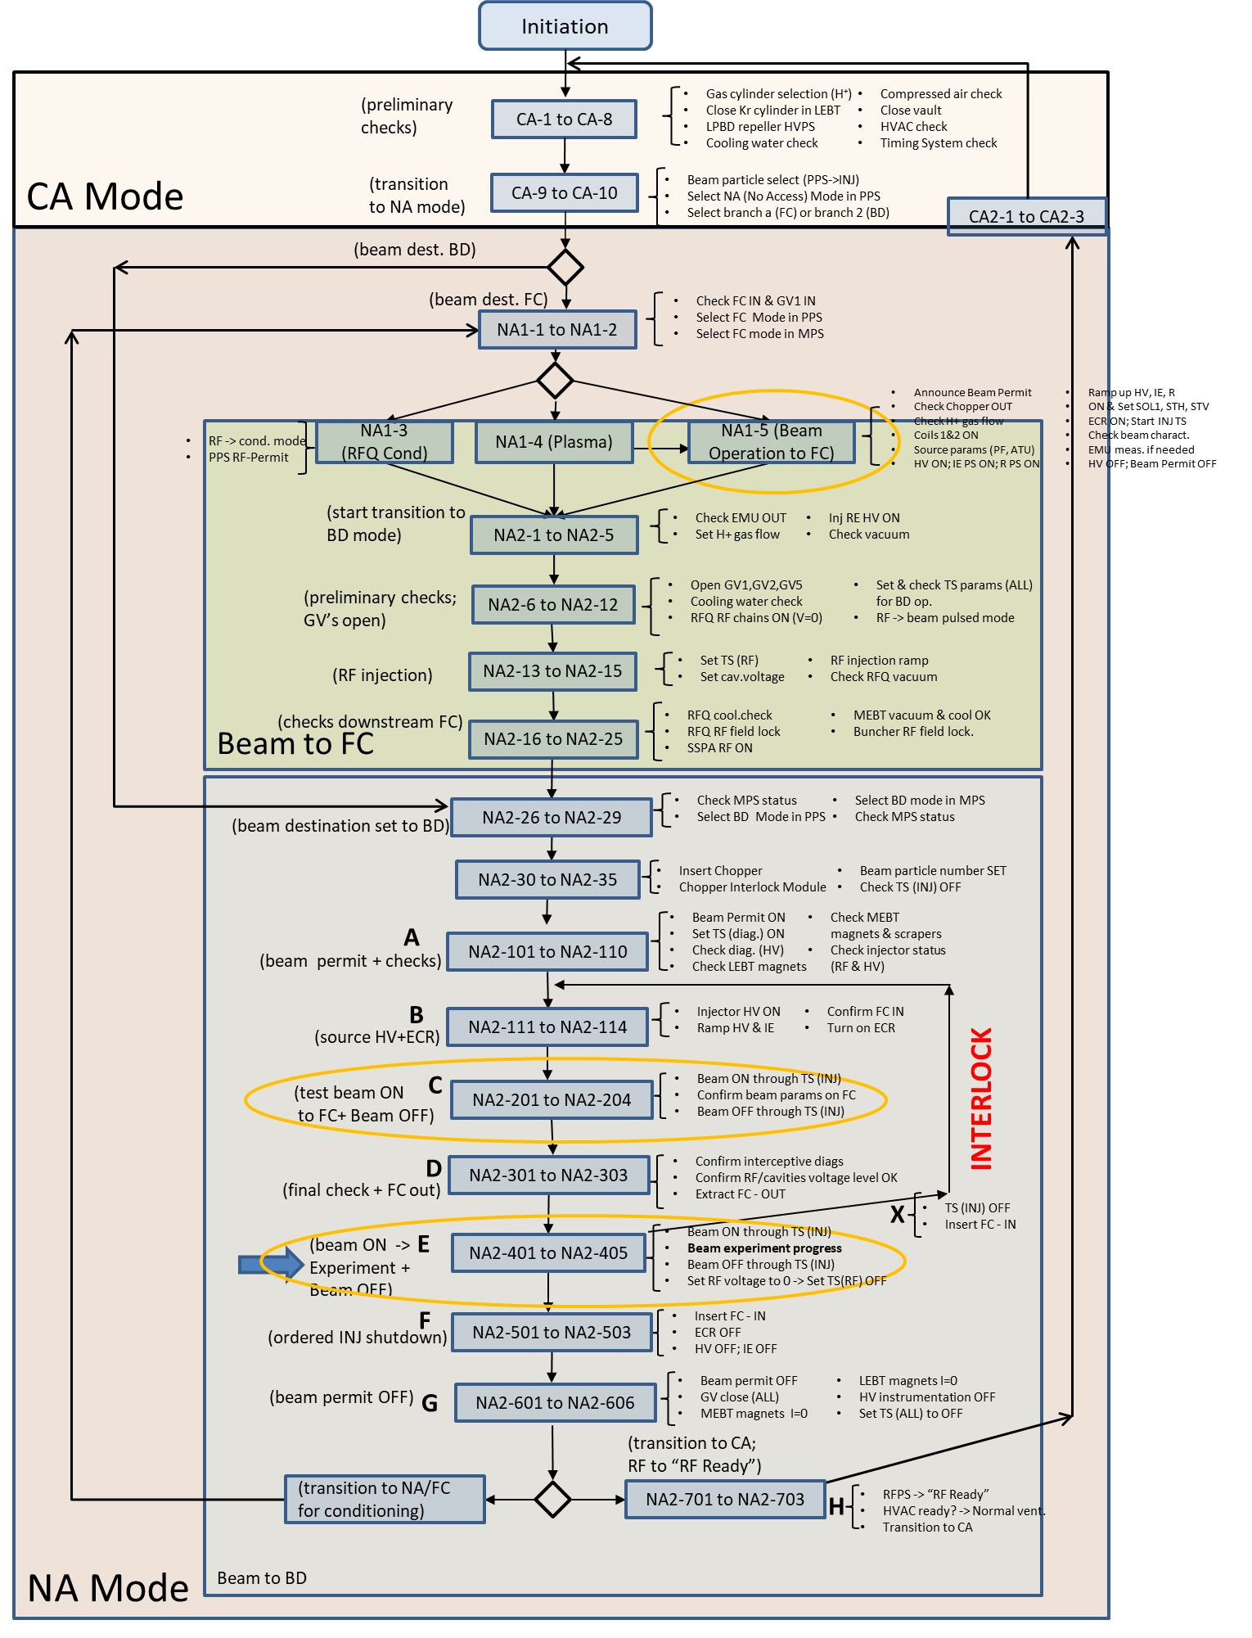
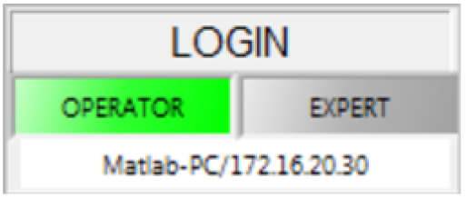
LCS Integration
Beam Operation OPI (and integrated OPI):
  When operating the machine there are certain conditions that have to be checked.
  Beam operation OPI was developed to automatize some of these checks.
  User management with pwd.

Slide 17
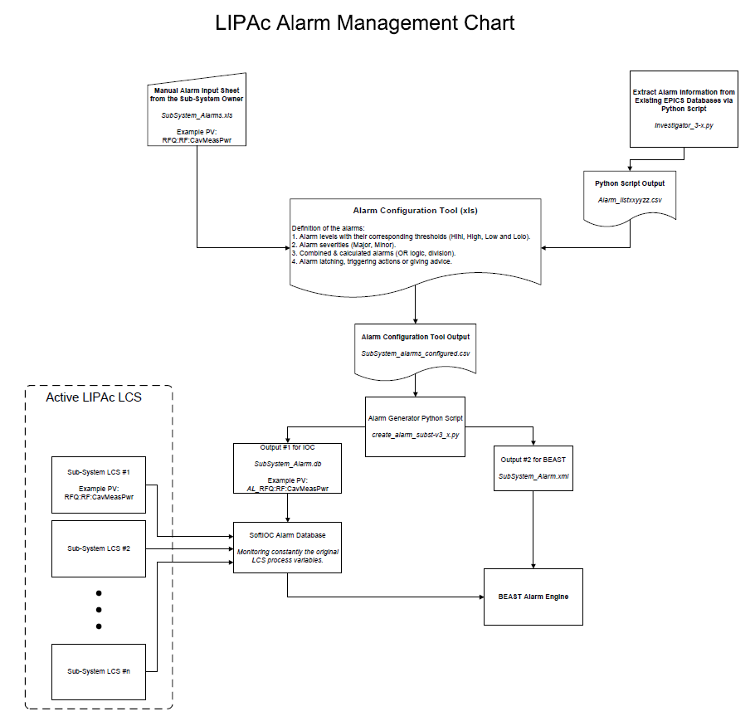
LCS Integration
LIPAc Alarm System (BEAST)
1. Sub-system alarm data:
Pre-defined (from institutes). Alarm template.
Extracted (from PVs by using a script). Create CSV file.
2. Alarm configuration tool:
All alarms listed.
Severity/Levels.
Logic e.g. OR/AND
Advice, latch, etc.
-> Out = xxyyzz.CSV file.
3. Alarm Generator Script:
Reads the CSV
Creates Alarm IOC (input from the LCS)
Creates XML for BEAST.
4. Run Alarm IOC and BEAST with the info defined above.
RFQ
MEBT
RFPS
Cooling
LPBD

Slide 18
Next Steps

Slide 19
Next Steps
The big picture in terms of controls.
  Short haul plan:
    Establish collaboration with other institutes to share info.
    Integrate LCS of HEBT/BD, SRF LINAc, Cryoplant (Phase B+ and Phase C).
  Long haul plan:
    Think about the LIPAc future in terms of Phase BA II (= Activity from 2020 – 2025).
      Renovation of the control systems of LIPAc.
      Timing system improvements.
      Virtualization.

Slide 20
Summary
LIPAc controls are evolving:
LCS for many sub-systems successfully integrated -> The machine is being operated in daily-basis.
Challenges have been faced but they’ve been sorted out.
The future looks bright:
We are currently open to collaboration to share the gained knowledge and operational feedback.
The refurbishment of the current control system is planned from 2020 onwards.

