Slide 1
Towards a More Resilient and Secure EPICS
EPICS Collaboration Meeting June 2019
ITER Cadarache, France
Sena Hounsinou, PH.D.
Embedded Systems Security LAB
howard university

Slide 2
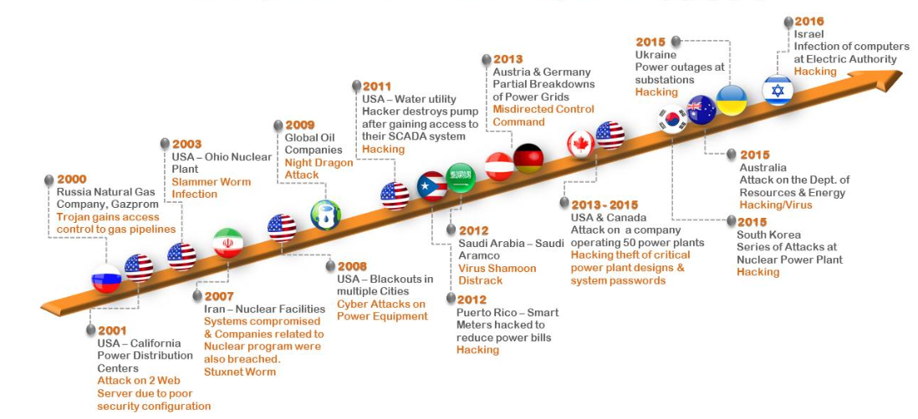
History of Cyber criminal Attacks in ICS
Source: Cyber Immunity, a holistic view for Industrial Control Systems
https://is5com.com/uncategorized/nov-22-2017-cyber-immunity-a-holistic-view-for-industrial-control-systems/

Slide 3
Motivation & Goal
  How we got here
      Hyper-connectivity
      Threat to major Industrial Control Systems
      Traditional Perimeter System Protection (Gateway, Password auth.)
  Our goal
  Hardening EPICS software to ensure security of scientific
  cyberinfrastructure which controls scientific instruments
Notes:
Hyper- connectivity
User-friendly Remote access
Large-scale data collection
Decrease in CPS isolation
Threat to Major Industrial Control Systems
Power Grids
Health Care Systems
EPICS
Facilitated by Traditional System Protection
Boundary Gateway
Password-based user authentication
Hard-on-the outside, Soft-within
Hard-on-the outside, Soft-within
Unfettered access to the control system once logged-in
Ability to launch and propagate cyber-physical attacks through the system
Damage infrastructure and hardware assets (IOC, OPI, LAN)
Invalidation of scientific Experiments
Our Objective:
Hardening EPICS software to ensure security of scientific cyberinfrastructure which controls scientific instruments

Slide 4
Expected Outcomes
EPICS
  Adopt security measures early in software development cycle
  Enhance cybersecurity capabilities
  Create a resilient scientific infrastructure for high energy physics research
EPICS Community
  Adoption of security best practices
  Creation of set of security tools
  Discovery and mitigation of potential vulnerabilities

Slide 5
What we will cover
  Threats considered
  Proposed approach
  Status of our project

Slide 6
Threat Models
  T0 – The Unintentional Threat
      Accidental Disruption of Scientific Operations
      Modification of PV Values
      Loss of Integrity of Scientific Experiments
Notes:
Nation States
- Able to interact with the system over an extended period of time before attack
- Disruption of scientific operations using a distributed denial of service (DDOS)
Compromise LAN routers, host workstations, and servers
Effects
- Undermine IOCs
- Cause long term damage to physical infrastructure
- Inject vulnerabilities in the open-source software development supply chain
Tamper with released software products to instrument malware into downloadable binary images

Slide 7
Threat Models
  T0 – The Unintentional Threat
  T1 – The Malicious Adversaries (untargeted, common)
      Destabilization of IOCs
      Modification of PV values in the IOC database
      Disruption of scientific mission of EPICS site
Notes:
Nation States
- Able to interact with the system over an extended period of time before attack
- Disruption of scientific operations using a distributed denial of service (DDOS)
Compromise LAN routers, host workstations, and servers
Effects
- Undermine IOCs
- Cause long term damage to physical infrastructure
- Inject vulnerabilities in the open-source software development supply chain
Tamper with released software products to instrument malware into downloadable binary images

Slide 8
Threat Models
  T0 – The Unintentional Threat
  T1 – The Malicious Adversaries (untargeted, common)
  T2 – The State Actors (targeted attacks, costliest)
      Undermine IOCs
      Cause long-term damage to physical infrastructure
      Inject malicious code in open-source software development supply chain
      Tamper with release software products to instrument malware into downloadable binary images
Notes:
Nation States
- Able to interact with the system over an extended period of time before attack
- Disruption of scientific operations using a distributed denial of service (DDOS)
Compromise LAN routers, host workstations, and servers
Effects
- Undermine IOCs
- Cause long term damage to physical infrastructure
- Inject vulnerabilities in the open-source software development supply chain
Tamper with released software products to instrument malware into downloadable binary images

Slide 9
Enhance & Leverage OS Security Services
Add Memory Protection to IOC OS Layers
Port Secure Communication Tools to IOC OSs
Establish Common Cryptographic Libraries
T0
Analyze & Improve Network Security for EPICS Protocols
Formally Model & Analyze PV Gateway
Enhance Security Logging of EPICS & PV Gateway
Add Network Security IDS to PV Gateway
T1
Security Throughout Software Development Life Cycle
Vulnerability Discovery with Static Analysis
Bug discovery with Fuzz Testing
Integrity Protection of EPICS Software Products
Secure Boot and Update
T2

Slide 10
Project Status: Memory Protection
Current Memory Protection in EPICS
  Memory management in GPOSs
  Available protection for VxWorks
  Non-existent in RTEMS
Desired Features
  Flexible (can be used with different OSs)
  Optional (for OSs with memory management unit)
  Low overhead
  Low performance degradation

Slide 11
Memory Protection Module (MPM) Design
MPM Activator
RTOS
MPM
P1 | P2 | … | Pn
Memory Region Activator
Privilege
Mode
Memory Region Controller
R1 | R2 | … | Rn

Slide 12
Our Team
Prajjwal Dangal | Uchenna Ezeobi | Abiola Ogundeko
Sena Hounsinou (sena.hounsinou@howard.edu)
Embedded Systems Security Lab
Howard University
Gedare Bloom, Ph.D.
University Of Colorado at Colorado Springs

